Slide 1
CS2501 – Data Structures and Algorithms II
Mark Floryan
mfloryan@cs.virginia.edu
Course Mechanics
Course content
Topics from earlier classes
Course learning objectives
What’s the course all about? A quick tour

Slide 2
Course introduction

Slide 3
General Info
See syllabus on course website for general information
Pre-requisites:
DSA1 (with C- or better)
Math topics: proof by induction, proof by contradiction, exponents, logarithms, limits, simple differentiations (covered in APMA 1090 or MATH 1210 or MATH 1310)
Teaching Assistants
Graduates (?):
TBD
Undergraduates (5 or 6)
Annie, Cassie, Daniel, and George (Probably 1 or 2 more this time)
Both will hold office hours, which will start next week
Locations and hours TBA
Also, we’ll use Piazza for questions
Post all questions about HW, topics, etc to Piazza NOT email to instructors!

Slide 4
Expectations
For a given week/unit, I will post:
The slides for that unit (all slides already on course website but will be updated throughout semester)
Any proofs that we are doing in class so you can review them
This will allow us to:
Have more interesting class sessions than just lecturing
A more successful educational experience (better grades)
Let’s all live up to our expectations (the high ones)!

Slide 5
Expectations
Of you:
When asked, prepare for things in advance
Participate in class activities when asked
Act mature, professional.
Plan ahead.
Don’t take advantage. Follow the Honor Code. (See the BOCM.)
Of me:
Be fair, open, and considerate.
Seek and listen to your feedback.
Not to waste your time.
Be effective in letting you know how you’re doing

Slide 6
General Info
Recommended (not required) Textbook:
Introduction to Algorithms, 3rd edition, by Cormen, et. al.
Other references:
Your DSA1 material (will be VERY useful here)
Discrete Math textbook / references
Other readings may be assigned
We’ll see…

Slide 7
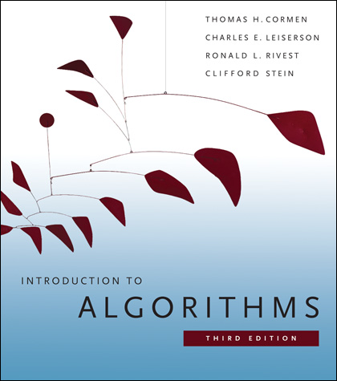
Recommended Textbook
Introduction to Algorithms by Cormen, et. al.
ISBN 0262033844
We will follow selected section of the textbook, but many lecture examples will not follow the textbook examples

Slide 8
Modules (Yes, we have modules again)
10 Topic Modules:
Graphs – Basic
Graphs – Advanced
Find-Union Data Structure
Greedy Algorithms (2)*
Divide and Conquer Algorithms (2)*
Dynamic Programming (2)*
Reductions Between Problems
*These each have a basic and advanced module (for hw and quizzes and such) but only one slide-deck which covers both

Slide 9
Modules (Yes, we have modules again)
4 Blind Assessment (Exam) Modules:
Midterm Exam 1
Midterm Exam 2
Final Exam (2 parts: First Half and Second Half)
More detail on this when we discuss grading. Short version is they are required if you want an A, but won’t destroy your letter grade if you fail them.

Slide 10
Workload
Each of the 10 topic modules will contain:
One Quiz
Two or more homework assignments
Each quiz/homework is pass/fail. Each module is in one of three states:
Incomplete: Requirement for competency not passed
Competency: Quiz AND one homework passed
Mastery: Quiz and all homework passed

Slide 11
Quizzes
Short assessments for each module
15 minutes. Taken during lecture bi-weekly on Friday
See course schedule for exact dates
Question pool published ahead of time but questions selected at random during quiz
You may attempt two quizzes per session (might raise this, need to think about it)

Slide 12
Homeworks
Most Homeworks are programming assignments or written descriptions of algorithms / proofs
Programming HW:
Can be written in Java, C++, or Python (your choice)
No code provided
Homework will specify the problem, input, and output specs. That is it. Sometimes a target runtime will be given
Written HW
Usually proofs of correctness, runtime, etc.
Written in Latex (first one will introduce you to this if you don’t know it already)

Slide 13
Homeworks (Cont’d)
Homeworks are all due on the final Wednesday of classes.
Recommended due dates will be posted to keep you up with these.
Highly recommended you try to keep up with HW so that you can:
Pass quizzes
Pass exams
Not fall too far behind in the course

Slide 14
Homework: Programming Hints
Understand the problem!
Consider all boundary cases
Use pre-existing library code
Number formatting: NumberFormat in Java, printf() in C/C++
Input: Scanner in Java, scanf() in C, cin in C++
Know how to handle floating point numbers
Understand float/double precision issues
Rounding, floating-point mod
Make sure it works for the provided test cases
Then write some of your own
Make sure you read the language specific details for submission!!!

Slide 15
Homework: Programming FAQ
Do I need to write my own sorting methods.
Yes! You should be able to do this, and it is good practice.
Why aren’t you providing a submission system that tells me if my code passes?
Because now you are an adult programmer. You should be able to write your own test harness and test cases. I’m doing this on purpose so that you have some practice.
Will you help me debug my code?
No, I won’t. You need to learn how to do this on your own. I’m happy to give you advice on how to approach your debugging problems, but I will not sit down and debug code with you.

Slide 16
Homework: Written
These assignments must be typeset in LaTeX
I will provide a couple tutorials, guides, and templates when the first assignment is given out
You may not embed images of text or formulas!

Slide 17
Working in groups
For the homeworks, you may work together in groups of ~5 or less to discuss the algorithmic aspects ONLY
State who you worked with (in code comments)
No looking at another person’s code, or ANY code online. If I catch you doing this, you will receive an F (no leniency!)
For the written homeworks, you may work together in groups of ~5 or less, but you MUST:
State who you worked with
Type up your own assignment!

Slide 18
Exams
Three blind assessments (exams)
Can only be attempted once. Contain unknown questions.
If you pass, your grade rised by one half-letter grade
If you fail, it doesn’t
See next slide for grading details….

Slide 19
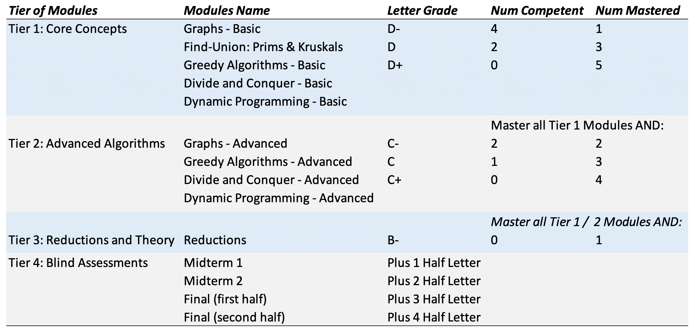
Grading Overview

Slide 20
What you know already from DSA1
Definition of an algorithm
Definition of algorithm “complexity”
Measuring worst-case complexity
Cost as a function of input size
Asymptotic rate of growth: Big-Oh, Big-Theta
Relative ordering of rates of growth
Analyzing an algorithm's cost:
sequences, loops, if/else, functions, recursion
Focus on counting one particular statement or operation; don’t count all statements

Slide 21
What you know already from DSA1 (2)
Problems and their solutions:
Linear data structures vs. tree data structures
Searching: linear/sequential search, binary search (?), hashing
Sorting: quicksort, mergesort in CS2110 (?)
Priority Queue ADT and Heap Implementation

Slide 22
What you know already from all your courses
Examples of Algorithm design methods:
Divide and Conquer (quicksort, mergesort)
Greedy (though you didn’t call it this)
Dynamic programming (fibonacci numbers, Floyd-Warshall)
NP-complete (traveling salesperson. Have you seen this?)

Slide 23
What you know already from Discrete Math and Theory of Computation…
From CS2102:
Proofs: induction, contradiction
If you are uncomfortable with these two, review them NOW!
Counting, probability, combinatorics, permutations
From some earlier math class:
Exponents, logarithms, limits, differentiation on polynomials and other simple functions
From CS3102 (if you have taken it)
Maturity in mathematics and computing theory
Ability to do proofs
Abstract models of computation, such as Turing machines

Slide 24
Questions? Concerns? Wrath to vent?

Slide 25
A first algorithm: making change

Slide 26
OK… But What’s It Really All About?
Let’s illustrate some ideas you’ll see throughout the course
Using one example
Concepts:
Describing an algorithm
Measuring algorithm efficiency
Families or types of problems
Algorithm design strategies
Alternative strategies
Lower bounds and optimal algorithms
Problems that seem very hard

Slide 27
Everyone Already Knows Many Algorithms!
Worked retail? You know how to make change!
Example:
My item costs $4.37. I give you a five dollar bill. What do you give me in change?
Answer: two quarters, a dime, three pennies
Why? How do we figure that out?

Slide 28
Making Change
The problem:
Give back the right amount of change, and…
Return the fewest number of coins!
Inputs: the dollar-amount to return
Also, the set of possible coins. (Do we have half-dollars? That affects the answer we give.)
Output: a set of coins
Note this problem statement is simply a transformation
Given input, generate output with certain properties
No statement about how to do it.
Can you describe the algorithm you use?

Slide 29
A Change Algorithm
Consider the largest coin
How many go into the amount left?
Add that many of that coin to the output
Subtract the amount for those coins from the amount left to return
If the amount left is zero, done!
If not, consider next largest coin, and go back to Step 2
Notes:
Will this always finish? Yes, because we have pennies!

Slide 30
Is this a “good” algorithm?
What makes an algorithm “good”?
Good time complexity. (Maybe space complexity.)
Better than any other algorithm
Easy to understand
How could we measure how much work an algorithm does?
Code it and time it. Issues?
Count how many “instructions” it does before implementing it
Computer scientists count basic operations, and use a rough measure of this: order class, e.g. O(n lg n)

Slide 31
Evaluating Our Greedy Algorithm
How much work does it do?
Say C is the amount of change, and N is the number of coins in our coin-set
Loop at most N times, and inside the loop we do:
A division
Add something to the output list
A subtraction, and a test
We say this is O(N), or linear in terms of the size of the coin-set
Could we do better?
Is this an optimal algorithm?
We need to do a proof somehow to show this

Slide 32
You’re Being Greedy!
This algorithm is an example of a family of algorithms called greedy algorithms
Suitable for optimization problems
There are many feasible answers that add up to the right amount, but one is optimal or best (fewest coins)
Immediately greedy: at each step, choose what looks best now. No “look-ahead” into the future!
What’s an optimization problem?
Some subset or combination of values satisfies problem constraints (feasible solutions)
But, a way of comparing these. One is best: the optimal solution

Slide 33
Does Greed Pay Off?
Greedy algorithms are often efficient.
Are they always right? Always find the optimal answer?
For some problems.
Not for checkers or chess!
Always for coin-changing problem? Depends on coin values
Say we had a 11-cent coin
What happens if we need to return 15 cents?
So how do we know?
In the real world:
Many optimization problems
Many good greedy solutions to some of these
Notes:
Use a funny name for the 11-cent coin. Name it after yourself, or call it a “Kardashian” or a Floryan or something.
If our set of coins contains a “Kardashian” plus the usual, then our algorithm will return first a Kardashian, then four pennies. Five coins. The best answer is a dime and a nickel, or two coins.

Slide 34
Formal algorithmic description
All algorithms in this course must have the following components:
Problem description (1 line max)
Inputs
Outputs
Assumptions
Strategy overview
1 or 2 sentences outlining the basic strategy, including the name of the method you are going to use for the algorithm
Algorithm description
If listed in English (as opposed to pseudo-code), then it should be listed in steps

Slide 35
Change solution (greedy)
Problem description: providing coin change of a given amount in the fewest number of coins
Inputs: the dollar-amount to return. Perhaps the possible set of coins, if it is non-obvious.
Output: a set of coins that obtains the desired amount of change in the fewest number of coins
Assumptions: If the coins are not stated, then they are the standard quarter, dime, nickel, and penny. All inputs are non-negative, and dollar amounts are ignored.
Strategy: a greedy algorithm that uses the largest coins first
Description: Issue the largest coin (quarters) until the amount left is less than the amount of a quarter ($0.25). Repeat with decreasing coin sizes (dimes, nickels, pennies).

Slide 36
Another Change Algorithm
Give me another way to do this?
Brute force:
Generate all possible combinations of coins that add up to the required amount
From these, choose the one with smallest number
What would you say about this approach?
There are other ways to solve this problem
Dynamic programming: build a table of solutions to small subproblems, work your way up

Slide 37
Change solution (brute-force)
Problem description: providing coin change of a given amount in the fewest number of coins
Inputs: the dollar-amount to return. Perhaps the possible set of coins, if it is non-obvious.
Output: a set of coins that obtains the desired amount of change in the fewest number of coins
Assumptions: If the coins are not stated, then they are the standard quarter, dime, nickel, and penny. All inputs are non-negative, and dollar amounts are ignored.
Strategy: a brute-force algorithm that considers every possibility and picks the one with the fewest number of coins
Description: Consider every possible combination of coins that add to the given amount (done via a depth-first search). Return the one with the fewest number of coins.

Slide 38
Motivating problems

Slide 39
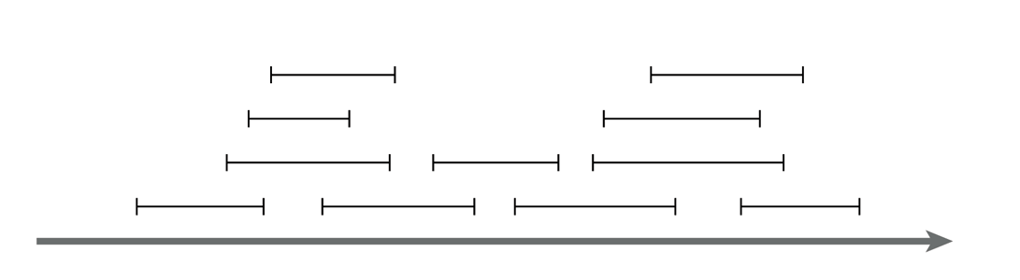
Motivating problem: Interval scheduling
Interval scheduling
Given a series of requests, each with a start time and end time, maximize the number of requests scheduled
This is solved by a greedy algorithm
Most of the CS 2150 algorithms you’ve seen are greedy algorithms: Dijkstra’s shortest path, both MST algorithms, etc.

Slide 40
Motivating problem: Weighted interval scheduling
Weighted interval scheduling
Same as the regular interval scheduling, but in addition each request has a cost associated with it
The goal is to maximize the cost from scheduling the items
This is solved by dynamic programming

Slide 41
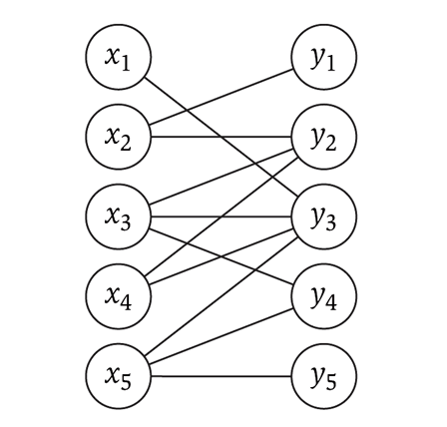
Motivating problem: Bipartite matching
Bipartite matching
Given a graph G, find the maximum sub-graph of G that partitions G into sets X and Y such that no node from X is connected to a node in Y, and vise-versa
Example: given a series of requests, and entities that can handle each request (such people, computers, etc.), find the optimal matching of requests to entities
This is a network flow problem

Slide 42
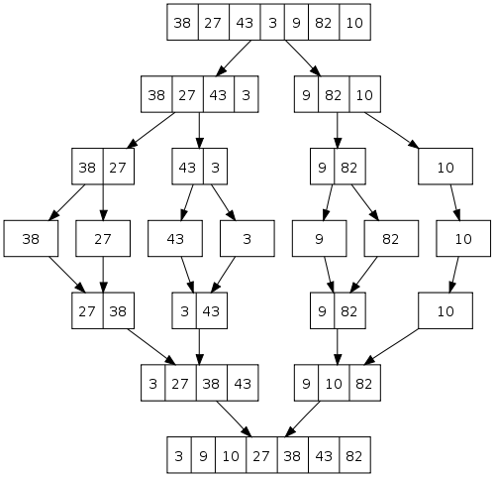
Motivating problem: Sorting
How do you implement a general-purpose sort that is as efficient as possible in both space and time, and is stable?
One solution is merge-sort
We’ll see later why quicksort, heapsort, and radix sort are not sufficient
This is an application of both sorting and divide and conquer

Slide 43
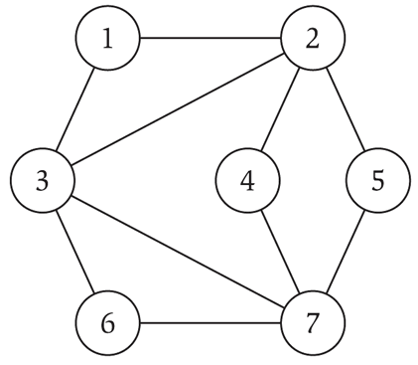
Motivating problem: Independent set
Independent set
Given a graph G, find the maximum size subset X of G such that no two nodes in X are connected to each other
This is a NP-complete problem
You’ve seen TSP (travelling salesperson problem) in CS 2150, which is a NP-complete problem

Slide 44
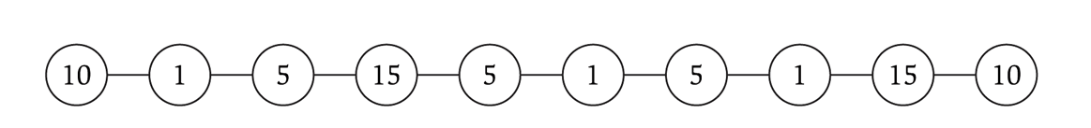
Motivating problem: Competitive facility location
Competitive facility location
Consider a graph G, where two ‘players’ choose nodes in alternating order. No two nodes can be chosen (by either side) if a connecting node is already chosen. Choose the winning strategy for your player.
This is a PSPACE problem, which are harder than NP-complete problems

