Slide 1
Find-Union Data Structure

Slide 2
Topics

Slide 3
Topics in this slide-deck:
Motivating Problem: Minimum Spanning Trees
This is a graph problem (ugh…more graphs?!)
Two solutions
Prim’s Algorithm (Uses graph data structure only)
Kruskal’s Algorithm (Uses a find-union structure)
Define and design the find-union to support Kruskal’s Algorithm

Slide 4
Minimum Spanning Trees

Slide 5
Prim’s Algorithm

Slide 6
Prim’s algorithm
Idea: Grow a tree by adding an edge from the “known” vertices to the “unknown” vertices. Pick the edge with the smallest weight.
G
v
known
Notes:
Pick one node as the root,
Incrementally add edges that connect a “new” vertex to the tree.
Pick the edge (u,v) where u is in the tree, v is not AND
where the edge weight is the smallest of all edges (where u is in the tree and v is not).

Slide 7
Prim’s Algorithm for MST
Pick one node as the root,
Incrementally add edges that connect a “new” vertex to the tree.
Pick the edge (u,v) where:
u is in the tree, v is not AND
where the edge weight is the smallest of all edges (where u is in the tree and v is not).

Slide 8
MST
v1
{v1, v4}
{v1, v2}
{v4, v3}
{v4, v7}
{v7, v6}
{v7, v5}
2
v₂
v₁
4
1
3
10
v₃
2
v₄
7
v₅
5
8
4
6
v₂
v₁
v₆
1
v₇
v₃
v₄
v₅
v₇
v₆

Slide 9
Minimum Spanning Tree
MSTs satisfy the optimal substructure property
If S is an optimal solution to a problem, then the components of S are optimal solutions to sub-problems
Here: an optimal tree is composed of optimal subtrees
Let T be an MST of G with an edge (u,v) in the middle
Removing (u,v) partitions T into two trees T₁ and T₂
Claim: T₁ is an MST of G₁ = (V₁,E₁), and T₂ is an MST of G₂ = (V₂,E₂)
Proof: w(T) = w(u,v) + w(T₁) + w(T₂)
There can’t be a better tree than T₁ or T₂, or T would be suboptimal

Slide 10
Minimum Spanning Tree
MSTs also satisfy the greedy choice property
If S is an optimal solution to a sub-problem, then the min weight edge ‘e’ leaving S is always in the optimal solution for all of G
Formal Claim:
Candidate edge e with minimum cost always member of T where T is MST of G
How to prove?
Assume ‘e’ is NOT in the MST of G
Finish on board→

Slide 11
Prim’s MST Algorithm
Greedy strategy:
Choose some start vertex as current-tree
Greedy rule: Add edge from graph to current-tree that
has the lowest weight of edges that…
have one vertex in the tree and one not in the tree.
Thus builds-up one tree by adding a new edge to it
Can this lead to an infeasible solution? (Tell me why not.)
Is it optimal? (Yes. Need a proof.)

Slide 12
Tracking Edges for Prim’s MST
Candidates edges: edge from a tree-node to a non-tree node
Since we’ll choose smallest, keep only one candidate edge for each non-tree node
But, may need to make sure we always have the smallest edge for each non-tree node
Fringe-nodes: non-trees nodes adjacent to the tree
Need data structure to hold fringe-nodes
Priority queue, ordered by min-edge weight
May need to update priorities!

Slide 13
Prim’s Algorithm
MST-Prim(G, wt)
init PQ to be empty;
PQ.Insert(s, wt=0);
parent[s] = NULL;
while (PQ not empty)
v = PQ.ExtractMin();
for each w adj to v
if (w is unseen) {
PQ.Insert(w, wt(v,w));
parent[w] = v;
}
else if (w is fringe && wt[v,w] < fringeWt(w)){
PQ.decreaseKey(w, wt[v,w]);
parent[w] = v;
}

Slide 14
Cost of Prim’s Algorithm
(Assume connected graph)
Clearly it looks at every node and edge, so Ω(V+E)
Is there more?
Yes, priority queue operations
ExtractMin called V times
How expensive? Depends on the size of the PQ
descreaseKey could be called for each edge
How expensive is each call?

Slide 15
Worst Case
If all nodes connected to start, then size of PQ is V-1 right away.
Decreases by 1 for each node selected
Total cost is O(cost of extractMin for size n-1)
Note use of Big-Oh (not Big-Theta)
Could decreaseKey be called a lot?
Yes! Imagine an input that adds all nodes to the PQ at the first step, and then after that calls descreaseKey every possible time. (For you to do.)

Slide 16
Priority Queue Costs and Prim’s
Simplest choice: unordered list
PQ.ExtractMin() is just a “findMin”
Cost for one call is Θ(V)
Total cost for all n calls is Θ(V²)
PQ.decreaseKey() on a node finds it, changes it.
Cost for one call is Θ(V)
But, if we can index an array by vertex number, the cost would be Θ(1). If so, worst-case total cost is Θ(E)
Conclusion: Easy to get Θ(V²)

Slide 17
Better PQ Implementations
Consider using a min-heap for the Priority Queue
PQ.ExtractMin() is O(log(V)) each time
Called V times, so like Heap’s Construct: efficient!
What about PQ.decreaseKey() ?
Our need: given a vertex-ID, change the value stored
But our basic heap implementation does not allow look-ups based on vertex-ID!
Solution: Indirect heaps
Heap structure stores indices to data in an array that doesn’t change
Can increase or decrease key in O(log(V)) after O(1) lookup

Slide 18
Better PQ Implementations (2)
Use Indirect Heaps for the PQ
PQ.decreaseKey() is O(log(V)) also
Called for each edge encountered in MST algorithm
So O(E * log(V))
Overall: Might be better: Θ(V²) than if E << V²
Fibonacci heaps: an even more efficient PQ implementation. We won’t cover these.
Θ(E + V * log(V))

Slide 19
Kruskal’s Algorithm

Slide 20
Kruskal’s MST Algorithm
Prim’s approach:
Build one tree. Make the one tree bigger and as good as it can be.
Kruskal’s approach
Choose the best edge possible: smallest weight
Not one tree – maintain a forest!
Each edge added will connect two trees. Can’t form a cycle in a tree!
After adding n-1 edges, you have one tree, the MST

Slide 21
Kruskal’s MST Algorithm
Idea: Grow a forest out of edges that do not create a cycle. Pick an edge with the smallest weight.
G=(V,E)
v

Slide 22
MST
2
v₂
v₁
4
1
3
10
v₃
2
v₄
7
v₅
5
8
4
6
v₆
1
v₇
v₁
v₂
v₃
v₄
v₅
v₇
v₆

Slide 23
Kruskal code
void Graph::kruskal(){
int edgesAccepted = 0;
DisjSet s(NUM_VERTICES);
while (edgesAccepted < NUM_VERTICES – 1){
e = smallest weight edge not deleted yet;
// edge e = (u, v)
uset = s.find(u);
vset = s.find(v);
if (uset != vset){
edgesAccepted++;
s.unionSets(uset, vset);
}
}
}
|E| heap ops
2|E| finds
|V| unions

Slide 24
Strategy for Kruskal’s
EL = sorted set of edges ascending by weight
Foreach edge e in EL
T1 = tree for head(e)
T2 = tree for tail(e)
If (T1 != T2)
add e to the output (the MST)
Combine trees T1 and T2
Seems simple, no?
But, how do you keep track of what trees a node is in?
Trees are sets. Need to findset(v) and “union” two sets

Slide 25
kruskal(edgelist,n) {
sort(edgelist)
for i = 1 to n
makeset(i)
count = 0
i = 1
while (count < n - 1) {
if (findset(edgelist[i].v) !=
findset(edgelist[i].w)) {
println(edgelist[i].v + “ ” + edgelist[i].w)
count = count + 1
union(edgelist[i].v,edgelist[i].w)
}
i = i + 1
}
}

Slide 26
Find-Union Data Structure

Slide 27
Union/Find and Disjoint Sets
Sets stored as a parent array
findset(v): trace upward in parent array
union(i,j): make one tree a child of a node it the other
Improvements!
Union by rank
Path compression

Slide 28
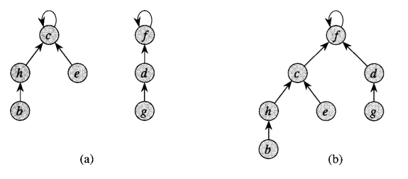
Union by rank

Slide 29
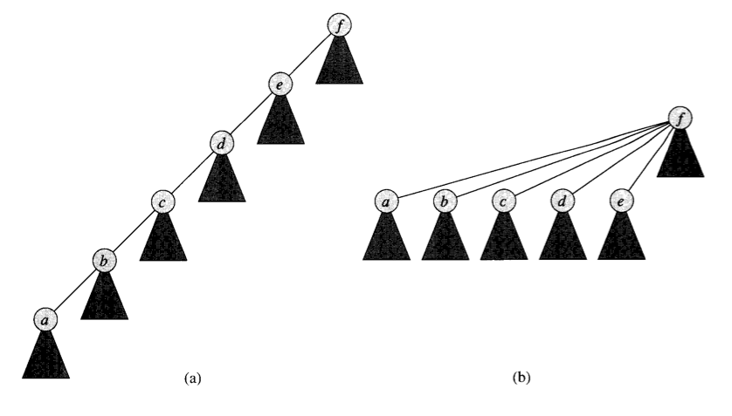
Path Compression

Slide 30
Complexity for Kruskal’s
A basic analysis leads us to Θ(E*V) = O(V³)
But with the optimizations presented here, it can be reduced to Θ(E * log(E))

Slide 31
Summary

Slide 32
What did we learn?
Minimum Spanning Trees
What they are. Motivations, etc.
Prim’s Algorithm
Nice graph algorithm for solving MST problem
Kruskal’s Algorithm
Another algorithm for solving MST problem
Nice excuse to introduce the find-union data structure
Find-union
How to implement
How to optimize

