Slide 1
Greedy Algorithms - Basics

Slide 2
Overview

Slide 3
Inventory of greedy algorithms
New problems we will see:
Coin change
Knapsack algorithm
Interval scheduling
Greedy algorithms we’ve already seen:
Prim’s MST
Kruskal’s MST
Dijkstra’s shortest path
Huffman Codes

Slide 4
Greedy Method: Overview
Optimization problems: terminology
A solution must meet certain constraints: A solution is feasible
Example: All edges in solution are in graph, form a simple path
Solutions judged on some criteria: Objective function
Example: Sum of edge weights in path is smallest
One (or more) feasible solutions that scores best (by the objective function) is the optimal solution(s)

Slide 5
Greedy Method: Overview
Greedy strategy:
Build solution by stages, adding one item to partial solution found so far
At each stage, make locally optimal choice based on the greedy rule (sometimes called the selection function)
Locally optimal, i.e. best given what info we have now
Irrevocable, a choice can’t be un-done
Sequence of locally optimal choices leads to globally optimal solution (hopefully)
Must prove this for a given problem!
Approximation algorithms, heuristics

Slide 6
Proving them correct
Given a greedy algorithm, how do you show it is optimal?
As opposed to other types of algorithms (divide-and-conquer , etc.)
One common way is to compare the solution given with an optimal solution

Slide 7
Making Change

Slide 8
Everyone Already Knows Many Algorithms!
Worked retail? You know how to make change!
Example:
My item costs $4.37. I give you a five dollar bill. What do you give me in change?
Answer: two quarters, a dime, three pennies
Why? How do we figure that out?

Slide 9
Making Change
The problem:
Give back the right amount of change, and…
Return the fewest number of coins!
Inputs: the dollar-amount to return
Also, the set of possible coins. (Do we have half-dollars? That affects the answer we give.)
Output: a set of coins
Note this problem statement is simply a transformation
Given input, generate output with certain properties
No statement about how to do it.
Can you describe the algorithm you use?

Slide 10
A Change Algorithm
Consider the largest coin
How many go into the amount left?
Add that many of that coin to the output
Subtract the amount for those coins from the amount left to return
If the amount left is zero, done!
If not, consider next largest coin, and go back to Step 2
Notes:
Will this always finish? Yes, because we have pennies!

Slide 11
Is this a “good” algorithm?
What makes an algorithm “good”?
Good time complexity. (Maybe space complexity.)
Better than any other algorithm
Easy to understand
How could we measure how much work an algorithm does?
Code it and time it. Issues?
Count how many “instructions” it does before implementing it
Computer scientists count basic operations, and use a rough measure of this: order class, e.g. O(n lg n)

Slide 12
Evaluating Our Greedy Algorithm
How much work does it do?
Say C is the amount of change, and N is the number of coins in our coin-set
Loop at most N times, and inside the loop we do:
A division
Add something to the output list
A subtraction, and a test
We say this is O(N), or linear in terms of the size of the coin-set
Could we do better?
Is this an optimal algorithm?
We need to do a proof somehow to show this

Slide 13
Formal algorithmic description
All algorithms in this course must have the following components:
Problem description (1 line max)
Inputs
Outputs
Assumptions
Strategy overview
1 or 2 sentences outlining the basic strategy, including the name of the method you are going to use for the algorithm
Algorithm description
If listed in English (as opposed to pseudo-code), then it should be listed in steps

Slide 14
Change solution (greedy)
Problem description: providing coin change of a given amount in the fewest number of coins
Inputs: the dollar-amount to return. Perhaps the possible set of coins, if it is non-obvious.
Output: a set of coins that obtains the desired amount of change in the fewest number of coins
Assumptions: If the coins are not stated, then they are the standard quarter, dime, nickel, and penny. All inputs are non-negative, and dollar amounts are ignored.
Strategy: a greedy algorithm that uses the largest coins first
Description: Issue the largest coin (quarters) until the amount left is less than the amount of a quarter ($0.25). Repeat with decreasing coin sizes (dimes, nickels, pennies).

Slide 15
Another Change Algorithm
Give me another way to do this?
Brute force:
Generate all possible combinations of coins that add up to the required amount
From these, choose the one with smallest number
What would you say about this approach?
There are other ways to solve this problem
Dynamic programming: build a table of solutions to small subproblems, work your way up

Slide 16
Change solution (brute-force)
Problem description: providing coin change of a given amount in the fewest number of coins
Inputs: the dollar-amount to return. Perhaps the possible set of coins, if it is non-obvious.
Output: a set of coins that obtains the desired amount of change in the fewest number of coins
Assumptions: If the coins are not stated, then they are the standard quarter, dime, nickel, and penny. All inputs are non-negative, and dollar amounts are ignored.
Strategy: a brute-force algorithm that considers every possibility and picks the one with the fewest number of coins
Description: Consider every possible combination of coins that add to the given amount (done via a depth-first search). Return the one with the fewest number of coins.

Slide 17
Algorithm for making change
This algorithm makes change for an amount A using coins of denominations
denom[1] > denom[2] > ··· > denom[n] = 1.
Input Parameters: denom, A
Output Parameters: None
greedy_coin_change(denom, A) {
i = 1
while (A > 0) {
c = A / denom[i]
println(“use ” + c + “ coins of denomination ” + denom[i])
A = A - c * denom[i]
i = i + 1
}
}

Slide 18
Making change proof
Prove that the provided making change algorithm is optimal for denominations 1, 5, and 10
Via induction, and on board -->

Slide 19
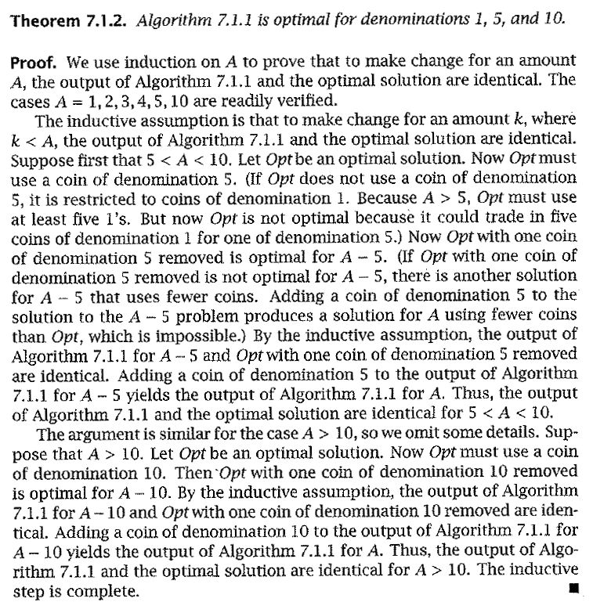
Formal proof
Formal proof of the change problem
Algorithm 7.1.1 is what is presented two slides previously

Slide 20
How would a failed proof work?
Prove that the provided making change algorithm is optimal for denominations 1, 6, and 10
Via induction, and on board -->

Slide 21
Knapsack Algorithm

Slide 22

Knapsack Problems
Motivated by a theoretical burglary scenario (realistically motivated by other similar problems)
A thief breaks into a house and must gather as many precious items as possible.
BUT…he cannot gather items, the total weight of which, exceeds the capacity of his knapsack.

Slide 23
Knapsack Problems
Inputs:
n items, each with a weight w_{i} and a value v_{i}
capacity of the knapsack, C
Output:
Fractions for each of the n items, x_{i}
Or…the actual weights of each item taken
Chosen to maximize total profit but not to exceed knapsack capacity

Slide 24
Two Types of Knapsack Problem
0/1 knapsack problem (or discrete knapsack)
Each item is discrete. Must choose all of it or none of it. So each x_{i} is 0 or 1
Greedy approach does not produce optimal solutions
But another approach, dynamic programming, does
Continuous knapsack problem
Can pick up fractions of each item
The correct selection function yields a greedy algorithm that produces optimal results

Slide 25
Greedy Rule for Knapsack?
Build up a partial solution by choosing x_{i} for one item until knapsack is full (or no more items). Which item to choose?
There are several choices. Pick one and try on this:
n = 3, C = 20
weights = (18, 15, 10)
values = (25, 24, 15)
What answer do you get?
The optimal answer is: (0, 1, 0.5), total=31.5
Can you verify this?

Slide 26
Possible Greedy Rules for Knapsack
Build up a partial solution by choosing x_{i} for one item until knapsack is full (or no more items). Which item to choose?
Maybe this: take as much as possible of the remaining item that has largest value, v_{i}
Or maybe this: take as much as possible of the remaining items that has smallest weight, w_{i}
Neither of these produce optimal values! The one that does “combines” these two approaches.
Use ratio of profit-to-weight

Slide 27
Example Knapsack Problem
For this example:
n = 3, C = 20
weights = (18, 15, 10)
values = (25, 24, 15)
Ratios = (25/18, 24/15, 15/10) = (1.39, 1.6, 1.5)
The optimal answer is: (0, 1, 0.5)

Slide 28
Continuous knapsack algorithm
a is an array containing the items to be put into the knapsack. Each element has the following fields:
p: the profit for that item
w: the weight for that item
id: the identifier for that item
C is the capacity of the knapsack
What is the running time?
continuous_knapsack(a, C)
n = a.last
for i = 1 to n
ratio[i] = a[i].p / a[i].w
sort (a,ratio)
weight = 0
i = 1
while ( i ≤ n && weight < C )
if ( weight + a[i].w ≤ C )
println (“select all of object “ + a[i].id)
weight = weight + a[i].w
else
r = (C – weight) / a[i].w
println (“select “ + r + “ of object “ + a[i].id)
weight = C
i++

Slide 29
How do we know it’s correct?
Proof time!!!
On board -->

Slide 30
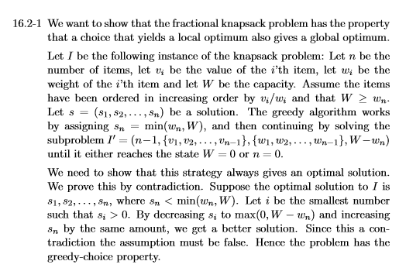
How do we know it’s correct?
Proof time!!!

Slide 31
Interval Selection

Slide 32
Activity-Selection Problem
Problem: You and your classmates go on Semester at Sea
Many exciting activities each morning
Each starting and ending at different times
Maximize your “education” by doing as many as possible. (They’re all equally good!)
Welcome to the activity selection problem
Also called interval scheduling

Slide 33
The Activities!
Id | Start | End | Activity
1 | 9:00 | 10:45 | Fractals, Recursion and Crayolas
2 | 9:15 | 10:15 | Tropical Drink Engineering with Prof. Bloomfield
3 | 9:30 | 12:30 | Managing Keyboard Fatigue with Swedish Massage
4 | 9:45 | 10:30 | Applied ChemE: Suntan Oil or Lotion?
5 | 9:45 | 11:15 | Optimization, Greedy Algorithms, and the Buffet Line
6 | 10:15 | 11:00 | Hydrodynamics and Surfing
7 | 10:15 | 11:30 | Computational Genetics and Infectious Diseases
8 | 10:30 | 11:45 | Turing Award Speech Karaoke
9 | 11:00 | 12:00 | Pool Tanning for Engineers
10 | 11:00 | 12:15 | Mechanics, Dynamics and Shuffleboard Physics
11 | 12:00 | 12:45 | Discrete Math Applications in Gambling

Slide 34
Generalizing Start, End
Id | Start | End | Len | Activity
1 | 0 | 6 | 7 | Fractals, Recursion and Crayolas
2 | 1 | 4 | 4 | Tropical Drink Engineering with Prof. Bloomfield
3 | 2 | 13 | 12 | Managing Keyboard Fatigue with Swedish Massage
4 | 3 | 5 | 3 | Applied ChemE: Suntan Oil or Lotion?
5 | 3 | 8 | 6 | Optimization, Greedy Algorithms, and the Buffet Line
6 | 5 | 7 | 3 | Hydrodynamics and Surfing
7 | 5 | 9 | 5 | Computational Genetics and Infectious Diseases
8 | 6 | 10 | 5 | Turing Award Speech Karaoke
9 | 8 | 11 | 4 | Pool Tanning for Engineers
10 | 8 | 12 | 5 | Mechanics, Dynamics and Shuffleboard Physics
11 | 12 | 14 | 3 | Discrete Math Applications in Gambling

Slide 35
Greedy Approach
Select a first item.
Eliminate items that are incompatible with that item. (i.e. they overlap.)
Apply the greedy rule (AKA selection function) to pick the next item.
Go to Step 2
What is a good greedy rule for selecting the next item?

Slide 36
Some Possibilities
Pick the next compatible one that starts earliest
Pick the shortest one
Pick the one that has the least conflicts (i.e. overlaps)
Do any of these work? Counter-examples?

Slide 37
Activity-Selection
Formally:
Given a set S of n activities
s_{i} = start time of activity i
f_{i} = finish time of activity i
Find max-size subset A of compatible activities
Assume (wlog) that f₁ ≤ f₂ ≤ … ≤ f_{n}
3
4
6
2
1
5

Slide 38
Activity Selection: A Greedy Algorithm
So actual algorithm is simple:
Sort the activities by finish time
Schedule the first activity
Then schedule the next activity in sorted list which starts after previous activity finishes
Repeat until no more activities
Intuition is even more simple:
Always pick next activity that finishes earliest

Slide 39
Activity Selection: Optimal Substructure
Let k be the minimum activity in A (i.e., the one with the earliest finish time). Then A - {k} is an optimal solution to S’ = {i ∈ S: s_{i} ≥ f_{k}}
In words: once activity #1 is selected, the problem reduces to finding an optimal solution for activity-selection over activities in S compatible with #1
Proof: if we could find optimal solution B’ to S’ with |B’| > |A - {k}|,
Then B’ U {k} is compatible
And |B’ U {k}| > |A|, which is a contradiction

Slide 40
Back to Semester at Sea…
Id | Start | End | Len | Activity
2 | 1 | 4 | 4 | Tropical Drink Engineering with Prof. Bloomfield
4 | 3 | 5 | 3 | Applied ChemE: Suntan Oil or Lotion?
1 | 0 | 6 | 7 | Fractals, Recursion and Crayolas
6 | 5 | 7 | 3 | Hydrodynamics and Surfing
5 | 3 | 8 | 6 | Optimization, Greedy Algorithms, and the Buffet Line
7 | 5 | 9 | 5 | Computational Genetics and Infectious Diseases
8 | 6 | 10 | 5 | Turing Award Speech Karaoke
9 | 8 | 11 | 4 | Pool Tanning for Engineers
10 | 8 | 12 | 5 | Mechanics, Dynamics and Shuffleboard Physics
3 | 2 | 13 | 12 | Managing Keyboard Fatigue with Swedish Massage
11 | 12 | 14 | 3 | Discrete Math Applications in Gambling
Solution: 2, 6, 9, 11

Slide 41
Visualizing these Activities
ID | Start | End |  | 0 | 1 | 2 | 3 | 4 | 5 | 6 | 7 | 8 | 9 | 10 | 11 | 12 | 13 | 14
1 | 0 | 6
2 | 1 | 4
3 | 2 | 13
4 | 3 | 5
5 | 3 | 8
6 | 5 | 7
7 | 5 | 9
8 | 6 | 10
9 | 8 | 11
10 | 8 | 12
11 | 12 | 14

Slide 42
Visualizing these Activities
ID | Start | End |  | 0 | 1 | 2 | 3 | 4 | 5 | 6 | 7 | 8 | 9 | 10 | 11 | 12 | 13 | 14
1 | 0 | 6
2 | 1 | 4
3 | 2 | 13
4 | 3 | 5
5 | 3 | 8
6 | 5 | 7
7 | 5 | 9
8 | 6 | 10
9 | 8 | 11
10 | 8 | 12
11 | 12 | 14

Slide 43
Sorted, Then Showing Selection and Incompatibilities
ID | Start | End |  | 0 | 1 | 2 | 3 | 4 | 5 | 6 | 7 | 8 | 9 | 10 | 11 | 12 | 13 | 14
2 | 1 | 4
4 | 3 | 5
1 | 0 | 6
6 | 5 | 7
5 | 3 | 8
7 | 5 | 9
8 | 6 | 10
9 | 8 | 11
10 | 8 | 12
3 | 2 | 13
11 | 12 | 14
Select solid-colored item,
Eliminates activities X’d
out of same color

Slide 44
Interval selection algorithm
greedy-interval (s, f)
n = s.length
A = {a₁}
k = 1
for m = 2 to n
if s[m] ≥ f[k]
A = A U {a_{m}}
k = m
return A
s is an array of the intervals’ start times
f is an array of the intervals’ finish times
A is the array of the intervals to schedule
How long does this take?

Slide 45
The proof…
On board -->
Show that the greedy algorithm stays ahead!

Slide 46
Conclusion

Slide 47
Greedy algorithm summary
Algorithms we saw:
Coin change
Knapsack algorithm
Interval scheduling
Other greedy algorithms we’ve seen previously:
Prim’s MST
Kruskal’s MST
Dijkstra’s shortest path
Huffman Codes

Slide 48
Greedy Method: Overview
Optimization problems: terminology
Solutions judged on some criteria: Objective function
Example: Sum of edge weights in path is smallest
A solution must meet certain constraints: A solution is feasible
Example: All edges in solution are in graph, form a simple path
One (or more) feasible solutions that scores highest (by the objective function) is the optimal solution(s)

Slide 49
Greedy Method: Overview
Greedy strategy:
Build solution by stages, adding one item to partial solution found so far
At each stage, make locally optimal choice based on the greedy rule (sometimes called the selection function)
Locally optimal, i.e. best given what info we have now
Irrevocable, a choice can’t be un-done
Sequence of locally optimal choices leads to globally optimal solution (hopefully)
Must prove this for a given problem!
Approximation algorithms, heuristics

Slide 50
Proving them correct
Given a greedy algorithm, how do you show it is optimal?
As opposed to other types of algorithms (divide-and-conquer , etc.)
One way is to compare the solution given with an optimal solution
Another way is through induction

Slide 51
Proving a greedy algorithm is correct
Show that it fulfills the greedy-choice property
Does making a greedy choice at any arbitrary point yield an optimal solution?
Consider an optimal solution to a sub-problem
Show that making the greedy choice will yield an optimal solution to the overall problem
Show that it has optimal sub-structure
Show that a solution to a problem contains optimal solutions to sub-problems
Or use a general proof that compares !

Slide 52
Warning!
Proving that an algorithm makes a greedy choice at each stage is NOT the same as showing that the algorithm has the greedy choice property
The first is a property of the algorithm designed
The second shows that making the greedy choice will yield an optimal solution to the overall problem

