Slide 1
Graphs - Basics

Slide 2
Graph Basics

Slide 3
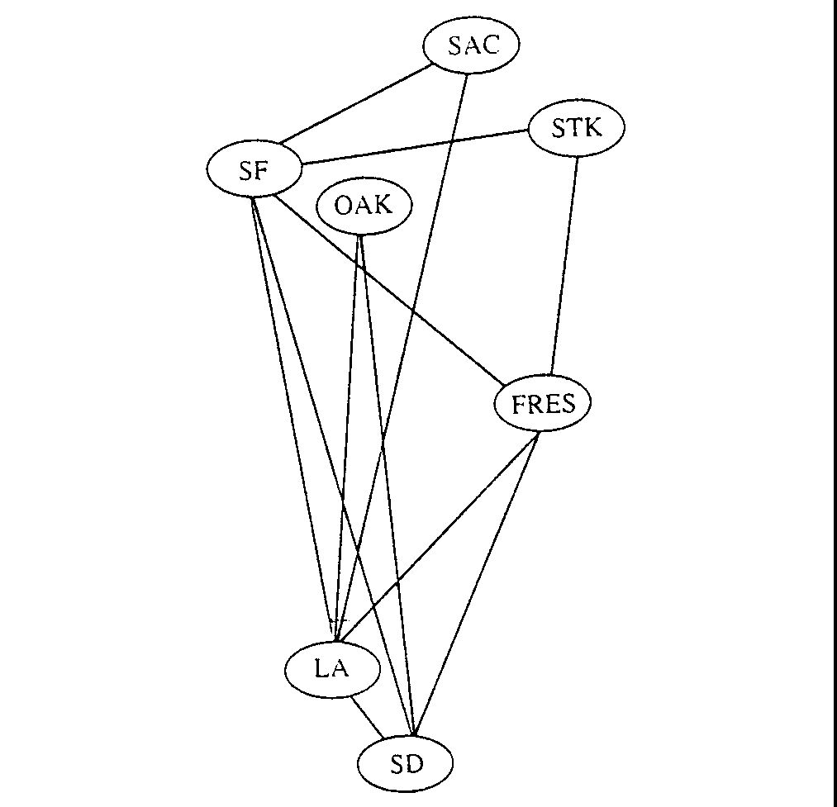
Problems: e.g. Airline Routes

Slide 4
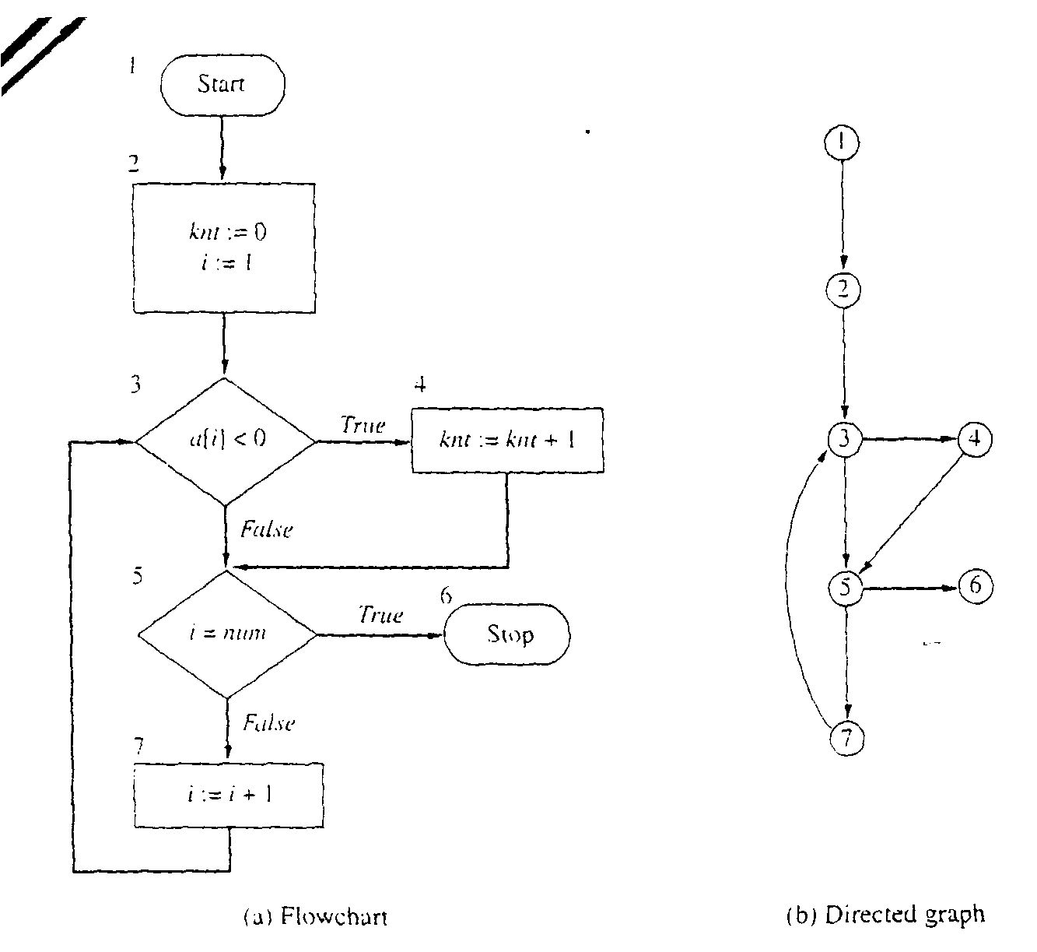
Problems: e.g. Flowcharts

Slide 5
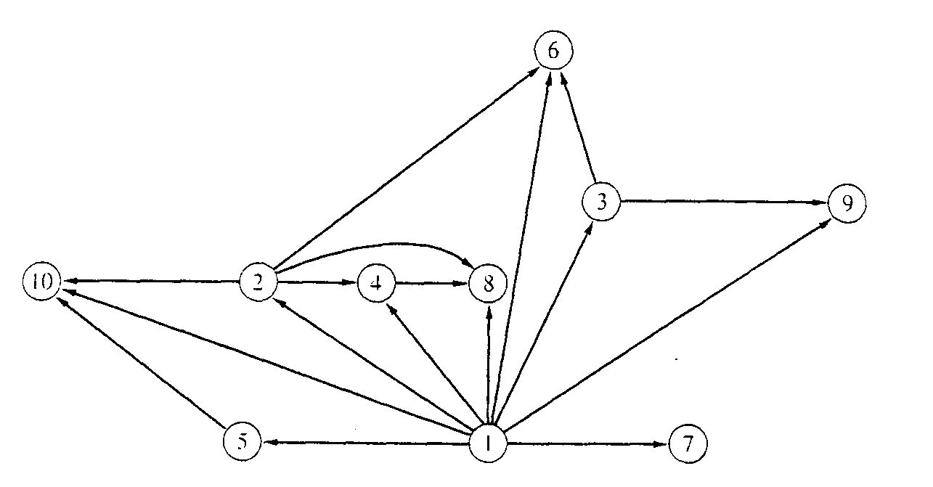
Problems: e.g. Binary relation
x is a proper factor of y

Slide 6
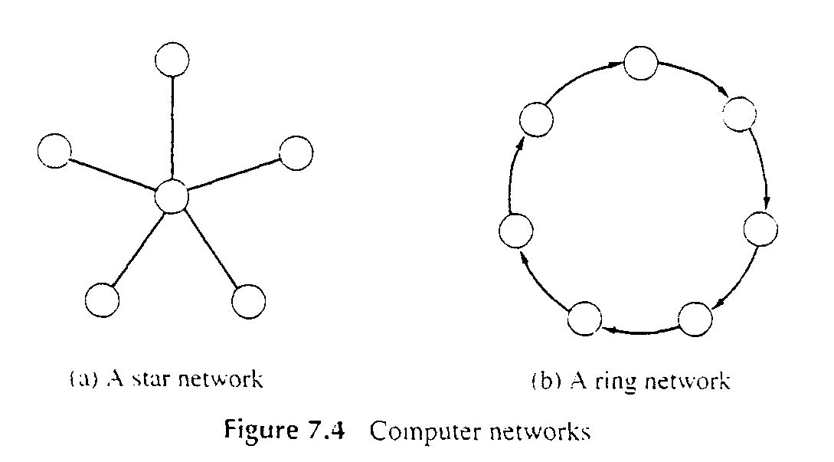
Problems: e.g. Computer Networks

Slide 7
Definition: Directed graph
Directed Graph
A directed graph, or digraph, is a pair
G = (V, E)
where V is a set whose elements are called vertices, and
E is a set of ordered pairs of elements of V.
Vertices are often also called nodes.
Elements of E are called edges, or directed edges, or arcs.
For directed edge (v, w) in E, v is its tail and w its head;
(v, w) is represented in the diagrams as the arrow, v -> w.
In text we simple write vw.

Slide 8
Definition: Undirected graph
Undirected Graph
A undirected graph is a pair
G = (V, E)
where V is a set whose elements are called vertices, and
E is a set of unordered pairs of distinct elements of V.
Vertices are often also called nodes.
Elements of E are called edges, or undirected edges.
Each edge may be considered as a subset of V containing two elements,
{v, w} denotes an undirected edge
In diagrams this edge is the line v---w.
In text we simple write vw, or wv
vw is said to be incident upon the vertices v and w

Slide 9
Terms You Should Know
Vertex (plural vertices) or Node
Edge (sometimes referred to as an arc)
Note the meaning of incident
Degree of a vertex: how many adjacent vertices
Digraph: in-degree (num. of incoming edges) vs. out-degree
Graphs can be:
Directed or undirected
Weighted or not weighted
weights can be reals, integers, etc.
weight also known as: cost, length, distance, capacity,…
Undirected graphs:
Normally an edge can’t connect a vertex to itself
A directed graph (also known as a digraph)
“Originating” node is the head, the target the tail
An edge may connect a vertex to itself

Slide 10
Terms You Should Know or Learn Now
Size of graph? Two measures:
Number of nodes. Usually ‘V’
Number of edges: usually ‘E’
Dense graph: many edges
Maximally dense?
Undirected: each node connects to all others, so e = v(v-1)/2 Called a complete graph
Directed: e = v(v-1) why?
Sparse graph: fewer edges
Could be zero edges…

Slide 11
Terms You Should Know or Learn Now
Path vs. simple path
One vertex is reachable from another vertex
A connected graph
undirected graph, where each vertex is reachable from all others
A strongly connected digraph:
direction affects this!
node u may be reachable from v, but not v from u
Strongly connected means both directions
Connected components for undirected graphs

Slide 12
Terms You Should Know or Learn Now
Cycle
Directed graph: non-empty path with same starting and ending node
An edge may appear more than once (but why?)
Simple cycle: no node repeated except start and end
Undirected graph: same idea
If an edge appears more than once (I.e. non-simple) then we traverse it in the same direction
Acyclic: no-cycles
A connected, acyclic undirected graph: free tree
If we specificy a root, it’s a rooted tree
Acyclic but not connected? a undirected forest
Directed acyclic graph: a DAG

Slide 13
Self-test: Understand these Terms?
Subgraph
Symmetric digraph
complete graph
Adjacency relation
Path, simple path, reachable
Connected, Strongly Connected
Cycle, simple cycle
acyclic
undirected forest
free tree, undirected tree
rooted tree
Connected component

Slide 14
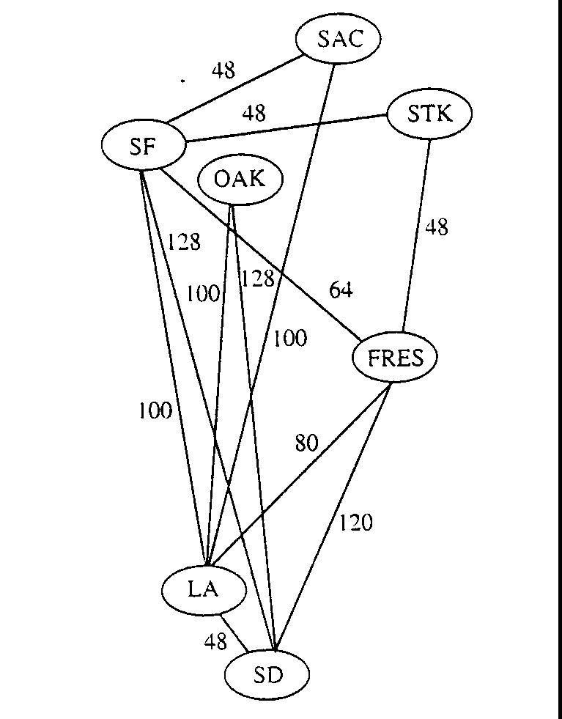
Definitions: Weighted Graph
A weighted graph is a triple (V, E, W)
where (V, E) is a graph (directed or undirected) and
W is a function from E into R, the reals (integer or rationals).
For an edge e, W(e) is called the weight of e.

Slide 15
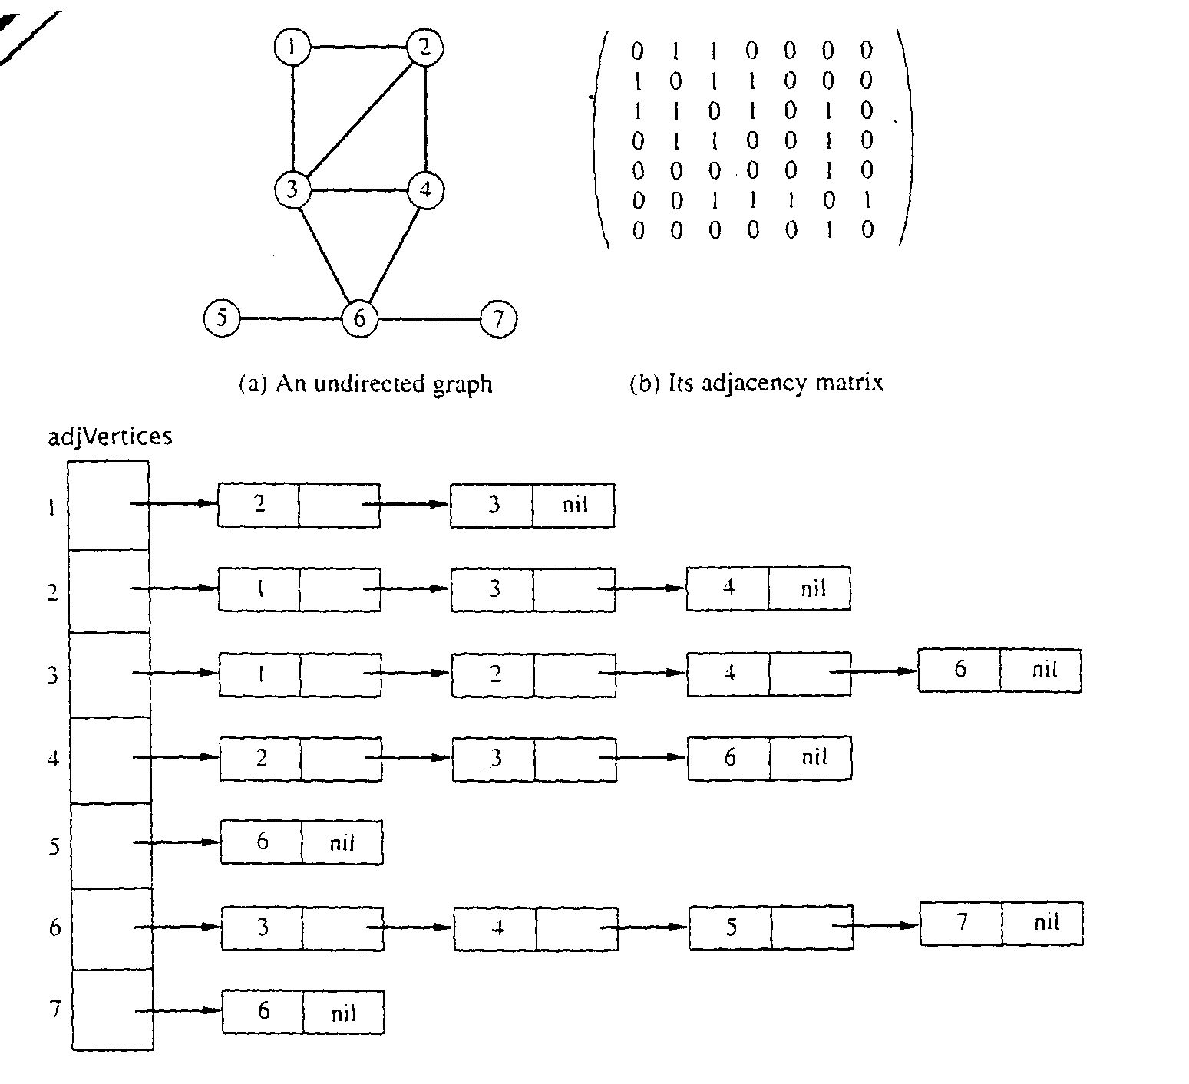
Graph Representations using Data Structures
Adjacency Matrix Representation
Let G = (V,E), n = |V|, m = |E|, V = {v1, v2, …, vn)
G can be represented by an n × n matrix

Slide 16
Array of Adjacency Lists Representation

Slide 17
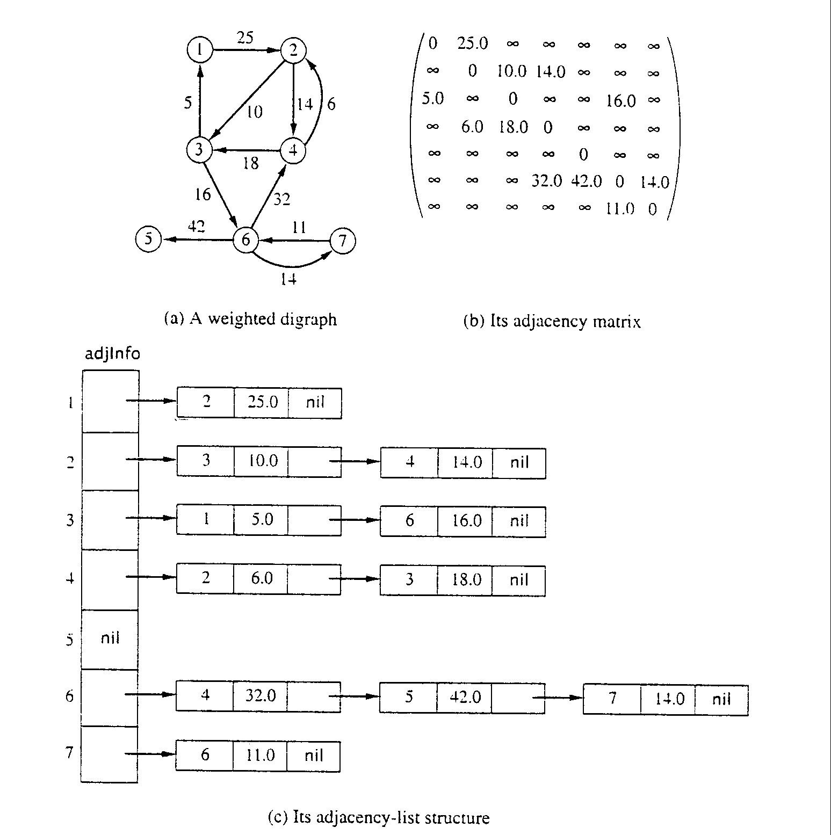
Adjacency Matrix for weight digraph

Slide 18
Array of Adjacency Lists Representation
from -> to, weight

Slide 19
Breadth-First Search

Slide 20
Traversing Graphs
“Traversing” means processing each vertex edge in some organized fashion by following edges between vertices
We speak of visiting a vertex. Might do something while there.
Recall traversal of binary trees:
Several strategies: In-order, pre-order, post-order
Traversal strategy implies an order of visits
We used recursion to describe and implement these
Graphs can be used to model interesting, complex relationships
Often traversal used just to process the set of vertices or edges
Sometimes traversal can identify interesting properties of the graph
Sometimes traversal (perhaps modified, enhanced) can answer interesting questions about the problem-instance that the graph models

Slide 21
Traversal Strategies
Note: traversal algorithms start at some vertex
Which? Trees have a root, but graphs don’t.
Might matter, might not.
Breadth-first search and depth-first search
efficient way to “visit” each vertex and edge exactly once.
We’ll see that BFS will tell us something about distances between a vertex and other vertices
We’ll see that DFS will be a generally useful approach for solving many graph problems.

Slide 22
BFS Strategy
Breadth-first search: Strategy (for digraph)
choose a starting vertex, distance d = 0
vertices are visited in order of increasing distance from the starting vertex,
examine all edges leading from vertices (at distance d) to adjacent vertices (at distance d+1)
then, examine all edges leading from vertices at distance d+1 to distance d+2, and so on,
until no new vertex is discovered

Slide 23
BFS Strategy: More Details
Maintain a Queue (Let’s call it Q)
Start at some node s (push s to Q and mark as visited)
s.dist = 0
While Q not empty
Pop a node n from queue
For each non-visited neighbor of n, let’s call it n’
Mark n’ as visited
n’.dist = n.dist + 1
Push n’ onto Q
Repeat

Slide 24
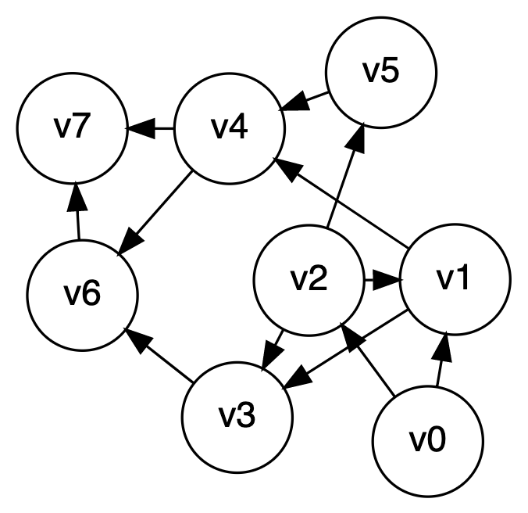
Breadth-first search, example
Let’s start at V0

Slide 25
BFS in Python
def bfs(graph, start):
parent = {}
color = {}
for v in graph:
color[v] = "white"
pending = Queue()
parent[start] = None
color[start] = "gray"
pending.add(start)
ctr = 0
while len(pending) > 0:
v = pending.remove()
ctr = ctr + 1
alist = graph.get_adjlist(v)
for w in alist:
if color[w] == "white":
color[w] = "gray"
pending.add(w)
parent[w] = (v, ctr)
color[v] = "black”
return parent
# Note: stores parent and “discovery” counter in parent

Slide 26
Breadth-first search: Analysis
For a digraph having V vertices and E edges
Each edge is processed once in the while loop for a cost of θ(E)
Each vertex is put into the queue once and removed from the queue and processed once, for a cost θ(V)
Total: θ(V+E)
Extra space is used for color array and queue, there are θ(V)
From a tree (breadth-first spanning tree)
the path in the tree from start vertex to any vertex contains the minimum possible number of edges
Not all vertices are necessarily reachable from a selected starting vertex

Slide 27
Depth-First Search

Slide 28
DFS: the Strategy in Words
Depth-first search: Strategy
Go as deep as can visiting un-visited nodes
Choose any un-visited vertex when you have a choice
When stuck at a dead-end, backtrack as little as possible
Back up to where you could go to another unvisited vertex
Then continue to go on from that point
Eventually you’ll return to where you started
Reach all vertices? Maybe, maybe not

Slide 29
Observations about the DFS Strategy
Note: we must keep track of what nodes we’ve visited
DFS traverses a subset of E (the set of edges)
Creates a tree, rooted at the starting point: the Depth-first Search Tree (DFS tree)
Each node in the DFS tree has a distance from the start. (We often don’t care about this, but we could.)
At any point, all nodes are either:
Un-discovered
Finished (you backed up from it), or
Discovered (I.e. visited) but not finished
On the path from the current node back to the root
We might back up to it
(Later we’ll call these states: white, black and gray respectively)

Slide 30
DFS Strategy 1: Use a stack
Maintain a Stack (Let’s call it S)
Start at some node ‘s’ (push ‘s’ to S and mark as visited)
While S not empty
Pop a node ‘n’ from S
Process ‘n’ if necessary (depending on problem you are solving)
For each non-visited neighbor of ‘n’
Mark neighbor as visited
Push neighbor onto S
Repeat
Sound familiar? Same as BFS but uses stack instead of queue!
Or we can implement recursively (see next slide)

Slide 31
depth-first search, example
Let’s start at V0

Slide 32
DFS Strategy 2: Recursion
def dfs(graph, start): //Main loop, inits and calls
visited = {}
dfs_recurse(graph, start, visited)
def dfs_recurse(graph, curnode, visited): //sometimes called dfs_visit()
visited[curnode] = True alist = graph.get_adjlist(curnode) //get the neighbors of curnode
for v in alist:
if v not in visited:
print " dfs traversing edge:", curnode, v
dfs_recurse(graph, v, visited)
# end for-all adjacent vertices
return

Slide 33
DFS to Process all Vertices in a Graph
Purpose: do all required initializations, then call dfs_recurse() as many times as needed to visit all nodes. May create a DFS forest.
Can be used to count connected components
Could remember which nodes are in each connected component
def dfs_sweep(graph, start):
visited = {}
# loop repeats DFS on every unvisited node
for v in graph:
if v not in visited:
dfs_recurse(graph, v, visited)

Slide 34
Using DFS to Find if a Graphic is Acyclic
Does a graph have a cycle?
DFS is great for this
But, slightly harder if graph is undirected
Use DFS tree: classify edges and nodes as you process them
Nodes:
White: unvisited
Black: done with it, backed up from it (never to return)
Gray: Have reached it; exploring it’s adjacent nodes; but not done with it

Slide 35
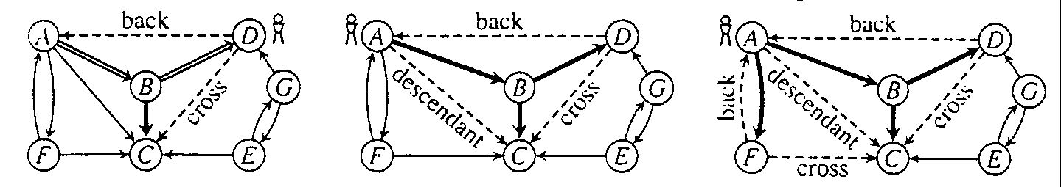
Depth-first search tree
edges classified:
tree edge, back edge, descendant edge, and cross edge

Slide 36
Using Non-Tree Edges to Identify Cycles
From the previous graph, note that:
Back edges (indicates a cycle)
dfs_recurse() sees a vertex that is gray
This back edge goes back up the DFS tree to a vertex that is on the path from the current node to the root
Cross Edges and Descendant Edges (not cycles)
dfs_recurse() sees a vertex that is black
Descendant edge: connects current node to a descendant in the DFS tree
Cross edge: connects current node to a node in another subtree – not a descendant of current node

Slide 37
Non-tree Edges in DFS
Question 1: Finding back edges for an undirected graph is not quite this simple:
The parent node of the current node is gray
Not a cycle, is it? It’s the same edge you just traversed
Question: how would you modify our code to recognize this?
Question 2:
In digraph, how could you modify the code to distinguish cross edges from descendant edges?
Hint: need to record the “time” at which a node was discovered (set to “gray”) and finished (set to “black”)

Slide 38
Time Complexity of DFS
For a digraph having V vertices and E edges
Each edge is processed once in the while loop of dfs_recurse() for a cost of θ(E)
Think about adjacency list data structure.
Traverse each list exactly once. (Never back up)
There are a total of 2*E nodes in all the lists
The dfs_sweep() algorithm will do θ(V) work even if there are no edges in the graph
Thus over all time-complexity is θ(V+E)
Remember: this means the larger of the two values
Note: This is considered “linear” for graphs since there are two size parameters for graphs.
Extra space is used for color array.
Space complexity is θ(V)

Slide 39
State-Space Search

Slide 40
State Space Search and Best-First Search
State-space Search
Given a start-state and a goal-state
Generate new states that can be “visited” from the current state
Choose (somehow) which state to go to next
Stop when you reach the goal (or exhaust all possible states)
Very useful for many problems in Artificial Intelligence
Puzzles, games
Expert systems
Theorem provers
Etc.

Slide 41
Heuristic Search
We could use BFS or DFS on such problems
Best-first Search strategy
Like BFS but use a priority queue and visit the state that has the highest heuristic score f(n)
Open states: a list of states that could be chosen next (i.e. they’re in the PQueue)
Closed states: a list of states we’ve already visited (i.e. they’re in the tree)

Slide 42
Best-First Strategy
The strategy:
While there are open states in the PQueue
current = PQueue.next();
Put current on the closed list.
If current is the goal, we’re done
For each state s that can be generated from current
If s is on the closed list, ignore it. Otherwise…
Calculate its score f(s)
Store (s, f(s)) in the PQueue
End for
End while
Usually, f(s) score here is distance to goal (or estimate of this)

Slide 43
Example: The 8-puzzle
8 numbered tiles in a 3x3 frame
Repeatedly slide a tile into the “blank” position to reach some goal configuration
Given a current state, generating child-states means seeing what moves are possible
See following slides.
Note: There’s also a 15-puzzle with a 4x4 frame

Slide 44


Example: 8-Puzzle
8 numbered tiles in a 3x3 grid
Repeatedly slide tiles into “blank” position until goal state is reached
Possible moves (in terms of “blank” space): UP, DOWN, LEFT, RIGHT
Initial state
Goal state

Slide 45
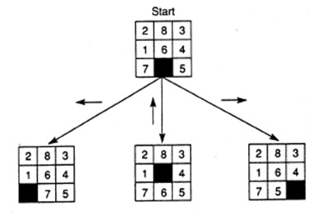
Successors of Initial State
Move blank LEFT, UP, or RIGHT

Slide 46
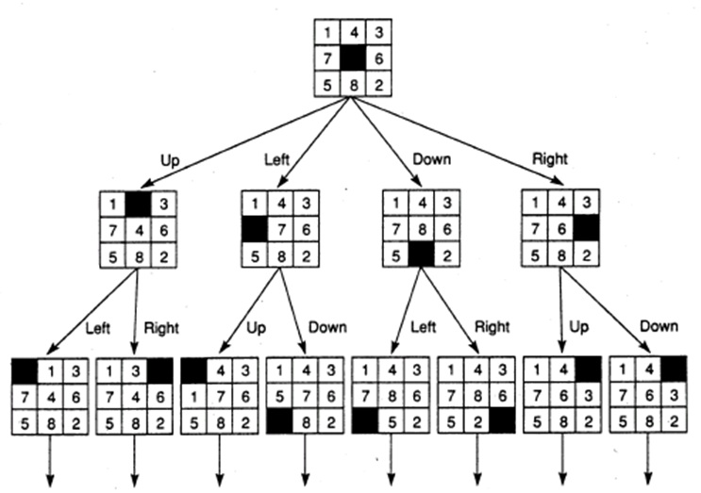
First two-levels of Search Tree

Slide 47
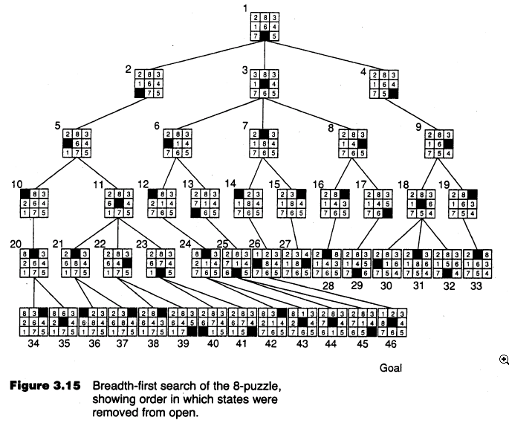

Slide 48
Heuristic
A function that evaluates each state in the state space
Used to determine which open state is “best”
Could give an estimate of the number of moves needed to reach the goal state
8-puzzle heuristic: number of tiles out of place
More informed heuristic: sum of Manhattan distances of tiles
Even better: Manhattan plus linear conflict heuristic

Slide 49
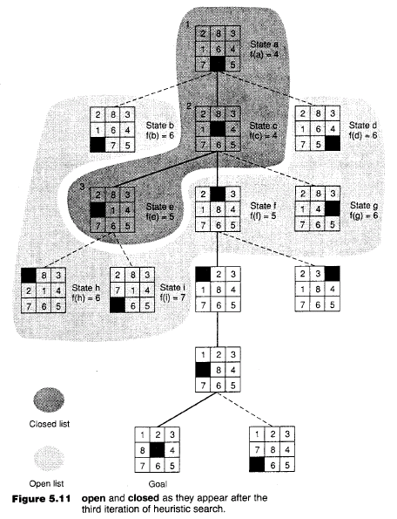
Corrected values?
a: 5
b: 6
c: 4
d: 6
e: 4
f: 4
g: 5
h: 4
i: 5
Here f(n) is a count of how many tiles (incl. the blank) are out of place. The next state that will be chosen will be State-f with score 5

Slide 50
A Better Use of Heuristics
If f(n) is the number of tiles out of place, this is really an estimate of how many moves are need to reach the goal from current node.
Better idea: let f(n) = g(n) + h(n) where
g(n) is the cost to the current node (the length of the path here), and
h(n) is an estimate of the cost to reach the goal from the current node

Slide 51
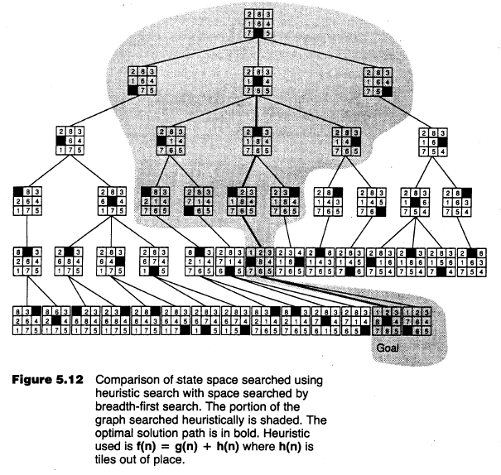

Slide 52
Optimal Search
Best-first search algorithm finds the optimal solution if the heuristic function does not overestimate the cost to the goal
Our example: optimal solution means shortest path, smallest number of moves
Such a heuristic is admissible
Search algorithm that uses f(n) = g(n) + h(n) where h(n) is admissible is called: A* search

Slide 53
Summary
Many graph algorithms assume nodes and edges are known (stored) a priori
But state-space search problems can be thought of as graph problem where nodes and edges are generated dynamically
Similar search problems as DFS, BFS traversal
Exhaustive search (a brute force method)
Heuristic search, artificial intelligence

Slide 54
Topological Sort

Slide 55
Topological Sort
Given a directed acyclic graph, construct an ordering of the vertices such that if there is a patch from v_{i} to v_{j}, then v_{j} appears after v_{i} in the ordering.
Uses in-degree: Number of incoming edges to a node

Slide 56
Topological Sort

Slide 57
Topological Sort
One valid topological sort is:
V1 V6 V8 V3 V2 V7 V4 V5

Slide 58
Topological Sort
What is the topological sort?

Slide 59
Topological Sort
What is the topological sort?

Slide 60
Topological Sort
This is already topologically sorted!

Slide 61
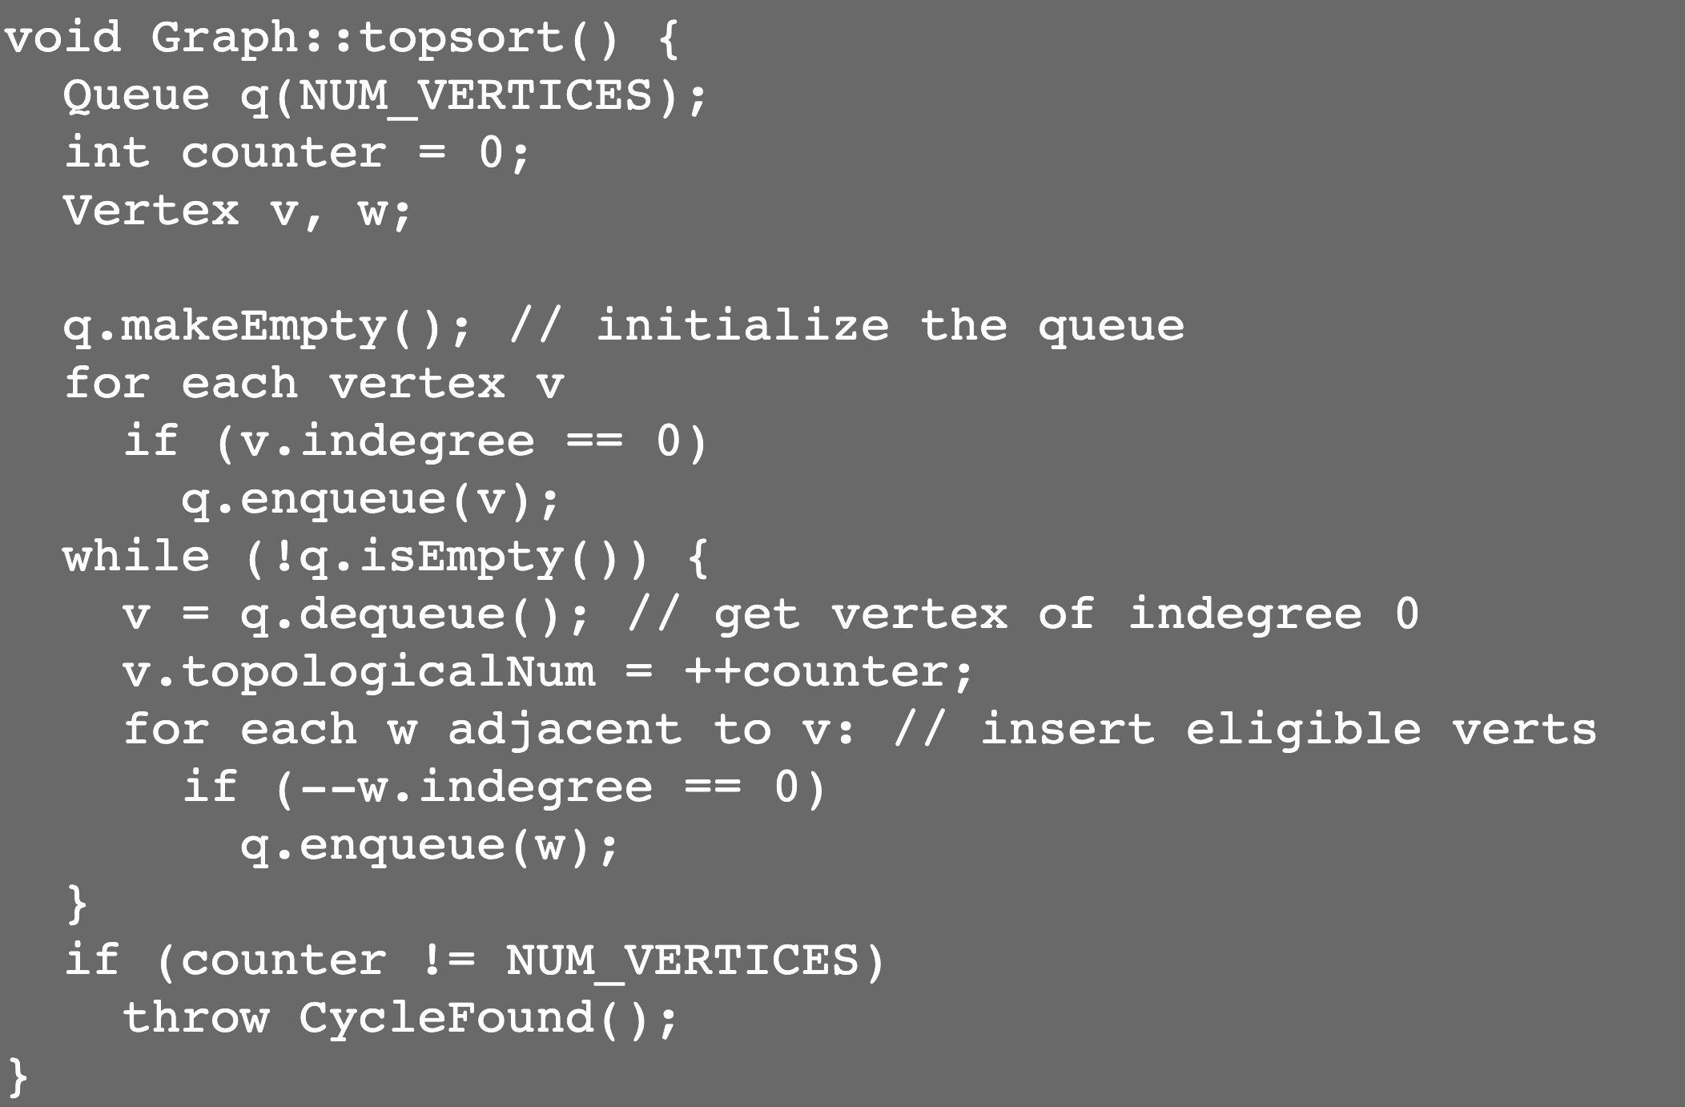
Topological Sort

Slide 62
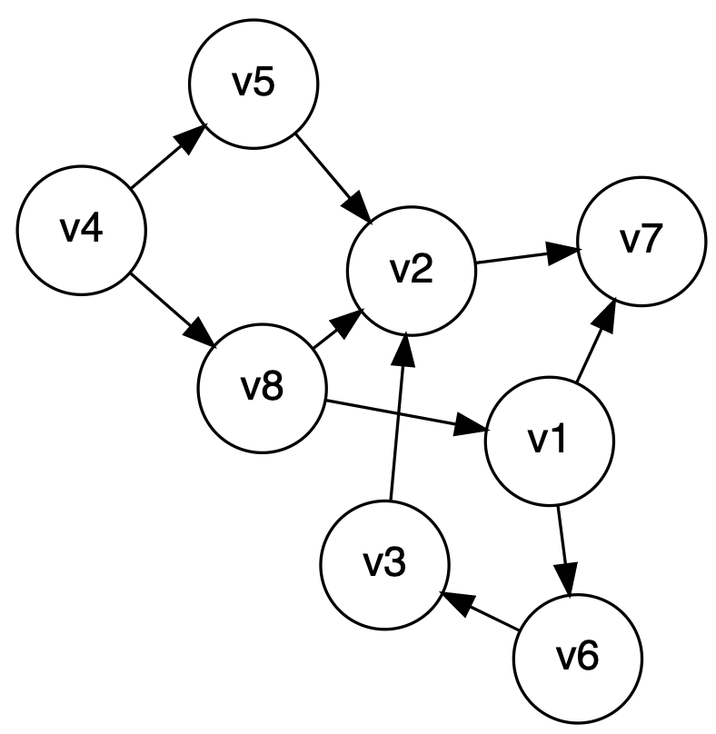
Topological Sort
Runtime of topological sort?
Each edge processed once total in inner loop
Each node processed once total in outer loop
Theta(V + E)

Slide 63
Topological Sort: One more example

Slide 64
Dijkstra’s Algorithm

Slide 65
Weighted Shortest Path
no negative weight edges.
Dijkstra’s algorithm: uses similar ideas as the unweighted case.
Greedy algorithms:
do what seems to be best at every decision point.
v
s
S
“known”
V - S
“unknown”

Slide 66
Dijkstra’s algorithm
Initialize each vertex’s distance as infinity
Start at a given vertex s
Update s’s distance to be 0
Repeat
Pick the next unknown vertex with the shortest distance to be the next v
If no more vertices are unknown, terminate loop
Mark v as known
For each edge from v to adjacent unknown vertices w
If the total distance to w is less than the current distance to w
Update w’s distance and the path to w

Slide 67
v₀
2
v₁
2
1
5
1
1
1
v₂
v₃
v₄
6
5
3
V | Known | Dist | path
v0
v1
v2
v3
v4
v5
v6
2
10
v₅
v₆

Slide 68
void Graph::dijkstra(Vertex s){
Vertex v,w;
s.dist = 0;
while (there exist unknown vertices, find the unknown v with the smallest distance)
v.known = true;
for each w adjacent to v
if (!w.known)
if (v.dist + Cost_VW < w.dist){
w.dist = v.dist + Cost_VW;
w.path = v;
}
}
}

Slide 69
Analysis
How long does it take to find the smallest unknown distance?
simple scan using an array: O(v)
Total running time:
Using a simple scan: O(v²+e) = O(v²)
Optimizations?
Use adjacency graphs and heaps
Assuming that the graph is connected (i.e. e > v-1), then the running time decreases to O(e + v log v)
We can simplify this to O(e log v)

Slide 70
Negative Cost Edges?
Perhaps the graph weights are the amount of fuel expended
Positive means fuel was used
And passing by a fuel station is a refueling, which is a negative cost edge
Dijkstra’s algorithm does not work for negative cost edges
Others do, but are much less efficient
What about negative cost cycles?

Slide 71
Dijkstra' Algorithm
dijkstra(G, wt, s)
init PQ to be empty;
PQ.Insert(s, dist=0);
parent[s] = NULL; dist[s] = 0;
while (PQ not empty)
v = PQ.ExtractMin();
for each w adj to v
if (w is unseen) {
dist[w] = dist[v] + wt(v,w)
PQ.Insert(w, dist[w] );
parent[w] = v;
}
else if (w is fringe && dist[v] + wt(v,w) < dist[w] ) {
dist[w] = dist[v] + wt(v,w)
PQ.decreaseKey(w, dist[w]);
parent[w] = v;
}

Slide 72
Notes on Dijkstra’s Algorithm
Use dist[] to store distances from start to any fringe or tree node
Store and calculate using distances instead of edge-weights
What’s the output?
Tree captured in the parent[] array
Shortest distance to each node in dist[] array
Trace shortest path in reverse by using parent[] to move from target back to start node, s

Slide 73
Correctness of These Greedy Algorithms
Recall that this greedy approach may or may not guarantee an optimal result
Answer: Yes, they do.

Slide 74
Proof of Dijkstra’s algorithm
Via induction and contradiction
On board -->

Slide 75
Summary

Slide 76
What Did We Learn?
What a graph is
Two ways to represent a graph (Matrix and List)
Traversals of graphs:
Breadth-first search
Depth-first search
Other Graph Algorithms:
Topological Sort
Dijkstra’s Algorithm

