Slide 1
Recommendation System --Principle and Application
Yang Yilin Chen Yangchun
ID: 1155112516 ID:1155121611

Slide 2
Content
Introduction
Related Work
Recommended System Types
Neighborhood-based Collaborative Filtering
Recommendation System Application

Slide 3
1 Introduction

Slide 4





1.Introduction
Purpose: To find and recommend items that a user is most likely to be interest in
User
Item
Notes:
We'll start first by looking at the fundamentals of recommendation systems. The fundamental purpose of a recommendation system is to find and recommend items that a user is most likely to be interested in.

Slide 5
1. Introduction
Meet the dual needs of users and firms
Users: Shorter time & Higher precision
Firms: Deeper analysis

Slide 6
2 Related Work

Slide 7
2. Related work
13 papers (2002-2017)
Comprehensive Survey
Adomavicius G(2005): Describe recommended methods types
Stuart E. Middleton(2005): handle the cold-start problem
Comprehensive Survey
classification method+ evaluation criteria+ recommendation algorithm+ problems & improvements
Content-based and Hybrid Approach Survey
Distributed Database System Survey

Slide 8
3 Recommended System Types

Slide 9
3. Recommended system types
Collaborative Filtering
Types
Hybrid Approaches
Content-based

Slide 10



3.1 Collaborative filtering recommendation
People with similar tastes
Types
Neighborhood-based Techniques
Model-based Techniques
Buy
Buy
Similar users

Slide 11
3.1 Neighborhood-based techniques
Types
User-based Collaborative Filtering
Item-based Collaborative Filtering

Slide 12



3.1.1 User-based collaborative filtering
Item 1
Concept
Users’ tastes similar: like the same things
Steps
1. Find the neighbor users
Users with more same historical behavior
User A and User C
2. Make recommendation
A user’s historical preference to his neighbor user
Item 4 to User A
User A
Item 2
User B
Item 3
User C
Item 4
Similar
Preference
Recommendation

Slide 13
3.1.1 Item-based collaborative filtering
Concept
The tastes of the same person is fixed
Items are similar if they are the preference of same person or neighbor users
Steps
1. Find the similar items
- Number of users who prefer both of some items
- Item 1 and Item 3
2. Make recommendation
- Items to who prefer its similar items
- Item 3 to User C
User A
Item 1
Item 2
User B
User C
Item 3
Similar
Preference
Recommendation

Slide 14
3.1.1 Neighborhood-based techniques
Advantages
Disadvantages
Limited scalability
Sparsity
Easy implementation
Any type of resource
Less interference to users
Open recommendations

Slide 15
3.1.1 Sparsity
User - Item Rating Matrix Data
User interaction with items is too little
Over-fitting of the recommendation algorithm

Slide 16
3.1.2 Model-based techniques
Calculation ＆ recommendation
Real-time forecasting
Train a model
Sample user preference

Slide 17
3.1.2 Model-based techniques
Advantages
Disadvantages
Scalability
Prediction speed
Inflexibility
Quality of predictions
Notes:
Scalability: Most models resulting from model-based algorithms are much smaller than the actual dataset, so that even for very large datasets, the model ends up being small enough to be used efficiently. This imparts scalability to the overall system.
Prediction speed: Model-based systems are also likely to be faster, at least in comparison to memory-based systems because, the time required to query the model (as opposed to the whole dataset) is usually much smaller than that required to query the whole dataset.
inflexibility: Because building a model is often a time- and resource-consuming process, it is usually more difficult to add data to model-based systems, making them inflexible.
Quality of predictions: not accuracy

Slide 18
3.2 Content-based recommendations
Based on users’ previous preferences
Buy
Similar items
Recommend

Slide 19
3.2 Content-based recommendation
Advantages
Disadvantages
More accurate
Users are independent
Regardless of the user’s attitude towards the item
Cold-start problem for new users

Slide 20
3.2 Cold-start problem
New item: no user rating record
New user: no user related information
New system: no information about users and items

Slide 21
3.3 Hybrid approaches
CF Recommendation
Content-based Recommendation
Hybrid Approaches
combine both collaborative and content-based approaches

Slide 22
3.3 Hybrid approaches
Weighted Hybridization
Switching Hybridization
Mixed Hybridization
90% Content-based
Hybrid result
10% CF
Situation 2
CF Commendation
Situation 1
Content-based Commendation
CF Commendation
Content-based
Display
Linear Formula
Weight
Different Situations
Different Approaches
Both Approaches Adopted
Both Results Are Displayed

Slide 23
4 Neighborhood-based Collaborative Filtering
Notes:
Then I’ll talk about the implementation of Neighborhood-based collaborative filtering.

Slide 24
4. Neighborhood-based collaborative filtering
Core Idea
What would you do if you want to watch a movie but do not know which to choose?
Find neighbors using historical data
Implementation
Data collection
Similarity calculation
Notes:
the core idea of it is very similar to what happens in real life. What would you do if you want to watch a movie but do not know which to choose? I think most of you will ask your friends about it as your friends share similar tastes with you. This is what Neighborhood-based collaborative filtering does. Find neighbors using historical data.

Slide 25
4.1 Implementation steps
Data Collection
Similarity Calculation
Notes:
Then I will talk about the Implementation step. Data collection and Similarity calculation.

Slide 26
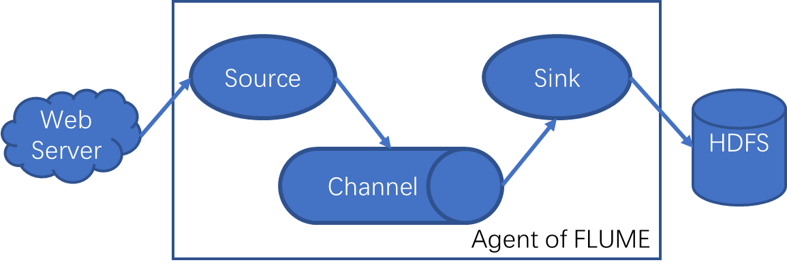
4.2.1 Data collection
Data Acquisition
- Use FLUME
Data Preprocessing
- MapReduce
Data Warehouse Technology and ETL
- Hive on Hadoop
- Data Extract-Transform-Load
Notes:
In the age of big data, most websites use FLUME, a distributed log collection system that collects data of user behaviors such as likes, comments, ratings, shares, etc. and sends it to the designated place such as HDFS.
Then Cast the data processing into Map and Reduce operations, as what we learned, to partition and write the data in an efficient way.
And then use Data Warehouse Technology and ETL to map the data into the tables we can use directly.

Slide 27
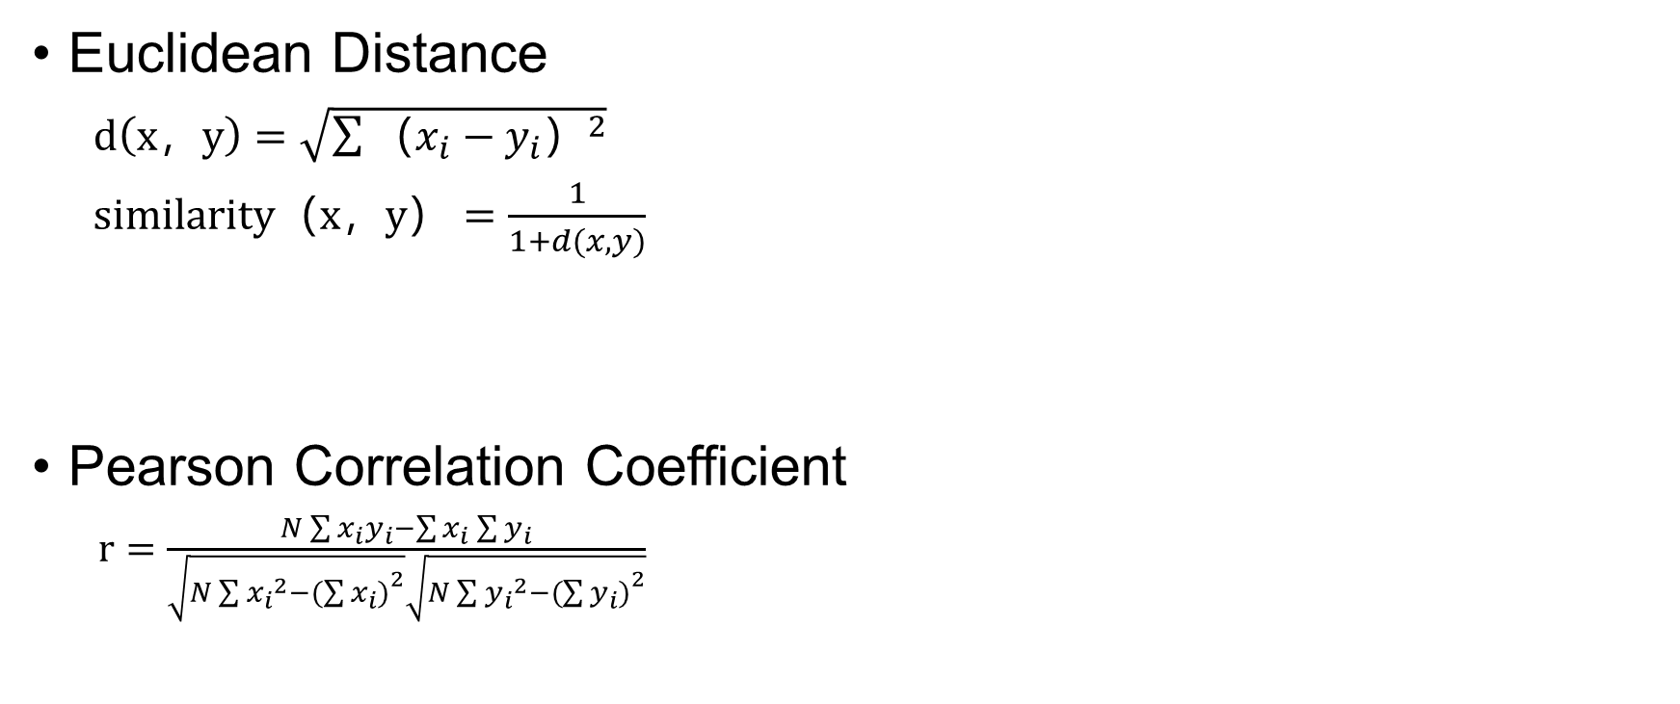

4.2.2 Similarity calculation(1/2)
y
Distance
Euclidean Distance
$d（x，y）=\sqrt{\sum{{（x_{i}−y_{i}）}^{2}}}$
$similarity（x，y）{=\frac{1}{1+d(x,y)}}$
Pearson Correlation Coefficient
$r=\frac{N\sum{x_{i}y_{i}−\sum{x_{i}\sum{y_{i}}}}}{\sqrt{N\sum{{x_{i}}^{2}−{(\sum{x_{i})}}^{2}}}\sqrt{N\sum{{y_{i}}^{2}−{(\sum{y_{i})}}^{2}}}}$
x
y
Fitting effect
x
Notes:
The second step is Similarity calculation. The functions of 4 methods of calculation may look complicated, but trust me, they are all high school math.
First one, Euclidean Distance. Take 2-dimensional plane as example. For different users, Set their rating of different items as x and y, then calculate the distance. The closer, the more similar.
For Pearson Correlation Coefficient, it is just like the slope of the linear regression we learned in statistics. Set users rating for different items as a curve, the fitting effect of the curve shows the similarity.

Slide 28


4.2.2 Similarity calculation(2/2)
Cosine Similarity
$T\left(x,y\right)=\frac{x∙y}{{\left\|x\right\|}^{2}×{\left\|y\right\|}^{2}}=\frac{\sum{x_{i}}\sum{y_{i}}}{\sqrt{\sum{{x_{i}}^{2}}}\sqrt{\sum{{y_{i}}^{2}}}}$
Tanimoto Coefficient
$T\left(x,y\right)=\frac{|A∩B|}{|A∪B|}=\frac{x∙y}{{\left\|x\right\|}^{2}+{\left\|y\right\|}^{2}−x∙y}$
$=\frac{\sum{x_{i}}\sum{y_{i}}}{\sqrt{\sum{{x_{i}}^{2}}}+\sqrt{\sum{{y_{i}}^{2}}}−\sum{x_{i}}\sum{y_{i}}}$
Intersection angle of 2 vectors
$$θ$$
Union
Inter-
section
Notes:
For Cosine Similarity, it is the calculation of intersection angle of 2 vectors. The vector is formed by the rating a user made to different items. If the two vectors overlapped, the Cosine Similarity quals to 1, the two neighbors have totally same tastes.
The Tanimoto Coefficient is the intersection of two sets divided by the union of them, showing the proportion of the overlap area. The larger, the more similar.

Slide 29
5 Recommendation System Application -Roommate matching of S. H. Ho College
Notes:
Then I am going to talk about our application case. For the time limit, I will talk about it very briefly.

Slide 30
5. Overview
Objective
- 4-person room matching based on student hobby similarity
Python programming method
- Data Processing
- Calculate Cosine Similarity
- Greed Algorithm
Reference
- Data structures method from MovieLens (http://grouplens.org/datasets/movielens/1m/)
- Data Processing and cosine similarity code modified from https://www.cnblogs.com/baihuaxiu/p/6617389.html
- Greed Algorithm code from discussion with friends learning CS
Notes:
The case is to perform the 4-person room matching of S. H. Ho College based on student hobby similarity, using python programming. As we are young programmer, we take a lot of reference from a case on the internet about recommending movies.

Slide 31
5.1 Steps of roommate matching
Assumption
Data Collection
Data Processing - Vectorization
Student Similarity Calculation
Roommate Matching - The Greed Algorithm
Roommate Matching Result
Notes:
These are the steps.

Slide 32
5.2 Assumption of S. H. Ho College roommate matching
4-person room with students with similar hobbies
Student hobbies rating from DDMBS of competitor list and attendance list of different activities
40 students
10 kinds of hobbies
Notes:
For the Assumption, we arrange 4-person rooms with students with similar hobbies.
The hobby rating comes from the competitor lists and attendance lists of different activities, keeping in the DDBMS of different colleges. Assume there are 40 students with 10 kinds of hobbies.

Slide 33
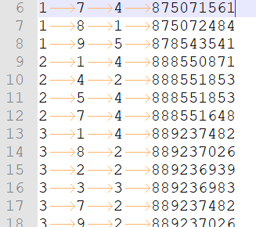
5.3 Data collection of roommate matching
10 hobbies
Data structure of raw data
No. | Hobby
1 | Swimming
2 | Chess
3 | Piano
4 | Dancing
5 | Violin
6 | Movie
7 | Music
8 | Basketball
9 | Football
10 | Badminton
User_id | Hobby_id | Rating | Timestamp
1 | 1 | 5 | 874965758
1 | 2 | 3 | 876893171
2 | 1 | 4 | 888550871
3 | 8 | 2 | 889237026
Notes:
Here are the hobbies and the data structure.

Slide 34
5.4 Data processing and similarity calculation
User dictionary
- test_dic[user id]=[(interest id, interest rating)...]
Interest dictionary
- test_item_to_user[interest id]=[user id1, user id2...]
Neighbor dictionary
- user_rate_dic[user id]=[(distance, user,neighbor id)...]
Calculating student hobby similarity
- Calculate average interest level
- If rating > avg, rate as 1;
- If rating < avg, rate as 0;
- Use Cosine Similarity
Notes:
In the processing step, we vectorize the data and make them to different dictionaries for easily looking up. We use the User dictionary to find hobbies by student ID, the Interest dictionary to find users by interest ID, the Neighbor dictionary to find neighbors by user ID
And calculate the consine similarity

Slide 35
5.5 The greed algorithm
Objective
- Solve problem that student not mutually nearest neighbor
Inspired by Logistic routing
Method
- Rank distance
- Arrange nearest 2 neighbors in the first room
- Arrange another available neighbor nearest to anyone in the room already
- Until 4 roommates arranged
- Start matching students for a new room
Notes:
Then the greed algorithm part. It shows the difference between the case we take reference. It is to solve the problem that students are not mutually nearest neighbors. For student 1, he is similar to student 2 most, but student 2 is similar to student 3 most. Just like a love triangle, 三角恋. But unlike movie arouting we learnt in another course, but find it called greed algorithm in computer science.
The Method is firstly to Rank distance, secondly put the nearest 2 neighbors in the first room. Then, put another available neighbor nearest to anyone in the room already. Do this Until 4 roommates arranged before Start matching students for another room.

Slide 36
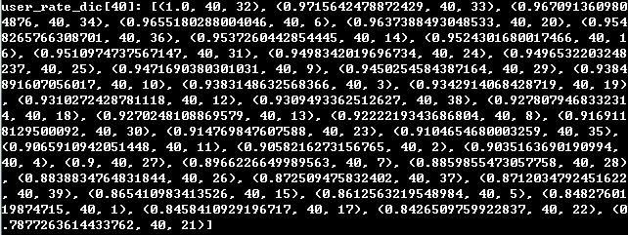
5.6 e.g. Roommate matching of the first room(1/3)
Step 1:
- After the ranking of similarity, student 40 and student 32 have the largest similarity than all other students.
- Put student 40 and student 32 in the room
Notes:
The is the real case of the first room.
Step 1, student 40 and student 32 have the largest similarity in the ranking, so Put them in the room

Slide 37
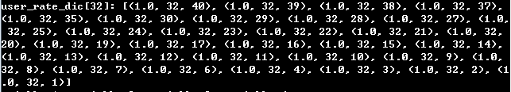
5.6 e.g. Roommate matching of the first room(2/3)
Step 2:
- Check neighbor dictionary of student 32. The nearest neighbor of student 32 is student 39.
- Put student 39 in the room
Notes:
Step 2, Check neighbor dictionary of student 32. The student 32’s nearest neighbor is student 39. so Put student 39 in the room

Slide 38
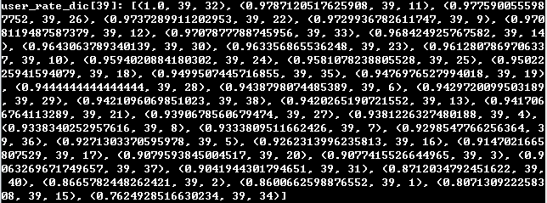
5.6 e.g. Roommate matching of the first room(3/3)
Step 3:
- Check neighbor dictionary of student 39. The nearest neighbor of student 39 is student 39 and student 11.
- Put student 11 in the room and finish matching in room 1.
Notes:
Step 3, Check neighbor dictionary of students 39. The nearest neighbors are student 32 and student 11. Student 32 is not available, so Put student 11 in the room and finish matching in room 1.

Slide 39
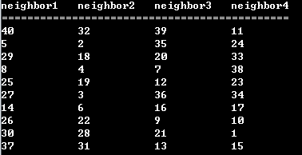
5.7 Roommate matching result
Notes:
Here is the matching result of all rooms.

Slide 40
THANKS!

