Slide 1
CyberSec EDU
Terminal
Linux and windows

Slide 2
What is a terminal
A CLI interface
Part of a shell interface

Slide 3
Important shorthand list
Dir: directory / folder
Root: the lowest dir
~ : home / your user dir
Path: the full location of a file

Slide 4
Important Commands

Slide 5
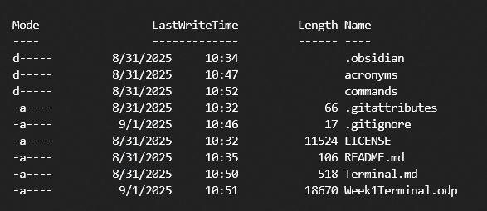
List file in current dir
Windows
dir
Linux
ls

Slide 6
change directory
Same both linux and windows
cd <dir>
How you navigate the file system

Slide 7
Delete file or dir
Windows:
del <file or dir>
Linux:
rm <file>
rm -r <dir>

Slide 8
read text file
both linux and windows
cat <file>
will print out the entire file

Slide 9
make directory
both linux and windows
mkdir <name>

Slide 10
find text in output
Windows
findstr <string>
Linux
grep <string>
Both are useualy piped into

Slide 11
Linux only commands

Slide 12
elevate access
sudo <command>
this will run the command as the “root” user

Slide 13
text edit
nano <file>
this is how you edit a text file in termial

Slide 14

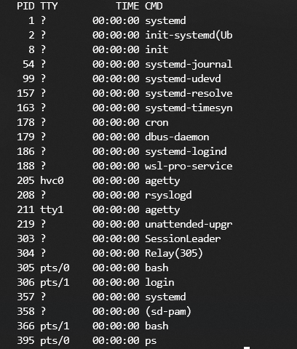
running processes
ps
ps -A

