Slide 1
CycloneDX v1.6 – Manufacturing BOM (MBOM) Object Diagrams
Notes:
https://github.com/CycloneDX/1.5-workstreams/blob/main/formulation/prototypes/example1.json

Slide 2
[bom] (root)
...
formulatation: []formula
...
component: object
type: string
name: string
...
dependency
dependsOn
formula
components: []component
services: []service
workflows: []workflow
...
dependency
dependsOn
[formulas]
[formulas]
service: object
provider: string
name: string
...
dependency
dependsOn
dependency
dependsOn
workflow: task
tasks: []task
taskDependencies: []dependency
...
Notes:
"type": {
"type": "string",
"enum": [
"application",
"framework",
"library",
"container",
"operating-system",
"device",
"firmware",
"file"
],

Slide 3
trigger: object
+ ...
task: object
trigger: trigger
taskTypes: []taskType
// string enum. (e.g., build, test, deliver, etc.)
workspaces: []workspace
steps: []step
inputs: []inputType
outputs: []outputType
resourceReferences: []resourceReferenceChoice
runtimeTopology: dependency
...
taskType: string
workflow: task
tasks: []task
taskDependencies: []dependency
// the graph of tasks
workspaces: []workspace
dependency
dependsOn
workflow: task
tasks: []task
taskDependencies: []dependency
// the graph of tasks
workspaces: []workspace
dependency
dependsOn
workspace: object
...
dependency
dependsOn
dependency
dependsOn
step: object
...
dependency
dependsOn
dependency
dependsOn
inputType: object
...
dependency
dependsOn
dependency
dependsOn
outputType: object
...
dependency
dependsOn
dependency
dependsOn
resourceReferenceChoice: object
...
dependency
dependsOn
dependency
dependsOn
dependency: object
...
Notes:
"type": {
"type": "string",
"enum": [
"application",
"framework",
"library",
"container",
"operating-system",
"device",
"firmware",
"file"
],

Slide 4
workflow: object
tasks: []task
taskDependencies: []dependency // graph of tasks
trigger: trigger
taskTypes: []taskType
workspaces: []workspace
inputs: []inputType
outputs: []outputType
resourceReferences: []resourceReferenceChoice
runtimeTopology: dependency
...
task: object
...
dependency
dependsOn
dependency
dependsOn
dependency: object
...
dependency
dependsOn
dependency
dependsOn
See task object attribute definitions for those shared by workflow
Notes:
"type": {
"type": "string",
"enum": [
"application",
"framework",
"library",
"container",
"operating-system",
"device",
"firmware",
"file"
],

Slide 5
trigger: object
resourceReferences: [] resourceReferenceChoice
event: event
conditions: []condition
inputs: []inputType
outputs: []outputType
...
resourceReferenceChoice: object
...
dependency
dependsOn
dependency
dependsOn
event: object
...
condition: object
expression: string
...
dependency
dependsOn
dependency
dependsOn
inputType: object
...
dependency
dependsOn
dependency
dependsOn
outputType: object
...
dependency
dependsOn
dependency
dependsOn
Notes:
"type": {
"type": "string",
"enum": [
"application",
"framework",
"library",
"container",
"operating-system",
"device",
"firmware",
"file"
],

Slide 6
step: object
commands: []command
...
command: object
executed: string
...
Notes:
"type": {
"type": "string",
"enum": [
"application",
"framework",
"library",
"container",
"operating-system",
"device",
"firmware",
"file"
],

Slide 7
workspace: object
resourceReferences: []resourceReferenceChoice
volume: volume
...
resourceReferenceChoice: object
...
dependency
dependsOn
dependency
dependsOn
volume: object
...
Notes:
"type": {
"type": "string",
"enum": [
"application",
"framework",
"library",
"container",
"operating-system",
"device",
"firmware",
"file"
],

Slide 8
inputType: object
source: resourceReferenceChoice
target: resourceReferenceChoice
resource: resourceReferenceChoice
parameters: []parameter
environmentVars: []property | []string
data: attachment
...
resourceReferenceChoice: object
// i.e., for source, target, resource
ref: refLinkType | bomLinkElementType
extrernalRef: externalReference
parameter: object
name: string
value: string
datatype: string
dependency
dependsOn
dependency
dependsOn
property: object
...
attachment: object
...
Notes:
"type": {
"type": "string",
"enum": [
"application",
"framework",
"library",
"container",
"operating-system",
"device",
"firmware",
"file"
],

Slide 9
outputType: object
source: resourceReferenceChoice
target: resourceReferenceChoice
resource: resourceReferenceChoice
parameters: []parameter
data: attachment
...
See inputType object attribute definitions for those shared by outputType.
Notes:
"type": {
"type": "string",
"enum": [
"application",
"framework",
"library",
"container",
"operating-system",
"device",
"firmware",
"file"
],

Slide 10
resourceReferenceChoice: object
ref: refLinkType | bomLinkElementType
extrernalRef: externalReference
refLinkType: object
...
bomLinkElementType: object
...
externalReference: object
...
Notes:
"type": {
"type": "string",
"enum": [
"application",
"framework",
"library",
"container",
"operating-system",
"device",
"firmware",
"file"
],

Slide 11
Formulation: Use Case Diagrams
Notes:
https://github.com/CycloneDX/1.5-workstreams/blob/main/formulation/prototypes/example1.json

Slide 12

Use Case: Simple Makefile: Event-Trigger-Workflow
trigger
{
“timeActivated”: “2025-01-01T14:00:00+00:00”,
“bom-ref": "cdx:mbom:trigger:uuid:1a9b…",
“uid": ”uuid:1a9b…",
“type": "manual",
“name": "make trigger",
“description": "Bash, command-line build trigger”,
“event”: {
// event content goes here
},
...
}
Event Source
(person)
event
{
“timestamp”: “2025-01-01T14:00:00+00:00”,
“name”: “make build”,
“description”: “Command line build”
}
$ make build
workflow
{
“bom-ref": "cdx:mbom:task:uuid:431f…",
“uid": ”uuid:431f…",
“taskTypes”: [“clean”, “build”],
“tasks”: […],
...
}
Notes:
"type": {
"type": "string",
"enum": [
"application",
"framework",
"library",
"container",
"operating-system",
"device",
"firmware",
"file"
],

Slide 13
Use Case: Simple Makefile: Workflow-Task
trigger
{
“timeActivated”: “2025-01-01T14:00:00+00:00”,
“bom-ref": "cdx:mbom:trigger:uuid:1a9b…",
“uid": ”uuid:1a9b…",
“type": "manual",
“name": "make trigger",
“description": "Bash, command-line build trigger”,
...
}
workflow
{
“bom-ref": "cdx:mbom:workflow:uuid:431f…",
“uid": ”uuid:431f…",
“taskTypes”: [“clean”, “build”],
“tasks”: [{
// task content goes here
}
],
“taskDependencies”: [{
“ref”: “cdx:mbom:task:uuid:dbb6…
}
],
“trigger”: {
// trigger content goes here
},
“resourceReferences”: […],
“runtimeTopology”: […],
...
}
task
{
“bom-ref": "cdx:mbom:task:uuid:dbb6…",
“uid": ”uuid:dbb6…",
“taskTypes”: [“clean”, “build”],
“inputs”: […],
“outputs”: […],
"steps": [{
"name": "run make build",
"commands": [{
"executed": "make build”
}
]
],
...
}
Notes:
"type": {
"type": "string",
"enum": [
"application",
"framework",
"library",
"container",
"operating-system",
"device",
"firmware",
"file"
],

Slide 14
Use Case: Simple Makefile: Formula-Workflow-Components
bom
{
"bomFormat": "CycloneDX",
"specVersion": "1.6",
"serialNumber": "urn:uuid:2820...",
"metadata": {
"component": {
"type": "application",
"name": "simple-application",
...
},
...
},
"formulation: [{
// formula content goes here
}
],
...
}
formula
{
components: [
// component content goes here
],
workflows: [
// workflow content goes here
]
}
component
{
"bom-ref": "file:///…/Makefile",
"type": "file",
"name": "Makefile",
...
}
dependency
dependsOn
dependency
dependsOn
workflow
{
“bom-ref": "cdx:mbom:workflow:uuid:431f…",
“uid": ”uuid:431f…",
“taskTypes”: [“clean”, “build”],
“tasks”:[…],
“taskDependencies”:[…],
“trigger”: {…},
...
}
Notes:
"type": {
"type": "string",
"enum": [
"application",
"framework",
"library",
"container",
"operating-system",
"device",
"firmware",
"file"
],

Slide 15
Use Case: Simple Makefile: Runtime-Topology
Runtime Topology
workflow
{
“bom-ref": "cdx:mbom:workflow:uuid:431f…",
“uid": ”uuid:431f…",
...,
“runtimeTopology”: ”: [{
“ref”: “file:///bin/bash”
"dependsOn” :[{
”ref”: “urn:cdx:os://macosx…”
],
},
{
“ref”: “urn:cdx:os://macosx…”
"dependsOn” :[{
”ref”: “urn:cdx:device:sn:…”
],
},
{
“ref”: “urn:cdx:device:sn:…”,
}
],
...
}
component
{
"bom-ref": "file:///bin/bash",
"type": "platform",
"name": "GNU bash",
"version": "3.2.57(1)…”
}
dependsOn
component
{
“bom-ref": "urn:cdx:os://macosx…",
"type": "operating-system",
"name": "macOS",
"version": "14.6.1+23G93"
}
dependsOn
component
{
"bom-ref": "urn:cdx:device:sn:…",
"type": "device",
"name": "Matt's MacBook Pro",
"description": "Apple M3 Max…”
}
Notes:
"type": {
"type": "string",
"enum": [
"application",
"framework",
"library",
"container",
"operating-system",
"device",
"firmware",
"file"
],

Slide 16
Formulation: Proposal diagrams
Notes:
https://github.com/CycloneDX/1.5-workstreams/blob/main/formulation/prototypes/example1.json

Slide 17
Proposal: Adopt Patterns for Referential Resource Types in Formula
Goals
Reuse : Encourage “reuse” of references to existing resources (via `bom-ref`) and `dependency` relationships
Do not create more places (in the schema) to inline `component‘ or `service` definitions
encourage (via schema) use of `refType` (i.e., bom-ref)
Meaningful External Refs : Adopt use of and improve data within `externalReference` as “the way” to point to dynamic or transient entities in CI/CD processes (e.g., `tool` or `yaml` configurations not in base source code repository)
e.g., recent proposal around including `schema` for the data pointed to by the URL
Reference Choice: Acknowledge that `bom-ref` and `externalReference` often are are paired “choices” (like LicenseChoice) that will be reused heavily in formulation work
Perhaps deserves its own type (i.e., `ResourceChoice`)
v1.6: Shared Schema: Formalize a shared `Resource` schema (abstract) type for use on existing concrete types
e.g., component, service and as we create more xBOM types (e.g., model, cipher, etc.)
Reduces errors in schema development (e.g., add `pedigree` in one place)
Notes:
Workspace source
openwhisk-workspace: tasks/persistent-volume-claim.yaml
Task source:
clone-app-repo-to-workspace: tasks/00-clone-app-repo.yaml
clone-runtime-repo-to-workspace: tasks/00-clone-runtime-repo.yaml
Unused:
Tasks/detect-runtimes.yaml

Slide 18
v1.5: Proposal: New `component` -> `type` enum values
Workflows and tasks will use or interact with component types that are familiar to Cloud Native and CI/CD and Cloud Native domain concepts
Note: “component” should support new “type” enum. values.
Proposed minimum adds:
"configuration",
// includes K8s resource definitions (and downstream definitions from Knative, Tekton, etc.)
"tool",
// A hardware or software to that was used in a task
// Note: Supports early examples where “tools” were special task objects
"task", // to designate workflow task “components” type
// Note: Could use “container” type for Tekton
"repository” (external, resource storage)
// define source/target for input/output to tasks e.g., GitHub
Others (TBD):
“storage” (more generic storage term)
“workspace” (in-workflow, ephemeral storage)
formula
components: []component
services: []services
workflows: []workflow
[formulas]
[formulas]
Note: workflows are specialized, orchestration “task” types and all “tasks” have a “bom-ref” so that they can be defined once and reused.
(e.g., build matrices may use the same workflow subsets to scan code for example)
Note: (TBD): “externalReference” MAY need to mirror some of these “type” enum. values
case: when dynamic resources are created or referenced during without a “component” declaration in the “formula”
e.g., source/target of inputs/outputs
one task creates a “resource” for another task
Notes:
"type": {
"type": "string",
"enum": [
"application",
"framework",
"library",
"container",
"operating-system",
"device",
"firmware",
"file"
],

Slide 19
Proposal: `workflow` captures a graph of `tasks` using workflow-specific components/services
Workflow is a specialized Task that serves as the entry point for all coordinated tasks
Complete list of transient “components” and “services” (concrete, reusable) resources that host, run, execute or used by workflows or tasks including source code, inputs, outputs and tools.
Effectively anything that partivpates in the workflow
[bom] (root)
...
formulation: []formula
formula
components: []component
services: []service
workflows: []workflow
[formulas]
[formulas]
“workflow” represents the “root” or “orchestration” task (singular).
Note: the term “workflow” is generic and applies to not only CI/CD, but also any other process we may want to capture in xBOMs in the future.
workflow: task
tasks: []task
taskDependencies: []dependency
// the graph of tasks
workspaces: []workspace
Note: For “array” types, by default, JSON Schema behaves as if the `additionalItems` parameter is set to `true` (link).
TODO: Adjust existing CDX schema
Note: the “tasks” / “taskDependencies” design mirrors existing CycloneDX “component” / “service” arrays (listings) and dependency declarations
task: object
// See next slide
dependency
dependsOn
dependency
dependsOn
Note: we SHOULD constrain the workflow “taskDependencies” schema to only permit “task” type as valid “refType” (i.e., task-only graph composition)
Note: “tasks” are NOT required (may be empty) since a ”workflow” is a specialized task, it can represent a simple, single-task CI/CD/build stage.
dependency: object
ref: refType
dependsOn
dependency
dependsOn
dependency
dependsOn
Parallels existing CycloneDX component compositions (i.e., `metadata.component` == `formula.workflow`)
Notes:
Workspace source
openwhisk-workspace: tasks/persistent-volume-claim.yaml
Task source:
clone-app-repo-to-workspace: tasks/00-clone-app-repo.yaml
clone-runtime-repo-to-workspace: tasks/00-clone-runtime-repo.yaml
Unused:
Tasks/detect-runtimes.yaml

Slide 20
Proposal: Task as the granular, reusable modeling unit for workflow
Note: inherited fields from “resourceInstance” object
trigger
event: event
// See later slide
step
name: string
description: string
commands: <Array> command
properties: <Array> property
component
...
task
<resourceInstance> type
name: string
description: string
types: <Array> string
startTime: string, "date-time”
endTime: string, "date-time”
steps: <Array> step
workspaces: workspace
inputs: <Array> input
outputs: <Array> output
runtimeTopology: <Array> dependency
component
...
event
// See later slide
Note: The task’s “types” enum indicates what functions are being performed. Current values indicate CI/CD terms:
"enum": [ "lint", "scan",
"merge", "build", "test", "deliver", "deploy", "release", "clean", "other” ]
workspaces
// See later slide
component
...
component
...
input:
// See later slide
output:
// See later slide
[output]:
// See later slide
runtimeTopology
// See later slide
[output]:
// See later slide
[output]:
// See later slide
I
component
...
O
[output]:
// See later slide
component
...
Notes:
"type": {
"type": "string",
"enum": [
"application",
"framework",
"library",
"container",
"operating-system",
"device",
"firmware",
"file"
],

Slide 21



Proposal: Event Model: `event`-`trigger`-`task`
Note: “timestamp” indicates time the event was received by the workflow runtime.
The “raw” event data itself likely has its “generated” timestamp which SHOULD NOT be created or tampered with by the receiver.
event
id: string
// uuid from source domain
timestamp: string // time received
name: string
description: string
data: attachment
// e.g., ”encoding": ["base64"]
// ”contentType": [”cloud-event"
source: resourceReferenceChoice
// from resource (e.g., a service)
target: resourceReferenceChoice
// to resource e.g., (a component)
condition
description: string
expression: string
properties: []property
trigger
<resourceInstance> type
type: string, enum
event: event
condition: object
timeActivated: date-time
task
name: string
...
startTime: "date-time”
endTime: "date-time”
...
Note: The trigger’s “type” enum. with values:
\ - “manual”, ”api", ”webhook", ”cron", "other”
Note: event “timestamp”, trigger “timeActivated” and task “startTime” and “endtime” values should correlate and represent a time sequence
Event
Sources
Multiple events can map to same trigger, multiple triggers can map to same task
Notes:
"type": {
"type": "string",
"enum": [
"application",
"framework",
"library",
"container",
"operating-system",
"device",
"firmware",
"file"
],

Slide 22
Proposal: `inputType` schema:
Represents dynamic resources brought into a task at runtime by executor or task commands
task
name: string
description: string
startTime: string, "date-time”
endTime: string, "date-time”
...
Example: “output” source could be a GitHub repository (with the source code as data
input: inputType
source: resourceReferenceChoice
// from resource (e.g., a database)
target: resourceReferenceChoice
// to resource e.g., (a workspace)
resource: resourceReferenceChoice
// e.g., a “configuration” which can be declared as a local “component” or “externalReference”
parameters: []property
// e.g., env. vars.
environmentVars: []property OR string
data: attachment
properties: []property
Example: “output” target could be a task workspace that the task can read from.
Note: Each input is constrained to be on type of input:
"oneOf": [
{"required": ["resource"]},
{"required": ["parameters"]},
{"required": ["environmentVars"]},
{"required": ["data"]}],
Note: “output” target could be a task operating system where env. vars. are created or modified.
Note: the workflow runtime can automatically bring in input resources <or> the task can be allowed to connect to external services and do so as part of its “steps”
Notes:
"type": {
"type": "string",
"enum": [
"application",
"framework",
"library",
"container",
"operating-system",
"device",
"firmware",
"file"
],

Slide 23
Proposal: `outputType` schema:
Represents dynamic resources output from a task at runtime by executor or task commands
Note: “output” has a “type” enum. with values:
“log”, “evidence”, “metrics”, “data”, “other”
TBD: “externalReference” SHOULD mirror these “type” values to ref. their final location.
case: dynamically created outputs (e.g., logs, evidence, metrics sent to external resources.
task
name: string
description: string
startTime: string, "date-time”
endTime: string, "date-time”
...
output: outputType
type: string, enum
source: resourceReferenceChoice
// from resource (e.g., a database)
target: resourceReferenceChoice
// to resource e.g., (a workspace)
resource: resourceReferenceChoice
// e.g., a “log” described by an
// “externalReference” within its target domain
environmentVars: []property OR string
data: attachment
properties: []property
Example: “output” source could be “workspace” the task wrote a file or data to…
Example: “output” target could be a a NoSQL database or artifactory
Note: Each input is constrained to be on type of input:
"oneOf": [
{"required": ["resource"]},
{"required": ["parameters"]},
{"required": ["environmentVars"]},
{"required": ["data"]}],
Note: the workflow runtime could automatically write output data <or> the task can be allowed to connect to external services and do so as part of its “steps”
Notes:
"type": {
"type": "string",
"enum": [
"application",
"framework",
"library",
"container",
"operating-system",
"device",
"firmware",
"file"
],

Slide 24
Proposal: Concrete resource definitions vs. workflow references
Concrete resource definitions
Referenced as transient resources within workflows and tasks
Note: MUST have ”bom-ref”
for workflow referencing
Workflows/Tasks reference resources
Internal: ”bom-refs” to reference resource definitions declared in “formula”
External: “externalReferences” to resources reposited in external sources
Reference to the Task’s component or serv9ce definition
would be a listed input “resource” of type “configurtion”
e.g., Tekton task.yaml or workflow.yaml
[formula]
components: []component
services: []services
workflows: []workflow
workflow: task
type: enum: string
tasks: []task
taskDependencies: []dependency
// the graph of tasks
"application",
"framework",
"library",
"container",
"operating-system",
“device",
"firmware",
"file",
"configuration",
”tool",
”task”,
“repository”
task
inputs: []input
outputs: []output
tools: []tool
runtime: runtime
tool:
trigger
tool
TBD
tool
TBD
input:
...
[output]:
...
Note: Use “components” and “services” lists of resources can also identify CVEs in workflows (as is done today in the same properties in the top-level BOM)
runtimeTopology
...
Notes:
"type": {
"type": "string",
"enum": [
"application",
"framework",
"library",
"container",
"operating-system",
"device",
"firmware",
"file"
],

Slide 25
v1.5: Abstract `resourceReferenceChoice`
Enables description of a task’s “runtimeTopology” using dependency graphs constructed from references to existing resource definitions
"resourceReferenceChoice": {
"type": "object",
"properties": {
"bom-ref": { "$ref": "#/definitions/refType"},
"externalReference": {"$ref": "#/definitions/externalReference"}
},
"oneOf":[
{"required": ["bom-ref"]},
{"required": ["externalReference"]}
]
}
bom-ref: internal reference (declared in SBOM)
externalReference: external resource (pointed to by URL)
Note: Formulation proposal assumes this type in many instances to support a referential “instance” model
It can also be used to reference source, target resources that interact with task via “inputs” and “outputs”

Slide 26
Proposal: Use a `runtimeTopology` to capture task execution environments
Leverage “externalReferences” to runtime platforms/stack components as well as CycloneDX BOMLink to point to their respective BOMs: https://cyclonedx.org/capabilities/bomlink/
Syntax:
urn:cdx:serialNumber/version#bom-ref
Example:
{
"bomFormat": "CycloneDX",
”specVersion": "1.4”,
"serialNumber": "urn:uuid:3e671687-395b-41f5-a30f-a58921a69b79",
"version": 1,
"components": [{
"type": "library", "group": "org.example",
"name": "persistence",
“version": "5.2.0",
"externalReferences": [{
"type": "bom",
"url": "urn:cdx:bdd819e6-ee8f-42d7-a4d0-166ff44d51e8/5",
"comment": ”Link to specified BOM, version 5 and bom-ref.",
"hashes": [{
"alg": "SHA-512",
"content": "45c6e3d03ec4207234...”
}]
}]
}]
}
TBD: Perhaps consider adding types that match Cloud Native (CN) and Open Container Initiative (OCI) runtime components? v1.6?
For example:
“pod”,
”machine",
“repository”
Note: BOMLinks are encoded using the `externalReferences` schema object; a second “externalReference”
would link to the component canonical repository/artifactory/catalog (including corporate/private software )
This would be align with the Open Container Initiative (OCI) artifactory spec. where BOMs are linked metadata
Notes:
"type": {
"type": "string",
"enum": [
"application",
"framework",
"library",
"container",
"operating-system",
"device",
"firmware",
"file"
],

Slide 27
v1.5: Reuse: Referencing resources `resourceReferenceChoice`
Purpose: Encourage dependency graphs to be constructed from references to existing resource definitions
"resourceReferenceChoice": {
"type": "object",
"properties": {
"bom-ref": { "$ref": "#/definitions/refType"},
"externalReference": {"$ref": "#/definitions/externalReference"}
},
"oneOf":[
{"required": ["bom-ref"]},
{"required": ["externalReference"]}
]
}
bom-ref: internal reference (declared in SBOM)
externalReference: external resource (pointed to by URL)
Note: assumes “schema” proposal (addition) to v1.5 RFC
Formulation Use Case: Compose Runtime Topologies (for Workflows/Tasks)

Slide 28
Examples:
Formulation: Tekton workflow
with Single “Build” Task
Notes:
https://github.com/CycloneDX/1.5-workstreams/blob/main/formulation/prototypes/example1.json

Slide 29
v1.5: Usage Example: `input` (TODO)
Schema: for “input” type
Usage: of “input” type
{
"$schema": "http://json-schema.org/draft-07/schema#",
"$id": "https://test-polymorphic",
"type": "object",
"required": ["input"],
"properties": {
"input": {
"type": "object",
"properties": {
"resource": {"$ref": "#/definitions/resourceReferenceChoice"},
},
"required": ["resource"]
}
},
...
}
{
"input": {
"resource": {
"bom-ref": "mytask",
"name": "build-config",
"description": "Input for build task",
"type": "configuration",
},
...
}
”type” enum uses new value “configuration"

Slide 30
Example: `runtimeTopology` for a Tekton Container runtime on K8s
TBD
Notes:
"type": {
"type": "string",
"enum": [
"application",
"framework",
"library",
"container",
"operating-system",
"device",
"firmware",
"file"
],

Slide 31
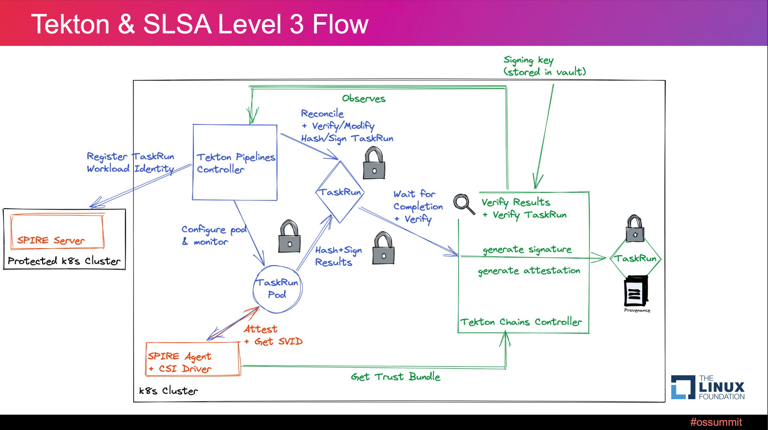
Road to SLSA3: Non-falsifiable Provenance in Tekton with SPIFFE/SPIRE

Slide 32
Containers Approach - ”Build your own Docker image with everything”
Developers Create a “Full Stack” Runtime image with Function and dependencies “baked in”
1
1
Select base language runtime image
Compatible with target cloud’s hardware architecture
Typically language communities provide versioned Docker image to select from
Runtime (Container image)
3
Server Framework or HTTP Server
4
Framework Context
2
Install ”Profile” libraries
approved by your project
Input
Fx
Output
3
Installing Service Framework or Http Server
to run your “function” as a service
7
“App” Libraries
4
Install “function” + Dependencies into Service Framework
Export route to your “function” on provider designated port
5
Environment Vars.
2
5
Configure your own Context
Fixed into Environment Variables
“System” Libraries
“Profile” Libraries
(Provider dependent)
6
Language Runtime
Handle Granular logging or monitoring
7
Manage Concurrency
6
CaaS Platform
Serverless Platform Invokes Endpoint and Scales Container
Notes:
Eclipse OMR: https://www.eclipse.org/omr/
What is OMR? https://www.eclipse.org/omr/starter/whatisomr.html

Slide 33
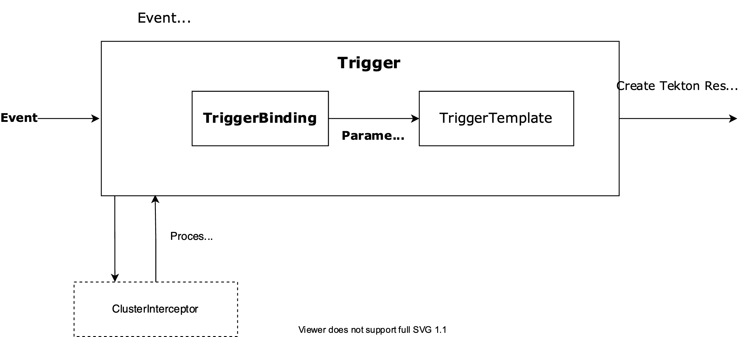
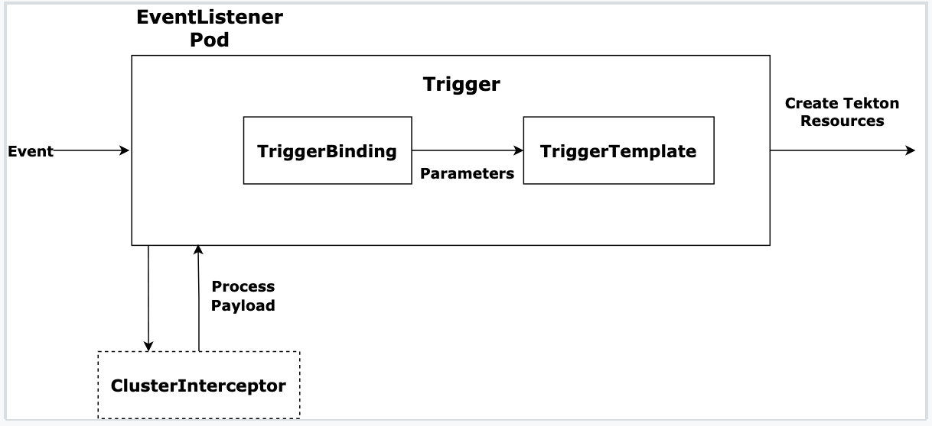
Tekton Trigger Flow
Notes:
https://github.com/CycloneDX/1.5-workstreams/blob/main/formulation/prototypes/example1.json

Slide 34




Tekton Pipeline Example – Spring Boot Docker Application
https://github.com/brightzheng100/spring-boot-docker
PersistentVolume
Claim
Workspace
Kubernetes
PersistentVolume
Trigger
workspace
tekton-trigger-binding
tekton-trigger-template
pipeline-git-clone-build-push-deploy
Trigger
Binding
Trigger
Template
Pipeline
PersistentVolumeClaim
Workspace
workspace
tekton-event-listener
Pipeline
Run
Event
Listener
git-clone
maven
buildah
kubernetes-actions
Task
Task
Task
Task
GitHub WebHook “Event”
Pre-configured
https://github.com/brightzheng100/spring-boot-docker
OpenShift
Container Registry (OCR)
Pull Request (PR)
Commit on `master`
Notes:
Workspace source
openwhisk-workspace: tasks/persistent-volume-claim.yaml
Task source:
clone-app-repo-to-workspace: tasks/00-clone-app-repo.yaml
clone-runtime-repo-to-workspace: tasks/00-clone-runtime-repo.yaml
Unused:
Tasks/detect-runtimes.yaml

