Slide 1
ID: 200010263
Rhaister
Back to basics: Observed statistics are
sufficient to predict drug responses
Can summary statistics predict drug responses
in a new cellular context?
Valentine Svensson et al. · Tahoe Therapeutics
June 2026 preprint
Svensson et al., bioRxiv, 12 June 2026. doi:10.64898/2026.06.09.731197
1 / 11
Notes:
TARGET 0:15. End by 00:15. Main talk 5:20, leaving 0:40 within a 6-minute slot.
TARGET 0:15. End by 00:15. Main talk 5:20, leaving 0:40 within a 6-minute slot.
讲稿 / SAY
今天介绍 Rhaister。这篇论文问：如果我们关心的是药物引起的差异表达和敏感性，能否直接预测这些统计量？作者用简单的回归模型，在新细胞背景中预测药物响应。接下来重点看它需要什么信息、效果如何，以及结论的边界。
可能的问题 / LIKELY QUESTION
论文题目中的 sufficient 是普适定理吗？不是，这是对本文所评估任务和指标的经验性主张。
SOURCE
Svensson et al. (2026). Back to basics: Observed statistics are sufficient to predict drug responses. bioRxiv, version posted 12 June 2026. DOI: 10.64898/2026.06.09.731197. Local source: rhaister_2026.pdf.
p. 1, title and abstract. This deck summarizes the supplied June 12 preprint, not a later revision.

Slide 2
Where this comes from: Tahoe’s atlas, Tahoe’s model
Tahoe Therapeutics built the perturbation atlas this field now trains on — and this paper is their own method on it
THE ATLAS · Feb 2025
THE MODEL · Jun 2026
Tahoe-100M
Rhaister / Rhaister-O
• 100M single-cell transcriptomes — the largest public perturbation atlas
• 50 cancer cell lines × 379 drugs × 3 doses, 24 h
• Mosaic “cell village”: the lines are pooled in one well and demultiplexed by genotype — batch effects die at the source
• 95.6M cells pass full QC · released free on HuggingFace
• Same group: 8 of its 10 authors wrote Tahoe-100M, including both of its corresponding authors
• So this is the data owner’s own method on their own benchmark — the reference point, not an outside challenger
• Weights and code on HuggingFace: tahoebio/Rhaister — seconds to train, milliseconds to predict
• We reproduced Rhaister-O at 0.6315 against the released ≈ 0.63
Lineage: Tahoe-100M (Feb 2025) → Tahoe-x1 foundation model (Oct 2025) → Rhaister (Jun 2026)
This is the benchmark’s owners telling you what a strong baseline looks like
Zhang et al., Tahoe-100M, bioRxiv 2025, doi:10.1101/2025.02.20.639398 · Svensson et al., 2026 · huggingface.co/tahoebio/Rhaister
2 / 11
Notes:
TARGET 0:30. End by 00:45. Main talk 5:20, leaving 0:40 within a 6-minute slot.
讲稿 / SAY
先花半分钟交代这篇论文的来历，因为它决定了该怎么读它。
左边是数据。Tahoe-100M 是 Tahoe Therapeutics 在 2025 年 2 月发布的扰动图谱：一亿个单细胞转录组，50 个癌细胞系乘 379 种药乘 3 个剂量，24 小时。关键的技术是他们的 Mosaic 平台——把 50 个细胞系混在同一个孔里做「细胞村」，测完之后靠基因型反解回各自的细胞系。这样同一个孔里的所有细胞系共享完全相同的批次条件，批次效应在源头就被消掉了，这也是能做到这个规模的原因。全 QC 通过 9,560 万个细胞，完全公开。做 therapeutic discovery 的，基本绕不开这个数据集。
右边是模型。这篇 Rhaister 的十个作者里有八个是 Tahoe-100M 的作者，包括 Tahoe-100M 的两位通讯作者。所以这不是外部团队来挑战这个 benchmark，而是数据的拥有者自己给出的方法——它是参照点。权重和代码都在 HuggingFace 上，训练几秒、推理毫秒级。我们自己也复现了 Rhaister-O，full-delta Pearson 0.6315，和公布的约 0.63 一致。
底下是这条线的脉络：Tahoe-100M、Tahoe-x1 基础模型、然后是 Rhaister。
可能的问题 / LIKELY QUESTION
Tahoe 是公司还是研究所？是一家公司，Tahoe Therapeutics，域名 tahoebio.ai；Tahoe-100M 的测序平台由 Parse Biosciences 合作完成。
数据owner自己发论文算不算利益冲突？值得注意，但数据和代码都公开、split 也公开，所以可复现；我们自己复现到 0.6315 就是一次独立检查。
Tahoe-x1 是什么？同组的细胞基础模型，把 Tahoe 的嵌入和 State Transition 组合使用；这里只作为脉络提及，不是本文内容。
为什么是 379 种药不是 1,100？1,100 指的是药物-剂量组合数量级的说法；QC 后是 379 个化合物、1,135 个药物-剂量组合。
SOURCE
Zhang et al. (2025). Tahoe-100M: A Giga-Scale Single-Cell Perturbation Atlas for Context-Dependent Gene Function and Cellular Modeling. bioRxiv, doi:10.1101/2025.02.20.639398. Local source: papers/tahoe-100m_v3.pdf.
Affiliation from the title page: 1 Tahoe Therapeutics; 3 Parse Biosciences. Corresponding authors Johnny Yu (johnny@tahoebio.ai) and Hani Goodarzi (hani@tahoebio.ai).
Atlas numbers from papers/README.md entry 1: 24-hour Mosaic screen, 95.6M full-QC cells, 50 assayed lines (47 used for most downstream analysis), 379 compounds, 1,135 drug-dose combinations, three doses, 14 plates. The abstract's "1,100 small-molecule perturbations" counts drug-dose conditions, not distinct compounds.
Author overlap, checked against both title pages: Svensson, Khan, Ubas, Thomas, Merico, Goodarzi, Yu, Alidoust appear on both; Heydari and Gandhi do not. Goodarzi and Yu are the Tahoe-100M corresponding authors. Gandhi is the Tahoe-x1 first author.
Tahoe-x1: Gandhi et al., bioRxiv 2025, doi:10.1101/2025.10.23.683759.
Our reproduction, 0.6315 +/- 0.0680 across splits: reports/TAHOE_DEPMAP_L1000_BILINGUAL_SYNTHESIS.md Experiment 1. "Seconds to train, milliseconds to predict" is the paper's own characterisation, not a hardware-normalised benchmark run here.

Slide 3
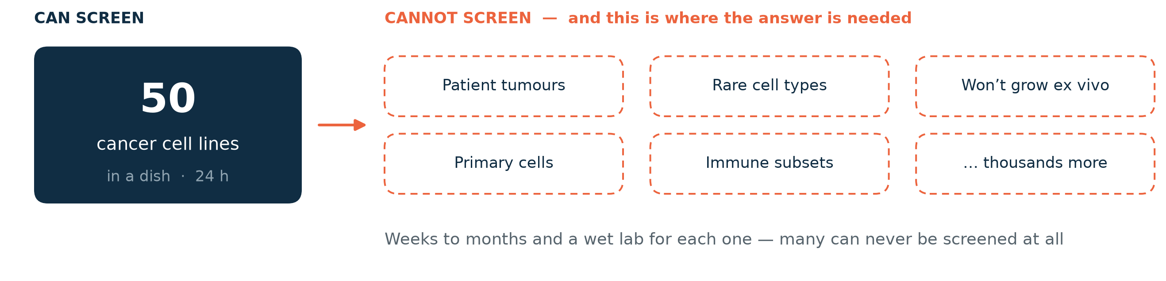
ID: 200010263
Motivation: the hardest contexts can’t be screened
A screen reaches cell lines in a dish. The contexts that matter most are not in that set.
Today’s answer: virtual-cell models simulate single cells, then aggregate
Slow to train and run · no zero-shot capability · sometimes no better than simple baselines
→ Rhaister inverts it: predict the statistics directly, from baseline expression
Svensson et al., 2026, Introduction, pp. 2–3 and Discussion, p. 9
3 / 11
Notes:
TARGET 0:20. End by 01:05. Main talk 5:20, leaving 0:40 within a 6-minute slot.
TARGET 0:25. End by 00:40. Main talk 5:20, leaving 0:40 within a 6-minute slot.
讲稿 / SAY
先说为什么要做这件事。看左边：一次扰动筛选能覆盖的，是培养皿里的 50 个癌细胞系。右边是我们真正想知道答案的地方——病人的肿瘤、罕见细胞类型、体外根本养不活的组织、原代细胞，还有成千上万种其他背景。对右边这些，每一个都要几周到几个月和一个湿实验室，而且很多根本做不了。所以问题不是「再多筛一点」，而是「能不能从左边推到右边」。
现在的主流做法是虚拟细胞模型：先模拟出反事实的单细胞，再汇总成统计量。训练和推理都昂贵，至今没有零样本能力，有时甚至不如简单基线。
这篇论文反过来做：既然下游分析用的本来就是统计量，那就直接预测统计量，输入只要未处理细胞的基线表达。
可能的问题 / LIKELY QUESTION
这是否否定了虚拟细胞模型？没有。虚拟细胞模型面向单细胞层面的生成任务（新细胞类型、谱系偏好、罕见状态）；本文针对的是已知药物库在群体统计量上的预测任务。
右边那些背景真的完全不能筛吗？不是全部，但规模上不可行；论文的论点是成本和可达性，不是物理上的不可能。
SOURCE
Svensson et al. (2026). Back to basics: Observed statistics are sufficient to predict drug responses. bioRxiv, 12 June 2026. DOI: 10.64898/2026.06.09.731197. Local source: rhaister_2026.pdf.
Introduction, pp. 2–3: screens take weeks to months; the hardest contexts cannot be screened at scale; three gaps in virtual-cell models (zero-shot, phenotypes, pace). Discussion, p. 9: virtual-cell models are slow to train and run, do not extend readily to direct phenotypes, have not delivered zero-shot prediction, and at points struggled to improve on simple baselines.
FIGURE: drawn for this deck, not reproduced from the paper. "50 cancer cell lines" is the Tahoe-100M cohort (p. 13). The right-hand list is illustrative of the categories the Introduction names; it is not a quantified inventory.

Slide 4
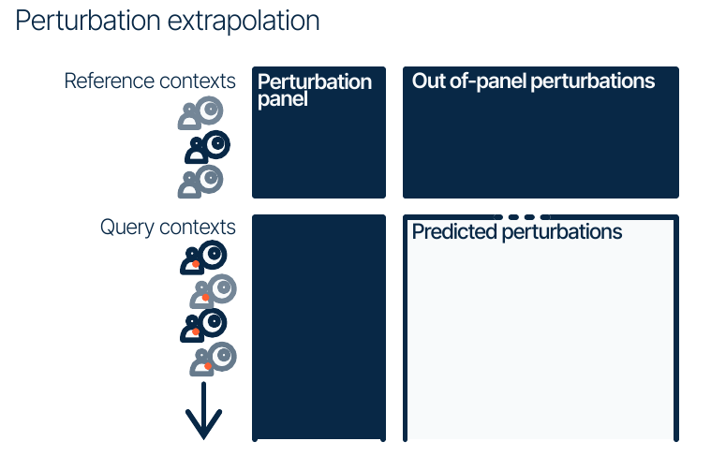
ID: 200010263
The task: complete a drug screen in a new context
Known in reference cell lines
Responses to the full drug library
Measured in a new cell line
A panel of drug responses
Predicted
How new cell line responses to the drugs
Tahoe benchmark: 45 reference + 5 query cell lines; 120 panel + 240 target drugs
Svensson et al., 2026, Fig. 1 (top left), pp. 3–4 and 13
4 / 11
Notes:
TARGET 0:20. End by 01:25. Main talk 5:20, leaving 0:40 within a 6-minute slot.
讲稿 / SAY
先看任务定义。图中每一行代表一个细胞背景，每一列代表一种扰动。上半部分是参考细胞系，已有完整药物筛选结果。下半部分是新的细胞系，深蓝色区域表示已经测过的药物 panel，浅色区域是待预测的其余药物。Tahoe 主实验每次用 45 个参考细胞系和 5 个查询细胞系。在查询细胞系里测 120 种药物，预测另 240 种，每种有三个剂量。因此，主模型需要新细胞系的实测响应，而且目标药物已在参考细胞系中出现。这是跨细胞背景的预测。
可能的问题 / LIKELY QUESTION
这是不是预测新药？不是。本文主要测试已知药物库在新细胞背景中的响应，不能据此声称泛化到新化学结构。
SOURCE
Svensson et al. (2026). Back to basics: Observed statistics are sufficient to predict drug responses. bioRxiv, version posted 12 June 2026. DOI: 10.64898/2026.06.09.731197. Local source: rhaister_2026.pdf.
Fig. 1 top-left schematic; p. 13, Tahoe train/test splits. Five independent context-level splits. Each drug has three doses: 360 panel and 720 target perturbations.
LOOK: top row = reference contexts, bottom row = query contexts, left column = panel, right column = target perturbations. Dark blue = observed, pale area = prediction. Diagram is schematic and not to scale. Counts describe the analyzed split, not all drugs in the raw atlas.

Slide 5
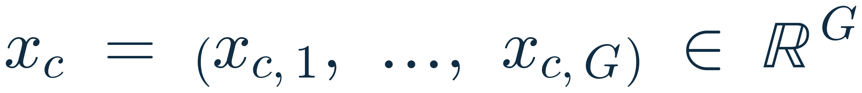
ID: 200010263
What do we have? The data and the notation
Every quantity below is a per-gene statistic over G genes — single cells are never modelled downstream
INPUT · context state
TARGET · perturbation response
Baseline expression of cell line c
Response of line c to perturbation p
• Pseudobulk over the untreated (DMSO) cells of line c
• Available for all 50 lines, treated or not
• The only query-line measurement Rhaister-O needs
• Treated vs. plate-matched DMSO, computed per line and plate
• p = (drug, dose): every dose is a separate perturbation
• Three views per gene: expression delta Δ, log₂ fold change, MWU p-value
Tahoe-100M: 50 cancer cell lines × 384 drugs × 3 doses (0.05, 0.5, 5 µM), 24 h readout
Split: 45 reference / 5 query lines · 120 panel + 240 target drugs → 360 + 720 perturbations
Svensson et al., 2026, Data, pp. 13–14; summary statistics Eqs. 19–20, p. 14
5 / 11
Notes:
TARGET 0:25. End by 01:50. Main talk 5:20, leaving 0:40 within a 6-minute slot.
讲稿 / SAY
在看模型之前，先把符号定下来，后面两条公式都用它。左边是模型的输入：x 下标 c，是细胞系 c 在未处理（DMSO）条件下的 pseudobulk 表达，长度是基因数 G。它对 50 个细胞系都有，不需要任何加药实验。右边是预测目标：y 下标 c、p，是细胞系 c 对扰动 p 的响应统计量，同样是 G 维向量。注意两点：第一，p 是「药物加剂量」，每个剂量算一个独立扰动；第二，y 是处理组和同一块板上 DMSO 对照的比较结果，论文用三种视角——表达差值 delta、log2 fold change、以及 Mann-Whitney U 的 p 值。所以整篇论文从头到尾都不生成单细胞，建模单位就是这条 G 维统计量向量。规模上，Tahoe 有 50 个细胞系、384 种药、3 个剂量；每个 split 用 45 个参考系、5 个查询系，120 个 panel 药物、240 个目标药物。
可能的问题 / LIKELY QUESTION
384 和 360 为什么不一致？384 是原子图中的药物总数，120+240=360 是这个 benchmark split 实际分析的子集。本页按论文分别标注，不把两者等同。
剂量为什么是浓度不是质量？Tahoe 的剂量是培养基浓度，单位 µM（0.05 / 0.5 / 5），不是给药质量。
SOURCE
Svensson et al. (2026). Back to basics: Observed statistics are sufficient to predict drug responses. bioRxiv, 12 June 2026. DOI: 10.64898/2026.06.09.731197. Local source: rhaister_2026.pdf.
p. 13, Tahoe-100M description and train/test splits (50 lines, 384 drugs, three concentrations; 45 reference + 5 query; 120 panel + 240 non-panel; 360 + 720 perturbations after treating each dose separately).
p. 14, Eq. 19 (log2 fold change, pdex) and Eq. 20 (expression delta, cell-eval); MWU definition on the same page.
Dose values 0.05 / 0.5 / 5 µM are from the Tahoe-100M release metadata used in this project, not printed in the Rhaister preprint.
SYMBOLS: c = biological context (cell line); p = perturbation = (drug, dose); g = gene; G = number of genes in the panel; x_{c,g} = baseline pseudobulk expression; y_{c,p,g} = response summary statistic. Vector notation on this slide is the presenter's, written to match the paper's indexed scalars.

Slide 6
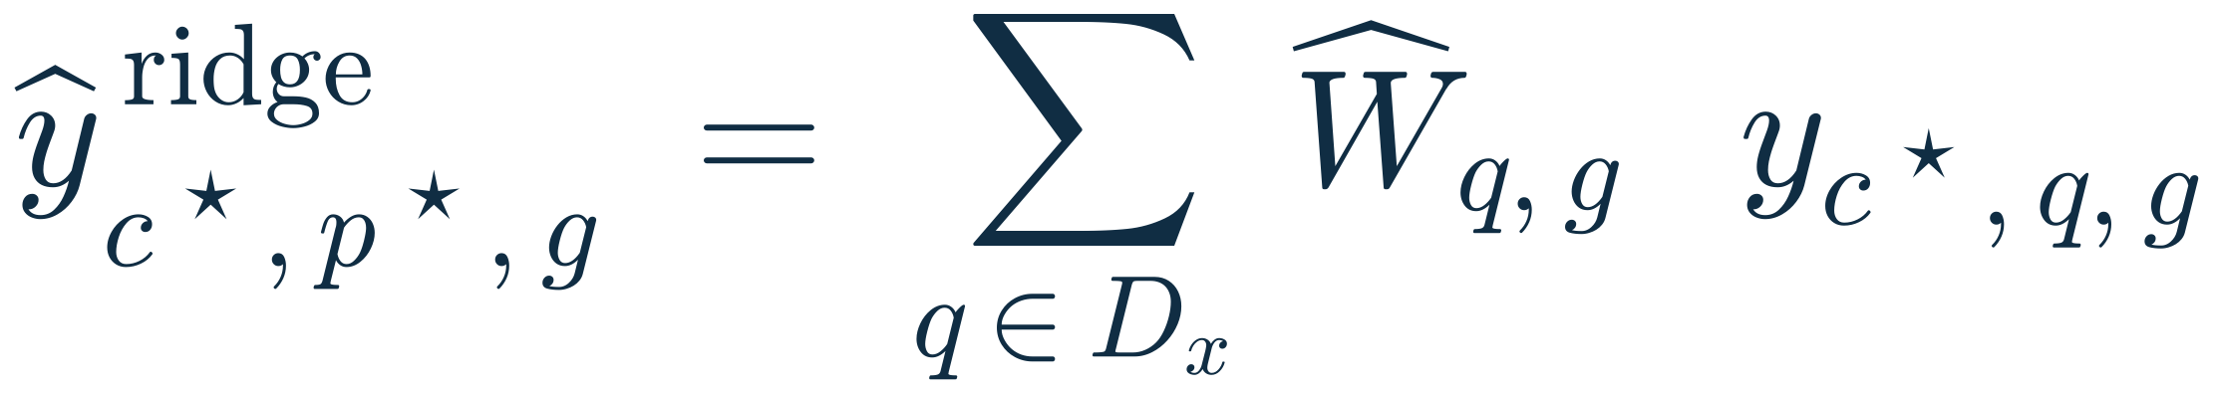
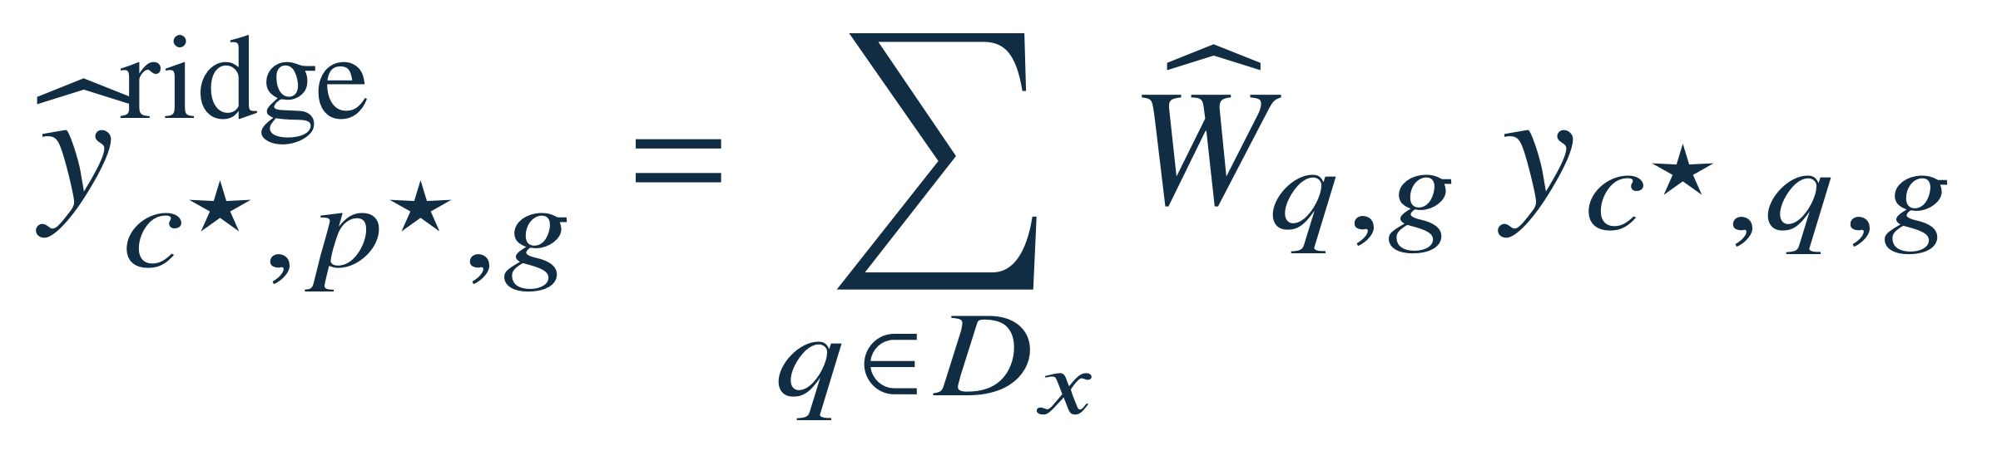
ID: 200010263
Rhaister learns a weighted sum of panel responses
Fit the weights on the 45 reference lines, then apply them in the query line
1 · FIT — one ridge problem per target drug p★, solved across reference lines only
X = panel responses of the 45 reference lines (45 × |Dₓ| × G) · Y = their responses to the target drug p★ (45 × G) · λ = ridge penalty
2 · PREDICT — a weighted sum of the panel responses measured in the query line c★
ŷ = the predicted statistic: one gene, one target drug, one query line.
y(c★, q, g) = the panel response already measured in the query line — the only query-line data Rhaister uses.
Fitted per view (delta, log₂FC, MWU), with an additive fallback and a small MWU calibration head
Svensson et al., 2026, p. 11, Eq. 3 (objective) and Eq. 4 (prediction); full framework Eqs. 1–7
6 / 11
Notes:
TARGET 0:40. End by 02:30. Main talk 5:20, leaving 0:40 within a 6-minute slot.
讲稿 / SAY
方法的核心是两步，上面是训练目标，下面是预测。
先看优化目标。对每一个待预测的目标药物 p 星，作者单独解一个岭回归。训练样本不是细胞，而是 45 个参考细胞系：X 把这 45 个细胞系对 panel 药物的响应堆起来，形状是参考系数乘 panel 扰动数乘基因数；Y 是这 45 个细胞系对该目标药物的响应，形状是参考系数乘基因数。目标函数就是平方误差加 lambda 乘 W 的 Frobenius 范数——标准的岭回归，闭式解，几秒钟训练完。所以「学到的东西」是：目标药物的响应，可以写成 panel 药物响应的哪一种加权组合；这个组合在细胞系之间是共享的。
第二步预测。把学到的 W 帽用在查询细胞系上：y 帽等于对所有 panel 药物 q 求和，权重 W 帽 q g 乘以查询细胞系里实测的 panel 响应。查询细胞系只提供实测值，从来不参与拟合权重。
三种统计量各拟合一套。
可能的问题 / LIKELY QUESTION
W 是所有药物共用一套吗？不是。公式针对固定目标扰动 p 星；论文印出的 W 帽省略了目标索引，但回归问题是逐目标建立的。
lambda 怎么选？论文正文未给出每个数据集的取值，这里只呈现目标函数形式。
为什么不直接端到端学一个大模型？这正是论文的论点：在这个任务上线性组合已经很强，而且训练秒级、推理毫秒级。
SOURCE
Svensson et al. (2026), p. 11. Eq. 3 (ridge objective) and Eq. 4 (prediction) reproduced as published; both are re-typeset here, not altered.
Eq. 1–2: additive ALS model. Eq. 5: fallback to the additive prediction where reference coverage is missing. Eqs. 6–7: MWU calibration MLP and equal blending — see backup slide B3.
SYMBOLS: c★ query context; p★ target perturbation; q panel perturbation; g gene; D_x = set of panel perturbations observed in the query context; C_ref = reference contexts; X ∈ R^{|C_ref|×|D_x|×G}; Y ∈ R^{|C_ref|×G}; W ∈ R^{|D_x|×G}; λ ridge penalty.
Eq. 3 as printed uses compressed matrix notation with Y_c and X_c the per-context slices. MWU predictions are significance statistics, not calibrated uncertainty for the model.

Slide 7
ID: 200010263
Rhaister leads the Tahoe-100M comparison
Held-out cell lines, five splits — read the two highlighted columns
Model | Discrim. | Pearson Δ | PR-AUC | LFC rank | DE overlap | ES rank
Rhaister | 0.96 | 0.87 | 0.73 | 0.81 | 0.59 | 0.96
STATE | 0.93 | 0.81 | 0.51 | 0.57 | 0.40 | 0.89
Additive | 0.82 | 0.55 | 0.55 | 0.61 | 0.43 | 0.85
Half-sample | 0.93 | 0.77 | 0.62 | 0.67 | 0.52 | 0.97
Additive = cell-line effect + drug effect, no interaction. Half-sample = half the cells predicting the other half.
Not uniform elsewhere: on Replogle–Nadig, Additive and STATE beat Rhaister on LFC rank (0.66 / 0.78 vs 0.63).
The half-sample reference is an empirical comparison, not a hard ceiling.
Svensson et al., 2026, Fig. 1, Tahoe-100M panel; p. 12, half-sample reference
7 / 11
Notes:
TARGET 0:35. End by 03:05. Main talk 5:20, leaving 0:40 within a 6-minute slot.
讲稿 / SAY
表里的 STATE 是目前最先进的虚拟细胞模型：对单细胞做条件集传输、生成反事实细胞再汇总统计量，成本高得多；Rhaister 训练只需几秒、预测毫秒级。这张表保留了 Tahoe 的六个评价指标，数值来自原文图一，各列都是越高越好。橙色一行是 Rhaister。请先看 Pearson，它比较表达变化的大小，Rhaister 是 0.87，STATE 是 0.81。再看 PR-AUC，也就是差异表达基因的识别，分别是 0.73 和 0.51。其余列衡量扰动区分、fold change 排序、差异基因重叠，以及扰动影响范围的排序。Rhaister 在这六列都高于 STATE。但这里的 half-sample 是把同一批细胞随机分成两半，互相预测得到的参考值。它反映采样与分析流程的稳定性，并非数学上的上限。所以结果支持这个任务上的强预测表现，不能等同于模型已经准确模拟完整细胞。
可能的问题 / LIKELY QUESTION
为什么模型能超过 half-sample？半样本统计量使用的细胞少于完整数据，而且随机拆分有波动。作者明确说它不是严格上限。
SOURCE
Svensson et al. (2026). Back to basics: Observed statistics are sufficient to predict drug responses. bioRxiv, version posted 12 June 2026. DOI: 10.64898/2026.06.09.731197. Local source: rhaister_2026.pdf.
Fig. 1 Tahoe-100M panel, p. 3. All table entries transcribed from the figure. Paper error bars are ±1 SD across splits; SD numbers are not printed and are not reconstructed. Definitions pp. 14–15. Half-sample caveat explicitly stated on p. 12.
TABLE GUIDE: rows = models or reference, columns = six distinct metrics, all unitless. Discrim. = rank-based perturbation discrimination using expression deltas. Pearson Δ = correlation across genes. PR-AUC = precision–recall area for DE classification using FDR q < 0.05. LFC rank = Spearman correlation of log fold changes among observed significant genes. DE overlap = overlap of selected differential-expression gene sets. ES rank = Spearman ranking of the number of significant genes across perturbations, not a physical or clinical effect size. Simplified abbreviations only; numbers are not changed.

Slide 8
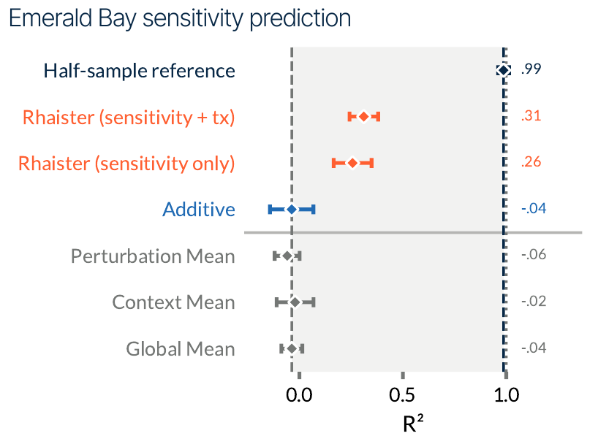
ID: 200010263
Transcriptomic responses improve sensitivity prediction
Emerald Bay
52 pooled cancer cell lines
5-day drug treatment
Paired abundance and RNA readouts
0.26 to 0.31
R² after adding transcriptomic
responses from the measured panel
Endpoint: change in relative cell-line abundance within a pooled culture
Svensson et al., 2026, Fig. 2 (Emerald Bay sensitivity prediction), pp. 5–6 and 13–14
8 / 11
Notes:
TARGET 0:25. End by 03:30. Main talk 5:20, leaving 0:40 within a 6-minute slot.
讲稿 / SAY
第二个结果更接近药物发现：能否预测敏感性？Emerald Bay 将 52 个癌细胞系混合培养，处理药物五天，同时读出细胞丰度和转录组。图的横轴是 R 平方，橙色是 Rhaister，蓝色是加性模型，灰色是均值基线。只用 panel 的敏感性，R 平方是 0.26；加入同一 panel 的转录响应后，升到 0.31。基线接近或低于零，但 half-sample 参考达到 0.99，说明这个表型任务还有很大的改进空间。也要注意，这里的敏感性来自混合培养中细胞系相对丰度的变化，不能直接当成患者的临床疗效。
可能的问题 / LIKELY QUESTION
0.31 是不是预测了 31% 的细胞会死亡？不是。R² 衡量模型相对于均值预测解释了多少变异，并非死亡比例。
SOURCE
Svensson et al. (2026). Back to basics: Observed statistics are sufficient to predict drug responses. bioRxiv, version posted 12 June 2026. DOI: 10.64898/2026.06.09.731197. Local source: rhaister_2026.pdf.
Fig. 2, Emerald Bay sensitivity prediction; p. 5 results; Eq. 18 p. 13. The full dataset has 91 treatments including combinations, but modeling uses 45 single-drug dose conditions spanning 19 drugs according to p. 13.
LOOK: all seven plotted rows remain visible and are explained. Half-sample = 0.99. Rhaister sensitivity + tx = 0.31; sensitivity only = 0.26. Additive = −0.04, perturbation mean = −0.06, context mean = −0.02, global mean = −0.04. Error bars are ±1 SD across five train/test splits, not confidence intervals for clinical efficacy. tx = transcriptomic responses from measured panel perturbations. Sensitivity = log2 of treatment/control cell-line proportions. It is a compositional relative-abundance endpoint.

Slide 9
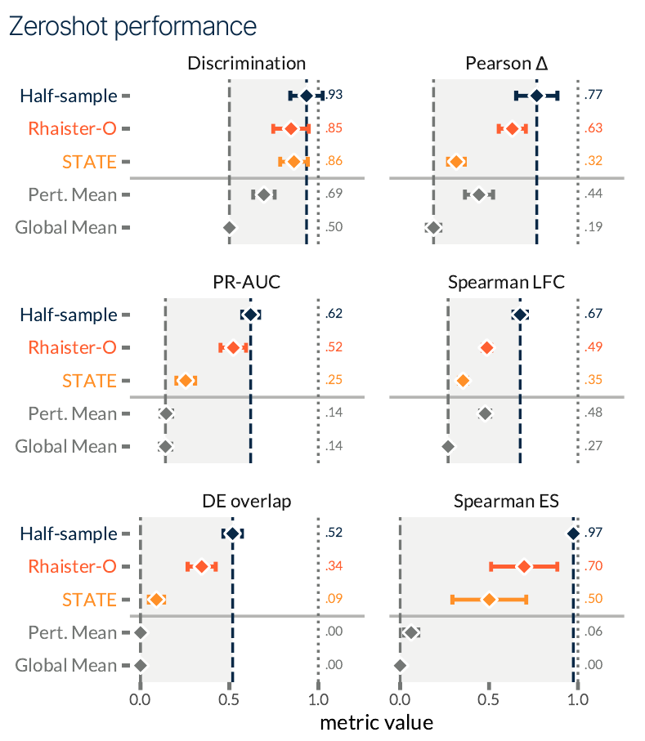
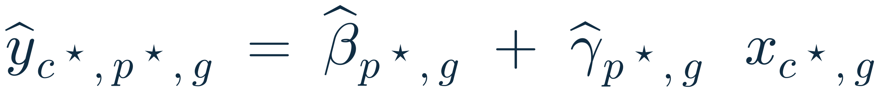
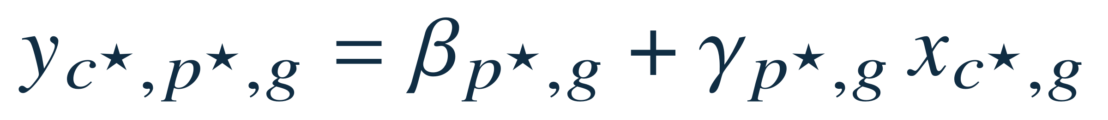
ID: 200010263
Rhaister-O predicts from baseline expression alone
Zero-shot: no treated cells from the query line
1 · FIT — per target drug p, per gene g, over the 45 reference lines
2 · PREDICT — query line c★, unseen target drug p★
Two parameters per (drug, gene), fitted on 45 points — one per reference line.
x(c★, g) is the only query-line input, and it is untreated.
Pearson Δ: 0.63 vs 0.32
Rhaister-O compared with STATE
Discrimination: 0.85 vs 0.86
Svensson et al., 2026, Fig. 4 (top), p. 8; Eqs. 8–9, p. 11
9 / 11
Notes:
TARGET 0:40. End by 04:10. Main talk 5:20, leaving 0:40 within a 6-minute slot.
讲稿 / SAY
如果新细胞系连 panel 都没测过呢？这就是 Rhaister-O，严格零样本。它把输入换成第 4 页定义的 baseline 表达 x。
优化目标在上面：对每一个药物 p 和每一个基因 g，单独做一条最小二乘直线——用 45 个参考细胞系作为 45 个数据点，拟合截距 beta 和斜率 gamma，使得该基因的响应 y 对该基因的 baseline 表达 x 的残差平方和最小。注意这是逐基因的一元回归，每条只有两个参数。
预测在下面：查询细胞系 c 星、目标药物 p 星，直接把该细胞系自己的 baseline 表达代进去。整个过程不需要查询细胞系的任何加药数据。
右图是六个指标。Pearson 从 STATE 的 0.32 提到 0.63，PR-AUC 从 0.25 到 0.52，DE overlap 和 effect-size 排序也更好；但 discrimination 是 0.85 对 0.86，略低。所以是五个指标领先，不是全面领先。这里的 zero-shot 指没有查询细胞系的扰动响应，不是指预测全新化学结构。
可能的问题 / LIKELY QUESTION
这算不算一个转录组编码器？不算。每个基因只看自己的 baseline 表达，没有跨基因的交互项，也没有任何非线性。
论文有没有印出这个 argmin？没有。论文印的是 Eq. 8 的模型形式和「fit using reference contexts」；这里把它写成显式的最小二乘目标，是为了让优化对象一眼可见。论文未指明是否加了正则化。
45 个点拟合 2 个参数会不会过拟合？每条回归的自由度很低，但整体参数量是「药物数 × 基因数 × 2」，所以真正的限制是参考细胞系的数量和多样性——见备用页 B2。
SOURCE
Svensson et al. (2026), p. 11. Eq. 8 (model) and Eq. 9 (prediction, printed without hats). The argmin form shown here is the standard least-squares reading of "we can fit a model ... using reference contexts"; the estimator is not printed in the paper.
Fig. 4 top, p. 8: discrimination, Pearson Δ, PR-AUC, Spearman LFC, DE overlap, Spearman ES.
Means, Rhaister-O vs STATE: discrimination .85/.86; Pearson .63/.32; PR-AUC .52/.25; LFC .49/.35; DE overlap .34/.09; ES .70/.50. Error bars are ±1 SD across five splits; no significance claim is made about small mean differences. Paper prose says "all metrics"; the plotted discrimination means do not support that.
SYMBOLS: β(p,g) intercept, γ(p,g) slope, both learned per perturbation and gene; x(c,g) baseline pseudobulk expression; C_ref the 45 reference lines.

Slide 10
Does it transfer? Our own check on L1000
Leave-one-cell-line-out · 8 LINCS L1000 lines, full 24 h coverage · 1,618 shared conditions · 949 landmarks · DepMap baseline
Line-macro Pearson | Tahoe (45 ref. lines) | L1000 (7 ref. lines)
Drug(-dose) mean | 0.4434 | 0.2992
Rhaister-O | 0.6315 | 0.2735
Gain from the treatment-specific slope | +0.1881 | −0.0257
Same gain, drug-residual level | +0.5380 | +0.0453
• Rhaister-O loses on 8 of 8 held-out lines, RMSE included; the bootstrap intervals do not overlap
• All four cell representations collapse onto the drug mean too (0.294–0.301 vs 0.300) — not a parameterisation problem
The estimator is not the point — Tahoe’s condition-level reproducibility is.
Not apples to apples: Level-5 z-scores vs plate-matched deltas · 978 landmarks, only 79 shared with the Tahoe 2K panel · DepMap bulk baseline vs Tahoe DMSO.
And 8 contexts against 45: the paper’s own scaling test saturates near 20 reference contexts for the panel model, while baseline-only Rhaister-O keeps improving.
Cohort size is a plausible partial cause — but “worse than doing nothing” is a different failure from “weak”.
This project’s own result, not Svensson et al. — Slurm jobs 274337 / 275031, 2026-09-23; report/09_25_report.md § 10
10 / 11
Notes:
TARGET 0:40. End by 04:50. Main talk 5:20, leaving 0:40 within a 6-minute slot.
讲稿 / SAY
这一页是我们自己的结果，不是论文的，展示时请先说明这一点。
问题是：Rhaister-O 在 Tahoe 上 0.63 的成绩，有多少属于估计量，有多少属于 Tahoe 这个数据集。做法是把完全相同的估计量搬到 LINCS L1000 上：GSE70138 里 24 小时全覆盖的 8 个细胞系，1,618 个在每条线上都出现的条件，949 个 landmark，baseline x 换成 DepMap 24Q4 的 log2(TPM+1)，leave-one-cell-line-out，20,000 次按线 bootstrap。
表格从左到右是 Tahoe 和 L1000。药物均值基线在 Tahoe 是 0.4434、L1000 是 0.2992；Rhaister-O 在 Tahoe 是 0.6315、L1000 是 0.2735。所以治疗特异斜率在 Tahoe 上买来 +0.188，在 L1000 上是 −0.026，是净损失。最后一行是最干净的：只看完全归因于这个斜率的 drug-residual 层，Tahoe 上 0.538，L1000 上 0.045，差十二倍。
下面两条补充。第一，8 条线全部落后，RMSE 也全部更差，bootstrap 区间不重叠——不是边缘现象。第二，我们同时把四种 cell 表征在同一批数据上重跑，四个臂全部落在 0.294 到 0.301，和药物均值 0.300 无法区分，所以不是 Rhaister-O 参数化的问题，是 L1000 在这个队列规模下就没有可提取的语境信号。
最底下灰字是必须一起说的不可比性。
可能的问题 / LIKELY QUESTION
是不是样本量的问题？8 个背景对 Tahoe 的 45 个，而且我们自己的 reference-line 扫描证明这个任务是数据受限的，所以队列规模是一个合理的部分解释。但结论不变：在 7 个参考系下它是「比什么都不做更差」，而不是「只是弱」。
这和之前那个 0.06 的跨平台一致性是同一个结果吗？不是，是两个不同的问题。0.0605 / 0.0153 回答的是「L1000 的 signature 能不能代替 Tahoe 的响应」；这一页回答的是「这个估计量在 L1000 上能不能工作」。只有后者支持「Rhaister-O 在 L1000 上没用」这个说法。
能不能推广到所有数据集？不能，只测了一个外部图谱。
SOURCE
This project. Slurm job 274337 (Rhaister-O estimator on L1000) and 275031 (cell-representation ablation on L1000), both run 2026-09-23 on cn-03; seed 0, 20,000 bootstrap resamples over lines, ridge lambda 1.0, blend 0.95.
Results: /l/users/yuqi.lei/Therapeutic/results/l1000_rhaister_o and .../l1000_cell_ablation. Write-up: report/09_25_report.md section 10; durable facts in KNOWLEDGE.md.
Tahoe reference values from reports/TAHOE_DEPMAP_L1000_BILINGUAL_SYNTHESIS.md Experiment 1-2 (drug-dose mean 0.4434, Rhaister-O 0.6315, drug-residual 0.5380).
Full numbers: full-delta drug mean 0.299222 [0.285917, 0.312716]; Rhaister-O 0.273483 [0.261773, 0.285291]. Drug-residual Rhaister-O 0.045328 [0.040273, 0.050406]. Per-line deltas range -0.0184 (HCC515) to -0.0333 (A375).
Ablation drug-residual: expression PCA 0.0210 [0.0035, 0.0360]; structured metadata 0.0115 [-0.0073, 0.0273]; template text 0.0085 [-0.0190, 0.0342]; Cellosaurus text -0.0141 [-0.0318, 0.0055]. Tahoe counterparts: 0.2087 / 0.0780 / 0.0930 / 0.0294.

Slide 11
ID: 200010263
Summary statistics provide a strong baseline
The contribution
• Predicts the analysis-ready statistic directly, not simulated cells
• Rhaister-O: first zero-shot model here that clearly beats simple baselines
The boundary
• Known drug library, new cell contexts — not new chemistry
• Population summaries leave single-cell heterogeneity unresolved
• Half-sample is a reproducibility reference, not a mathematical ceiling
• It needs an atlas as reproducible as Tahoe — on L1000 the same estimator loses to the drug mean
A strong baseline — but the atlas’s reproducibility is part of the result
For therapeutic discovery: useful prioritization still needs experimental validation
Svensson et al., 2026, Discussion p. 9 · model and code: huggingface.co/tahoebio/Rhaister · “Our own check” is this project’s result
11 / 11
Notes:
TARGET 0:30. End by 05:20. Main talk 5:20, leaving 0:40 within a 6-minute slot.
讲稿 / SAY
总结。贡献是把任务定义到下游分析真正使用的读出上——直接预测统计量，而不是先生成细胞；在这个定义下，简单模型就成了很强的基线，Rhaister-O 还是这个任务上第一个真正零样本、并明显超过简单基线的模型。
边界有四条：预测的是已知药物库在新细胞背景中的响应，不是新化学结构；群体统计量还原不了单细胞异质性；half-sample 只是重复性参考，不是数学上限；最后就是上一页那条——它需要一个和 Tahoe 一样可重复的图谱，换到 L1000 上同一个估计量就打不过药物均值。
所以一句话：这是一个很强的基线，但图谱本身的重复性是结果的一部分。对我们自己的药物发现项目，直接启示是把 Rhaister-O 和简单基线纳入比较，再检验额外模态是否真的改善 held-out cell-line 预测。
可能的问题 / LIKELY QUESTION
论文否定 virtual-cell 模型了吗？没有。它支持在特定群体统计预测任务上先比简单基线；生成细胞分布、罕见状态或新细胞类型是不同的任务。
"sufficient" 是普适定理吗？不是，是针对本文所评估任务和指标的经验性主张。
SOURCE
Svensson et al. (2026), Discussion p. 9; Figs. 1–4. Local source: rhaister_2026.pdf. Model and code: https://huggingface.co/tahoebio/Rhaister (checked 20 September 2026).
The fourth boundary bullet is this project's own result (Slurm jobs 274337 / 275031, 2026-09-23), not the paper's — it is presented in full on the previous slide.
The last sentence about the local course project is presenter interpretation, not a claim made by the paper.
Metric definitions, if asked: discrimination = rank of the correct perturbation among alternatives; Pearson delta = agreement of expression-change magnitudes across genes; PR-AUC = differential-expression classification at FDR q < 0.05; DE overlap = agreement of selected DE gene sets; Spearman LFC = rank agreement of fold changes among significant genes; Spearman ES = rank of the number of significant genes across perturbations. Paper pp. 14-15.
SOURCE DISCREPANCIES carried from the earlier backup page: (1) Fig. 4 discrimination .85/.86 conflicts with the prose claim of improvement across all metrics. (2) p. 13 states 19 unique drugs in the filtered Emerald Bay subset, p. 14 describes six panel plus fourteen target drugs. (3) The raw Tahoe description lists 384 drugs; the benchmark split uses 120 + 240 = 360. (4) The live model card reports Rhaister-O PR-AUC .53; the supplied paper Fig. 4 prints .52, which is the value used here.

