Slide 1
ID: 200010263
Rhaister
Back to basics: Observed statistics are
sufficient to predict drug responses
Can summary statistics predict drug responses
in a new cellular context?
Valentine Svensson et al. · Tahoe Therapeutics
June 2026 preprint
Svensson et al., bioRxiv, 12 June 2026. doi:10.64898/2026.06.09.731197
1 / 8
Notes:
TARGET 0:15. End by 00:15. Main talk 5:20, leaving 0:40 within a 6-minute slot.
讲稿 / SAY
今天介绍 Rhaister。这篇论文问：如果我们关心的是药物引起的差异表达和敏感性，能否直接预测这些统计量？作者用简单的回归模型，在新细胞背景中预测药物响应。接下来重点看它需要什么信息、效果如何，以及结论的边界。
可能的问题 / LIKELY QUESTION
论文题目中的 sufficient 是普适定理吗？不是，这是对本文所评估任务和指标的经验性主张。
SOURCE
Svensson et al. (2026). Back to basics: Observed statistics are sufficient to predict drug responses. bioRxiv, version posted 12 June 2026. DOI: 10.64898/2026.06.09.731197. Local source: rhaister_2026.pdf.
p. 1, title and abstract. This deck summarizes the supplied June 12 preprint, not a later revision.

Slide 2
ID: 200010263
Motivation: the hardest contexts can’t be screened
• We want to predict the drug perturbated gene expression on rare or unseen cell lines
• But we cannot test the drug response on that cell line directly:
a) rare cell types
b) Tissues that won’t grow ex vivo
c) A lab is required
d) MONEY and time
Virtual-cell models simulate single cells, then aggregate — slow, costly, no zero-shot, sometimes no better than simple baselines
→ Rhaister inverts this: predict the analysis-ready statistics directly, from the baseline gene expression
Svensson et al., 2026, Introduction, pp. 2–3 and Discussion, p. 9
2 / 8
Notes:
TARGET 0:25. End by 00:40. Main talk 5:20, leaving 0:40 within a 6-minute slot.
讲稿 / SAY
先说为什么要做这件事。扰动筛选很慢：一轮要数周到数月。更关键的是，最需要预测的背景——罕见细胞类型、体外养不活的组织、病人体内的细胞——根本无法大规模筛选。现有的虚拟细胞模型先模拟单细胞、再汇总统计量，训练推理昂贵、至今没有零样本能力，有时甚至不如简单基线。所以作者反其道而行：不模拟细胞，直接预测下游分析真正要用的统计量。
可能的问题 / LIKELY QUESTION
这是否否定了虚拟细胞模型？没有。虚拟细胞模型面向单细胞层面的生成任务（如新细胞类型、谱系偏好）；本文针对的是已知药物库在群体统计量上的预测任务。
SOURCE
Svensson et al. (2026). Back to basics: Observed statistics are sufficient to predict drug responses. bioRxiv, version posted 12 June 2026. DOI: 10.64898/2026.06.09.731197. Local source: rhaister_2026.pdf.
Introduction, pp. 2–3: screens take weeks to months; the hardest contexts cannot be screened at scale; three gaps in virtual-cell models (zero-shot, phenotypes, pace). Discussion, p. 9: virtual-cell models are slow to train and run, do not extend readily to direct phenotypes, have not delivered zero-shot prediction, and at points struggled to improve on simple baselines.

Slide 3
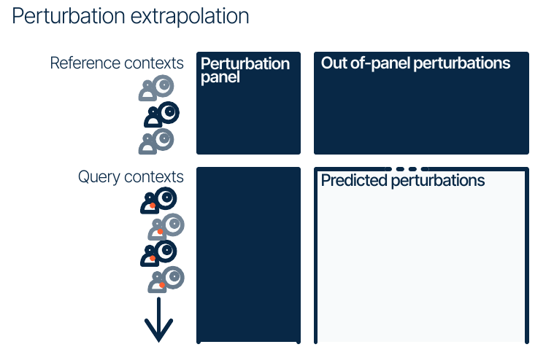
ID: 200010263
The task: complete a drug screen in a new context
Known in reference cell lines
Responses to the full drug library
Measured in a new cell line
A panel of drug responses
Predicted
How new cell line responses to the drugs
Tahoe benchmark: 45 reference + 5 query cell lines; 120 panel + 240 target drugs
Svensson et al., 2026, Fig. 1 (top left), pp. 3–4 and 13
3 / 8
Notes:
TARGET 0:25. End by 01:05. Main talk 5:20, leaving 0:40 within a 6-minute slot.
讲稿 / SAY
先看任务定义。图中每一行代表一个细胞背景，每一列代表一种扰动。上半部分是参考细胞系，已有完整药物筛选结果。下半部分是新的细胞系，深蓝色区域表示已经测过的药物 panel，浅色区域是待预测的其余药物。Tahoe 主实验每次用 45 个参考细胞系和 5 个查询细胞系。在查询细胞系里测 120 种药物，预测另 240 种，每种有三个剂量。因此，主模型需要新细胞系的实测响应，而且目标药物已在参考细胞系中出现。这是跨细胞背景的预测。
可能的问题 / LIKELY QUESTION
这是不是预测新药？不是。本文主要测试已知药物库在新细胞背景中的响应，不能据此声称泛化到新化学结构。
SOURCE
Svensson et al. (2026). Back to basics: Observed statistics are sufficient to predict drug responses. bioRxiv, version posted 12 June 2026. DOI: 10.64898/2026.06.09.731197. Local source: rhaister_2026.pdf.
Fig. 1 top-left schematic; p. 13, Tahoe train/test splits. Five independent context-level splits. Each drug has three doses: 360 panel and 720 target perturbations.
LOOK: top row = reference contexts, bottom row = query contexts, left column = panel, right column = target perturbations. Dark blue = observed, pale area = prediction. Diagram is schematic and not to scale. Counts describe the analyzed split, not all drugs in the raw atlas.

Slide 4
ID: 200010263
What do we have?
Baseline (DMSO) single cell expression matrix over 50 cell lines
X(cell_line) = R (cell by genes)
Tahoe benchmark
50 cell lines, 360 types of drugs, and 3 types of dose (0.5mg, 5mg, 50mg)
Y(cell_line, drug, dose) = R (cell by genes)
Measure:
Y(cell_line, drug, dose) = R (cell by genes)
Tahoe benchmark: 45 reference + 5 query cell lines; 120 panel + 240 target drugs
Svensson et al., 2026, Fig. 1 (top left), pp. 3–4 and 13
3 / 8
Notes:
TARGET 0:25. End by 01:05. Main talk 5:20, leaving 0:40 within a 6-minute slot.
讲稿 / SAY
先看任务定义。图中每一行代表一个细胞背景，每一列代表一种扰动。上半部分是参考细胞系，已有完整药物筛选结果。下半部分是新的细胞系，深蓝色区域表示已经测过的药物 panel，浅色区域是待预测的其余药物。Tahoe 主实验每次用 45 个参考细胞系和 5 个查询细胞系。在查询细胞系里测 120 种药物，预测另 240 种，每种有三个剂量。因此，主模型需要新细胞系的实测响应，而且目标药物已在参考细胞系中出现。这是跨细胞背景的预测。
可能的问题 / LIKELY QUESTION
这是不是预测新药？不是。本文主要测试已知药物库在新细胞背景中的响应，不能据此声称泛化到新化学结构。
SOURCE
Svensson et al. (2026). Back to basics: Observed statistics are sufficient to predict drug responses. bioRxiv, version posted 12 June 2026. DOI: 10.64898/2026.06.09.731197. Local source: rhaister_2026.pdf.
Fig. 1 top-left schematic; p. 13, Tahoe train/test splits. Five independent context-level splits. Each drug has three doses: 360 panel and 720 target perturbations.
LOOK: top row = reference contexts, bottom row = query contexts, left column = panel, right column = target perturbations. Dark blue = observed, pale area = prediction. Diagram is schematic and not to scale. Counts describe the analyzed split, not all drugs in the raw atlas.

Slide 5
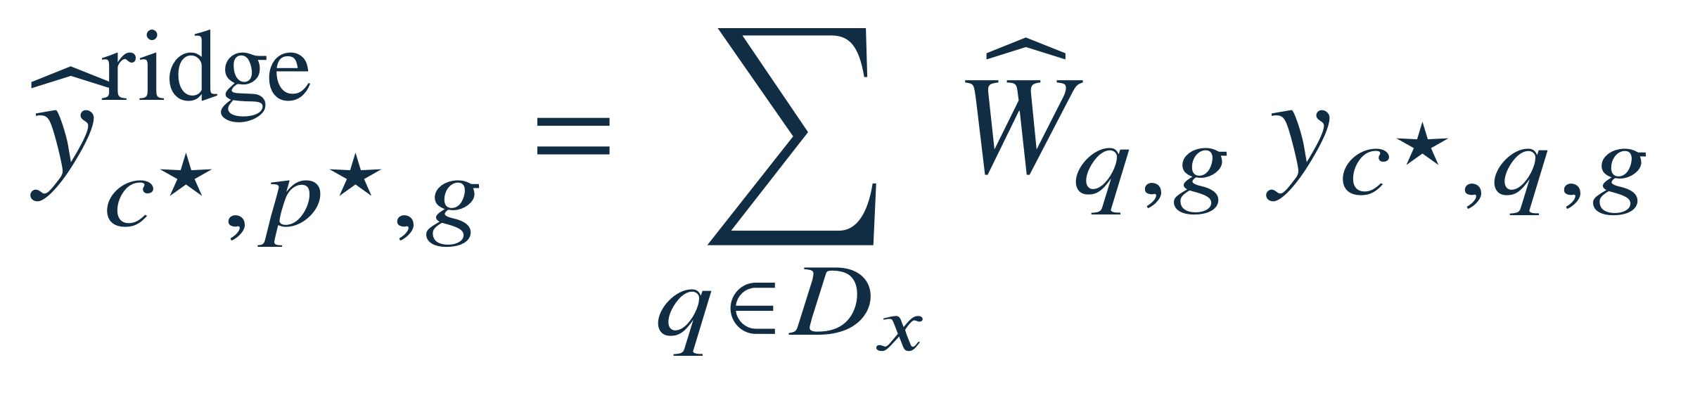
ID: 200010263
Rhaister learns a weighted sum of panel responses
Learn the weights across reference contexts
Predicted target response
Observed panel responses
One gene, one target drug,
one query context
Weights fitted by ridge regression
for each target drug and gene
Outputs: expression delta, log₂ fold change, and MWU significance statistics
Svensson et al., 2026, p. 11, Eq. 4 and Eqs. 1–7
4 / 8
Notes:
TARGET 0:55. End by 02:00. Main talk 5:20, leaving 0:40 within a 6-minute slot.
讲稿 / SAY
方法的核心很简单：把目标药物的响应写成已测 panel 响应的加权和。这里 y 是某个基因的响应统计量，c 星号是查询细胞背景，p 星号是目标药物，q 遍历 panel，g 是基因。权重 W 从参考细胞背景中通过岭回归学习，目标药物不同、基因不同，权重也可以不同。作者分别处理表达差值、log2 fold change 和 Mann–Whitney U 检验统计量。完整模型还有两步：参考数据覆盖不足时，回退到加性模型；显著性统计量经过一个小型 MLP 校准，再与回归预测等权混合。因此这是以线性回归为核心的框架。
可能的问题 / LIKELY QUESTION
W 是否所有药物共用？不是。公式针对固定目标扰动 p*，其权重由该目标的参考响应拟合，图中省略了权重上的目标索引。
SOURCE
Svensson et al. (2026). Back to basics: Observed statistics are sufficient to predict drug responses. bioRxiv, version posted 12 June 2026. DOI: 10.64898/2026.06.09.731197. Local source: rhaister_2026.pdf.
p. 11, Eq. 4 reproduced as published. Eqs. 1–2: additive ALS. Eq. 5: fallback when coverage is missing. Eqs. 6–7: MWU calibration and equal blending.
SYMBOLS: c* query context; p* target perturbation; g gene; D_x observed panel; q panel perturbation; y observed summary-statistic scalar; W_hat[q,g] learned scalar coefficient for a fixed target and view. For a fixed gene and target, coefficients form a vector of length |D_x|. Displayed equation is publication Eq. 4, not a new derivation. The matrix expression in Eq. 3 uses compressed notation; it is not reproduced here. MWU = Mann–Whitney U. Predictions of significance statistics do not constitute calibrated uncertainty for model predictions.

Slide 6
ID: 200010263
Rhaister leads the Tahoe-100M comparison
Held-out cell lines, measured drug panel, five splits
Model | Discrim. | Pearson Δ | PR-AUC | LFC rank | DE overlap | ES rank
Rhaister | 0.96 | 0.87 | 0.73 | 0.81 | 0.59 | 0.96
STATE | 0.93 | 0.81 | 0.51 | 0.57 | 0.40 | 0.89
Additive | 0.82 | 0.55 | 0.55 | 0.61 | 0.43 | 0.85
Half-sample | 0.93 | 0.77 | 0.62 | 0.67 | 0.52 | 0.97
Higher is better. Values are reported means; SD bars omitted from this table.
The half-sample reference is an empirical comparison, not a hard ceiling.
Svensson et al., 2026, Fig. 1, Tahoe-100M panel; p. 12, half-sample reference
5 / 8
Notes:
TARGET 1:00. End by 03:00. Main talk 5:20, leaving 0:40 within a 6-minute slot.
讲稿 / SAY
表里的 STATE 是目前最先进的虚拟细胞模型：对单细胞做条件集传输、生成反事实细胞再汇总统计量，成本高得多；Rhaister 训练只需几秒、预测毫秒级。这张表保留了 Tahoe 的六个评价指标，数值来自原文图一，各列都是越高越好。橙色一行是 Rhaister。请先看 Pearson，它比较表达变化的大小，Rhaister 是 0.87，STATE 是 0.81。再看 PR-AUC，也就是差异表达基因的识别，分别是 0.73 和 0.51。其余列衡量扰动区分、fold change 排序、差异基因重叠，以及扰动影响范围的排序。Rhaister 在这六列都高于 STATE。但这里的 half-sample 是把同一批细胞随机分成两半，互相预测得到的参考值。它反映采样与分析流程的稳定性，并非数学上的上限。所以结果支持这个任务上的强预测表现，不能等同于模型已经准确模拟完整细胞。
可能的问题 / LIKELY QUESTION
为什么模型能超过 half-sample？半样本统计量使用的细胞少于完整数据，而且随机拆分有波动。作者明确说它不是严格上限。
SOURCE
Svensson et al. (2026). Back to basics: Observed statistics are sufficient to predict drug responses. bioRxiv, version posted 12 June 2026. DOI: 10.64898/2026.06.09.731197. Local source: rhaister_2026.pdf.
Fig. 1 Tahoe-100M panel, p. 3. All table entries transcribed from the figure. Paper error bars are ±1 SD across splits; SD numbers are not printed and are not reconstructed. Definitions pp. 14–15. Half-sample caveat explicitly stated on p. 12.
TABLE GUIDE: rows = models or reference, columns = six distinct metrics, all unitless. Discrim. = rank-based perturbation discrimination using expression deltas. Pearson Δ = correlation across genes. PR-AUC = precision–recall area for DE classification using FDR q < 0.05. LFC rank = Spearman correlation of log fold changes among observed significant genes. DE overlap = overlap of selected differential-expression gene sets. ES rank = Spearman ranking of the number of significant genes across perturbations, not a physical or clinical effect size. Simplified abbreviations only; numbers are not changed.

Slide 7
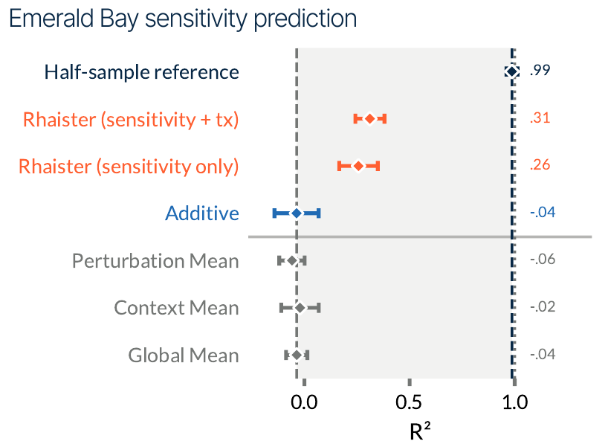
ID: 200010263
Transcriptomic responses improve sensitivity prediction
Emerald Bay
52 pooled cancer cell lines
5-day drug treatment
Paired abundance and RNA readouts
0.26 to 0.31
R² after adding transcriptomic
responses from the measured panel
Endpoint: change in relative cell-line abundance within a pooled culture
Svensson et al., 2026, Fig. 2 (Emerald Bay sensitivity prediction), pp. 5–6 and 13–14
6 / 8
Notes:
TARGET 0:50. End by 03:50. Main talk 5:20, leaving 0:40 within a 6-minute slot.
讲稿 / SAY
第二个结果更接近药物发现：能否预测敏感性？Emerald Bay 将 52 个癌细胞系混合培养，处理药物五天，同时读出细胞丰度和转录组。图的横轴是 R 平方，橙色是 Rhaister，蓝色是加性模型，灰色是均值基线。只用 panel 的敏感性，R 平方是 0.26；加入同一 panel 的转录响应后，升到 0.31。基线接近或低于零，但 half-sample 参考达到 0.99，说明这个表型任务还有很大的改进空间。也要注意，这里的敏感性来自混合培养中细胞系相对丰度的变化，不能直接当成患者的临床疗效。
可能的问题 / LIKELY QUESTION
0.31 是不是预测了 31% 的细胞会死亡？不是。R² 衡量模型相对于均值预测解释了多少变异，并非死亡比例。
SOURCE
Svensson et al. (2026). Back to basics: Observed statistics are sufficient to predict drug responses. bioRxiv, version posted 12 June 2026. DOI: 10.64898/2026.06.09.731197. Local source: rhaister_2026.pdf.
Fig. 2, Emerald Bay sensitivity prediction; p. 5 results; Eq. 18 p. 13. The full dataset has 91 treatments including combinations, but modeling uses 45 single-drug dose conditions spanning 19 drugs according to p. 13.
LOOK: all seven plotted rows remain visible and are explained. Half-sample = 0.99. Rhaister sensitivity + tx = 0.31; sensitivity only = 0.26. Additive = −0.04, perturbation mean = −0.06, context mean = −0.02, global mean = −0.04. Error bars are ±1 SD across five train/test splits, not confidence intervals for clinical efficacy. tx = transcriptomic responses from measured panel perturbations. Sensitivity = log2 of treatment/control cell-line proportions. It is a compositional relative-abundance endpoint.

Slide 8
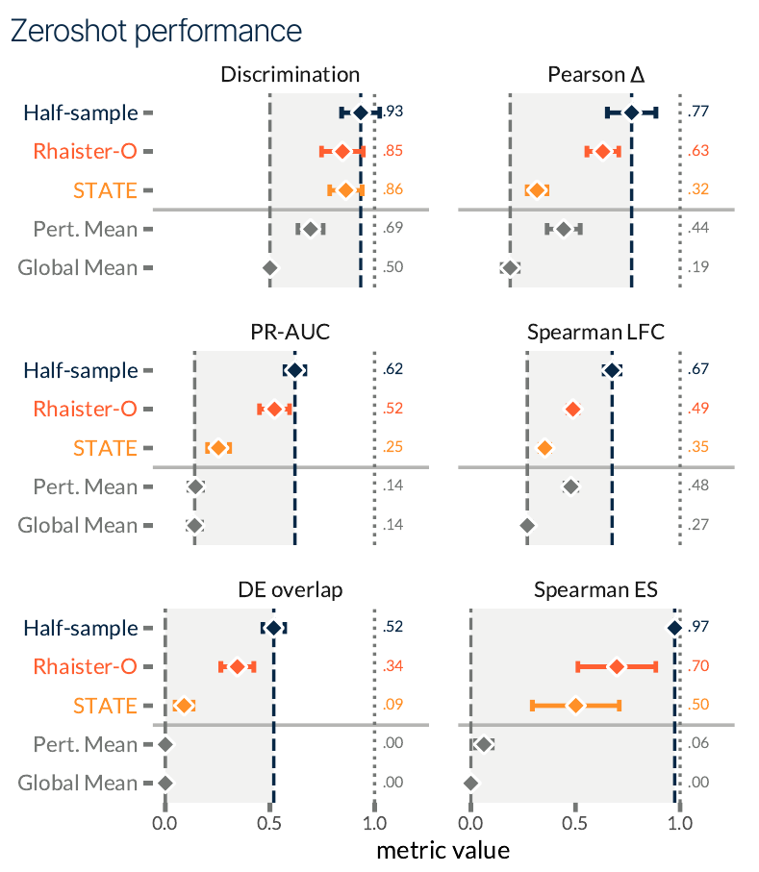
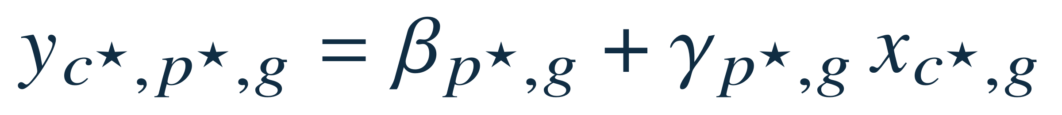
ID: 200010263
Rhaister-O predicts from baseline expression alone
No treated cells from the query context
x = baseline pseudobulk expression
Pearson Δ: 0.63 vs 0.32
Rhaister-O compared with STATE
Discrimination: 0.85 vs 0.86
Svensson et al., 2026, Fig. 4 (top), p. 8; Eq. 9, p. 11
7 / 8
Notes:
TARGET 1:00. End by 04:50. Main talk 5:20, leaving 0:40 within a 6-minute slot.
讲稿 / SAY
如果新细胞背景没有任何处理后的数据，作者提出 Rhaister-O。它只需要未处理细胞的 pseudobulk 表达。作者称这是第一个在该任务上做到零样本、且明显超过简单基线的模型。这个公式对每个药物和基因，用基线表达乘一个斜率，再加截距来预测响应，参数在参考细胞系中学习。右侧图仍是六个指标，橙红色是 Rhaister-O，橙黄色是 STATE，深蓝色是 half-sample。最明显的是 Pearson，从 STATE 的 0.32 提高到 0.63；PR-AUC 从 0.25 到 0.52。DE overlap 和 effect-size 排序也更好。不过 discrimination 是 0.85，对 STATE 是 0.86，略低。因此图支持五个指标的平均值更高，而不是所有指标全面领先。这里 zero-shot 只表示没有查询背景的扰动响应，并不表示预测从未见过的新药。
可能的问题 / LIKELY QUESTION
它是不是跨整个转录组的复杂编码器？展示的是论文 Eq. 9：同一基因的 baseline 表达配合该药物、该基因的截距和斜率。完整代码可能含额外处理，不能把简写公式外推为所有实现细节。
SOURCE
Svensson et al. (2026). Back to basics: Observed statistics are sufficient to predict drug responses. bioRxiv, version posted 12 June 2026. DOI: 10.64898/2026.06.09.731197. Local source: rhaister_2026.pdf.
p. 11 Eq. 9 as printed. Fig. 4 top: discrimination, Pearson Δ, PR-AUC, Spearman LFC, DE overlap, Spearman ES. Paper text says all metrics, but the plotted discrimination means are 0.85 vs 0.86.
SYMBOLS: y = predicted response (the publication prints y without a hat); c* = query context; p* = target perturbation; g = gene; x[c*,g] = observed baseline pseudobulk expression; beta[p*,g] = learned intercept; gamma[p*,g] = learned slope. All are scalar per target and gene. LOOK: panels read left-to-right, top-to-bottom. Means for Rhaister-O versus STATE: discrimination .85/.86; Pearson .63/.32; PR-AUC .52/.25; LFC .49/.35; DE overlap .34/.09; ES .70/.50. Error bars = ±1 SD across five splits. No statistical significance claim about small mean differences. Figure values from supplied PDF take precedence over model-card rounding.

Slide 9
ID: 200010263
Summary statistics provide a strong baseline
The contribution
Direct prediction of the readouts
that downstream analyses use
The boundary
Known perturbations, new contexts
Population summaries leave single-cell heterogeneity unresolved
For therapeutic discovery: useful prioritization still needs experimental validation
Svensson et al., 2026, Discussion, p. 9; interpretation of Figs. 1–4
8 / 8
Notes:
TARGET 0:40. End by 05:20. Main talk 5:20, leaving 0:40 within a 6-minute slot.
讲稿 / SAY
最后，我认为这篇论文最重要的贡献，是证明先把任务定义到真正需要的分析读出，简单模型就能成为很强的基线。实测 panel 对跨细胞背景的预测很有帮助，baseline-only 分支也值得比较。但这些结果主要针对已有药物库和有限的细胞背景，统计量不能还原完整单细胞分布，敏感性预测也还有很大空间。对我们的药物发现项目，直接启示是把 Rhaister-O 和简单基线纳入比较，再检验额外模态是否真的改善 held-out cell-line 预测。
可能的问题 / LIKELY QUESTION
论文否定了 virtual-cell 模型吗？没有。它支持在特定群体统计预测任务上比较简单基线；生成细胞分布、罕见状态或新细胞类型是不同的任务。
SOURCE
Svensson et al. (2026). Back to basics: Observed statistics are sufficient to predict drug responses. bioRxiv, version posted 12 June 2026. DOI: 10.64898/2026.06.09.731197. Local source: rhaister_2026.pdf.
p. 9 Discussion; Figs. 1–4. Last sentence about the local course project is presenter interpretation, not a claim made by the paper.
The six-minute slot assumes speaking plus transitions. Main content ends at 5:20 with 40 seconds of buffer. Backup slides are optional and should not be included in the timed talk.

Slide 10
BACKUP · OPTIONAL
ID: 200010263
Cross-dataset gains depend on the metric
Selected metrics from the additional perturbation screens
Screen / metric | Rhaister | STATE | Additive
Parse PBMC: Pearson Δ | 0.46 | 0.25 | 0.43
Parse PBMC: LFC rank | 0.59 | 0.34 | 0.63
Replogle–Nadig: Pearson Δ | 0.41 | 0.37 | 0.39
Replogle–Nadig: LFC rank | 0.63 | 0.78 | 0.66
PRISM sensitivity: Rhaister R² 0.87; perturbation mean R² 0.81
A high absolute score can coexist with a strong context-independent baseline.
Svensson et al., 2026, Fig. 1 and Fig. 2, pp. 3–6
B1
Notes:
OPTIONAL BACKUP. Excluded from the 6-minute talk.
讲稿 / SAY
这页用于回答普适性的问题。表格只选取 Pearson 和 LFC 排序，并非完整六项排名。Parse PBMC 的 Pearson 上 Rhaister 有优势，但 LFC 上加性基线更高。Replogle–Nadig 只有四个细胞背景，Rhaister 的 Pearson 略高于 STATE，LFC 排序却明显低于 STATE。作者认为参考背景的多样性重要，但跨数据集比较本身不能隔离这一原因。PRISM 的 R² 很高，可药物均值基线已经达到 0.81，因此要同时看绝对分数和相对基线的增益。
可能的问题 / LIKELY QUESTION
为什么不只报告最好的分数？不同指标评价不同生物问题。选择性展示优势会夸大模型的适用范围。
SOURCE
Svensson et al. (2026). Back to basics: Observed statistics are sufficient to predict drug responses. bioRxiv, version posted 12 June 2026. DOI: 10.64898/2026.06.09.731197. Local source: rhaister_2026.pdf.
Fig. 1 Parse-PBMC and Replogle-Nadig panels; Fig. 2 PRISM sensitivity. Values are means printed in the supplied paper.
TABLE: columns = model, rows = explicitly selected screen/metric pairs. No uncertainty values are reconstructed. Parse uses a held-out-donor split; Replogle–Nadig uses four cell-line holdouts. PRISM is a different phenotype assay and its R² should not be directly ranked against Emerald Bay.

Slide 11
BACKUP · OPTIONAL
ID: 200010263
Panel size and reference diversity affect performance
Measured perturbation panel
Reference contexts
1–120 drugs
~20 cell lines
Three doses per drug
Larger panels improve the six metrics
Marginal further gains in the
panel-based setting
Baseline-only Rhaister-O continues to benefit from more reference contexts.
Svensson et al., 2026, Fig. 3 and Results, p. 7; Fig. 4 bottom, p. 8
B2
Notes:
OPTIONAL BACKUP. Excluded from the 6-minute talk.
讲稿 / SAY
这一页是原文 scaling 实验的文字概括。图三左边依次测试 1、3、6、10、20、60、120 种 panel 药物，每种三个剂量。更多 panel 药物总体带来更好的表现，但各指标损失不一致。右边测试 5、10、20、45 个参考细胞背景，作者总结大约 20 个以后提升比较有限。这里说的是 Rhaister 的 panel-based 设置。图四 baseline-only 的 Rhaister-O 仍随参考细胞系增加而改善，因此不能把二十个背景理解成所有模型的充分数据规模。
可能的问题 / LIKELY QUESTION
是不是一个药物就足够？这取决于数据、指标和容许损失。文中小 panel 的结果不能保证任意一种药物都具有同样的覆盖能力。
SOURCE
Svensson et al. (2026). Back to basics: Observed statistics are sufficient to predict drug responses. bioRxiv, version posted 12 June 2026. DOI: 10.64898/2026.06.09.731197. Local source: rhaister_2026.pdf.
p. 7 Fig. 3 and accompanying text; p. 8 Fig. 4 bottom. This slide summarizes the reported range and qualitative trend without reconstructing individual curve values.
Paper scaling plots use percentages relative to the full panel/all-context model, not absolute accuracy. “~20” is the authors’ qualitative assessment, not an experimentally established universal cutoff.

Slide 12
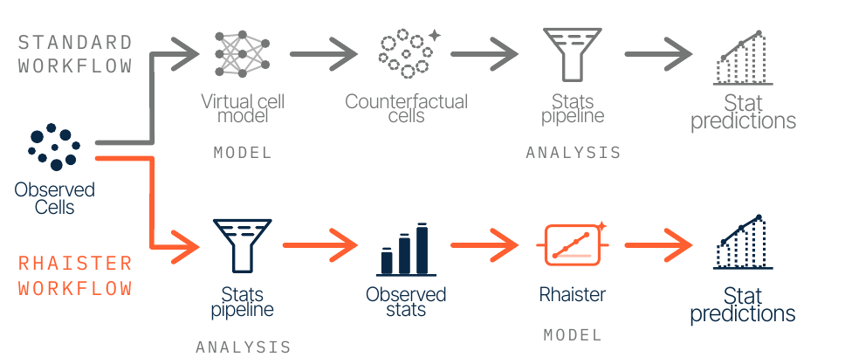
BACKUP · OPTIONAL
ID: 200010263
The full framework adds fallback and calibration
Additive fallback
Used when reference coverage
is insufficient
MWU calibration
Small MLP, then an equal blend
with the ridge prediction
Predicted significance statistics do not quantify uncertainty in the model prediction.
Svensson et al., 2026, Fig. 1 top right; Details, p. 11, Eqs. 1–7
B3
Notes:
OPTIONAL BACKUP. Excluded from the 6-minute talk.
讲稿 / SAY
从左到右读原图。上方灰色流程先利用单细胞模型生成反事实细胞，再做统计分析。下方橙色流程先从真实细胞计算统计量，再预测统计量。右侧两条补充说明完整 Rhaister 框架：加性模型包含总体、背景和扰动主效应，参考数据覆盖不足时回退到它。MWU 校准网络使用 fold change 大小、回归结果、基线表达和基因层面的统计信息，再与回归预测等权混合。由于预测的是原始分析流程中的显著性读出，这不能自动替代预测区间或模型不确定性估计。
可能的问题 / LIKELY QUESTION
是否完全不用神经网络？不是。核心是岭回归，但显著性校准含小型 MLP。
SOURCE
Svensson et al. (2026). Back to basics: Observed statistics are sufficient to predict drug responses. bioRxiv, version posted 12 June 2026. DOI: 10.64898/2026.06.09.731197. Local source: rhaister_2026.pdf.
Fig. 1 top-right workflow, p. 3; Eqs. 1–7, p. 11.
The figure is reproduced unaltered except for cropping to the self-contained workflow panel. Both workflows and every stage are explained. The uncertainty interpretation is the presenter’s methodological qualification. No hardware-normalized runtime comparison is claimed in this deck.

Slide 13
BACKUP · OPTIONAL
ID: 200010263
Metric definitions and source
Metric | What it evaluates
Discrimination | Rank of the correct perturbation among alternatives
Pearson Δ | Agreement of expression-change magnitudes across genes
PR-AUC / DE overlap | Differential-expression classification / gene-set agreement
Spearman LFC | Rank agreement of fold changes in significant genes
Spearman ES | Rank of the number of significant genes across perturbations
Source version: supplied PDF, posted 12 June 2026 (preprint)
Model and code: https://huggingface.co/tahoebio/Rhaister
Full definitions: paper pp. 14–15. Source discrepancies are documented in the speaker notes.
Primary source: Svensson et al., bioRxiv, 2026. doi:10.64898/2026.06.09.731197
B4
Notes:
OPTIONAL BACKUP. Excluded from the 6-minute talk.
讲稿 / SAY
如果有人追问指标，可用这一页解释。Discrimination 关注正确扰动在候选响应中的相对排名。Pearson 比较表达差值的大小；PR-AUC 与 DE overlap 分别关注显著基因的识别和集合一致性。LFC 是显著基因之间的变化幅度排序；ES 是不同扰动所影响的显著基因数量的排序。六个分数不是同一个意义上的准确率。
可能的问题 / LIKELY QUESTION
数据数量为什么可能不同？原始数据规模、经过筛选的分析子集和代码版本可以不同，复现时必须明确采用哪个版本。
SOURCE
Svensson et al. (2026). Back to basics: Observed statistics are sufficient to predict drug responses. bioRxiv, version posted 12 June 2026. DOI: 10.64898/2026.06.09.731197. Local source: rhaister_2026.pdf.
Metric definitions pp. 14–15. Model repository: https://huggingface.co/tahoebio/Rhaister (checked 20 September 2026). Primary numerical source is the supplied June 12 PDF.
SOURCE DISCREPANCIES: (1) Fig. 4 discrimination .85/.86 conflicts with the prose claim of improvement across all metrics. (2) Paper p. 13 states 19 unique drugs in the filtered Emerald Bay modeling subset, whereas p. 14 describes six panel plus fourteen target drugs, totaling twenty. This deck does not silently reconcile those statements. (3) The raw Tahoe description lists 384 drugs; the benchmark split uses 120 + 240 = 360. We report the split as an analyzed subset rather than equate it with the raw atlas. (4) The live model card reports Rhaister-O PR-AUC .53; the supplied paper Fig. 4 prints .52, which is the value used here. Data/version claims in the deck refer to the paper, not a merged later revision.
Full citation: Valentine Svensson, Umair Khan, Hamed Heydari, Airol A. Ubas, Nicole Thomas, Daniele Merico, Hani Goodarzi, John Yu, Nima Alidoust, Shreshth Gandhi. Back to basics: Observed statistics are sufficient to predict drug responses. bioRxiv (2026), doi:10.64898/2026.06.09.731197.

