Slide 1
BIDScoin: an easy toolkit to convert your data into BIDS
Marcel Zwiers

Slide 2
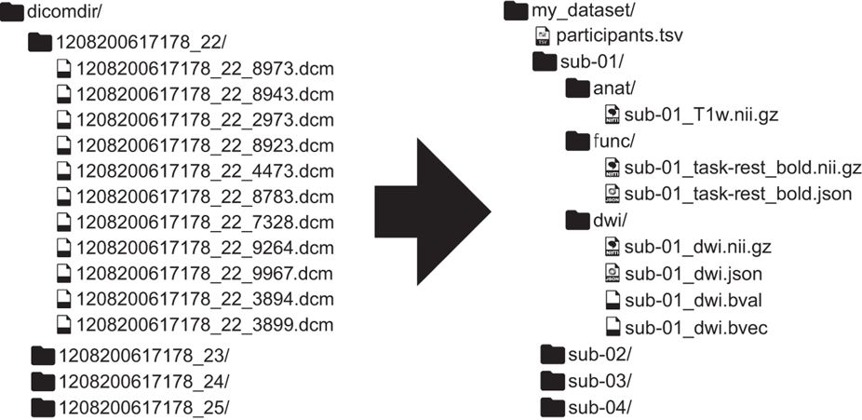
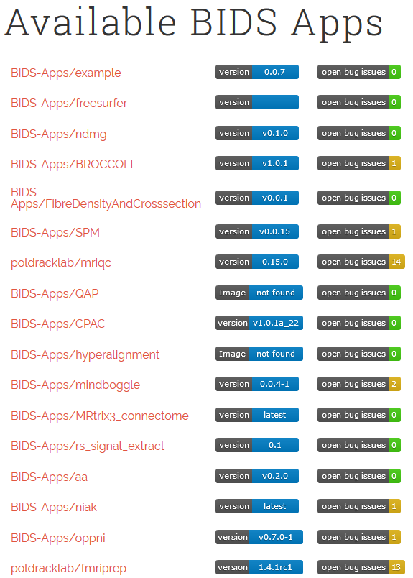
The goal: Brain Imaging Data Structure (BIDS)
Data Source
Data Sharing: BIDS
Software Sharing: BIDS apps

Slide 3
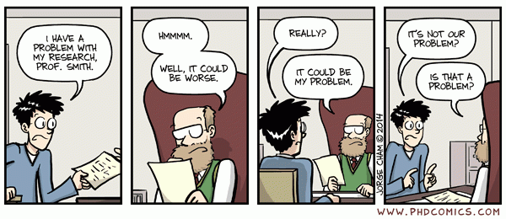
Getting your data into BIDS should not be such a hard problem

Slide 4
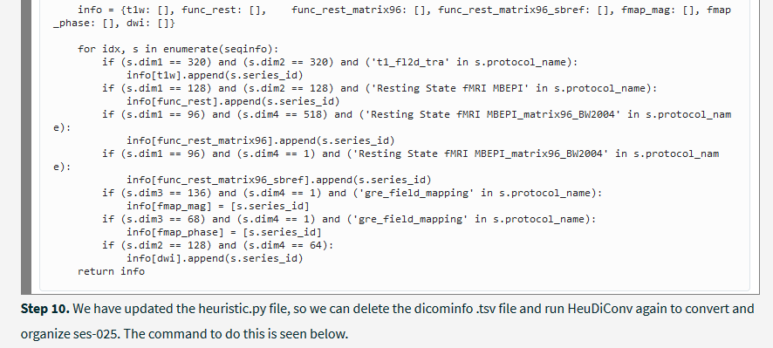
Getting your data into BIDS should not be such a hard problem

Slide 5
Converting to BIDS: A mapping problem
User knowledge

Slide 6
BIDScoin
It is not rule based but maps prior knowledge as well as individual user knowledge
DICOM header information
PAR(/REC) header information
P*.7 header information
Nifti header information
File system information
Plugin
The gathered information is stored in a flexible and human readable yaml file, the bidsmap
You can easily edit the yaml file / bidsmap to your needs
BIDScoin tools run automatically and require no programming knowledge

Slide 7
Workflow
Step 1: Run the bidsmapper
usage: bidsmapper.py [-h] [-t TEMPLATE] [-n SUBPREFIX] [-m SESPREFIX]
sourcefolder bidsfolder
Step 2: Run the bidseditor
usage: bidseditor.py [-h] [-s SOURCEFOLDER] [-b BIDSMAP] [-t TEMPLATE]
bidsfolder
Step 3: Run the bidscoiner
usage: bidscoiner.py [-h] [-p PARTICIPANT_LABEL [PARTICIPANT_LABEL ...]]
[-f] [-s] [-b BIDSMAP] [-n SUBPREFIX] [-m SESPREFIX] [-v]
sourcefolder bidsfolder

Slide 8
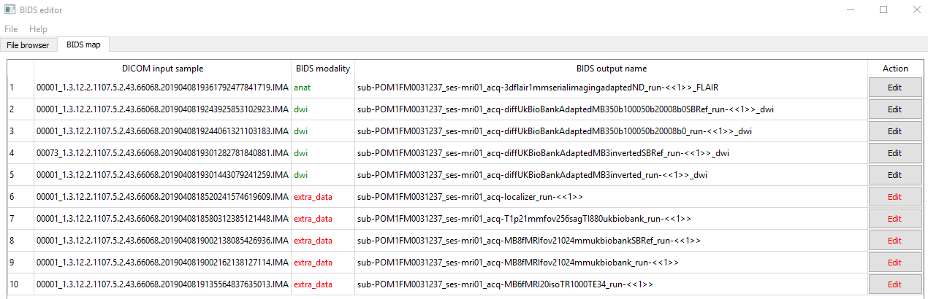
Overview / short worklist
Main window
Add user knowledge
Template info

Slide 9
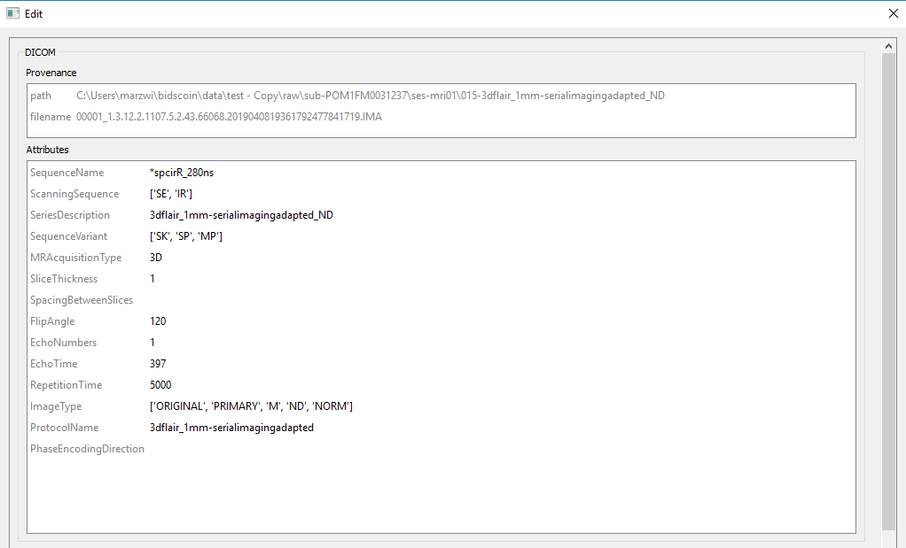
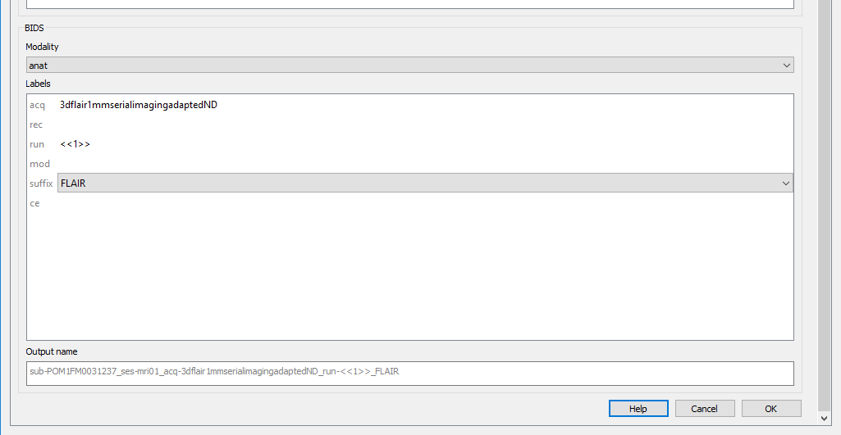
Edit window
DICOM input
BIDS output

Slide 10
BIDScoin
An open-source python toolkit that converts ("coins") source-level (raw) neuroimaging data-sets to the BIDS standard
The user does not need programming knowledge and can directly edit the mapping with a GUI
Institutes can provide their users with a custom template already containing the mappings for the scans that are typically performed in the institute
Tested over a broad spectrum of (DICOM) input data, including fieldmaps, mutli-echo data, multi-coil data, PET scans and various kinds of anatomical, diffusion and functional MRI scans.

Slide 11
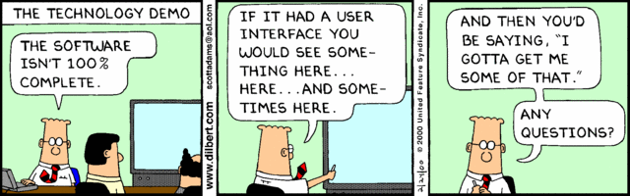
Poster: W581
https://github.com/Donders-Institute/bidscoin

Slide 12
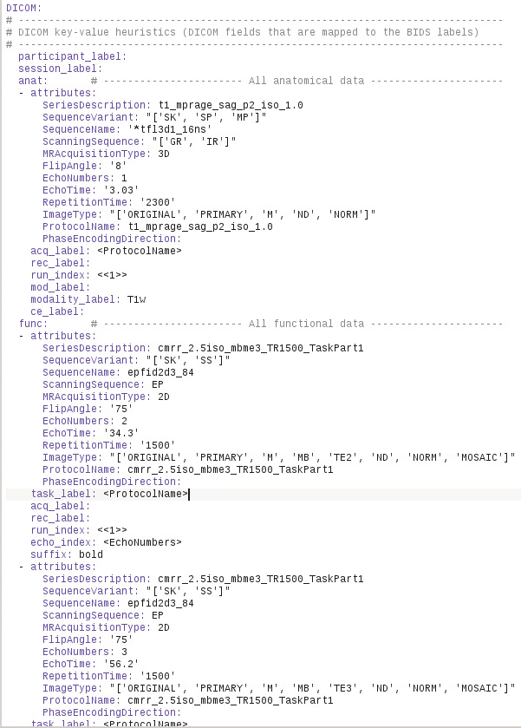
DICOM keys
BIDS values

