Slide 2
Overall (intra) Parameters
Parameter Examples
Specific (inter) Parameters
Single Spool Turbfofan
Double Spool Turbfofan
Required:
'Ta': Atmospheric static temperature
'Pa': Atmospheric static pressure
'rfan': Fan Pressure Ratio
'rc': Compressor Pressure Ratio
'BPR': Bypass Ratio (If not passed, assumed 1 so no bypass occurs (assumed to happen between fan and hpc)
'T_turb_in': Turbine inlet temp
Optional
'Vinf': None, # Or Minf
'Minf': None, # Or Vinf, if none its assumed stationary
'mdot_a': # Mass flow rate of air into engine (kg/s)
'Q_fuel': Heat energy of fuel, pass if real to calculate f and include fuel flow in power/velecity calcs
'F': Thrust of the engine produced
Efficiencies (Assumed to be 1 if not passed)
'ni': Inlet Isentropic Efficiency
'nj': Nozzle Isentropic Efficiency
'nf': Fan Isentropic Efficiency
'nc': Compressor Isentropic Efficiency
'nt': Turbine Isentropic Efficiency
'nb': Cobustor Efficincy
'nm': Mechanical Efficiency
'npf': Fan Polytropic Efficiency (overrides isentropic)
'npc': Compressor Polytropic Efficiency (overrides isentropic)
'npt': Turbine Polytropic Efficiency (overrides isentropic)
'dP_combustor': Decimal pressure drop in combustor (ex: 0.05 for 5% P loss, 0 for ideal)
Required:
'Ta': Atmospheric static temperature
'Pa': Atmospheric static pressure
'rfan': Fan Pressure Ratio
'rc': Compressor Pressure Ratio
'BPR': Bypass Ratio (If not passed, assumed 1 so no bypass occurs)
'T_turb_in': Turbine inlet temp (HP Turbine)
Optional
'Vinf': Or Minf
'Minf': Or Vinf, if none its assumed stationary
'mdot_a': Mass flow rate of air into engine (kg/s)
'Q_fuel': Heat energy of fuel, pass if real to calculate f and include fuel flow in power/velecity calcs
'F': Thrust of the engine produced
Efficiencies (Assumed to be 1 if not passed)
'ni': Inlet Isentropic Efficiency
'nj': Nozzle Isentropic Efficiency
'nf': Fan Isentropic Efficiency
'nc': Compressor Isentropic Efficiency
'nt': Turbine Isentropic Efficiency
'nb': Cobustor Efficincy
'nm': Mechanical Efficiency
'npf': Fan Polytropic Efficiency (overrides isentropic)
'npc': Compressor Polytropic Efficiency (overrides isentropic)
'npt': Turbine Polytropic Efficiency (overrides isentropic)
'npt_lp': Low Pressure Turbine Polytropic Efficiency (overrides isentropic)
'dP_combustor': Decimal pressure drop in combustor (ex: 0.05 for 5% P loss, 0 for ideal)

Slide 3
Simple Engine Analysis Input Params
Other:
Nozzle expansion pressure and such
Maybe for burner the FAR or equivalence ratio may be able to be selected along with mdot and Q_Fuel in order to calculate Temp increase?
Efficiencies
(Assumed to be 1 if not passed)
Isentropic Efficiencies:
Inlet Isentropic Efficiency
Nozzle Isentropic Efficiency
Turbomachinery Isentropic Efficiency
Combuster Efficiency
Polytropic Efficiencies: (Overrides Isentropic efficiency if passed)
Turbomachinery Polytropic Efficiency
Other Efficiencies:
Combustor Efficiency
Mechanical Efficiency (bearing friction losses in turbomachinery)
Pressure drop in combustor as a decimal(ex: 0.05 for 5% P loss, 0 for ideal)
Initial Conditions
Altitude
Type of Atm Stndrd
or
P_atm (static)
T_atm (Static)
V_inf or M_inf (assumed 0 if not entered)
Overall Optional
Mass flow rate of air into engine (kg/s
or??
Thrust produced by engine
Q_fuel -> Calculates FAR and includes fuel mass flow, is serpate from cobuster since same would be used in afterburner too
BPR of each component (assumed 1 if not entered)

Slide 4
Component Specific Parameters - General
A
A
= B overrides A
= A or B (one needed)
User-defined
B
B
Stage
= Not Needed
Intake
Isentropic Efficiency (ni)
Turbine
Isentropic Efficiency (nt)
Polytropic Efficiency (npt)
Inlet Temp (Toi,t) (depends on burner, Toi,t = Toe,b )
Pressure Ratio (rt)
Note: BPR can be made toapply to any component to allow for bleed offs. May also need a way to re-introduce this flow eventually
Compressor
Isentropic Efficiency (nc)
Polytropic Efficiency (npc)
Pressure Ratio (r, PR)
Bypass Ratio (BPR)
Combustor
Nozzle
Combustor Efficiency (nb)
Pressure Drop (dPo)
Temperature Increase (dTo)
Outlet Temperature (Toe,b)
Fuel to air ratio (f)
Fuel heat capacity (Qfuel)
Isentropic Efficiency (nj)

Slide 5
Component Specific Parameters – Specific/Advanced
Intake
Turbine
Physical Parameters
Number of Stages
Blade angles
Gas angles
Physical params
Compressor
Number of Stages
Blade angles
Gas angles
Physical params
De Haller min = 0.65
Mach max = 1.2
Nozzle
Physical Parameters
Combustor
stuff

Slide 6
GUI Designs

Slide 7
Engine Geometry Selection
Functionality:
The only flow path will be the primary flow path with the option to add additional flow paths (By-passes) where the air could be later re-entered into the main stream.
For now. May be able t combine this page and the next page so you add params as you add stages.
Could also have next slide pre-set for testing.
Engine Geometry
Primary Air Flow
Secondary Air Flow
+ Add Flow Path
Stage 1
Stage 1
Stage 2
+ Add Stage
+ Add Stage
Stage Compilation Diagram
Maybe color code rectangles first?
1
2
Back
Next

Slide 8
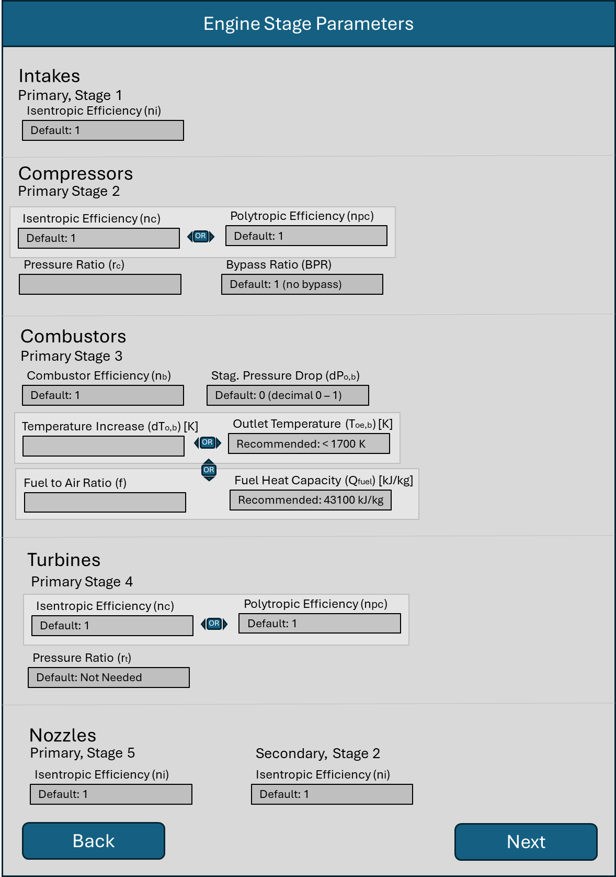
Stage
OR
Airflow Path, Stage Number
Parameter
OR
Parameter Value

Slide 9
OR
Engine Overall Parameters and Conditions
Engine Overall Params
Mechanical Efficiency (nm)
Default: 1
Optional
Air Mass Flow Rate (ma) [kg/s]
Engine Thrust (F) [N]
Initial Conditions
Altitude (h) [m]
Standard Atm
Atm Pressure (Patm) [kPa]
OR
Atm Temperature (Tatm) [K]
Relative Airspeed (Vinf) [m/s]
Relative Mach Speed (Minf)
Default: 0
OR
Back
Next

Slide 10
Extra Slids

Slide 11
Engine Stage Parameters
Intakes
Primary, Stage 1
Isentropic Efficiency (ni)
Default: 1
Compressors
Primary Stage 2
Isentropic Efficiency (nc)
Polytropic Efficiency (npc)
Default: 1
OR
Default: 1
Pressure Ratio (rc)
Bypass Ratio (BPR)
Default: 1 (no bypass)
Combustors
Primary Stage 3
Combustor Efficiency (nb)
Stag. Pressure Drop (dPo,b)
Default: 1
Default: 0 (decimal 0 – 1)
Temperature Increase (dTo,b) [K]
Outlet Temperature (Toe,b) [K]
OR
Recommended: < 1700 K
Fuel to Air Ratio (f)
OR
Fuel Heat Capacity (Qfuel) [kJ/kg]
Recommended: 43100 kJ/kg
Turbines
Primary Stage 4
Isentropic Efficiency (nc)
Polytropic Efficiency (npc)
Default: 1
OR
Default: 1
Pressure Ratio (rt)
Default: Not Needed
Nozzles
Primary, Stage 5
Secondary, Stage 2
Isentropic Efficiency (ni)
Isentropic Efficiency (ni)
Default: 1
Default: 1
Back
Next

