Slide 1


Slide 2
Hello!
I am Radu

Slide 3

Problem
Local administrations are struggling with noise pollution management

Slide 4

Problem
Noise pollution is growing
Decibel Hell became a world problem

Slide 5

Solution
IoT helps the city grow healthy

Slide 6
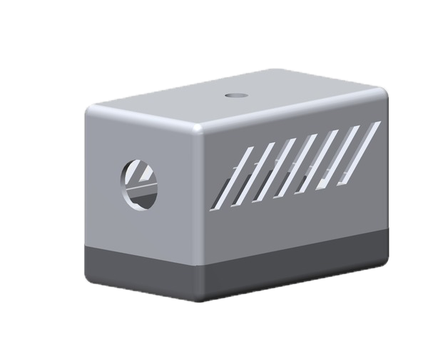
Solution
Detects noise pollution
Generate helpful statistics
Real-time data

Slide 7
Solution
Healthy Growth
Real-time Statistics
Greener Future

Slide 8
Business Model
Initial Package
Follow Up Subscription
Long-term Relationship

Slide 9

30.000.000
$1000 per km²
people in the US are exposed to hazardous sound levels
£7 to 10 billion
annual social cost of urban road noise in England
Total success!

Slide 10

Differentiator
We help your local administration manage noise pollution.
We aim to increase the quality of life.

Slide 11
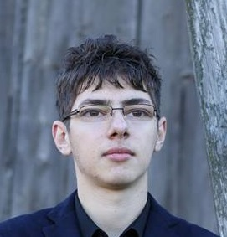



Stefan
Simulator & Embedded
Radu
FrontEnd & BackEnd
Dragos
WebApp & BackEnd
Ionut
Designer & Embedded

Slide 12
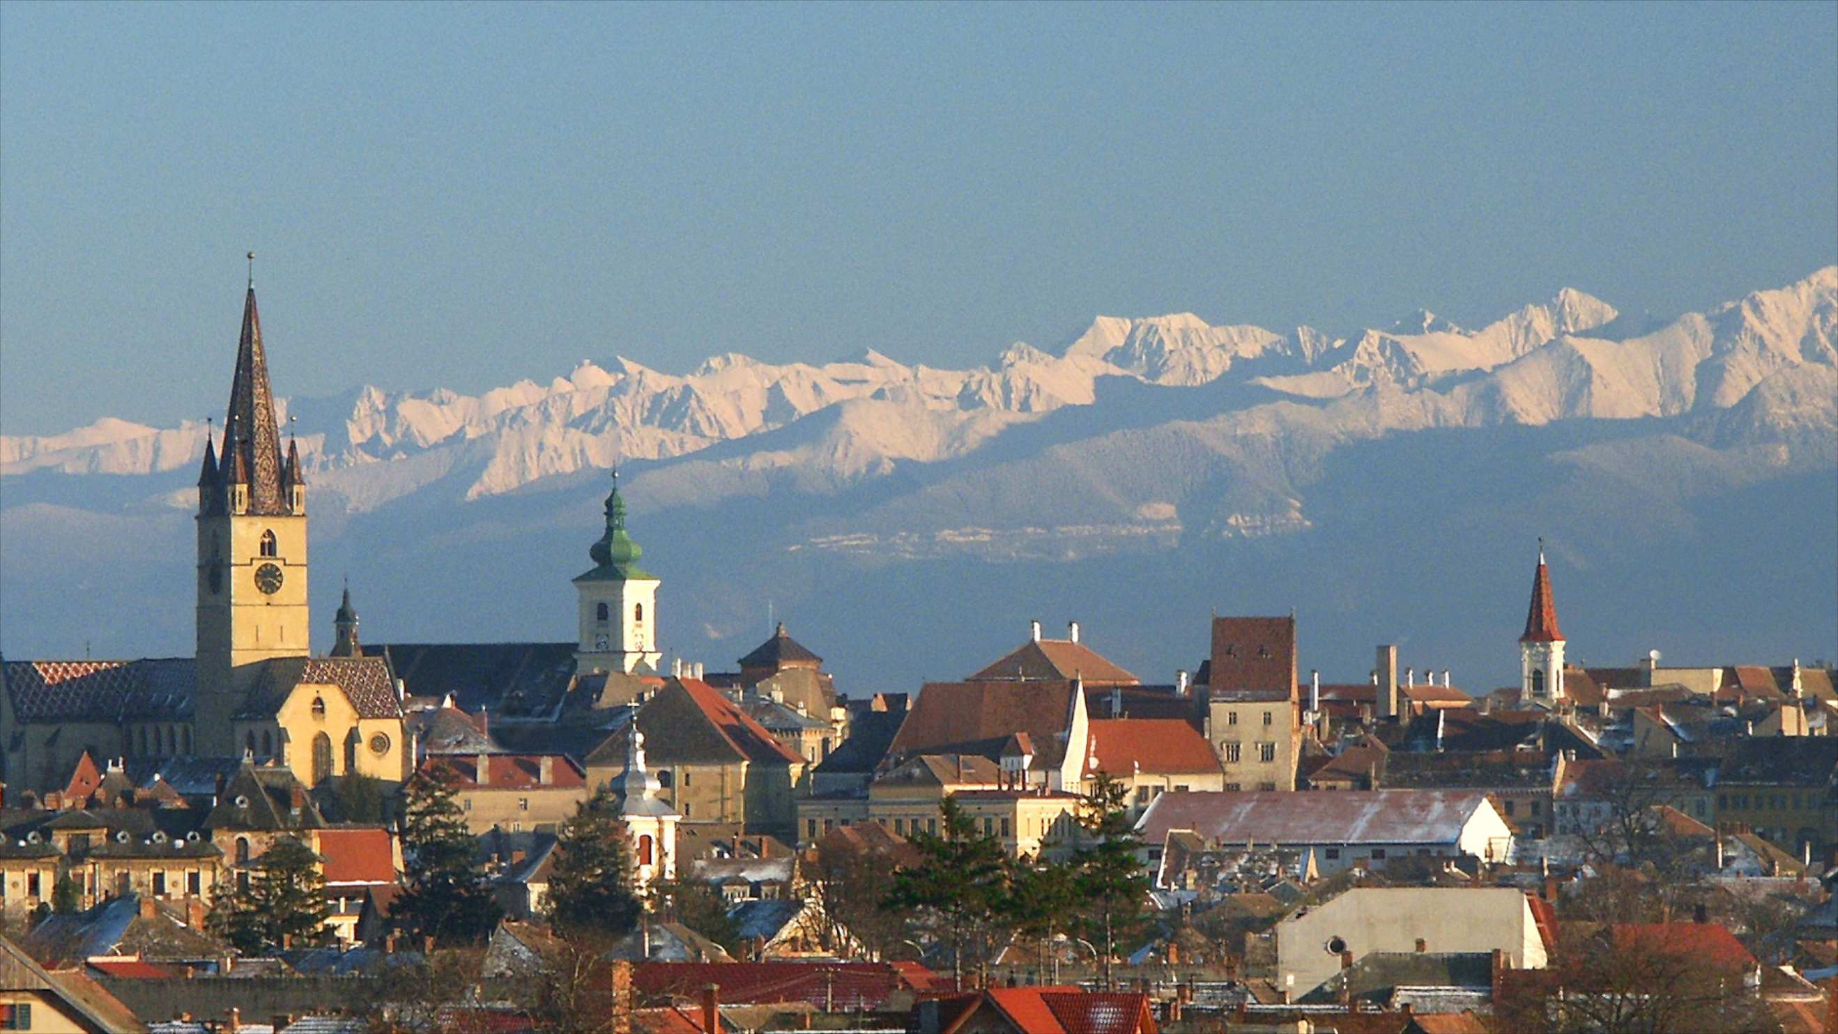
Improve the world one noise at a time

Slide 13
Thanks!

