Slide 1

Building an Interpretable NLP model to classify tweets
Kasia Kulma & Grace Meyer

Slide 2
Prerequisites
Download the data from Kaggle
https://www.kaggle.com/benhamner/clinton-trump-tweets/data#
Have R & RStudio installed (of course!)
Packages:
Quanteda
LIME
Tidyverse (readr, dplyr, stringr, lubridate, ggplot2)
Additional if we get time: tm, tidytext, text2vec
Notes:
UPDATE

Slide 3


Introductions
Kasia uses NLP and customer focused ML to personalise the insurance market at Aviva
Grace is exploring the use of R & ML in economics at Oxera Consulting

Slide 4
Why are we here today?
More data is textual
We want to be able to get closer to people’s actual thoughts
There is now an analysis framework for text analysis and new packages that make it more simple
We want to show off how cool LIME is

Slide 5
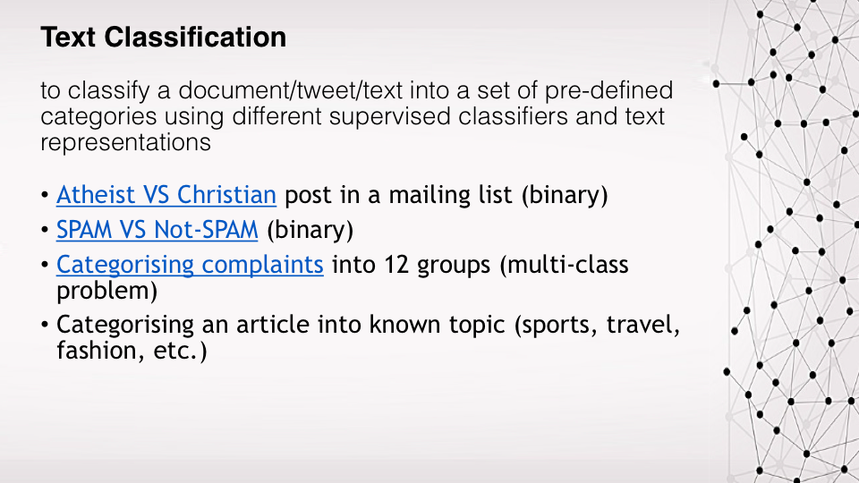

Slide 6
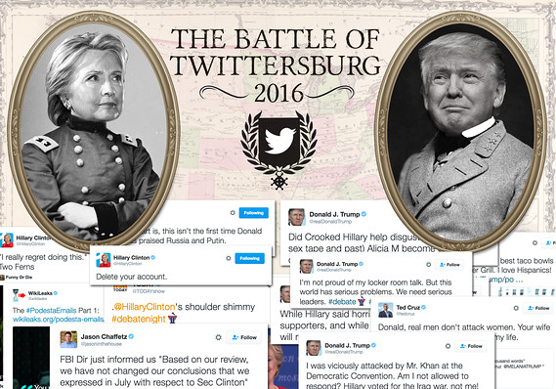

Slide 7
Agenda
Look at our data [9.15]
Introduce Text data formats [9.30]
Format and explore our data [9.50]
Coffee Break [10.30-11.00]
Create a classification model for the tweets [11.00]
Introduce LIME [11.20]
Interpret our models with LIME [11.30]
Summary & Learnings [11.45]

Slide 8
Our Text Data
Our data is ~3,000 tweets by Hilary Clinton and Donald Trump from over 2016 (during the run up to the election)
Includes other meta-data such as date, time and whether it was a retweet or not
Stored in a .csv file
Notes:
Data description, what is it, where does it come from
Data structure
How to download

Slide 9
Read in data and first look
Notes:
Head, str, summary, missmap, some tables

Slide 10

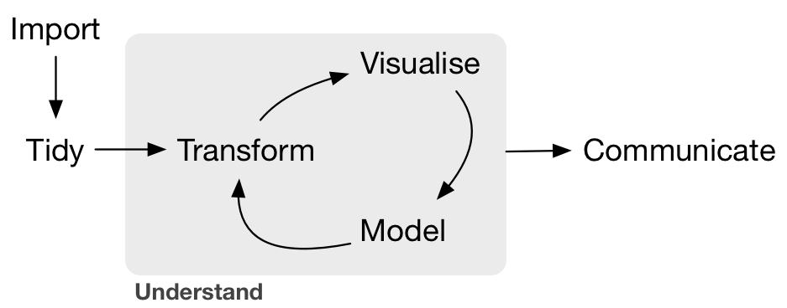

Slide 11


Slide 12
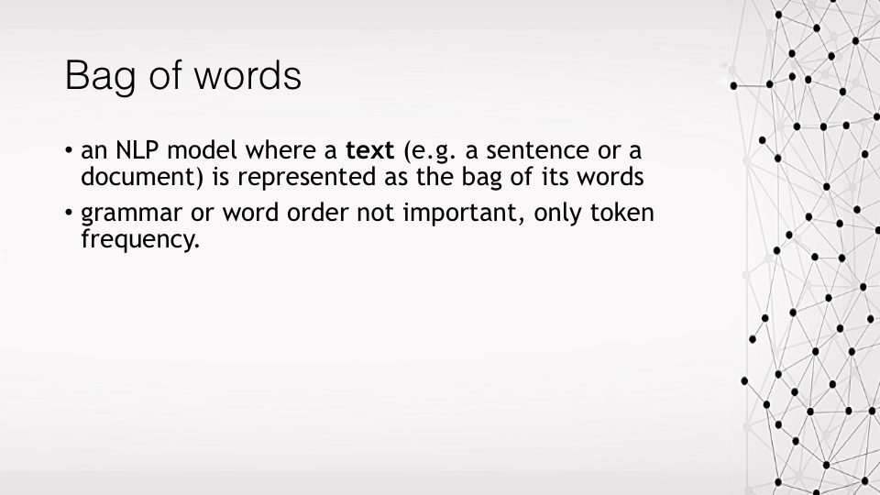

Slide 13
What is a corpus?
A collection of text data is called a corpus
The corpus structure contains multiple text data (documents) and metadata
Often how data is extracted (some R packages contains data in corpus format)
Notes:
We don’t really have a corpus as our text is in csv format and if we wanted to
In quanteda summary(corpus) also has the number of tokens and sentences but not the tokens themselves

Slide 14
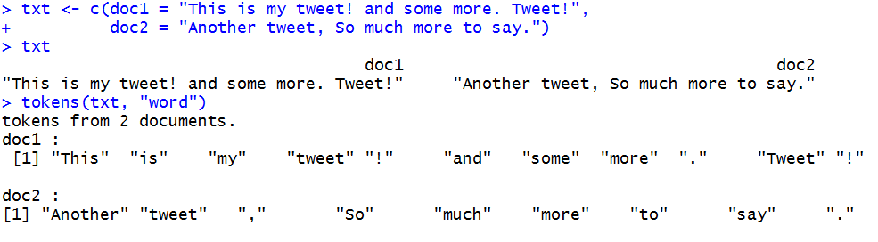
What is tokenising?
The main features of text data are tokens
Breaks down each document into words and punctuation
Notes:
These are our features
Good resources
Tokenisation: https://nlp.stanford.edu/IR-book/html/htmledition/tokenization-1.html

Slide 15
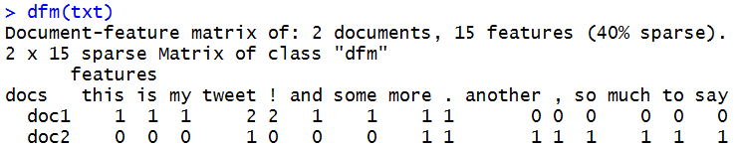
What is a dfm?
Document Feature Matrix
A frequency table for each token per document
This is the stage where we can start analysis
Notes:
This is in quanteda, in the tm package it is called term-document matric (tdm)

Slide 16
What is a sparse matrix?
Sparse matrices can be treated as a normal matrix but are stored in a much more efficient way
Most dfms are based on sparse matrix types as each column is every word in the corpus and each row is a document

Slide 17
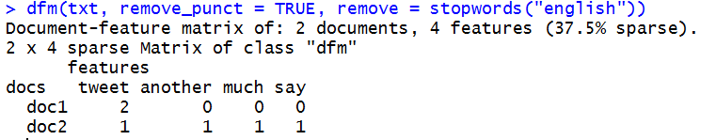
How should I clean my data?
You can choose from many different options:
Make all letters lower case
Truncate words to the root of the word (stem)
Remove small repetitive words (to)
Remove punctuation
Remove urls
Remove repetitive words that don’t make sense

Slide 18
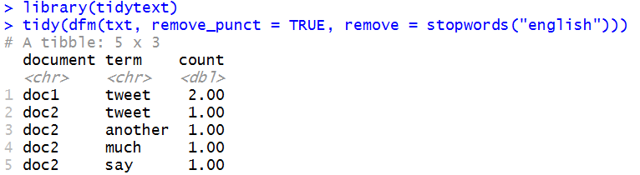
What is the tidy text format?
Stores the data in a dataframe with tidy data principles
Works really well with tidyverse and for data exploration
Space efficiency trade-offs
Notes:
We may work with this at the end if we have enough time

Slide 19
Format our data More exploration
Notes:
Create the corpus, create the dfm and make word clouds

Slide 21
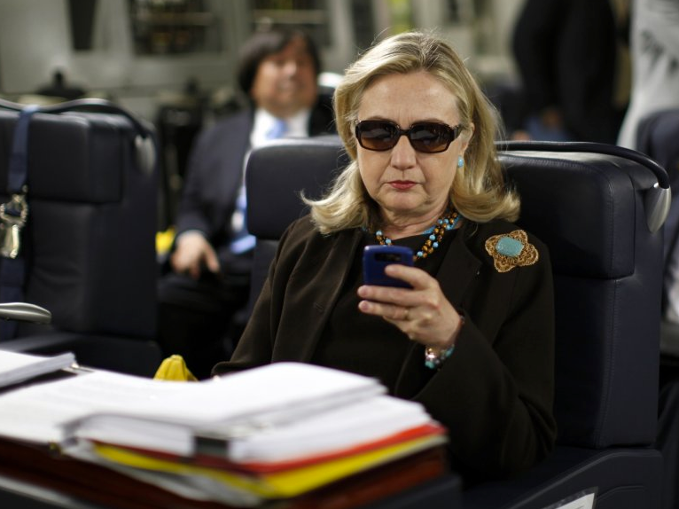

Slide 22
Build a classification model
We are going to use Naïve Bayes in the workshop
In-built in quanteda package
Lighter than using CARET or H20 ML for workshop
Normal data science workflow
Split train/test
Feature engineering
Fit models
Predict & evaluate

Slide 23
Split train/test Feature engineering Fit models, predict & evaluate

Slide 25


Slide 26
What is my model doing?
One of the big downfalls of machine learning models is how “black box” they are due to their structures of averaging many models or having multiple feature creation layers.
This raises questions such as:
What is driving this model?
What insights can I gain?
How reliable are the results?
What might happen if the inputs change?
It would be amazing to be able to explain the why of our models and results

Slide 27
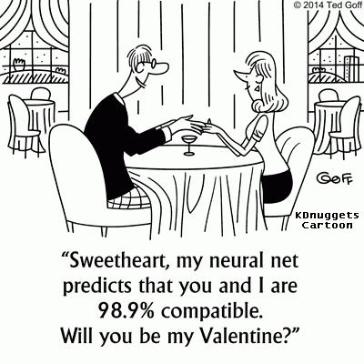

Slide 28
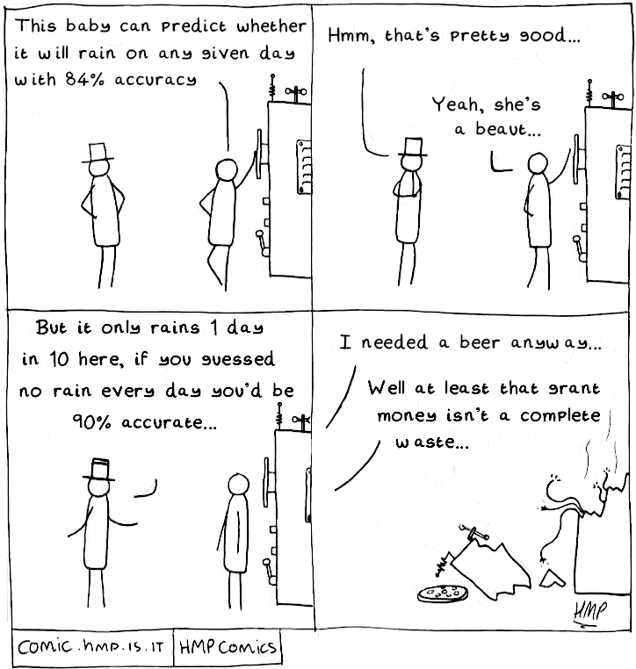

Slide 29
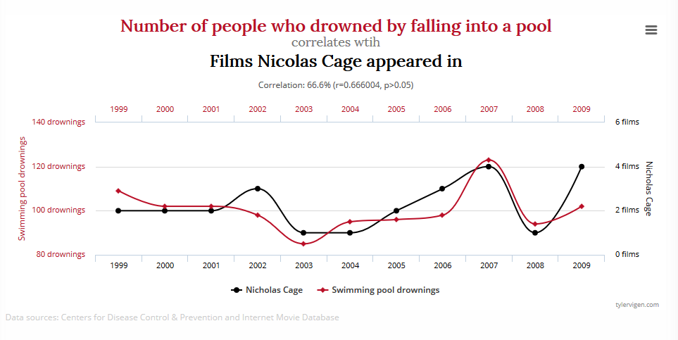

Slide 30
It’s all about trust
Should I trust the results of this prediction and take action?
Cancer diagnosis, movie recommendations
Will the results give me my desired effect?
High propensity for users to read “click-bait” type ads, but will that actually be detrimental to long term goals?
Will my model work “in the wild”?
Which model should I choose?

Slide 31
What is LIME?
Local – describes drivers for local areas, not globally
Interpretable – results are understandable to normal people
Model-agnostic – works on all models, treated as black-box
Explanations – shows the drivers of the model predictions
Can be used on text, images and numerical data

Slide 32
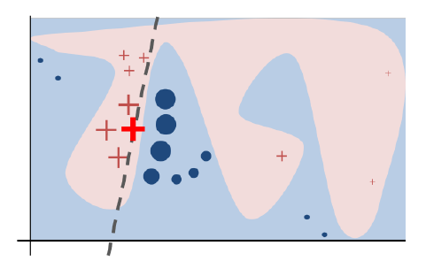

Slide 33
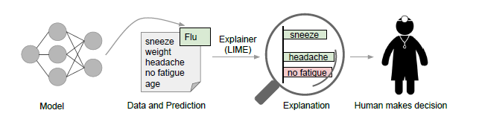

Slide 34
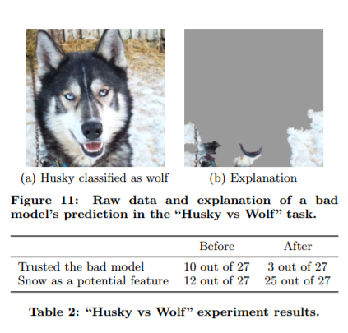

Slide 35
Evaluate models with LIME

Slide 37


Slide 38
Learnings
Text analysis
R packages make text analysis straightforward
Converting text data into different formats allows us to run machine learning models
We can use LIME to test whether we can trust our models (reinforced data science is all about testing results against common sense)

Slide 40
What have we done today?
Talked about how to tidy and store text data
Converted text data into different formats
Created additional features
Trained a classification model and predicted results
Introduced LIME and explained our predictions
Summarised our results

Slide 41





Big thanks to...
Julia Silge
(tidytext pkg)
Ken Benoit (quanteda pkg)
Thomas Lin Pedersen (lime pkg)
Weihuang Wong
R-Ladies London

