Slide 1

How we measure your impact
Causal Impact

Slide 2

Best ROI?
Want to know the ROI on a marketing campaign but don’t want to spend your profit testing it? What if you could look into the future and know profitable that campaign will be before you run it?
We can do that for you using the R package CausalImpact. We can simulate what would have happened in the absence of the campaign and can therefore measure its benefits. Its also known as introducing ‘synthetic control’.

Slide 3
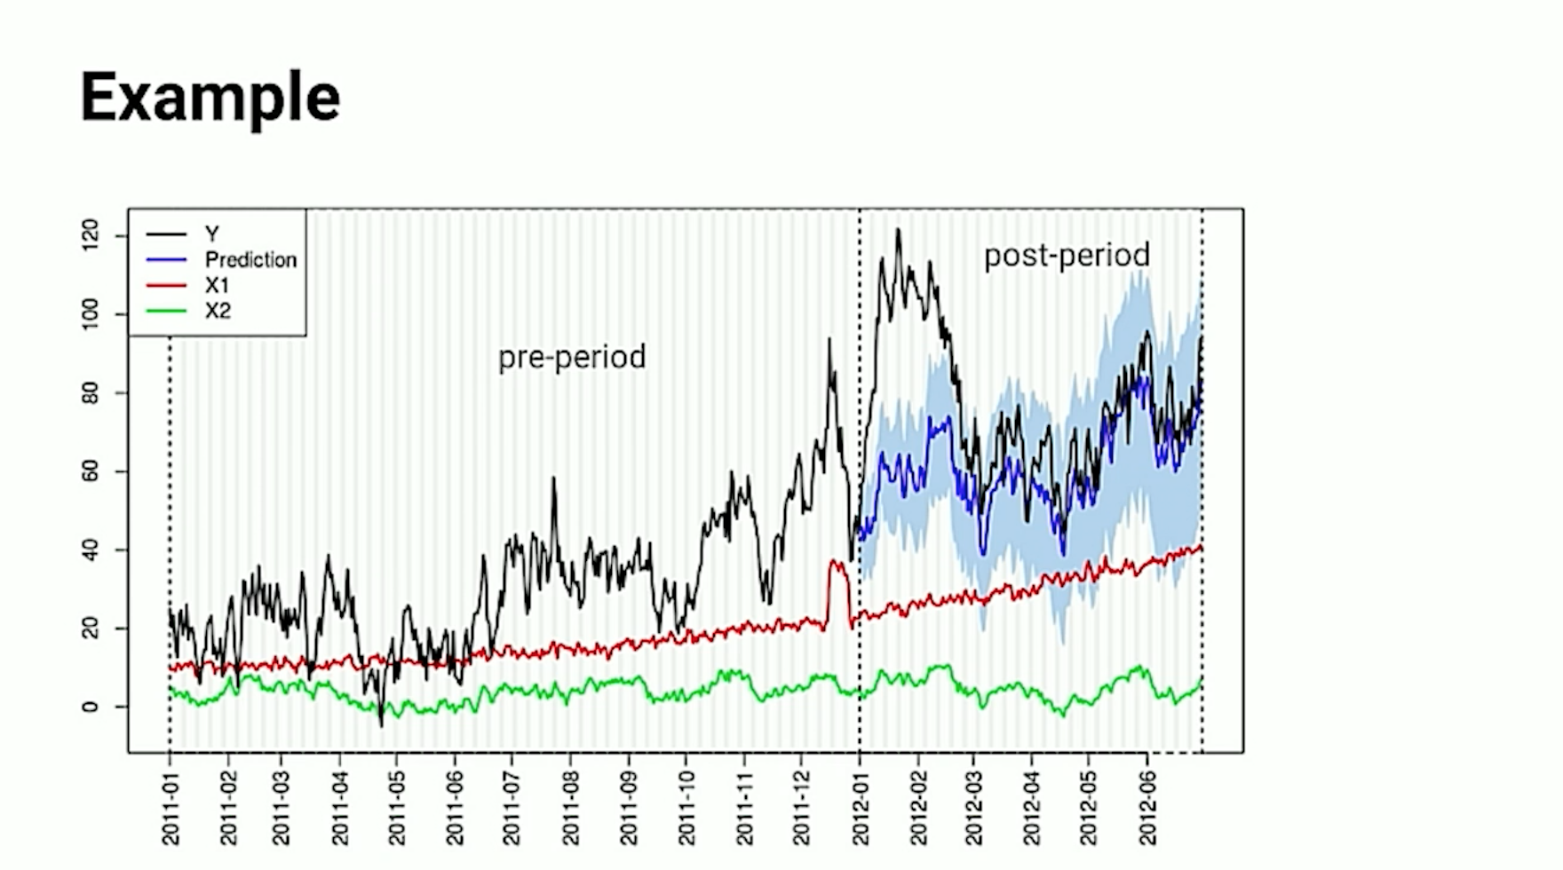
Assumptions
We can study your past campaign data and explore its historic relationship with other independent datasets, like Google Trends or web searches for example. This can leverage huge predictive power if we follow a couple of important assumptions:
We assume that this is a ‘control’ dataset, and is unaffected by the campaign, so that we can measure performance against it. This allows for an unbiased experiment that provides statistically robust results.
We assume that any identified relationship trends will continue into the post-period (after the start of the campaign).

Slide 4

Segmentation
In the digital marketing world there are just so many variables. It’s so difficult to identify one unique user and compare their behaviour their reactions to the same ad as another’s – their ‘statistical twin’. But we have to. Causal Impact creates another world that contains that twin – the identical user that never saw the ad.

Slide 5
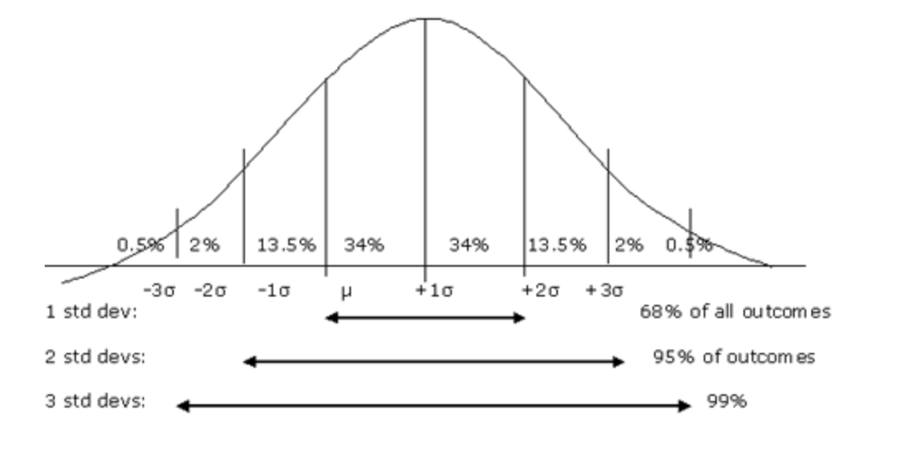
Methods
To increase credibility we need to sample our hypothesis space repeatedly in order to build up a distribution of the potential outcomes.
This means we can predict within a given confidence interval or degree of certainty that our results are not due to chance alone.
So we repeat experiments until we have enough data to build a hill like this one
…and then we have to climb it

Slide 6
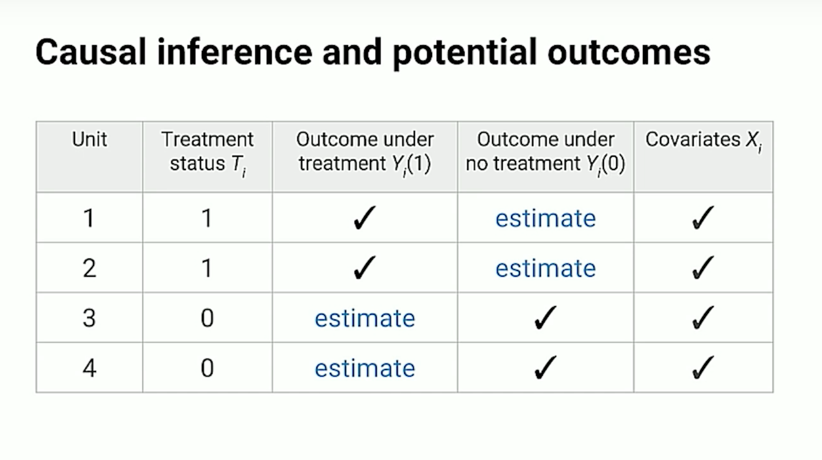
Worlds Apart
TWIN A
TWIN B
It’s impossible to do and not do the same thing at once, so for this reason, we must estimate the gaps. One dataset has the treatment (the campaign group), one does not (the control group). Rather than actually running the experiment, we can forecast the potential results based on the path of our covariant variables. These are relevant comparisons, like competitor sales or web searches that will continue into the future unaffected by and regardless of our campaign. We can then measure the difference between the two result sets to estimate our causal effect estimate.

Slide 7

Incremental Learning
We train the model on our datasets and it learns how to explain one variable as a function of another, that is to recognise the way in which they affect one another over time.
They can then go on to predict that pattern into the future, into our post-period world. When this prediction is mapped, we can evaluate it against the ‘campaign’ world and quantify by just how much they differ.

Slide 8

Optimisation
TWIN A – TWIN B = Causal Effect Estimate

Slide 9
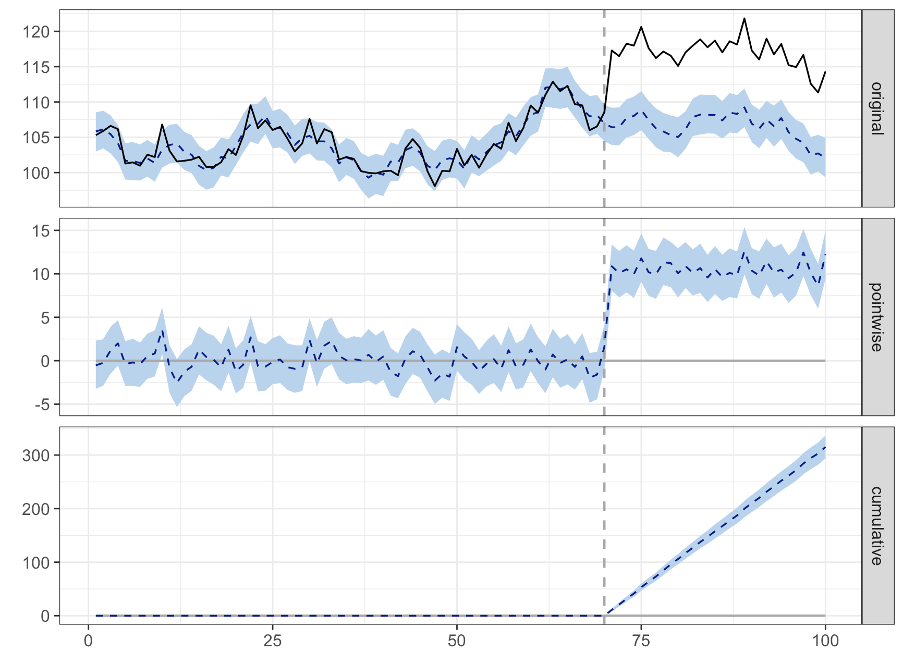
Conclusion
If we plot our data in R, using the CausalImpact package, we can visualise our original data against a pointwise plot of the causal Impact and also the cumulative impact over the period to draw our conclusions based on any statistically significant results.

