Slide 1

Industrial IoT Data Science with H2O
Jo-fai (Joe) Chow
Data Scientist
joe@h2o.ai
(Draft Version 0.2)
Workshop Day 1
La Fosse Associates
27th & 28th September, 2016

Slide 2
About Me: Civil Engineer → Data Scientist
2005 - 2015
Water Engineer
Consultant for Utilities
EngD Research
Machine learning + Water Engineering
Discovered H2O in 2014!
2015 - Present
Data Scientist
Virgin Media (UK)
Domino Data Lab (US)
H2O.ai (US)
Why? Long story – see bit.ly/joe_h2o_talk2

Slide 3
Agenda
Workshop #1 (Today)
About H2O
Data Munging in H2O
Case 1 (Basics)
Classification
Importing data
Exploring data
Training models
Evaluating models
Tuning models (manual)
Workshop #2 (Tmr.)
Case 1 (Advanced)
Early stopping
Tuning models (auto)
Stacking models
Saving/loading models
Case 2
Anomaly detection
Other H2O features

Slide 4
About H2O

Slide 5
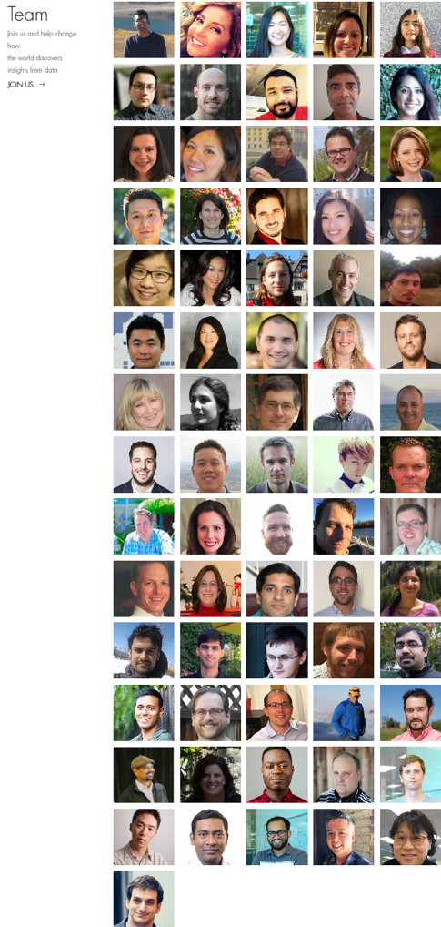
About H2O.ai
H2O.ai, the Company
Team: 80 (71 shown)
Founded in 2012,
HQ: Mountain View, California
H2O, the Platform
Open Source (Apache 2.0)
R, Python, Scala, Java and Web Interfaces
Distributed Algorithms that Scale to Big Data
Works with Laptop, Hadoop & Spark
Joe
Notes:
Team is growing rapidly
Based in Mountain View – I am the only guy in UK/Europe
VC: $34M in total

Slide 6







H2O Platform Overview
Core algorithms written in high performance Java.
Fast, distributed and scalable.
APIs available in R, Python, Scala, REST/JSON and web.
Works with laptop, cloud, Hadoop and Spark

Slide 7
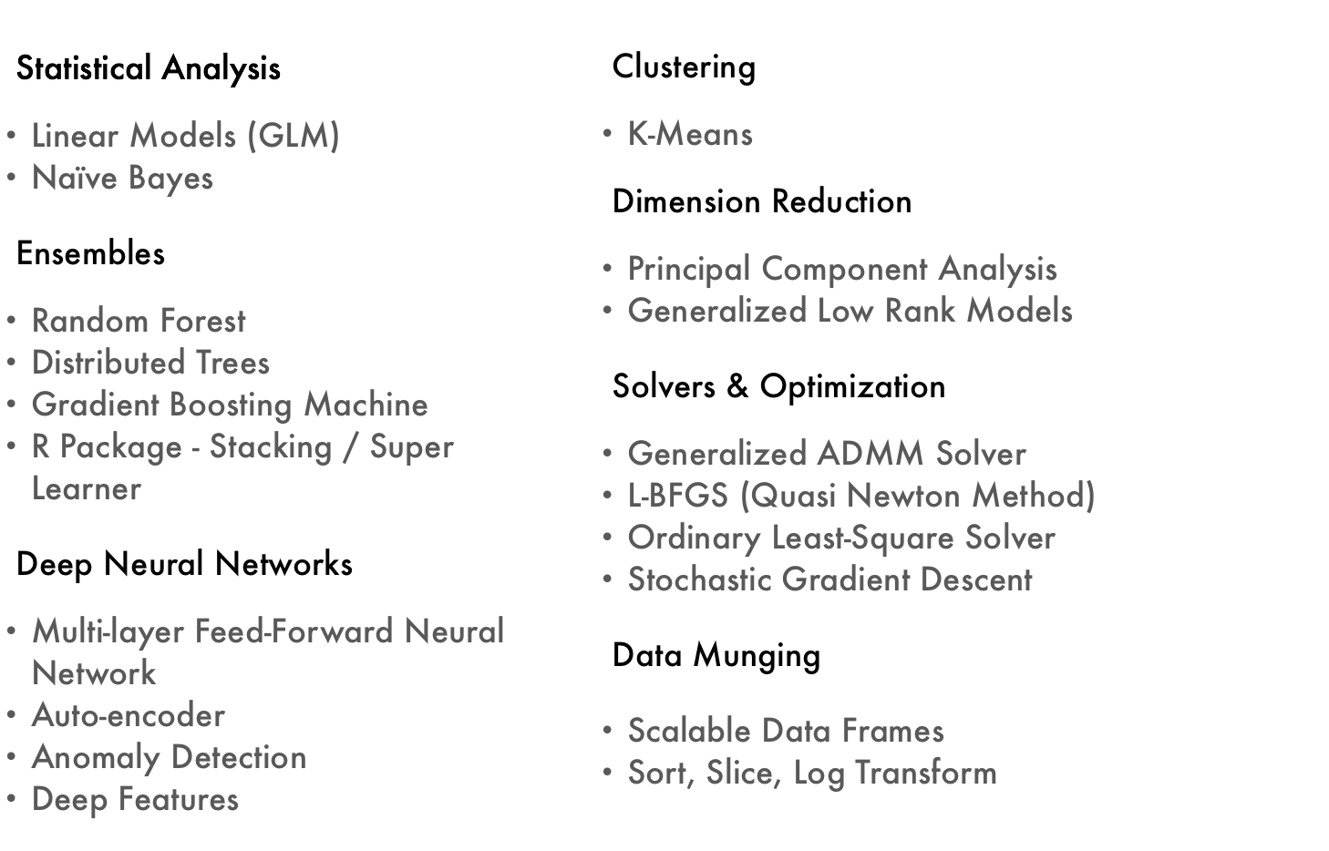
Current Algorithm Overview
Joe’s Strata Hadoop
London Talk
bit.ly/joe_h2o_talk4
Workshop
Joe’s LondonR Talk
bit.ly/joe_h2o_talk3

Slide 8

H2O Overview
8

Slide 9
Data Munging in H2O
by Jan Gorecki & Matt Dowle
(link to slides)

Slide 10
Workshop #1
Use Case 1: Classification

Slide 11
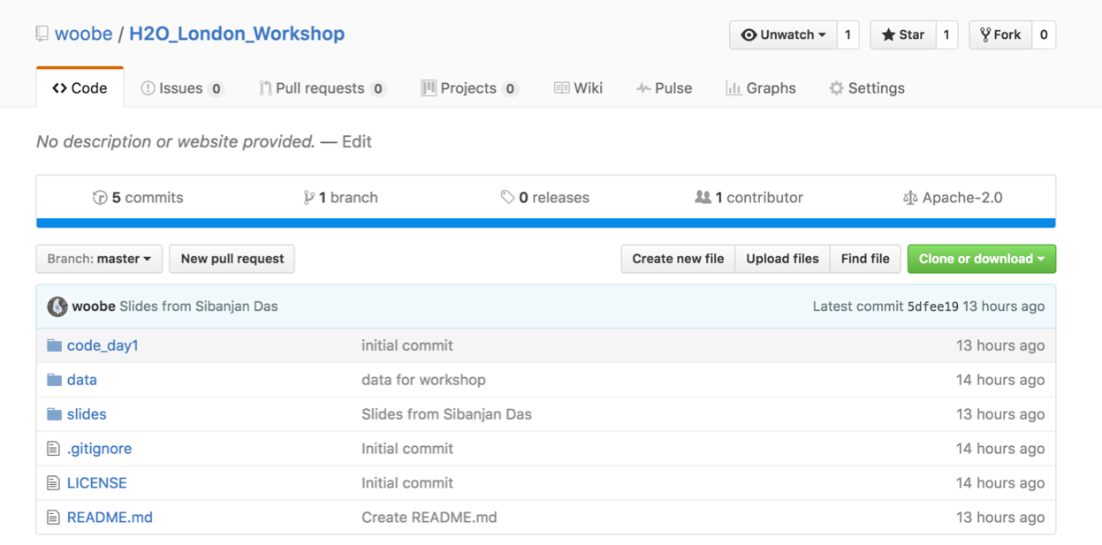
Download Data & Code for Workshop
Please go to bit.ly/h2o_iot_workshop1

Slide 12
Workshop #1
Use Case 1: Classification
Step 1: R Packages

Slide 13
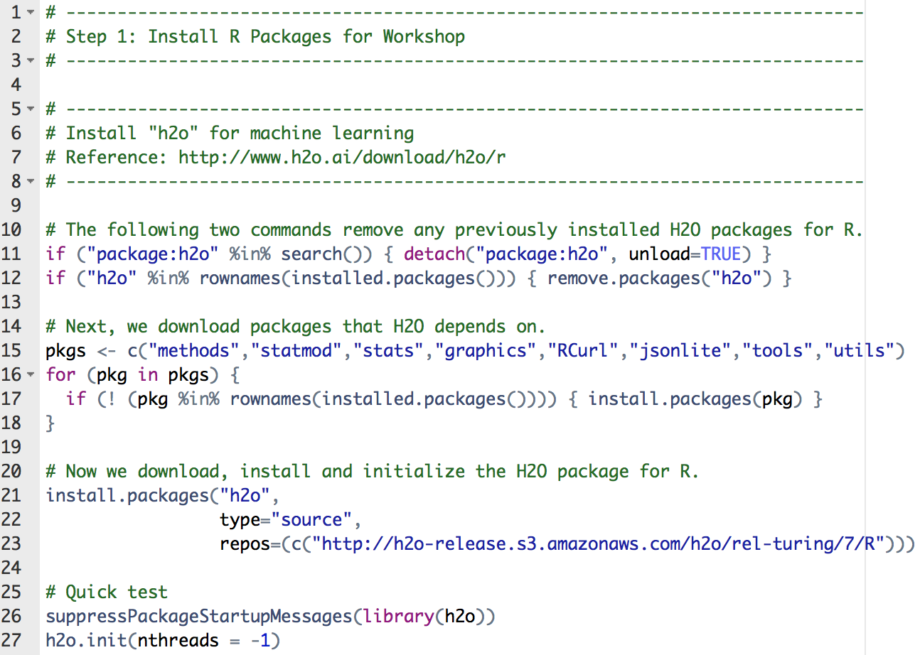
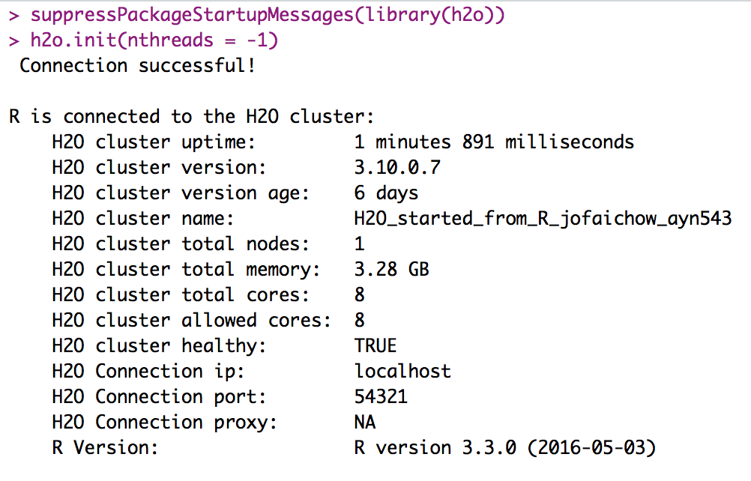
step_01_install_packages.R
Package ‘h2o’

Slide 14
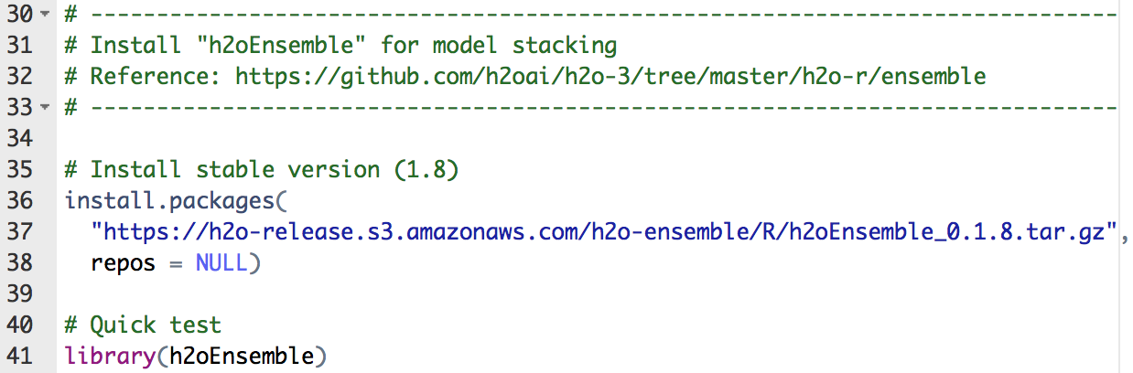
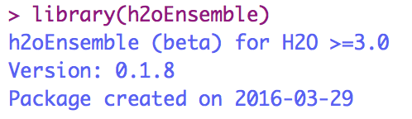
step_01_install_packages.R
Package ‘h2oEnsemble’

Slide 15
Workshop #1
Use Case 1: Classification
Step 2: Exploratory Analysis

Slide 16
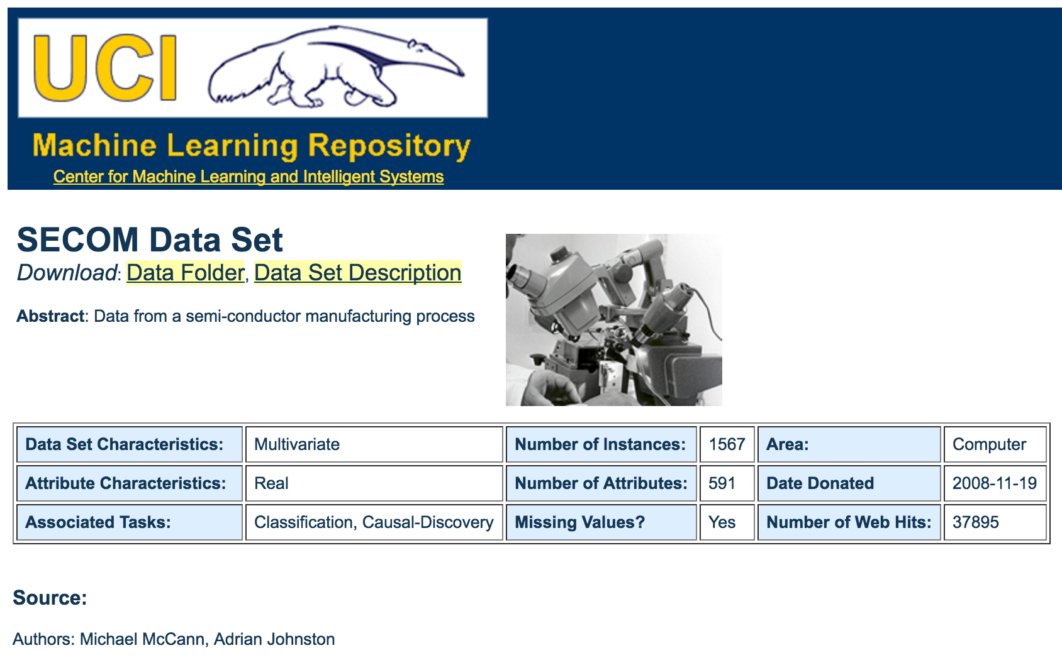
Data for Use Case 1: SECOM

Slide 17
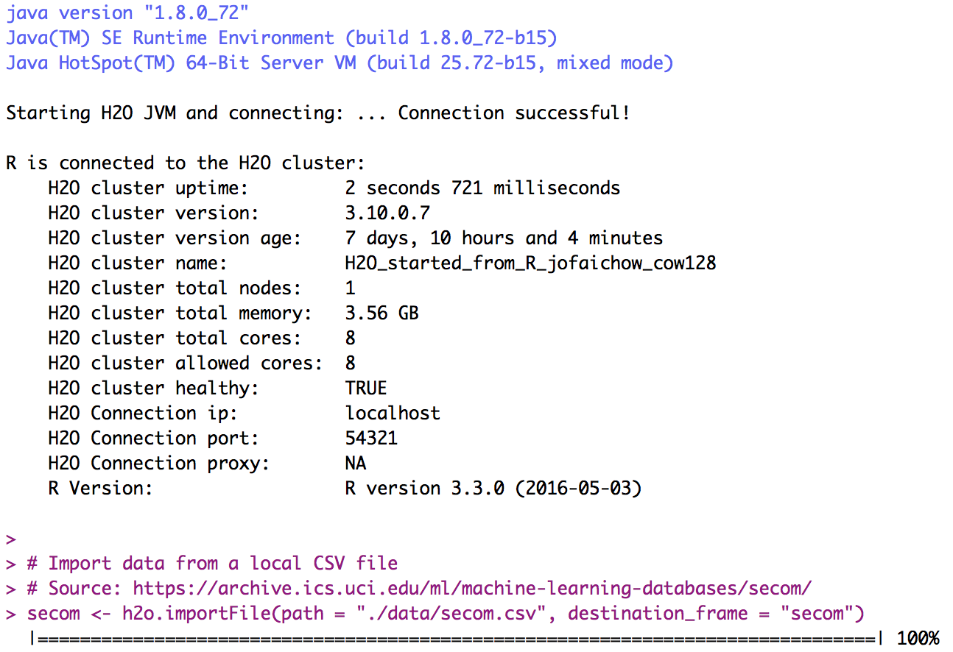
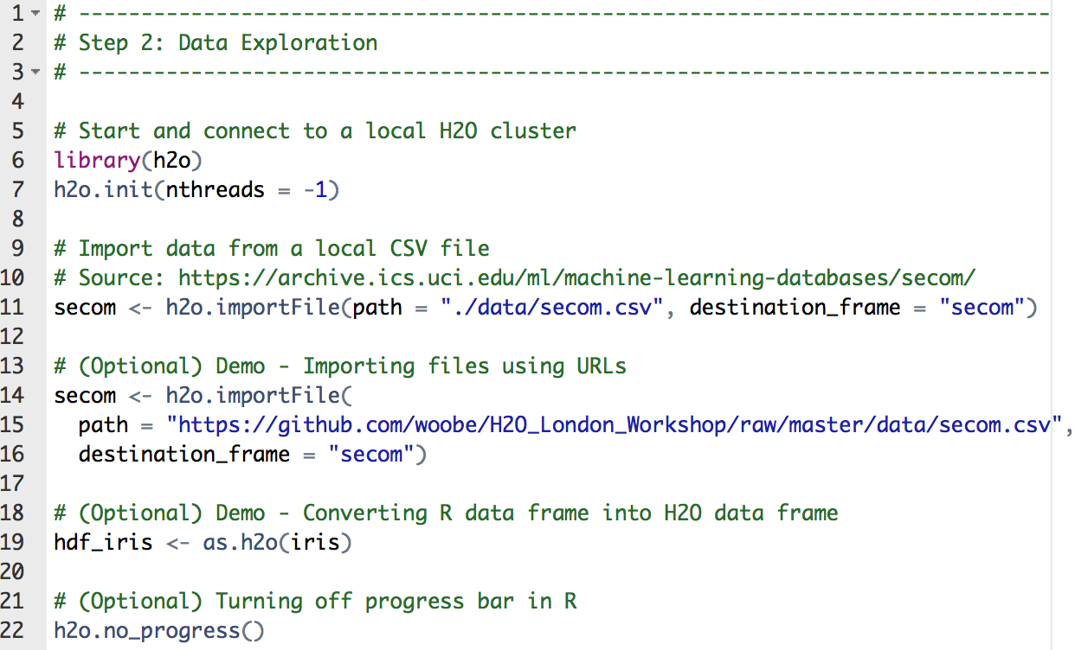
step_02_exploratory_analysis.R
Importing SECOM data
Optional (different ways to import data)

Slide 18
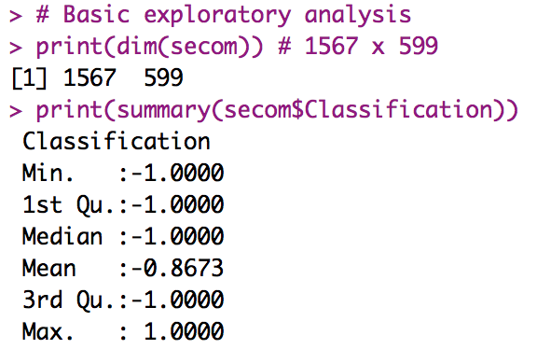
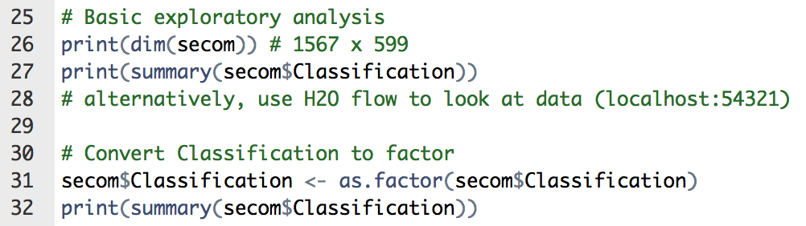
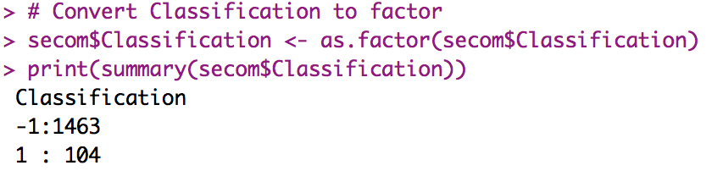
step_02_exploratory_analysis.R
Basic exploratory analysis
Convert -1 and 1 to categorical value

Slide 19
Workshop #1
Use Case 1: Classification
Step 3: Building & Evaluating Models

Slide 20
Workshop #1
Use Case 1: Classification
Step 4: Tuning Models

Slide 21
Workshop #2
Use Case 1: Classification

Slide 22
Workshop #2
Use Case 1: Classification
Step 6: Tuning Models with Early Stopping

Slide 23
Workshop #2
Use Case 1: Classification
Step 7: Tuning Models with Grid Search

Slide 24
Workshop #2
Use Case 1: Classification
Step 8: Stacking Models with h2oEnsemble

Slide 25
Workshop #2
Use Case 1: Classification
Step 9: Saving / Loading Models

Slide 26
Workshop #2
Use Case 2: Anomaly Detection

Slide 27
Workshop #2
Other H2O Features

