Slide 1

Workshop on
Data Science and Industrial IoT
Sibanjan Das
Ajit Jaokar
Jo-Fai Chow, H2O.ai

Slide 2
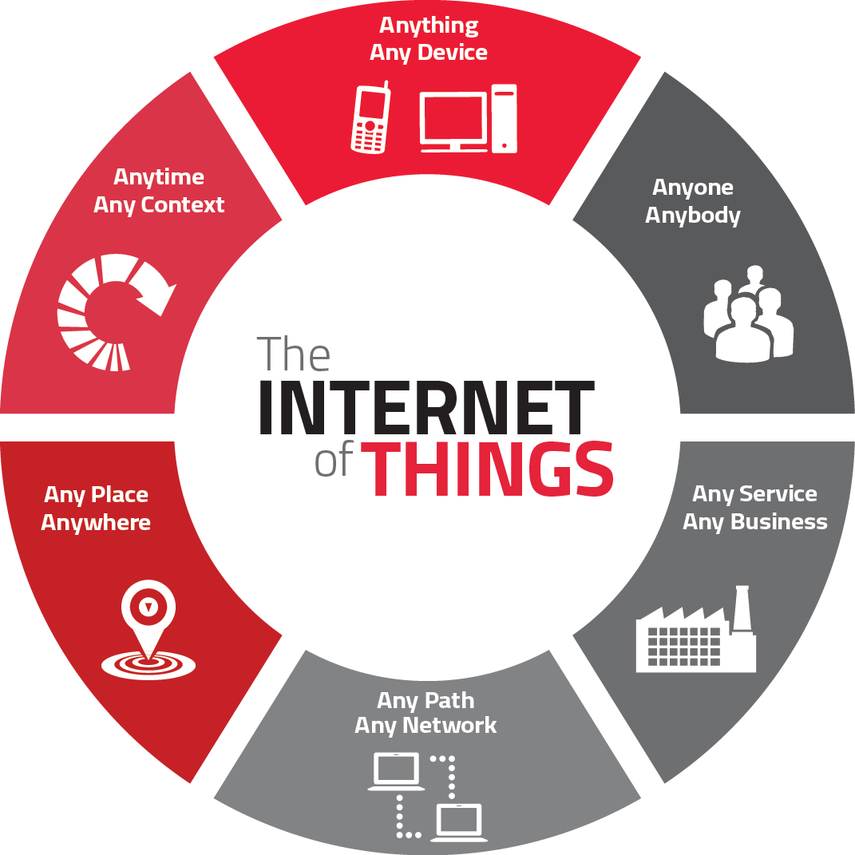
Internet of Things
The Internet of Things (IoT) is a futuristic technology trend
It is the first step in becoming a truly digital business.
By connecting people, assets, devices and systems, IoT delivers an Omni channel experience between the physical and digital world.

Slide 3
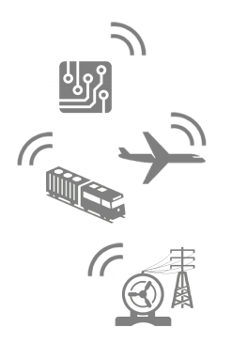
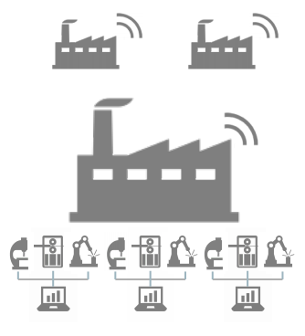
Future of Manufacturing and Industrial Internet of Things
Sensor enabled devices
Devices interconnected
Multiple digital lines form the factory of the future
Network of digital enabled devices forms the Internet of Things
The Biggest Challenge…. Data Explosion!!!!!
Manufacturers are looking for ways to leverage value from this data

Slide 4
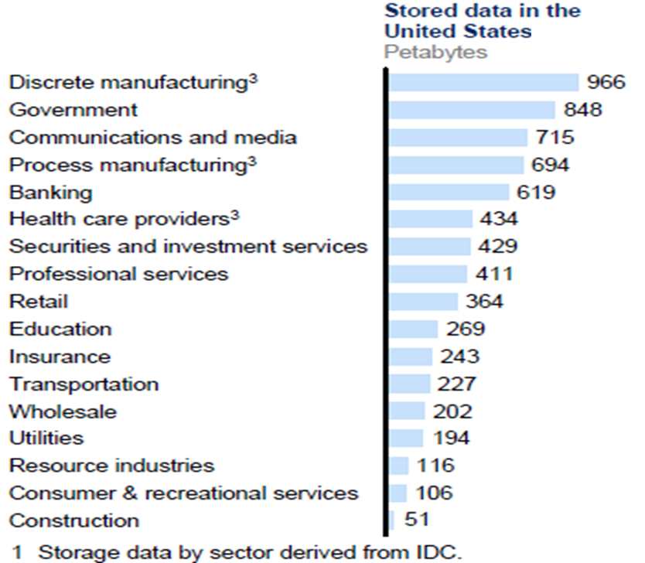
Manufacturing IoT: Big Data
Manufacturers are deploying instruments such as sensors and controllers or even smart, networked cameras or RFID readers to measure a wide range of operational processes
As the amount of data used by business grows, there are new opportunities for analyzing it, which stands to change how we make day-to-day business decisions.

Slide 5
Contribution of Data Scientists in IIoT
As Michael Rothschild discusses manufacturers seeking to extract maximum value from investing in big data projects should work backwards
and ask a few fundamental questions:
What business processes or decisions do you want to improve?
How will these decisions improve the business?
Customer profitability?
Product rationalization?
Capacity planning?
What are you trying to maximize?
Profits? Asset utilization? ROI? Revenues?
What are the most meaningful metrics to measure progress toward those goals?
Unit margins? Profit-per-hour of machine time?
What types of analysis do you need to perform to expose the data,
Explore ‘what if’ scenarios and iterate through alternatives to maximize profitability?
And then, finally, what types of data do you need to collect in
Order to feed the above analysis and decision-making?

Slide 6

Contribution of Data Scientists in IIoT
Predictive Maintenance Models
Anomaly Detection
Production Forecast
Time Series Analysis
3D Printing

Slide 7

Predictive Maintenance

Slide 8

Reactive vs Proactive Maintenance
Reactive Maintenance:
Reactive approach; dealing with breakdowns or problems when they occur
Proactive(Predictive) Maintenance
Proactive approach
An attempt to determine when best to perform preventive maintenance activities. Example: Reducing breakdowns through a program of lubrication, adjustment, cleaning, inspection, and replacement of worn parts

Slide 9

Advantages of Predictive Maintenance
Reduces fuel/energy costs
Reduces parts and labor
Increased machine availability
Increased throughout
Fewer catastrophic failures
Improved safety
Optimizes manpower deployment

Slide 10
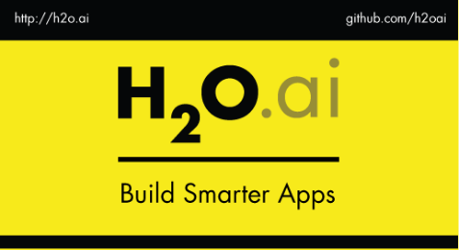
Workshop: Predictive Maintenance and Anomaly Detection using H2O.ai

Slide 11

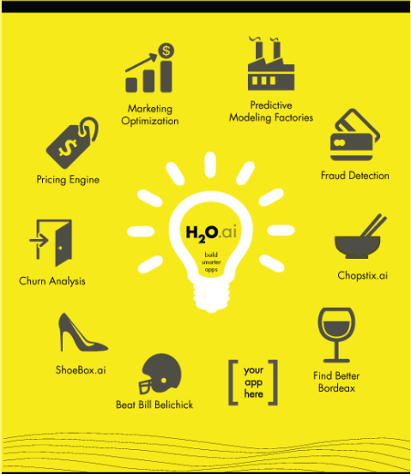
A Data Scientist’s H2O.ai Toolbox
Some of the Smart Applications using H2O.ai

Slide 12
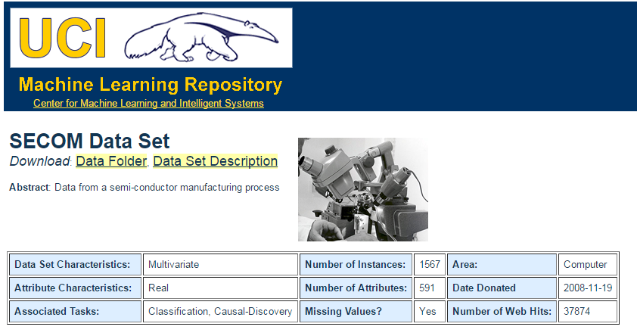
Predictive Maintenance Use Case Data Set:
SECOM dataset from UCI Machine Learning Repository
It consists of 1567 records taken from a wafer fabrication production line. Each record is a vector of 590 sensor measurements plus a label of pass/fail test.
Among the 1567 records, there are 104 fail cases which are labeled as 1 and the rest are labeled as negative 0.

Slide 13

Anomaly Detection
MTCARS Dataset
The data was extracted from the 1974 Motor Trend US magazine, and comprises fuel consumption and 10 aspects of automobile design and performance for 32 automobiles (1973–74 models).

Slide 14
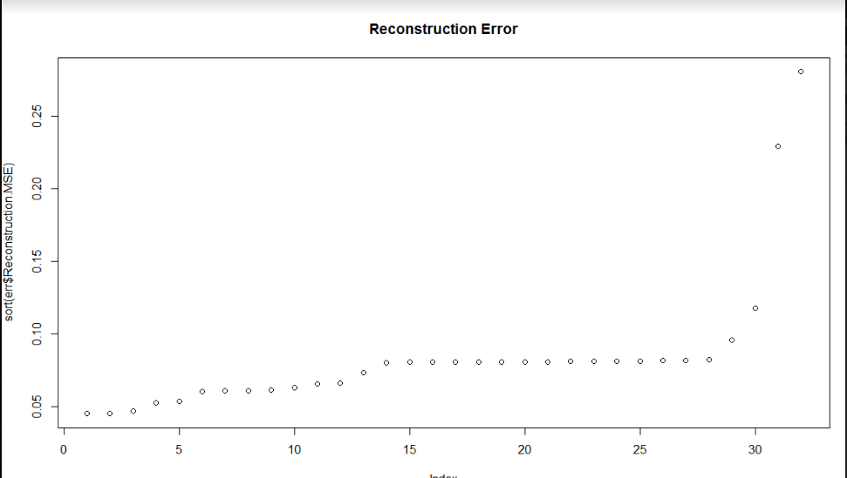
Results – Anomalies in Automobile Design

