Slide 1


LandSense
Rapid-Response Geo-Intelligence for Landslide Early Warning
Sentinel-LEWS is a critical initiative (POOL-2026) focused on delivering hyper-local landslide risk prediction with unparalleled precision. Our system provides a 6-hour early warning at a 100 m² resolution, operating fully edge-native and offline to ensure reliability when it matters most.
Our primary target user is the District Disaster Management Officer, who requires immediate, actionable intelligence to protect communities.
Team Name: Team_Genz
Hackathon: Hack The Winter
Theme: Disaster Resilience / Governance
Domain: Machine Learning + IoT + Early Warning Systems

Slide 2
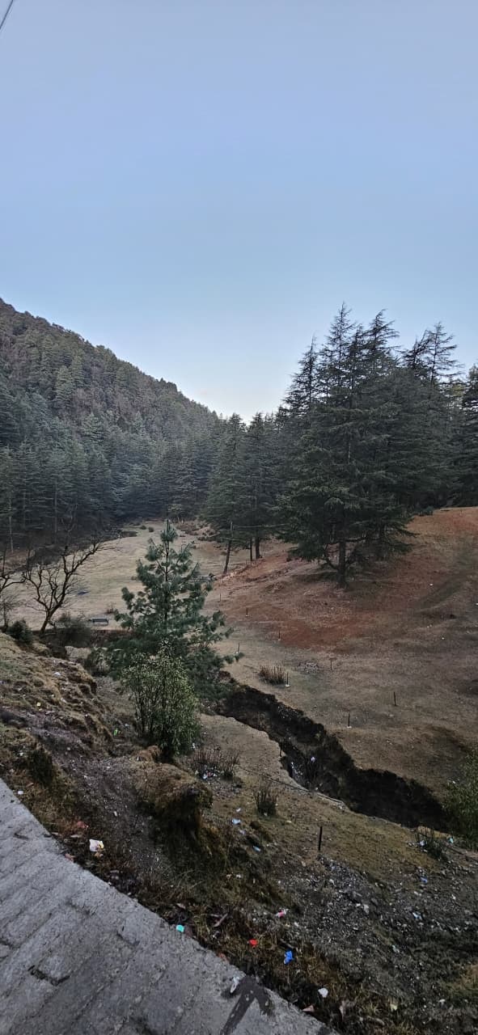

Why Landslides Are Still Deadly
India’s hilly regions face devastating and sudden landslides, often leading to significant loss of life and property. Existing early warning systems fall short:
  They operate at a district level, offering predictions that are too coarse for effective localized response.
  Many are cloud-dependent, rendering them useless during critical monsoon-induced network outages.
The key failure is a lack of systems that work locally, offline, and at a hyper-local scale, leaving vulnerable communities exposed.

Slide 3
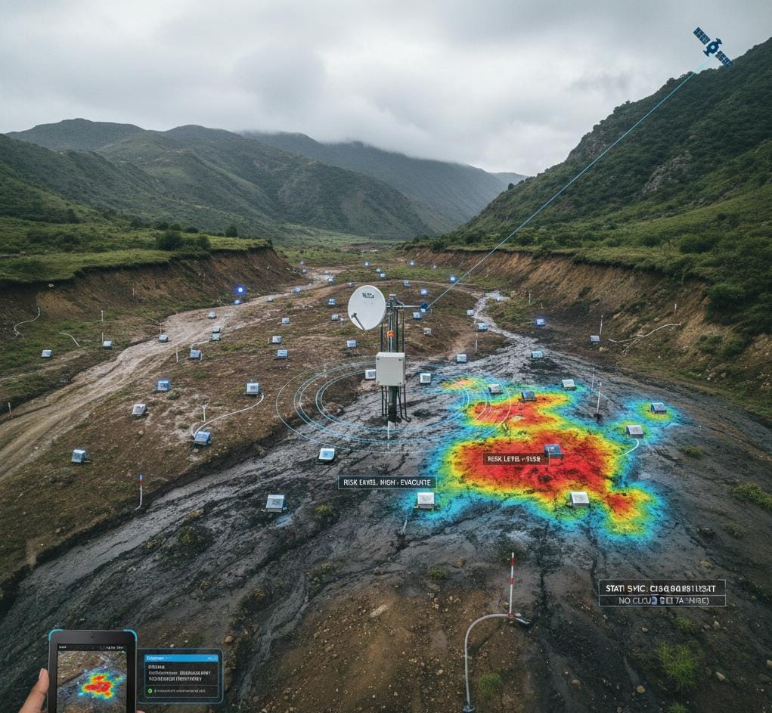
User Story & Hard Constraints
As a District Officer, I want to predict landslide risks at a 100m² resolution using fused sensor data to issue hyper-local evacuation alerts 6 hours before an event.
Hard Constraints for Sentinel-LEWS:
  Response Time: Less than 15 seconds for a 500 km² area.
  Model Size: Model must be under 50 MB for edge hardware deployment.
  Data Synchronization: Requires 256 kbps VSAT sync capability.
  Operational Independence: Absolutely no cloud dependency for core functions.

Slide 4
Real-World Challenges
1
2
3
Data Heterogeneity
Offline Resilience
Sensor Failure
We grapple with diverse data sources: rainfall data at 25 km grids, terrain data from 30 m Digital Elevation Models (DEMs), and sensor data that is often noisy and sparse.
Internet infrastructure is often the first casualty during natural disasters, making offline functionality a paramount requirement for any effective early warning system.
Approximately 40% of deployed sensors can fail during heavy storms, posing a significant challenge to data integrity and system reliability.

Slide 5
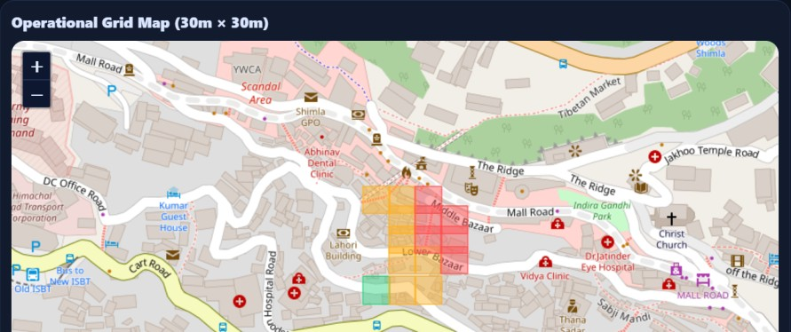
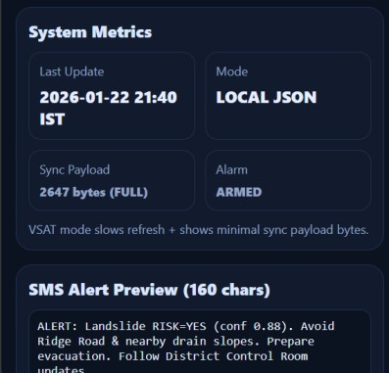
Our Solution: Sentinel-LEWS
Sentinel-LEWS is a groundbreaking terrain-anchored, edge-native ML system designed to overcome current limitations. It:
  Utilizes terrain as the fundamental spatial backbone for all predictions.
  Intelligently converts low-resolution rainfall data into precise soil saturation estimates.
  Operates entirely on local district hardware, ensuring continuous functionality.
Key Insight: Terrain defines resolution — sensors refine confidence.

Slide 6
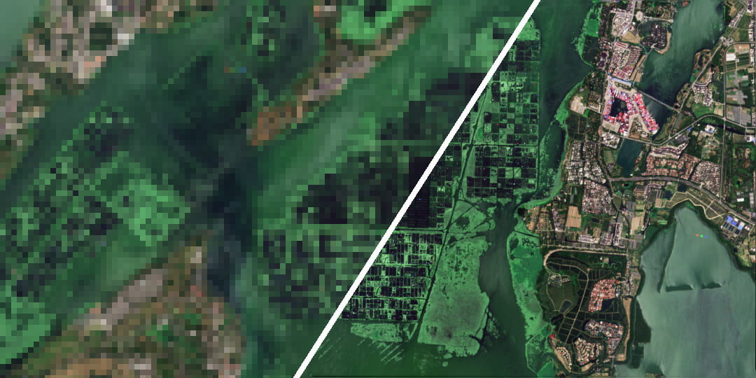
Achieving Hyper-Local Resolution
Our system achieves unprecedented hyper-local resolution by leveraging:
  Base Layer: A high-resolution 30 m Digital Elevation Model (DEM).
  Terrain Cells: Each DEM pixel is treated as a fundamental terrain cell.
  Operational Zones: These cells are then aggregated into precise 100 m² operational zones for risk assessment.

Slide 7
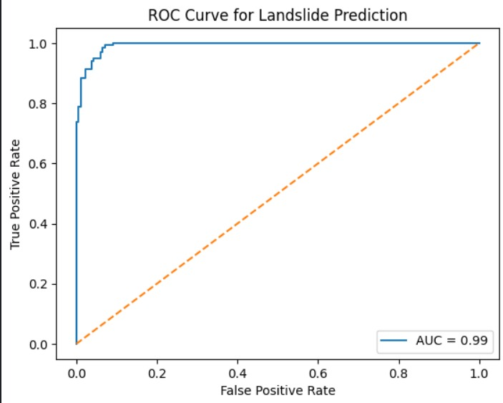
Data & Feature Engineering
Input Data
  Digital Elevation Model (DEM): Slope angles and drainage patterns.
  Historical Rainfall: Detailed CSV records for context.
  Proximity to Water Bodies: Identifying potential saturation zones.
  Vibration / Earthquake Signals: Real-time seismic data.
  Vegetation Cover: Assessing density and type.
  Soil Characteristics: Analyzing composition and permeability.
1
Soil Saturation (Derived)
4
Proximity to Water
2
Rainfall (Trigger)
5
Vegetation Cover
3
Slope Angle
5

Slide 8
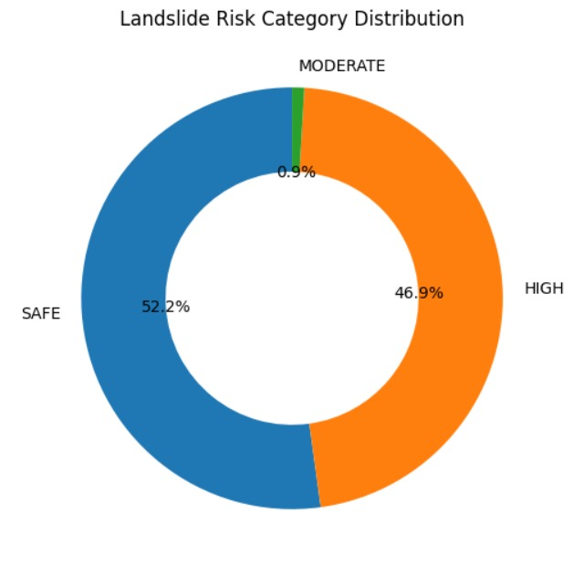
ML Model & Explainability
Machine Learning Model
We utilize a Random Forest Classifier with 300 trees and an average depth of approximately 9. This model provides a binary output: predicting 'Yes' or 'No' for landslide risk.
Why Random Forest?
  Exceptional handling of non-linear geophysical data patterns.
  Robustness against data noise and missing sensor inputs.
  High explainability through feature importance, crucial for trust.
Model Insight : Rainfall is a trigger — soil saturation decides
failure.
Top Predictors
  Soil Saturation
  Earthquake / Vibration
  Rainfall
  Proximity to Water

Slide 9

Offline & Failure-Resilient Design
Offline-First Architecture
  The ML model operates entirely on a dedicated edge device.
  No live cloud calls are needed, ensuring operation during outages.
  Dashboard functionalities and alert systems function locally.
Sensor Failure Handling
  Intelligent algorithms detect and address faulty sensors.
  Drift readings are automatically discarded to maintain accuracy.
  System reduces confidence in predictions, rather than ceasing them.
“We separate risk estimation from confidence estimation.”

Slide 10
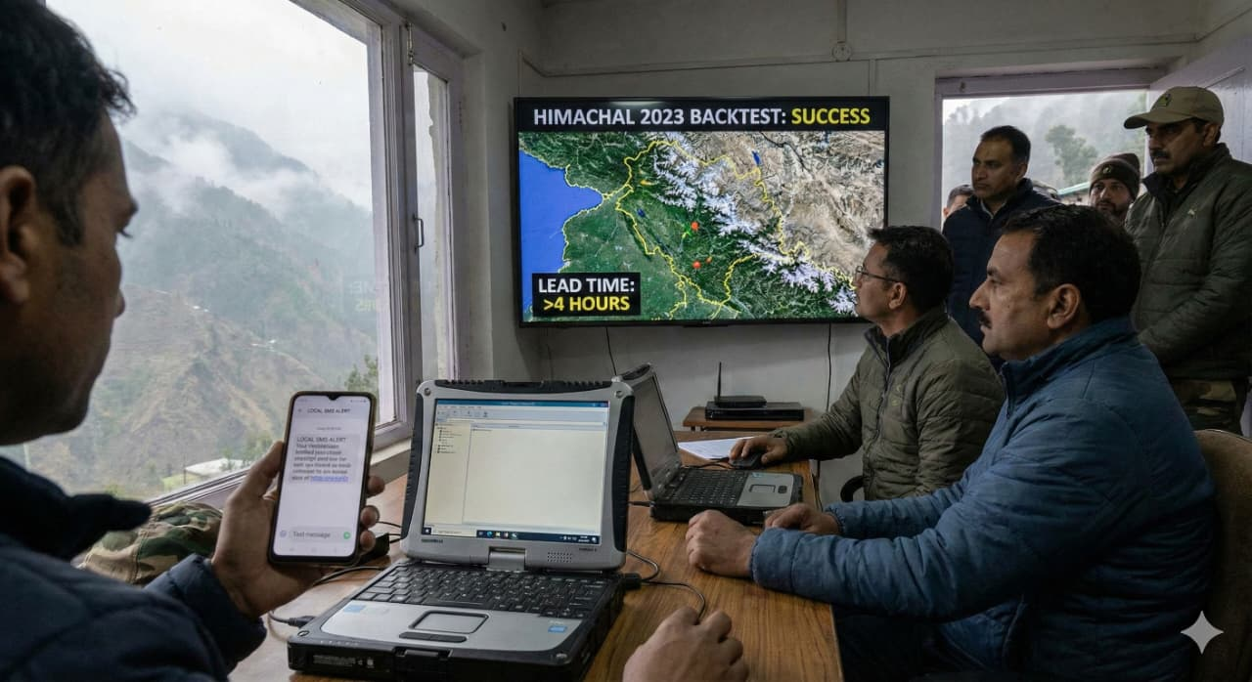
Validation, Impact & Conclusion
Definition of Done
  Successfully backtested on historical events, including
  Himachal 2023.
  Achieved greater than 4 hours lead time for warnings.
  Initiated local-only 160-character SMS alerts during blackout
  conditions.
Impact
  Enables faster, more informed evacuation decisions.
  Delivers hyper-local alerts directly to at-risk communities.
  Guarantees operation even during critical internet outages.
  Designed for scalability across all hill districts.
Sentinel-LEWS empowers District Disaster Management Officers with the vital tool needed to safeguard lives and livelihoods.

