Slide 1
SSTM PHASE 5 #123 Revised on 17/1/2023

Slide 2
Centralized overall update, Edit Template (Allow to share PPT in the classroom , Incorporate New Technology In Classroom PPT Quiz program ,Video Games,Puzzles,Micro learning,AR,5Dtechnology Hologram & Video play option )
Centralized course update, course edit, Amendment history ,Version revision history,
Option to mark the assessment paper with in the SSTM
Sync D drive and SSTM ( up to date) –parthiban/ Sivaraman
Bulk upload and download option in SSTM
Lesson plan monitoring option
Restore potion ( Revert portion)
Developer monitoring page

Slide 3
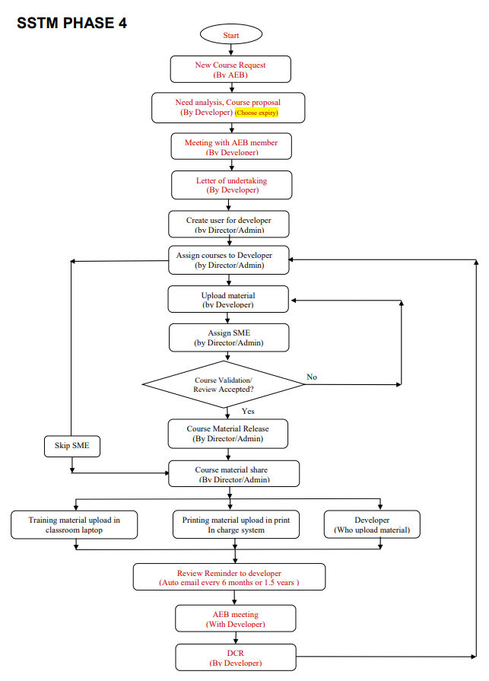
1. Centralized course update (Add in phase 4)
Developer page
Add the option here
Note: This page is required to add in phase 4 as per above flowchart

Slide 4
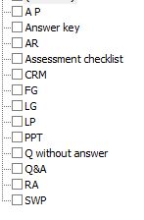
1.1 Centralized course update (Developer page)
Choose docs:
Choose Type:
Worker
Supervisor
Manager
Professional
Choose Language:
English
Tamil
Mandarin
Note: Only filling info should be in
respective language.
And,,……
Save

Slide 5
Mandatory page 1
Mandatory page 2
page 3
1.Course name:
2. Duration:
3. Theory Hrs:
4. Practical Hrs:
5. BL Hrs:
6. Theory exam Hrs:
7. Practical exam Hrs:
8. Total assessment Hrs:
9. Trainer Leaner ratio:
10.
.
.
.
15
Repeat pg(1,5,6,7)
1. Option 1 :
Theory only
PPT
Repeat-pg(1,5,8)
Theory &practical
Click here
(Refer next page)
Repeat pg(9,10)
2. Option 2:
BL -IPR
Repeat pg(7,8)
BL -AR
BL -Micro
Repeat pg(9,8)
And,,………
Repeat pg( 3,15)
Repeat pg( 3,15)
3. Option 3:
Syc-Learning
.
Asyc-Learning
.
.
15,,……….
Save
Save

Slide 6
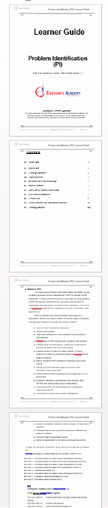

Page4
PPT to add contents
(Developer needs to add all the text and images)
Page 5
For all the remaining docs
Page 6
LG to add contents
(Developer needs to add all the text and images if necessary )
Note: All the above documents will be in word format
LG
FG
LP
CRM
Q&A
Q without answer
A P
Answer sheet
Assessment checklist
RA
SWP
Click here
(Refer next page)
Save
Save

Slide 7
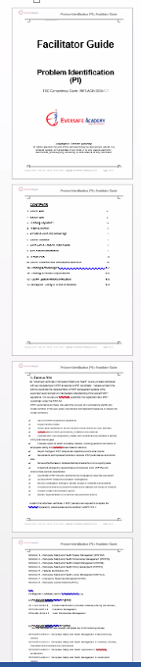
Page 7
FG to add contents
(Developer needs to add all the text and images if necessary )
Page 5
For all the remaining docs
Note: All the above documents will be in word format
LG
FG
LP
CRM
Q&A
Q without answer
A P
Answer sheet
Assessment checklist
RA
SWP
Click here
(Refer next page)
Save

Slide 8
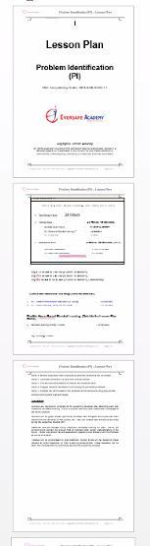
Page 8
LP to add contents
(Developer needs to add all the lesson hours )
Page 5
For all the remaining docs
Note: All the above documents will be in word format
LG
FG
LP
CRM
Q&A
Q without answer
A P
Answer sheet
Assessment checklist
RA
SWP
Click here
(Refer next page)
Note:
1. All the topics should be auto filled
( Except lesson hours)
Save

Slide 9
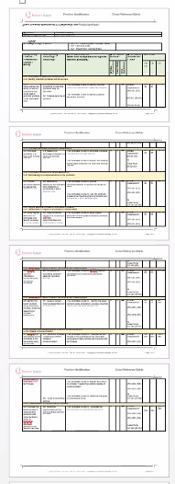
Page 9
CRM to add contents
(Developer needs to add all the text and images if necessary )
Page 5
For all the remaining docs
Note: All the above documents will be in word format
LG
FG
CRM
LP
Q&A
Q without answer
A P
Answer sheet
Assessment checklist
RA
SWP
Click here
(Refer next page)
Note:
1.System should automatically
fill the page number
2. All the topics should be auto filled
3.Should be completely automated
Save

Slide 10
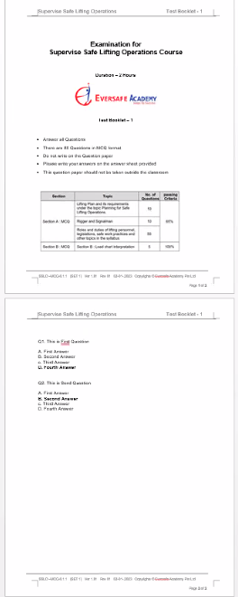
Page 10
Q&A to add contents
(Developer needs to add all the questions with answer )
Page 5
For all the remaining docs
Note: All the above documents will be in word format
LG
FG
CRM
LP
Q&A
Q without answer
A P
Answer sheet
Assessment checklist
RA
SWP
Note: Programmer need to give a
tick option for every answer
Click here
(Refer next page)
Save

Slide 11
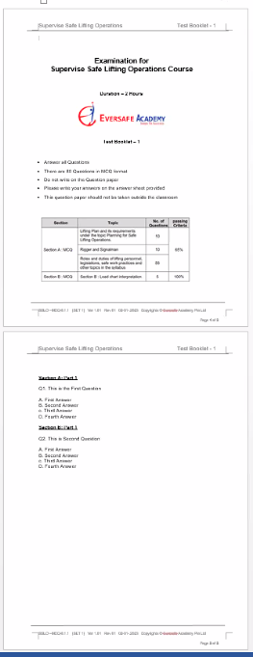
Page 11
Q without answer to add contents
(Developer needs to add all the text and images if necessary )
Page 5
For all the remaining docs
Note: All the above documents will be in word format
LG
FG
CRM
LP
Q&A
Q without answer
A P
Answer sheet
Assessment checklist
RA
SWP
Note: Programmer need to be removed
the answer
(Should not highlight the answers)
Click here
(Refer next page)
Save

Slide 12
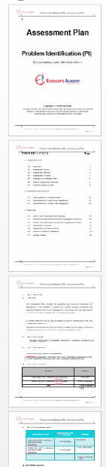
Page 12
AP to add contents
(Developer needs to add all the text and images if necessary )
Page 5
For all the remaining docs
Note: All the above documents will be in word format
LG
FG
CRM
LP
Q&A
Q without answer
A P
Answer sheet
Assessment checklist
RA
SWP
Click here
(Refer next page)
Note:
1. Most of the items should be auto filled
Save

Slide 13
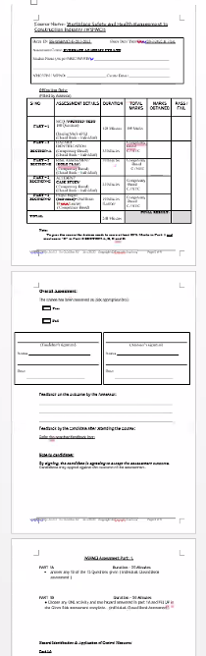
Page 13
Answer sheet to add contents
(Developer needs to add all the text and images if necessary )
Page 5
For all the remaining docs
Note: All the above documents will be in word format
LG
FG
CRM
LP
Q&A
Q without answer
A P
Answer sheet
Assessment checklist
RA
SWP
Note:
Most of the items should be
auto filled
Click here
(Refer next page)
Save

Slide 14
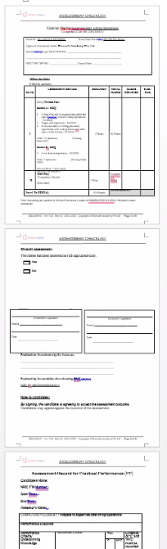
Page 14
Assessment checklist to add contents
(Developer needs to add all the text and images if necessary )
Page 5
For all the remaining docs
Note: All the above documents will be in word format
LG
FG
CRM
LP
Q&A
Q without answer
A P
Answer sheet
Assessment checklist
RA
SWP
Click here
(Refer next page)
Save

Slide 15
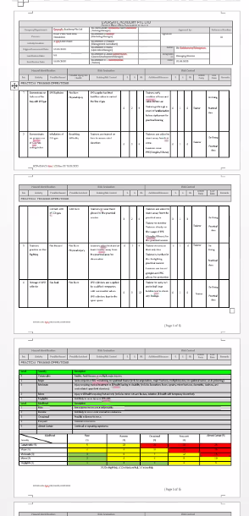
Page 15
RA to add contents
(Developer needs to add all the text and images )
Page 5
For all the remaining docs
Note: All the above documents will be in word format
LG
FG
CRM
LP
Q&A
Q without answer
A P
Answer sheet
Assessment checklist
RA
SWP
Click here
(Refer next page)
Save

Slide 16
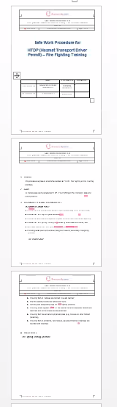
Page 16
SWP to add contents
(Developer needs to add all the text and images )
Page 5
For all the remaining docs
Note: All the above documents will be in word format
LG
FG
CRM
LP
Q&A
Q without answer
A P
Answer sheet
Assessment checklist
RA
SWP
Click here
(Refer next page)
Save

Slide 17
2.2 Course edit (Developer page)
Choose Course name :
ACS-Eng
PWAH-Eng
WSHMCI
MWAH
PMSE-ENG
MWSHCS
Develop course
Reason for the update :
………………………………….
Course Name:
.
.
.
.
.
Course Content:
Submit
Note: This page is mainly to edit the course based on the comments received from students
or trainer. Every edit, developer required to add the reason.
After edit, it should reflect in all the documents in the particular course.
NOTE: After edit, All the documents (14) will be created and shared in the relevant place

Slide 18
2.2 Amendment History ( Auto generation)
Choose Course name :
Choose document type :
ACS-Eng
PPT
PWAH-Eng
LP
WSHMCI
FG
MWAH
CRM
PMSE-ENG
AP
MWSHCS
Answer Key
S.NO | Document | Page Number | Previous Text | Amended text | Reason from the change | Date of change | Changes by
2.3 Version revision History
Ref. Document | Version | Revision | Effective Date | Change Description
Note: This page is mainly to retrieve all the amendment history which was saved automatically
during the amendment time.

Slide 19
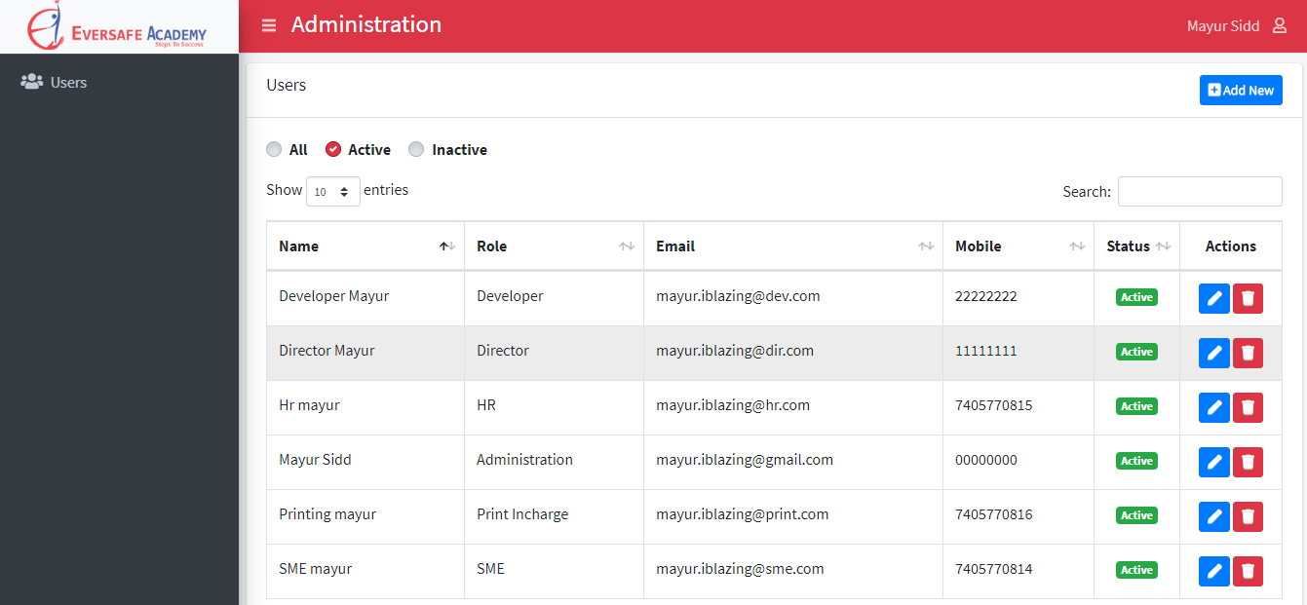

3.Option to mark the assessment paper with in the SSTM
CI-Login
Send
(Assessment paper)
This option is required for “CI ” to upload the assessment paper in the SSTM (trainer login)
Course Name :
Batch Number:
Note :
1.Access for CI to upload assessment paper
2. Li - API need to link with the trainer SSTM schedule page.
3. Trainer will receive the email/SMS notification to mark the assessment paper.
Quantity :
Upload Assessment Paper :
Choose File
Submit

Slide 20
3.2 Option to mark the assessment paper with in the SSTM
Trainer Login
Mark
(Assessment paper)
This option is required for “Trainer ” to mark the assessment paper in the SSTM (trainer login)
Course Name :
Auto
Batch Number:
Auto
Quantity :
Auto
Assessment Paper :
View File
Refer next page to see the preview of assessment paper

Slide 21
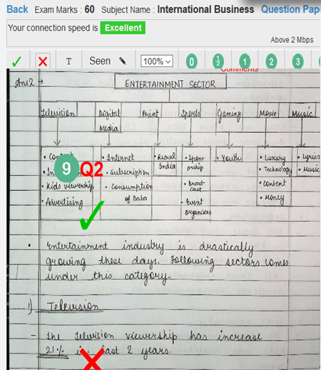
3.3 Option to mark the assessment paper stylus pen
S.no | Q.No | Marks
1 | 1(A)
2 | 1(B)
3 | 2
4 | 3
5 | 4
Total Marks
Enter marks
Enter marks
Enter marks
Enter marks
Enter marks
Enter marks
Submit
1.IT team should give API to save this data from in Li system
2. Eversafe will provide API to insert each students marks based on course and batch ID
3. Consultant need to provide one interface to download in Li

Slide 22




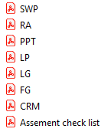
4. Sync D drive and SSTM ( up to date) –parthiban/ Sivaraman
Note : Every updated documents in SSTM need to auto sync in
D drive as per the above format.

Slide 23
5.Bulk upload and download option in SSTM for admin ( Complete course material )
Note: Admin should have the option to download and upload
complete course material in a single click.

Slide 24
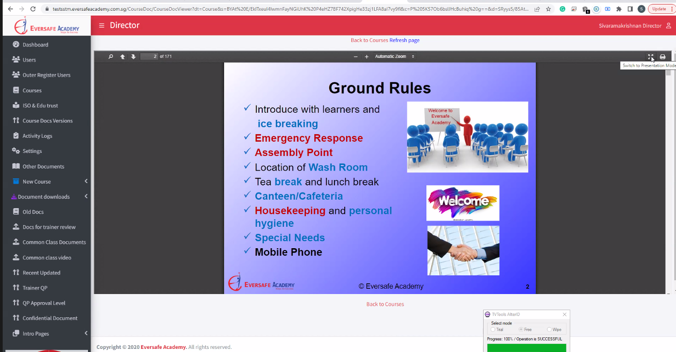

6. Lesson plan monitoring
Dear Trainer,
Please comply the lesson plan
Note:
1. This page is mainly to monitor the trainer timing during the class time.
2. SSTM needs to link with Trainer schedule, Lesson Plan & Blended Learning Activities
3. SSTM needs to give a pop message to trainer when fail to comply the lesson plan.
4. SSTM needs to control the trainer’s activities such as lesson plan hours, IPR,
Learning activities, Blended learning activities, Asynchronous learning hour, Practical class, Examination, projects, and class end time.

Slide 25
6. Lesson plan monitoring 1.Fix ppt timing
Note:
Based on the lesson plan system need to assign the ppt slide teaching time
If the trainer too late , the system will pop up reminder message

Slide 26
6. Lesson plan monitoring 2.Tea break time &Lunch time
Note:
Mr.Biljo provide API for tea break hours. System will link the with the API, it remains the
trainer about the tea break and lunch break timings
2. POP should appear in the full page

Slide 27
6. Lesson plan monitoring 3.Practical &exam timing
Note:
Mr.Biljo provide API for schedule. System will link the with the API, it remains the
trainer about the exam timing
2. POP should appear in the full page

Slide 28
6. Lesson plan monitoring 4.Learning Activity
Note:
Currently all the learning activities happening in the hardcopy so the trainer
should have option in “LI” mark the status of the learning activates
2. Mr.Biljo provide API for schedule. System will link the with the API, it remains the
trainer about the learning activity timing.
2. POP should appear in the full page

Slide 29
6. Lesson plan monitoring 5.IPR
Note:
Based on the lesson plan, IPR need to be complete without fail. If failed to complete, the
system should block the trainer to move further.

Slide 30
6. Lesson plan monitoring 6.BL
Note:
Based on the lesson plan, Mr.Biljo need to link all the BL activities in SSTM

Slide 31
6. Lesson plan monitoring 7.Attendance
Note:
Based on the lesson plan, the system should remained the trainer to take the attendance
If the trainer fail to take attendance, the system should block the trainer to continue the class.

Slide 32
7. Restore update

Slide 33
8. Developer monitoring page
Choose Developer name :
From :
Calendar
TO:
Calendar
Name 1
Name 2
Name 3
Name 4
Search
Name 5
Date | Log in | Log out | Ideal hours | Working hours
Note:
1.This page is mainly for monitor the developer during working time.
2.This system needs to monitor log in, log out, ideal hrs, working hrs
3. <4 HRS , Trigger email/SMS to admin (….)

Slide 34
THANK YOU

