Slide 1
Okofen Pellet Boiler
BMON Configuration
By Alan Mitchell, Analysis North
December 8, 2016

Slide 2
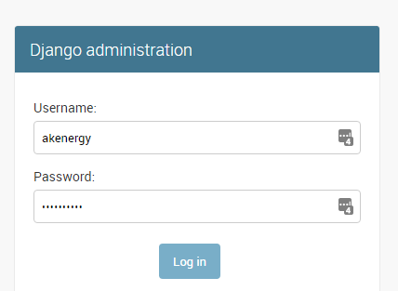
Log In to Admin Interface
https://bmon.akenergy.webfactional.com/admin/
User: akenergy
Password: xxxxxxx

Slide 3
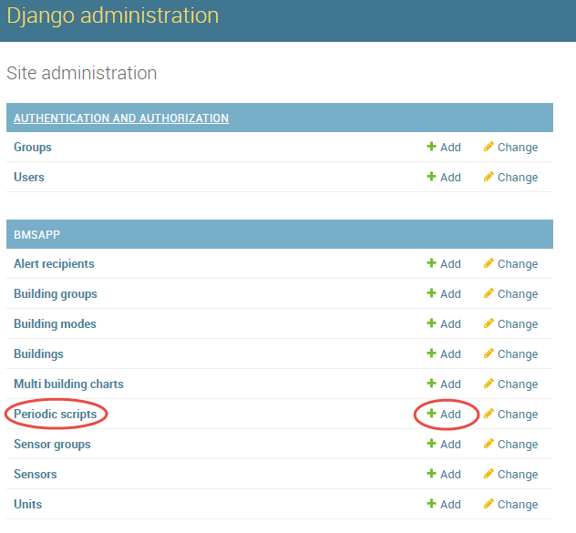
Add a Periodic Script

Slide 4
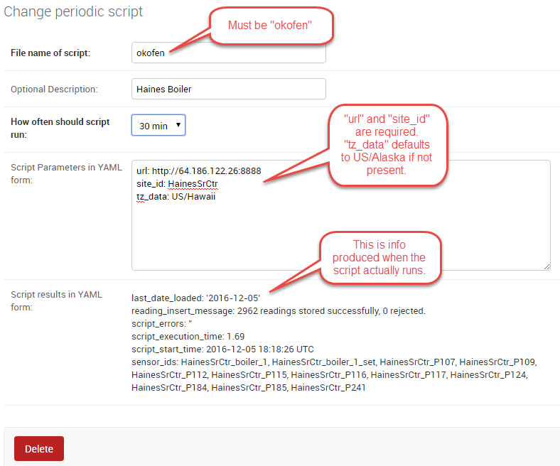
Okofen Configuration
More Documentation in the “Collect Data from Okofen Pellet Boilers” section of this page: https://github.com/alanmitchell/bmon/wiki/Periodic-Scripts

Slide 5
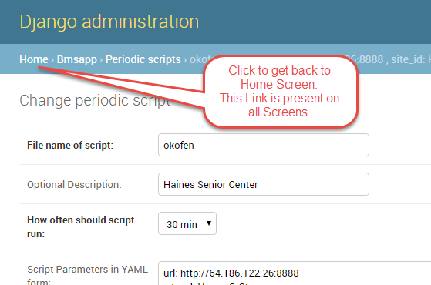
Get Back to the Home Screen

Slide 6
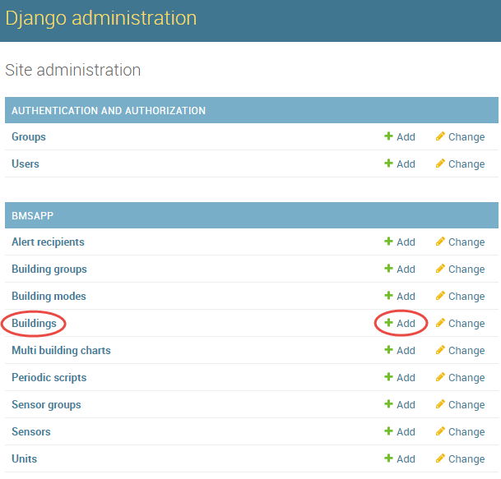
Add a New Building

Slide 7
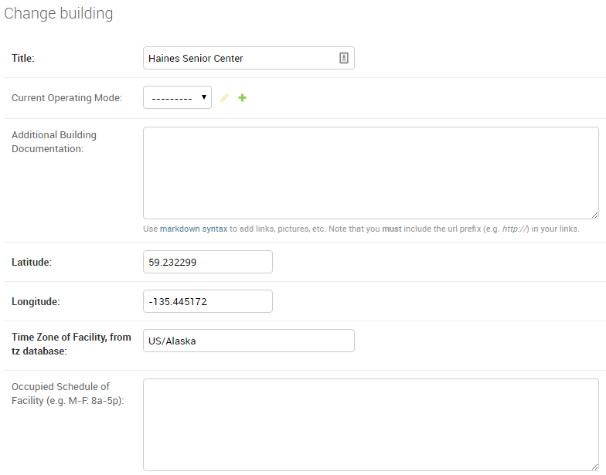
Configure Building
More Documentation in the “Adding a Building” section of this page: https://github.com/alanmitchell/bmon/wiki/Adding-Buildings-and-Sensors

Slide 8
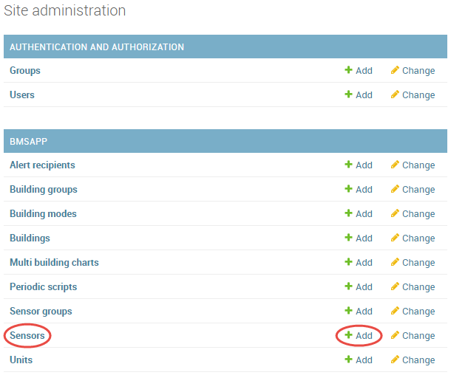
Add all the Sensors

Slide 9
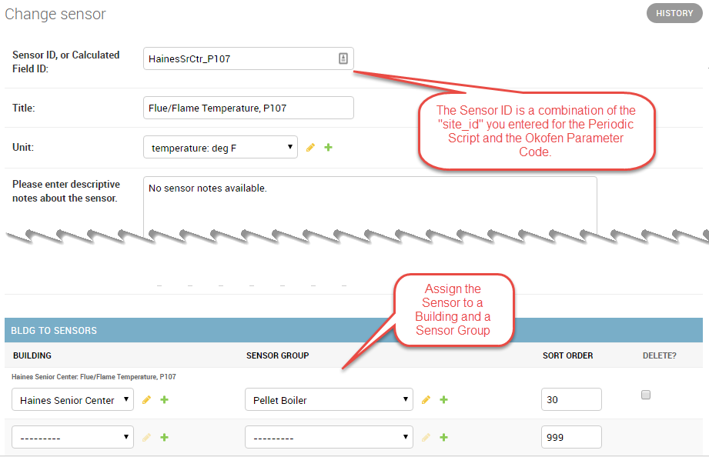
Configure Each Boiler Sensor
More Documentation in the “Adding Sensors” section of this page: https://github.com/alanmitchell/bmon/wiki/Adding-Buildings-and-Sensors

Slide 10
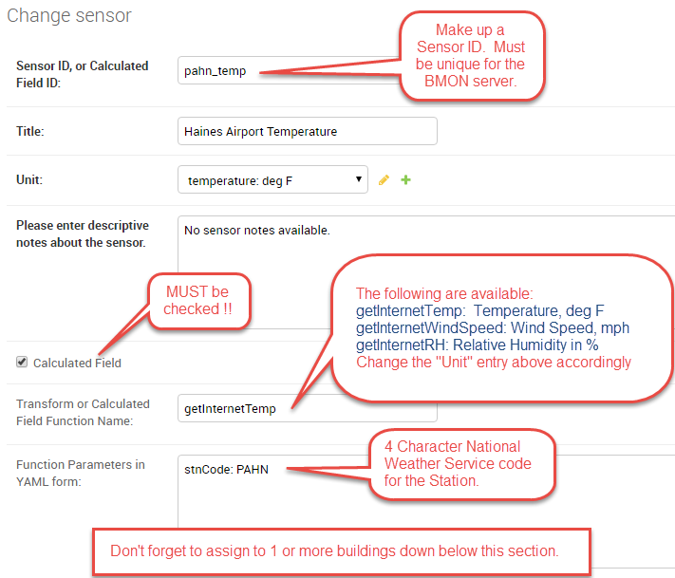
Add Weather Data Sensors
More Documentation in the “Acquiring Weather Data from the Internet” section of this page: https://github.com/alanmitchell/bmon/wiki/Calculated-Fields

Slide 11
Sensor IDs for Boiler Sensors
The Table below assumes the “site_id” was set to “HainesSrCtr”
Sensor Name | Sensor ID
P107 Flue/Flame temp | HainesSrCtr_P107
P112 Burner Startups | HainesSrCtr_P112
Boiler 1 | HainesSrCtr_boiler_1
In general, if the Sensor has a Pxxx parameter number, the Sensor ID will be <site_id>_Pxxx.
If there is no Pxxx ID number, the Sensor ID will be <site_id>_<formatted sensor name>, where the <formatted sensor name> is the Sensor Name converted to lower case with all spaces and slashes converted to an underbar character (_), and period characters are removed.

Slide 12
Final Comments
Don’t worry about making mistakes, as the database is backed up regularly.
Call Alan Mitchell with questions: 907-310-9124, 907-338-0963.
Remember to Refresh (F5) your Browser to see the changes you have made in the Admin interface.
Lots more BMON Administration Documentation at: https://github.com/alanmitchell/bmon/wiki/System-Administrator-Introduction

