Slide 1

Creative T-shirt
Trading Platform
Team 11

Slide 2

Team members
梁皓鈞 104360098
蔡一玄 104590024
陳志芳 104590027
洪晟毅 104590048
李宇傑 104590452

Slide 3
SIMPLE

Slide 4




How Do I Sell T-shirt ?
That Designed By Myself
Utilities Expense
Rent Expense
Purchase Expense
……
Purchase Expense
Web Design Expense
……

Slide 5



Platform Purpose
You Design
We Sell
Trading
Platform

Slide 6



Everyone is Designer Everyone is Customer

Slide 7
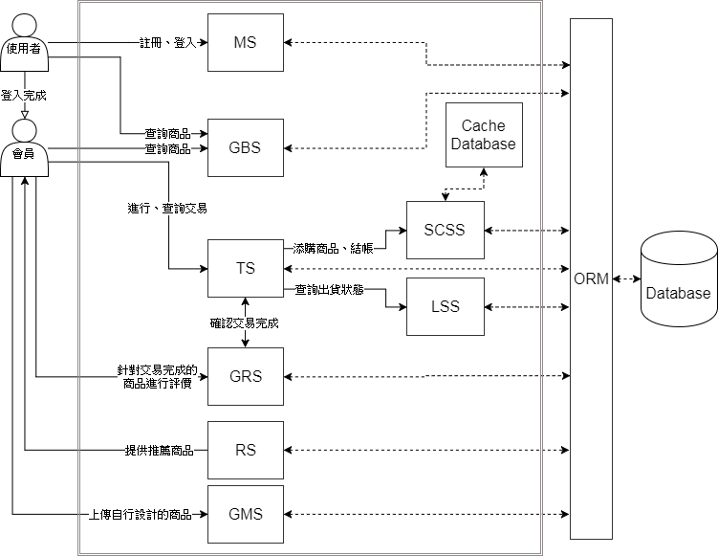
System Architecture

Slide 8
System Architecture
Member System
Goods Management
System

Slide 9
System Architecture
Trading System
Goods Rating System
Recommender System
Goods Management System

Slide 10
System Architecture
Shopping Cart
Subsystem
Trading System
Logistics
Subsystem

Slide 11
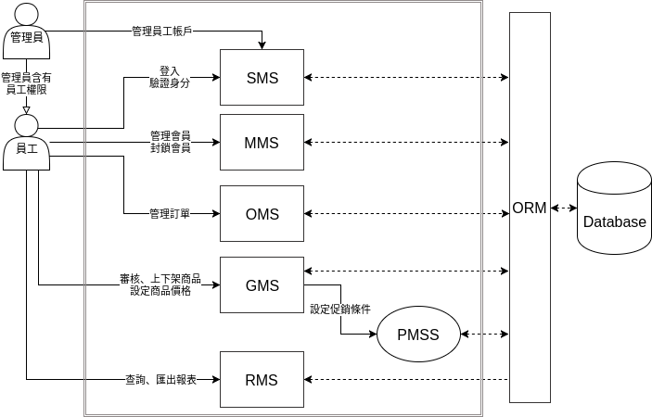
System Architecture

Slide 12
System Architecture
Staff Management System
Membership Management System
Order Management System
Goods Management System
Report Management System

Slide 13
System Architecture
Goods Management System
Promotional Management Subsystem

Slide 14
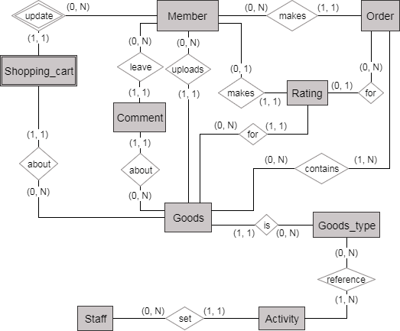
ER Diagram

Slide 15
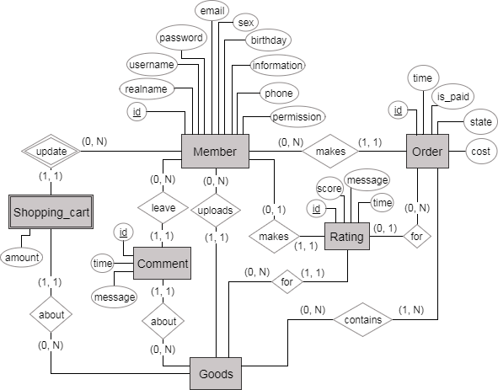
ER Diagram

Slide 16
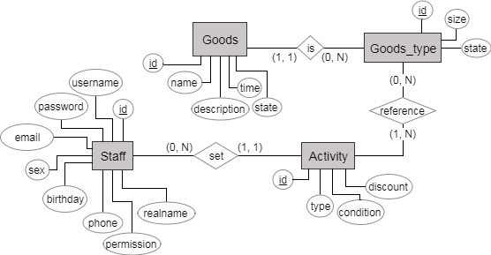
ER Diagram

Slide 17
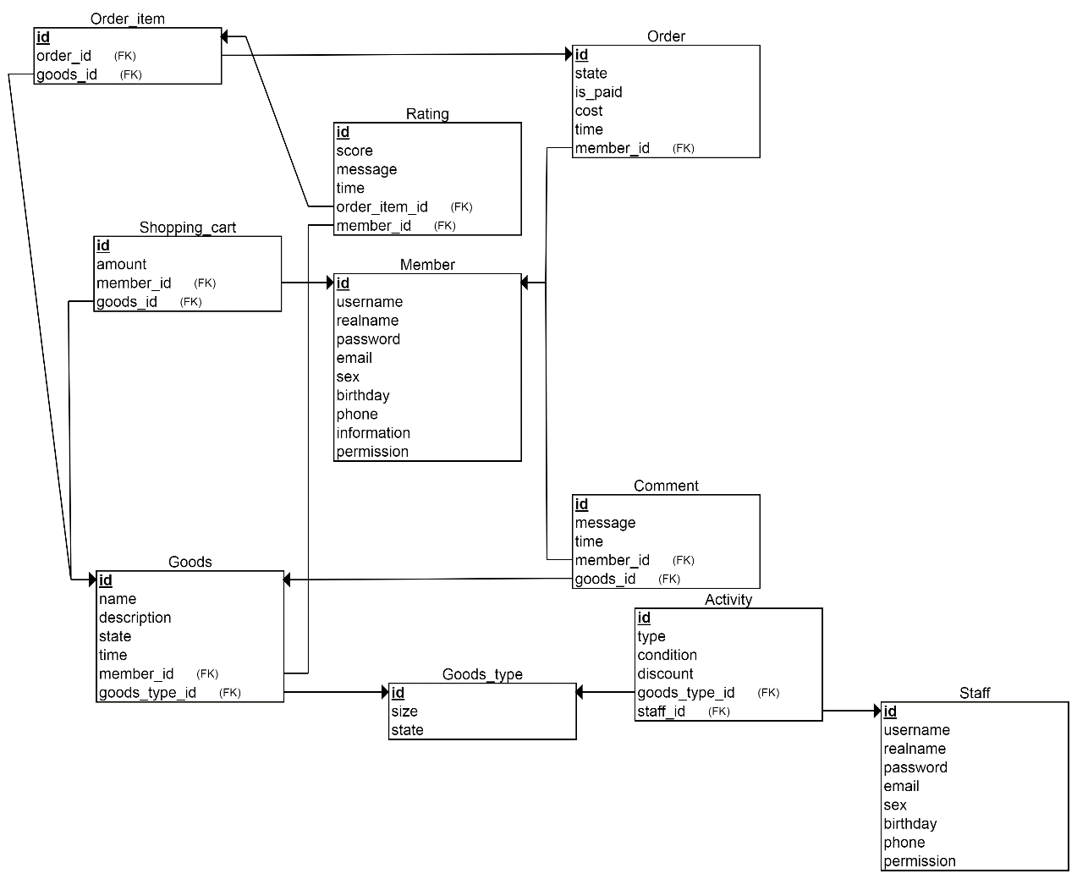
Database Schema

Slide 18
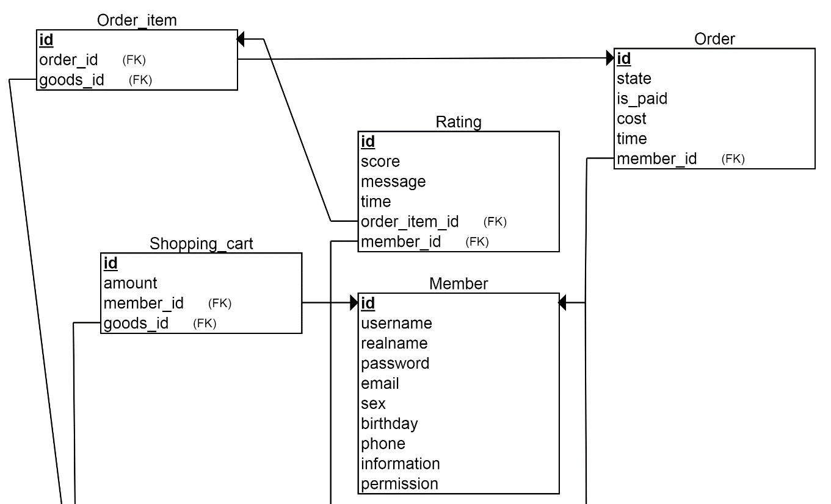
Database Schema

Slide 19
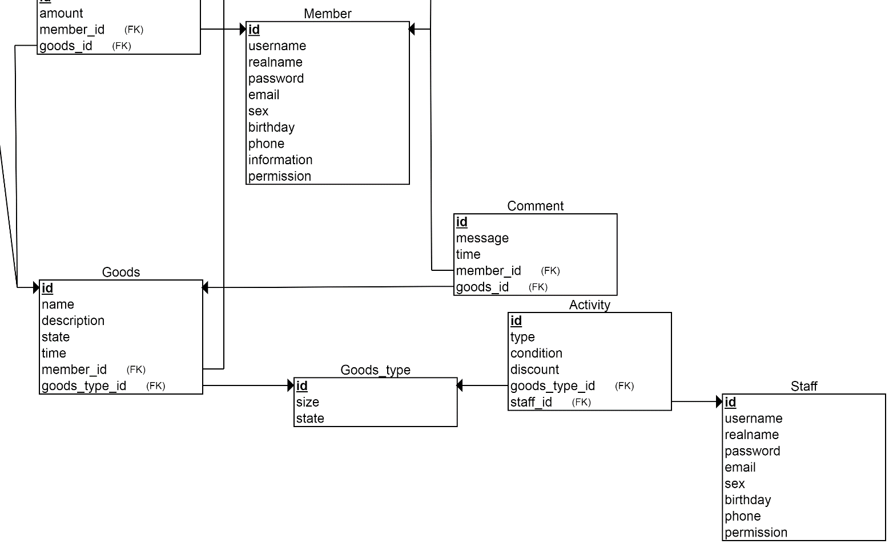
Database Schema

