Slide 1
Creative T-shirt
Trading Platform
Team 11

Slide 2
Team Members
梁皓鈞 104360098
蔡一玄 104590024
陳志芳 104590027
洪晟毅 104590048
李宇傑 104590452

Slide 3
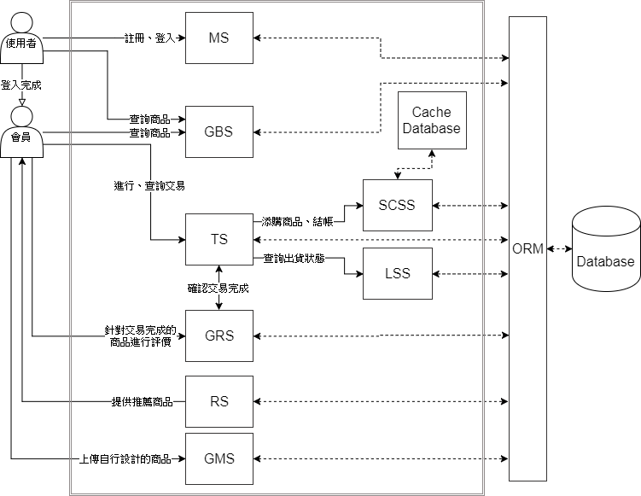
System Context Diagram

Slide 4
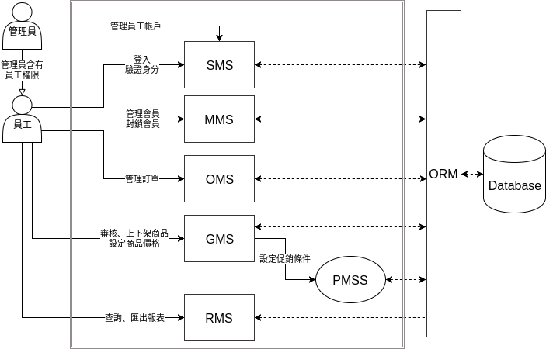
System Context Diagram

Slide 5
System Context Diagram

Slide 6
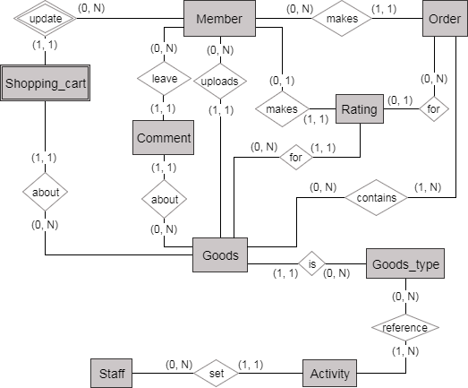
ER Diagram

Slide 7
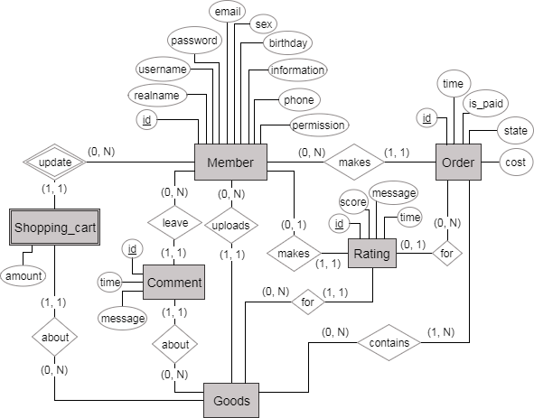
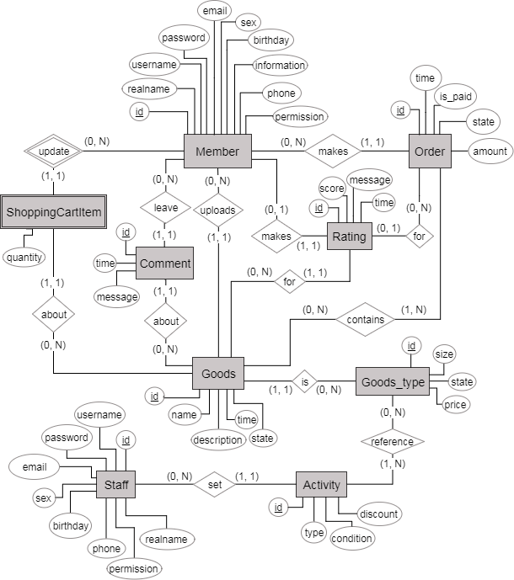
ER Diagram

Slide 8
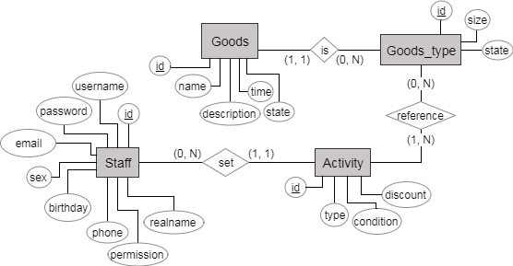
ER Diagram

Slide 9
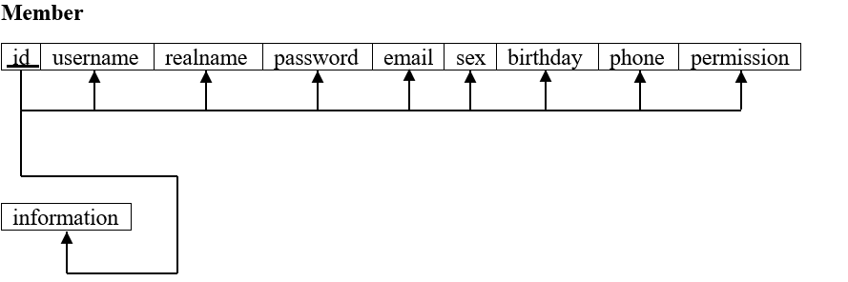
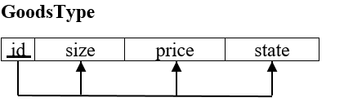
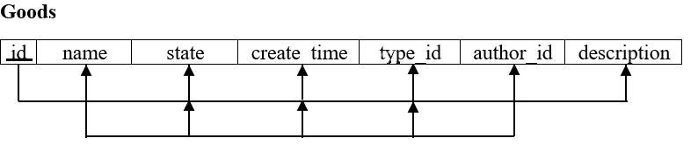
Functional Dependencies

Slide 10
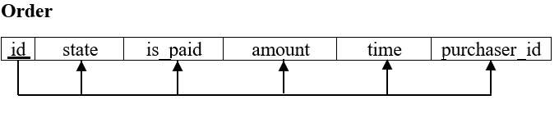
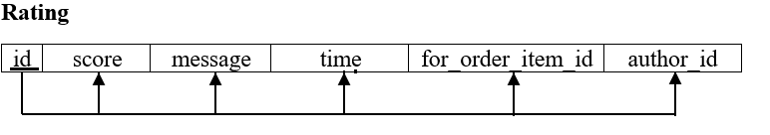
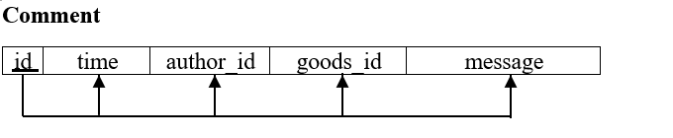
Functional Dependencies

Slide 11
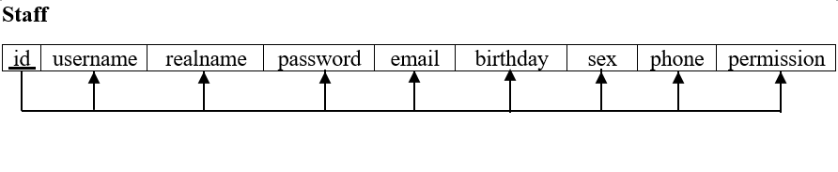
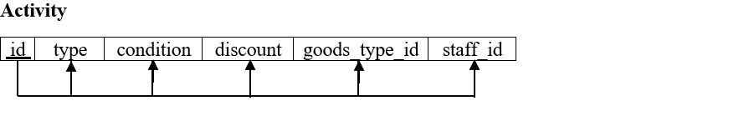
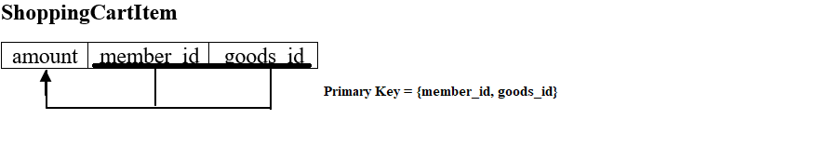
Functional Dependencies

Slide 12


Python/Flask
Micro
Extensible

Slide 13
MVT / Model 2
View
Business Logic
Template
Model
Presentation Logic
DB

Slide 14
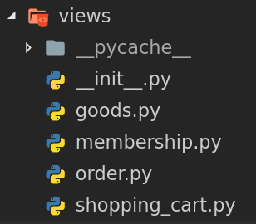
MVT / Model 2
A system is a module
藕荷性
可擴充性
可維護性

Slide 15


Model - FlaskSQLAlchemy
Object-Relational Mapping
Connection Pool 管理
Session 管理 (Transaction)

Slide 16
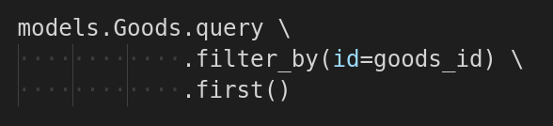
Model - FlaskSQLAlchemy
mapping
SELECT Goods.*
FROM Goods
WHERE Goods.id = @goods_id
LIMIT 1

Slide 17
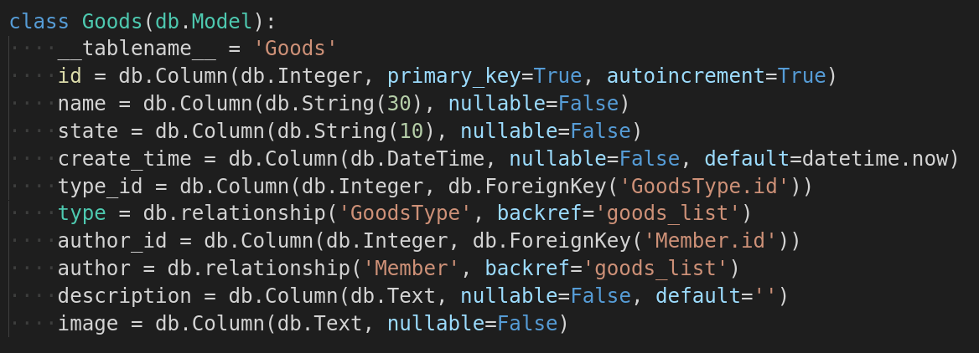
Model - FlaskSQLAlchemy
goods.author
member.goods_list
Relationship Mapping

Slide 18
Middleware - Validator
Request
Validator
Filtered invalid request
View

Slide 19
Middleware - Validator
分離驗證邏輯、商務邏輯
可維護性
可複用性
Validator
View

Slide 20
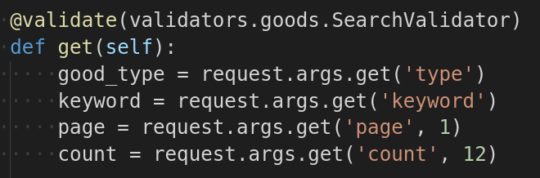
Middleware - Validator
Validation Logic
No need to care about type

Slide 21
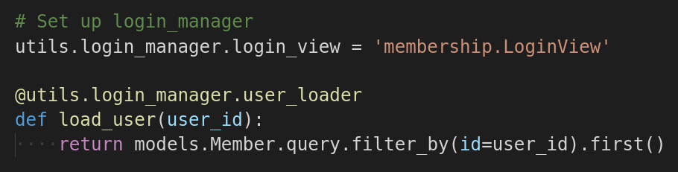
Middleware - Flask-Login
Redirect non-login user to LoginView

Slide 22
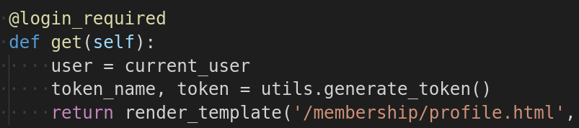
Middleware - Flask-Login
Get current logged in user

