Slide 1


Data Mgmt. – Art of the Possible
Madhav Shidhaye
October 23, 2024
Why ?
Look through the lens of
S - Safety Security of data at rest and transit. Reduce risk.
Q - Quality Data quality
D - Delivery Fast data retrieval and storage
C – Cost Least data footprint without compromises
Move towards a more scalable, secure and lean Data Systems architecture
Reduce or eliminate the technical debt
Democratize the process of interrogating and creating test data
Reduce data footprint by implementing lean principles
GE Vernova Confidential

Slide 2
SQ Lite
October 2024
How ?
Look through the lens of
SQ Lite
is a C-language library that implements a small, fast, self-contained, high-reliability, full-featured, SQL database engine.
is the most used database engine in the world.
is built into all mobile phones and most computers and comes bundled inside countless other applications that people use every day
S - Safety Security of data at rest and transit Reduce risk.
Q - Quality Data quality
D - Delivery Fast data retrieval and storage
C – Cost Least data footprint without compromises
Source : SQLite.org
GE Vernova Confidential

Slide 3
SQ Lite
October 2024
What ?
Look through the lens of
SQ Lite
Is a container for data – any type of data
We can use it to store Test data and meta data for a test
Data is easily searchable via SQL and via high level programming languages such as C#, Python, C…
We can compress the raw data prior to storing it in the database
APEX Systems uses it in DX+ platform
S - Safety Security of data at rest and transit Reduce risk.
Q - Quality Data quality
D - Delivery Fast data retrieval and storage
C – Cost Least data footprint without compromises
GE Vernova Confidential

Slide 4
SQ Lite
October 2024
TestData Table structure
Look through the lens of
Column Name | Data Type | Example Data
ID | INTEGER PRIMARY KEY | 1
TRNumber | TEXT | 1111
DataType | INT | Non-DTM, DTM, DATX
SystemDataType | INT | Int16, float, double
Description | TEXT | Some description of test
StartDateString | TEXT | 10/22/2024 13:07:27.048
StartDate | DATETIME | Date in Native format
EndDateString | TEXT | 10/22/2024 14:07:27.048
EndDate | DATETIME | Date in Native format
ChannelCount | INT | 128
ChannelInfo | TEXT | JSON String containing Channel info ( Tagname, Units, Access level ) etc
ScanCount | INT | 200000
SampleRate | INT | 50000
IsDataCompressed | INT | 1
ChannelData | BLOB | 100101111001001011110
ChannelStats | TEXT | JSON String containing basic stats for each channel ( min, max, StdDev )
S - Safety Security of data at rest and transit Reduce risk.
Q - Quality Data quality
D - Delivery Fast data retrieval and storage
C – Cost Least data footprint without compromises
GE Vernova Confidential

Slide 5
SQ Lite
October 2024
TestData Example statistics 25kHz , 60 Sec duration
Look through the lens of
Column Name | Example Data
SystemDataType | float
Description | Some description of test
StartDate | 10/21/2024 16:48:51.5018433
EndDate | 10/21/2024 16:49:51.5018433
ChannelCount | 128
Data Randomness | 70% ( 70% rows have random data rest have zeroes )
ScanCount | 1500000
SampleRate | 25000
IsDataCompressed | 1
Uncompressed data Size | 731.51 MB
Compressed data Size | 459.74 MB
How many rows | 1
How many files | 1
Size of the db file | 471.2 MB
S - Safety Security of data at rest and transit Reduce risk.
Q - Quality Data quality
D - Delivery Fast data retrieval and storage
C – Cost Least data footprint without compromises
GE Vernova Confidential

Slide 6
SQ Lite
October 2024
Comparison Matrix of datatypes ( non-dtm )
Look through the lens of
Column Name | SQ Lite System | Non-DTM Data TR10908
DataType | float
StartDate | 10/22/2024 06:51:05.352
EndDate | 10/22/2024 21:15:43.116
ChannelCount | 8520
ScanCount | 51877 (26408 + 25469 )
SampleRate | 1
How many rows | 15
How many files | 1 | 199
Size of the data file(s) | 786 MB | 7.15 GB
S - Safety Security of data at rest and transit Reduce risk.
Q - Quality Data quality
D - Delivery Fast data retrieval and storage
C – Cost Least data footprint without compromises
GE Vernova Confidential

Slide 7
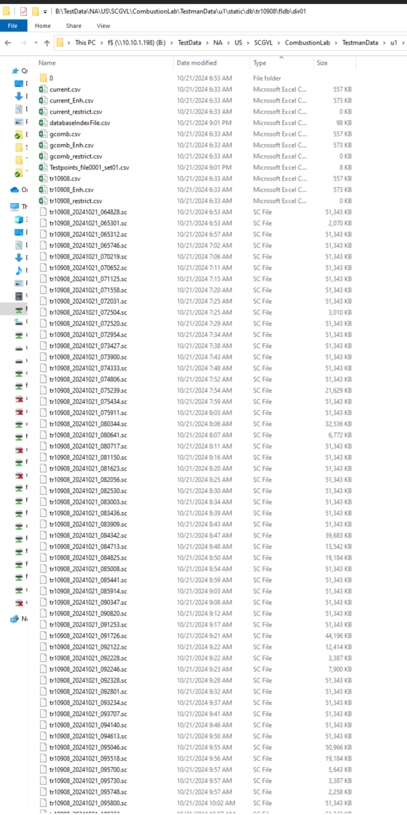
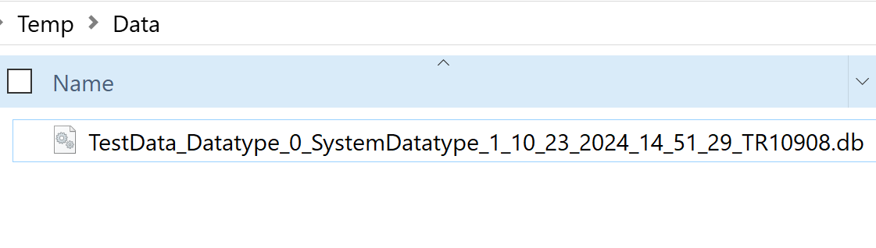
SQ Lite
October 2024
Less data files = simpler and faster performance
Look through the lens of
S - Safety Security of data at rest and transit Reduce risk.
Q - Quality Data quality
D - Delivery Fast data retrieval and storage
C – Cost Least data footprint without compromises
Existing Data | Future Data
GE Vernova Confidential

Slide 8
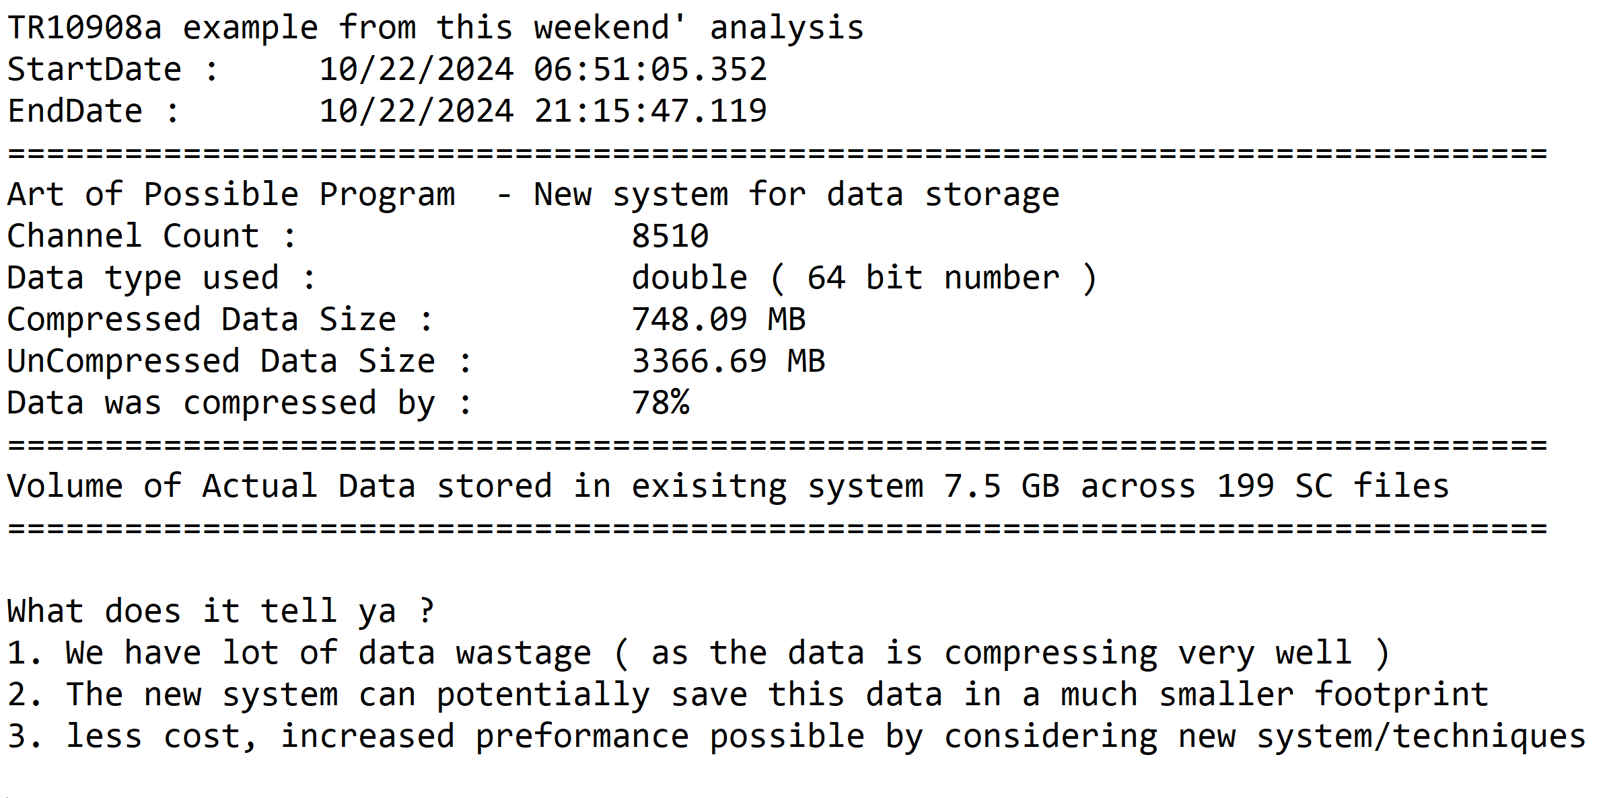
SQ Lite
October 2024
Less data files = simpler and faster performance
Look through the lens of
S - Safety Security of data at rest and transit Reduce risk.
Q - Quality Data quality
D - Delivery Fast data retrieval and storage
C – Cost Least data footprint without compromises
GE Vernova Confidential

Slide 9
SQ Lite
October 2024
Next Steps ?
Look through the lens of
Short term ‘24
Evaluate performance scalability and other parameters
Develop adapters to migrate POC dataset by data types (existing data )
Benchmark performance
Long term ‘25…
Develop a module to stream data live into this container ( new data from scratch )
Compare other Technologies ( TDMS, NCD Output )
Timeline/Resources/Priorities
S - Safety Security of data at rest and transit Reduce risk.
Q - Quality Data quality
D - Delivery Fast data retrieval and storage
C – Cost Least data footprint without compromises
GE Vernova Confidential

