Slide 1
Operating Systems
Page Replacement Algorithms
A. Frank - P. Weisberg

Slide 2
Virtual Memory Management
Background
Demand Paging
Demand Segmentation
Paging Considerations
Page Replacement Algorithms
Virtual Memory Policies
A. Frank - P. Weisberg

Slide 3
Page Replacement Algorithms
Want lowest page-fault rate.
Evaluate algorithm by running it on a particular string of memory references (reference string) and computing the number of page faults and page replacements on that string.
In all our examples, we use a few recurring reference strings.
A. Frank - P. Weisberg

Slide 4

Graph of Page Faults vs. the Number of Frames
A. Frank - P. Weisberg

Slide 5
The FIFO Policy
Treats page frames allocated to a process as a circular buffer:
  When the buffer is full, the oldest page is replaced. Hence first-in, first-out:
    A frequently used page is often the oldest, so it will be repeatedly paged out by FIFO.
  Simple to implement:
    requires only a pointer that circles through the page frames of the process.
A. Frank - P. Weisberg

Slide 6
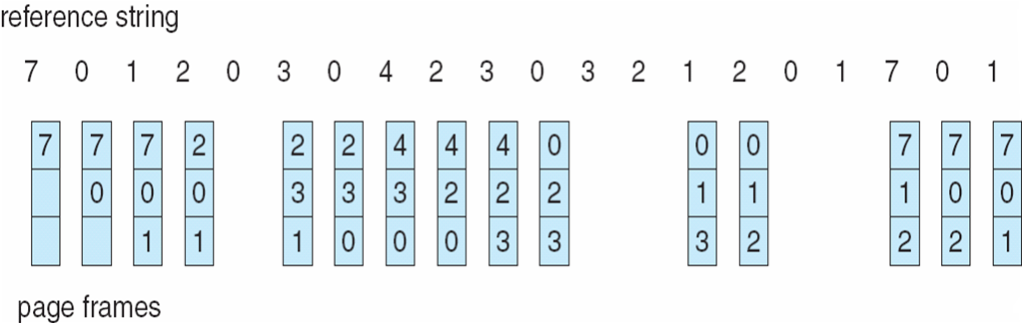
FIFO Page Replacement
A. Frank - P. Weisberg

Slide 7
First-In-First-Out (FIFO) Algorithm
Reference string: 1, 2, 3, 4, 1, 2, 5, 1, 2, 3, 4, 5
3 frames (3 pages can be in memory at a time per process):
4 frames:
FIFO Replacement manifests Belady’s Anomaly:
  more frames ⇒ more page faults
1
1
4
5
2
2
1
3
9 page faults
3
3
2
4
1
1
5
4
2
2
1
5
10 page faults
3
3
2
4
4
3
A. Frank - P. Weisberg

Slide 8
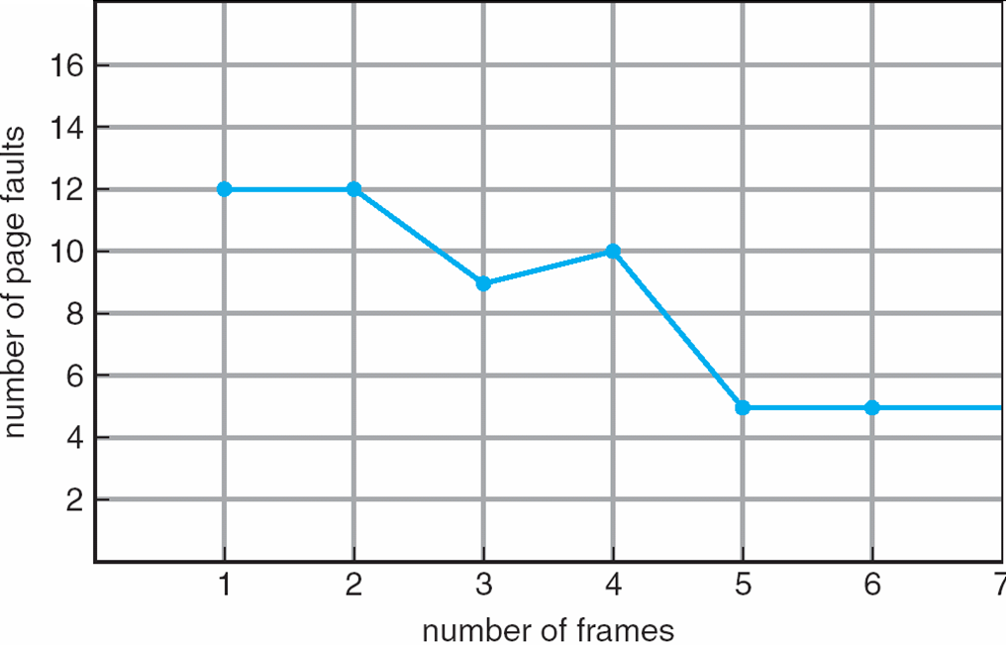
FIFO Illustrating Belady’s Anomaly
A. Frank - P. Weisberg

Slide 9
Optimal Page Replacement
The Optimal policy selects for replacement the page that will not be used for longest period of time.
Impossible to implement (need to know the future) but serves as a standard to compare with the other algorithms we shall study.
A. Frank - P. Weisberg

Slide 10
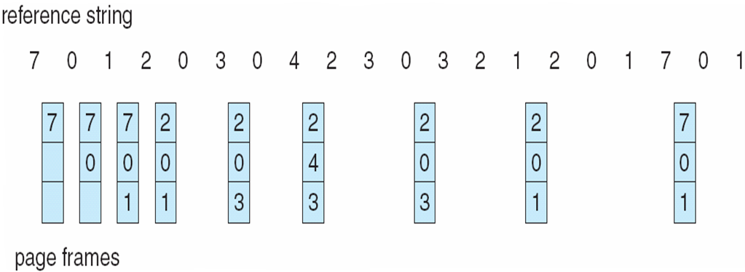
Optimal Page Replacement
A. Frank - P. Weisberg

Slide 11
Optimal Algorithm
Reference string : 1, 2, 3, 4, 1, 2, 5, 1, 2, 3, 4, 5
4 frames example
How do you know future use? You don’t!
Used for measuring how well your algorithm performs.
1
4
2
6 page faults
3
4
5
A. Frank - P. Weisberg

Slide 12
The LRU Policy
Replaces the page that has not been referenced for the longest time:
  By the principle of locality, this should be the page least likely to be referenced in the near future.
  performs nearly as well as the optimal policy.

Slide 13

LRU Page Replacement
A. Frank - P. Weisberg

Slide 14
Least Recently Used (LRU) Algorithm
Reference string: 1, 2, 3, 4, 1, 2, 5, 1, 2, 3, 4, 5
1
1
1
1
5
2
2
2
2
2
8 page faults
3
5
5
4
4
4
4
3
3
3
A. Frank - P. Weisberg

Slide 15
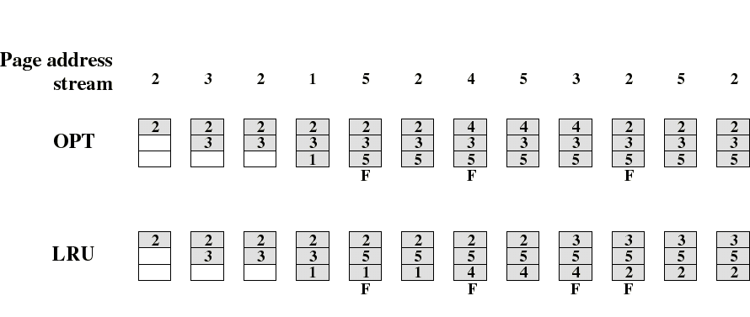
Comparison of OPT with LRU
Example: A process of 5 pages with an OS that fixes the resident set size to 3.

Slide 16

Comparison of FIFO with LRU
LRU recognizes that pages 2 and 5 are referenced more frequently than others but FIFO does not.
A. Frank - P. Weisberg

Slide 17
Implementation of the LRU Policy
Each page could be tagged (in the page table entry) with the time at each memory reference.
The LRU page is the one with the smallest time value (needs to be searched at each page fault).
This would require expensive hardware and a great deal of overhead.
Consequently very few computer systems provide sufficient hardware support for true LRU replacement policy.
Other algorithms are used instead.
A. Frank - P. Weisberg

Slide 18
LRU Implementations
Counter implementation:
  Every page entry has a counter; every time a page is referenced through this entry, copy the clock into the counter.
  When a page needs to be changed, look at the counters to determine which are to change.
Stack implementation – keep a stack of page numbers in a double link form:
  Page referenced:
    move it to the top
    requires 6 pointers to be changed
  No search for replacement.
A. Frank - P. Weisberg

Slide 19

Use of a stack to implement LRU
Stack implementation – keep a stack of page numbers in a double link form:
  Page referenced:
    move it to the top
    requires 6 pointers to be changed
  No search for replacement – always take the bottom one.
A. Frank - P. Weisberg

Slide 20
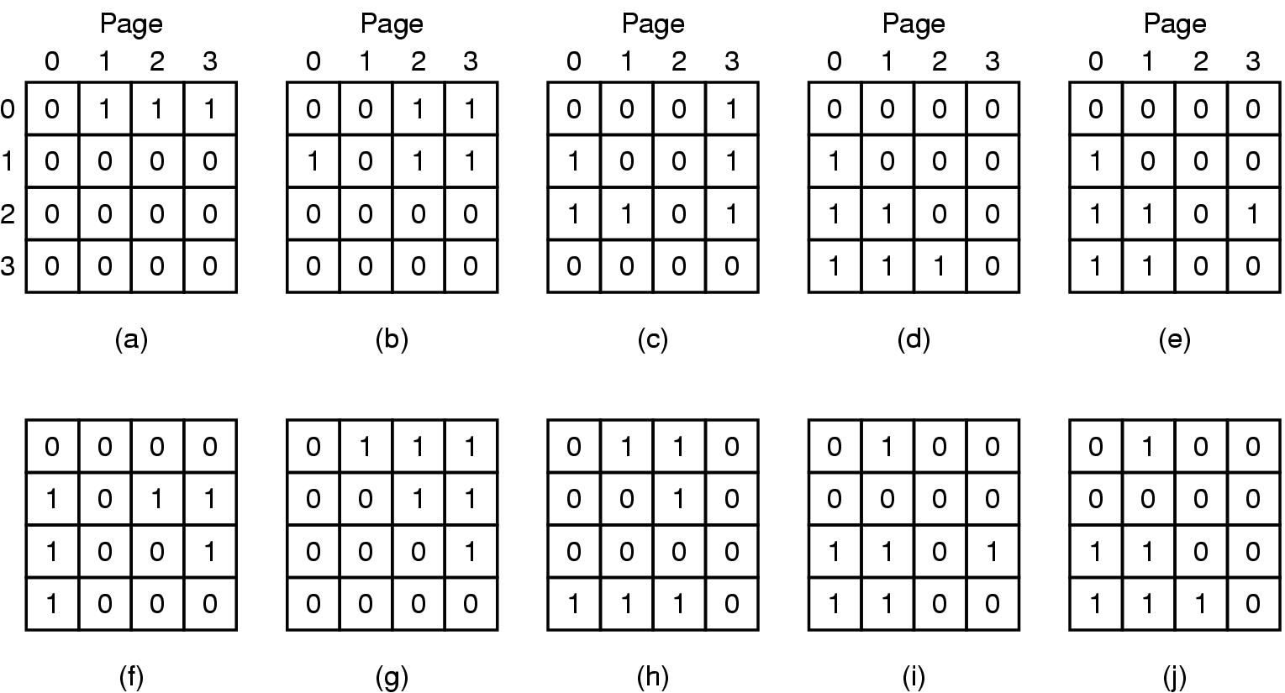
Hardware Matrix LRU Implementation
Pages are referenced in the order 0, 1, 2, 3, 2, 1, 0, 3, 2, 3
A. Frank - P. Weisberg

Slide 21
LRU Approximation Algorithms (1)
Reference Bit:
  With each page associate a bit, initially = 0
  When page is referenced, bit is set to 1.
  Replace the one which is 0 (if one exists) –
  we do not know the real order of use, however.
A. Frank - P. Weisberg

Slide 22
LRU Approximation Algorithms (2)
Reference Byte:
  Idea is to record reference bits at regular intervals;
  Keep a byte of reference bits for each page.
  At regular intervals (say, every 20 ms), left shift
  the reference bit of each page into the high-order
  bit of the byte.
  Each reference byte keeps the history of the page
  use (aging) for the last eight time intervals.
  If we interpret the reference byte as an unsigned integer, the page with the lowest number is the
  LRU page.
A. Frank - P. Weisberg

Slide 23
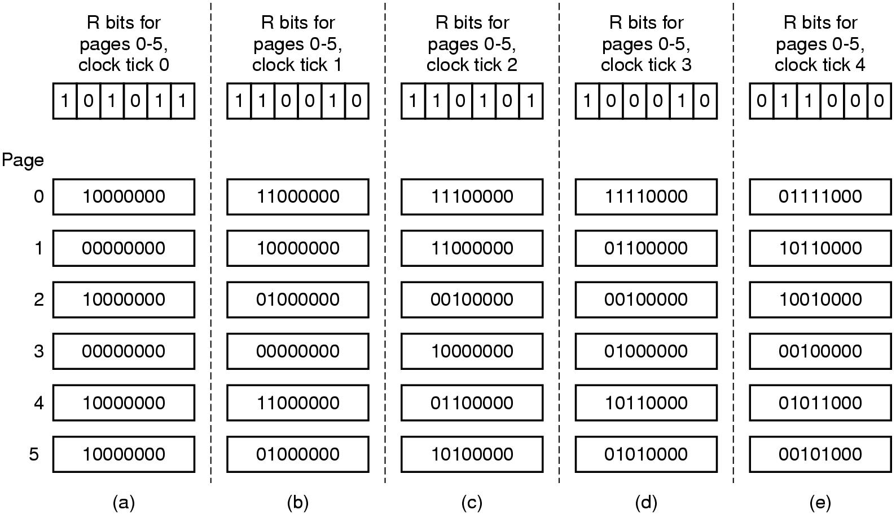
Reference Byte Example
A. Frank - P. Weisberg

Slide 24
The Clock (Second Chance) Policy
The set of frames candidate for replacement is considered as a circular buffer.
When a page is replaced, a pointer is set to point to the next frame in buffer.
A reference bit for each frame is set to 1 whenever:
  a page is first loaded into the frame.
  the corresponding page is referenced.
When it is time to replace a page, the first frame encountered with the reference bit set to 0 is replaced:
  During the search for replacement, each reference bit
  set to 1 is changed to 0.
A. Frank - P. Weisberg

Slide 25
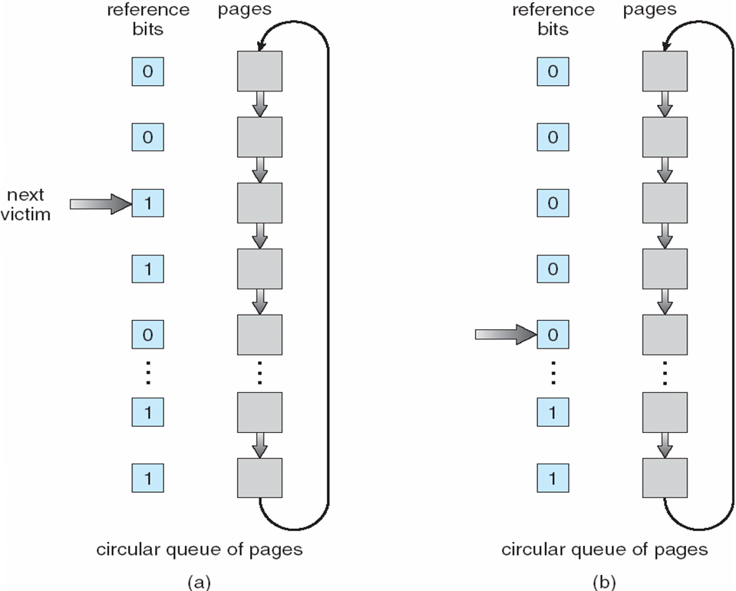
Clock Page-Replacement Algorithm
A. Frank - P. Weisberg

Slide 26
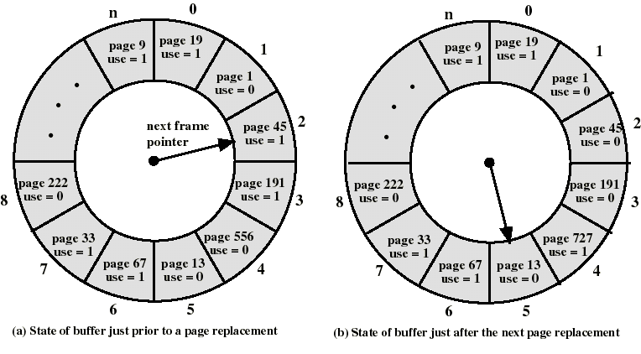
The Clock Policy: Another Example
A. Frank - P. Weisberg

Slide 27
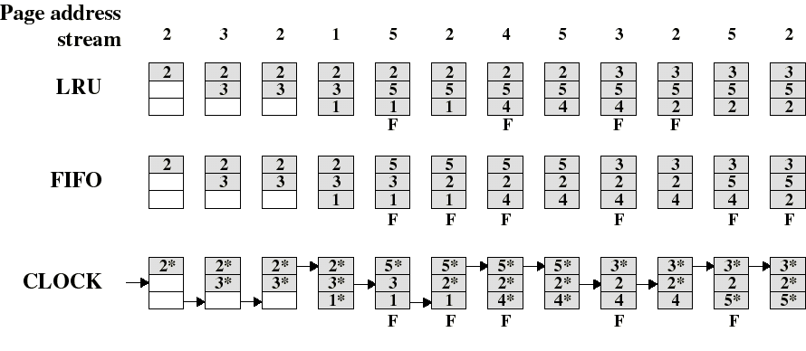
Comparison of Clock with FIFO and LRU (1)
Asterisk indicates that the corresponding use bit is set to 1.
The arrow indicates the current position of the pointer.
Note that the clock policy is adept at protecting frames 2 and 5 from replacement.
A. Frank - P. Weisberg

Slide 28
Comparison of Clock with FIFO and LRU (2)
Numerical experiments tend to show that performance of Clock is close to that of LRU.
Experiments have been performed when the number of frames allocated to each process is fixed and when pages local to the page-fault process are considered for replacement:
  When few (6 to 8) frames are allocated per process, there is almost a factor of 2 of page faults between LRU and FIFO.
  This factor reduces close to 1 when several (more than 12) frames are allocated. (But then more main memory is needed to support the same level of multiprogramming).
A. Frank - P. Weisberg

Slide 29
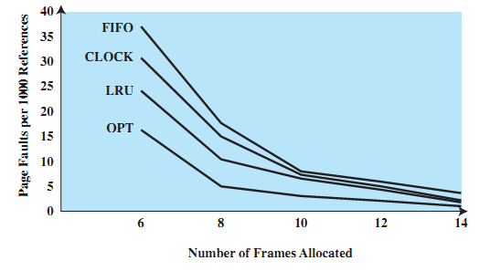
Fixed-Allocation, Local Page Replacement
A. Frank - P. Weisberg

Slide 30
Counting-based Algorithms
Keep a counter of the number of references that have been made to each page.
Two possibilities: Least/Most Frequently Used (LFU/MFU).
LFU Algorithm: replaces page with smallest count; others were and will be used more.
MFU Algorithm: based on the argument that the page with the smallest count was probably just brought in and has yet to be used.
A. Frank - P. Weisberg

Slide 31
Page Buffering (1)
Pages to be replaced are kept in main memory for a while to guard against poorly performing replacement algorithms such as FIFO.
Two lists of pointers are maintained: each entry points to a frame selected for replacement:
  a free page list for frames that have not been modified since brought in (no need to swap out).
  a modified page list for frames that have been modified (need to write them out).
A frame to be replaced has a pointer added to the tail of one of the lists and the present bit is cleared in corresponding page table entry; but the page remains in the same memory frame.
A. Frank - P. Weisberg

Slide 32
Page Buffering (2)
At each page fault the two lists are first examined to see if the needed page is still in main memory:
  If it is, we just need to set the present bit in the corresponding page table entry (and remove the matching entry in the relevant page list).
  If it is not, then the needed page is brought in, it is placed in the frame pointed by the head of the free frame list (overwriting the page that was there); the head of the free frame list is moved to the next entry.
  (the frame number in the page table entry could be used to scan the two lists, or each list entry could contain the process id and page number of the occupied frame).
The modified list also serves to write out modified pages in cluster (rather than individually).
A. Frank - P. Weisberg

Slide 33
Cleaning Policy (1)
When should a modified page be written out to disk?
Demand cleaning:
  a page is written out only when it’s frame has been selected for replacement
    but a process that suffers a page fault may have to wait for 2 page transfers.
Pre-cleaning:
  modified pages are written before their frames are needed so that they can be written out in batches:
    but makes little sense to write out so many pages if the majority of them will be modified again before they are replaced.
A. Frank - P. Weisberg

Slide 34
Cleaning Policy (2)
A good compromise can be achieved with page buffering:
  recall that pages chosen for replacement are maintained either on a free (unmodified) list or on a modified list.
  pages on the modified list can be periodically written out in batches and moved to the free list.
  a good compromise since:
    not all dirty pages are written out but only those chosen for replacement.
    writing is done in batch.
A. Frank - P. Weisberg

