Slide 1
Virtual Memory Management
G. Anuradha
Ref:- Galvin

Slide 2
Virtual Memory
Background
Demand Paging
Copy-on-Write
Page Replacement
Allocation of Frames
Thrashing
Memory-Mapped Files
Allocating Kernel Memory
Other Considerations
Operating-System Examples

Slide 3
Objectives
To describe the benefits of a virtual memory system
To explain the concepts of demand paging, page-replacement algorithms, and allocation of page frames
To discuss the principle of the working-set model
To examine the relationship between shared memory and memory-mapped files
To explore how kernel memory is managed

Slide 4
What is Virtual Memory?
Technique that allows the execution of processes that are not completely in memory.
Abstracts main memory into an extremely large, uniform array of storage.
Allows processes to share files easily and to implement shared memory.

Slide 5
Background
For a program to get executed the entire logical address space should be placed in physical memory
But it need not be required or also practically possible. Few examples are
  Error codes seldom occur
  Size of array is not fully utilized
  Options and features which are rarely used

Slide 6
Benefits of program which are partially in memory
No constraint on the amount of physical memory
Increase in cpu utilization and throughput but with no increase in response time and turnaround time
User program would run faster on account of less I/O

Slide 7
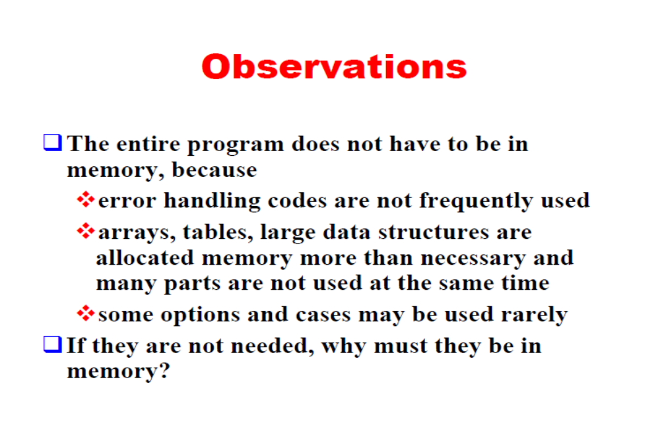

Slide 8
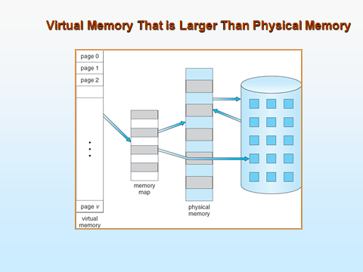

Slide 9
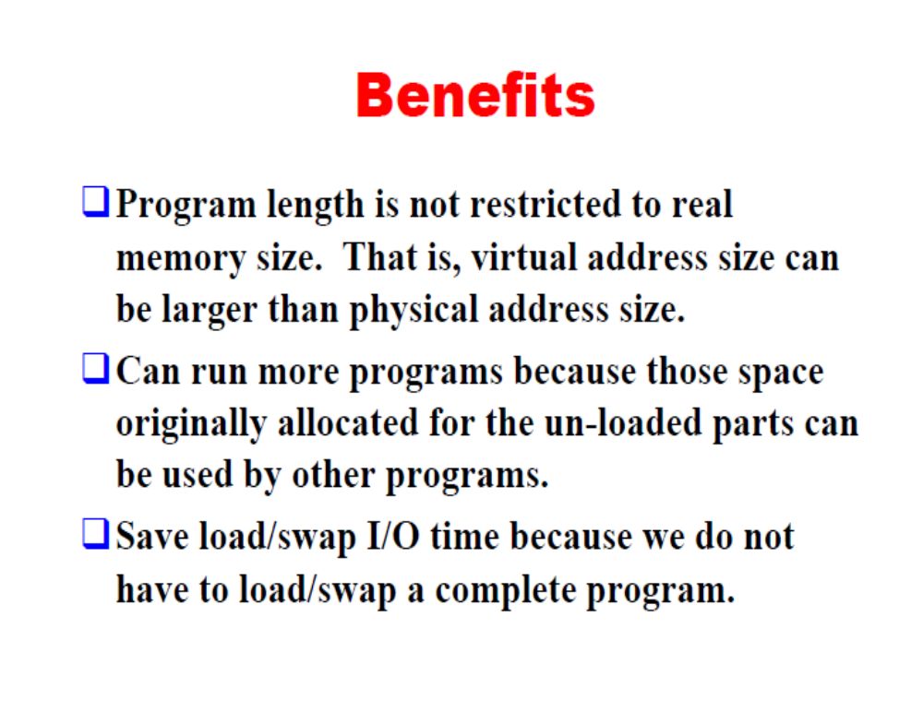

Slide 10
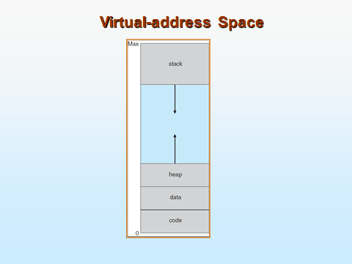
Heap grows upwards and the stack grows downwards and the hole between these two is the virtual memory

Slide 11
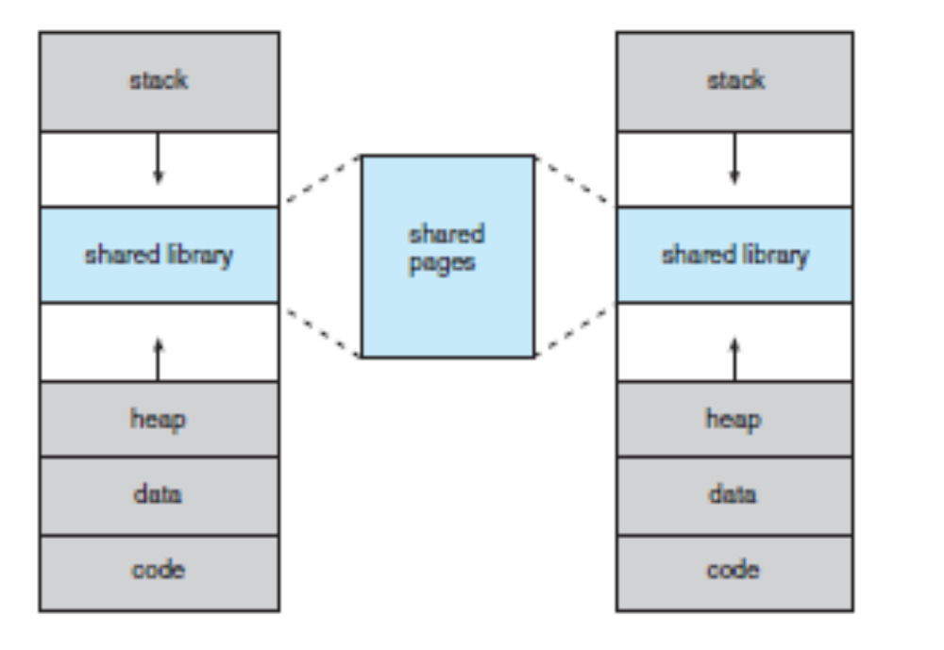
Shared Library using virtual memory

Slide 12
Advantages of using shared library
  System libraries can be shared by mapping them into the virtual address space of more than one process.
  Processes can also share virtual memory by mapping the same block of memory to more than one process.
  Process pages can be shared during a fork( ) system call, eliminating the need to copy all of the pages of the original ( parent ) process.

Slide 13
Virtual memory is implemented using DEMAND PAGING

Slide 14
Demand Paging
Bring a page into memory only when it is needed
  Less I/O needed
  Less memory needed
  Faster response
  More users
Page is needed ⇒ reference to it
  invalid reference ⇒ abort
  not-in-memory ⇒ bring to memory
Lazy swapper – never swaps a page into memory unless page will be needed
  Swapper that deals with pages is a pager

Slide 15
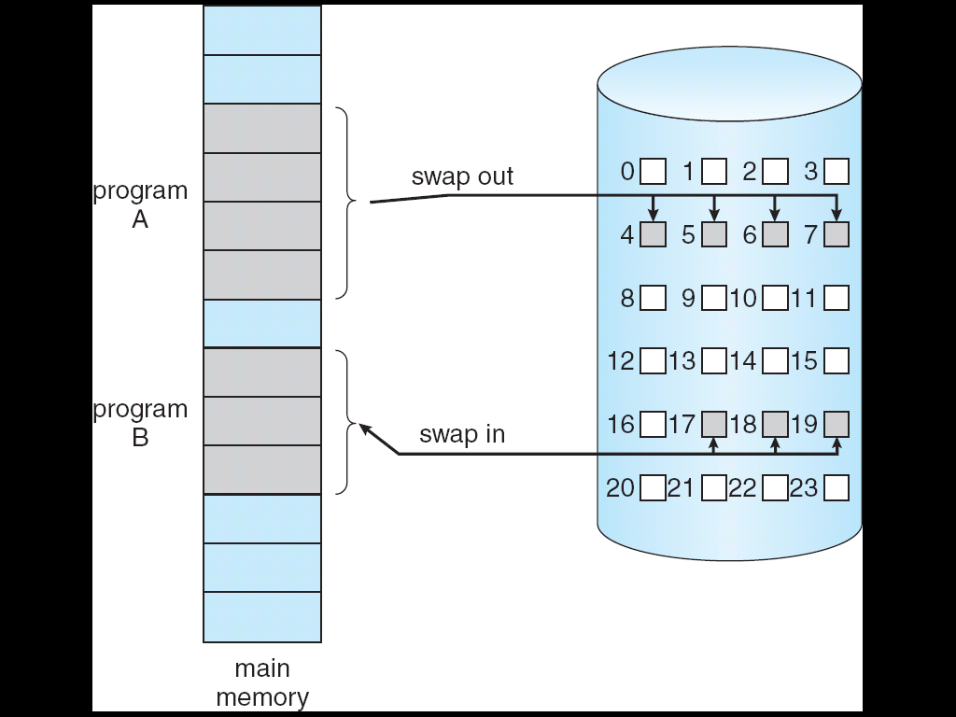
Transfer of a Paged Memory to Contiguous Disk Space

Slide 16
Basic concepts
When a process is to be swapped in, the pager guesses which pages will be used before the process is swapped out again
The pager brings only those pages into memory
Valid-invalid bit scheme determines which pages are there in the memory and which are there in the disk.

Slide 17
Valid-Invalid Bit
With each page table entry a valid–invalid bit is associated
(v ⇒ in-memory, i ⇒ not-in-memory)
Initially valid–invalid bit is set to i on all entries
Example of a page table snapshot:
During address translation, if valid–invalid bit in page table entry
is I ⇒ page fault
Frame #
valid-invalid bit
v
v
v
v
i
….
i
i
page table

Slide 18
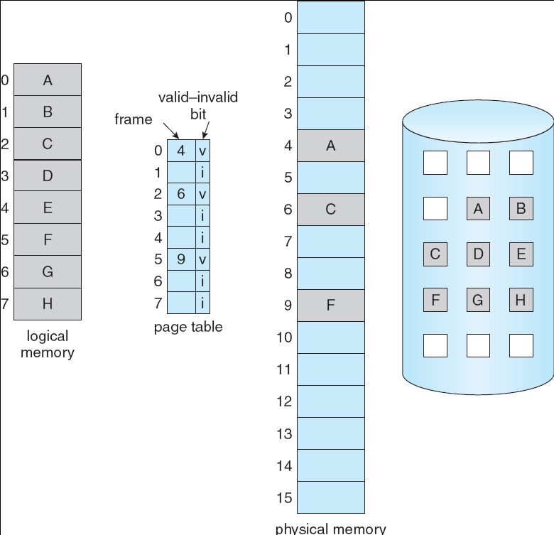
Page Table When Some Pages Are Not in Main Memory

Slide 19
Page Fault
If there is a reference to a page, first reference to that page will trap to operating system:
page fault
Operating system looks at another table to decide:
  Invalid reference ⇒ abort
  Just not in memory
Find free frame
Swap page into frame via scheduled disk operation
Reset tables to indicate page now in memory
Set validation bit = v
Restart the instruction that caused the page fault

Slide 20

Steps in Handling a Page Fault

Slide 21
Page Fault
Access to a page marked invalid causes a page fault .
Procedure for handling page faults.
Check whether the reference is valid or invalid memory access.
If reference was invalid, terminate the process. If valid, but the page not in memory , page it in
Get empty frame
Schedule a disk operation to read the desired page into the newly allocated frame
Reset tables
Restart the instruction that caused the page fault

Slide 22
Aspects of Demand Paging
Extreme case – start process with no pages in memory
  OS sets instruction pointer to first instruction of process, non-memory-resident -> page fault
  And for every other process pages on first access
  Pure demand paging
Actually, a given instruction could access multiple pages -> multiple page faults
  Consider fetch and decode of instruction which adds 2 numbers from memory and stores result back to memory
  Pain decreased because of locality of reference
Hardware support needed for demand paging
  Page table with valid / invalid bit
  Secondary memory (swap device with swap space)
  Instruction restart

Slide 23
Worst case example of demand paging
Fetch and decode the instruction(ADD)
Fetch A
Fetch B
Add A and B
Store the sum in C
Page fault at this point . Get page and restart

Slide 24
Performance of Demand Paging
Stages in Demand Paging (worse case)
Trap to the operating system
Save the user registers and process state
Determine that the interrupt was a page fault
Check that the page reference was legal and determine the location of the page on the disk
Issue a read from the disk to a free frame:
  Wait in a queue for this device until the read request is serviced
  Wait for the device seek and/or latency time
  Begin the transfer of the page to a free frame
While waiting, allocate the CPU to some other user
Receive an interrupt from the disk I/O subsystem (I/O completed)
Save the registers and process state for the other user
Determine that the interrupt was from the disk
Correct the page table and other tables to show page is now in memory
Wait for the CPU to be allocated to this process again
Restore the user registers, process state, and new page table, and then resume the interrupted instruction

Slide 25
Performance of Demand Paging (Cont.)
Three major activities
  Service the interrupt – careful coding means just several hundred instructions needed
  Read the page – lots of time
  Restart the process – again just a small amount of time
Page Fault Rate 0 ≤ p ≤ 1
  if p = 0 no page faults
  if p = 1, every reference is a fault
Effective Access Time (EAT)
EAT = (1 – p) x memory access
+ p (page fault overhead
+ swap page out
+ swap page in)

Slide 26
Demand Paging Example
Memory access time = 200 nanoseconds
Average page-fault service time = 8 milliseconds
EAT = (1 – p) x 200 + p (8 milliseconds)
= (1 – p x 200 + p x 8,000,000
= 200 + p x 7,999,800
If one access out of 1,000 causes a page fault, then
EAT = 8.2 microseconds.
This is a slowdown by a factor of 40!!
If want performance degradation < 10 percent
  220 > 200 + 7,999,800 x p
  20 > 7,999,800 x p
  p < .0000025
  < one page fault in every 400,000 memory accesses

Slide 27
Demand Paging Optimizations
Disk I/O to swap space is faster than file system.
  Swap allocated in larger chunks, less management needed than file system
Copy entire process image to swap space at process load time
  Then page in and out of swap space
Demand paging from program binary files.
    Demand pages for such files are brought directly from the file system
    When page replacement is called for these frames can simply be overwritten and the pages can be read in from the file system again.
Mobile systems
  Typically don’t support swapping
  Instead, demand page from file system and reclaim read-only pages (such as code)

Slide 28
Copy-on-Write
Copy-on-Write (COW) allows both parent and child processes to initially share the same pages in memory
  If either process modifies a shared page, only then is the page copied
COW allows more efficient process creation as only modified pages are copied
When is a page going to be duplicated using copy-on-write?
  Depends on the location from where a free page is allocated
OS uses Zero-fill-on-demand technique to allocate these pages.
UNIX uses vfork() instead of fork() command which uses Copy-on-write.

Slide 29

Before Process 1 Modifies Page C

Slide 30

After Process 1 Modifies Page C

Slide 31
What Happens if There is no Free Frame?
The first time a page is referenced a page fault occurs
This means that page fault at most once
But this is not the case always
Suppose only 5 pages among 10 pages are commonly used then demand paging pages only those required pages
This helps in increasing the degree of multiprogramming
By multiprogramming the memory is over allocated.

Slide 32
Page Replacement
Prevent over-allocation of memory by modifying page-fault service routine to include page replacement
Use modify (dirty) bit to reduce overhead of page transfers – only modified pages are written to disk
Page replacement completes separation between logical memory and physical memory – large virtual memory can be provided on a smaller physical memory

Slide 33

Need For Page Replacement
If no frame is free, we find one that is not currently being used and free it.

Slide 34
Basic Page Replacement
Find the location of the desired page on disk
Find a free frame:
- If there is a free frame, use it
- If there is no free frame, use a page replacement algorithm to select a victim frame
Bring the desired page into the (newly) free frame; update the page and frame tables
Restart the process

Slide 35

Page Replacement
Use modify (dirty) bit to reduce overhead of page transfers – only modified pages are written to disk
Notes:
The modify bit is set by the hardware whenever any word or byte in the page is written into, indicating that the page has been modified.
If set, page is modified and we must write the page to the disk.
If not set the page has not neen modified since it was read into memory. In this case we need not write the memory page to the disk.

Slide 36
Features of page replacement
With page replacement an enormous virtual memory can be provided on a smaller physical memory
If a page that has been modified is to be replaced, its contents are copied to the disk.
A later reference to that page will cause a page fault.
At that time, the page will be brought back into memory, replacing some other page in the process.

Slide 37
Page Replacement contd…
Two major problems must be solved to implement demand paging
  Frame allocation algorithm:- Decide frames for process
  Page-replacement algorithm:- decide frames which are to be replaced.
How to select a page replacement algorithm?
  One having the lowest page-fault rate.
  Evaluate algorithm by running it on a particular string of memory references (reference string) and computing the number of page faults on that string
The number of frames available should be determined

Slide 38
Page replacement algorithms
FIFO
Optimal
LRU

Slide 39
First In First Out(FIFO)
Associates with each page the time when that page was brought into memory
When a page must be replaced, the oldest page is replaced
FIFO queue is maintained to hold all pages in memory
The one at the head of Q is replaced and the page brought into memory is inserted at the tail of Q

Slide 40
First-In-First-Out (FIFO) Algorithm
Reference string: 1, 2, 3, 4, 1, 2, 5, 1, 2, 3, 4, 5
3 frames (3 pages can be in memory at a time per process)
4 frames
Belady’s Anomaly: more frames ⇒ more page faults
1
1
4
5
2
2
1
3
9 page faults
3
3
2
4
1
1
5
4
2
2
1
5
10 page faults
3
3
2
4
4
3

Slide 41
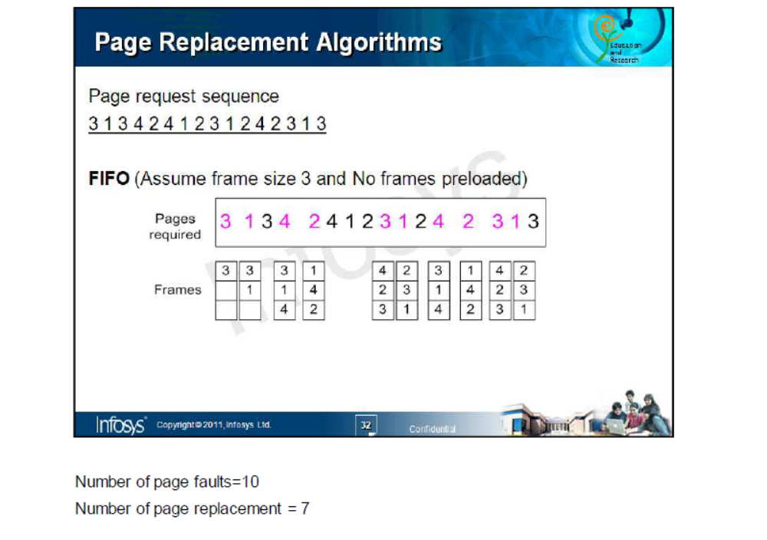


Slide 42

FIFO Page Replacement
Page faults:15
Page replacements:12

Slide 43
Adv and Disadv of FIFO
Adv
Easy to understand and program
Disadv
Performance not always good
The older pages may be initialization files which would be required throughout
Increases the page fault rate and slows process execution.

Slide 44
What is belady’s anomaly
1 2 3 4 1 2 5 1 2 3 4 5
Compute using 4 frames
Compare the page faults by using frame size 3
Difference is because of belady’s anomaly

Slide 45

FIFO Illustrating Belady’s Anomaly

Slide 46

Optimal Algorithm
Result of discovery of Belady’s anomaly was optimal page replacement algorithm
Has the lowest page-fault rate of all algorithms
Algorithm does not exist. Why?

Slide 47

Optimal Page Replacement
Number of page faults:- 9
Number of replacements:-6

Slide 48
Adv and Disadv of Optimal Page replacement algorithm
Gives the best result.
Reduces page fault
But difficult ot implement because it requires future knowledge of the reference string.
Mainly used for comparison studies.

Slide 49
LRU page replacement algorithm
Use the recent past as an approximation of near future then we replace the page that has not been used for the longest period of time. (Least Recently Used)

Slide 50

LRU Page Replacement
Number of page faults:- 12
Number of page replacements:- 9

Slide 51
How to implement LRU Algorithm
Clock
Stack

Slide 52
Counter
Counter: Add to page-table entry a time-of-use field and add to the CPU a logical clock or counter.
  Clock is incremented for every memory reference.
  Whenever a reference to a page is made, the contents of the clock register are copied to the time-of-use field in the page-table entry for that page.
  We replace the page with the smallest time value.

Slide 53
Stack
Stack implementation – keep a stack of page numbers in a double link form:
Page referenced move it to the top
Most recently used page is always at the top of the stack and least recently used page is always at the bottom
Can be implemented by a double linked list with a head pointer and a tail pointer
Both LRU and ORU comes under the class of algos called as stack algorithm
Does not suffer from Belady’s Anamoly

Slide 54
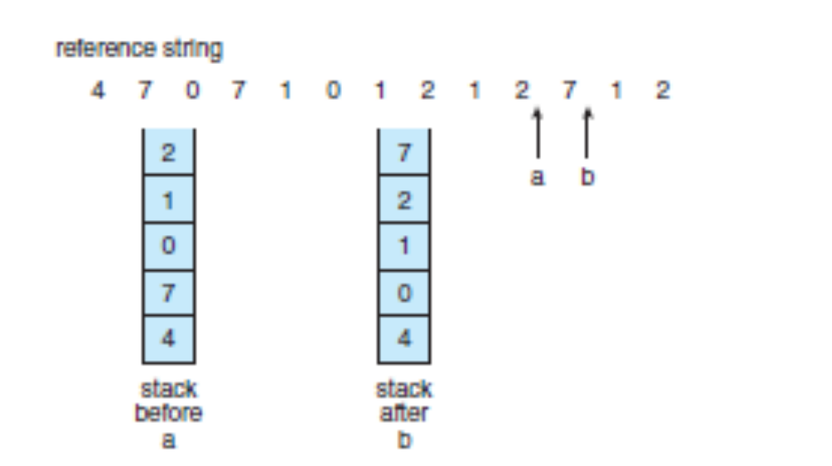
Use of Stack to record the most recent page references

Slide 55
LRU-Approximation Page Replacement
Hardware support for LRU is provided in the form of reference bit
Reference bits are associated with each entry in the page table
Initially all bits are set to 0. as and when the page is referenced its set to 1 by the hardware.
This is the basis for approximation of LRU replacement algorithm

Slide 56
Additional-reference-bits algorithm
Additional ordering information is gained by recording the reference bits at regular intervals
At regular intervals, a timer interrupt transfers control to OS and OS shifts the reference bit for each page to high order bit of 8-bit byte shifting other bits to right by 1 bit
Last 8 time period history of page is stored in this 8 bits.

Slide 57
Contd…
00000000-page not used for the last 8 time periods
11111111-page used once in each time period
11000100-used recently
01110111-not used recently
The page with a lowest number(integer) is the LRU page.

Slide 58
Second chance algorithm
Basic algo-FIFO
Page is selected, reference bit is checked
  Ref bit is 0 –replace page
  Not 0 then give second chance and move to select the next fifo page
When a page gets a second chance, reference bit is cleared and arrival time is reset to current time.

Slide 59
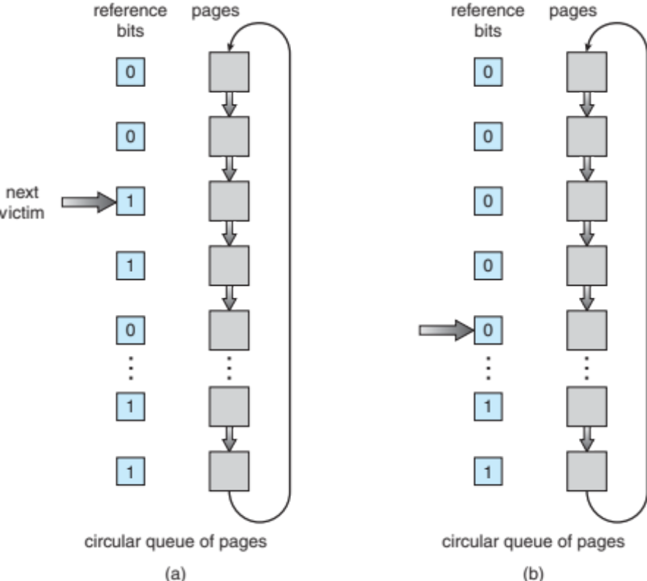
Implementation of second chance algo-clock algorithm

Slide 60
Enhanced Second-chance algorithm
Improve algorithm by using reference bit and modify bit (if available) in concert
Take ordered pair (reference, modify)
(0, 0) neither recently used not modified – best page to replace
(0, 1) not recently used but modified – not quite as good, must write out before replacement
(1, 0) recently used but clean – probably will be used again soon
(1, 1) recently used and modified – probably will be used again soon and need to write out before replacement
When page replacement called for, use the clock scheme but use the four classes replace page in lowest non-empty class
  Might need to search circular queue several times
This algo is different from second-chance algo is that here we give preference to those pages that have been modified

Slide 61
Counting Algorithms
Keep a counter of the number of references that have been made to each page
  Not common
Lease Frequently Used (LFU) Algorithm: replaces page with smallest count
Most Frequently Used (MFU) Algorithm: based on the argument that the page with the smallest count was probably just brought in and has yet to be used

Slide 62
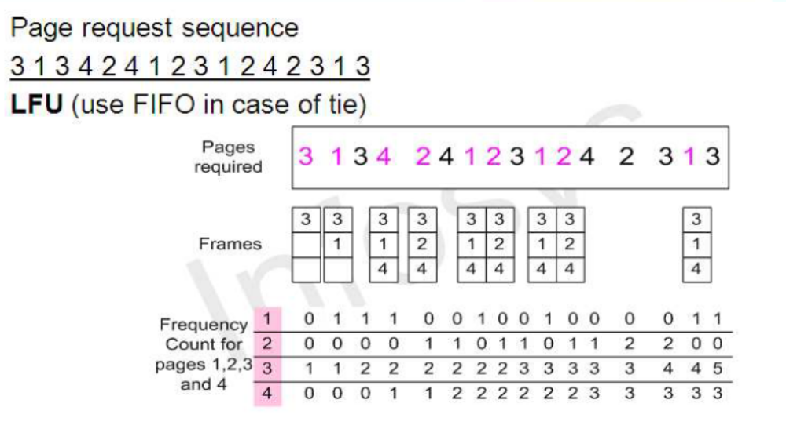
LFU
Number of page fault is 9

Slide 63
Page-Buffering Algorithms
Keep a pool of free frames, always
  When page fault occurs, a victim frame is chosen as before
  Desired page is read into a free frame from the pool before the victim is written out.
  Allows to restart immediately
  When victim is written out, its frame is added to the free-frame pool
Possibly, keep list of modified pages
  Whenever paging device is idle, a modified page is selected and written to the disk. Its modify nit is then reset.
  Possibly, keep free frame contents intact and note what is in them
  If referenced again before reused, no need to load contents again from disk
  Generally useful to reduce penalty if wrong victim frame selected

Slide 64
Summary of page replacement algorithms
What is page replacement?
  If no frame is free, one that is not currently being used is taken and freed.
Types
  FIFO (Disadv: Belady’s Anomaly)
  OPR
  LRU
LRU Approximation
  Additional reference bits algorithm
  Second chance algorithm
  Enhanced second-chance algorithm
Counting Based (Infrequently used)
  LFU
  MFU
Page Buffering Algorithms

Slide 65
Allocation of Frames
Each process gets the minimum number of frames which is defined by the architecture
The maximum number is defined by the amount of available physical memory

Slide 66
Allocation Algorithms
Split m frames among n processes is give every process m/n frames
The leftover frames can be used as a free-frame buffer pool. This is called as equal allocation
if processes are of different sizes use proportional allocation

Slide 67
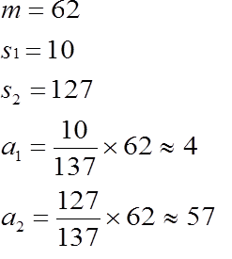

Proportional Algorithm
Allocate according to the size of process
  Dynamic as degree of multiprogramming, process sizes change

Slide 68
Priority Allocation
Use a proportional allocation scheme using priorities rather than size
If process P_{i} generates a page fault,
  select for replacement one of its frames
  select for replacement a frame from a process with lower priority number

Slide 69
Global vs. Local Allocation
Global replacement – process selects a replacement frame from the set of all frames; one process can take a frame from another
  But then process execution time can vary greatly
  But greater throughput so more common
Local replacement – each process selects from only its own set of allocated frames
  More consistent per-process performance
  But possibly underutilized memory

Slide 70
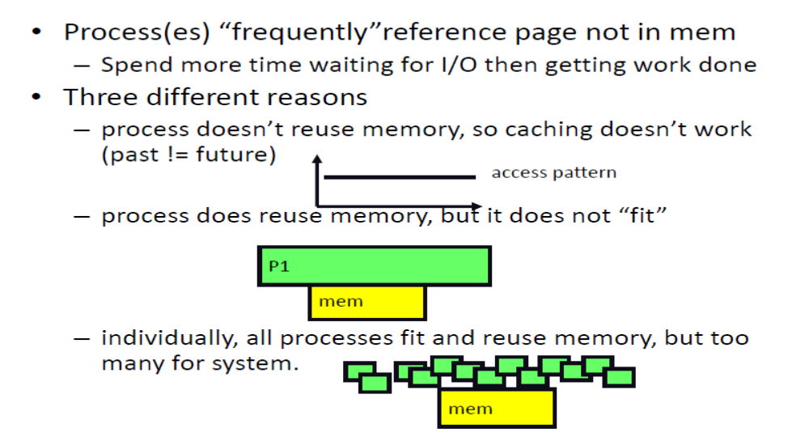
Thrashing

Slide 71
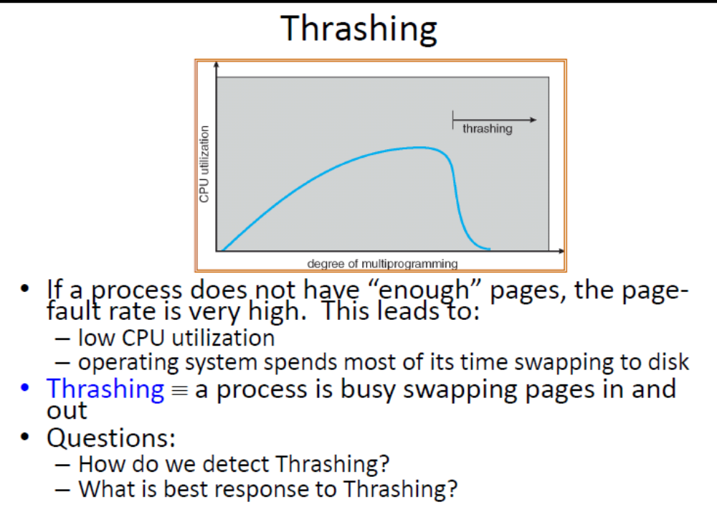

Slide 72
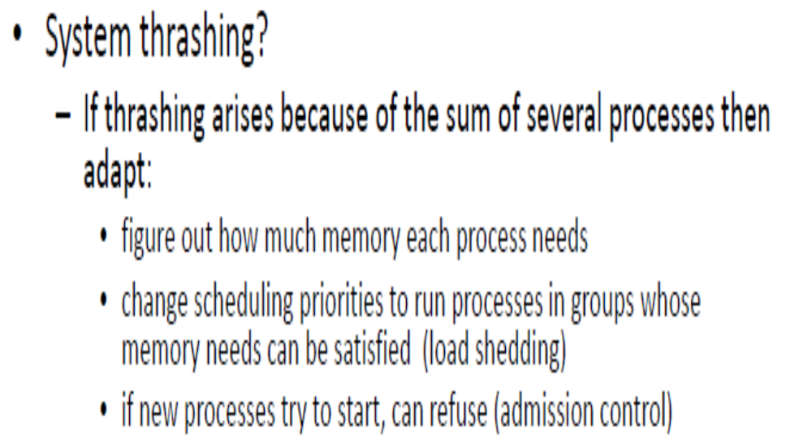

Slide 73
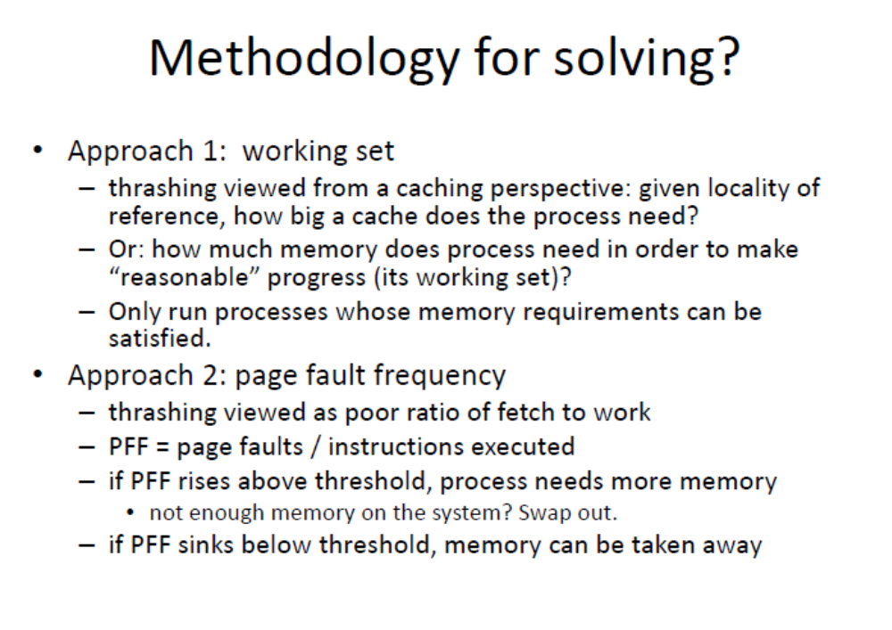

Slide 74
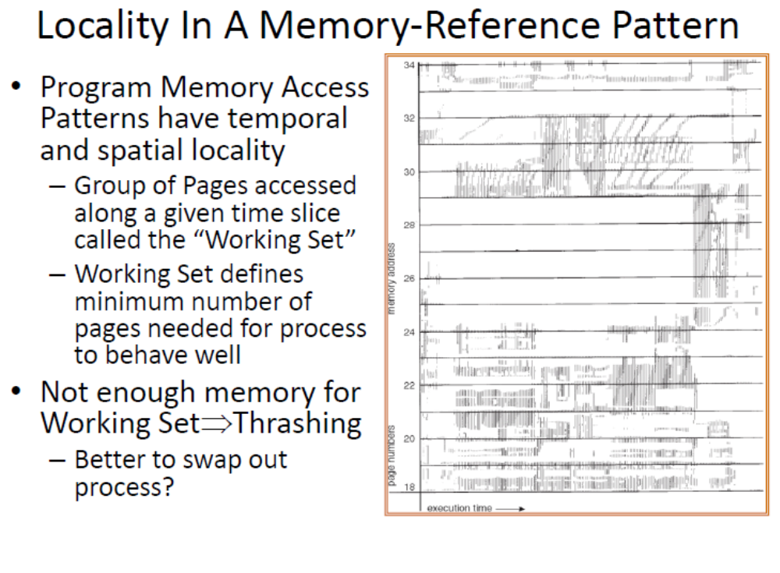

Slide 75
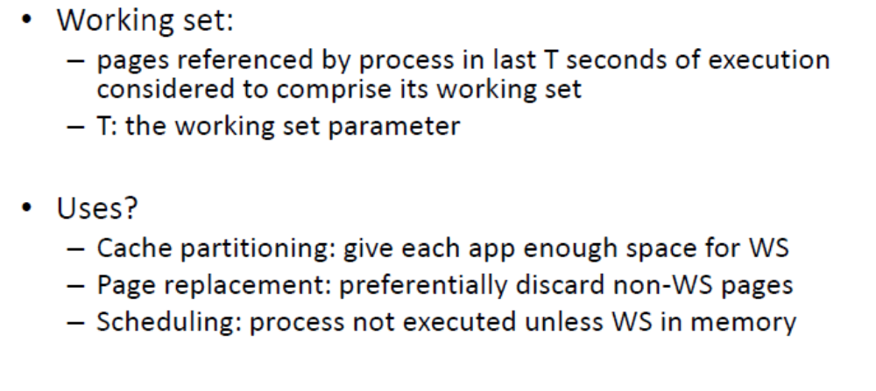

Slide 76
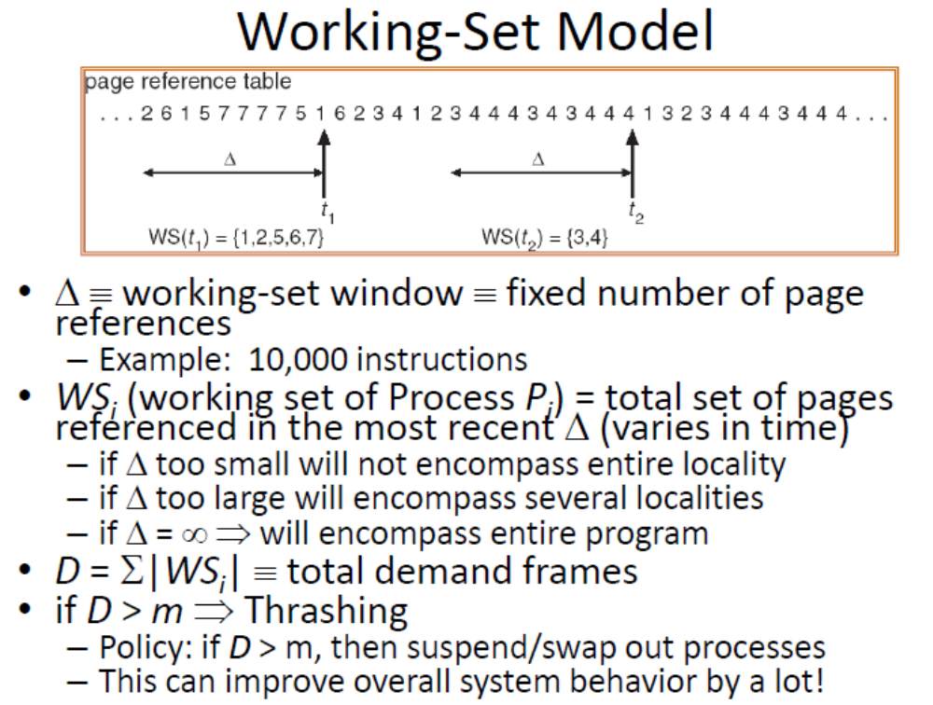

Slide 77
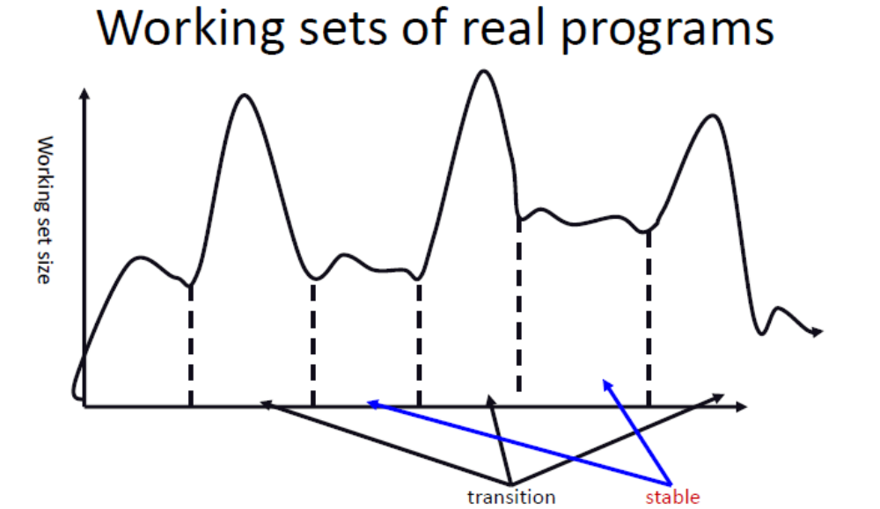

Slide 78
Important questions
What is paging? Explain the structure of page table
What is belady’s algorithm? Explain LRU, FIFO, OPR algos. Which algorithm suffers from Belady’s anomaly?
Short note on page fault handling
Explain virtual memory and demand paging
Draw and explain paging hardware with TLB
Explain paging in detail. Describe how logical address converted to physical address
Explain how memory management takes place in Linux

