Slide 1
GROUP B
Presenters
Elizabeth Mwakatimbo
Asha Charo
Abubakar Yussuf
Simon Machera

Slide 2
Problem
Accidents Occurring At Road Junctions

Slide 3
BAMAGA JUNCTION TRAFFIC LIGHTS
CASE STUDY:

Slide 4
JUSTIFICATION
1 student and 1 staff had an accident at Bamaga Junction this semester

Slide 5
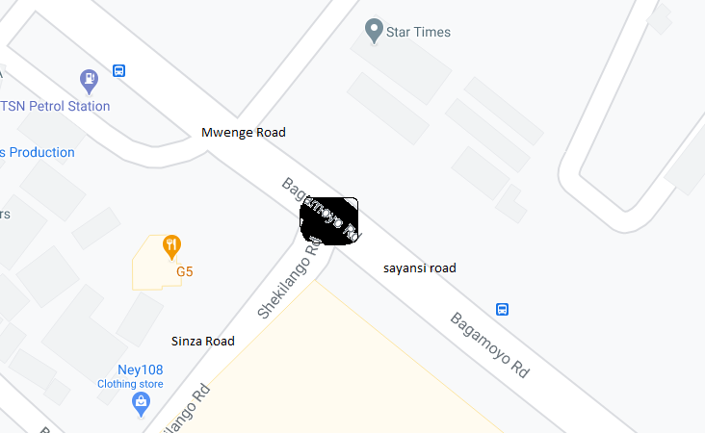
A Google Map Snapshot Of Bamaga Junction Area

Slide 6
HYPOTHESIS
The following do_{s} may lead to accidents around traffic light area
Negligence of the vehicles to abide to traffic light regulations
Negligence of the Bodaboda not wearing helmets
Negligence of the Pedestrians to use zebra crossing when crossing the road

Slide 7
HYPOTHESIS cont..
The following do_{s} may lead to accidents around traffic light area
Positioning of the zebra crossing
Rough driving or cycling
Dropping randomly passengers around traffic light areas

Slide 8
Methodologies
Tally the number of Cars that do not abide to the traffic lights rules
Tally the number of Bodaboda that do not abide to the traffic lights rules
Tally the number of pedestrians who do not use zebra crossing
Tally Vehicles that rough drive (likely pose to accident risk)
Tally the number of cars that outboard passengers around traffic light area
We observed the positioning of the zebra crossing around the area
Tally the number of Bodaboda that do not have helmets

Slide 9
Data collected from 0950 – 1050hrs
 | Morning (from 09500 - 1050 hrs)
 | side | x | y | z | A | B | c | TOTAL
 | SINZA ROAD | 5 | 19 | 36 | 39 | 29 | 0 | 128
 | MWENGE ROAD | 7 | 67 | 29 | 17 | 13 | 3 | 136
 | SAYANSI ROAD | 12 | 71 | 3 | 52 | 22 | 0 | 160
 | TOTAL | 24 | 157 | 68 | 108 | 64 | 3 | 424
 | KEY
 | X | Number of cars that pass red light |  |  |  | A | Number of events that posed great risk of accident
 | Y | Number of Bodaboda that pass red light |  |  |  | B | Number of Bodaboda's with no Helmet on
 | Z | Number of pedestrians that do not use zebra crossing |  |  |  | C | Number of cars outboarding passengers at Red light location

Slide 10
Data collected from 1400 – 1500hrs
 | Afternoon (from 1400 - 1500 hrs)
 | side | x | y | z | A | B | c | TOTAL
 | SINZA ROAD | 3 | 6 | 21 | 28 | 12 | 0 | 70
 | MWENGE ROAD | 7 | 54 | 71 | 41 | 35 | 9 | 217
 | SAYANSI ROAD | 7 | 52 | 20 | 31 | 27 | 0 | 137
 | TOTAL | 17 | 112 | 112 | 100 | 74 | 9 | 424
 | KEY
 | X | Number of cars that pass red light |  |  |  | A | Number of events that posed great risk of accident
 | Y | Number of Bodaboda that pass red light |  |  |  | B | Number of Bodaboda's with no Helmet on
 | Z | Number of pedestrians that do not use zebra crossing |  |  |  | C | Number of cars out boarding passengers at Red light location

Slide 11
A Graph Showing The Number Of Cars Violating Traffic Light Versus The Side That The Car Comes From

Slide 12
A Graph Showing The Number Of Bodaboda Violating Traffic Light Versus The Side That The Bodaboda Comes From

Slide 13
A Graph Showing The Number Of Pedestrians Not Using Zebra Crossing Versus The Side Of The Road They Are Using

Slide 14
A Graph Showing Number Of Risk Events That Happened And The Side Of The Road That They Occured

Slide 15
Analysis From The Graphs And Field Observation
The number of violations from cars not observing traffic lights is very low
The number of violations from Bodaboda not observing traffic lights is very high
A large number of pedestrians do not prefer using zebra crossing when crossing the road
A large number of risk events that may result to accident come from Bodabodas

Slide 16
Possible Solutions
Construct a footbridge for pedestrian on the Mwenge Road side (Side with a lot of pedestrians)
Red light cameras, Automatically photograph vehicles that run red lights
Use of mass media to educate all citizens on the importance of Zebra crossing

Slide 17
Note
These data were collected when construction activities were taking place
The outcome of the study may be different when construction activities are done

Slide 18
THANK YOU!

Slide 19
QUESTIONS AND ANSWERS

