Slide 1
DriverPass
System Analysis
Cynthia Turner | CS 255 | October 2026
A clear path from customer registration to confident lesson scheduling
Notes:
This presentation summarizes the proposed DriverPass system in plain language. I will focus on how the design supports customers and employees, while the full system design document provides the technical detail for the development team.

Slide 2
System Requirements
The first release focuses on dependable scheduling, learning access, and secure records.
What the system must do
How the system should work
• Customers can register, choose a package, and manage their own reservations.
• The secretary can help customers and assign available drivers and vehicles.
• Customers can use online classes and practice tests when their package includes them.
• The owner can view and download business activity reports.
• Pages should load within about three seconds in normal conditions.
• Reservation searches and confirmations should return within five seconds.
• The service should work through supported browsers on computers and mobile devices.
• The system should keep backups and preserve changes when several people work at once.
Notes:
The functional requirements describe the services DriverPass employees and customers need every day. The nonfunctional requirements describe the experience around those services: reasonable response times, browser access, reliable updates, and backups. Together they support the business goal of making driver training easier to manage without creating scheduling conflicts.

Slide 3
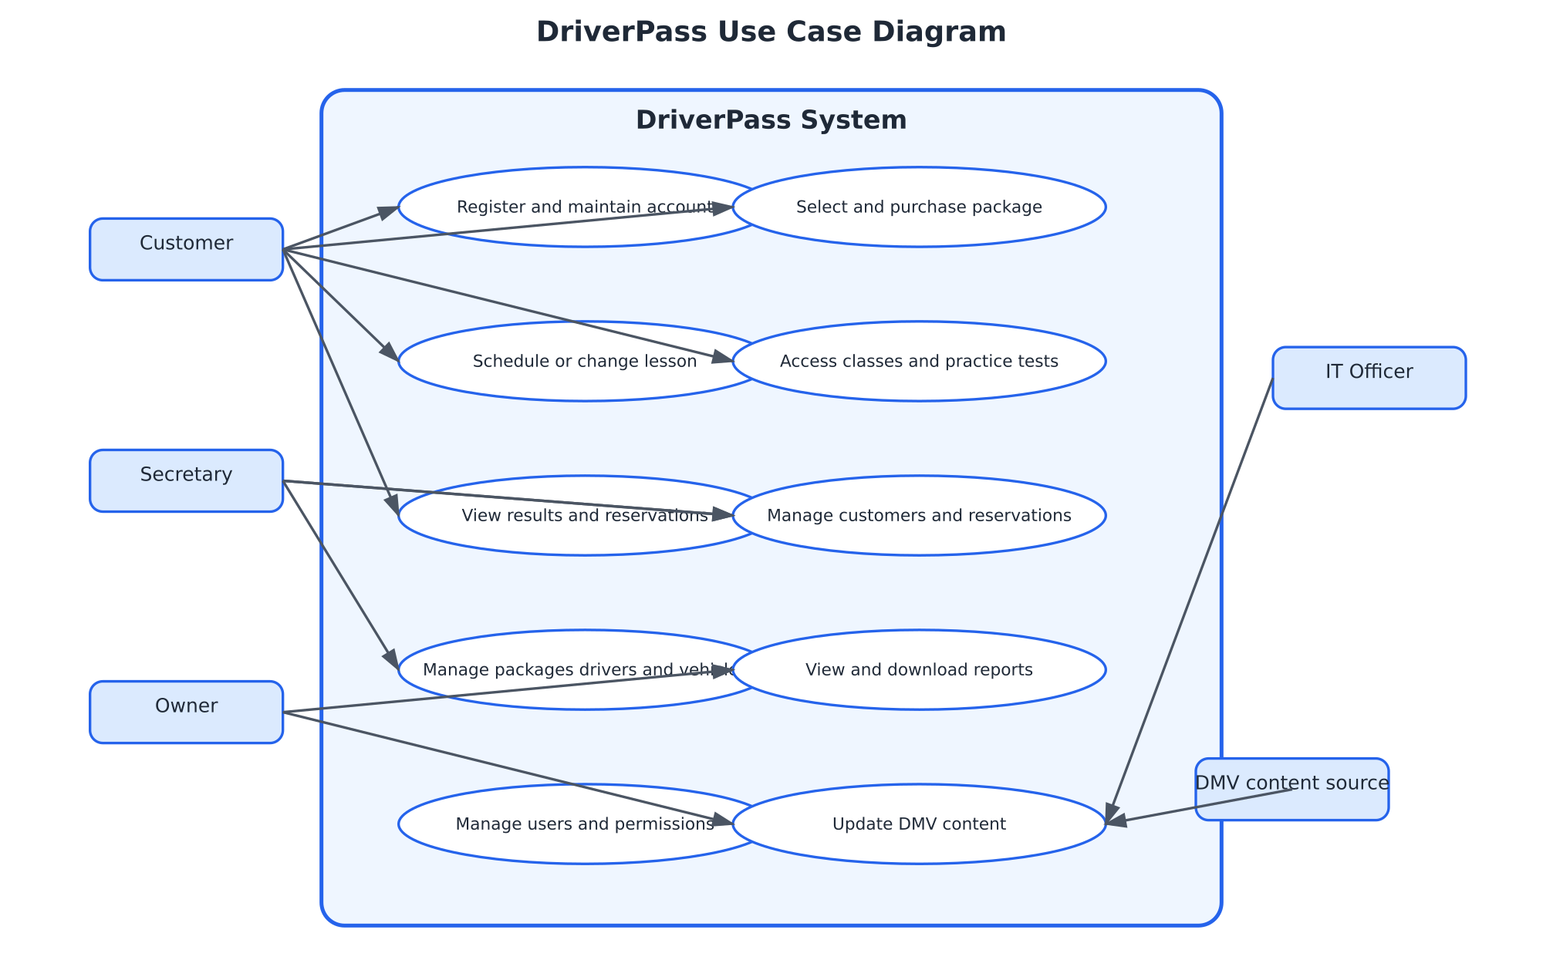
Use Case Diagram
The system gives each person a focused set of responsibilities.
Notes:
This diagram shows the people who use DriverPass and the outside source that provides DMV content. Customers manage their accounts, packages, lessons, learning materials, and results. The secretary supports account and scheduling work. The owner reviews reports. The IT officer manages access and system settings. The design meets DriverPass’s needs by separating responsibilities while keeping the customer experience connected from registration through training.

Slide 4
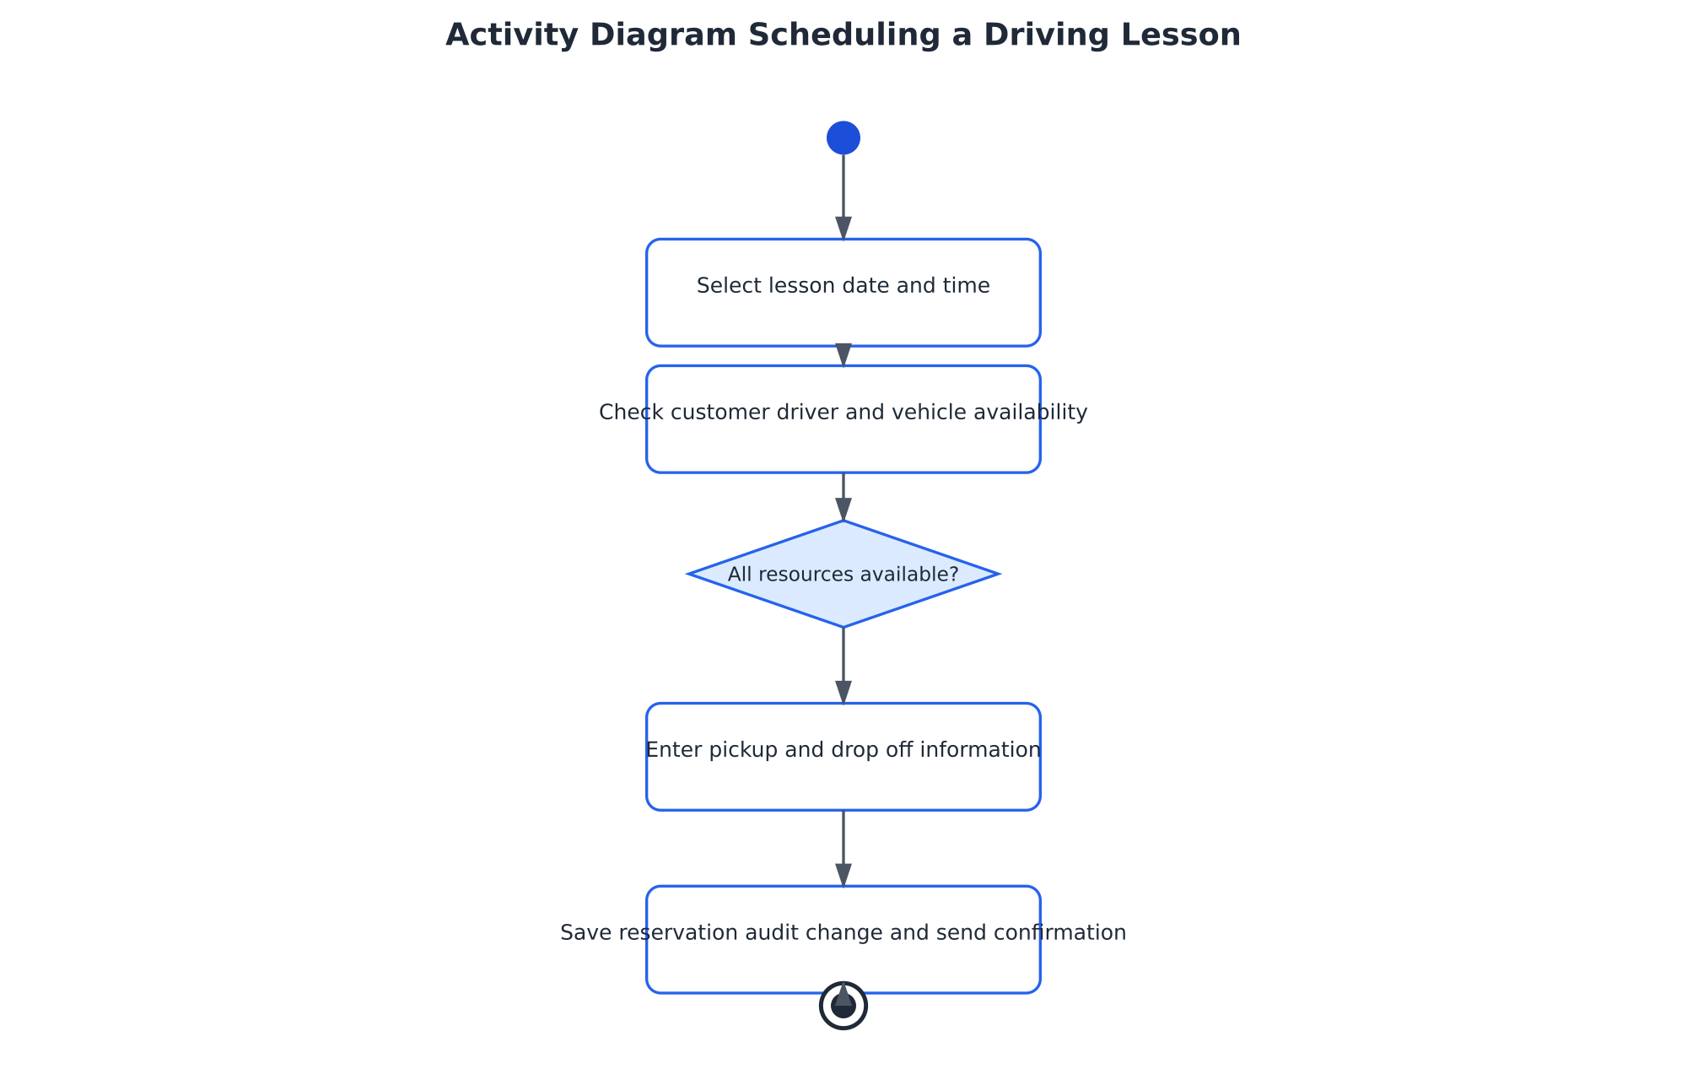
Activity Diagram
Scheduling a lesson includes an availability check before the appointment is saved.
Notes:
This diagram breaks down the lesson scheduling process. A customer or secretary chooses a time, and the system checks whether the customer, driver, and vehicle are available. If any resource is already assigned, the user chooses again. If everything is available, the system records the pickup and drop-off details, saves the appointment, records who made the change, and sends a confirmation. This protects DriverPass from double-booking and gives the customer a clear result.

Slide 5
Security
The design protects customer information and makes important changes traceable.
• Secure browser connections protect information while it travels between the user and DriverPass.
• Passwords are stored in a protected form and are never saved as readable text.
• Repeated failed sign-ins can trigger a temporary lockout and an alert to the IT officer.
• Customers can access only their own information. Employee access depends on job responsibility.
• The system records account, reservation, security, and administrative changes.
Security supports trust without adding unnecessary steps for routine customers.
Notes:
Security was included as part of the design rather than added after the main features. Customers need confidence that their contact, payment, and training information is protected. Employees need access to perform their jobs, but they should not see or change information outside their responsibilities. The activity history also helps DriverPass understand what happened when an account or reservation changes.

Slide 6
System Limitations
The first release has a clear boundary so the core service can be delivered reliably.
• The first release may not include a native mobile app, offline access, or voice interaction.
• The system may not connect to every DMV system automatically.
• DriverPass must provide current driver, vehicle, schedule, package, and DMV content information.
• Available lesson times depend on the drivers and vehicles entered by DriverPass employees.
• The service supports preparation and training but cannot guarantee that a customer passes a driving test.
• Budget, schedule, and staffing may limit advanced reports and additional locations at launch.
Notes:
These limitations set reasonable expectations for the first release. A browser-based system allows DriverPass to support customers on many devices without maintaining a separate mobile application immediately. The service can prepare students and organize training, but the final driving-test result remains outside the system’s control. Future releases can add integrations, locations, and more advanced reporting as the business gains experience with the core system.

