Slide 1
Programming Patterns

Slide 2
Programming Patterns
1994 – Gang of four release “Elements of Reusable Code”
  Program to an interface not an implementation
  Favor object composition over inheritance
I'm assuming you all know this...

Slide 3
Unity
Unity is actually Design Pattern heavy. It's built on:
  Behavioral Patterns:
    “Type Object”
  Sequencing Patterns:
    “Game Loop”
    “Update Method”
  Decoupling Patterns:
    “Component Model”

Slide 4
But we can take this further
Unity does not enforce any structure on us, so we need to be careful when we build our own

Slide 5
Singleton
You definitely should know this...
  Ensure there's one instance of a class
  With a globally accessible point of access
In practice, a static class member variable we init on first use.
Why?
  “Managers”

Slide 6
Singleton
Pros:
  Doesn't exist if we don't use it (CPU/Mem)
  Initialised at runtime. (Static classes are initialised before “main()”)
  Can be subclassed – variants for different platforms!

Slide 7
Singleton
Cons:
  It's Global – Anything could be touching that data during this Update()
    We'll end up putting Set{...} wrappers around data to debug efficiently
    Instead, we can pass references in through inheritance / add functionality to base classes
  Encourages “managers”
    “Bullet Manager” / “Baddie Manager”

Slide 8
Object Pool
Another we know about
  “Create” all the GameObjects we need during Start/Awake
  Stick them in an array, or “pool”
  Instead of Instantiate(), grab a “new” object from the pool
  When object “dies” it returns to the pool
Why?
  Garbage collection is bad, m'kay?

Slide 9
Command
“Object Oriented replacements for callbacks”
Allows us to wrap a method and data into an object that can be executed and/or stored
Instead of:
if(m_CharAction.Jump.IsPressed)
    DoJump();

Slide 10
We add a layer of indirection:
  interface ICommand
  {
    void Execute() …
  if(m_CharAction.Jump.IsPressed)
      Jump.Execute()

Slide 11
Why?
Through inheritance or Interface implementation we can perform a direct “action” on any object that implements the command.
Or through composition, we can perform the command on the object instance we hold, to affect ourselves
We can modify this indirection to “return” commands, which can be stored
  if(Action) return Command

Slide 12
What's the big win?
  If you can defined “Execute” you can also define “Undo”
When we're returning commands, we can store them in an array.

Slide 13
Advance Wars:
  Want to cancel an order? Call Unit.Undo() and move the current pointer in the array back by one.
  Redo? Unit.Execute() and move the pointer forward.
UI
  Track user changes, allow for “cancel”
Dead useful...

Slide 14
Observer
This pattern is everywhere.
Is the basis of the Model-View-Controller pattern
  Java.util.Observer
  Or in C#: public event MyEventHandler …
Relevant code can trigger an event, Observers can respond to the event
Most common use in games: Achievements

Slide 15
I use this a lot in the UI
  One component on a GameObject setup as an observer
  Has functions that respond to button events
  Buttons fire events when player does something
  The observer can “block” new events until it has responded to the initial one
  Observer can directly effect canvas objects it knows about
  Less logic in individual UI Canvas / Buttons – they remain decoupled.

Slide 16
State
This is what we care about today.
Games have many, many different states.
At a high level:
Splash
Screen
Main Menu
Level 1

Slide 17
But it's more fine grained:
Splash Screen will:
  Fade logo in
  Play some animation
  Fade Logo out
  And do setup work in the background.
Each of these is a “state” of the Splash Screen

Slide 18
AI & NPCs all have state
  Behaviour trees are effectively state machines
Animation
  Mecanim is a state machine
So we'll use this pattern again and again...

Slide 19
Most people's first approach at this is a collection of If statements, or a Switch:
  switch(currentState)
  {
    Case SplashScreen:
      if(LogoFading)
        Do something here
      Else
        Ok, do this other thing here

Slide 20
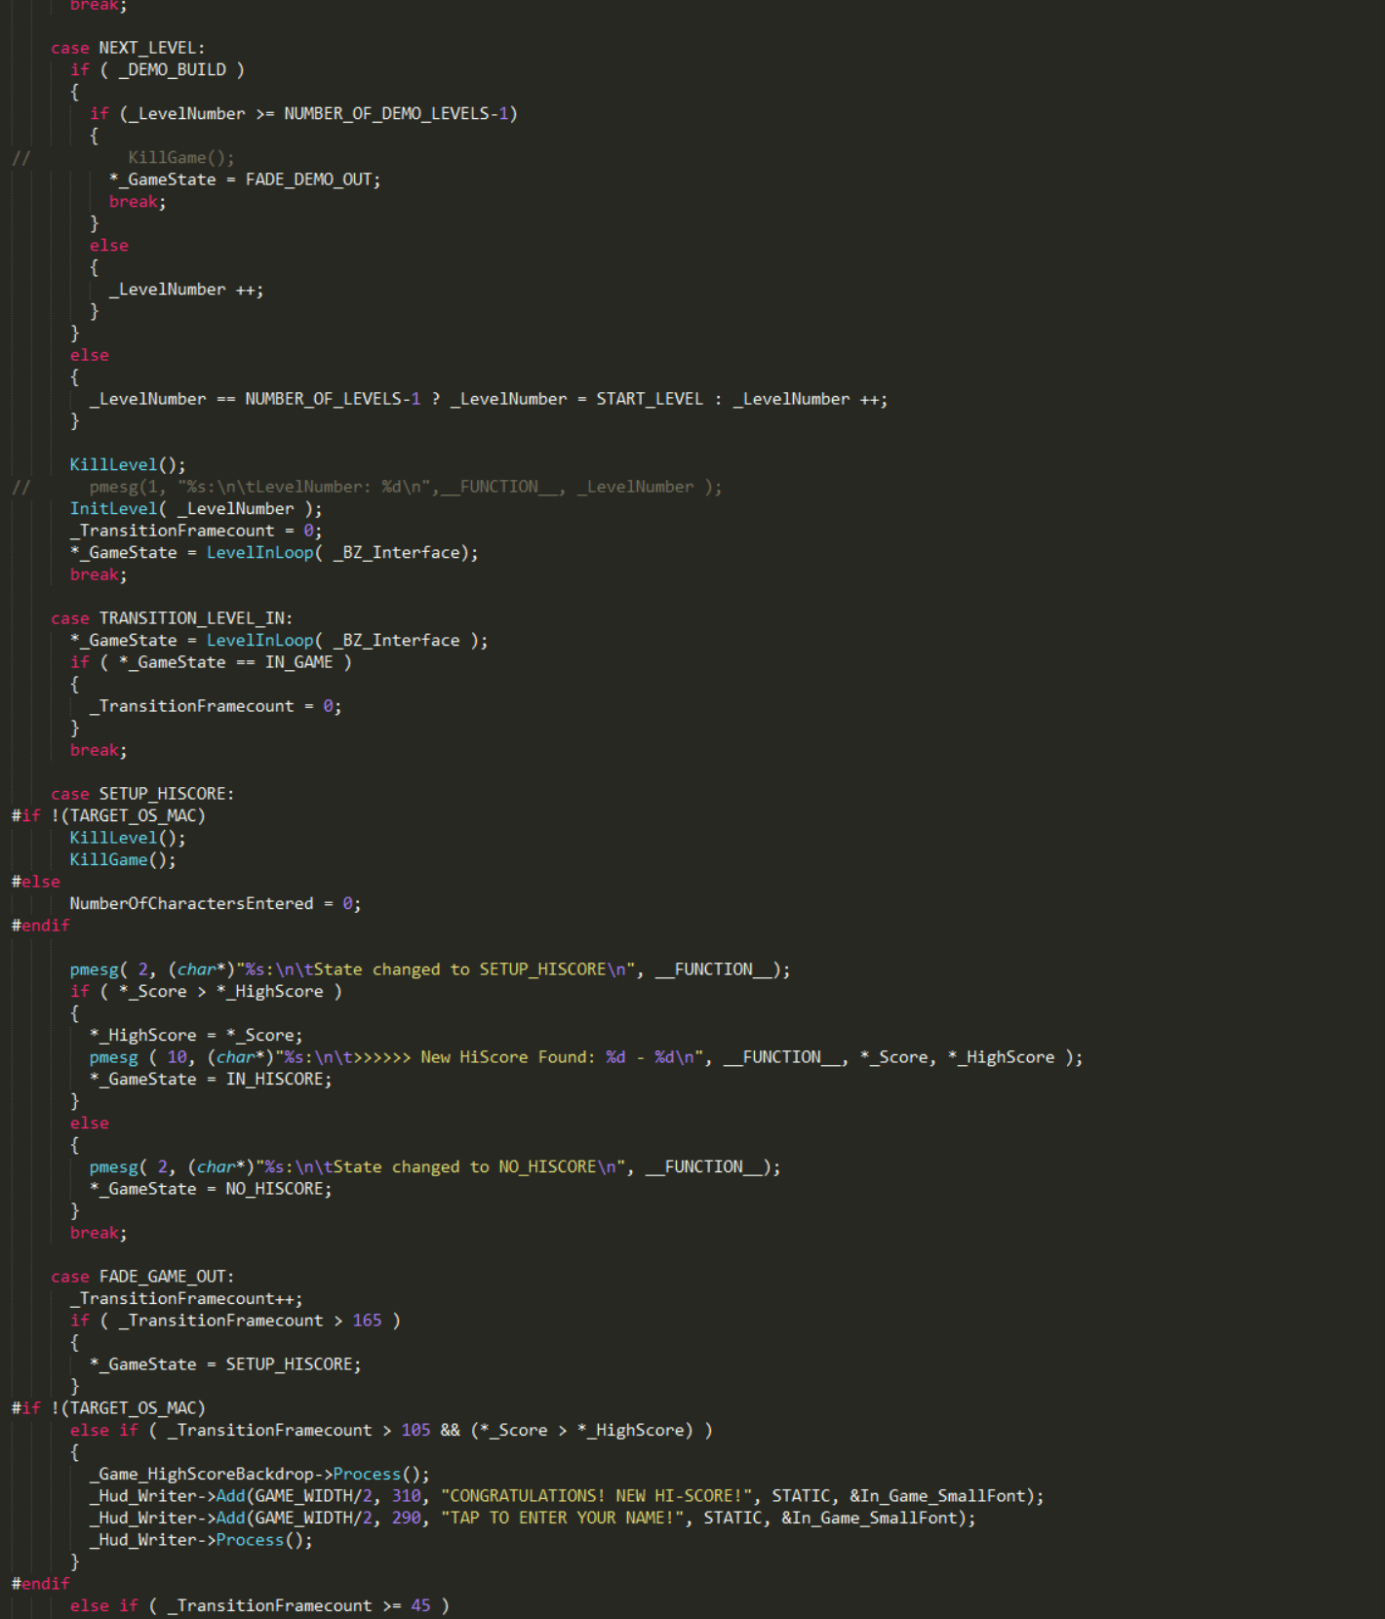

Slide 21
900 line switch statement
Most cases had several embedded IF statements
When it did get to a function call, many of these contained their own switch statements
Debugging this was “not fun”
Adding features (Demo version) was “not fun”

Slide 22
To use the technical term:
“This grows arms and legs”

Slide 23
Finite State Machines
The FSM is a mathematicl model of computation
  Computer Scientists love it
State machines can be represented by directed graphs (State Diagrams)
  Software Engineers love these
Game developers love stealing things, so lets take the bits we want and bend it to our will...

Slide 24
State
In terms of Unity, simplest implementation:
  A “state” is a component on a GameObject
The state's Update() handles our processing
We can add Observers / other functionality through composition
  Either through direct invocation
  Or by defining events
It is solely responsibly for movement to the next state

Slide 25
State
public class GameState : MonoBehaviour
{
protected string m_sStateName = "BaseClass";
virtual public void Start()
{
Debug.Log("GameState: " + m_sStateName + "\n" );
}
virtual public void Update()
{
}
virtual public void OnDisable()
{
Debug.Log("Exiting game state...\n");
}
}

Slide 26
The base class needs a couple of other things to be useful:
public class GameState : MonoBehaviour
{
protected GameStateManager m_gcGameStateManager;
protected GameGlobals m_gcGameGlobals;

Slide 27
We can compose this in many ways, but one is:
virtual public void Start()
{
Debug.Log("GameState: " + m_sStateName + "\n" );
m_gcGameGlobals = GameGlobals.Instance;
m_gcGameStateManager =
m_gcGameGlobals.m_gcGameStateManager;
}

Slide 28
Simple derivation example [SplashScreen_In]:
public class gs_SplashScreenIn : GameState
{
private float m_fEventTime;
new void Start()
{
m_sStateName = "Splash Screen";
base.Start();
m_fEventTime = Time.time;
}
new void Update()
{
if (Time.time - m_fEventTime > 1.0f)
m_gcGameStateManager.ChangeState(...);
}

Slide 29
Game State Manager
Instead of a single Switch statement, and a lot of Ifs
We break down the game into a series of defined states
Create a set of components that we can instantiate – at runtime – to control the flow of the game
But we need functionality to manage this...

Slide 30
Unity also has some quirks that we need to take into account
  Existing objects are deleted when a new scene is loaded
    DontDestroyOnLoad
  When loading a scene, all scripts are paused
    The C# runtime is not executing at all
  There is no promise about execution order
    This leads to race conditions
    Although we can set priorities in the editor

Slide 31
GameStateManager can sit over the top of this
  Provides a function to “ChangeState”
  Sets up a new game object with the correct game state component
  Handle Unity specifics for scene changes
  Do any funky tricks we need for dev mode verses release (more on that later)

Slide 32
Change State
public void ChangeState(GameState.tStateType iState, string sLevelName="" )
{
Destroy(m_goGameState);
m_goGameState = new GameObject();
DontDestroyOnLoad(m_goGameState); // Never destroy...
if (sLevelName != "")
{
m_bWaitingForLoad = true;
m_iNewState = iState;
SceneManager.LoadScene(sLevelName);
}
else
SetState(iState);
}

Slide 33
Set State
private void SetState(GameState.tStateType iState)
{
switch (iState)
{
case GameState.tStateType._SplashScreenIn:
m_goGameState.AddComponent<gs_SplashScreenIn>();
m_goGameState.name = "GS: Splash Screen";
break;
case GameState.tStateType._MainMenuIn:
m_goGameState.AddComponent<gs_MainMenuIn>();
m_goGameState.name = "GS: Main Menu";
break;
Etc.
}
m_iNewState = GameState.tStateType._NULL;
m_bWaitingForLoad = false;
}

Slide 34
void OnEnable()
{
SceneManager.sceneLoaded += LevelWasLoaded;
}
void OnDisable()
{
SceneManager.sceneLoaded -= LevelWasLoaded;
}

Slide 35
public void LevelWasLoaded(Scene scene, LoadSceneMode mode)
{
if (m_bWaitingForLoad)
{
SetState(m_iNewState);
}
}

Slide 36
When ChangeState is called
  Destroys the existing GameState
  Tells Unity to load a new scene (if required)
  Waits for Unity to finish and responds to sceneLoaded event (if required)
  Creates a new Game Object and attaches the new Game State component to it
  Game State will then go through it's initialisation process as expected (Awake/Start)

Slide 37
Game State Manager can be a
  Static class
  Singleton
  Component on a game object
  etc
I tend to do the latter during development
  Exposing variables makes them visible in the editor
  Much easier to debug stuff at runtime when you can click on a game object and see what it's doing!

Slide 38
Scene Setup
We're going to end up with a few classes that are omnipotent in our game
  Audio Interface
  Game State Manager
  Input Interface
  Game Globals
  Achievements / Leaderboard Observers – Platform specific
  Localisation
  Save Games

Slide 39
What I tend to do is set these up in a Splash Screen
A “Persistent Objects” game object (DontDestroyOnLoad)
  Child objects, each with a manager component on.
  Obviously you can drop these all on one GameObject but I like some segregation
Often my GameGlobals singleton will contain a member variable for each manager

Slide 40
If I'm being amazingly lazy:
  GameGlobals.Instance.m_gcGameStateManager….
  GameGlobals.Instance.m_gcAudioManager…
  Danger, Danger, Danger!
Handy for quick access to events for delegation, tho...

Slide 41
One BIG problem with this…
  If I'm working in a random level, and press play…
  No persistent objects!
  Game's not going to run properly!

Slide 42
DevModeCheck
public class DevModeCheck : MonoBehaviour {
public string m_sSceneName;
void Awake()
{
GameObject obj = GameObject.Find("PersistentObjects");
if (null == obj)
{
Debug.Log("Unable to find Persistent objects, loading the splashscreen...");
DontDestroyOnLoad(gameObject);
SceneManager.LoadScene("SplashScreen");
}
}
}

Slide 43
Game State Manager
void Awake()
{
DontDestroyOnLoad(GameObject.Find("PersistentObjects"));
// Check for Dev Mode
GameObject obj = GameObject.Find("DevModeCheck");
if (null != obj)
{
Debug.Log("Found a DevModeCheck from open scene, entering dev mode...");
DevModeCheck scene = obj.GetComponent<DevModeCheck>();
m_sDevModeSceneToLoad = scene.m_sSceneName;
Destroy(obj);
}
}

Slide 44
Game State Manager
void Start ()
{
// Did Awake find a dev mode check game object?
if (m_sDevModeSceneToLoad != "")
{
ChangeState(GameState.tStateType._GameIn, m_sDevModeSceneToLoad);
m_sDevModeSceneToLoad = "";
}
else
{
// No? Start up as normal then
DontDestroyOnLoad(m_goGameState);
SetState(GameState.tStateType._SplashScreenIn);
}
}

Slide 45
So we create a game object called DevModeCheck
We set the “scene name” string to the name of the scene we're working in (dur)
And woo, no matter where we press play, the game will be setup as if we'd gone through the normal boot process
  Handy shortcut
  No duplication of stuff in every scene

Slide 46
Your Misson
Create 2 new scenes:
  SplashScreen
  MainMenu
Two new classes: GameStateManager & GameGlobals
  Set them up in the Splash Screen scene
Write a base GameState class
  And derive 3 game states:
    SplashScreen_In
    MainMenu_In
    Game_In

Slide 47
For the first pass:
  Splash Screen should just load Main Menu
  Main Menu should just load Level 1
  Level 1 should play as we have it now…
  Extra points for DevModeCheck
When you've done this, zip up your project, keep it safe
  You will be required to hand it in at the end of the course!

