Slide 1

House Price Prediction
By Cynthia Matinou
Data 606- Capstone Project
Dr. Chaojie Wang, May 14th,2023

Slide 2
Contents
Abstract
About the Data set
Pre-processing
EDA
Machine Learning Models
Demo
Conclusion

Slide 3
Abstract
Things to know about the real estate industry
Some reasons why it is important
Clients will benefit from being able to invest money in a bequest without turning to a broker.
There is even a possibility to predict future cost.

Slide 4
About the Data Set
So I picked the dataset from Kaggle. This dataset is about organizing a sizable collection of real estate sales records that are kept in unknown format and have unknown data quality issues based on the info supplied.
Data Overview This dataset is made up of 18 columns, with dtypes: float64(4), int64(9), object(5) memory usage: 647.0+ KB.
The columns are price, bedrooms, bathrooms, sqft_living, sqft_lot, floors, waterfront, view, condition, sqft_above, sqft_basement, yr_built, yr_renovated, street, city, statezip, and country. This Data is for America as a whole, from 2005 to 2022

Slide 5
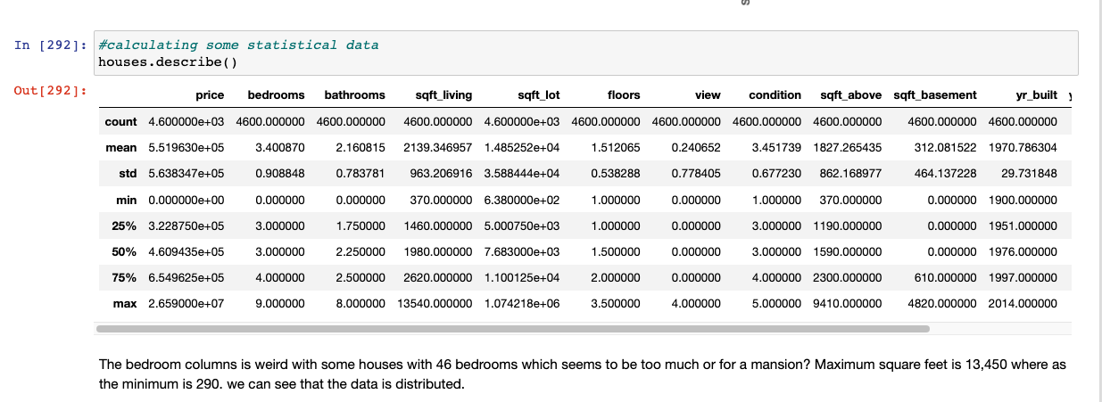
Pre-processing
Got rid of nulls
Got rid of duplicates
Got rid of columns I did not want to use
Then I did the describe function (describe()) to see some stats

Slide 6

Exploratory Data Analysis

Slide 7
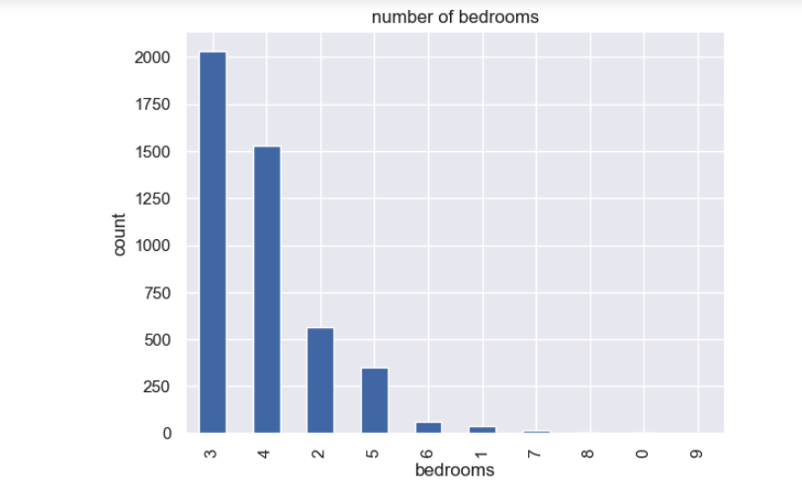
Data distribution plots
Bedrooms

Slide 8
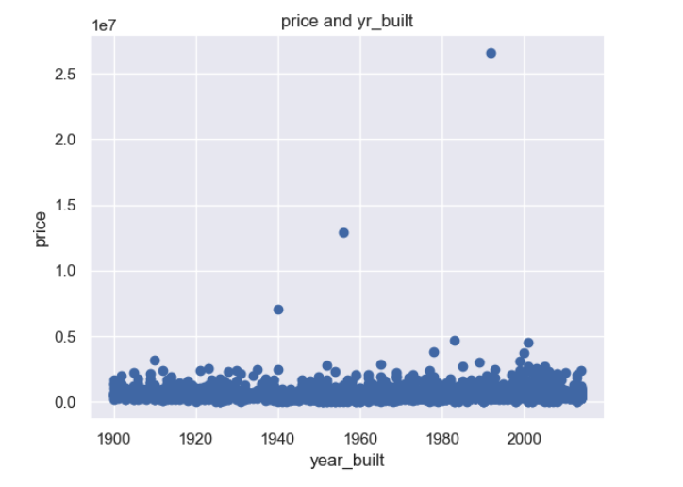
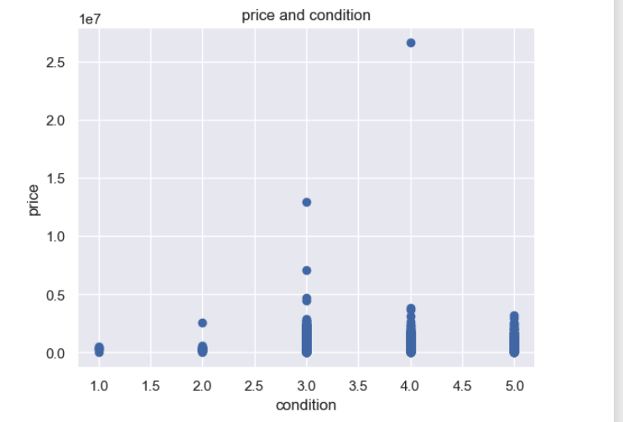
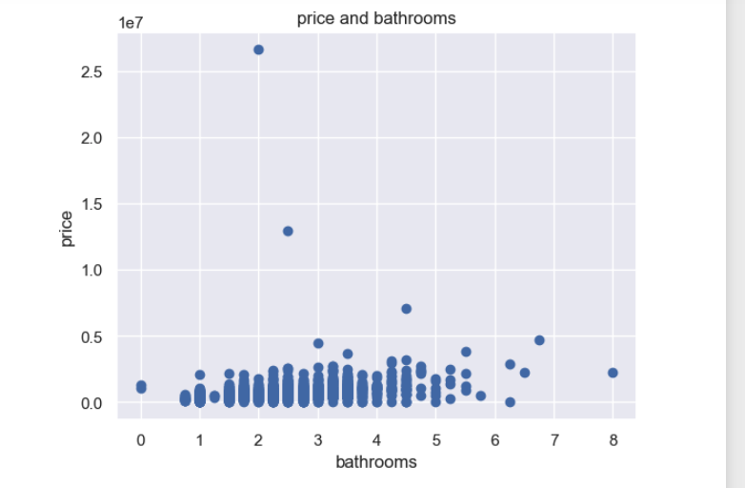
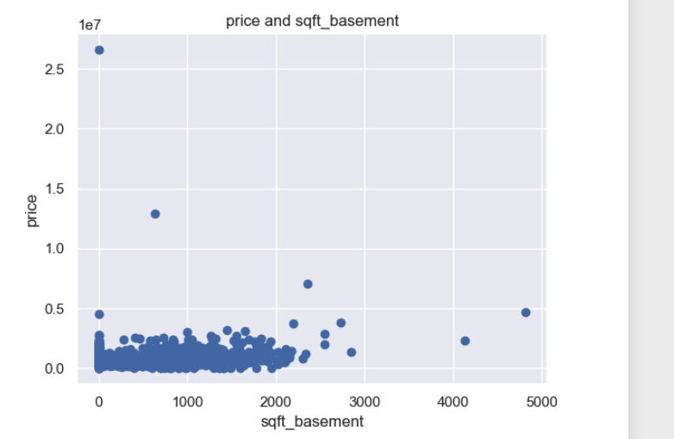
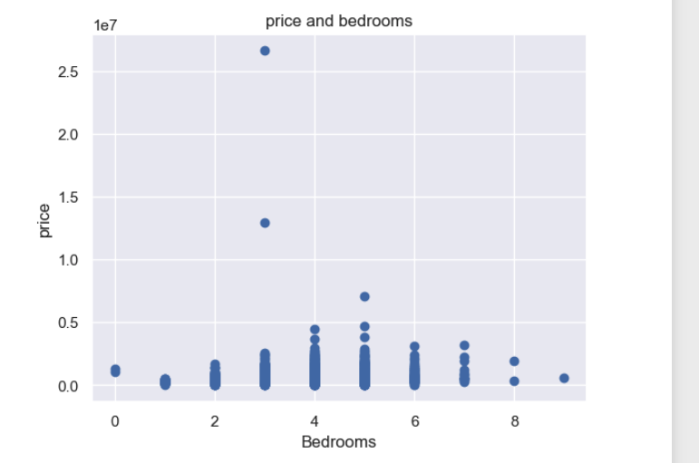
How common factors are affecting the price of the houses

Slide 9
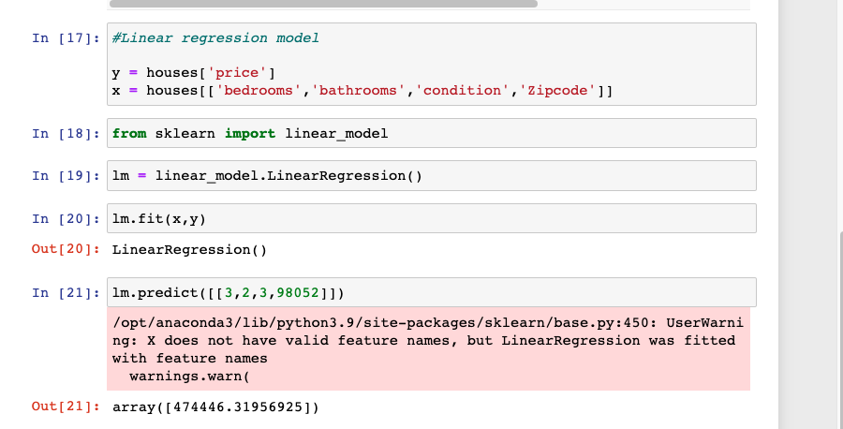
Linear regression model
imported my dependencies , for linear regression we use sklearn (built in python library) and import linear regression from it.
Here are my dependent and independent variables.
Dependent variable: “Price”
Independent variables: Bedrooms, bathrooms, condition, and Zipcode
Then fitted and saved the model
I built the model
Then predicted

Slide 10
Deploying all of that on a website
lm.predict() accepts inputs in dataframe format [[]].
I used Flask to send verythong from the backend to the frontend
Before that save the model with pickle

Slide 12
Conclusions from the EDA

Slide 14
Machine Learning Model

Slide 15
Demo of the web Application

Slide 16
Conclusions/comments

