Slide 1
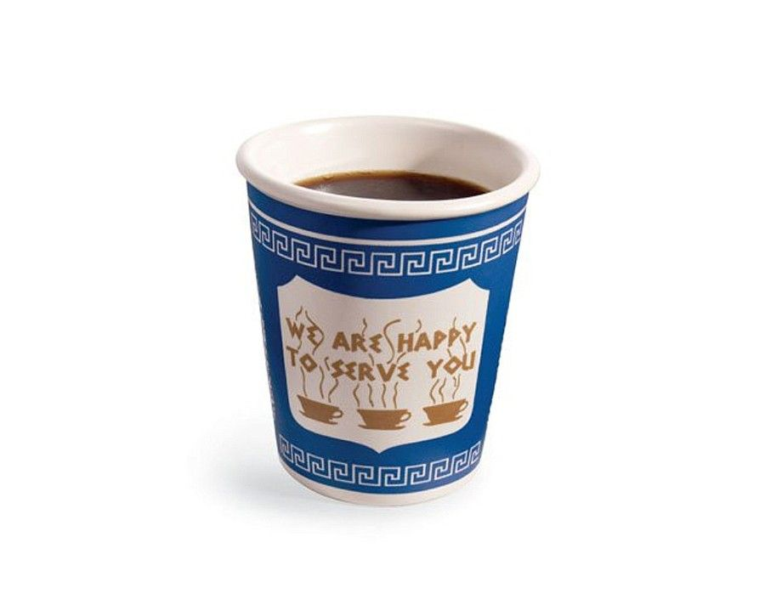
R, R Markdown, data frames, and categorical data

Slide 2
Overview
Quick review from last class
Statistics concepts
Continuation with R
R as a calculator, objects, data types
Functions, vectors and packages
R Markdown
Formatting
Code Chunks
More R
Data frames
If there is time: Categorical data - statistics and plots

Slide 3

Any questions about anything?

Slide 4
Announcement: learning groups!
Abby is organizing learning groups where students can get together (independent of TAs) to work on the homework and other class projects.
If you are interested in being part of a learning group please sign up!
A link to sign up will be put on Canvas and will be sent out as an announcement.
Notes:
Learning Groups

Slide 5
Announcement: Short reading and homework 1
1. Please read the article The Big Lies People Tell in Online Dating and fill out a quick survey about the article
2. Also, it would be good to start on homework 1
> SDS230::download_homework(1)
Homework 1 is due on Gradescope by 11pm on Sunday September 10th
Instructions for how to submit homework on Gradescope are on Canvas

Slide 6


Slide 7

Quick Review of central concepts in Intro Statistics
We need to see through the random variation (noise)
to get to the underlying consistency (Truth)

Slide 8
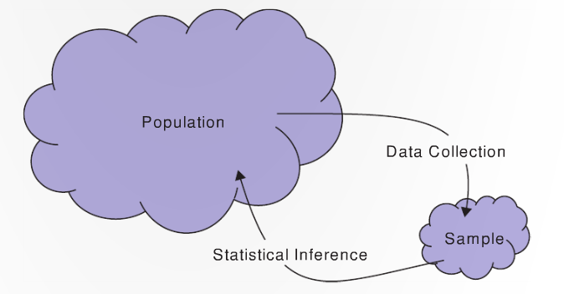
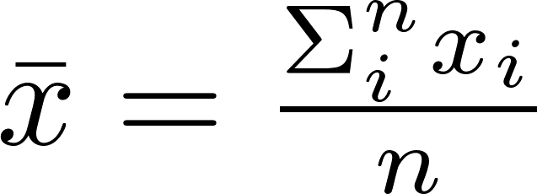
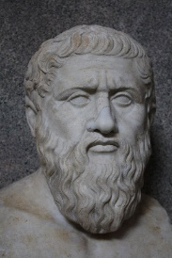

Parameters and statistics commonly used symbols
 | Population parameter (Plato) | Sample statistic (shadow)
Mean | μ | x̄
Standard deviation | σ | s
Proportion | π | p̂
Correlation | ρ | r
Regression slope | β | b

Slide 9
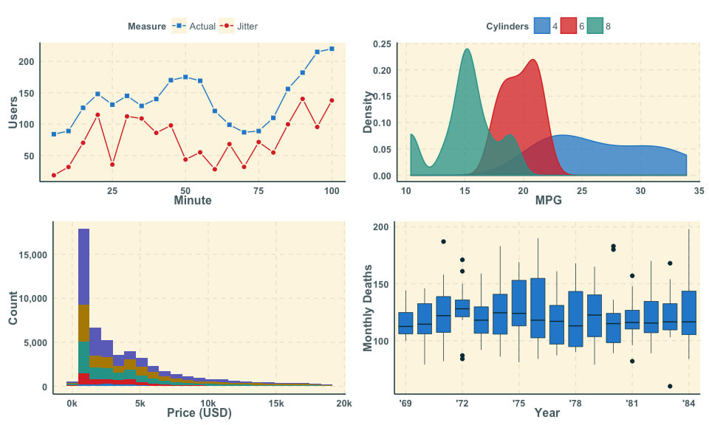
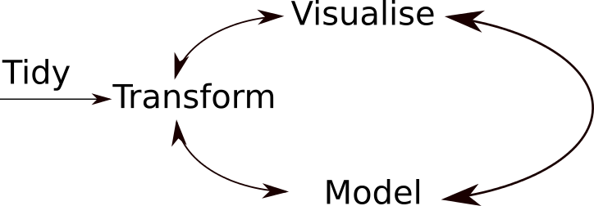
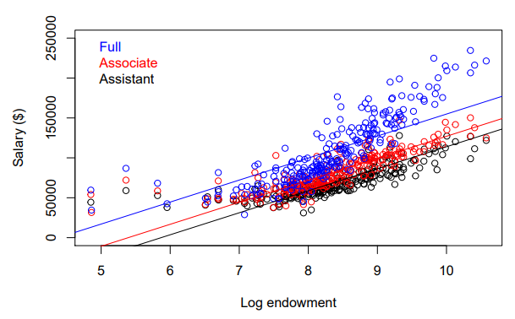
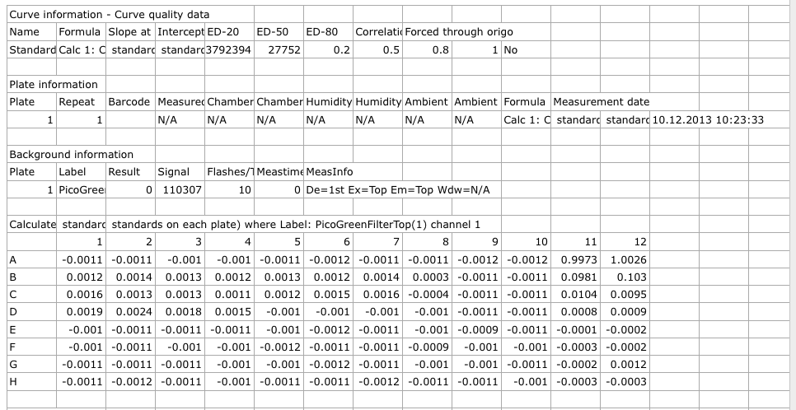
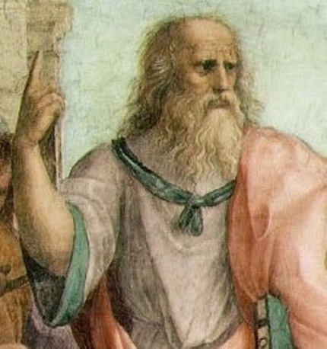
Sometimes the Truth is more complicated…

Slide 10

Question
Q: What kind of grades the pirate get in Data Exploration and Analysis?
Q: Worst joke of the semester?
Notes:
http://www.piratejokes.net/jokes/arr?pg=1

Slide 11
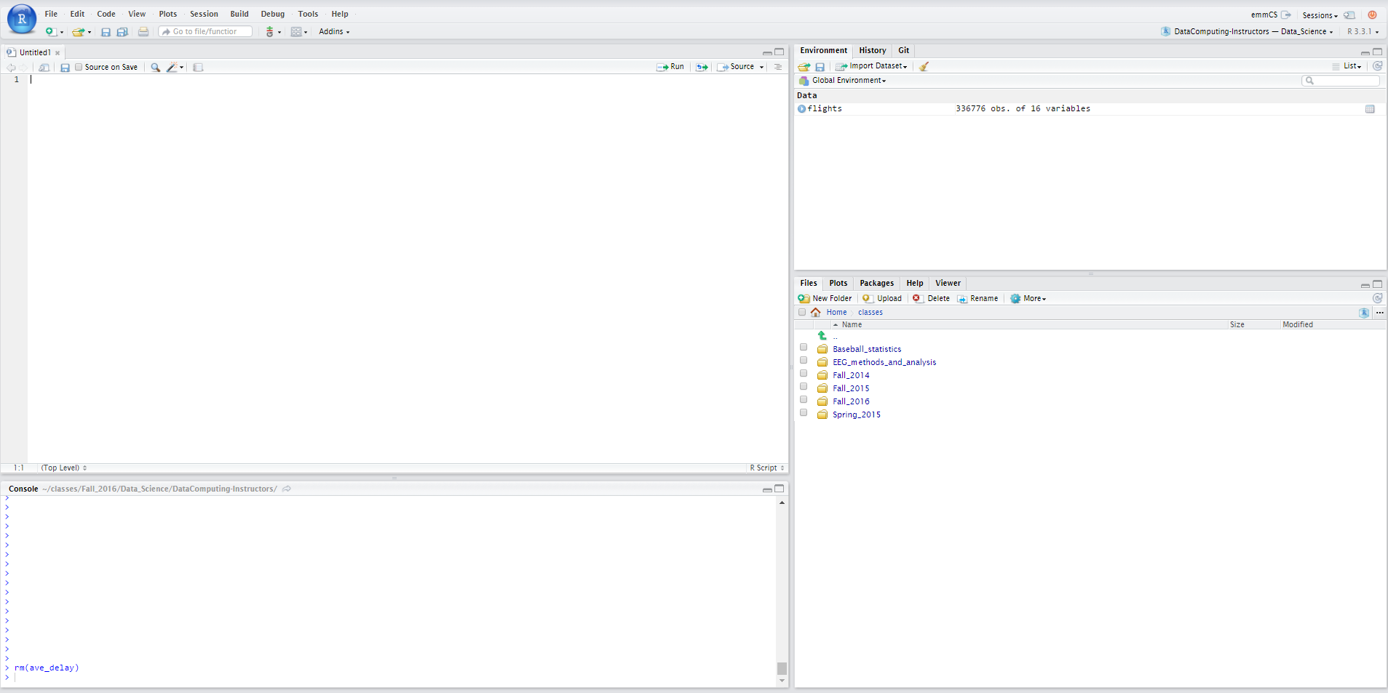
Please open up RStudio
3. Environment
1. RMarkdown and scripts
4. Files, etc.
2. Console

Slide 12
R Basics
Arithmetic:
> 2 + 2
> 7 * 5
Assignment of values to objects:
> a <- 4
> b <- 7
> z <- a + b
> z
[1] 11
Number journey…
Notes:
a <- 7
b <- 52
d <- a * b
> d

Slide 13
Number journey
> a <- 7
> b <- 52
> d <- a * b
> d
[1] 364
Notes:
a <- 7
b <- 52
x <- a * b
> x

Slide 14
Character strings and Booleans
> a <- 7
> s <- "s is a terrible name for an object"
> b <- TRUE
> class(a)
[1] numeric
> class(s)
[1] character

Slide 15
Functions
Functions use parenthesis: functionName(x)
> sqrt(49)
> tolower("DATA is AWESOME!")
To get help
> ? sqrt
One can add comments to your code
> sqrt(49) # this takes the square root of 49

Slide 16
Vectors
Vectors are ordered sequences of numbers or letters
The c() function is used to create vectors
> v <- c(5, 232, 5, 543)
> s <- c("statistics", "data", "science", "fun")
One can access elements of a vector using square brackets []
> s[4] # what will the answer be?
We can get multiple elements from a vector too
> s[c(1, 2)]

Slide 17
Vectors continued
One can assign a sequence of numbers to a vector
> z <- 2:10
> z[3]
One can test which elements are greater than a value
> z > 3
Can add names to vector elements
> names(v) <- c("first", "second", "third", "fourth")

Slide 18
Vectors continued
One can also apply functions to vectors
> z <- 2:10
> sqrt(z)
> mean(z)

Slide 19

Questions?

Slide 20

R packages
Packages add additional functionality to R
We will use many additional packages in this class
gplyr, ggplot2, tidyr, etc.
There is a class specific package (SDS230) I wrote that you can use to download homework and other files
All class materials are also on GitHub: https://github.com/emeyers/SDS230
Was everyone able to install the SDS230 package?

Slide 21
Downloading class 2 code
If you have the class SDS230 package, you can get code for today’s class by typing the following commands at the console:
> library(SDS230)
> download_class_code(2)

Slide 22


R Markdown
R Markdown (.Rmd files) allow you to embed written descriptions, R code and the output of that code into a nice looking document
Creates a way to do reproducible research!
Notes:
Let’s see how R Studio Cloud is doing: https://status.rstudio.com

Slide 23
R Markdown
Everything in R chunks is executed as code:
```{r}
# this is a comment
# the following code will be executed
2 + 3
```
Everything outside R chunks appears as text

Slide 24
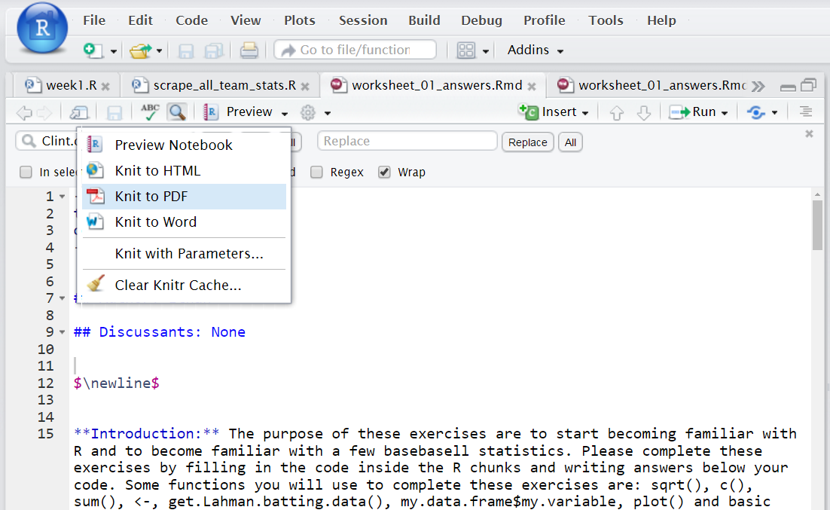
Knitting to a pdf
Turn in a pdf or html document
with your solutions to Canvas

Slide 25
R Markdown
Note: When you knit, RMarkdown files do not have access to variables in the global environment, but instead have their own environment.
Why is this a good thing???

Slide 26
Formatting in R Markdown
We can add formatting to text outside the code chunks
Examples:
## Level 2 header
**bold**
![](https://statistics.yale.edu/sites/default/files/logo2.png)

Slide 27
LaTeX in R Markdown
We can also add LaTeX symbols to documents using $\symbol$ syntax
For example, try these:
$\theta$
$\hat{p}$
Knit early and knit often to avoid errors!!!

Slide 28
LaTeX in R Markdown
I have added a link on Canvas in the resources section to help find LaTeX symbols
How else could you get help to learn more about LaTeX symbols?

Slide 29


Slide 30
To repeat: avoid hard to debug code!
Only change a few lines at a time and then knit your document to make sure everything is working!
If you document isn’t knitting:
For code chunks: use the # symbol to comment out code until you can find the line of code that is giving the error message
Outside of code chunk: cut out part of the document until it knits and then paste it back

Slide 31
Announcement: Homework 1
Due Sunday September 10th at 11pm
I recommend getting started early on this!
To download the homework please do the following:
> library(SDS230)
> download_homework(1)
From the file panel, open the homework and try knitting it

Slide 32
Announcement: Homework 1
Instructions for how to submit homework on Gradescope are on Canvas
Please mark all pages that answers correspond to on Gradescope!
Be sure to also "show your work" by printing out any values you report
Although don't print out hundreds of access pages of numbers
Ask/answer questions on Ed Discussions, but don't give away the solutions!

Slide 33

Questions?

Slide 34
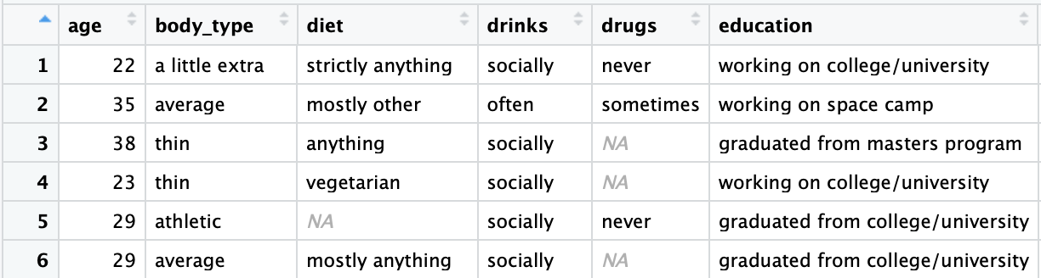
Data frames
Data frames contain structured data

Slide 35
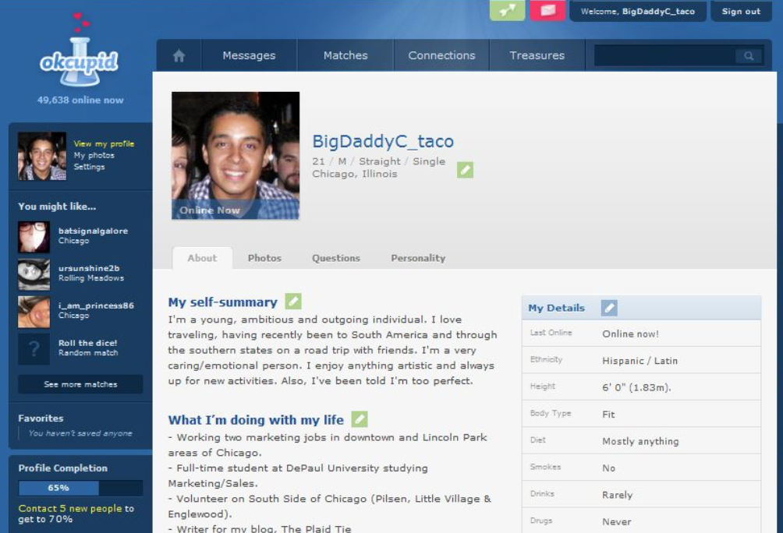
OK Cupid data

Slide 36
Back to R: Data frames
Data frames contain structured data
> library(SDS230)
> download_data("profiles_revised.csv") # only needs to be run once
> profiles <- read.csv("profiles_revised.csv")
> View(profiles) # the View() function only works in R Studio!

Slide 37
Data Frames
Variables
Cases

Slide 38
An Example Dataset
Quantitative Variable
Categorical Variable
Cases
(observational units)

Slide 39
Data frames
We can extract the columns of a data frame as vector objects using the $ symbol
> the_ages <- profiles$age
Can you get the mean() age of users in this data set?
> mean(the_ages)

Slide 40
Extracting rows from a data frame
We can extract rows from a data frame in a similar way as extracting values from a vector by using the square brackets
> profiles[1, ] # returns the first row of the data frame
> profiles[, 1] # returns the first column of the data
Note, the first column of the profiles data frame is the variable age, so we can also get the first column using:
> profiles$age # this is the same as profiles[, 1]

Slide 41
Extracting rows from a data frame
We can also create vectors of numbers or Booleans specifying which rows we want to extract from a data frame
# create a vector with the numbers 1, 10, 20
> my_vec <- c(1, 10, 20)
# use my_vec to get the 1st, 10th, and 20th row in profiles
> small_profiles <- profiles[my_vec, ]
> dim(small_profiles) # number of rows and columns in the data frame

Slide 42
Extracting rows from a data frame
Finally, we can also extract rows by creating a Boolean vector that is of the same length as the number of rows in the data frame
TRUE values will be extracted from the data frame while FALSE values will not
# create a vector of booleans
> my_bools <- c(TRUE, FALSE, TRUE)
# use the Boolean vector to get the 1st and 3rd row
> small_profiles[my_bools, ]

Slide 43

Questions?

Slide 44
For next class…
1. Please read the article The Big Lies People Tell in Online Dating and fill out a quick survey about the article
2. Also, it would be good to start on homework 1
> SDS230::download_homework(1)
Homework 1 is due on Gradescope by 11pm on Sunday September 10th
Instructions for how to submit homework on Gradescope are on Canvas

Slide 45
Categorical variables
What is a categorical variable?
A: A categorical variable assigns each observation to one of k groups
Which variables in the profiles data frame are categorical?
Is heights a categorical variable?
For categorical variables, we usually want to view:
How many items are each category OR
The proportion (or percentage) of items in each category
Proportion in a category = number in that category
total number

Slide 46
Categorical data
# Get information about drinking behavior
> drinking_vec <- profiles$drinks
# Create a table showing how often people drink
> drinks_table <- table(drinking_vec)
> drinks_table
Notes:
https://www.datacamp.com/groups/cs-173t-fall-2016

Slide 47
Relative frequency table
We can create a relative frequency table using the function:
> prop.table(my_table)
Can you create a relative frequency table for the drinking behavior of the people in the okcupid data set?
> drinks_table <- table(profiles$drinks)
> prop.table(drinks_table)
What is the proper statistical notation for these values: p̂ or π ?

Slide 48
Bar plots (pun intended?)
We can plot the number of items in each category using a bar plot
> barplot(my_table)
Can you create a bar plot for the drinking behavior of the people in the okcupid data set?
> drinks_table <- table(profiles$drinks)
> barplot(drinks_table)

Slide 49
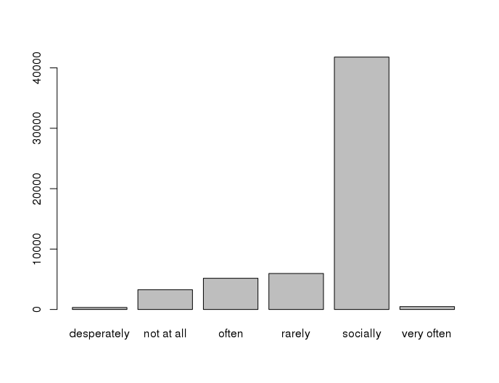
What is wrong with this plot?
A: the axes are not labeled!!!

Slide 50
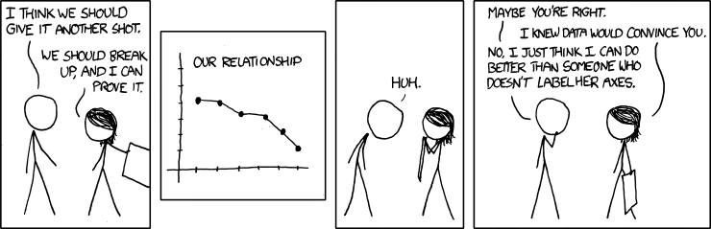
If you don’t want exes, label you axes!

Slide 51
Details matter!
Can you figure out how to label the axes?
A: ? barplot
A: xlab and ylab!
> barplot(drinks_table,
ylab = "Count",
xlab = "Type of drinker",
main = "Counts of different types of drinkers")

Slide 52
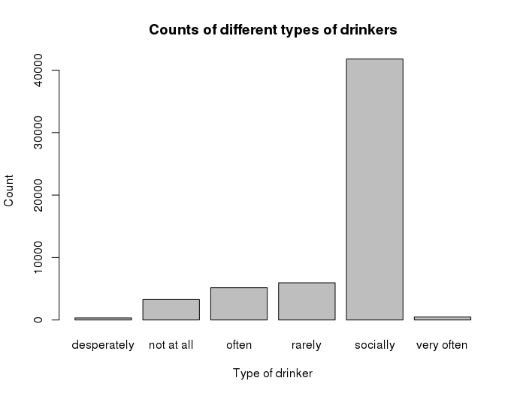
So much better!!!

Slide 53
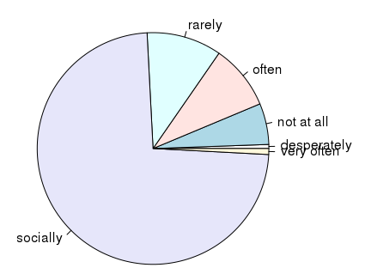
Pie charts
We can also use the pie() function to create pie charts
> pie(drinks_table)

Slide 54

Which is best: bar plots or pie charts?
> barplot(table(profiles$sex, useNA = "always"))
> pie(table(profiles$sex, useNA = "always"))
Q1: Is one better than the other?
Q2: Can you figure out how to add colors to these plots?
Notes:
Why? Discuss!

Slide 55
Removing social drinkers
Social drinkers are dominating our plot ☹
We can get rid of social drinkers by only plotting counts less than 10,000
> nonsocial_inds <- drinks_table < 10000
> nonsocial_drinks_table <- drinks_table[nonsocial_inds]
> barplot(nonsocial_drinks_table)

Slide 56

Questions?

Slide 57
For next class…
1. Please read the article The Big Lies People Tell in Online Dating and fill out a quick survey about the article
2. Also, it would be good to start on homework 1
> SDS230::download_homework(1)
Homework 1 is due on Gradescope by 11pm on Sunday September 10th
Instructions for how to submit homework on Gradescope are on Canvas

