Slide 1
MSc Software Development
CSC7061 - Programming
Importing
Use of Scanner class
Static imports

Slide 2

Content
Keywords
Java import. Scanner class. Static fields and methods
Understanding how and why to import
Getting input from the keyboard – the Scanner class
Static imports
What you will learn

Slide 3

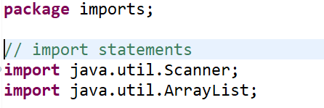
Importing
An import statement is a way of making more of the functionality of Java available to your program.
The Java API has a very rich function set but not every program needs access to all functionality. So, to cut things down to size Java has its classes divided into packages that you can optionally import. In Java, import is a keyword used to bring classes, interfaces, and other types from one package into another.
Java packages are a way to organise classes and avoid naming conflicts. When you want to use a class from another package in your current class, you need to either fully qualify the class name with its package name or use the import statement to make the code more readable.
To import a specific member into the current file, put an import statement at the beginning of the file before any type definitions but after the package statement.
Notes:
Software Development

Slide 4
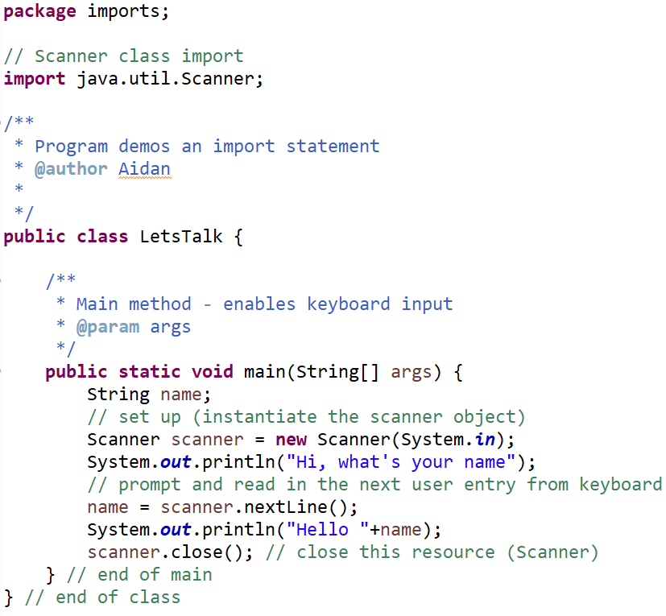

Import example
To import a specific member into the current file, put an import statement at the beginning of the file before any type definitions but after the package statement.
The Scanner class is a part of the java.util package and is used to read user input from various sources like the console, files, and streams. It provides methods for reading different types of data, such as integers, floating-point numbers, strings, and more. The Scanner class simplifies the process of getting input from the user or from a file by automatically handling the conversion of input to the appropriate data types
Now you can refer to the Scanner class by its simple name from within the code.
Hi, what's your name
Aidan McGowan
Hello Aidan McGowan

Slide 5

Import statements
Importing doesn't increase the size of the compiled code; it's purely for ease of coding and readability.
Remember that while importing makes your code more readable, excessive use of wildcard imports can lead to confusion about the origins of various classes. It's generally recommended to only import the classes you need, to keep the code clean and maintainable.
Importing a Package Member
import java.util.Scanner;
Importing an Entire Package (use of wildcard)
import java.util.*;
Referring to a Package Member by the class fully qualified name
java.util.Scanner scanner = new java.util.Scanner(System.in);
Takes longer to type
Default Imports:
Certain classes are automatically imported without needing explicit import statements. These classes belong to the java.lang package, which is automatically available to every Java program. Examples include String, Object, and basic data types like int, double, etc.
Unused Imports: Import statements that are not used in your code have no impact on the compiled code or runtime behavior. However, keeping your code clean by removing unused imports is considered good practice.

Slide 6


Exercise I
Create a Java program that asks the user to input his / her age
Depending on the input the output should then be :
Hints : Store the user’s age as an int
The Scanner class has a specific method for getting the next int. You will need an if statement
if (age >=18) {
…..
}
Input (Age) | Output
>= 18 | You can vote
< 18 | You cannot vote
Exercise II
Hints : You will need an int for the user’s entry for length. And a String for their name
Create a Java program that prompts the user to input his / her full name. Then ask the user for the number of characters that they consider to be a long name (ie number of characters in a name)
If the name is greater than the length the user has entered then output “So you think you have a long name !” otherwise “You have a short name.”
Notes:
Exercise 1 solution :
import java.util.Scanner;
public class ScannerAgeExercise {
public static void main(String[] args) {
// vars
int userAge;
userAge = 0;
// set up scanner
Scanner scanner = new Scanner(System.in);
// get the input from the user
System.out.println("What age are you ?");
userAge = scanner.nextInt();
// if statement to deal with 18 or over
if (userAge >= 18){
System.out.println("You are able to vote");
}
// if statement to deal with under 18
if (userAge <18){
System.out.println("Sorry you can't vote");
}
scanner.close();
}
Exercise II solution public static void main(String[] args) {
String name;
int userMaxLength;
// set up (instantiate the scanner object)
Scanner scanner = new Scanner(System.in);
// get user input (int)
System.out.println("How many letters in a long name ? ");
userMaxLength = scanner.nextInt();
scanner.nextLine(); // need to do this as nextInt just takes the int and not the /n (enter key)
// get the users name - string
System.out.println("What's your name");
// prompt and read in the next user entry from keyboard
name = scanner.nextLine();
// not make a decision based on the user's name (length) and their max length entry
if (name.length() >= userMaxLength){
System.out.println("So you think you have a long name !");
}
if (name.length() <= userMaxLength){
System.out.println("You have a short name");
}
scanner.close(); // close this resource (Scanner)

Slide 7
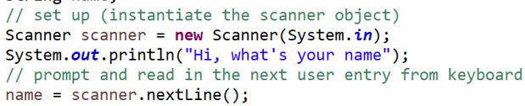

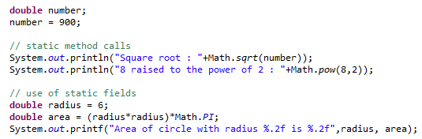
Static imports
The previous examples demonstrate an import followed the instantiation of the class imported.
It is however possible to use parts of some imported classes directly without creating the object instantiation.
These ready-to-use parts are declared internally within the imported class as static
Static fields and methods
Note : The Math class is part of the java.lang package which is imported automatically into all Java programs so you do not need to an import statement in your class
In Java, static fields and methods are associated with a class itself rather than with instances (objects) of the class. This means that static fields and methods are shared among all instances of the class and can be accessed directly through the class name, without creating an object.

Slide 8
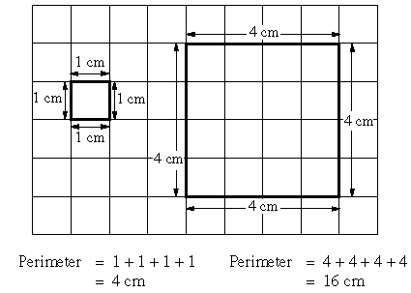
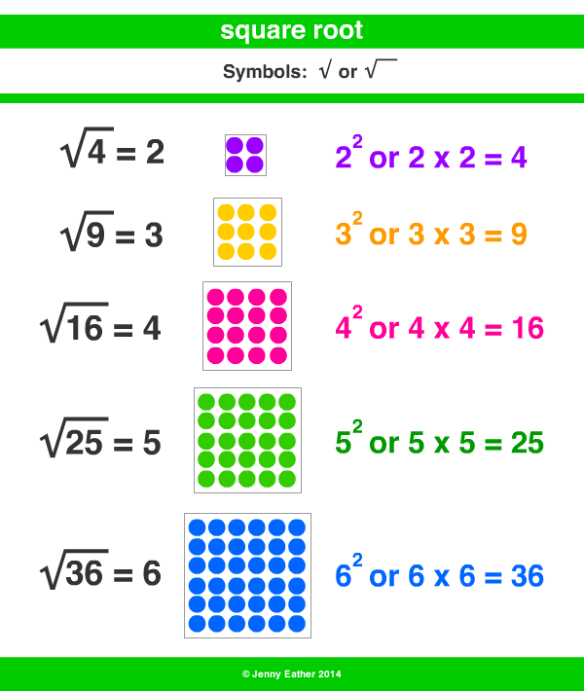
Exercise III
Create a Java program that prompts the user for the length of one side of a square (as a double). Then calculate and output the perimeter and the area of the square (to two decimal places)
Exercise IV
Create a Java program that prompts the user for a whole number and then outputs the square root of the number.
Notes:
Exercise III solution :
Scanner scanner = new Scanner(System.in);
double side = 0;
System.out.println("Enter the side of the square (in cms) ?");
side = scanner.nextDouble();
System.out.printf("Perimeter : %.2f %s",side*4 ," cm \n");
System.out.printf("Area : %.2f %s",Math.pow(side, 2) ," cm2");
scanner.close();
Exercise IV solution
import java.util.Scanner;
public class Exercise3 {
public static void main(String[] args) {
// declare var
double inputNum;
// initialise the scanner
Scanner scanner = new Scanner(System.in);
System.out.println("Enter number ...");
// read from keyboard
inputNum = scanner.nextDouble();
// output the value
System.out.println("Square root is : " + Math.sqrt(inputNum));
scanner.close();
}
}

