Slide 1

The Long Way to Care
Can you call for help, and how far is care, from a remote Northern Territory community?
429
of 782 remote NT communities have no confirmed way to call for help
Team DIC 031 · CDU IT Code Fair 2026
Chepngenoh Chepkwony and Cynthia Ebele Ikegbunam

Slide 2

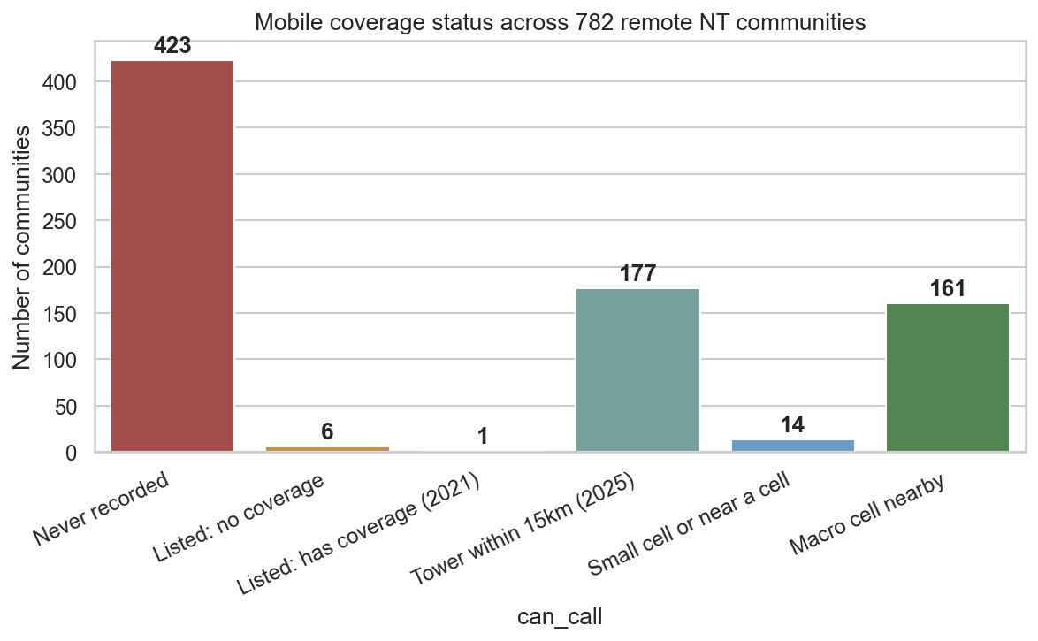
The problem
In an emergency you need two things: a way to call, and a way to get there.
429 of 782
remote communities (55%) have no confirmed way to call for help.
423 never recorded
Nobody has confirmed a signal there. It may exist, but no one has checked.
6 listed as none
These are officially listed with no mobile coverage.
The Long Way to Care · Team DIC 031
2

Slide 3
Where the data comes from
Nine open public sources, cleaned and combined into one community table and one clinic table.
DATASET | PUBLISHER AND YEAR
Remote communities register | NT Government, 2021
Mobile coverage in remote areas | NT Government, 2022
Mobile Infrastructure Report | ACCC, 2025
Healthdirect facilities, NT | Geoscience Australia, 2025
National road network | Geoscape (Digital Atlas Australia)
Remote health clinics register | NT Government, 2026
Tropical cyclone tracks | Bureau of Meteorology
Preventable hospitalisations | AIHW
First Nations digital inclusion | Australian Digital Inclusion Index
The Long Way to Care · Team DIC 031
4
All sources are publicly available data

Slide 4
How we measured it: Gap Index
Four simple questions about each community, combined into one score.
Can they call?
Nearest clinic
Nearest hospital
Sealed road?
Is there confirmed mobile coverage nearby?
How long is the drive to the closest remote clinic?
How long is the drive to a hospital emergency department?
Is there a sealed road all the way out?
Average of the four
Gap Index, 0 to 1
Four risk tiers
0 means well connected. 1 means most cut off.
Example: Tennant Creek scores 0.01. Kumunu, a remote family outstation, scores 1.0.
Where a drive time could not be mapped, we scored the place as worst case rather than leave it out.
The Long Way to Care · Team DIC 031
3

Slide 5
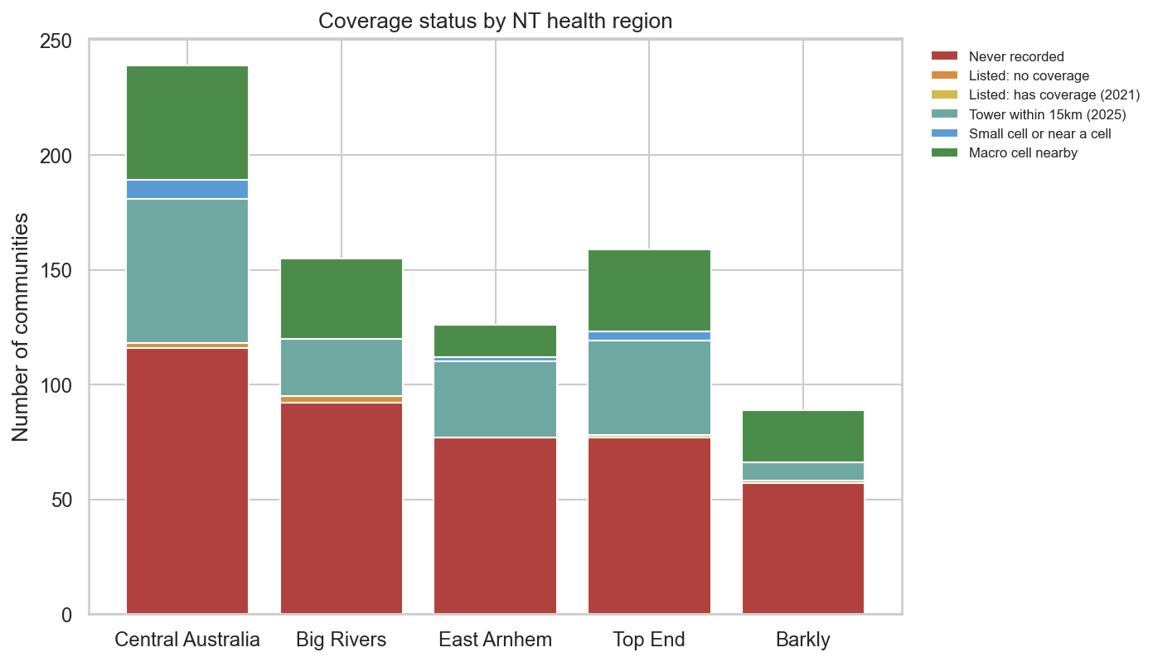
Every region is affected
Coverage status of communities in the five NT health regions.
Red is the biggest block
In all five regions, 'never recorded' is the largest group.
Highest share with no call
Barkly 65%, Big Rivers 61% and East Arnhem 61% of communities.
Most communities
Central Australia has 239 places. About half (49%) cannot call.
The Long Way to Care · Team DIC 031
5

Slide 6
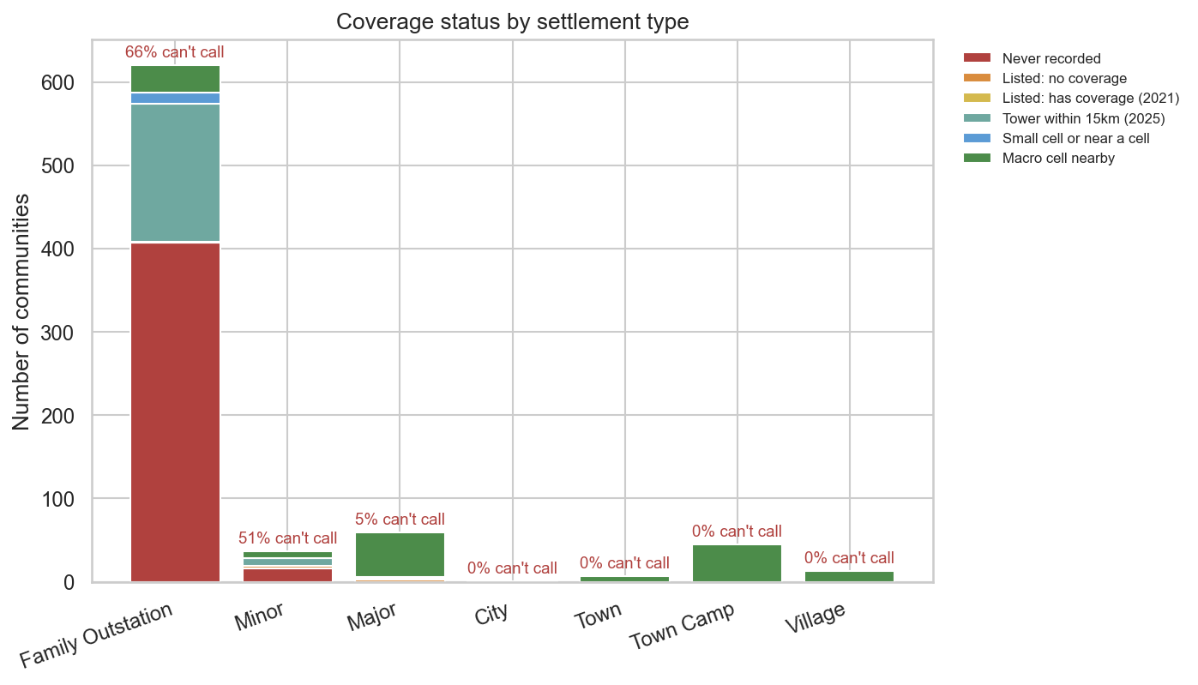
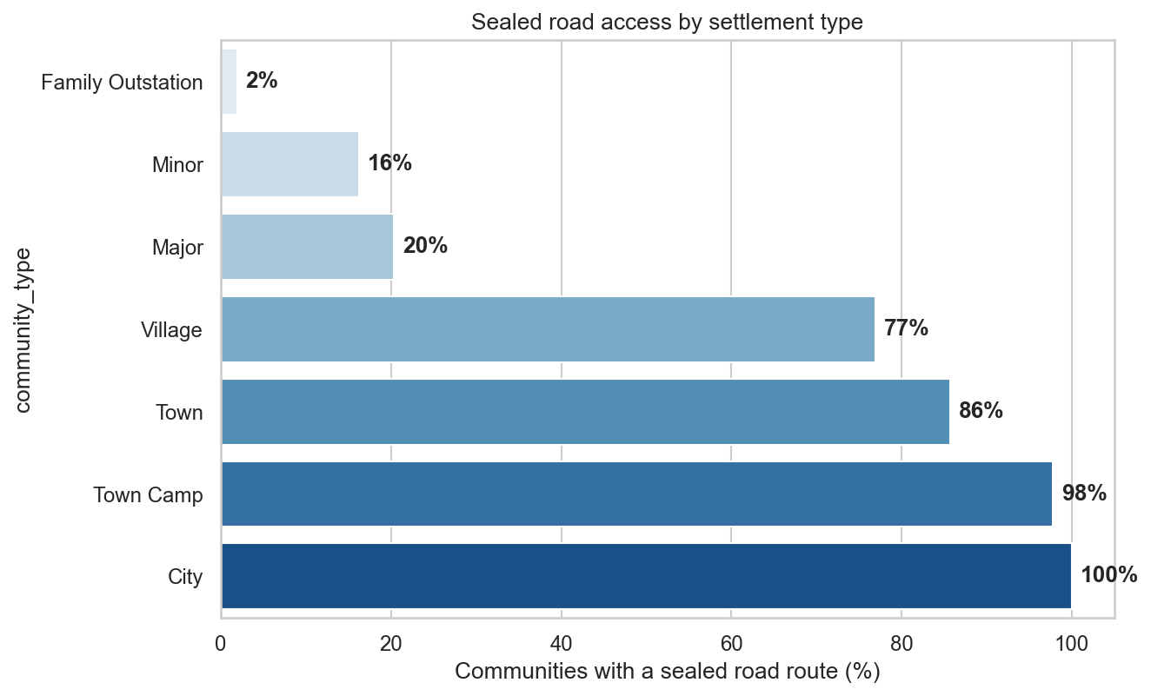
Small family outstations are hit hardest
Who can call?
Who has a sealed road to the outside?
Two in three family outstations (66%) cannot call, and only 2% have a sealed road. Towns and town camps are well connected.
The Long Way to Care · Team DIC 031
6

Slide 7
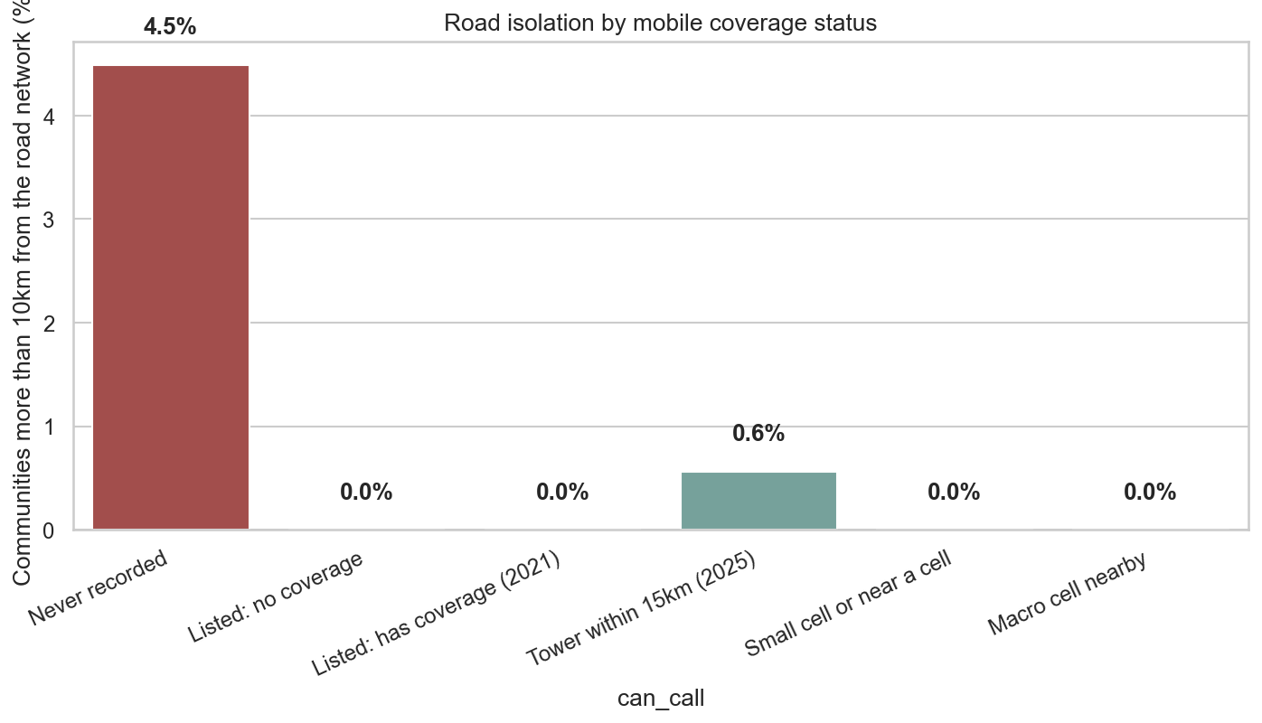
Far from care, and cut off by road
Where the signal is missing, the road is often missing too.
3 h 56 min
median road trip to a hospital emergency department. 340 places are over 4 hours away.
85 places
have no mapped road to a hospital at all. 469 have 20 km or more of unsealed road.
49 of 91 clinics
list no 24/7 emergency service. After hours, help may be much further.
The Long Way to Care · Team DIC 031
7

Slide 8
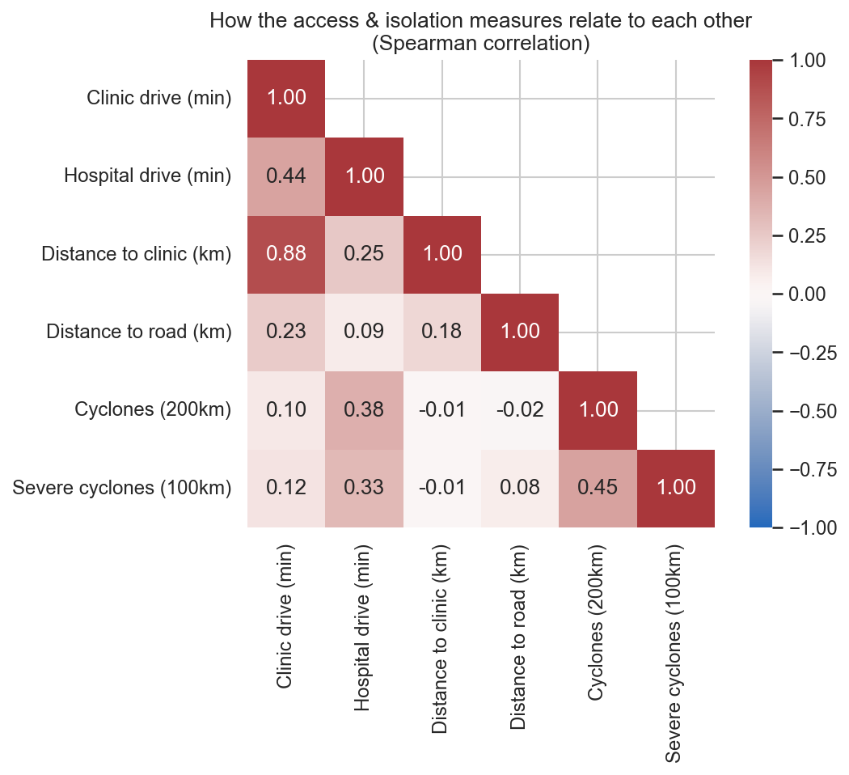
Are we counting the same thing twice?
A Spearman correlation measures how closely two scores move together.
1 means the perfect correlation. 0 means no link.
Our four measures are related but different, so each adds something and all four stay in the score.
0.88: drive time to the clinic and distance to the clinic are nearly the same thing.
The Long Way to Care · Team DIC 031
8

Slide 9
Would different weights change the answer?
We tried three ways of weighing the four measures.
Coverage
Clinic time
Hospital time
Sealed road
1 Equal weights
2 Drive time counts double
3 Coverage counts double
Our final choice
Clinic and hospital time count more
Coverage counts more
25%
25%
25%
25%
15%
30%
30%
25%
40%
20%
20%
20%
Top 20: all the same
Top 20: all the same
Top 20: all the same
the reference
99% agreement (ρ = 0.991)
99.7% agreement (ρ = 0.997)
The same 20 communities came out on top of the risk tier every time.
The Long Way to Care · Team DIC 031
9

Slide 10
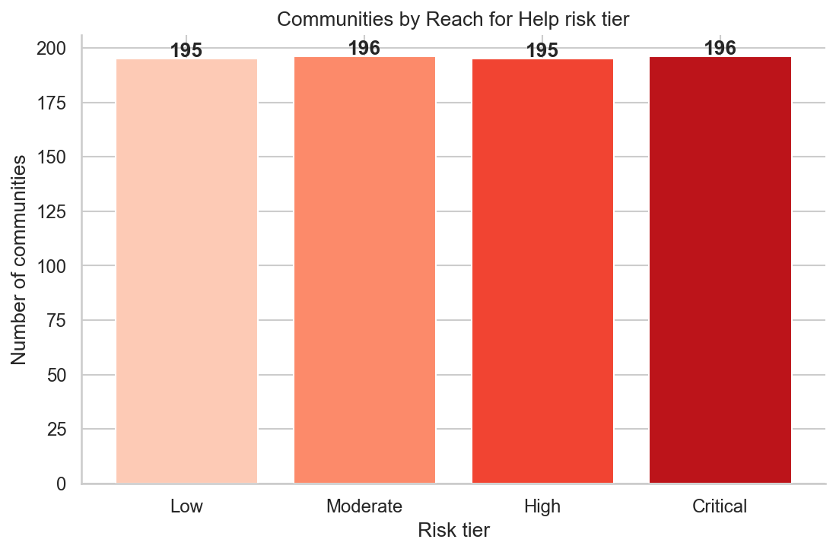
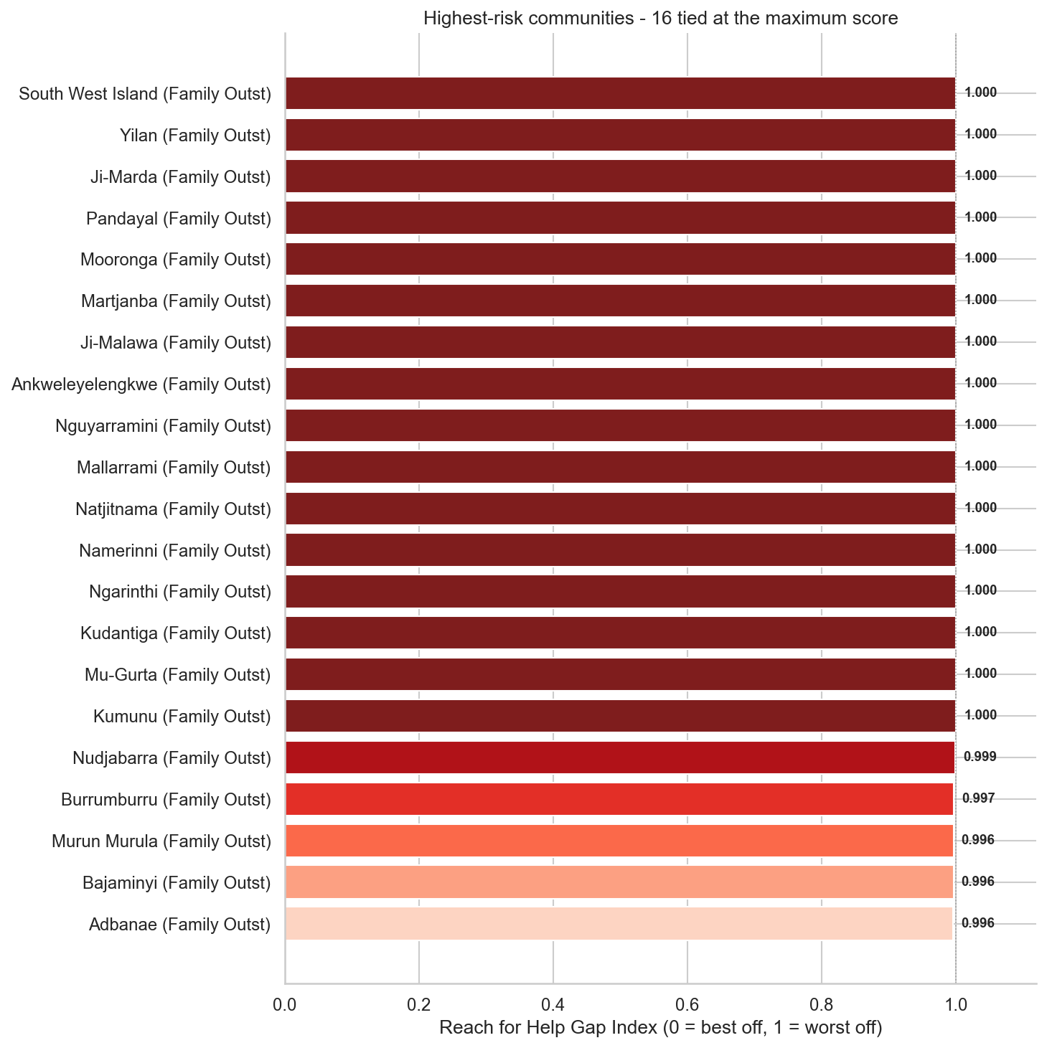
Who is most at risk?
We split all 782 communities into four equal risk tiers, then looked at the top.
About 195 communities in each tier, from Low to Critical.
98% of the Critical tier are family outstations.
→ 16 places tie at the maximum score of 1.0.
The Long Way to Care · Team DIC 031
10

Slide 11
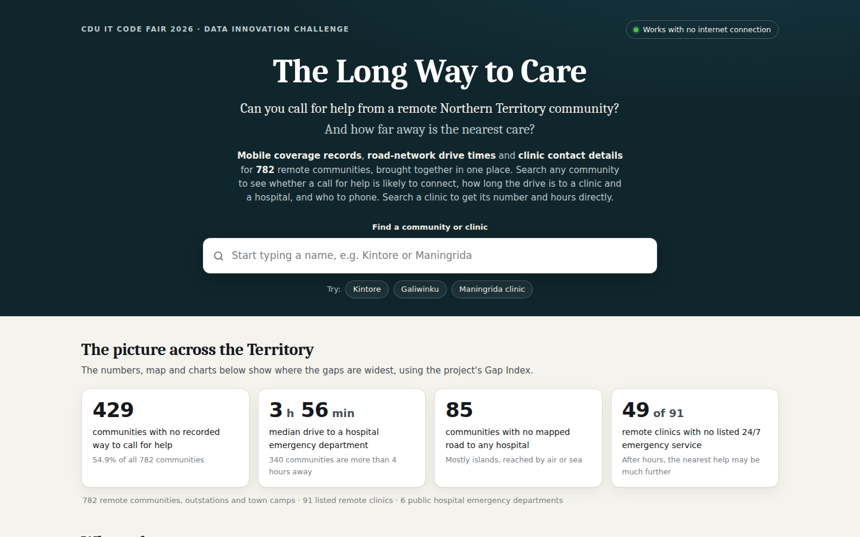
The offline dashboard
A working prototype: one file that runs in any browser with no internet.
Search any community or clinic
See coverage, drive times and risk tier
Get the clinic phone, hours and 24/7 status
No install, no server
Log/report signal information in your area
Works where signal is weakest
The Long Way to Care
The Long Way to Care · Team DIC 031
11

Slide 12
Recommendations
Three actions, in order of priority.
1 CONNECT
2 CLOSE
3 SHARE
Stakeholders;
Connect the Critical tier first
Stakeholders;
Close the 24/7 gap
Stakeholders;
Put the dashboard in local hands
Start with family outstations: prioritise coverage and a confirmed way to call for help.
Start with the 210 communities that cannot call and whose nearest clinic lists no 24/7 service.
Through remote health services and Aboriginal community-controlled health organisations, so coverage can be checked with communities.
The Long Way to Care · Team DIC 031
12

Slide 13
Limitations
What this analysis cannot tell us, and how we handled it.
Coverage is unconfirmed
Missing routes are assumed
Dry-season, best-case travel
'Never recorded' means nobody has confirmed a signal. Some of the 423 places may have one.
Where no road route could be mapped, the place was scored worst case, so 16 places tie at 1.0.
Wet-season closures and road conditions are not captured, so real trips can be longer.
How we handled it: We say 'no confirmed way to call' and recommend local checks.
How we handled it: Read the very top of the list as 'most cut off', not a precise rank.
How we handled it: Unsealed-road distance is shown so wet-season risk is visible.
The Long Way to Care · Team DIC 031
13

Slide 14
Summary
429 of 782
Hardest hit
remote communities have no confirmed way to call for help, and care can be hours away by road.
Small family outstations: 2 in 3 cannot call and almost none have a sealed road.
Model Reliability
Ethical Consideration
Different weightings give the same top 20, and the tests show the gaps are not chance.
No personal or health data. Results are for checking with communities, not judging them.
The Long Way to Care · Team DIC 031
14
Notes:
[7:50 to 8:00] To sum up: 429 of 782 communities have no confirmed way to call, and care can be hours away. The pattern holds however we weigh it, and it is not chance. Thank you. We would be glad to take your questions.

Slide 15

Thank you
Team DIC 031
Chepngenoh Chepkwony
Cynthia Ebele Ikegbunam
The Long Way to Care

