Slide 1
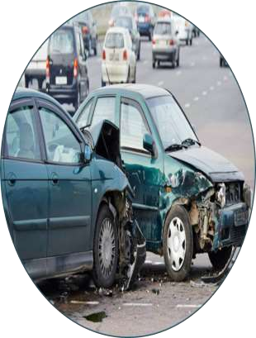
CITY OF CHICAGO TRAFFIC CRASHES
STUDENT NAMES; Aggrey Timbwa, Richard Macharia, Pamela Jepkorir Chebii, Cynthia Njambi, Josphat Wanjiru, Omara Waldea
GROUP; Group 4
STUDENT PACE; Part time
SCHEDULE PROJECT REVIEW DATE; phase four(14/10/2024)
INSTRUCTOR NAME; Winnie Anyoso

Slide 2
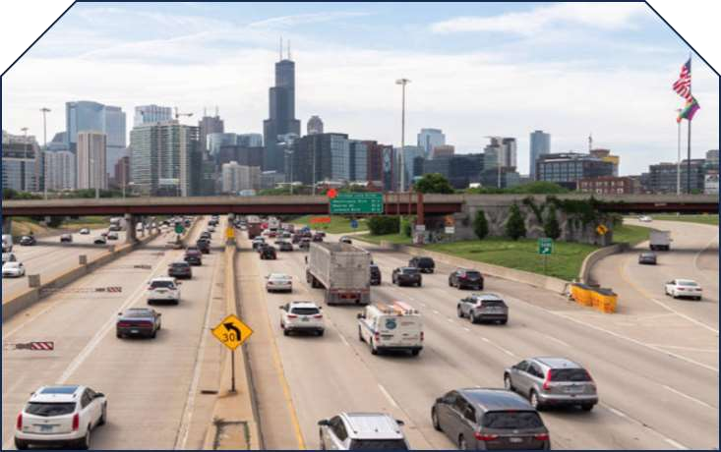
PROJECT INTRODUCTION
Chicago’s crash dataset details traffic incidents within city limits under the Chicago Police Department (CPD) jurisdiction, compiled from the electronic E-Crash reporting system.
The dataset excludes personal identifiers and is
updated as reports are finalized or amended.
Approximately half of the reports are self- reported by drivers at police stations, while the remainder is recorded by officers on-site.
We aim to predict the primary causes of these accidents

Slide 3

OVERVIEW
The goal of this project is to build a model that predicts the primary contributory cause of a car accident based on factors such as road conditions, vehicle characteristics, and the people involved
Traffic accidents are a major concern in large cities like Chicago, leading to property damage, injuries, and fatalities.
Understanding the primary causes of these accidents can enable city planners, traffic safety boards, and policymakers to implement proactive measures to reduce incidents and enhance road safety.
This project utilizes a dataset provided by the City of Chicago, which contains comprehensive information on accidents, vehicles, and individuals involved.
This data offers valuable insights into the root causes of traffic crashes.
BUSINESS PROBLEM

Slide 4
OBJECTIVES
Main Objective:
Build a model to predict the PRIM_CONTRIBUTORY_CAUSE of car accidents.
Data Quality:
Ensure the dataset is of high quality by maintaining completeness and accuracy, especially in critical variables like road conditions, weather, and vehicle information. Reliable data will enable more accurate predictions and ensure robust models
.
Data Imbalance:
Address the severe imbalance in the target variable (PRIM_CONTRIBUTORY_CAUSE) by applying techniques such as SMOTE, class weighting, or ensemble methods.
Feature Importance:
Investigate the relationships between key features, such as road conditions, vehicle types,
and driver behavior.

Slide 5
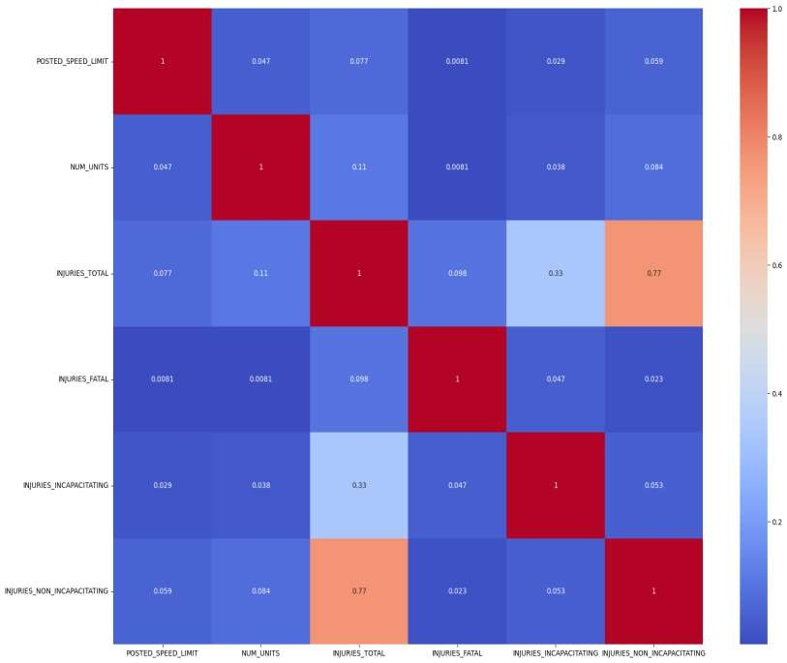
VISUALIZATIONS
CORRELATIONS MATRIX
Our correlation analysis only includes numerical features with only INJURIES_TOTAL and INJURY_NON_INCAPACITATI
NG having high correlation
(77%) which is to be expected

Slide 6
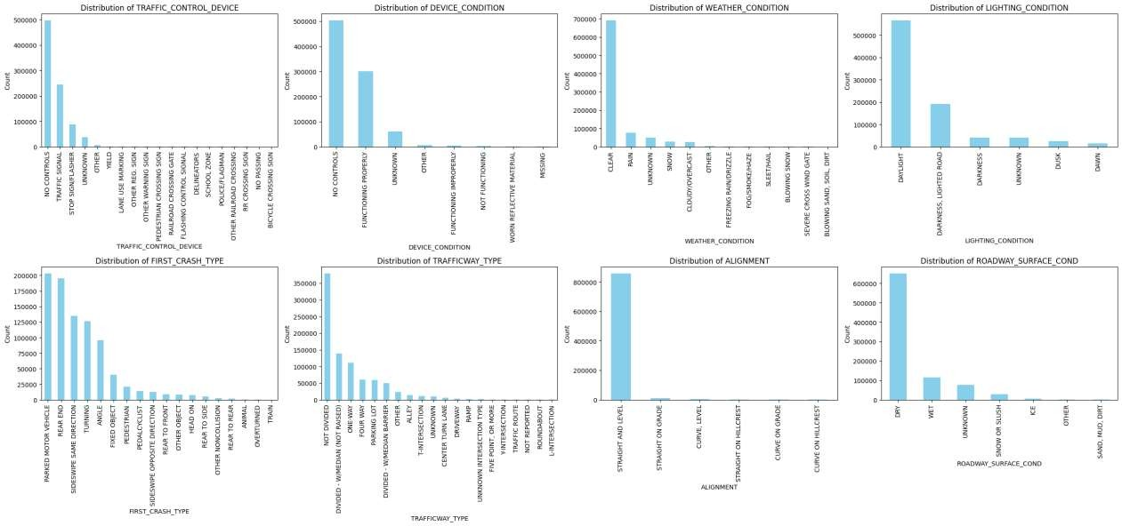
BAR PLOTS

Slide 7
BAR PLOTS
The data from the bar plots above suggests that many accidents occur under clear weather, daylight, and dry conditions, indicating that environmental factors like adverse weather or poor lighting are not the primary causes of most accidents.
Instead, driver-related factors (like inattentiveness, tailgating, and speeding) and road design (such as undivided roads and intersections without controls) appear to play a more significant role in accident occurrences.
This insight could guide traffic safety measures focusing on driver education, enforcement at
high-risk intersections, and safety improvements on undivided roads.

Slide 8
MODELLING TECHNIQUES
Baseline Model: Dummy Classifier
Baseline Model Accuracy: The accuracy of the baseline model is 0.5953, indicating that the model
correctly predicts approximately 59.53% of the instances.
Findings
The model exhibits a strong imbalance in predictions, as it only predicts the
class "Pedestrian/Cyclist Errors" effectively, achieving a recall of 1.00. This indicates that all instances of this class were correctly identified.
However, the model fails to predict any instances of the other classes, resulting in zero precision and recall for them. This highlights a significant shortfall in the model's ability to generalize across all categories.
The macro average metrics indicate overall poor performance, with an F1-score of only 0.12,
emphasizing the need for improvement.

Slide 9
Model Performance Overview
Model | Accuracy | Key Insights
Logistic Regression | 0.6303 | Struggled with most classes; good recall for Pedestrian/Cyclist Errors but poor overall performance.
Logistic Regression (SMOTE) | 0.3066 | Significant drop in accuracy; failed to effectively address class imbalance.
Random Forest | 0.6140 | Good recall for Pedestrian/Cyclist Errors; poor performance on minority classes.
XGBoost | 0.6393 | Comparable to the neural network; maintains good performance for certain classes, particularly Pedestrian/Cyclist Errors.
Neural Network | 0.6429 | Highest accuracy; performs well for Pedestrian/Cyclist Errors but shows signs of potential overfitting.

Slide 10
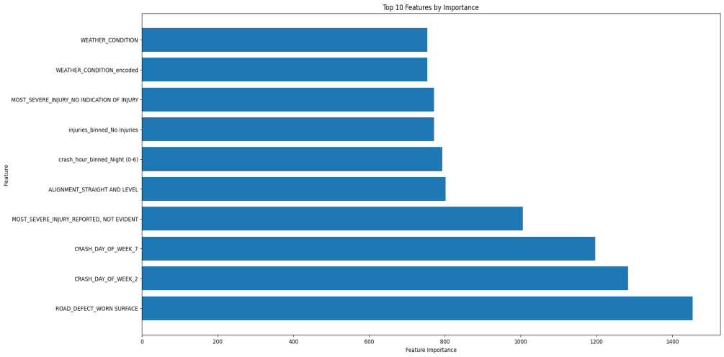
Model Comparison: Random Forest vs. XGBoost

Slide 11
CONCLUSION
Addressing the Problem with Predictive Models:
Neural Network and XGBoost models effectively identified key factors like road conditions, time of day,
and human behavior, providing actionable insights for stakeholders.
The Neural Network achieved the highest accuracy (0.6429) by capturing complex patterns and relationships in the data, but it showed signs of overfitting, indicating a need for further tuning to improve consistency. XGBoost achieved an accuracy of 0.6393, offering strong performance with minimal overfitting, making it a reliable choice for practical applications
Insights on Contributory Causes:
Key features identified by the models, such as road defects and day of the week, align with real-world safety concerns. This demonstrates that the models are not only predictive but also relevant to stakeholder needs.
Handling Data Challenges:
Class Imbalance: Despite mitigation efforts like SMOTE, models such as Logistic Regression struggled to accurately predict minority classes, reflecting the complexity of modeling rare accident causes. The Neural Network and XGBoost demonstrated stronger performance across categories, indicating a better ability to manage data imbalance, though further improvement is still warranted.

Slide 12
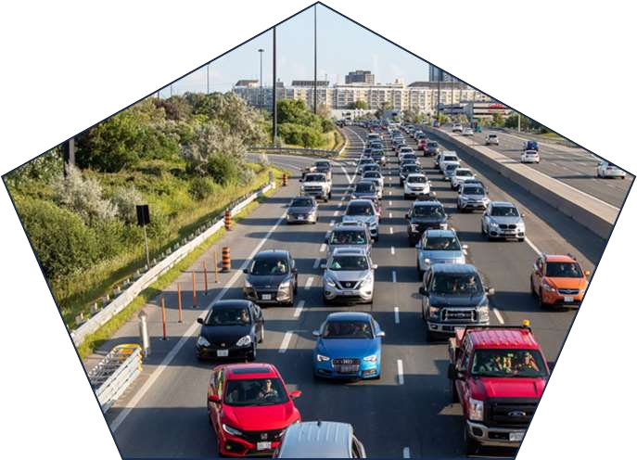
RECOMMENDATIONS
Hyperparameter Tuning:
Further refine the Neural Network to address overfitting and unlock additional performance gains.
Feature Engineering:
Explore new features, such as weather and traffic congestion interactions, to capture more nuanced relationships between accident causes.
Continuous Learning:
As new data becomes available, retrain models periodically to maintain predictive relevance and adapt to changing traffic patterns.

Slide 13


