Slide 1
Data Analysis & Decision Making for Streaming Business

Slide 2
CONTENT
1
Introduction & Objectives
2
Data Cleaning
3
Data Analysis & Insights
4
Conclusion & Recommendations

Slide 3
01
Introduction

Slide 4
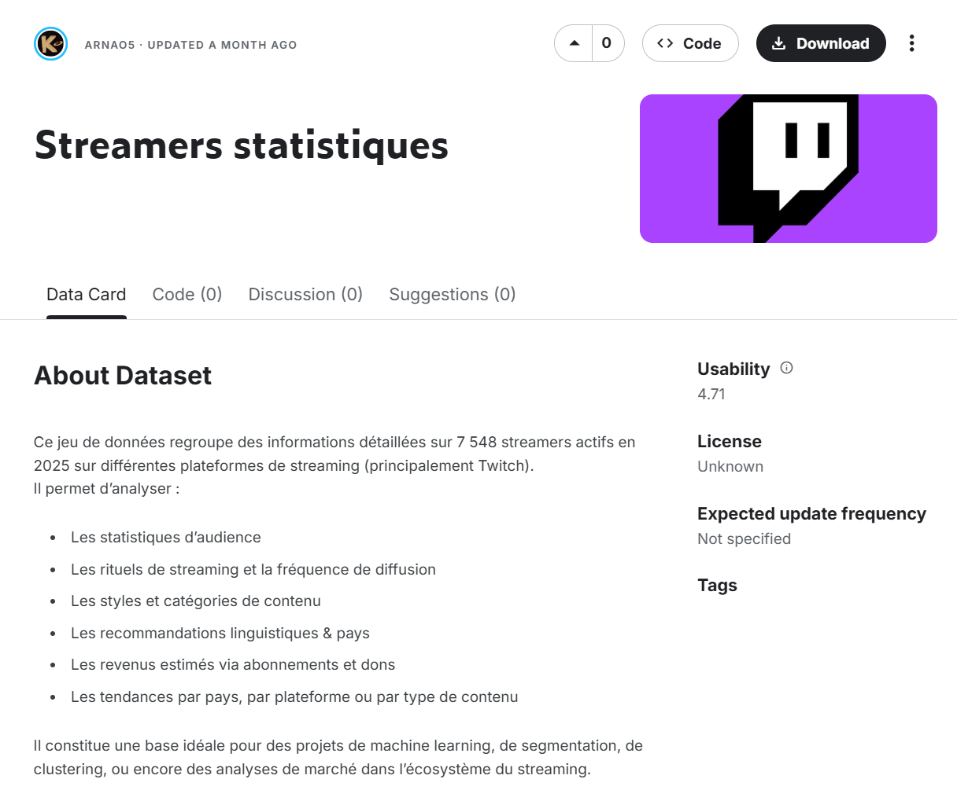
1.1 Background
The live-streaming industry has grown exponentially. For new streamers or investors, understanding the factors that drive revenue and viewership is crucial. This report analyzes a dataset of 7,548 streamers active in 2025 to provide data-driven strategies.
Source: Data obtained from Kaggle: https://www.kaggle.com/datasets/arnao5/streamers-statistiques and updated a month ago

Slide 5
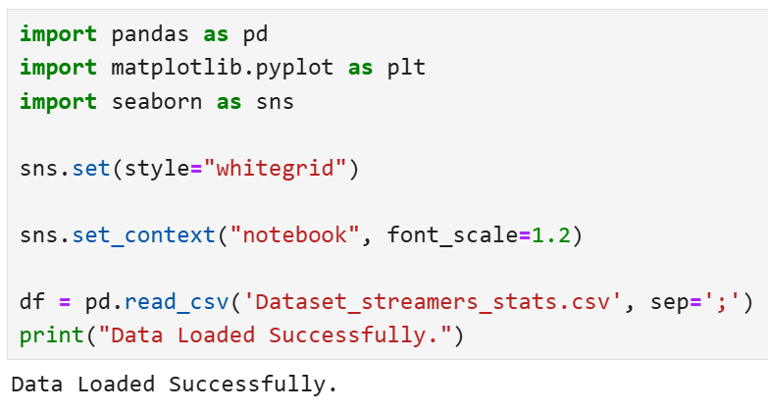
1.2 Objectives
Aimed to answer 3 key business questions:
Platform Strategy: Which platform offers the best financial return and stability?
Content Strategy: Which content categories yield the highest viewer engagement?
Efficiency Analysis:
Is there a direct correlation between hours streamed and revenue?
CODE.

Slide 6
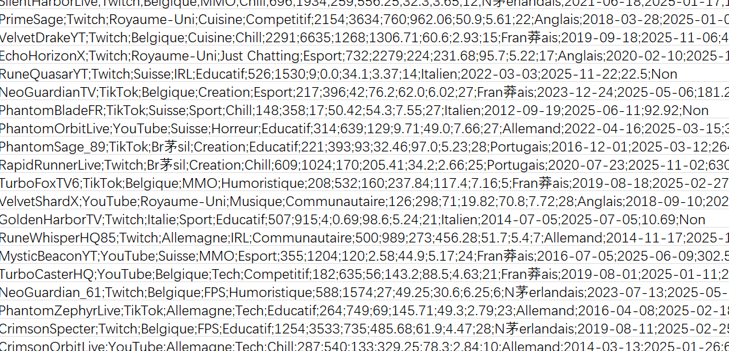
02
Data Cleaning
Since the data is in French, to ensure a professional English report, we translate French columns and values into English.

Slide 7
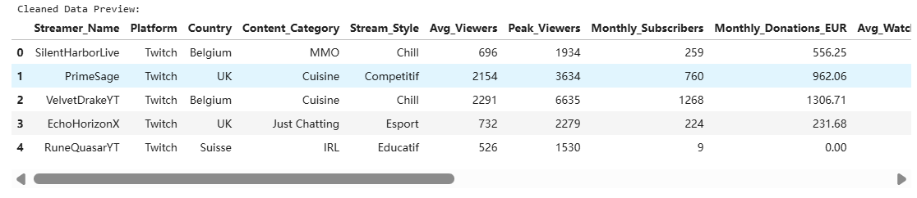
CODE.
column_mapping = {
'nom_streamer': 'Streamer_Name',
'plateforme': 'Platform',
'pays': 'Country',
'categorie_contenu': 'Content_Category',
'style_stream': 'Stream_Style',
'moyenne_viewers': 'Avg_Viewers',
'pic_viewers': 'Peak_Viewers',
'abonnements_mensuels': 'Monthly_Subscribers',
'dons_mensuels_eur': 'Monthly_Donations_EUR',
'duree_watch_moyenne_min': 'Avg_Watch_Time_Min',
'duree_stream_moyenne_h': 'Avg_Stream_Duration_Hours',
'frequence_stream_mois': 'Stream_Frequency_Month',
'langue': 'Language',
'revenu_mensuel_eur': 'Monthly_Revenue_EUR',
'partenaire_officiel': 'Official_Partner'
}
df = df.rename(columns=column_mapping)
df['Official_Partner'] = df['Official_Partner'].map({'Oui': 'Yes', 'Non': 'No'})
country_map = {'Etats-Unis': 'USA', 'Royaume-Uni': 'UK', 'Allemagne': 'Germany',
'France': 'France', 'Espagne': 'Spain', 'Belgique': 'Belgium'}
df['Country'] = df['Country'].replace(country_map)
print("Cleaned Data Preview:")
display(df.head())

Slide 8
03
Data Analysis & Insights

Slide 9
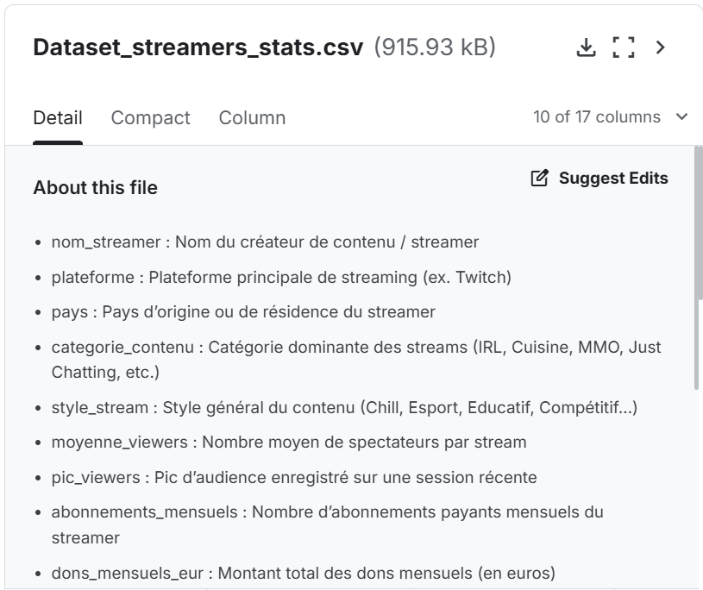
3.1 Platform Strategy: Revenue Distribution
Which platform generates the highest gross revenue?
Bar Chart: Shows the average income.
Boxplot: Shows the range of income (Min, Max, and Outliers). This helps us understand if the income is stable or relies on a few lucky streamers.
CODE.
fig, axes = plt.subplots(1, 2, figsize=(16, 6))
sns.barplot(data=df, x='Platform', y='Monthly_Revenue_EUR', estimator='mean', errorbar=None, palette='viridis', ax=axes[0])
axes[0].set_title('Average Monthly Revenue by Platform')
axes[0].set_ylabel('Avg Revenue (€)')
sns.boxplot(data=df, x='Platform', y='Monthly_Revenue_EUR', palette='viridis', ax=axes[1], showfliers=False)
axes[1].set_title('Income Distribution (Excluding Top 1% Outliers)')
axes[1].set_ylabel('Monthly Revenue (€)')
plt.tight_layout()
plt.show()

Slide 10
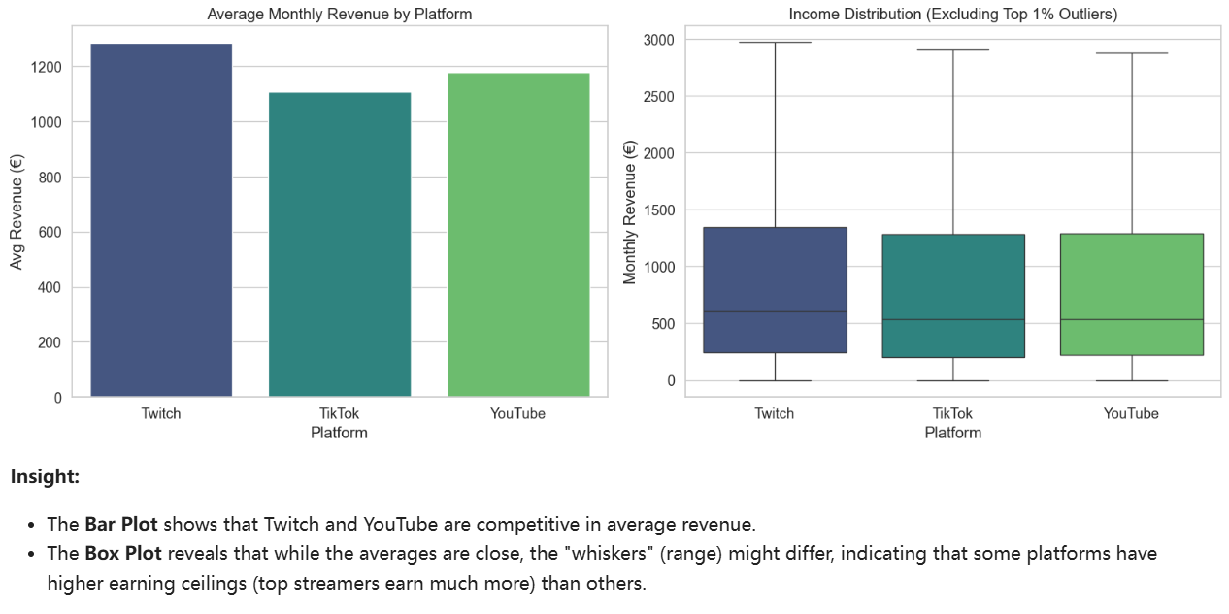
3.1 Platform Strategy: Revenue Distribution

Slide 11
3.2 Content Strategy: What to stream?
Analyzing which content categories attract the most viewers on average.
CODE.
top_categories = df.groupby('Content_Category')['Avg_Viewers'].mean().sort_values(ascending=False).head(10).index
df_top_cat = df[df['Content_Category'].isin(top_categories)]
plt.figure(figsize=(12, 6))
sns.barplot(data=df_top_cat, x='Avg_Viewers', y='Content_Category',
order=top_categories, palette='magma')
plt.title('Top 10 Content Categories by Average Viewers', fontsize=15)
plt.xlabel('Average Viewers')
plt.ylabel('Category')
plt.show()

Slide 12
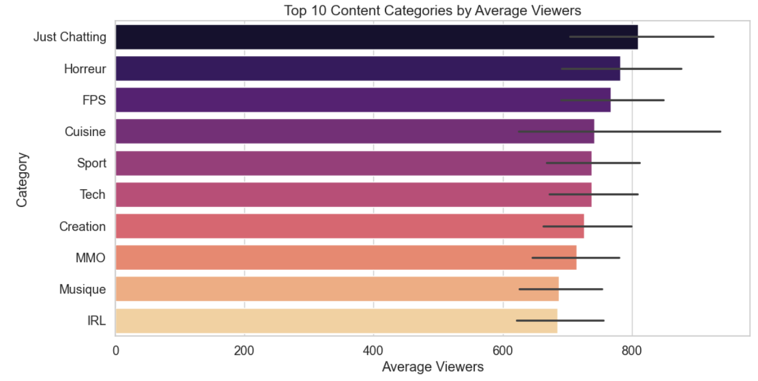
3.2 Content Strategy: What to stream?

Slide 13
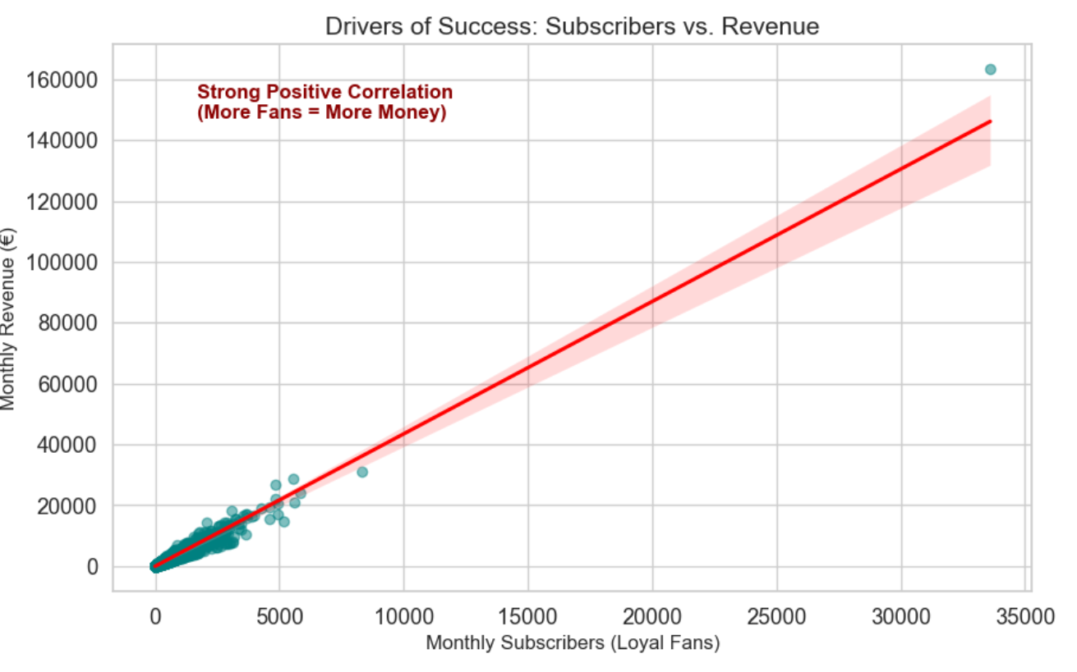
3.3 Drivers of Success:
What makes a streamer wealthy?
We often ask: "How can I become a top streamer?" Is success driven by working harder (streaming more hours) or by building a loyal community (subscribers)?
To answer this, I visualize the relationship between Monthly Subscribers and Monthly Revenue.
CODE.
plt.figure(figsize=(10, 6))
sns.regplot(data=df, x='Monthly_Subscribers', y='Monthly_Revenue_EUR',
scatter_kws={'alpha':0.5, 'color':'teal'}, line_kws={'color':'red'})
plt.title('Drivers of Success: Subscribers vs. Revenue', fontsize=15)
plt.xlabel('Monthly Subscribers (Loyal Fans)', fontsize=12)
plt.ylabel('Monthly Revenue (€)', fontsize=12)
plt.text(x=df['Monthly_Subscribers'].max()*0.05, y=df['Monthly_Revenue_EUR'].max()*0.9,
s='Strong Positive Correlation\n(More Fans = More Money)',
fontsize=12, color='darkred', weight='bold')
plt.show()

Slide 14
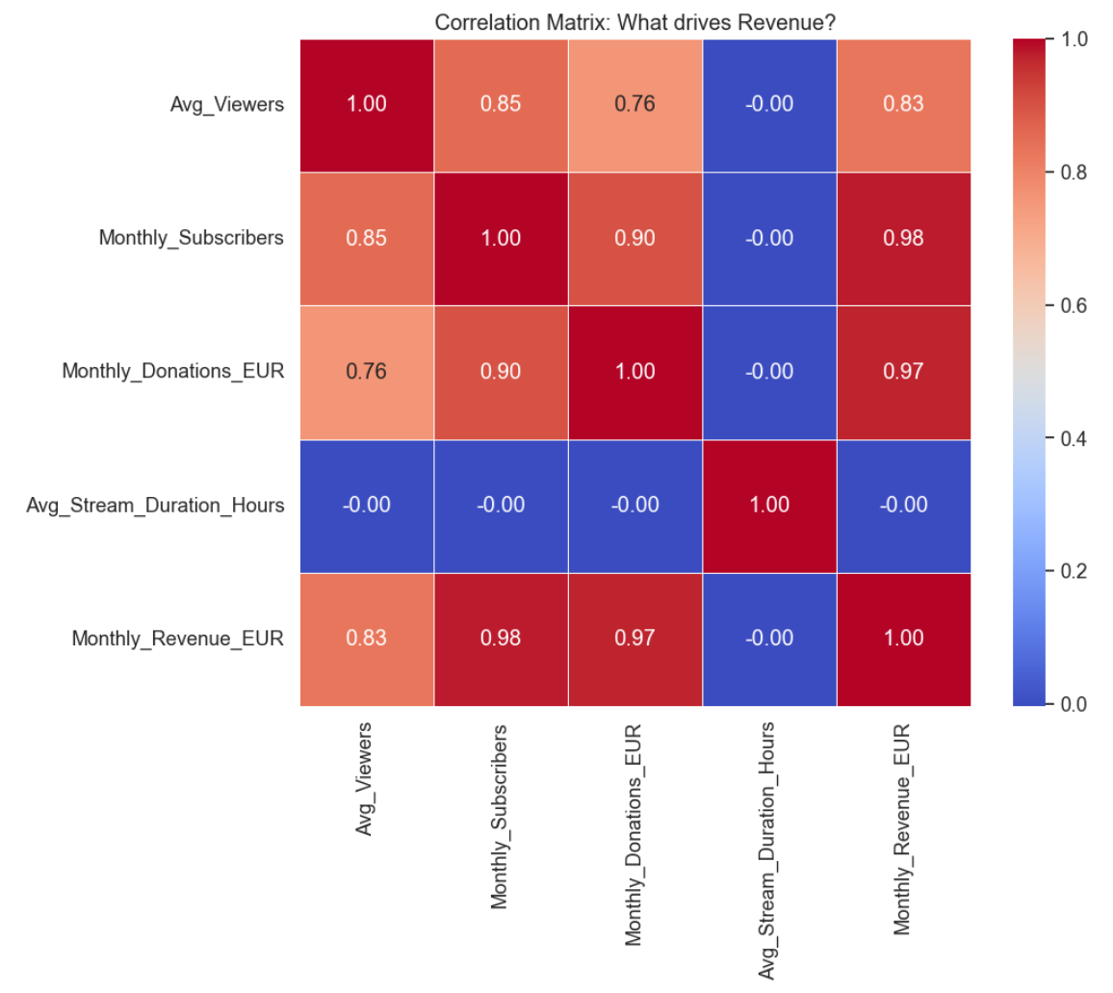
3.4 Efficiency Analysis: Heatmap
Do longer stream hours lead to more money? So I analyze the correlation between Stream Duration, Subscribers, and Revenue.
CODE.
cols_to_corr = ['Avg_Viewers', 'Monthly_Subscribers', 'Monthly_Donations_EUR',
'Avg_Stream_Duration_Hours', 'Monthly_Revenue_EUR']
corr_matrix = df[cols_to_corr].corr()
plt.figure(figsize=(10, 8))
sns.heatmap(corr_matrix, annot=True, cmap='coolwarm', fmt='.2f', linewidths=0.5)
plt.title('Correlation Matrix: What drives Revenue?')
plt.show()

Slide 15
04
Conclusion & Recommendations

Slide 16
4.1 Key Findings
Platform Strategy (Risk vs. Reward)
As shown in the Boxplot (Section 3.1), while average revenues are competitive across platforms, the income distribution varies. Major platforms (like Twitch) show a higher "ceiling" for top earners, but also significant disparity.
Content Strategy
Categories such as Just Chatting and specific competitive games consistently attract the highest Average Viewers (Section 3.2). These are the "high-traffic" zones for new streamers.
The Formula for Success
The most critical finding comes from the Scatter Plot (Section 3.3): There is a strong positive correlation between Monthly Subscribers and Revenue.
Conversely, the Heatmap (Section 3.4) reveals a weak correlation between Stream Duration and Revenue.

Slide 17
4.2 Strategic Recommendations
For a new streamer or investor entering the market in 2025:
Don't "Grind" Blindly:
Simply increasing streaming hours (e.g., streaming 10+ hours a day) yields diminishing returns. The data proves that time does not equal money.
Focus on Community Building:
The primary business goal should be converting viewers into Subscribers. Revenue is driven by the loyalty of the fan base, not the length of the broadcast.
Start Smart:
Launch with high-interest content categories to maximize initial visibility, then focus on viewer retention strategies.

Slide 18
4.3 Limitations (Critical Reflection)
To ensure academic honesty and professional transparency, we acknowledge:
Data Scope:
The analysis is limited to the year 2025; long-term trends (2020-2024) are not accounted for.
Missing Variables:
We lack data on External Social Media Influence (e.g., TikTok/Twitter followers), which is likely a hidden variable driving the subscriber count.

Slide 19
Thanks for listening

