Slide 1
Research Portfolio

Slide 2
Goal
Distinguishing between PCA and Gram-Schmidt Dimensionality Reduction Process:
GFR (Gram-Schmidt Functional Reduction)
GFA (Gram-Schmidt Feature Analysis)
GFS (Gram-Schmidt Feature Selection)
GCA (Gram-Schmidt Component Analysis)

Slide 3
Notation
X_original: original data matrix
X: processed data matrix (centering or standardized)
d_j: data matrix that is updated in iteration
V: eigenvectors of the covariance matrix = direction of principal components
Z: projection of the data matrix to the principal component direction
F

Slide 4

PCA Workflow
Covariance Matrix: $sigma= E[XX.T]$
Ranking based on eigenvalues: get a list of v
Extracting the top k numbers of eigenvectors
Project the data matrix to the selected eigenvectors

Slide 5
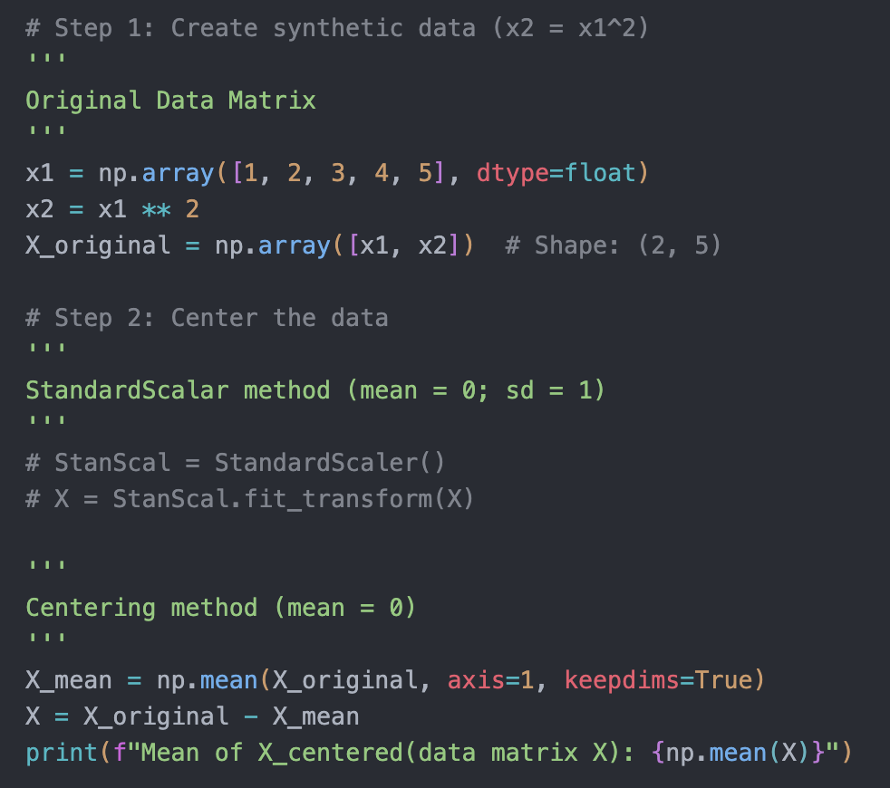
GFR
Standardized and normalized the original data matrix
mean = 0 and standard deviation = 1
❓However, I am a bit confused that some cases we only centering data sometimes we do both.

Slide 6
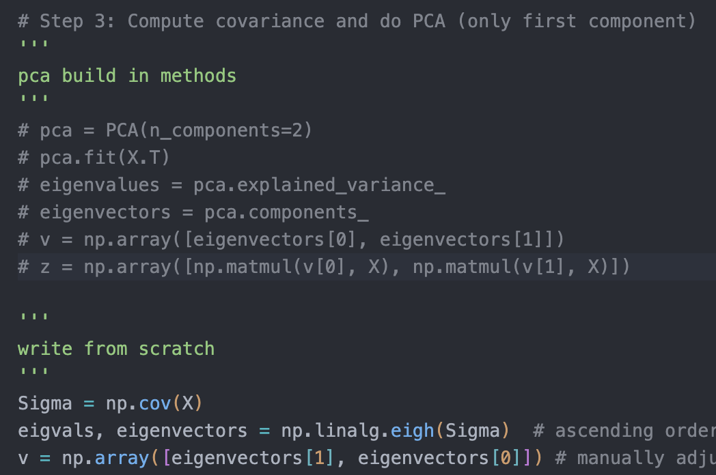
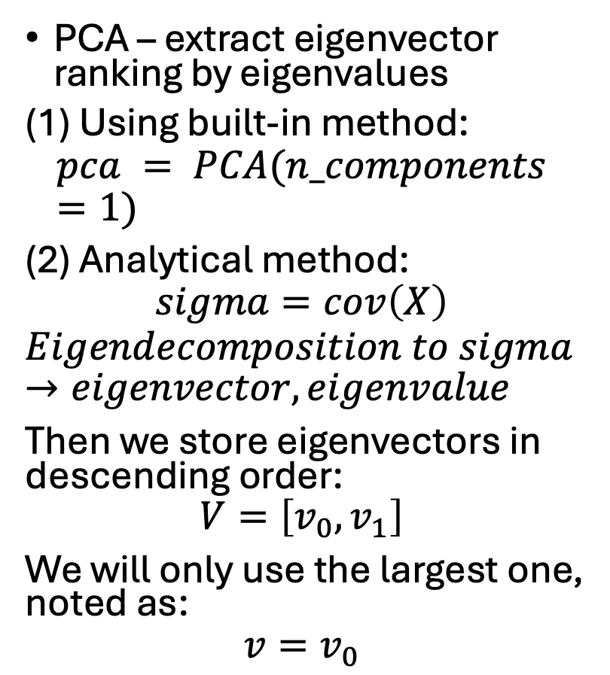
PCA – extract eigenvector ranking by eigenvalues
(1) Using built-in method:
$$pca = PCA(n_components=1)$$
(2) Analytical method:
$$sigma=cov\left(X\right)$$
$$Eigendecomposition to sigma →eigenvector, eigenvalue$$
Then we store eigenvectors in descending order:
$$V=\left[v_{0}, v_{1}\right]$$
We will only use the largest one, noted as:
$$v=v_{0}$$

Slide 7
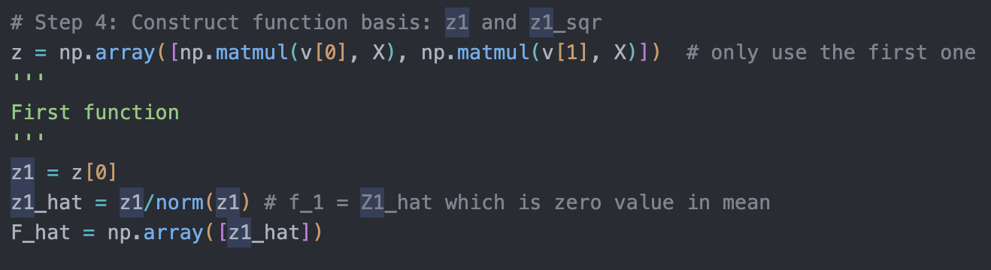
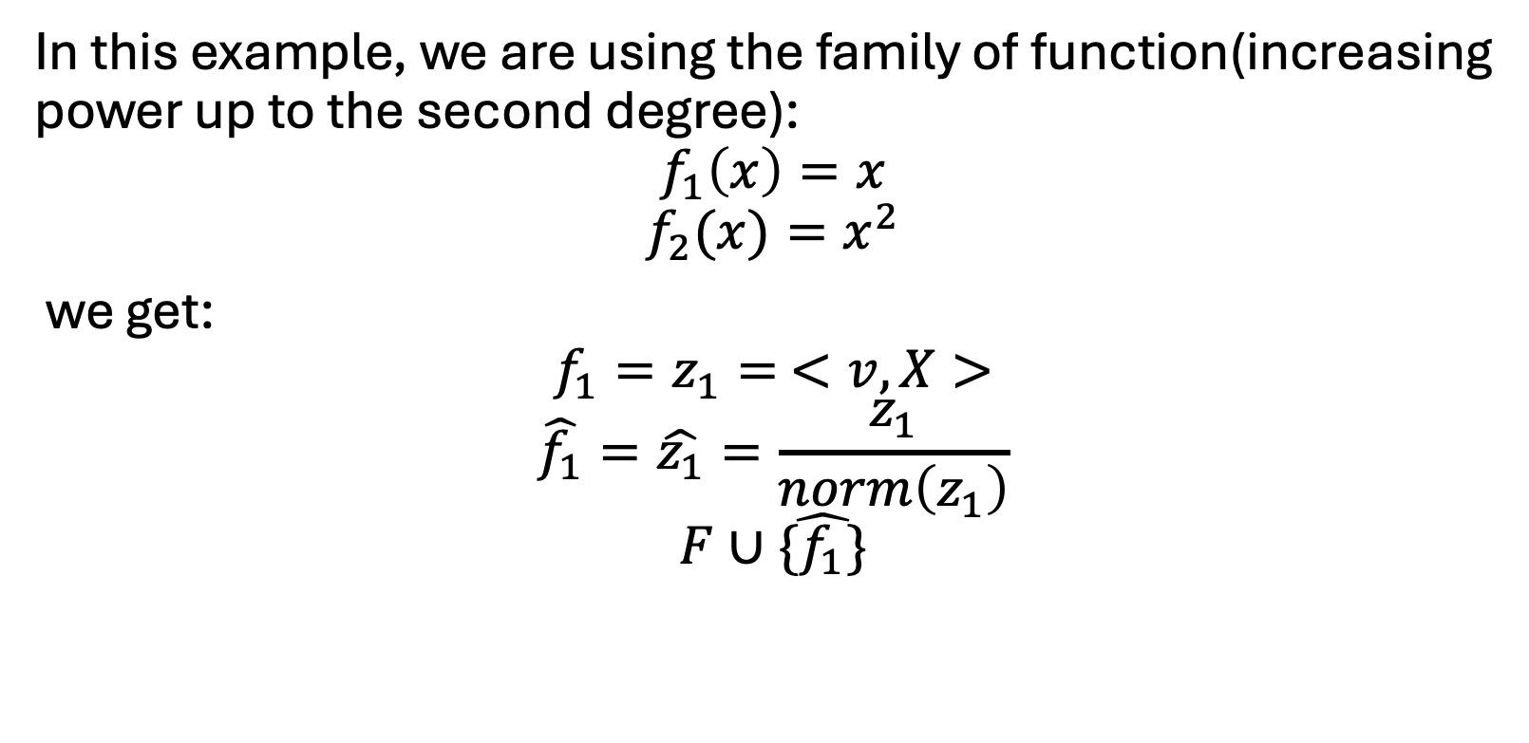
In this example, we are using the family of function(increasing power up to the second degree):
$$f_{1}\left(x\right)=x$$
$$f_{2}(x)=x^{2}$$
we get:
$${f_{1}=z}_{1}= <v, X>$$
$$\hat{f_{1}}=\hat{z_{1}}=\frac{z_{1}}{norm\left(z_{1}\right)}$$
$$F∪\hat{{\{f}_{1}\}}$$

Slide 8
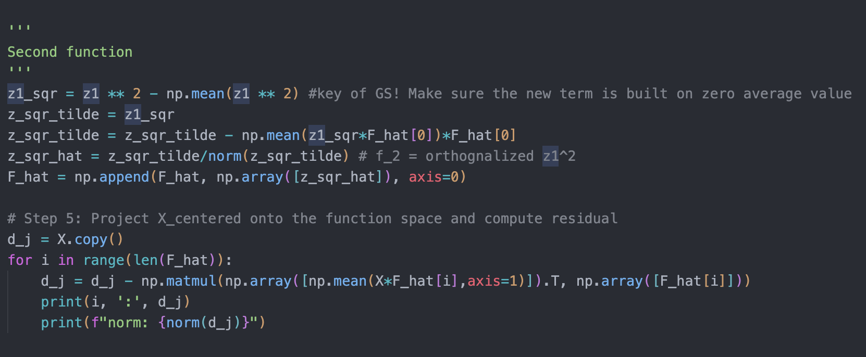
z1_sqr = f_1^2 and centering it to zero (mean = 0), because we don’t want the size of the f1 drifting our data away. We only want to capture the “dynamic” of the data
Using z_sqr to perform GS orthogonal process to get z_sqr_tilde
Normalized the z_sqr_tilde to get z_sqr_hat which is f_2

Slide 9
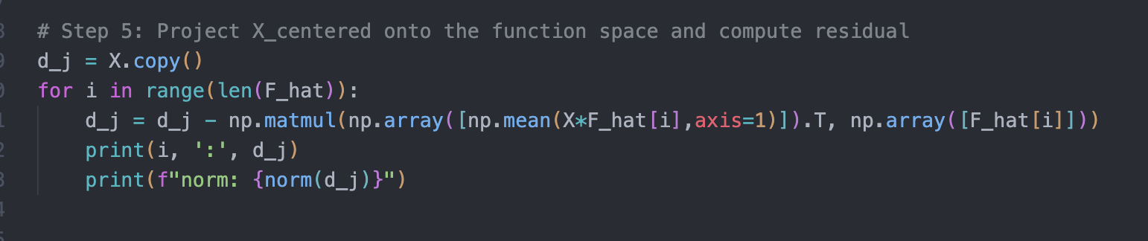
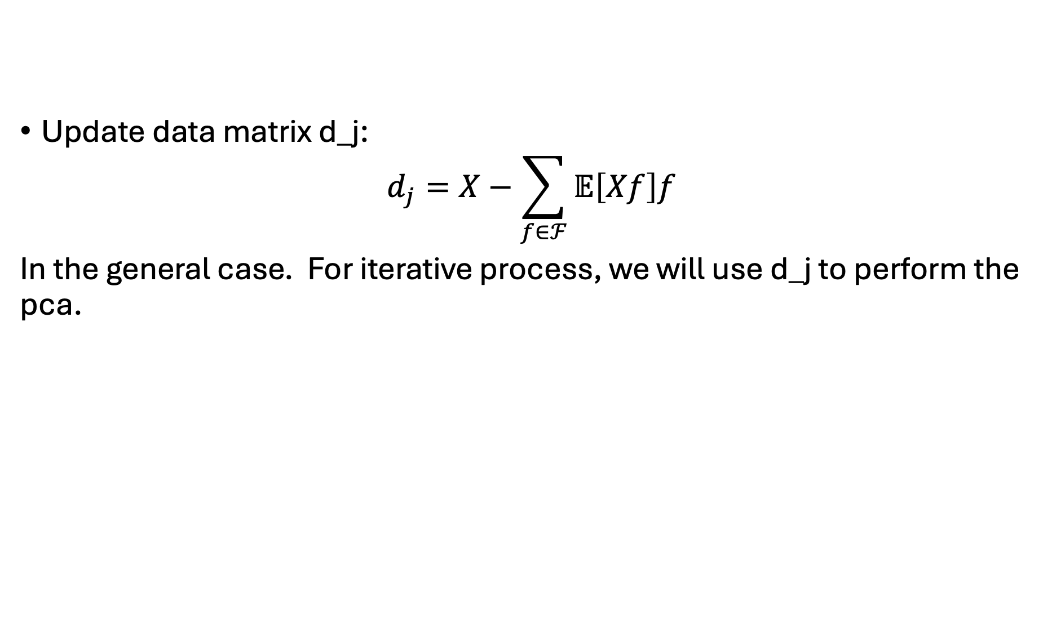
Update data matrix d_j:
$$d_{j}=X−\sum_{f∈ℱ}{𝔼\left[Xf\right]f}$$
In the general case. For iterative process, we will use d_j to perform the pca.

Slide 10
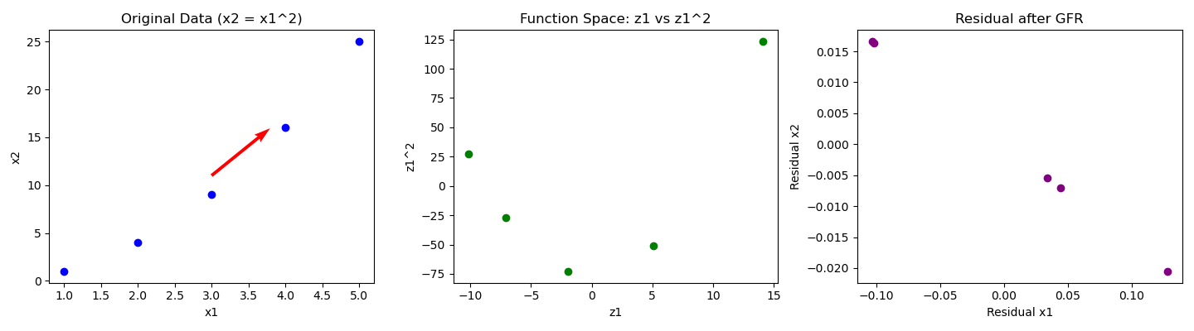

Slide 11

Generalized form – initial element of each iteration
$${f_{j}=z}_{j}=<v_{largest e−value},X>$$
$$\hat{f_{j}}=\frac{f_{j}}{𝔼[f_{j}]}$$
$$F∪\hat{\{f_{j}}\}$$

Slide 12
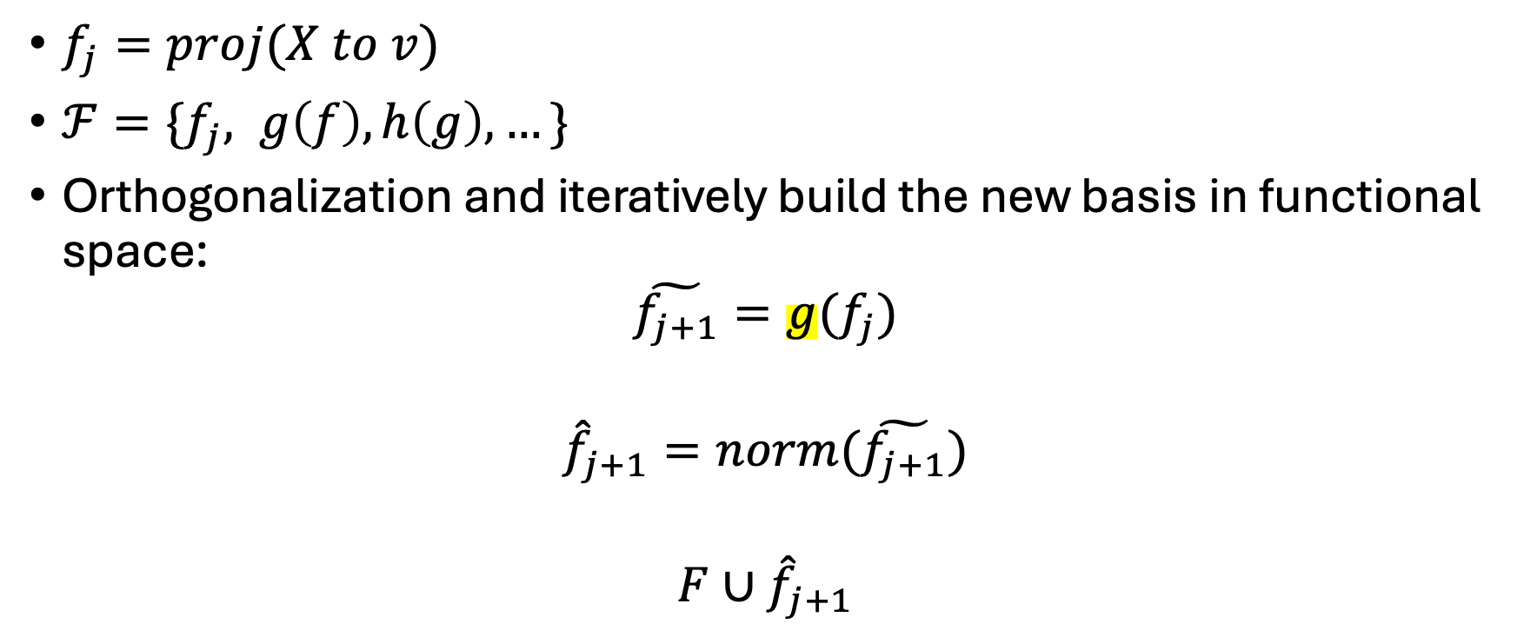
Interactive terms
$f_{j}=proj(X to v)$
$ℱ=\{f_{j}, g\left(f\right), h\left(g\right),…\}$
Orthogonalization and iteratively build the new basis in functional space:
$$\tilde{f_{j+1}}=g(f_{j})$$
$${\hat{f}}_{j+1}=norm(\tilde{f_{j+1}})$$
$$F∪{\hat{f}}_{j+1}$$

Slide 13
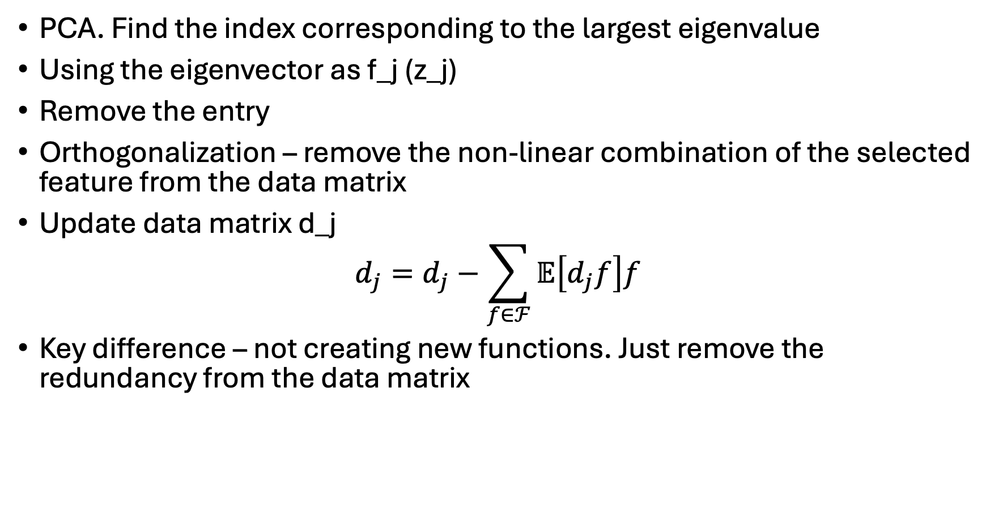
GFS
PCA. Find the index corresponding to the largest eigenvalue
Using the eigenvector as f_j (z_j)
Remove the entry
Orthogonalization – remove the non-linear combination of the selected feature from the data matrix
Update data matrix d_j
$$d_{j}=d_{j}−\sum_{f∈ℱ}{𝔼\left[d_{j}f\right]f}$$
Key difference – not creating new functions. Just remove the redundancy from the data matrix

Slide 14
Plan
Write an report, like a case study, recording and reflecting what I have learned from this paper.
Gram-Schmidt Orthogonal Process
Vector Space: relation between function and vector
PCA and its mathematical foundation:
Eigendecomposition
SVD
Summarized the Improvements on the beyond PCA methods

Slide 15
Reflection
Desk
Communication skill
Faculty Advisor
ESE105 TA
Summer

