Slide 1
NALAPRO Project
11,314
Train
20 Newsgroups Text Classification
7,532
Neural Networks • BERT • LLMs
Test
20 Newsgroups Dataset • 20 Classes • 18,846 Documents
20
Classes
Notes:
The dataset is 20 Newsgroups — about 19,000 internet forum posts from the early 90s covering topics like sports, computers, religion and politics. I split it into 11,314 training and 7,532 test samples. I removed headers, footers and quotes so the model learns from content only — not metadata like the sender's email address.

Slide 2
Problem & Dataset
THE TASK
18,846
11,314
Given a newsgroup post, automatically classify it into 1 of 20 topic categories.
Total Documents
Training Samples
Removed headers, footers and quotes so the model must learn from actual content and not metadata like sender emails.
7,532
20
This is a multi-class classification problem with 20 possible labels.
Test Samples
Topic Classes
Notes:
The task is simple to state: given a post, predict which of 20 categories it belongs to — things like sports, computers, religion, politics. I removed headers, footers and quotes from every document so the model genuinely learns from the content, not from metadata like the sender's email address. It's a multi-class classification problem with exactly one label per document
why remove headers: "Because headers contain the newsgroup name — leaving them in would be cheating. The model would just read the category directly instead of learning from the text."

Slide 3
Tasks Overview
Preprocessing
Word2Vec + NN
1a
1b
Lowercase → tokenize → remove stopwords → lemmatize
Avg word vectors (100d) → Linear → ReLU → Linear
TF-IDF + NN
TF-IDF + Bigrams+LSA
1c
1d
Word importance scores (5000d) → same network
Phrases + SVD compression (300d) → same network
BERT Fine-tuning
BERT + MLM
2
3
110M param transformer, fine-tuned end-to-end
Domain adapt via masking → then classify
Llama-3 Prompting
Llama-3 QLoRA
4
★
Zero-shot & few-shot, no training at all
Fine-tune with LoRA adapters, ~0.04% params trained
Notes:
I ran the 4 tasks in total.
Tasks 1a through 1d all use the same neural network but with different ways of converting text to numbers.
Then BERT fine-tuning, BERT with an extra MLM pretraining stage, Llama-3 prompting with zero-shot and few-shot,
and as a bonus, Llama-3 fine-tuned with QLoRA adapters
Extra experiment:
I chained them like a pipeline — TF-IDF with bigrams first converted each document into a 20,000-dimensional vector where each position represents either a single word or a two-word phrase like "hard drive" or "space shuttle" and its importance score.
That vector is massive and mostly zeros, so LSA then compressed it down to just 300 dense dimensions by finding the most important patterns and discarding the rest.
The neural network then receives those 300 numbers as input instead of 20,000. So it's not three separate experiments merged together — it's one continuous process where each step feeds into the next.
LSA - a compression technique that takes a large sparse matrix and squashes it down to a smaller dense one by keeping only the most important patterns and throwing away the noise.

Slide 4
Task 1: Neural Network Architecture
FIXED ARCHITECTURE
VECTORIZATION METHODS
Input Vector
Word2Vec (1 epoch)
100d / 5000d / 300d
100d • Shallow semantic learning
Linear Layer
→ 256 hidden units
Word2Vec (10 epochs)
0.586
ReLU
100d • Better cluster structure
max(0, x) activation
Linear Layer
TF-IDF
0.636
→ 20 class scores
5000d • Word importance, no semantics
Prediction
argmax → class label
TF-IDF + Bigrams + LSA
0.615
300d • Phrases + topic compression
Notes:
The network is fixed for all of Task 1 — two linear layers with a ReLU activation in between. The input size changes depending on the vectorization method: 100 dimensions for Word2Vec, 5,000 for TF-IDF, 300 for LSA, Latent Semantic Analysis (LSA). All of them go through 256 hidden units then output 20 scores — one per class. Whichever score is highest is the predicted category.“
If asked what ReLU does: "ReLU is just max(0, x) — it sets negative values to zero. Without it, two linear layers are mathematically identical to one, so the network can't learn complex patterns."
If asked why TF-IDF has 5,000 dimensions: "The TF-IDF vectorizer keeps the 5,000 most informative words from the vocabulary. Each document becomes a vector of 5,000 importance scores — one per word

Slide 5
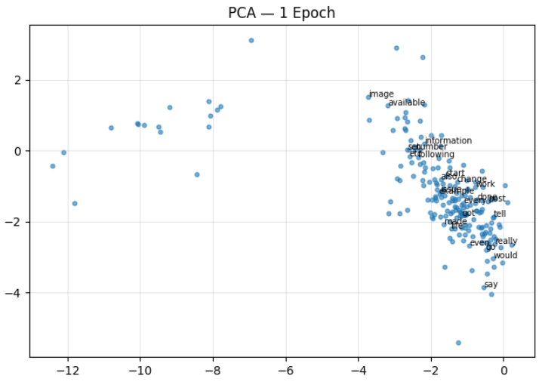
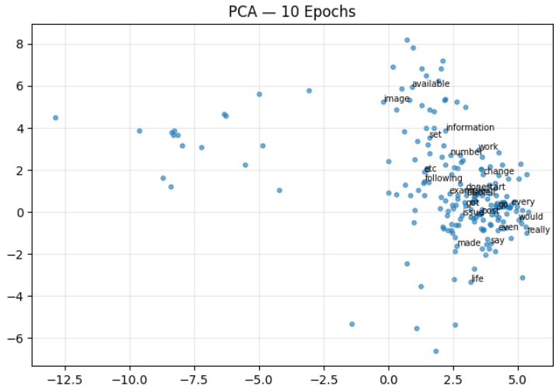
Word2Vec: Effect of Training Epochs
PCA — 1 Epoch
PCA — 10 Epochs
Mean cosine shift: 0.6876 — vectors moved significantly
Notes:
I trained Word2Vec for 1 epoch and 10 epochs and visualised the top 200 words using PCA — reducing from 100 dimensions down to 2 so we can see them.
After 1 epoch on the left, the words are tightly clustered in the centre — the model hasn't trained enough to separate them meaningfully.
After 10 epochs on the right, the vectors spread out and words move to more distinct positions.
The mean cosine shift of 0.6876 confirms the vectors moved significantly — so more training genuinely changes what the model learned about word relationships."
If asked why PCA: "PCA finds the two directions of maximum variance in the data and projects everything onto them. We stack both models' vectors together before reducing so they share the same coordinate system — otherwise the plots wouldn't be comparable

Slide 6
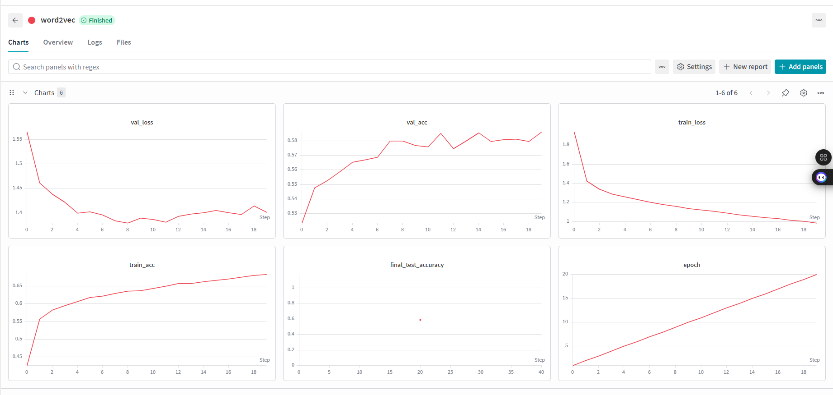

Slide 7
Task 2: BERT Fine-Tuning → 0.698
HOW IT WORKS
PARAMETERS
1. Start from bert-base-uncased (110M parameters, pretrained on Wikipedia + BookCorpus) 2. Add a classification head on top of the [CLS] token 3. Fine-tune the entire model end-to-end for 3 epochs 4. AdamW optimizer + linear warmup scheduler (10% warmup) 5. Gradient clipping (1.0) prevents exploding gradients
Epochs
3
Batch size
16
Learning rate
2e-5
Max length
128 tokens
Final accuracy
0.698
Notes:
For Task 2 I used bert-base-uncased — 110 million parameters already pretrained on Wikipedia and BookCorpus.
I added a classification head on top of the CLS token and fine-tuned the whole model for 3 epochs.
The learning rate is very small at 2e-5 because BERT's weights are already good — a large learning rate would destroy the pretrained knowledge.
I also used a warmup scheduler that starts the learning rate at zero and gradually increases it for the first 10% of steps to protect the weights early on. Gradient clipping at 1.0 prevents any single batch from causing a destructive update. Final result: 0.698.“
If asked why only 3 epochs: "BERT is already pretrained on billions of words — it doesn't need many passes to adapt. More epochs risk overfitting on the 11,000 training samples.
EPOCHS=3 — BERT is already pretrained on billions of words so it doesn't need many epochs to adapt. 3 is standard — more risks overfitting.
BATCH_SIZE=16 — lower than Task 1's 64 because BERT is huge and each document takes much more GPU memory than a simple vector.
LR=2e-5 — much smaller than Task 1's 0.001. BERT's weights are already good from pretraining — a large learning rate would destroy them. 2e-5 nudges them gently toward the new task.

Slide 8
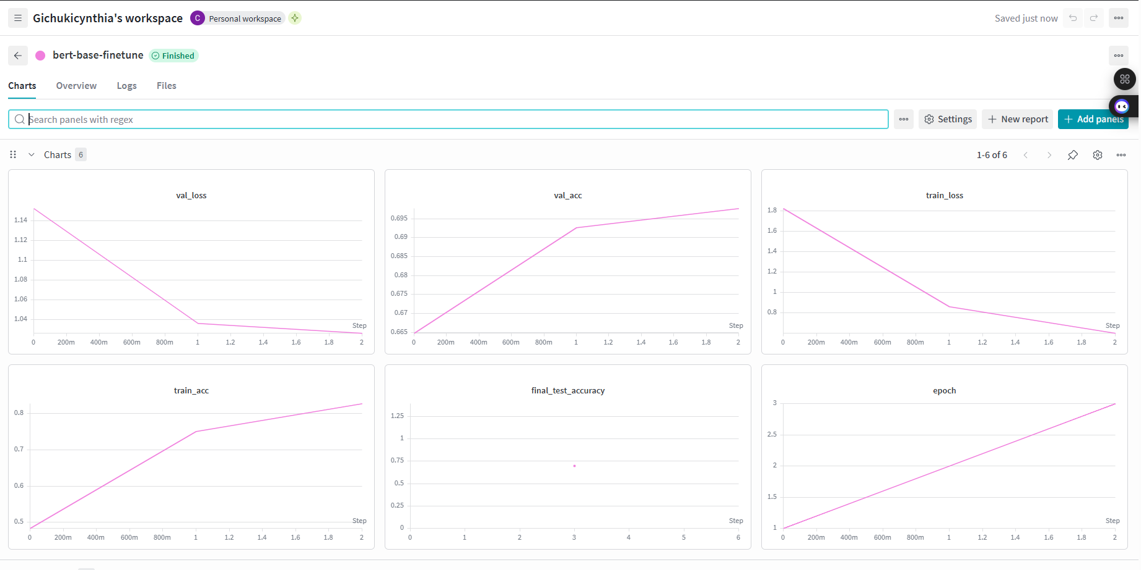

Slide 9
Task 3: BERT + MLM → 0.710
STAGE 1 — MLM PRETRAINING
STAGE 2 — CLASSIFICATION
Mask 15% of tokens across all 18,846 newsgroup documents. Train BERT to predict the missing words.
No labels needed — the text teaches itself (self-supervised).
Runs for 2 epochs. MLM loss: 2.46 → 2.30
Load MLM-adapted weights. Add fresh classification head on [CLS] token.
Fine-tune for 3 epochs.
Result: 0.710 vs 0.698 in Task 2 (+0.012)
→
Why it helps: Standard BERT was pretrained on Wikipedia and books — formal, clean text. Newsgroup posts contain technical jargon, abbreviations and internet language. The MLM stage lets BERT adapt its internal representations to this specific domain before classification, so the starting point for fine-tuning is better.
Notes:
Task 3 adds a stage before classification.
In Stage 1, I ran BERT's original masked language modeling on all 18,846 newsgroup documents — masking 15% of tokens and training BERT to predict them.
No labels needed, the text teaches itself. The MLM loss dropped from 2.46 to 2.30 over 2 epochs.
Then in Stage 2 I loaded those adapted weights and ran the same classification fine-tuning as Task 2.
CLS stands for Classification token.
It's a special token that BERT automatically adds to the very beginning of every input
The reason this helps is that standard BERT was trained on Wikipedia — formal, clean text. Newsgroup posts have technical jargon and internet language BERT has never seen. The MLM stage adapts its vocabulary before classification, which is why we went from 0.698 to 0.710
mlm_probability=0.15 — masks 15% of tokens per document

Slide 10
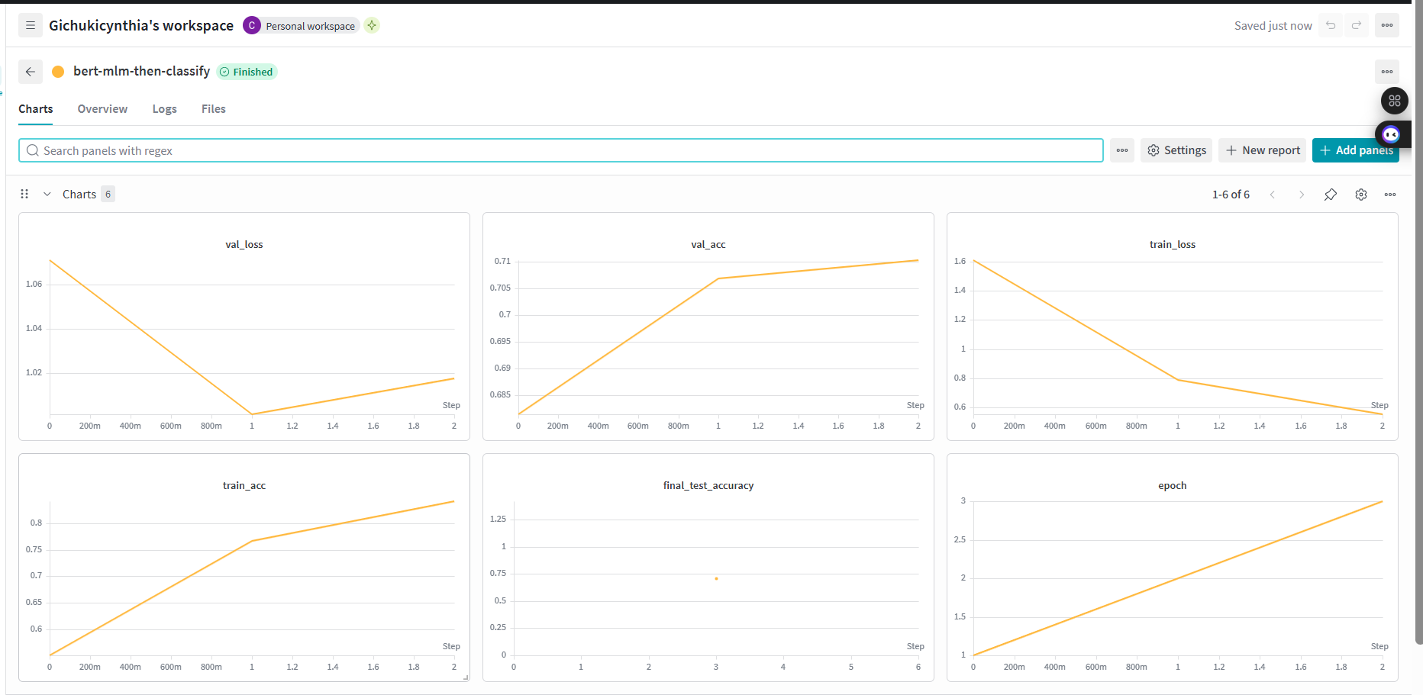

Slide 11
Task 4 + Bonus: Llama-3 Experiments
ZERO-SHOT
0.255
FEW-SHOT
0.430
QLORA
0.645
No examples given. Prompted Llama-3 with the text + 20 class names. Achieves 5× better than random (0.05) but struggles to distinguish 20 similar categories without training.
One labeled example per class provided in the prompt. Model follows the pattern and improves significantly over zero-shot. Shows that in-context examples help LLMs on fine-grained classification.
Fine-tuned LoRA adapters on top of Llama-3. Only ~0.04% of 8B parameters trained. Shows that task-specific training dramatically outperforms pure prompting.
Notes:
Task 4 uses a completely different approach — no training at all.
I loaded Llama-3 8B in 4-bit quantization to fit in GPU memory and just prompted it.
Zero-shot: give the text and 20 class names, ask it to choose — result 0.255, which is 5 times better than random guessing but still low because 20 categories is hard without any training.
So it's not totally clueless, it has general knowledge from training on the internet, but it's never specifically practiced this task so it struggles.
Few-shot gave 0.430 by providing one example per class in the prompt — the examples helped the model understand the pattern.
The QLoRA bonus fine-tuned LoRA adapters on top of Llama-3 — 0.04% of everything you know. It just updated the most relevant parts of it’s knowledge for this specific task. That's what LoRA does — instead of retraining all 8 billion parameters which would take forever, it adds small trainable pieces on top and only updates those.
Result: 64.5% — way better than just winging it with prompting which shows that even minimal task-specific training dramatically outperforms pure prompting

Slide 12
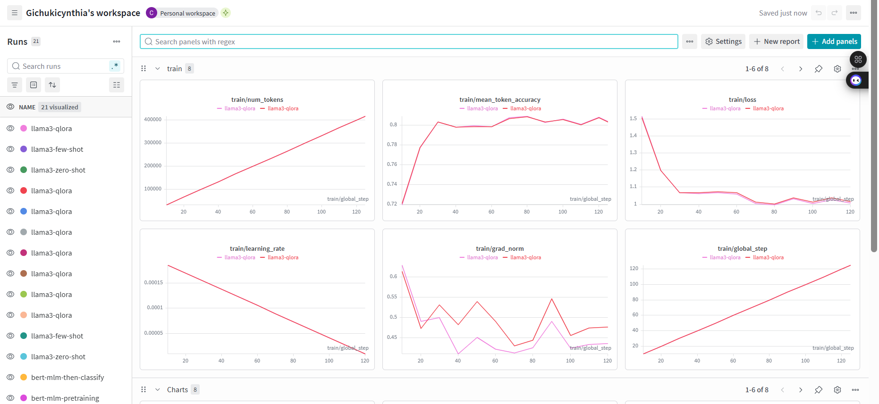
Notes:
text[:300] — how many characters of the document you feed in.
Increase to 500: model sees more context, potentially better accuracy
max_new_tokens=20 — how many tokens Llama can generate in its response
Too low (e.g. 5): model might get cut off mid-answer
max_length=512 — maximum total prompt length before truncation
FOR QLORA
r=8 — rank of the LoRA adapter matrices, controls how many parameters are trained
Increase to 16 or 32: more trainable parameters, potentially better accuracy but slower

Slide 13
Results & Comparison
📊 This shows all the models final comparison performance
Notes:
Looking at all the results, the winner is BERT with MLM pretraining at 0.710, followed closely by standard BERT at 0.698.
What's interesting is that TF-IDF at 0.636 beats Word2Vec at 0.586 — you'd expect the smarter semantic method to win, but for this task the simple word importance scores work better because each newsgroup topic has very specific vocabulary that TF-IDF captures directly.
LSA at 0.615 sits between the two — it tried to combine the best of both but the compression lost some useful information.
And the biggest story is Llama-3 zero-shot at 0.255 — this is an 8 billion parameter model that loses badly to a much smaller BERT that was simply trained on the right task.
That proves that targeted fine-tuning matters far more than raw model size

Slide 14
Key Takeaways
01
Fine-tuning beats prompting
02
TF-IDF > Word2Vec here
BERT at 0.698 crushes Llama-3 zero-shot at 0.255 — a much larger model. Task-specific training matters more than model size.
For topic classification, exact word matches (TF-IDF) outperform averaged semantic vectors (Word2Vec). The topic name vocabulary is a strong signal.
03
Domain adaptation helps
04
Context window is critical
MLM pretraining raised BERT from 0.698 → 0.710. Adapting to newsgroup language before classification gives a better starting point.
Few-shot improved significantly over zero-shot, reaching 0.430 by providing one labeled example per class. In-context examples meaningfully guide LLMs on fine-grained classification tasks.
Notes:
Four lessons.
First, fine-tuning beats prompting — task-specific training matters more than model size.
Second, TF-IDF beat Word2Vec here because topic vocabulary is a stronger signal than semantic similarity.
Third, domain adaptation helped — 2 epochs of MLM gave a free boost from 0.698 to 0.710.
And fourth, context window matters — few-shot at 0.430 shows examples help, but you have to engineer your prompts carefully to fit within token limits.
Thank you

Slide 15
THANK YOU

