Slide 1

PHASE 1 PROJECT
PRESENTED BY:CYNTHIA KARUGA

Slide 2
DATA ANALYSIS
BY PANDAS

Slide 3
PROBLEM STATEMENT
Microsoft sees all the big companies creating original video content and they want to get in on the fun. They have decided to create a new movie studio, but they don’t know anything about creating movies. You are charged with exploring what types of films are currently doing the best at the box office. You must then translate those findings into actionable insights that the head of Microsoft's new movie studio can use to help decide what type of films to create.

Slide 4
DATA USED
tn.movie_budgets.csv
title.basics.csv
title.ratings.csv

Slide 5
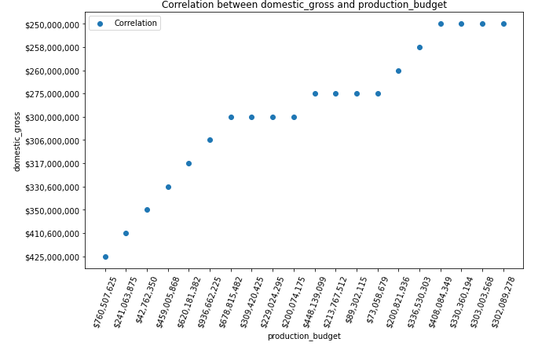
FINDINGS
1.A positive correlation exists between Correlation between domestic gross and production budget

Slide 6
A sample size was used rather the whole population
Therefore, as the budget increases so does the gross upto a certain point where it plateaus then picks again

Slide 7
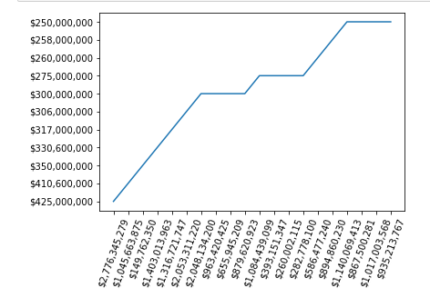
2.A positive correlation exists between Correlation between foreign gross and production budget

Slide 8
Both domestic and gross product behave the same with regards to budget
They increase then plateau at a certain level

Slide 9
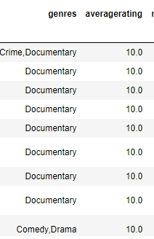
3.Documentaries have the highest ratings

Slide 10
Just a quick look into the sample data shows that Documentaries have the highest rating

Slide 11
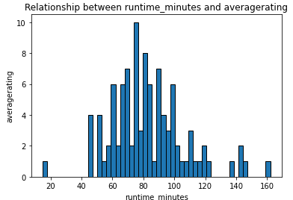
4. A relationship does exist between runtime minutes and average rating

Slide 12
The data is centralized at the middle meaning an a movie with an average runtime is most likely to receive a high rating

Slide 13
Conclusion
Sample data was used rather the population data
This was a general view of data but calculation of numerical values e.g median and correlation could be useful for clarity

Slide 14
Recommendations
Microsoft should invest more on documentaries
The running time of the movies is important and should be kept at an ‘average’
The budget put forth should is an indication of the gross they are most likely to receive in the short term

