Slide 1

Intermediate SQL
for Data Analysis

Slide 2
Agenda
Installing SQLiteStudio
Subqueries, Derived Tables, CTE’s, and Unions
Regular Expressions
Advanced Joins
Window Functions

Slide 3
Setting Up SQLite
SQLiteStudio or SqliteOnline.com can be accessed here:
https://sqlitestudio.pl/
https://sqliteonline.com
You can access either of these platforms.
If you cannot install or download any software, you can use SQLiteOnline.com which is an online-only SQLite editor.

Slide 4
Getting Resource Files
The few resources needed for this class are available on GitHub:
https://github.com/thomasnield/oreilly_intermediate_sql_for_data
Unzip the contents to a location of your choice, and note where you put them
Contents include:
A SQLite database file called thunderbird_manufacturing.db
Class notes with all examples (in three formats)
Slides

Slide 5
Section II Exercise
Bring in all fields from CUSTOMER_ORDER, but for each record show the total quantity ordered for that given CUSTOMER_ID and PRODUCT_ID.

Slide 6
Section III Exercise
Find all customers with an address containing a 3-4 digit street number

Slide 7
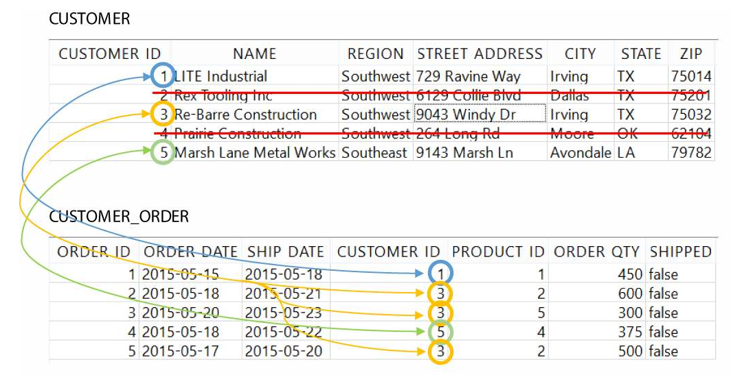
INNER JOIN

Slide 8
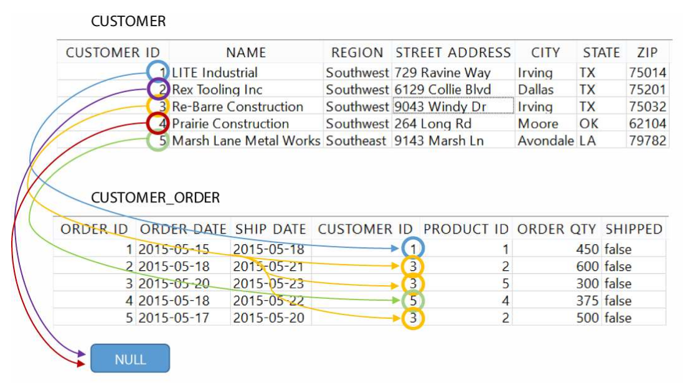
LEFT OUTER JOIN

Slide 9
Section VI Exercise
For every CALENDAR_DATE and CUSTOMER_ID, show the total QUANTITY ordered for the date range of 2017-01-01 to 2017-03-31:

Slide 10
Section V Exercise
For the month of March, bring in the rolling sum of QUANTITY ordered (to each ORDER_DATE) by CUSTOMER_ID and PRODUCT_ID.

Slide 11
Windowing Functions Support
Windowing functions are found on many database platforms, including:
Oracle
Teradata
PostgreSQL
SQL Server
Apache Spark SQL
MySQL (as of version 8)
SQLite (as of version 3.25.0)
These platforms notably do not have windowing functions:
MySQL (previous to version 8)
SQLite (previous version 3.25.0)
MariaDB

