Slide 1
Non-Technical Project / Technical Project
Non-Technical Project
Credit Suisse Crisis & Liqudity Risk
Unveiling the Risks and Collapse Behind a Global Financial Giant
Authors: Shiyue (Cynthia) Zhou, Kaisen Yao, Arko Bhattacharya, Skye Augsorn, Mona Saeed
Notes:
Hello everyone.. so we are Group 5 and this is our non-technical project, 'Credit Suisse Crisis & Liquidity Risk: Unveiling the Risks and Collapse Behind a Global Financial Giant.' which explores the factors leading to Credit Suisse's crisis and the liquidity risks that contributed to its downfall.

Slide 2


Credit Suisse Risk Management Departments
Risk Management Division
Liquidity Risk Management
Market Risk Management
Operational Risk Management
Credit Risk Management
Audit and Internal Controls
Compliance and Regulatory Affairs
Asset and Liability Management (ALM)
Governance, Risk, and Compliance (GRC) Framework
Notes:
Credit Suisse's risk management structure encompassed various divisions like Liquidity, Market, Operational, and Credit Risk Management, supported by compliance, audit, and governance teams, but systemic weaknesses were exposed in high-profile cases like the Greensill and Archegos collapses

Slide 3
Credit Suisse Crisis
UBS Acquisition of Credit Suisse
Credit Suisse
In March 2023, UBS Group AG acquired Credit Suisse Group AG for 3 billion CHF ($3.3 billion USD).
The acquisition aimed to stabilize the global banking system.
The move prevented the potential collapse of Credit Suisse.
Credit Suisse traces its roots to Schweizerische Kreditanstalt, founded in 1856.
It was one of 30 globally systemically important banks, critical to the financial system.
A full collapse of Credit Suisse could have had catastrophic global financial consequences.
Notes:
"these risk management pitfalls in conjunction with few other contributing factors, led to a major crisis for Credit Suisse in March 2023, leading to its acquisition by UBS Group AG for 3.3 billion USD. This move aimed to stabilize the global banking system and prevent Credit Suisse’s potential collapse. With roots tracing back to 1856, Credit Suisse was one of 30 globally systemically important banks. Its failure could have had catastrophic financial consequences worldwide, making this acquisition a critical step in maintaining global economic stability.
Given the scale of the crisis, lets dive deeper into a couple of its major triggers, them being the Archegos and Greensill collapses.

Slide 4


Triggers of the Crisis
Greensill Collapse
Archegos Collapse
Greensill’s Business Model: Focused on supply chain financing (low risk) and future accounts receivables financing (high risk). Collateralized client notes were sold to Credit Suisse (CS) as a funding source.
Role of Credit Suisse: CS purchased Greensill’s notes, becoming its primary source of funding. Greensill’s insolvency left it unable to repay CS.
Banks' Losses: CS’s lack of due diligence—attributed to Greensill’s high reputation, charismatic CEO, and seemingly innovative business model—exacerbated the collapse. Greensill’s downfall resulted in over $2.2 billion in losses for Credit Suisse.
Archegos' Business Model: Operated as a hedge fund with a large "total return swap" portfolio, leading to significant leverage and limited cash reserves.
Prime Service Divisions' Role: Acted as Archegos' investment bankers and counterparties in its total return swap strategy.
Banks' Losses: Prime Service Divisions liquidated Archegos' assets to recover losses, causing over $10 billion in combined losses, including $5.5 billion at Credit Suisse.
Notes:
Building on these lessons, we turn our attention to an equally pressing question for investors: How do risk factors influence stock prices, and how can we integrate these factors into predictive models to enhance investment strategies? This brings us to our study's central purpose: to investigate the relationship between UBS stock returns and various risk factors, applying advanced machine learning models to assess their predictive capabilities.
By incorporating risk factors such as market volatility, liquidity indicators, and macroeconomic variables into our models, we aim to address a critical challenge faced by investors and financial institutions—optimizing predictive accuracy while maintaining a robust understanding of risk influences. Our findings will contribute to better-informed investment decisions and showcase the value of machine learning in financial markets.
Let us now explore our research approach and findings in detail, beginning with the key variables, model design, and evaluation methods that form the foundation of this study.

Slide 5




Credit Suisse Risk Challenges
Credit Suisse faced significant risks due to its involvement in alternative investments and complex fund structures.
Market Risk
Liquidity Risk
Regulatory Risk
Operational Risk
Value of assets under management may fluctuate, impacting revenue from management fees.
Risk associated with funds’ ability to meet investor redemption requests, especially for alternative investments.
Heightened due to stringent global regulations on asset management practices and reporting.
Risks from fund mismanagement, or errors in managing portfolios
Notes:
Credit Suisse faced challenges across multiple units, Liquidity risk played a central role in Credit Suisse’s crisis, highlighting the bank's inability to manage cash flow and meet obligations without incurring significant losses.

Slide 6
Liquidity Risk on Credit Suisse
Liquidity risk is the risk that a financial institution cannot meet its cash and collateral obligations without incurring significant losses.
Overexposure to
High-Risk Investments
Immediate financial losses strained liquidity
Exposed vulnerabilities in meeting liabilities
Amplified Liquidity Constraints
Emergence of
Liquidity Shortages
Cash flow mismatches worsened liquidity issues
Reduced funding access exacerbated constraints
Loss of Market Confidence
Downward Spiral of
Liquidity Risk
Asset sales eroded capital, deepening the crisis
Notes:
Credit Suisse’s crisis was largely driven by liquidity risk, which escalated due to poor risk management.
First, The bank's overexposure to high-risk investments led to major financial losses when these clients defaulted, straining their cash reserves.
These financial losses revealed weaknesses in managing short-term liabilities.
Market volatility caused asset values to drop sharply, making it increasingly difficult to sell them. This worsened cash flow mismatches and deepened the liquidity crisis.
As concerns over solvency grew, market confidence in the bank eroded, limiting their access to outside funding.
Finally, this led to a downward spiral where the bank was forced to sell assets at heavy losses, depleting capital and creating a self-reinforcing cycle that ultimately pushed the bank into crisis.

Slide 7
Key Takeaways & Future Implications
Market Risk
Overexposure to
High-Risk Investments
Broader Implications for Financial Institutions
Lessons from Credit Suisse Crisis
The Importance of Advanced Risk Assessment
The failure to manage liquidity risk effectively led to cascading financial instability.
Overexposure to high-risk clients like Archegos and Greensill highlighted systemic governance flaws.
Market volatility exacerbated vulnerabilities, resulting in a loss of investor confidence.
Comprehensive risk models can help identify vulnerabilities before they escalate.
Integration of machine learning can enhance the predictive power of financial analysis.
Effective risk management requires transparency, governance, and adaptive tools.
Liquidity and solvency must be continuously monitored, especially during market stress.
Notes:
As we conclude, it’s clear that the Credit Suisse crisis underscores the vital importance of robust risk management practices in the financial industry. By understanding how liquidity risk spiraled into a full-blown crisis, we gain invaluable insights into the systemic flaws that need addressing—not just at Credit Suisse, but across global financial institutions.
Our research illustrates the potential of advanced machine learning models to bridge the gap between risk identification and actionable strategies. By incorporating nuanced risk factors, we can better predict market behaviors and make more informed investment decisions.

Slide 8
Non-Technical Project / Technical Project
Technical Project
Modeling Stock Prices Based on Risk Indicators
A Comparative Study of Machine Learning Models Using Time Series Analysis
Authors: Shiyue (Cynthia) Zhou, Kaisen Yao, Arko Bhattacharya, Skye Augsorn, Mona Saeed

Slide 9




Research Introduction
Statement of Purpose
Purpose
Question
Evaluate the predictive power of machine learning models in forecasting stock returns by incorporating key risk factors, providing insights into improving prediction accuracy and understanding the impact of risk on stock price movements.
How can integrating risk factors into machine learning models improve the prediction accuracy of stock returns, and what insights do these factors provide about the relationship between risk and stock price behavior?
Notes:
Building on these lessons, we turn our attention to an equally pressing question for investors: How do risk factors influence stock prices, and how can we integrate these factors into predictive models to enhance investment strategies? This brings us to our study's central purpose: to investigate the relationship between UBS stock returns and various risk factors, applying advanced machine learning models to assess their predictive capabilities.
By incorporating risk factors such as market volatility, liquidity indicators, and macroeconomic variables into our models, we aim to address a critical challenge faced by investors and financial institutions—optimizing predictive accuracy while maintaining a robust understanding of risk influences. Our findings will contribute to better-informed investment decisions and showcase the value of machine learning in financial markets.
Let us now explore our research approach and findings in detail, beginning with the key variables, model design, and evaluation methods that form the foundation of this study.

Slide 10

Research Method
Test models on the 2023–2024 dataset to validate forecasting performance.
Compare predicted stock returns against actual stock returns to assess model effectiveness.
ARIMAX
Bayesian Model
Yahoo Finance
Decision Trees
GBM
LSTM
Data Preprocessing
Models Development
Performance Evaluation
Testing and Validation
Data Collection
Data Preprocessing
Models Development
Performance Evaluation
Testing and Insight
Data Collection
Target Variable: UBS Log Return
Predictor Variables：
Bid-Ask Spread
Trading Volume
VIX Log
SPY Log Return
FTSE Log Return
EUR/CHF Exchange Rate Log
Oil Log Return
Gold Log Return
DB Log Return
MS Log Return
MSFE
Research Coding: Python
Mean Squared Forecast Error (MSFE) metric to evaluate the prediction accuracy of each model.
Compare the predictive power of risk factors in improving stock return forecasts.
Notes:
Let us now explore our research method. Using Python as our primary tool, we collected data from Yahoo Finance and, after preprocessing. We then applied five different machine learning models to develop our prediction framework. To evaluate forecasting performance, we calculated the MSFE for each model and compared the predicted results with the testing data for validation.

Slide 11
Data Source / Preprocessing
Data Preprocessing
Data Collection
Data Preprocessing
Period: January 4, 2021 – January 5, 2024
Dataset (From Yahoo Finance):
UBS stock returns
Risk factors: Bid-ask spreads, trading volume, macroeconomic indicators (SPY 500 & FTSE 100)
Market risk indicators: VIX, EUR/CHF exchange rate, gold and oil prices.
Data Cleaning: Removed missing values/outliers, standardized variables
Dataset Split: Training (Jan 4, 2021 – Jan 2, 2023), Testing (Jan 3, 2023–Jan 5, 2024)
Notes:
To build our forecasting models, we collected data from Yahoo Finance, covering a period of just over three years from January 4, 2021, to Jaunary 5, 2024.
As we can see, our core target variable is the UBS stock return, and we also included a set of explanatory variables, including the liquidity measures like bid-ask spreads and trading volume, the macroeconomic indicators such as the S&P 500 and FTSE 100 indices, and key market risk measures like the VIX, currency fluctuations in the EUR/CHF pair, and commodity prices of gold and oil.
And before modeling, we cleaned the dataset by removing missing values, outliers, and standardizing the explanatory variables to ensure the usability. And finally, we split the dataset into training and testing sets that prepares for the modeling processes.
Next page please.

Slide 12
Data Source / Preprocessing
Variable Calculation
Target Variable: UBS daily log return (to ensure stationarity)
Explanatory Variables:
Liquidity: log return Bid-ask spread, trading volume
Macroeconomic: log return S&P 500 (SPY), log return FTSE 100 (FTSE)
Market Risk: log return CBOE Volatility Index (VIX)
Currency: log return EUR/CHF exchange rate
Commodities: log return Oil (WTI Crude Futures), log return Gold (Gold Futures)
Peers: log return Morgan Stanley (MS), log return Deutsche Bank (DB) returns
* We incorporate raw daily trading volume Vt​ without any transformation, since it directly reflects market participation and can be easily interpreted without normalization.
Notes:
We also do the variable calculation for both target and explantory variables.
So basically, we applied log returns for the every variables excepted for the trading volume, becaues it directly reflects market participation and can be easily interpreted without normalization.
And after completing the transformation, our model can ensure stationarity.
Then Arko will move to the next step.

Slide 13
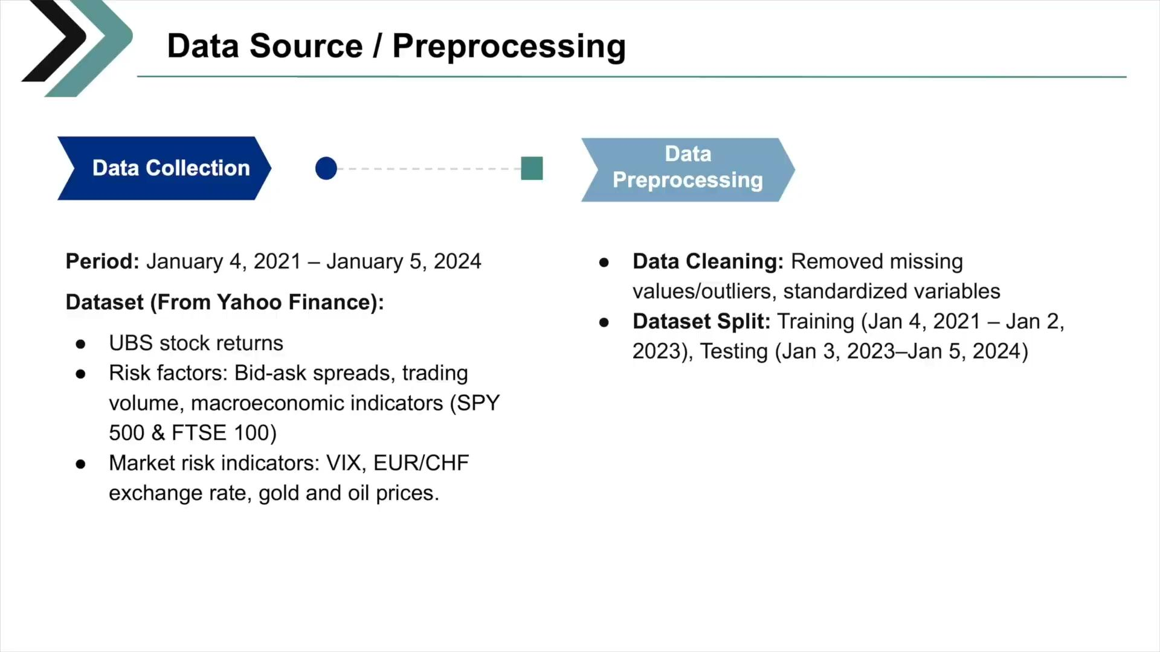

Slide 14
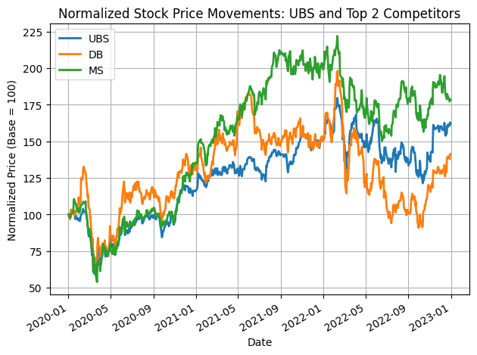
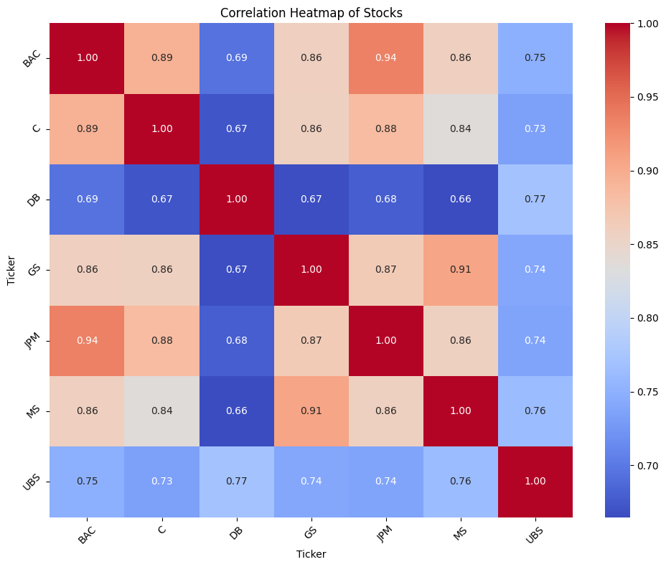
Stock Correlation Analysis
Data Collection
Correlation Mapping
Normalized Stock Movement
Data Preprocessing
Period: January 1, 2020 – January 1, 2023
Dataset (From Yahoo Finance):
'UBS', 'DB', 'GS', 'MS', 'JPM', 'C', 'BAC' stock returns
Target Variable: Adjusted Close Price
Top Correlated Competitors
Notes:
"This analysis focuses on stock correlations from January 2020 to January 2023, using adjusted closing prices for major banks like UBS, Deutsche Bank, Goldman Sachs, Morgan Stanley, JPMorgan, Citigroup, and Bank of America. Adjusted close is ideal as it accounts for factors that affect the stock's value but aren't directly tied to market performance. By normalizing stock movements, we mapped correlations to identify top competitors, providing accurate insights into performance trends and investor returns while eliminating distortions from raw data."
The adjusted closing price is preferred for stock return analysis across multiple stocks because it accounts for factors that affect the stock's value but aren't directly tied to market performance, such as:
Corporate Actions: Adjusted close reflects the impact of events like stock splits, dividends, and mergers, ensuring consistent valuation over time.
Comparability: By normalizing for these corporate actions, the adjusted close allows for fair comparisons across different stocks.
Accurate Returns Calculation: Returns calculated using the adjusted close provide a true measure of the investor’s gain or loss, incorporating reinvested dividends and other adjustments.
Eliminates Distortions: Using the adjusted close avoids misleading conclusions that could arise from raw closing prices, especially for stocks with frequent splits or dividends.
This makes the adjusted close the most reliable metric for analyzing performance trends and correlations across multiple stocks.

Slide 15
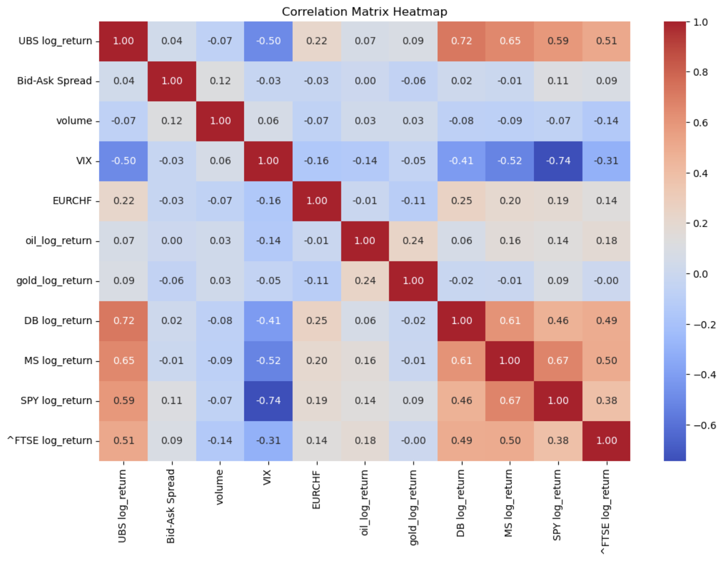
Correlation Analysis for all explanatory variables
Key Insights from Variable Correlation Matrix:
Positive Correlations: SPY, FTSE 100, DB, MS log_returns, EUR/CHF, oil prices.
Negative Correlations: Volume (-0.07) and VIX (-0.62) indicate an inverse relationship with UBS log_return.
Significant Predictors: Variables with correlations > 0.5 (e.g., VIX, SPY log_return, FTSE log_return) are likely strong contributors to the model.
Low Correlation Variables: Bid-Ask Spread (0.04), gold_log_return (0.09), and volume may have limited predictive power but warrant further analysis to account for potential nonlinear relationships.
Notes:
As part of our exploratory data analysis, we examined the correlation between UBS log_returns and our explanatory variables to identify potential predictors and gain initial insights into their relationships. Among the significant predictors, variables with correlations exceeding 0.5, such as SPY, FTSE 100 log_returns, and VIX, are expected to have a stronger influence on our model. These will likely play a central role in driving predictive performance.
We identified some low-correlation variables—such as the Bid-Ask Spread (0.04), gold_log_return (0.09), and volume. While these may have limited predictive power in a linear context, their inclusion allows us to explore potential nonlinear relationships, which might emerge as significant contributors in more sophisticated models.
The heatmap displayed here visually represents these correlations, with warmer colors signifying stronger relationships. This analysis forms the foundation for feature selection and model development, guiding us to focus on the most relevant variables while keeping an open mind about less obvious predictors.

Slide 16
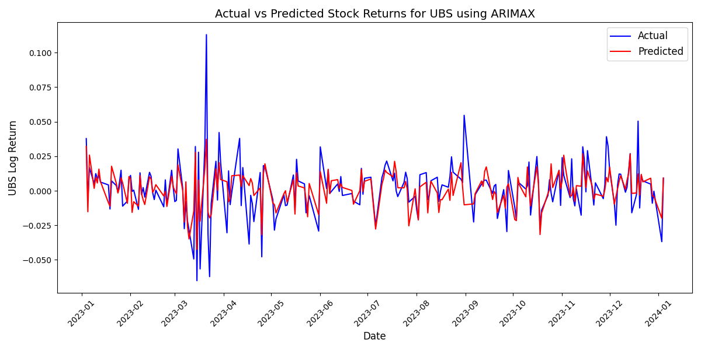
Models Development
ARIMAX
Models Development
What is an ARIMAX ?
ARIMAX extends ARIMA by incorporating exogenous variables to account for external factors affecting the target variable.
Components:
AR (AutoRegression): Past values.
I (Integration): Removes trends..
MA (Moving Average): Past forecast errors.
X (Exogenous Predictors): External variable.
MSFE: 0.000181
Performance Metrics
Insights & Limitations
MSFE: Model achieved 0.000181, demonstrating low forecast error.
R Square: Achieved 0.54, indicating moderate predictive accuracy.
Struggles with highly nonlinear relationships and extreme volatility due to its linear framework.
Transparent and computationally efficient compared to more complex machine learning models.
Notes:
ARIMA is a foundational time series model that captures linear relationships in stationary data but cannot handle external factors. ARIMAX extends ARIMA by including exogenous variables (external predictors) like VIX and trading volume to address this limitation.
To build ARIMAX, we ensured stationarity and carefully selected predictors. The final model, ARIMA(0,0,1) with exogenous variables, achieved an MSFE of 0.000181. It captured overall trends well, as shown in the graph, but struggled during extreme market fluctuations due to its linear nature.
ARIMAX demonstrates the value of incorporating external factors in financial forecasting, providing a solid foundation for more complex modeling approaches.

Slide 17
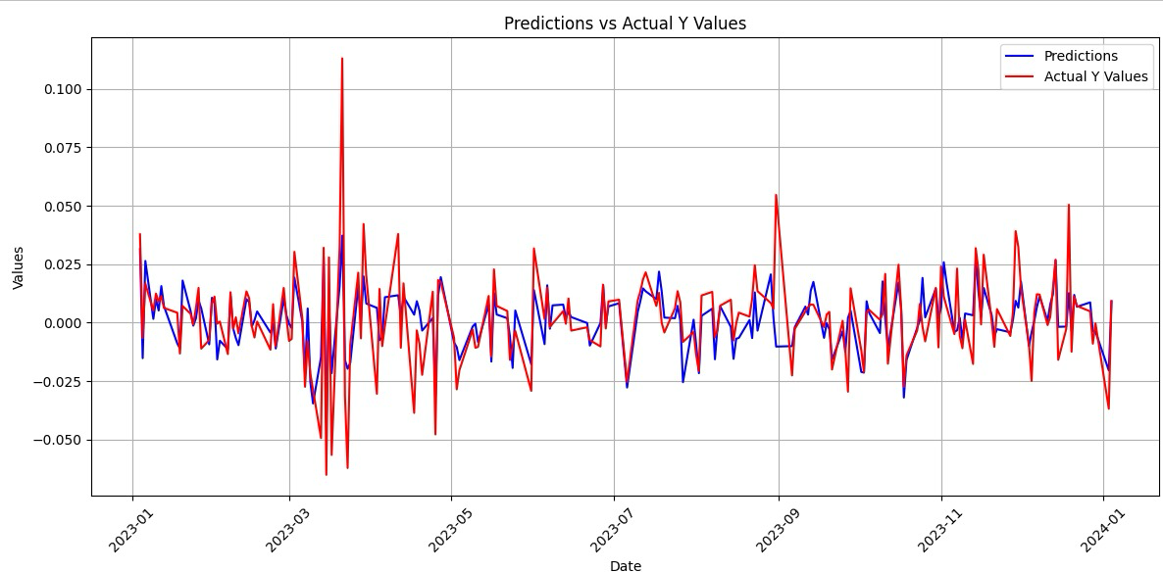
Models Development
Bayesian Model
What is Bayesian?
Definition: Uses probabilities to quantify uncertainty and model unknown phenomena.
Process: Starts with prior probabilities, updates them with observed data, and generates posterior probabilities for future predictions.
Advantage: Adapts to new data and captures the inherent randomness in time series data
Performance & Insight
Accurate Forcasting: A low MSFE value of 0.00018 demonstrates the model's high forecasting accuracy.
Trend Consistency:
Small deviations highlight the model's reliability in leveraging historical data.
Hierarchical priors enhance prediction accuracy by accounting for structured variability:
Date ----> Weekdays {0, 1, . . . , 6}
MSFE: 0.00018
imiation
Limitations:
Nonlinear Relationships:
The model may overlook nonlinear or complex interactions among risk factors, potentially limiting accuracy.
Data Dependency:
Missing or noisy data could reduce model effectiveness.
Notes:
As a statistical approach, Bayesian methods help quantify uncertainty and model unknown phenomena. The process begins with prior probabilities, updates them using observed data, and generates posterior probabilities for future predictions.
In this study, I applied a hierarchical Bayesian model to improve prediction accuracy by accounting for group-level variability. In addition to incorporating risk variables, the model also includes weekday effects as hierarchical priors, which share information across weekdays to enhance parameter stability.
As shown in the plot, the constructed Bayesian model effectively captures risk factors and performs well in predictions, achieving a low MSFE of 0.00018. This demonstrates the model's high forecasting accuracy.
The Bayesian model's accuracy could be limited by its potential to overlook nonlinear interactions among risk factors and sensitivity to missing or noisy data, but it serves as a strong foundation that can be enhanced by integrating it with other machine learning models.

Slide 18
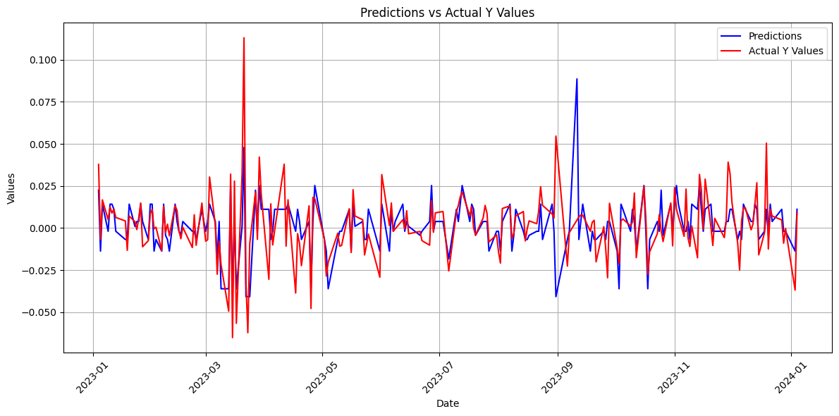
Models Development
Decision Trees
What is Decision Tree?
A decision tree is a supervised learning algorithm used for classification and regression tasks. It splits data into subsets based on feature conditions to make predictions.
Performance Metrics
MSFE: Our Decision Tree achieved an MSFE of 0.0002, indicating low forecast error.
R Square: indicates the proportion of variance explained by the model. Higher is better. Our model achieved 0.386 indicating moderate predictive accuracy
Insights & Limitations
MSFE: 0.0002
Captures non-linear relationships effectively
Prone to overfitting if not carefully tuned.
Performance can decline with high-dimensional or noisy data.
Notes:
Here, we examine the performance of our Decision Tree model, selected for its ability to handle non-linear relationships and its interpretability, which is crucial for financial applications.
The model achieved an MSFE of 0.0002, demonstrating low forecast error, and an R² of 0.3861, indicating it explained onyl 38% of the variance in stock returns. While the Decision Tree performed well, we remain cautious of its tendency to overfit, which was mitigated through careful tuning of hyperparameters.
These results validate the model's strength in capturing complex patterns, making it a valuable tool for predictive analysis in financial markets. However, further evaluation with additional models will provide a more comprehensive perspective.

Slide 19
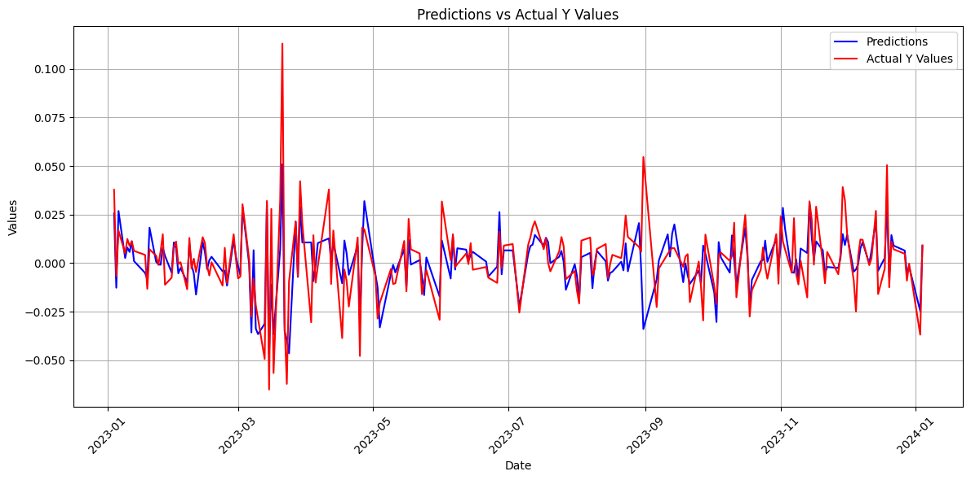
Models Development
Random Forest
What is a random forest?
Random Forest is an ensemble learning method that builds multiple decision trees and aggregates their outputs to improve accuracy and reduce overfitting.
Performance Metrics
MSFE: Our Random Forest model achieved an MSFE of 0.0002, indicating low forecast error.
R Square: Our model achieved 0.54 indicating higher moderate predictive accuracy
Insights & Limitations
MSFE: 0.0002
Improves predictive performance by reducing variance and handling diverse features effectively.
Computationally intensive compared to a single Decision Tree.
Can be less interpretable due to its ensemble nature.
Notes:
Building on the limitations of the Decision Tree, we implemented a Random Forest model to enhance predictive accuracy and reduce overfitting. Random Forest leverages multiple decision trees, combining their predictions to improve overall performance.
The model significantly improved our results, while the MSFE remained at 0.0002 the R² rised up to 0.54. This indicates a stronger ability to explain stock return variances and predict market behaviors more accurately.
While the Random Forest is computationally more intensive, its robustness and improved accuracy make it a powerful tool for capturing complex relationships in financial data. With this, we take a significant step forward in optimizing our predictive modeling approach.

Slide 20
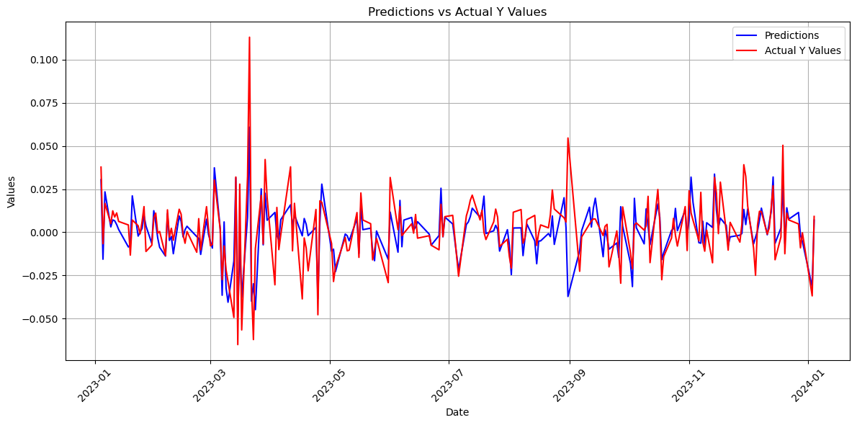
Models Development
Gradient Boosting Machines (GBM)
What is GBM?
Gradient Boosting Machines (GBM) is an advanced ensemble learning technique designed for predictive tasks. It improves upon decision trees by using a sequential approach where each tree corrects the errors of the previous ones.
Performance Metrics
MSFE: our model achieved an MSFE of 0.000192, outperforming both the Random Forest and Decision Tree.
MSFE: 0.000192
Insights & Limitations
GBM identified Deutsche Bank returns as the primary driver of UBS stock returns, aligning with market dynamics.
The model showed strong predictive accuracy but required substantial computational resources for tuning.
Its black-box nature limited interpretability compared to simpler models like ARIMAX
Notes:
To push predictive performance further, we applied the Gradient Boosting Machines, which is a sequential ensemble method that refines predictions by correcting residual errors from prior trees. This iterative approach allowed the model to identify subtle patterns in the data that Random Forest could not fully capture.
As we can see on the right, the results were significant, with the GBM achieving an MSFE of 0.00192, which is one of the lowest among all our models so far. This highlights its exceptional ability to handle complex relationships and interactions.
However, this comes at the cost of increased computational complexity and a higher risk of overfitting, which we mitigated through hyperparameter tuning and cross-validation.
But overall, GBM shows the power of boosting techniques in financial modeling.
Next, we will move to the Long Short-Term Memory.

Slide 21
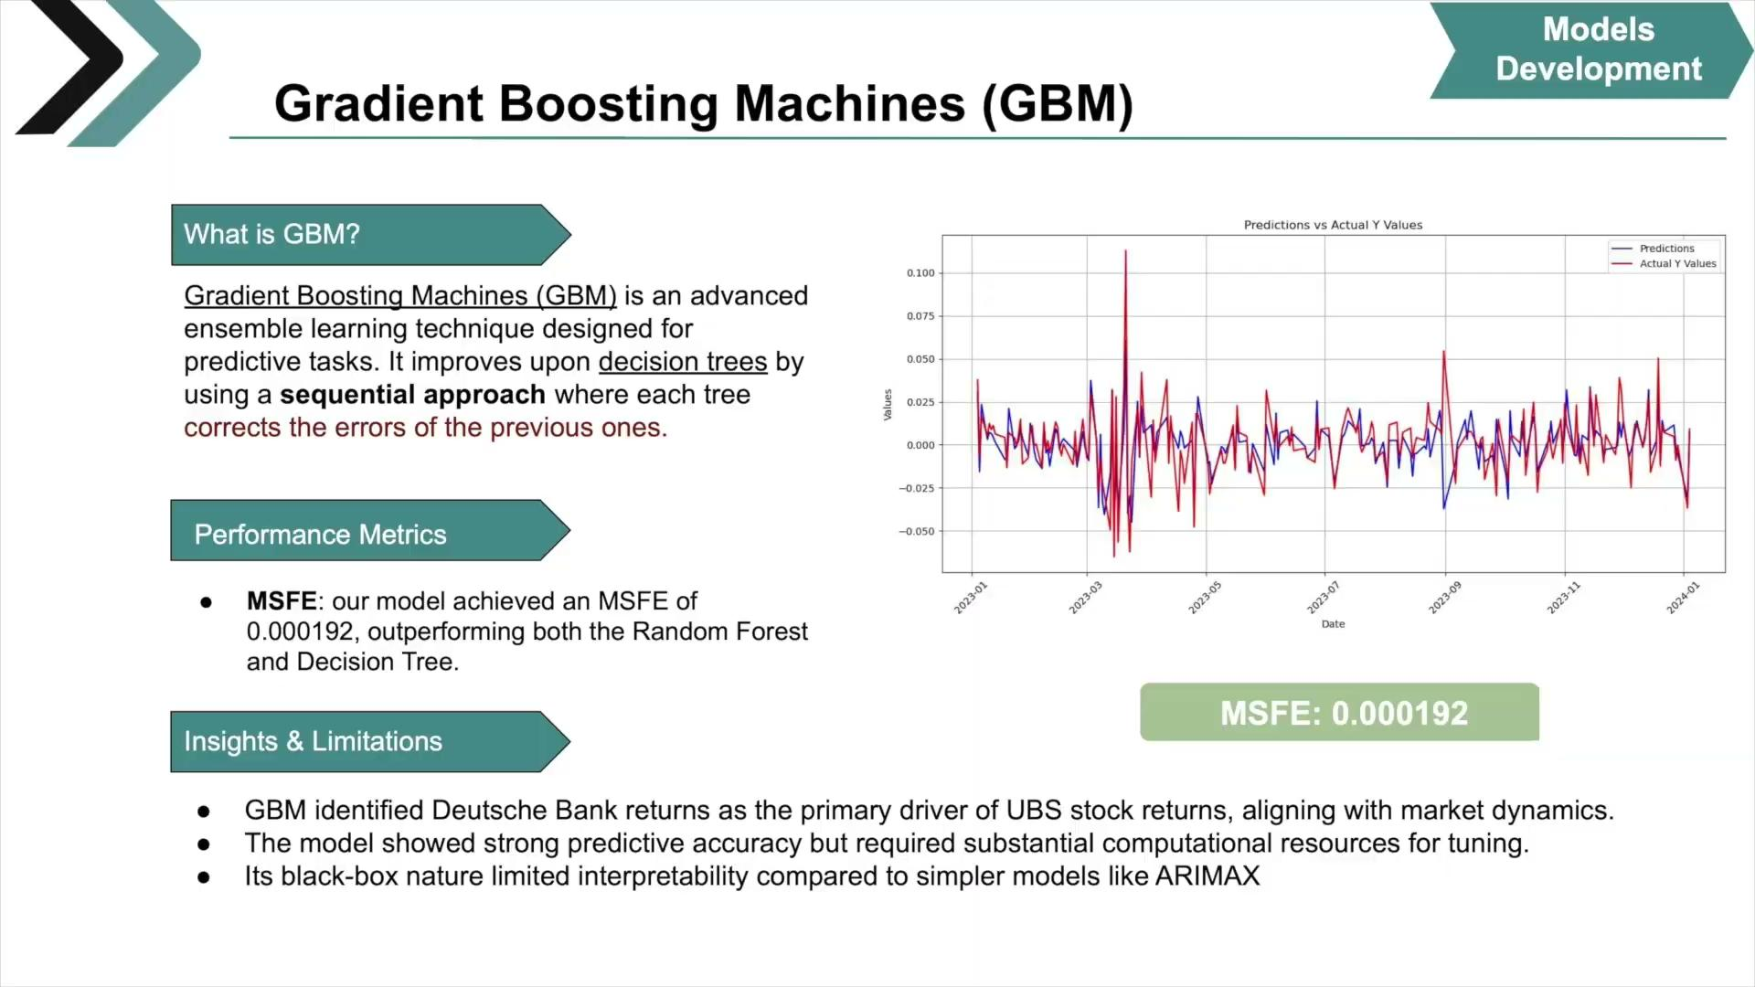

Slide 22
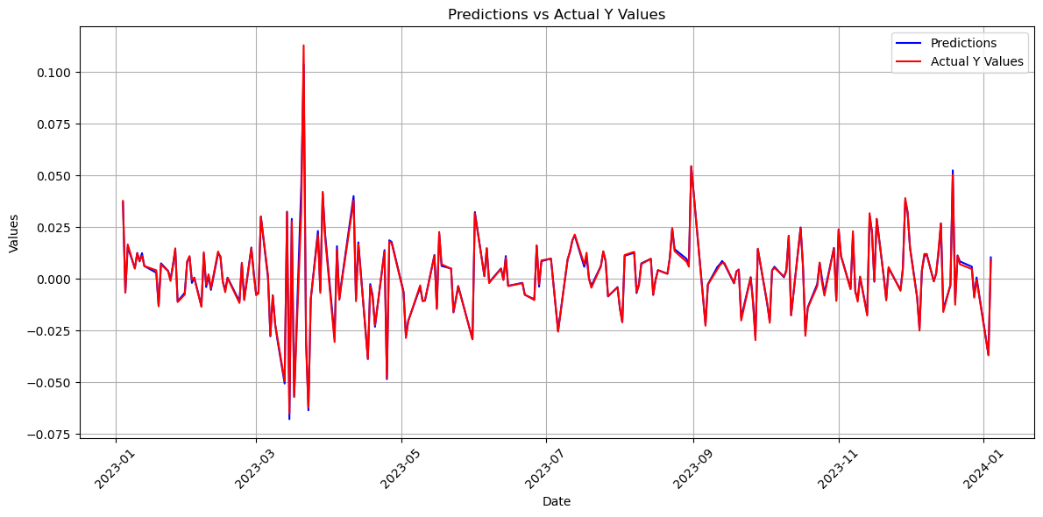
Models Development
LSTM
What is a LSTM?
The Long Short-Term Memory (LSTM) network, a type of Recurrent Neural Network (RNN). LSTMs are particularly suited for time-series data due to their ability to capture long-term dependencies and temporal relationships.
Performance Metrics
MSFE: Our LSTM model achieved an MSFE of 0.00000392, indicating extremely low forecast error.
MSFE: 0.00000392
Insights & Limitations
The LSTM model effectively captures sequential patterns in UBS log returns, aiding its strong forecasting capability.
Performance depends on the quality and consistency of the input data, making it vulnerable to noise and requiring careful preprocessing.
As a deep learning model, the LSTM lacks transparency in its decision-making process, which can hinder trust and regulatory compliance in financial applications.
Notes:
LSTMs, a type of Recurrent Neural Network, are ideal for time-series data due to their ability to capture long-term dependencies and temporal patterns.
Our architecture was tailored for sequential data. The first LSTM layer, with 128 units, returned sequences for further processing by a second LSTM layer with 64 units. Dropout regularization was applied after each LSTM layer, randomly setting 20% of the weights to zero to reduce overfitting. A dense layer with 32 units captured additional representations, while the output layer—a single dense unit—predicted the next UBS log return.
We used the Adam optimizer for its efficiency with sparse gradients, and Mean Squared Error as the loss function. Training spanned 50 epochs with mini-batches of size 32, and consistent preprocessing, including standardization and reshaping, ensured reliable results.
The LSTM demonstrated strong forecasting capabilities by capturing sequential patterns. However, its performance heavily depends on the quality of input data, making it sensitive to noise. Additionally, as a black-box model, it poses challenges in transparency and regulatory compliance, requiring careful validation for financial applications."

Slide 23



Conclusion: Key Result
Risk factors like trading volume, VIX, and peer bank performance are critical to predicting UBS stock returns.
Best Performer:
LSTM (MSFE: 3.92e-06): Highest accuracy, captured nonlinear dependencies but lower interpretability
Moderate Performers:
ARIMAX and Bayesian Models (MSFE: 0.000181): Balanced accuracy and interpretability.
Other Models:
GBM (MSFE: 0.000192): Effective but limited by feature engineering. Decision Tree (MSFE: 0.0002): Baseline with limited complexity.

Slide 24



Conclusion: Future Direction
Expand dataset to include longer periods and more metrics.
Integrate additional alternative data sources for sentiment analysis as a factor
Explore hybrid models to balance accuracy and interpretability.

Slide 25
Q&A

Slide 26
IDS789 / Group5
Thank You!

