Slide 1
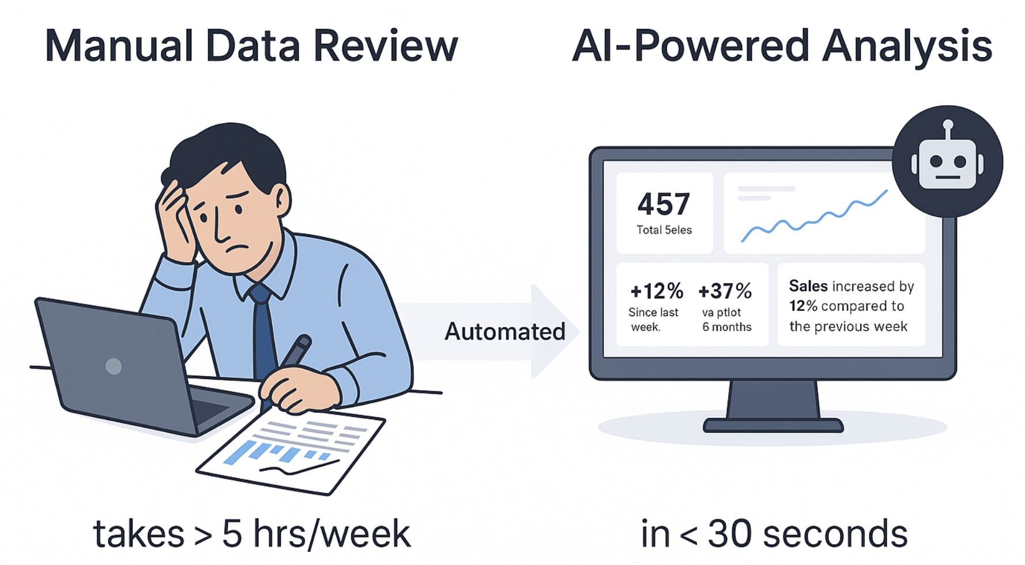
Problem & Objective
——From Manual Reporting to Automated Insight
Retail managers spend hours manually checking spreadsheets to find trends and track performance
— a slow, error-prone process.
AI Data Analyst that automates sales trend detection, generates insights, and recommends next actions
— enabling faster, data-driven decisions.

Slide 2





Solution Architecture —— From Data to Insight
Upload
CSV / Excel
Data Standardization (LLM)
Insight Generation
(LLM)
Dynamic KPI & Anomaly Computation
Interactive Dashboard (Streamlit)
Users upload weekly retail sales data for automated analysis.
The LLM maps inconsistent column names to a unified schema.
AI analyzes trends and summarizes business insights and recommendations.
Computes key metrics and detects outliers via Z-score.
Displays insights and KPIs in an interactive view where users filter by region and date range.
This workflow illustrates how raw retail data is transformed into actionable insights through an LLM-powered analysis pipeline.

Slide 3
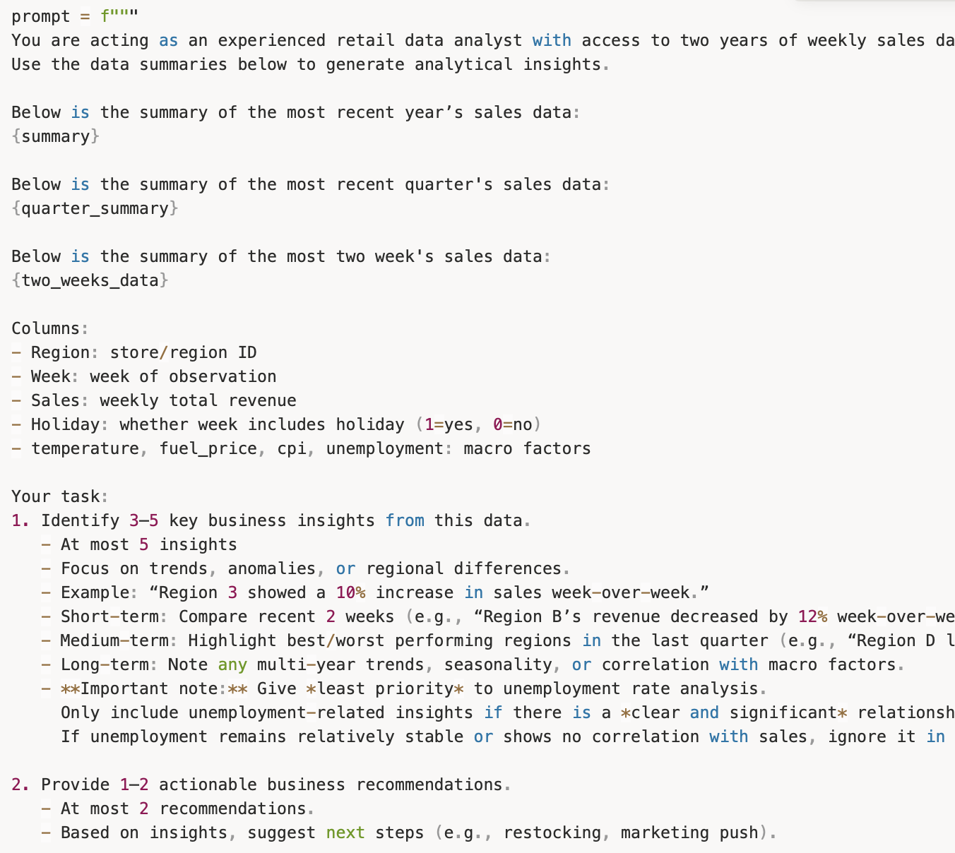
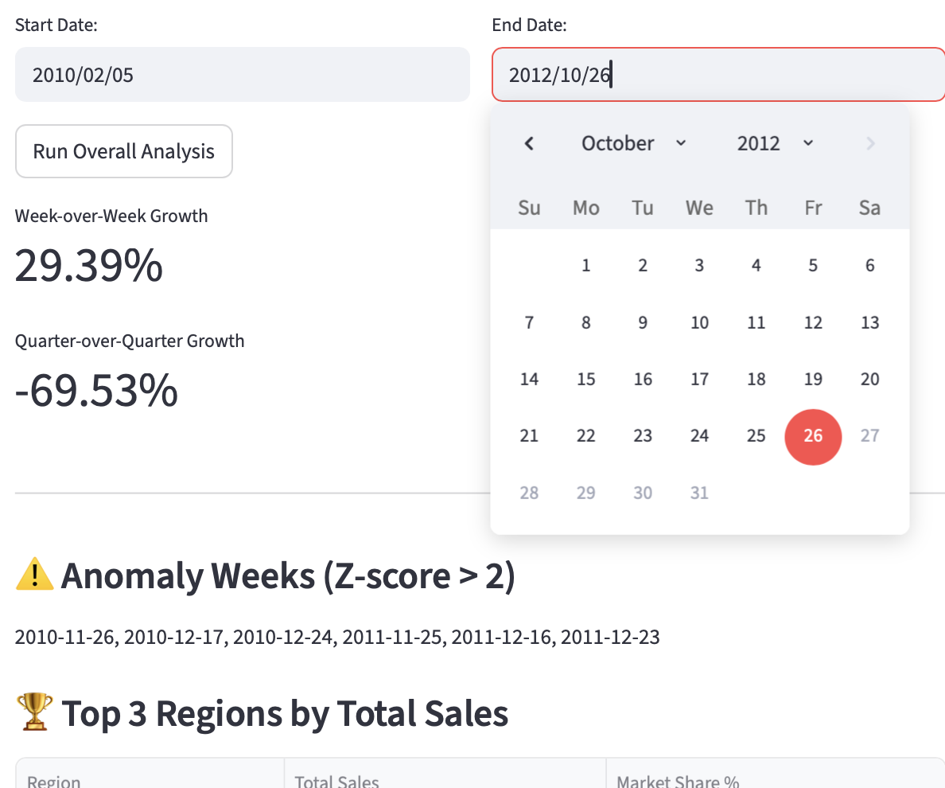
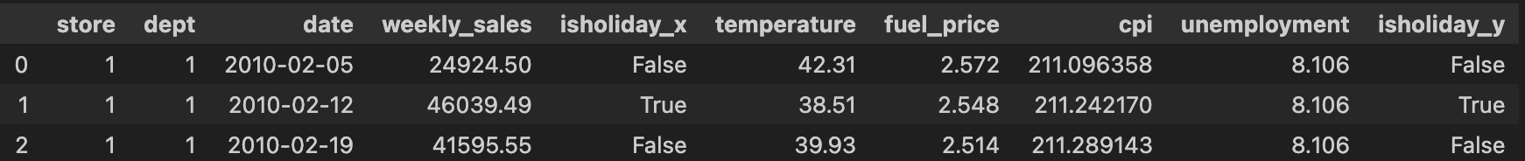
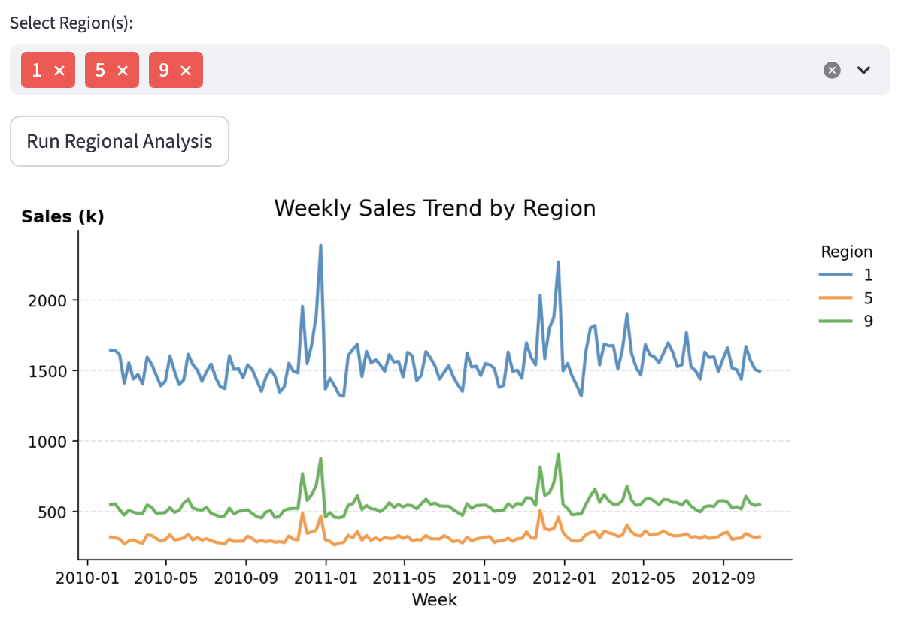
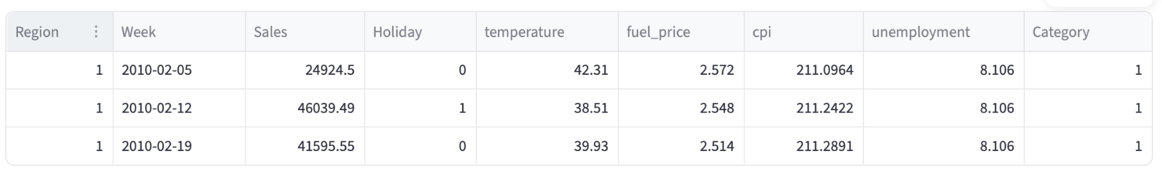
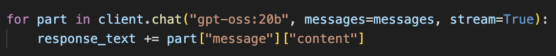
Implementation Highlights
Data Preprocessing Module
（LLM-based Schema Standardization）
Overall Insight Module
（AI-Generated Narrative Analysis）
Dynamic Metrics Module
（ Interactive KPI & Anomaly Engine）
Integrates Ollama GPT API for automated column mapping.
The LLM infers target schema fields (Region, Week, Sales) and aligns optional variables (Holiday, CPI, etc.) through semantic matching.
Handles edge cases such as datasets with only store IDs (treated as Region categories).
Final output is a standardized, validated dataset with consistent field names for downstream analysis.
Employs LLM integration via Ollama to analyze short-, medium-, and long-term sales trends.
Summarizes key regional differences, performance anomalies, and growth dynamics.
Generates the top 5 insights and 2 data-driven recommendations automatically.
Highlights both top- and bottom-performing markets to support managerial decision-making.
Allows users to select custom time ranges and compare multiple regions interactively.
Computes core KPIs such as Total Sales, Average Weekly Sales, and Growth Rates (WoW, MoM, QoQ, YoY).
Detects statistical anomalies (|Z| > 2) for rapid outlier identification.
Visualizes results through a Regional Trend Plot, enabling side-by-side performance comparison.

Slide 4
Challenges & Learnings
——From Prototype to Insight — Key Trade-offs
Challenge / Trade-off
VS
Resolution / Learning
LLM Schema Mapping Instability
LLM occasionally misidentified critical fields like Region or Week when column names varied across files.
Added a fallback rule-based system that heuristically detects date/region columns when LLM mapping fails. Combined semantic matching (LLM) with deterministic rules to ensure stable schema generation.
State Persistence in Streamlit
Each user interaction triggered a full script rerun, clearing computed summaries and breaking workflow continuity.
Implemented st.session_state to store intermediate results (standardized data, KPI summaries). This preserved state consistency across user actions, improving usability and experience.
Caching & Performance Trade-off
Function-level caching improved speed but caused serialization issues with LLM clients and plotting objects.
Applied selective caching: only cached pure-data functions (load_csv, preprocess_data) while excluding LLM calls and matplotlib figures. This balance improved responsiveness without breaking dependencies.
Visualization Responsiveness
Plotly-based interactive charts caused lag on large datasets, limiting dashboard performance.
Switched to lightweight Matplotlib static plots with key metrics displayed separately. The dashboard remained visually clear while maintaining fast rendering.

Slide 5




Demo & Next Steps
Overview
An AI-powered retail analytics prototype that automates sales trend detection, anomaly discovery, and business insight generation — turning raw weekly data into actionable intelligence within seconds.
Demo & Repository
https://youtu.be/nzP00j29Lig
🌐 GitHub Repository
https://github.com/CynthiaShiyue/Retail-Data-to-Insight-Agent
Demo Video
Core Modules
LLM-Powered Preprocessing
  Standardizes inconsistent CSV/Excel schemas (Region, Week, Sales, etc.) via Ollama API + rule-based fallback.
Dynamic KPI Engine
  Computes Total Sales, Growth %, and Z-score anomalies (Z > 2) across custom date ranges and multiple regions.
Insight Generator
  Summarizes short-, medium-, and long-term trends, highlights top/bottom regions, and recommends next business actions.
Future Enhancements
ML-based Anomaly Detection
  Integrate Isolation Forest for contextual pattern recognition.
Conversational Analytics
  Add natural-language query interface (e.g., “Which region grew fastest last quarter?”).
Predictive Forecasting
  Incorporate ARIMA/XGBoost to forecast next-quarter sales and marketing KPI.

