Slide 1
EDA Final
周昀、劉芸欣、高紹芳

Slide 2
Outline
Problem define
Reference and possible approach
Our approach
Current progress

Slide 3
Outline
Problem define
Reference and possible approach
Our approach
Current progress

Slide 4
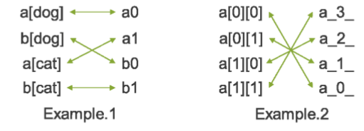
2018 ICCAD Problem A
The name mapping problem

Slide 5
Outline
Problem define
Reference and possible approach
Our approach
Current progress

Slide 6
Possible approach
Find the mathematical function of input and output
The solution space is too big. Related papers usually focus on binary output.
Machine learning model
It’s really hard to use a well developed model and tune the function for 100% match.
Regular expression
Might help in some level.

Slide 7
Outline
Problem define
Reference and possible approach
Our approach
Current progress

Slide 8

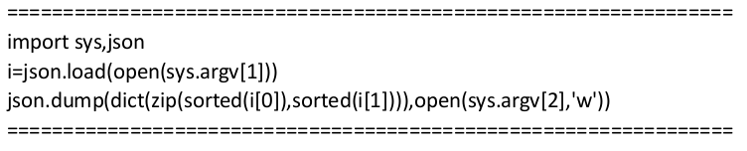
Sorting
If we can find and record a certain sequence of the string, then we can simply match the strings by sorting them according to that sequence.

Slide 9
Basic Idea
First we sort the string pairs according to the first strings.
We try to build a hash function for the second strings where the hash number of a string reflects its order.
1
2
3

Slide 10
Basic Idea
As we get the two groups of strings.
Sort the first group, and find a hash number for each string in the second group according to our hash function.
Sort the second group according to those numbers.
3
1
2
1
2
3

Slide 11
Name Group
Critical observation from testcases: the given name pairs usually have a long common substring.
We only need to consider the different part.
Group some name pairs to reduce the complexity of the hash functions.

Slide 12
Name Group
Cut the name into numbers and substring without number.
Group the name pair together with the same longest common substring.
a [ 1 ] b b [ 2 ] _ a b c : a [ 1 ] b b [ 2 ]
a [ 1 ] b b [ 2 ] _ a b c : a [ 1 ] b b [ 2 ]
a [ ] b b [ ] _ a b c a [ ] b b [ ]
common substring

Slide 13
Find the Hash Functions
Slice the string into array of strings and numbers. We see each character as one number, so the input becomes a vector.
Objective: Find a vector f such that for any two vector x₁ and x₂, if x₁ > x₂, then x₁^{T} f > x₂^{T} f.
We can solve it by linear programming!

Slide 14
Workflow
Main Program :
Python Script :
Group the strings
Group the string pairs
Sort first strings
Sort each group
Calculate hash number
Find hash functions
Sort second strings

Slide 15
Outline
Problem define
Reference and possible approach
Our approach
Current progress

Slide 16
Progress & Goal
Parsing and data structure defining finished.
Finish the implementation (that give the correct answers for the testcases) before alpha test.

Slide 17
Thank You

