Slide 1
Alias Analysis with IFDS Applied Static Analysis 2016 Johannes Lerch Dr. Michael Eichberg, Ben Hermann, Sebastian Proksch, Karim Ali Ph.D.
Steven Arzt, Siegfried Rasthofer, Christian Fritz, Eric Bodden, Alexandre Bartel, Jacques Klein, Yves Le Traon, Damien Oteau, and Patrick McDaniel: FlowDroid: Precise Context, Flow, Field, Object-sensitive and Lifecycle-aware Taint Analysis for Android Apps. PLDI‘14

Slide 2
On-Demand Alias Analysis
void main() {
a = new A();
b = a.g;
foo(a);
sink(b.f);
}
z.g.f
void foo(z) {
x = z.g;
w = source();
x.f = w;
}
a.g.f
a.g.f
x.f
b.f
w
x.f
Spawn a backward analysis searching for aliases, when writing a field
Spawn a forward analysis for each found alias

Slide 3
Activation Statement
void main() {
a = new A();
b = a.g;
sink(b.f);
foo(a);
}
z.g.f
void foo(z) {
x = z.g;
w = source();
x.f = w;
}
a.g.f
<a.g.f, foo()>
b.f
x.f
<b.f, foo()>
w
a.g.f
x.f
Spawn a backward analysis searching for aliases, when writing a field
Spawn a forward analysis for each found alias
Use activation statement to enable a taint only after passing that statement

Slide 4
Context-Free Language Reachability Problem Applied Static Analysis 2016 Johannes Lerch Dr. Michael Eichberg, Ben Hermann, Sebastian Proksch, Karim Ali Ph.D.
Thomas Reps: Program analysis via graph reachability. ILPS’97
David Melski, and Thomas Reps: Interconvertibility of a Class of Set Constraints and Context-Free-Language Reachability. Theoretical Computer Science Journal, Volume 248, 2000

Slide 5

Context-Sensitive Analysis
Describe Valid Paths
via Language:
main() {
x = source();
if(unknown()) {
y = foo(x);
}
else {
z = foo(“const”);
}
sink(z);
}
foo(a) {
return a;
}
x = source()
$$B→\left(B\right) \left| \left[B\right] \right| BB | ε$$
foo(x)
(
)
return a;
]
y = foo(x)
z = foo(“…”)
sink(z)

Slide 6
Context-Free Language Reachability Problem
Edges in some graph are labeled
Each path in the graph defines a word by concatenating labels of its edges
A path is valid, if the corresponding word is in some (context-free) language

Slide 7
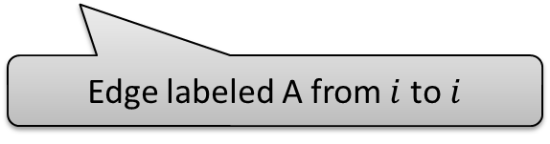
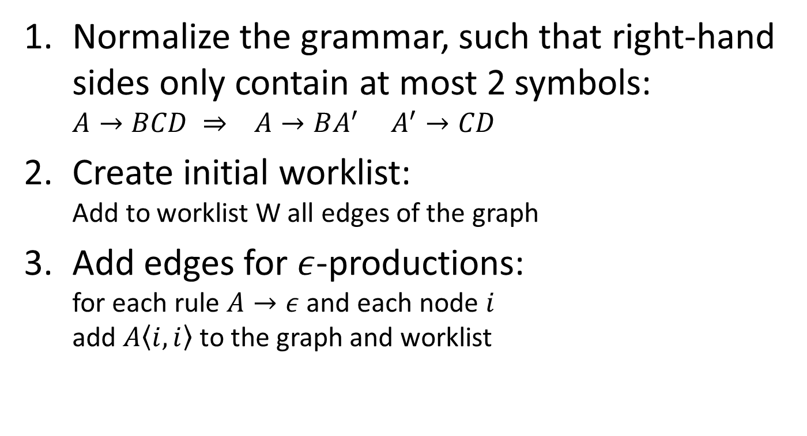
Algorithm to Solve CFL-RP
Normalize the grammar, such that right-hand sides only contain at most 2 symbols: $A→BCD ⇒ A→BA^{′} A^{′}→CD$
Create initial worklist: Add to worklist W all edges of the graph
Add edges for $ε$-productions: for each rule $A→ε$ and each node $i$ add $A〈i,i〉$ to the graph and worklist
Edge labeled A from $i$ to $i$

Slide 8







Algorithm to Solve CFL-RP (2)
Add edges for other productions: while W is not empty select and remove edge $B〈i,j〉$ from W add edges to graph and W (if not already in graph):
for $A→B:$
for $A→BC:$
$$A$$
$$A$$
B
B
C
i
j
i
j
k
for $A→CB:$
$$A$$
C
B
i
j
k

Slide 9









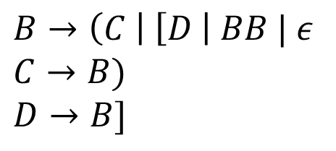


Context-Sensitive Analysis (2)
Describe Valid Paths
via Language:
$$B$$
x = source()
$$B→\left(B\right) \left| \left[B\right] \right| BB | ε$$
$$B$$
$$B$$
foo(x)
$$B→\left(C \right| \left[D \right| BB | ε$$
$$C→B)$$
$$D→B]$$
$$B$$
(
$$B$$
$$B$$
return a;
$$C$$
)
$$B$$
$$B$$
]
$$D$$
y = foo(x)
z = foo(“…”)
$$B$$
sink(z)
Notes:
1 normalize grammar
2 self-loop edges
3 transitive B edges
4 C edge for )
5 D edge for ]
6 B edge over ( C
7 transitive B edge

Slide 10


















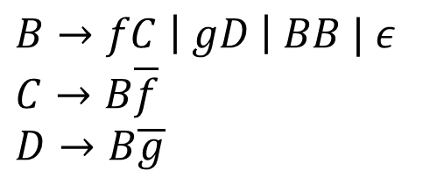


Field-Sensitive Analysis
$$B$$
Describe Valid Paths
via Language:
1:
2:
3:
4:
5:
6:
7:
8:
9:
main() {
x = source();
a = new A();
a.f = x;
a.g = a;
while(unknown()) {
b = a.g
a = b.f
}
sink(a);
}
source()
$$B$$
$$B→fB\overline{f} \left| gB\overline{g} \right| BB | ε$$
$$B$$
1: x
$$f$$
$$B$$
$$B→fC \left| gD \right| BB | ε \\ C→B\overline{f} \\ D→B\overline{g}$$
$$g$$
2: a
$$D$$
$$\overline{g}$$
$$B$$
$$,B$$
$$C$$
6: b
$$B$$
$$\overline{g}$$
$$D$$
$$\overline{f}$$
$$B$$
$$C$$
7: a
$$B$$
$$B$$
sink()
Notes:
1-8 graph
9 grammar
10 normalize grammar
11 self-loop edges
12 transitive B edges
13 C for read f and D for read g
14 gD -> B
15 C for read Bf (prev B)
16 transitive B

Slide 11



Aliasing
main() {
a = new A();
b = a.g;
b.f = source();
c = a.g;
sink(c.f);
}
new A()
source()
a
f
$$\overline{g}$$
$$\overline{g}$$
b
c
$$\overline{f}$$
sink()
Add “bridges” for detected aliases

Slide 12

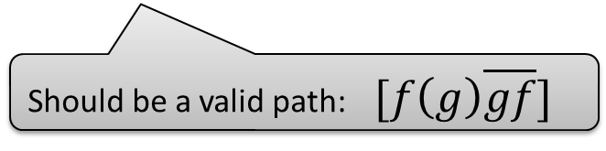




Context- and Field-Sensitive Analysis
Context-Sensitive:
Field-Sensitive:
$$A→\left(A\right) \left| \left[A\right] \right| AA | ε$$
$$\left| fA \right| gA \left| A\overline{f} \right| A\overline{g}$$
$$B→fB\overline{f} \left| gB\overline{g} \right| BB | ε$$
$$\left| \left(B \right| \left[B \right| B\right) | B]$$
Context- and
Field-Sensitive:
$$L\left(A\right)∩L(B)$$
In general, intersection of context-free languages is an undecidable problem.
Should be a valid path: $[f\left(g\right)\overline{gf}]$
context- and field-sensitive analysis is proven to be undecidable:
Thomas Reps: Undecidability of Context-Sensitive Data-Dependence Analysis. TOPLAS 2000.

Slide 13
IDE Framework Applied Static Analysis 2016 Johannes Lerch Dr. Michael Eichberg, Ben Hermann, Sebastian Proksch, Karim Ali Ph.D.
Mooly Sagiv , Thomas Reps, and Susan Horwitz : Precise interprocedural dataflow analysis with applications to constant propagation. TAPSOFT '95

Slide 14




SPL^{LIFT}
0
a
b
void main() {
a = source();
//ifdef F
b = a;
//endif
//ifdef G
a = null;
//endif
b = foo(a);
//ifdef G
b = a;
//endif
sink(b);
}
F
$¬$F
void foo(d) {
//ifdef F
e = d;
//endif
return e;
}
d
e
$¬$G
F
$¬$F
G
$¬$G
Eric Bodden, Társis Tolêdo, Márcio Ribeiro, Claus Brabrand, Paulo Borba, and Mira Mezini: SPL^{LIFT}: statically analyzing software product lines in minutes instead of years. PLDI‘13

Slide 15

Interprocedural, Distributive, Environment Problems
Environment Transformer / Edge Function:
$$e:V→V$$
Finite height semi-lattice
distributive function
Characteristics:
meet operator can be chosen arbitrarily
computes composition of edge functions (always possible, but ideally generates early results)

Slide 16




Lattice used in SPL^{LIFT}
all edges initialized with $⊤$
$⊤=$False
move down when
joining facts
F&G
F
G
…
F|G
move up when
composing functions
$⊥ =$True
at initial seeds we use $⊥$

Slide 17



















SPL^{LIFT}
Client provides edge function for each flow-function result
a = source();
$$eFn\left(0→0\right)=λl.l$$
F
$$eFn\left(0→a\right)=λl.F∘λl. l=λl.F\&l$$
$¬$F
b=a;
$$¬F\&¬G$$
G
$$¬G$$
a=null;
$$eFn\left(0→a\right)=λl.¬F\&l⊓λl.F\&G\&l=λl. \left(¬F | G\right)\&l$$
$eFn\left(0→b\right)=λl.F\&G\&l$
Independent of callers!
$eFn\left(0→a\right)=λl. ¬G$&l
void foo(d) {
$$eFn\left(d→d\right)=λl.l$$
b=foo(a);
$$eFn\left(0→b\right)=λl.F\&l$$
G
$$eFn\left(0→a\right)=λl. ⊤$$
$$eFn\left(d→d\right)=λl.F\&l$$
F
$$eFn\left(0→b\right)=λl. ⊤$$
$$¬G$$
b=a;
$¬$F
e=d;
G
$$eFn\left(d→d\right)=λl.l$$
$$¬G$$
return e;
$$eFn\left(d→e\right)=λl. F\&l$$
sink(b);
}
$$eFn\left(0→a\right)=λl. ¬G\&l$$
$$eFn\left(0→b\right)=λl. F\&¬G\&l$$

Slide 18
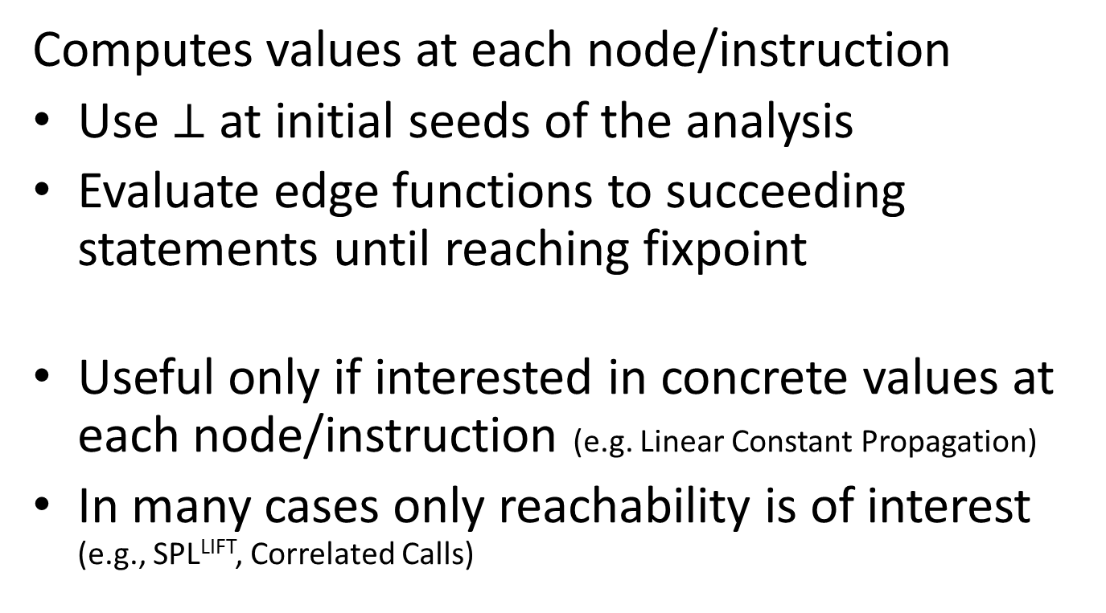
Phase 2 of the Algorithm
Computes values at each node/instruction
Use $⊥$ at initial seeds of the analysis
Evaluate edge functions to succeeding statements until reaching fixpoint
Useful only if interested in concrete values at each node/instruction (e.g. Linear Constant Propagation)
In many cases only reachability is of interest (e.g., SPL^{LIFT}, Correlated Calls)

Slide 19
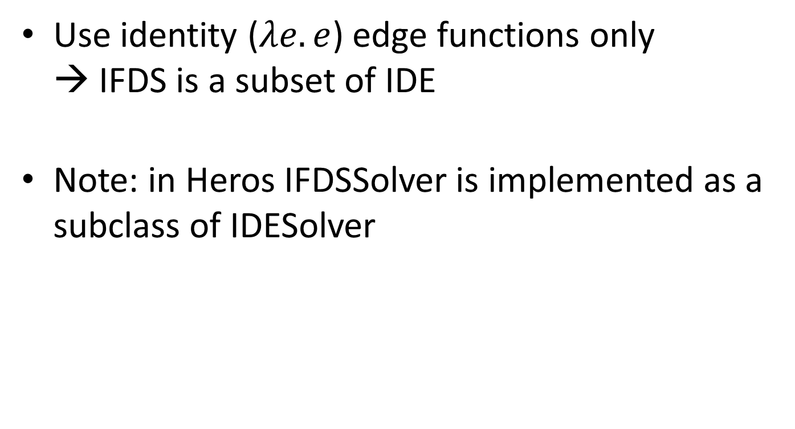
From IDE to IFDS
Use identity ($λe.e$) edge functions only → IFDS is a subset of IDE
Note: in Heros IFDSSolver is implemented as a subclass of IDESolver

Slide 20
IDE-Exercise
Extend the Analysis built in the IFDS Exercise to an IDE Analysis that Considers Correlated Calls

Slide 21
Correlated Method Calls
Could be type B or C
at runtime
interface A {
X foo(X);
X bar(X);
}
class B implements A {
X foo(X x) {
return x;
}
X bar(X x) {
return null;
}
}
main() {
A a = unknown();
x = source();
b = a.foo(x);
c = a.bar(x);
sink(c);
}
class C implements A {
X foo(X x) {
return null;
}
X bar(X x) {
return x;
}
}
Marianna Rapoport, Ondřej Lhoták, and Frank Tip: Precise Data Flow Analysis in the Presence of Correlated Method Calls. SAS’15

Slide 22
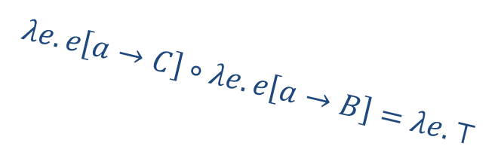
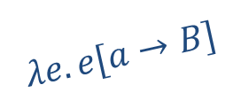
Task
Use Edge Functions to track the upper type boundaries of variables used as receiver
class B implements A {
X foo(X x) {
return x;
}
X bar(X x) {
return null;
}
}
main() {
A a = unknown();
x = source();
b = a.foo(x);
c = a.bar(x);
sink(c);
}
$$λe.e[a→B]$$
$$λe.e\left[a→C\right]∘λe.e\left[a→B\right]=λe. ⊤$$

Slide 23












Lattice
$$⊤$$
A
$$e[a→B]$$
$$e[a→C]$$
…
B
C
$$e[a→A]$$
$$e[b→A]$$
$$⊥ =e[∗→Object]$$
Partial-order function
is the subtype relation for
each mapped variable
$$λe.e\left[a→B\right]∘λe.e\left[a→A\right]=$$
$$λe.e\left[a→B\right]$$
$$λe.e\left[a→B\right]∘λe.e\left[a→C\right]=$$
$$λe. ⊤$$
$$λe.e\left[a→B\right]⊓λe.e\left[a→C\right]=$$
$$λe.e[a→A]$$

Slide 24
EdgeFunctions Interface
public interface EdgeFunctions<N, D, M, V> {
public EdgeFunction<V> getNormalEdgeFunction(N curr, D currNode,
N succ, D succNode);
public EdgeFunction<V> getCallEdgeFunction(N callStmt, D srcNode,
M destinationMethod, D destNode);
public EdgeFunction<V> getReturnEdgeFunction(N callSite, M calleeMethod,
N exitStmt, D exitNode, N returnSite, D retNode);
public EdgeFunction<V> getCallToReturnEdgeFunction(N callSite, D callNode,
N returnSite, D returnSideNode);
}
Already implemented in IDE-Exercise template project

Slide 25
EdgeFunction Interface
public interface EdgeFunction<V> {
V computeTarget(V source);
EdgeFunction<V> composeWith(EdgeFunction<V> secondFunction);
EdgeFunction<V> joinWith(EdgeFunction<V> otherFunction);
public boolean equalTo(EdgeFunction<V> other);
}
Needs to be implemented

Slide 26
Exercise Template
apsa/2016/ifds
ifds-exercise
ifds-solution
ide-exercise
testcases
Template for last exercise
Example solution to last exercise
Template for this exercise (extending ifds-solution)
Updated to include testcase for correlated calls

