Slide 1
IFDS-Exercise Set-Up
Compiling OPAL may take some time, therefore start with the set up now, if not already done.
git clone https://bitbucket.org/delors/opal.git
git clone https://github.com/Sable/heros.git
git clone https://github.com/stg-tud/apsa.git
cd opal
git checkout develop
sbt publishLocal
cd ../heros
cp ant.settings.template ant.settings
mkdir javadoc
ant publish-local
cd ../apsa/2016/ifds/ifds-exercise
sbt eclipse
Import projects IFDS-exercise and IFDS-testcases in Eclipse
Verify set-up: should compile without errors, some tests should succeed
From within Eclipse select Run As → Ant Build… on the build.xml file

Slide 2
IFDS Framework Applied Static Analysis 2016 Johannes Lerch Dr. Michael Eichberg, Ben Hermann, Sebastian Proksch, Karim Ali Ph.D.
Thomas Reps, Susan Horwitz, and Mooly Sagiv: Precise Interprocedural Dataflow Analysis via Graph Reachability. PoPL’95
Nomair A. Naeem, Ondřej Lhoták, and Jonathan Rodriguez: Practical Extensions to the IFDS Algorithm. CC’10

Slide 3
A Framework for Interprocedural, Finite, Distributive, Subset Problems
Inputs to the Framework:
Interprocedural Control-Flow Graph (ICFG)
Flow Function for each ICFG-Edge
finite set of data-flow facts
distributive function
S_{l}
S_{r}
Example for: a=b;
S = S_{l}∪ S_{r}
a
b
joins subsets
Notes:
1 inputs
2 flow function
3 finite set; what is a fact?
4 distributive
5 example
6 graphical representation
7 joins subsets

Slide 4
Graph Reachability
0
a
b
c
void main() {
a = source();
b = a;
a = null;
c = foo(b);
b = c
sink(b);
}
0
d
e
void foo(d) {
e = d;
return e;
}
Notes:
1-8 edges
9 path through graph

Slide 5
Four Types of Edges
0
a
b
c
void main() {
a = source();
b = a;
a = null;
c = foo(b);
b = c
sink(b);
}
0
d
e
void foo(d) {
e = d;
return e;
}
Normal Edge
Call Edge
Return Edge
Call-to-Return Edge

Slide 6

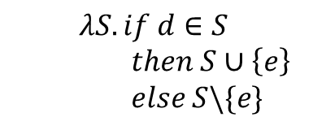





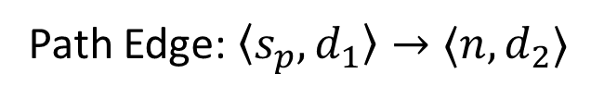

source statement
source fact
0
0
Path Edge: $〈s_{p}, d_{1}〉→〈n, d_{2}〉$
a = source();
$$λS.if 0∈S then \left\{a\right\} else ∅$$
target fact
a
target statement
b=a;
$$λS.if a∈S then S∪\left\{b\right\} else S\backslash \{b\}$$
a, b
a=null;
$$λS.S\backslash \{a\}$$
d
b
void foo(d) {
d
c=foo(b);
e=d;
$$λS.if d∈S$$
$then S∪\left\{e\right\}$
$else S\backslash \{e\}$
$$λS.if b∈S then \left\{d\right\} else ∅$$
$$λS.S\backslash \{c\}$$
b
, c
d, e
b=c;
return e;
$$λS.if e∈S then \left\{c\right\} else ∅$$
$$λS.if c∈S then S∪\left\{b\right\} else S\backslash \{b\}$$
}
b, c
sink(b);
Notes:
1-8 edges for main
9-10 edges for foo
11-12 edges for main

Slide 7
Interprocedural Analysis
x
void bar(x) {
x
b=x;
d
b, x
void foo(d) {
d
y=foo(b);
e=d;
b, x, y
d, e
return y;
return e;
}
}
Summaries contain the intraprocedural effects and effects of called methods
Notes:
1-3 edges for bar
4 reuse summary
5 edge in bar
6 summary of bar
7 summary of intraproc. and called methods

Slide 8
Finite Domain of Data-Flow Facts
x=0
Range of Integer is bound,
thus domain is theoretically finite
x=0
x=1
Eventually, no new path edge will be created and the algorithm terminates
…
x++
x=1
x=2
x=1
x=2
However, in practice this will run out of memory
Notes:
Track value of variables
1-4 edges (simplified representation!)
5 integer bound
6 termination guaranteed
7 out of memory

Slide 9










Distributive Flow Functions
$$x$$
$$y$$
$$x$$
$$y$$
$$f(x)$$
$$f(y)$$
$$f(x∪y)$$
$$f\left(x\right)∪f(y)$$
$$=$$
$$f(x∪y)$$

Slide 10
Subset Problem
a=1
a=1
IFDS cannot infer that c is 3,
if we track a and b independently
b=2
a=1
b=2
c=a+b
print(c)

Slide 11


Subset Problem (2)
x=0
Meet operator is limited to
union or intersection
x=0
x=1
…
x=0 $⊓$ x=1
x=[0,1]
x++
x=1
x=2
x$≥$0
x=1
x=2
Implicitly possible, but tracked as two independent facts
Impossible as outcome of meet
Notes:
1 x=0 meet x=1
2 limited to union/intersection
3 range notation
4 implicitly possible
5 x>=0
6 impossible

Slide 12
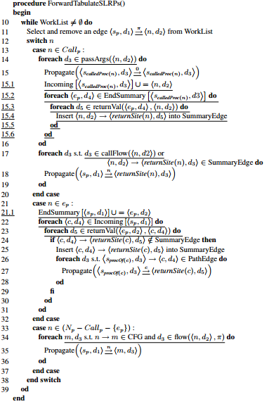
For a complete view of the algorithm, check Figure 2 and Figure 4 of
Nomair A. Naeem, Ondřej Lhoták, and Jonathan Rodriguez: Practical Extensions to the IFDS Algorithm. C’10

Slide 13
Static-Analysis Buzzword Bingo
Flow-Sensitive
Context-Sensitive
Field-Based / Field-Sensitive
depends on
chosen domain

Slide 14
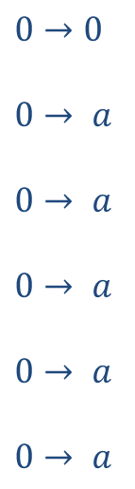




Field-Based Tracking
$$Domain=Locals∪Fields$$
$$0→0$$
$$0→ a$$
$$0→ a$$
$$0→ a$$
$$0→ a$$
$$0→ a$$
Simplified representation for a Path Edge (only showing facts)
a = source();
b = new DS();
c = new DS();
b.f = a;
d = c.f
sink(d);
$$0→DS.f$$
$$0→DS.f$$
$$0→d$$
Notes:
1 domain
2 code
3 bootstrap path edge
4 path edges
5 field based fact
6 read fact

Slide 15
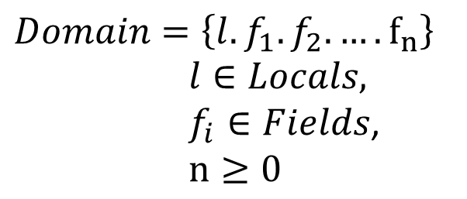


Field-Sensitive Tracking
$$Domain=\left\{l.f_{1}.f_{2}.….f_{n}\right\}$$
$l∈Locals,$
$f_{i}∈Fields$,
$n≥0$
$$0→0$$
$$0→ a$$
$$0→ a$$
$$0→ a$$
$$0→ a$$
$$0→ a$$
a = source();
b = new DS();
c = new DS();
b.f = a;
d = c.f
sink(d);
$$0→b.f$$
$$0→b.f$$
Notes:
1 simple path edges
2 write
3 read

Slide 16


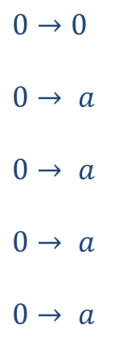









Field-Sensitive Tracking (2)
$$Domain=\left\{l.f_{1}.f_{2}.….f_{n}\right\}$$
$l∈Locals,$
$f_{i}∈Fields$,
$n≥0$
$$0→0$$
$$0→ a$$
$$0→ a$$
$$0→ a$$
$$0→ a$$
a = source();
while(random()) {
b = new DS();
b.f = a;
a = b;
}
sink(a);
$$0→ a.f$$
$$0→b.f$$
$$…$$
Domain is not finite
$$0→ a.f$$
$$0→b.f$$
$$0→ a.f$$
$$0→b.f.f$$
$$0→ a.f$$
$$0→b.f$$
$$0→ a.f.f$$
$$0→b.f.f$$

Slide 17
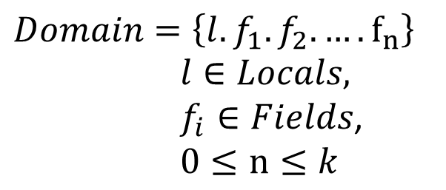
k-limiting
$$Domain=\left\{l.f_{1}.f_{2}.….f_{n}\right\}$$
$l∈Locals,$
$f_{i}∈Fields$,
$0≤n≤k$
$$0→0$$
$$0→ a$$
$$0→ a$$
$$0→ a$$
$$0→ a$$
a = source();
while(random()) {
b = new DS();
b.f = a;
a = b;
}
sink(a);
$$0→ a.f$$
$$0→b.f$$
$$…$$
Domain is now finite
$$0→ a.f$$
$$0→b.f$$
$$0→ a.f$$
$$0→b.f.f$$
$$0→ a.f$$
$$0→b.f$$
$$0→ a.f.f$$
$$0→b.f.f$$

Slide 18








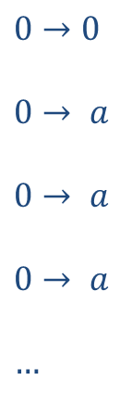

k-limiting (2)
$$Domain=\left\{l.f_{1}.f_{2}.….f_{n}\right\}$$
$l∈Locals,$
$f_{i}∈Fields$,
$0≤n≤k$
$$0→0$$
$$0→ a$$
$$0→ a$$
$$0→ a$$
$$…$$
a = source();
b = new DS();
c = new DS();
b.f = a;
c.f = b;
d = c.f;
e = d.f;
sink(e);
Domain is not sound!
For $k≥2:$
For $k=1:$
$$0→b.f$$
$$0→b.f$$
$$0→c.f.f$$
$$0→c.f$$
$$0→d.f$$
$$0→d$$
$$0→e$$
Notes:
Unsound without wildcard

Slide 19

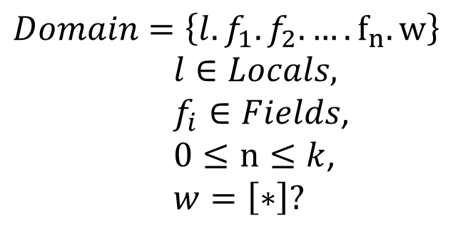


k-limiting (3)
$$Domain=\left\{l.f_{1}.f_{2}.….f_{n}.w\right\}$$
$l∈Locals,$
$f_{i}∈Fields$,
$0≤n≤k$,
$w=\left[∗\right]?$
$$0→0$$
$$0→ a$$
$$0→ a$$
$$0→ a$$
$$…$$
a = source();
b = new DS();
c = new DS();
b.f = a;
c.f = b;
d = c.f;
e = d.f;
sink(e);
For $k≥2:$
For $k=1:$
$$0→b.f$$
$$0→b.f$$
$$0→c.f.f$$
$$0→c.f.∗$$
$$0→d.f$$
$0→d$.*
$$0→e$$
$$0→e.∗$$
Notes:
Introduce wildcard

Slide 20
k-limiting (4)
$$Domain=\left\{l.f_{1}.f_{2}.….f_{n}.w\right\}$$
$l∈Locals,$
$f_{i}∈Fields$,
$0≤n≤k$,
$w=\left[∗\right]?$
$$0→0$$
$$0→ a$$
$$0→ a$$
$$0→ a$$
$$…$$
a = source();
b = new DS();
c = new DS();
b.f = a;
c.f = b;
d = c.f;
e = d.g;
sink(e);
For $k≥2:$
For $k=1:$
$$0→b.f$$
$$0→b.f$$
$$0→c.f.f$$
$$0→c.f.∗$$
over-approximation may yield false positives
$$0→d.f$$
$0→d$.*
$$0→e.∗$$
Notes:
Over-approximation by using wildcard

Slide 21
IFDS-Exercise
Implement a simple Taint Analysis
using Heros’ IFDS-Solver and OPAL
public static foo() {
Object a = source();
Object b = a;
sink(b);
}
Detect if values returned by source() flow as argument into sink()

Slide 22
Set Up
git clone https://bitbucket.org/delors/opal.git
git clone https://github.com/Sable/heros.git
git clone https://github.com/stg-tud/apsa.git
cd opal
git checkout develop
sbt publishLocal
cd ../heros
cp ant.settings.template ant.settings
mkdir javadoc
ant publish-local
cd ../apsa/2016/ifds/ifds-exercise
sbt eclipse
Import projects IFDS-exercise and IFDS-testcases in Eclipse
Verify set-up: should compile without errors, some tests should succeed
From within Eclipse select Run As → Ant Build… on the build.xml file

Slide 23
Quickstart
Heros implementation of IFDS (https://github.com/sable/heros)
Important classes:
IFDSSolver / IDESolver Implementation of the IFDS framework
IFDSTabulationProblem / IDETabulationProblem settings & input configuration: ICFG, flow functions
FlowFunctions provides FlowFunction implementations for edges of the ICFG
FlowFunction implementation of a flow function

Slide 24
FlowFunctions
N = Statement / Instruction
D = Data-Flow Fact
M = Method
public interface FlowFunctions<N, D, M> {
FlowFunction<D> getNormalFlowFunction(N curr, N succ);
FlowFunction<D> getCallFlowFunction(N callStmt, M destinationMethod);
FlowFunction<D> getReturnFlowFunction(N callSite, M calleeMethod,
N exitStmt, N returnSite);
FlowFunction<D> getCallToReturnFlowFunction(N callSite, N returnSite);
}
public interface FlowFunction<D> {
Set<D> computeTargets(D source);
}

Slide 25
The Domain
For simplicity we used some intermediate representation in the previous slides
Does not match Bytecode using an operand stack
Track registers containing tainted values
public static foo() {
Object a = source();
Object b = a;
sink(b);
}
public static void foo();
0 invokestatic source()
3 astore_0
4 aload_0
5 astore_1
6 aload_1
7 invokestatic sink(java.lang.Object)
10 return
Track where on the operand stack the tainted value is
Notes:
1 registers
2 operand stack values

Slide 26
The Domain (2)
case class RegisterFact(
registerIndex: Int,
opStack: List[StackEntry]
)
Track registers containing tainted values
Top
0
case class OperandStackFact(
stackIndex: Int,
opStack: List[StackEntry]
)
Track where on the operand stack the tainted value is
1
2
…
Notes:
1 example stack

Slide 27
Track the Operand Stack
Object a = source();
DS b = new DS();
DS c = new DS();
b.f = a;
Object d = c.f;
sink(d);
aload_1 [b]
aload_0 [a]
putfield DS.f
aload_2 [c]
getfield DS.f
astore_3 [d]
To taint b.f you need to know register 1 [b] is on the operand stack
Object a = source();
Object[] arr = new Object[1];
arr[0] = a;
Object b = arr[0];
sink(b);
aload_1 [arr]
iconst_0
aload_0 [a]
aastore
aload_1 [arr]
iconst_0
aaload
astore_2 [b]
Not only required for field-sensitivity, but also for arrays

Slide 28
Some Instructions of Interest (listed as types of OPAL)
LoadLocalVariableInstruction(_, localVarIndex)
StoreLocalVariableInstruction(_, localVarIndex)
PUTFIELD(declaringClass, fieldName, _)
PUTSTATIC(declaringClass, fieldName, _)
GETFIELD(declaringClass, fieldName, _)
GETSTATIC(declaringClass, fieldName, _)
ArrayLoadInstruction
ArrayStoreInstruction
ReturnValueInstruction
…

