Slide 1
Applied Static Analysis 2016
Recommendation Systems in Software Engineering
Sebastian Proksch
Dr. Michael Eichberg (Organizer), Johannes Lerch,
Ben Hermann, Karim Ali Ph. D.

Slide 2


Slide 3
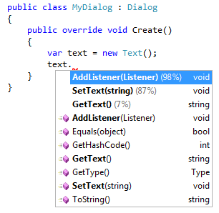
KaVE – Intelligent Method Completion

Slide 4
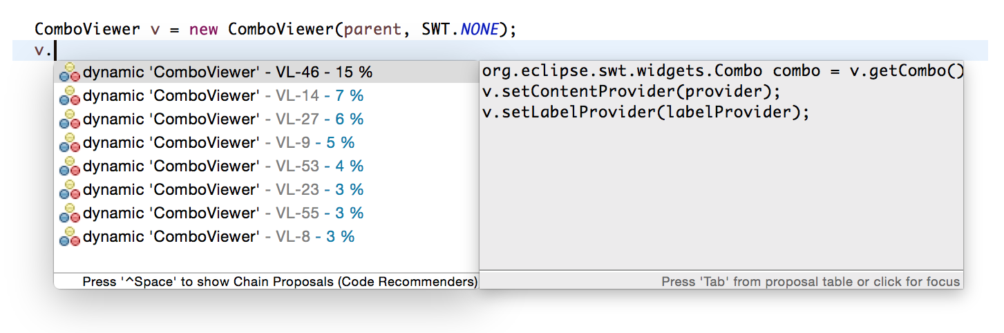
Eclipse Code Recommenders

Slide 5
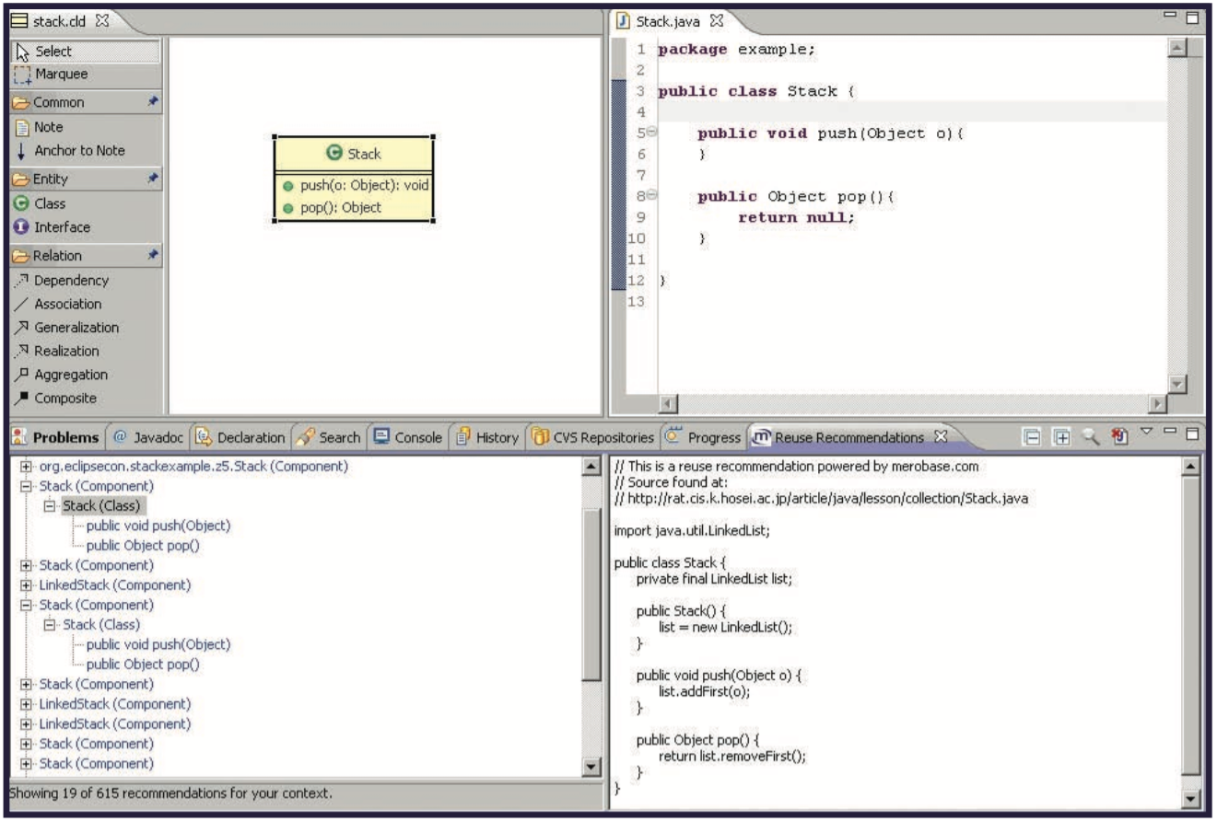
Code Conjurer

Slide 6


Slide 7
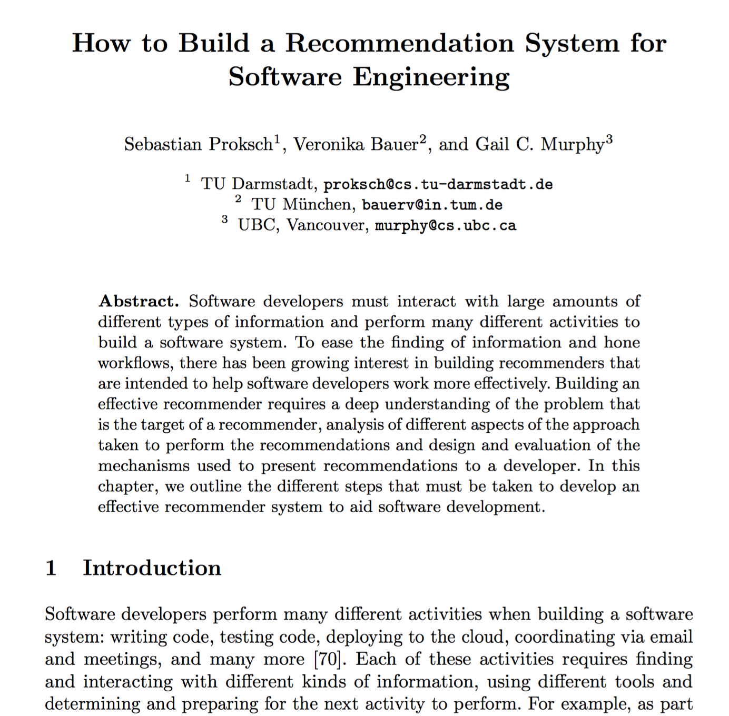

Slide 8
What do RSSE have to do with Static Analysis?

Slide 10
Typical RSSE Pipeline
4
1
2
3
Notes:
Outline of the lecture
As the query is build from the dev context, we also have SA here!

Slide 11
Input

Slide 12
Mining Software Repositories
Lot’s of open source data available
(Usually) stable source code
(Usually) Compilable
Analysis frameworks available, once compiled
Three-address representation easy to analyze
Notes:
Might not be stable, open-source devs commit intermediate versions
Might not compile, dependencies might be missing

Slide 13
Source Code Under Development
Problem in practice
Incomplete code
Invalid Statements
Usually all types are resolved, environment is “functional”
Often, analysis based on AST
Notes:
AST-based for various reasons:
Close to what the developer sees
Pragmatic: that’s what is there

Slide 14
Source Code Nested in Plaintext
(Stackoverflow, Mailinglists, Tutorials, etc.)
Types are not resolved
Incomplete code (e.g., missing imports)
Invalid Code (e.g., pseudo-code parts)
Language not always obvious
…

Slide 15
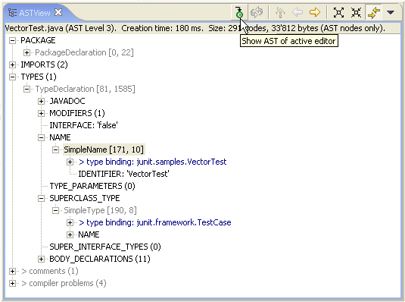
Once everything is set up…
Notes:
Byte code vs. AST
Much more complex to analyze, because no 3-Addr-Rep, but closer to source code

Slide 16
It is often the first challenge to make the source code analyzable.

Slide 17
Models (?)
(Machine) Learning
Notes:
Idioms vs. patterns vs. ?
Control Structures?
Method calls?
Order/Protocol?
Points-to?

Slide 18
Models represent the knowledge gained in the learning process. The model is used to infer proposals, its contents depend on the recommendation goal. The static analysis depends on the model.
Notes:
Which means also the static analysis depends on the goal

Slide 19
Models
Use Case: Best Matching Neighbor Algorithm

Slide 20
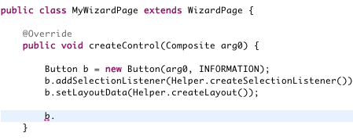
Capture Structural Context
ctx: WizardPage.createControl(Composite)
call: Button.<init>(...)
call: addSelectionListener(...)
call: setLayoutData(...)
Notes:
Other interesting features?

Slide 21
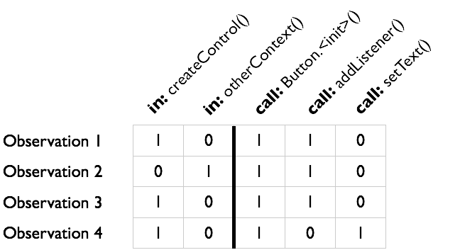
Notes:
Frequency based
BMN

Slide 22
Models
Use Case: Pattern-based Bayesian Network

Slide 23
Make it Better, Use More Features
Already in Use
Type
Enclosing Method
Receiver Callsites
New Features
Enclosing Class
Parameter Callsites
Definition

Slide 24
Existing Solution Does Not Scale
BMN Table
More features
More examples

Slide 25
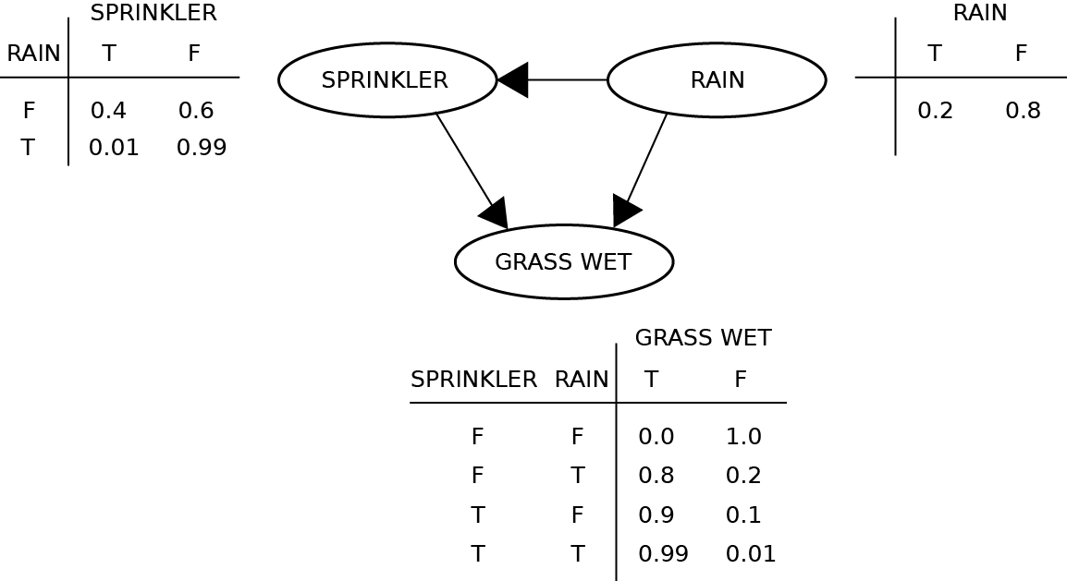
Bayesian Networks to the Rescue!
Example query: P(RAIN | GRASS WET)?

Slide 26
Pattern-based Bayesian Network (PBN)
What is the enclosing method?
 | U1 | U2 | U3
createDialog(…) | 100% | 0% | 0%
modifyText() | 0% | 100% | 0%
… | 0% | 0% | 100%
Examples
U1 | 33%
U2 | 33%
U3 | 33%
Was “<init>” called?
 | U1 | U2 | U3
TRUE | 100% | 100% | 100%
FALSE | 0% | 0% | 0%
Was “setText” called?
 | U1 | U2 | U3
TRUE | 0% | 100% | 0%
FALSE | 100% | 0% | 100%
Was “getText” called?
 | U1 | U2 | U3
TRUE | 0% | 0% | 0%
FALSE | 100% | 100% | 100%
Examples: P(«method» == TRUE)?
P(«method» == TRUE | Context = “createDialog”)?

Slide 27
Clustering Data Points

Slide 28
Finding the Cluster Representative
in: ctx1
in: ctx2
call: m1
call: m2
call: m3
call: m4
…
1
1
0
1
0
0
1
1
1
0
1
0
0
1
1
1
0
1
0
0
1
0.97
0.81
0.02
0.43
0.11
0.00
0.28
Dimensions =
Average (
,
, …,
) =

Slide 29
Probabilities Allow Clustering
What is the enclosing method?
 | P1 | P2
Ctx1 | 50% | 0%
Ctx2 | 50% | 0%
Ctx3 | 0% | 100%
Patterns
P1 | 67%
P2 | 33%
Was “<init>” called?
 | P1 | P2
TRUE | 100% | 100%
FALSE | 0% | 0%
Was “setText” called?
 | P1 | P2
TRUE | 50% | 100%
FALSE | 50% | 0%
Was “getText” called?
 | P1 | P2
TRUE | 0% | 0%
FALSE | 100% | 100%

Slide 30
Detect and Remove Outliers
Notes:
Crucial difference to security that are super interested in finding these outliers, RSSE want to get rid of them…

Slide 31
In general, machine learning tries to abstract from examples, but, very often, the learning boils down to statistics. RSSE is interested in finding the “common case”.

Slide 32
Static AnalysES
How to describe the context?

Slide 33
Call-graph Construction
public class D {
public void M(B b) {
b.x()
}
}

Slide 34
Excursion: Liskov Substitution Principle
Subtype Requirement:
Let f(x) be a property provable about objects x of type T. Then f(y) should be true for objects y of type S where S is a subtype of T.
Notes:
Cp. Betrand meyer pre-/postconditions and invariants

Slide 35
LSP Violation?
public class Rectangle {
public int getX() { … }
public void setX(int x) { … }
public int getY() { … }
public void setY(int y) { … }
public int area() {
return getX() * getY();
}
}
public void testArea(Rectangle r) {
r.setX(2);
r.setY(3);
assert(6, r.area());
}
public class Square extends Rectangle {
public int getX() { return getY(); }
public void setX(int x) { setY(x) }
}
Breaks for Squares!

Slide 36
Call-graph creation (revisited)
public class D {
public void M(B b) {
b.x()
}
}
A.x() defines the “Contract”
Notes:
A.X defies the “contract”
Security has to assume it is broken, so the over-approximate…
only badly designed APIs break LSP, so we can simplify the problem…

Slide 37
RSSE focuses on reusable information, (project-) specific information is less important.
Notes:
Custom Button
Nobody else will ever see it
Not interested in extracting facts about your custom button, but about anything I can learn about the original

Slide 38
Scope of the Static Analysis
Interprocedural?
Interprocedural, but intraclass?
Intraprocedural?

Slide 39
Extract Object Usages…
public class C implements I {
private F f;
@Override
public int M1(G g) {
f.a();
g.x(f);
M2();
M3();
}
@Override
public int M2() {
f.b()
}
private int M3() {
f.c();
}
}
Interesting Features:
Type
Enclosing (Super-) Class
Enclosing Method
Receiver Callsites
Parameter Callsites
Definition
Notes:
Think about reuse-boundaries!
Libraries vs. Frameworks?

Slide 40
Analyzed Part of the Source Code is (Usually) Heavily Pruned. Research on RSSE often focuses on class/method level.
Notes:
often caused by scalability problems…

Slide 41
Points-to Analysis
Context-sensitivity
Field-sensitivity
Flow-sensitivity
…
Many different analysis styles exist, precision varies…

Slide 42
Example
public class C {
private F f;
public void M() {
if (…) {
f = new F();
f.init();
} else {
f = Helper.getF()
}
f.doSomething();
}
}

Slide 43
Evaluation of the Differences
Type-based analysis
Reference-name-based analysis
Steensgard-style unification analysis
Contraint-inclusion analysis
Precision
How big is the difference between the analyses?

Slide 44
Artificial Evaluation
Object Usage
type: MyType
ctx: Other.mContext()
call: mA()
call: mB()
call: mC()
Expectation
Query
call: mB()
call: mC()
type: MyType
ctx: Other.mContext()
call: mA()
Quality Measurement (e.g., F1/MRR)
call: mB() – 90%
call: mX() – 87%
call: mC() – 60%
call: mY() – 12%
Recommender
Engine
Proposals
Notes:
We used MRR as the performance measure

Slide 45
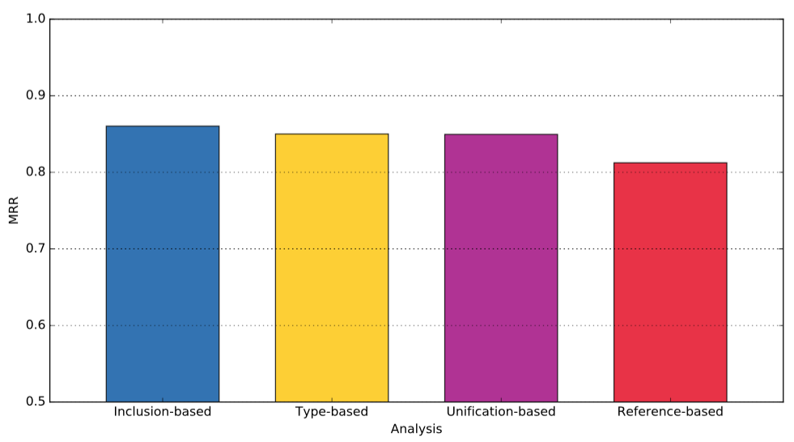
MRR Comparison of Diff. P2 Analyses
(in the context of RSSE)
Mean Reciprocal Rank
Simon Reuß, “On the Effects of Pointer Analysis on Intelligent Code Completion”, M.Sc. Thesis, 2016

Slide 46
Preliminary Result: Precise Points-to analyses seems to be negligible for RSSE.
Notes:
Most likely caused by pruning. We are talking about APIs... how many "clashes" exist for interesting APIs?

Slide 47
Take Home Message

Slide 48
Take Home Message
Making the sources analyzable is often first step
Model and static analysis depend on each other; both strongly depend on the recommendation goal
Security is interested in the corner case, empirical SE is interested in the common case.
Accepting under-approximation, the analysis gets easier:
Heavily prune…
Scope (e.g., intra-class analysis)
Call graph (e.g., "first occurrence" of method signature)
Strip away (project-) specific information
RSSE is very specific domain of applied static analyses
Often no clear recipe exists for static analysis, alternatives need to be explored

