Slide 1


Call Graph Construction for Java Libraries Applied Static Analysis 2016
Michael Reif
Dr. Michael Eichberg, Ben Hermann, Johannes Lerch, Karim Ali Ph.D., Sebastian Proksch

Slide 2
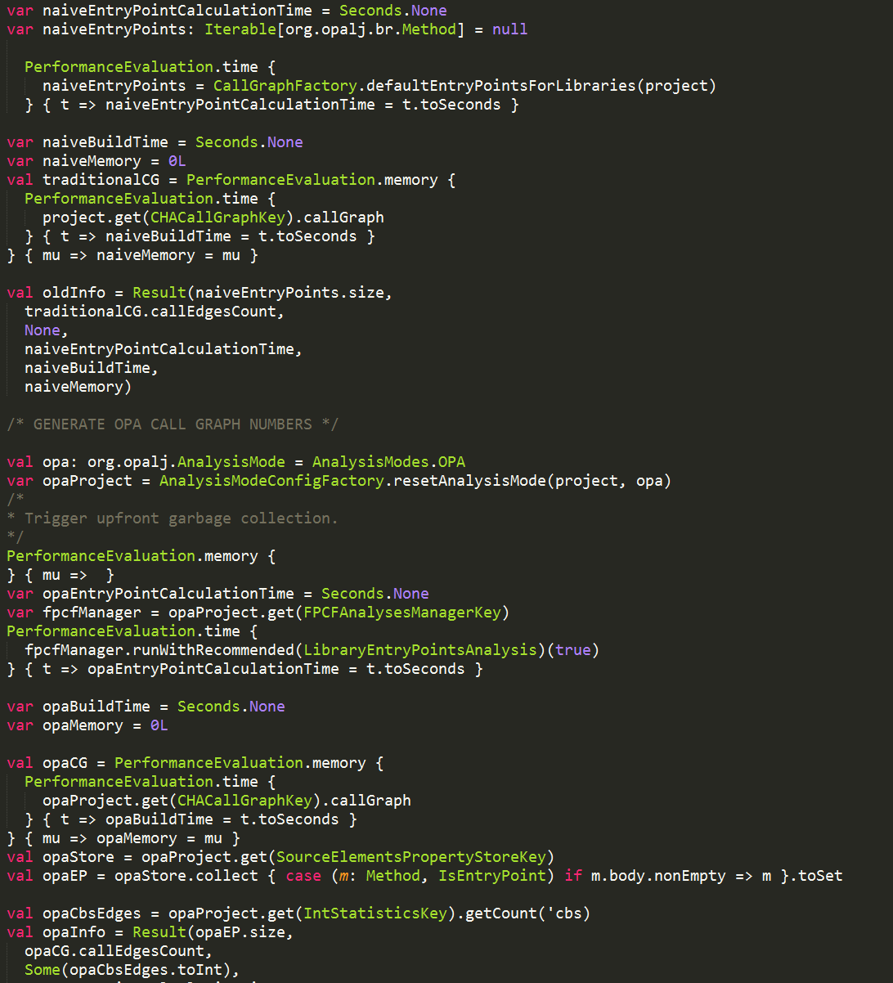
An Application of Call Graphs is Dead Method Detection
Entry Point
build call graph

Slide 3
An Application of Call Graphs is Dead Method Detection
Entry Point
build call graph
Dead Methods are all non-entry point methods that are not called by another method (excluding self-recursive calls).

Slide 4
Dead Code Detection in Applications is straight forward
public class Main { public static void main(String[] args) { new SimpleLogger().
log("arguments", args.length + " input parameter."); // ... } } public interface Logger { void log(String category, String message); } public class SimpleLogger
implements Logger{ public void log(String category, String message){ /* ... */ } } public class AncientLogger{ public void log(String category, String message){ /*... */ } }
AncientLogger.
Log()
AncientLogger.
<init>()
Main.main()
SimpleLogger.<init>()
SimpleLogger.log(…)

Slide 5
Dead Code Detection in Applications is straight forward
public class Main { public static void main(String[] args) { new SimpleLogger().
log("arguments", args.length + " input parameter."); // ... } } public interface Logger { void log(String category, String message); } public class SimpleLogger
implements Logger{ public void log(String category, String message){ /* ... */ } } public class AncientLogger{ public void log(String category, String message){ /*... */ } }
AncientLogger.
Log()
AncientLogger.
<init>()
Main.main()
SimpleLogger.<init>()
SimpleLogger.log(…)

Slide 6
What to do when analyzing libraries?
All non-privates methods are assumed to be called by a client!
public class Main { public static void main(String[] args) { new SimpleLogger().
log("arguments", args.length + " input parameter."); // ... } } public interface Logger { void log(String category, String message); } public class SimpleLogger
implements Logger { public void log(String category, String message){ /* ... */ } } public class AncientLogger { public void log(String category, String message){ /*... */ } }
When Code is intended to be library code, there is no single entry point!

Slide 7
On the Challenges when analyzing Libraries
They call no method, but are entry points!
public class Main { public static void main(String[] args) { new SimpleLogger().
log("arguments", args.length + " input parameter."); // ... } } public interface Logger { void log(String category, String message); } public class SimpleLogger
implements Logger { public void log(String category, String message){ /* ... */ } } public class AncientLogger { public void log(String category, String message){ /*... */ } }
AncientLogger.
<init>()
AncientLogger.
Log()
Main.main()
SimpleLogger.<init>()
SimpleLogger.log(…)

Slide 8
On the Challenges when analyzing Libraries
public class Main { public static void main(String[] args) { Logger logger = …
logger.log("arguments", args.length + " input parameter."); // ... } } public interface Logger { void log(String category, String message); } public class SimpleLogger
implements Logger{ public void log(String category, String message){ /* ... */ } } public class AncientLogger{ public void log(String category, String message){ /*... */ } }
Libraries are intended to be extended! Applications can introduce new subtypes!

Slide 9
Call-By-Signature (CBS) Resolution
When a method is invoked all methods that share the same method signature are determined as call targets. The method signature includes the method’s name, return type and parameter types.
public static void main(String[] args) {
Class<?> cls = args.getClass();
cls.getName();
}
public class Person{
String name; public String getName(){ /* ... */ }
}

Slide 10
Interface Invocations have to be resolved by method signature
public interface Logger { void log(String category, String message); } public class SimpleLogger
implements Logger{ public void log(String category, String message){/* ... */} } public class AncientLogger{ public void log(String category, String message){ /*... */ }
/* Somewhere in the library */
Logger l = …; l.log(…);
public class MyLogger
extends AncientLogger implements Logger {
/* log method is inherited */ }
}
Library
Interface invocations require call-by-signature resolution! Hence, log should also point to AncientLogger.log(…).
Application
Notes:
Library extensions can lead to direct call dependencies between library methods.
Because of that we have do resolve interface invocations by method signature. Other constructs, e.g., Java 8’s interface default methods, can not lead to direct call dependencies between library methods.

Slide 11
But why do we have to use only on interfaces invocations?
public interface Logger { default void log(String category, String message) {/*...*/} }
public abstract class SimpleLogger { abstract public void log(String category, String message); }
/* Somewhere in the library */
Logger l = …; l.log(…);
public class MyLogger
extends SimpleLogger implements Logger {
/* log method is inherited */
}
Library
That doesn’t work! Abstract methods have to implemented by the subclass!
Application
Other virtual calls are resolved soundly by each call graph algorithm!

Slide 12
The Problem with Libraries is that they are not closed worlds
Libraries are intended to be extended by future applications (inheritance)
call-by-Signature becomes necessary in library call graph construction
The public interface of libraries is quite huge because every non-private method becomes an entry point

Slide 13
To start the call graph construction, we need the entry points into the library
Application
public methods
public API
package visible/ protected method
private methods
library private implementation

Slide 14
Assumption: the application developer does not contribute to the used libraries
Application
public methods
public API
package visible/ protected method
private methods
library private implementation

Slide 15
Contributing to a library
package de.tud.example
public class Example {
public void getPublicInfo(){ /*... */ }
void getInternalInfo(){ /*... */ }
private void getSecretInfo(){ /*... */ }
}
package de.tud.example
public class Demo{
Example ex = new Example();
public void printInfo(){
System.out.println(
ex.getInternalInfo());
}
}
Library
Since both classes are defined in the same package. Protected and package visible members can be accessed!
Application

Slide 16
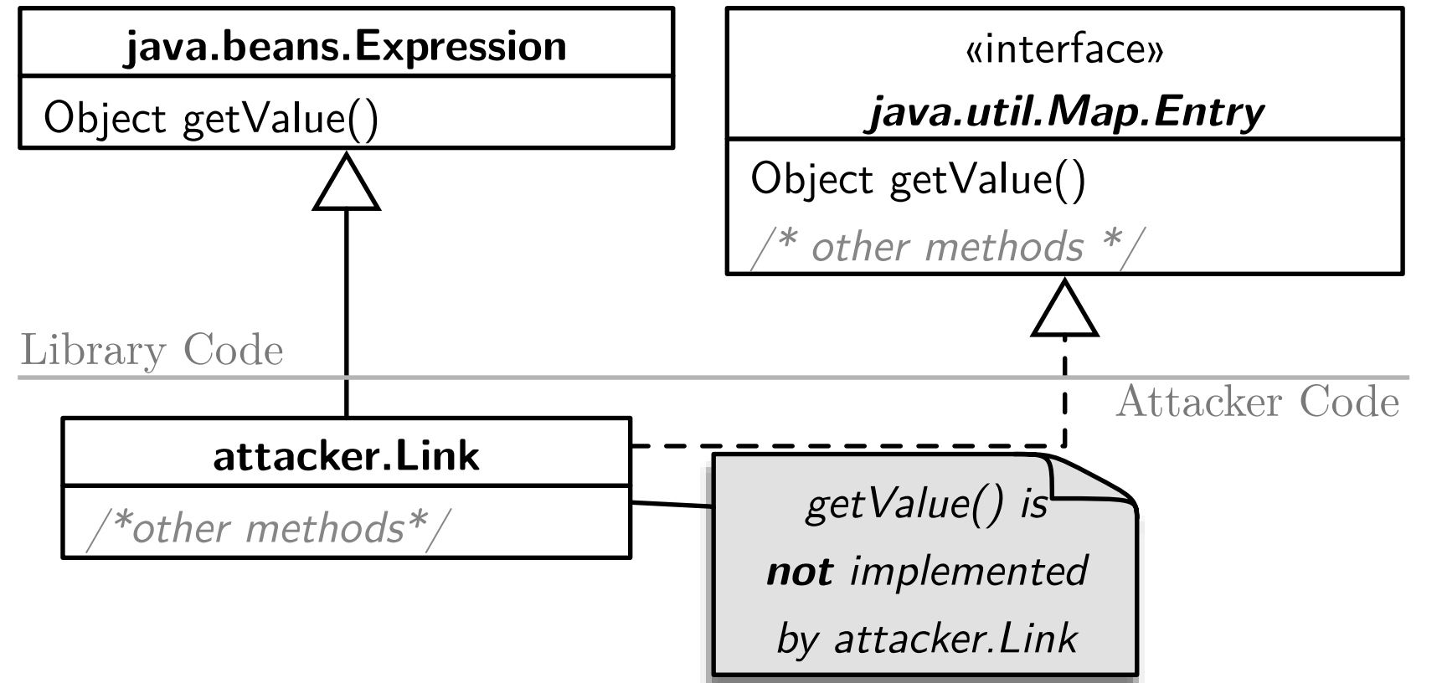
But attackers want to create dependencies within the libraries if it enables exploitation
CVE-2010-0840

Slide 17
Some theory: Java has a stack-based security model
SecurityManager.checkPermission | FilePermission, SocketPermission, ...
SecurityManager.checkWrite | FilePermission, SocketPermission, ...
FileOutputStream.<init> | FilePermission, SocketPermission, ...
Attacker.doEvil | Ø
MyApplet.init | Ø
∩ = Ø
Notes:
Scenario: writing a file
checkPermission call before writing
1) code has permissions
2) computes intersection
checks should be done like this

Slide 18
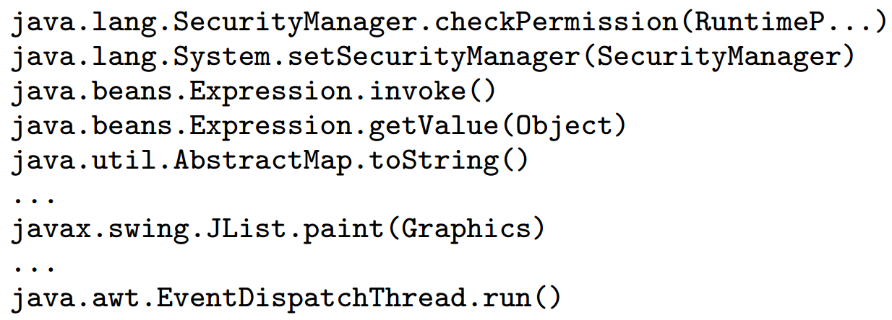
Code that leads to the exploit
CVE-2010-0840
HashSet<Map.Entry<Object, Object>> set = new HashSet<>();
set.add(new Link(System.class, ”setSecuritymanager”, null));
JList list = new JList(new Object[]{
new HashMap<Object, Object>(){
public Set<Map.Entry<Object, Object>> entrySet(){
return set;
}}
});
JFrame frame = new Jframe():
frame.getContentPane().add(list);
frame.setSize(50, 50);
frame.setVisible(true);
Only trusted caller on the stack!

Slide 19
Developers really want to write code that is not accessed by an application…
package java.awt.datatransfer; /** * A Multipurpose Internet Mail Extension (MIME) type, as defined * in RFC 2045 and 2046. * * THIS IS *NOT* - REPEAT *NOT* - A PUBLIC CLASS! DataFlavor IS * THE PUBLIC INTERFACE, AND THIS IS PROVIDED AS A ***PRIVATE*** * (THAT IS AS IN *NOT* PUBLIC) HELPER CLASS! */ class MimeType implements Externalizable, Cloneable {
/* A lot of Code! */
}
Oracle JDK 8u77
Library developers write intentionally library private code!

Slide 20
Library private implementation in two different scenarios
open-package assumption (OPA)
all private methods and fields
closed-package assumption (CPA)
All classes, methods and fields that have at most package visibility
All public and protected methods or fields that are in a package visible class, unless:
The class inherits from a public class or interface which defines the respective method
The class has a public subclass which inherits the respective method
java.* packages are always closed
Hardcoded in the JVM

Slide 21


Which methods are visible w.r.t. the given Assumption?
class SimpleLogger {
public void log(){/*...*/}
public void error(){/*...*/}
void internal() {/*...*/}
}
public class ComplexLogger
extends SimpleLogger(){
public void log(){/*...*/}
private void init() {/*...*/}
}
method | OPA | CPA
ComplexLogger.log()
ComplexLogger.init()
SimpleLogger.log()
SimpleLogger.error()
SimpleLogger.internal()

Slide 22
Which methods are visible w.r.t. the given Assumption?
public interface Logger { public void log(); }
class SimpleLogger {
public void log(){/*...*/}
}
class ComplexLogger
extends SimpleLogger() implements Logger {
public void internal(){/*...*/}
}
public class Factory{
public Logger createLogger(){ return new ComplexLogger(); }
}
method | OPA | CPA
SimpleLogger.log()
ComplexLogger.internal()

Slide 23
Design Space for Library Call Graphs
 | Analysis Context |  | Closed-Package Assumption | Call-By-Signature Resolution
Library | Security Issues | in our library | ✘ Someone will try to break it. | ✔
 |  | in 3rd party libraries | ✘ Other libraries may try to break it. | ✔
 | Software Quality | in our library | ✔ If someone behaves badly, we don‘t care. | ✔
 |  | in 3rd party libraries | ✔ We use it as intented! | ✔
Applicaton | Both security and general issues |  | (implicitly) | (Not relevant). ✘

Slide 24










Yes, there is really a need to analyze software libraries

Slide 25
Library Call Graph Algorithms

Slide 26
Standard Call Graph Algorithms (CHA, RTA, VTA…) do not work as they are
There is no all-in-one call graph algorithm
Too many entry points
both
Unnecessarily huge
Not fit the use case
No call-by-signature
Unsound

Slide 27
Steps to extend the CHA-based call graph to be sound for libraries
Compute the entry point set w.r.t. to the applied assumption (OPA/CPA)
Start to build the call graph starting from each entry point
Resolve each call sites by the class hierarchy
If the receiver type an interface, resolve it additionally with a constrained call-by-signature resolution

Slide 28
Entry Point Computation

Slide 29
Compute the entry point set under the open-package assumption
The following algorithm determines whether a given concrete method is an entry point.
def isEntryPoint(declType, method): Boolean =
maybeCalledByTheJVM(method) ||
Method.isStaticInitalizer ||
(!method.isPrivate &&
(method.isStatic || declType.isInstantiable))
Denotes the library private implementation

Slide 30
The JVM calls some methods implicitly during execution
finalize() is called during Garbage Collection
readObject(), writeReplace(), readResolve(), writeObject() etc. are called during (de-)serialization of Serializable or Externalizable classes
maybeCalledByTheJVM(method)
These methods are often private, hence, would not be considered as entry points!

Slide 31
Non-static methods can only be called if the declaring class is instantiable
Irrelevant for static methods
the class either has:
A non-private constructor
Or a (static!) factory method that returns instances of the class
declType.isInstantiable
A static method that calls the private constructor and returns a supertype (reflexive) of the class type

Slide 32
Examples for instantiablity in OPA
instantiable
Not instantiable
class Foo{
Foo(){/*…*/}
}
class Foo{
private Foo(){/*…*/}
public static Foo newInst(){
return new Foo();
}
}
class Foo{
private Foo(){/*…*/}
public static Foo newInst(){
new Foo();
return null;
}
}
The object will be created but not returned!
A factory method!

Slide 33
Compute the entry point set under the closed-package assumption
The following algorithm determines whether a given concrete method is an entry point.
def isEntryPoint(declType, method): Boolean =
maybeCalledByTheJVM(method) ||
(Method.isStaticInitalizer && declType.isAccessible) ||
(method.isClientCallable &&
(method.isStatic || declType.isInstantiable))
Denotes the library private implementation
We can be more restrictive under CPA!

Slide 34
Static initializers are executed when the class or a subclass is accessed
access takes place when the name of the class or a subclass can appear in the application code
accessible classes are either:
Public
Package private and have a public subclass (transitive)
declType.isAccessible

Slide 35
Accessibility and the execution of a static initializer in case of OPA
class Foo { }
public class Bar extends Foo {
public static final int num = 12;
public static String s1 = “const”;
public static final String s2= “realConst”;
public static final Object obj = new Object();
}
/* somewhere in the application */}
new Bar() ✔
Bar.num; ✘
Bar.s1 ✔
Bar.s2 ✘
Bar.obj ✔
Library
Application
Access of primitive constants does trigger the static intializer

Slide 36
All method that can be called by a future application
def isClientCallable(declType, method): Boolean =
(method.isPublic || method.isProtected) &&
(declType.isPublic ||
declType.subclasses.exists { subC =>
subC.isPublic && subC.inherits(m)})
method.isClientCallable
If the method is not defined in a public class, it must be inherited by a public subclass, hence, the method is not overridden on the path from the declaring class to the public subclass!

Slide 37
Using visibility and inheritance concepts to determine when a method is client callable
class Foo { protected void protBar(){/* ... */}
public void pubBar(){/* ... */}
}
public class Bar extends Foo {
public void pubBar(){/* ... */}
void defaultVisBar() {/* ... */}
private void priv() {/* ... */}
}
/* somewhere in the application */}
Bar.pubBar(); ✔
Bar.defaultVisBar(); ✘
Bar.priv(); ✘
Foo.protBar(); ✔
Foo.pubBar(); ✘
Library
Application
Overridden by Bar.pubBar!

Slide 38
instance methods can only be called if the declaring class is instantiable
Same as in case of OPA
The class has to be accessible as discussed earlier
declType.isInstantiable

Slide 39
Call-By-Signature Computation

Slide 40
Necessary CBS Resolution differs from a pure call-by-signature call graph
call-by-signature is only used on interface invocations
call targets are disjunct from the call targets of a more advanced call graph algorithm

Slide 41
How to compute call-by-signature call targets in the case of OPA
The following algorithm determines the call-by-signature call targets of call sites with an interface receiver.
def cbsTargets(declIntf, mSig): Set[Method] =
project.findConreteMethods(mSig).filter { m =>
m.isPublic &&
!m.definingClass.isEffectivelyFinal &&
!(m.definingClass <: declIntf)
}
All interface methods are public
The class is either final or has only private constructor(s)
<: denotes the (reflexive) subtype relation

Slide 42
How to compute call-by-signature call targets in the case of CPA
def cbsTargets(declIntf, mSig): Set[Method] =
project.findConreteMethods(mSig).filter { m =>
m.isPublic &&
!m.definingClass.isEffectivelyFinal &&
!(m.definingClass <: declIntf)
&&
( m.definingClass.isPublic ||
m.definingClass.subclasses.exists { subC =>
subC.isPublic &&
!(subC <: declIntf) && subC.inherits(m)})
}
The subclass does not implement the interface!

Slide 43
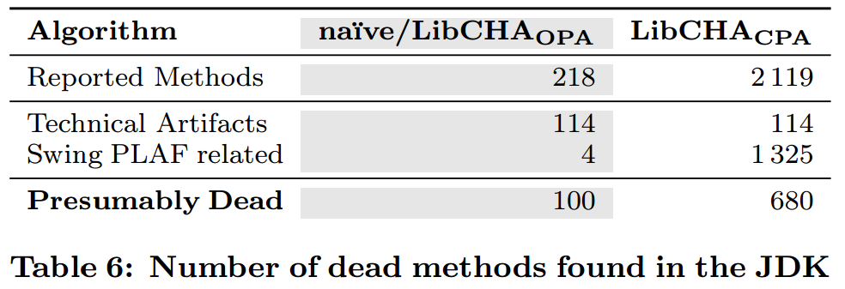
Software quality analyses improve in case of CPA over OPA
Oracle JDK 7u80
We don’t resolve reflection...
6.8 times more dead methods found
In case of CPA it is also possible to report non-private methods as dead!

Slide 44
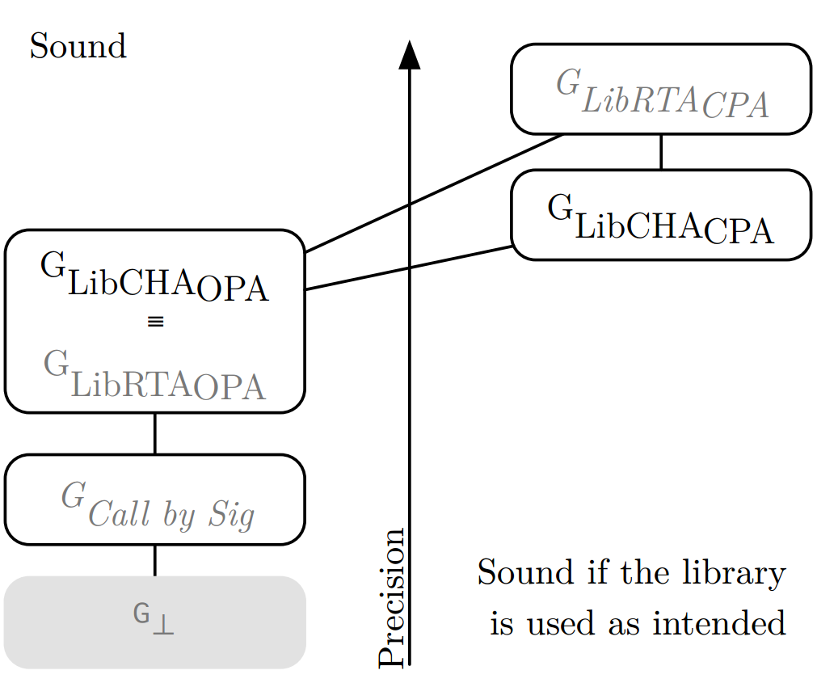
What is about more advanced call graph algorithms like RTA?
RTA is slightly better in case of CPA!
Why is CHA in case OPA equivalent to RTA?

Slide 45
LibRTA degenerates to LibCHA in the case of OPA
public static void main(String[] args) {
Collection c = makeCollection(args[0]);
c.add(“elem”);
}
static Collection makeCollection(String s) {
if(s.equals(”elem”)) {
return new ArrayList();
} else {
return new HashSet();
}
}

Slide 46
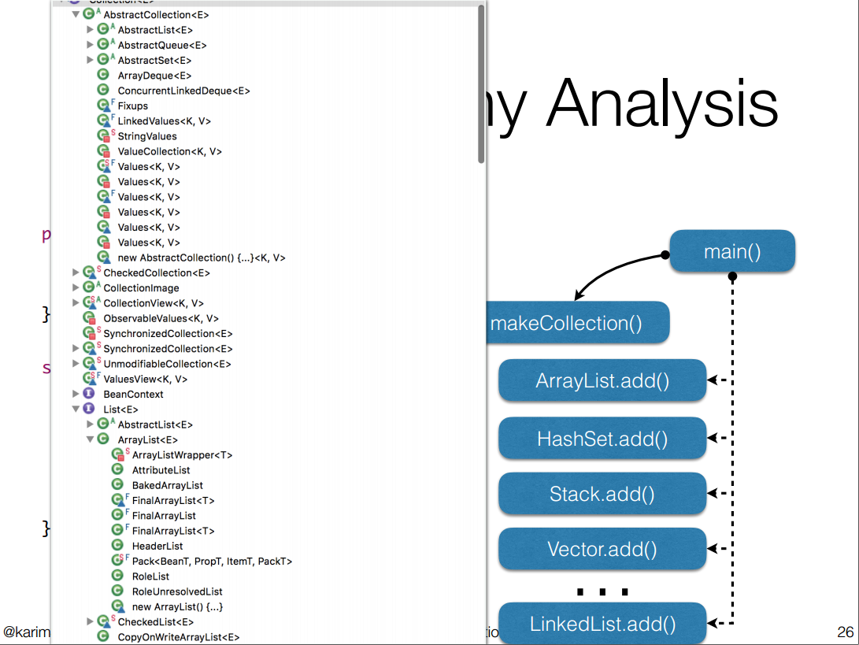
LibRTA degenerates to LibCHA in the case of OPA
public static void main(String[] args) {
Collection c = makeCollection(args[0]);
c.add(“elem”);
}
static Collection makeCollection(String s) {
if(s.equals(”elem”)) {
return new ArrayList();
} else {
return new HashSet();
}
}
All these classes could be instantiated in a future application!

Slide 47
LibRTA can be more precise in some cases than LibCHA in the case of CPA
interface InternalCollection { public void add(String s); }
class List implements InternalCollection {
public void add(String s){/*…*/}}
class Set implements InternalCollection {
public void add(String s){/*…*/}}
public static void main(String[] args) {
InternalCollection c = makeCollection(args[0]);
c.add(“elem”);
}
static Internal makeCollection(String s) {
return new List();
}
Never instantiated in this package.
All classes belong to the library private implementation!

Slide 48
Also VTA can be adapted to work with libraries
start with a pre-computed library call graph
The entry points changed accordingly to the assumption
entry point method parameters have to be resolved to all types in the type hierarchy that can be instantiated by the client!
Recap: Main Idea is to propagate types from allocation sites to potential variable references

Slide 49
Also VTA can be adapted to work with libraries
Build type propagation graph
Collapse strongly-conntected components
Propagate types along the final Directed Acyclic Graph
Use call-by-signature on interface invocations when resolving call sites!

