Slide 1
An Introduction to Backpropagation
Tianyi Li

Slide 2
Index
What is BP
Some explanations
Steps of BP
Why BP is faster
Reference

Slide 3
What is BP
The backward propagation of errors, or backpropagation, is a common method of training artificial neural networks and used in conjunction with an optimization method such as gradient descent.
Backpropagation requires a known, desired output for each input value in order to calculate the loss function gradient – it is therefore usually considered to be a supervised learning method; but it is also used in some unsupervised networks.

Slide 4

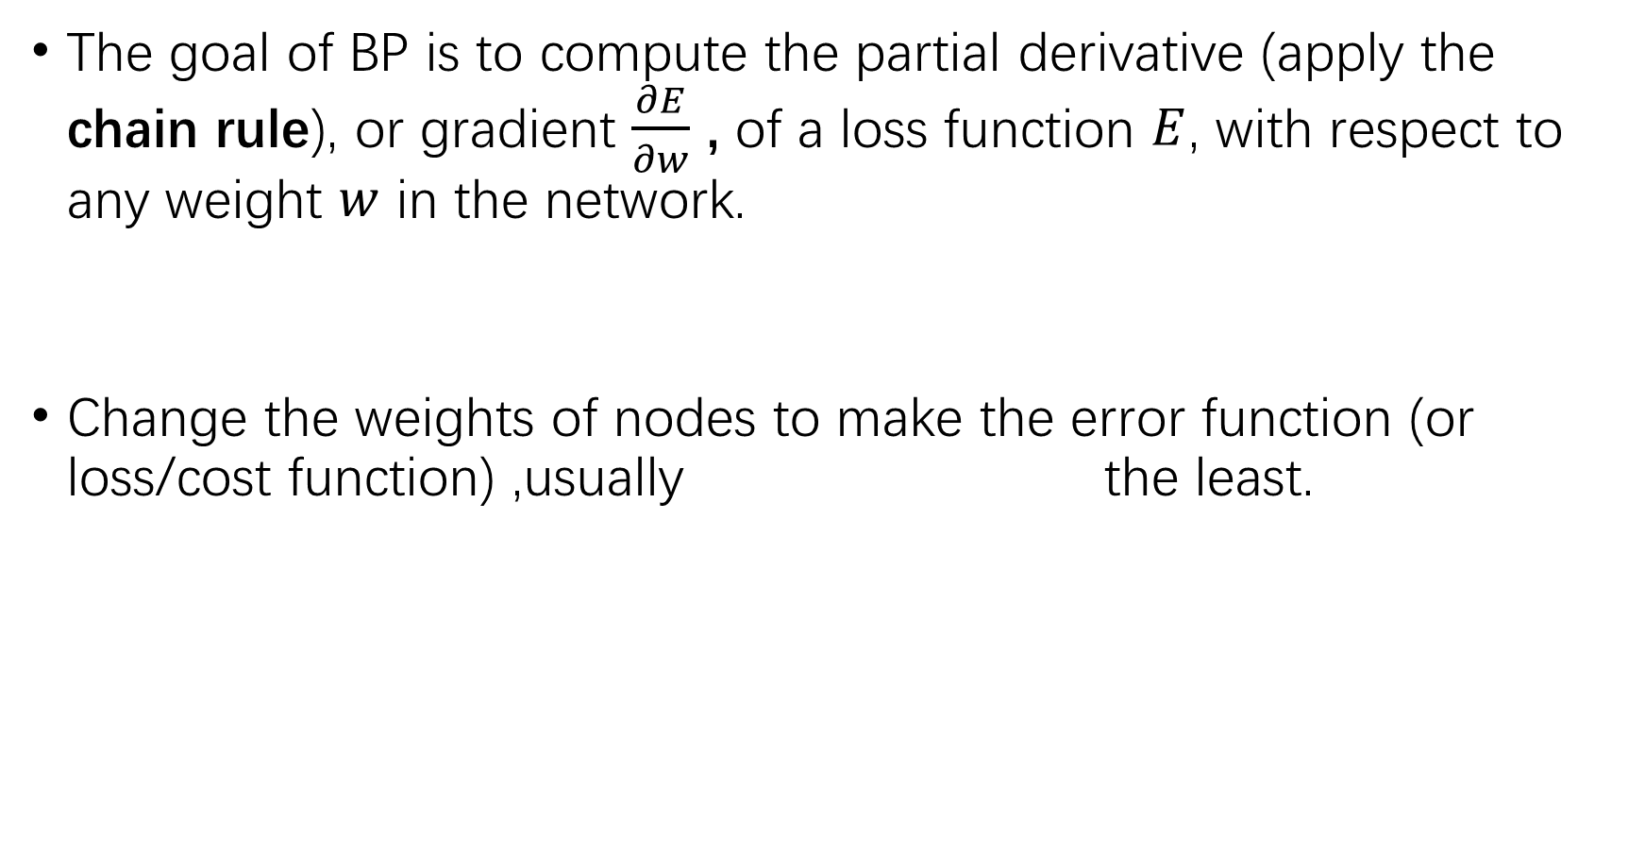
The goal of BP is to compute the partial derivative (apply the chain rule), or gradient $\frac{∂E}{∂w}$ , of a loss function $E$, with respect to any weight $w$ in the network.
Change the weights of nodes to make the error function (or loss/cost function) ,usually the least.

Slide 5
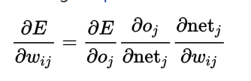
Explanation
Chain rule

Slide 6

Explanation
Delta rule：
$$∆w=−η∇E$$
$\frac{∂E}{∂w_{ij}}= o_{i}δ_{j}$
${∆w}_{ij}=−ηo_{i}δ_{j}$

Slide 7
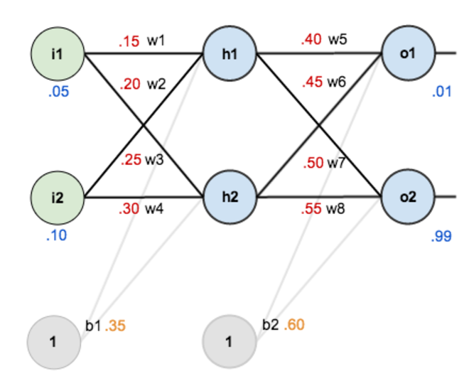
Steps of BP
(Bias b can be considered as input node with value 1.)

Slide 8
#activation function
It is used to turn a linear model to a non-linear one.
When adding layers and nodes to a neuron network without an activation function, it still a linear combination of weights, which can’t classify complex data.

Slide 9
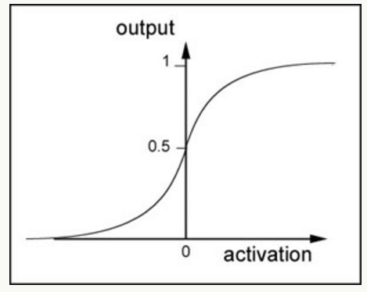
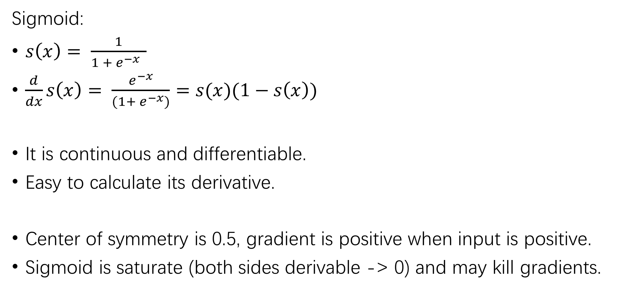
example: sigmoid function
Sigmoid:
$s\left(x\right)= \frac{1}{1 + e^{−x} }$
$\frac{d}{dx}s\left(x\right)= \frac{e^{−x}}{(1+ e^{−x})}=s(x)(1−s\left(x\right))$
It is continuous and differentiable.
Easy to calculate its derivative.
Center of symmetry is 0.5, gradient is positive when input is positive.
Sigmoid is saturate (both sides derivable -> 0) and may kill gradients.

Slide 10
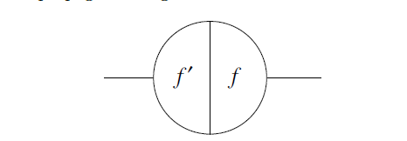
Steps of BP
Step 1 : feed-forward computation
Compute and store all the nodes
Each node has two sides.

Slide 11
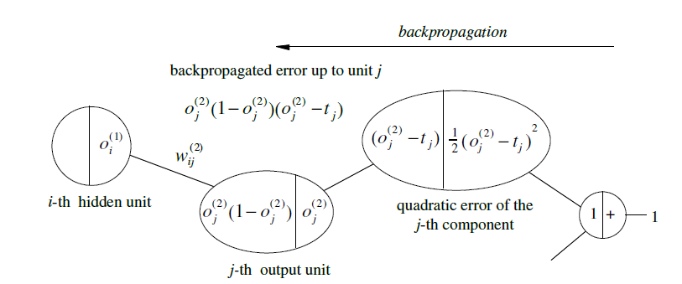
Steps of BP
Step 2 : BP to the output layer

Slide 12
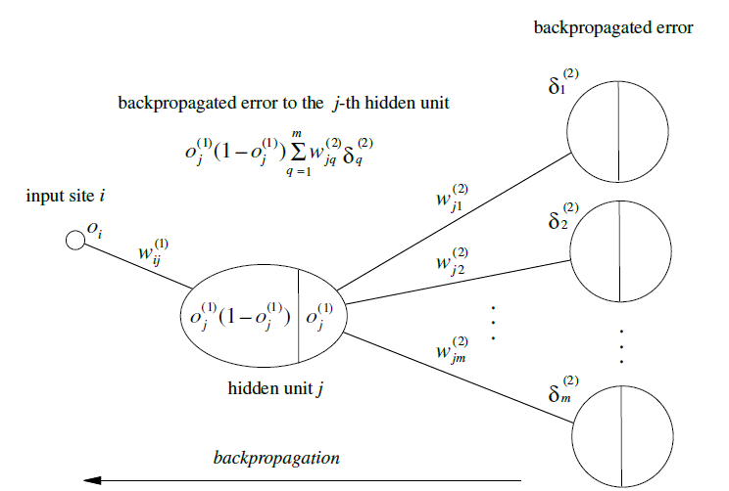
Steps of BP
Step 3: BP to the hidden layer

Slide 13
Steps of BP
Step 4: weight updates
Stop when the value of the error function has become sufficiently small and then we get a trained network.

Slide 14
# Why BP is faster:
In forward propagation:
Calculate how an input node affect all output nodes
Need to repeat many times to get every loss
In backward propagation:
Calculate how an output node affect all input nodes
Only need a forward and a backward to get every loss

Slide 15
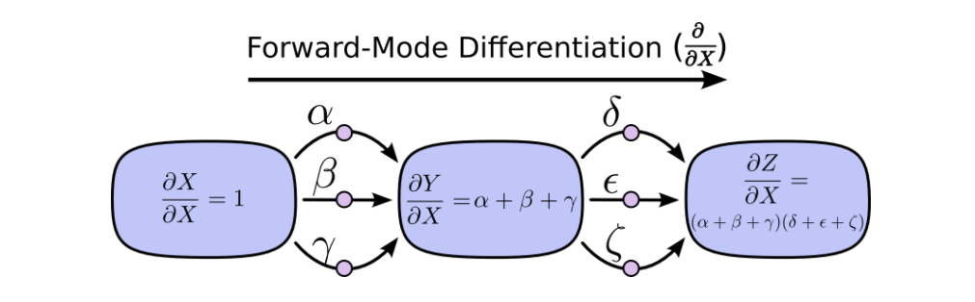
Forward
At every node, it sums all the paths feeding in.
Calculate how the node is affected by the input.

Slide 16
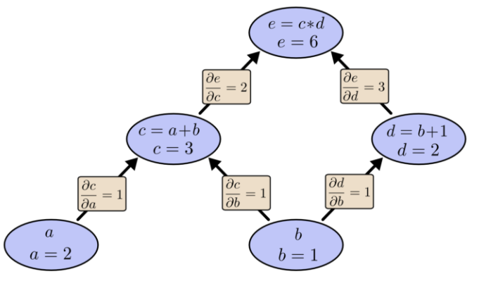
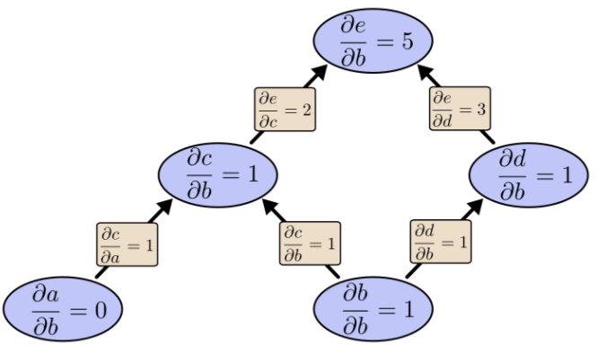
Forward (example: node b)

Slide 17
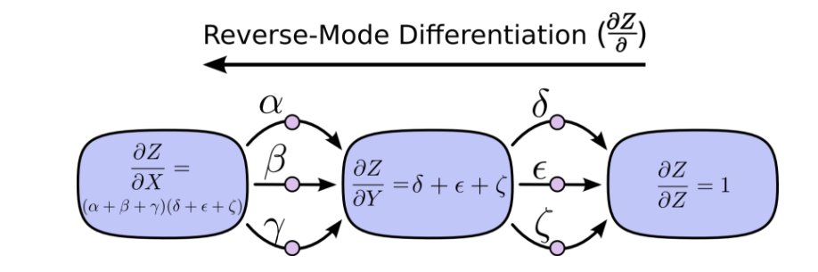
Backward
At each node, it merges all paths which originated at that node.
Calculate how the output is affected by the node.

Slide 18
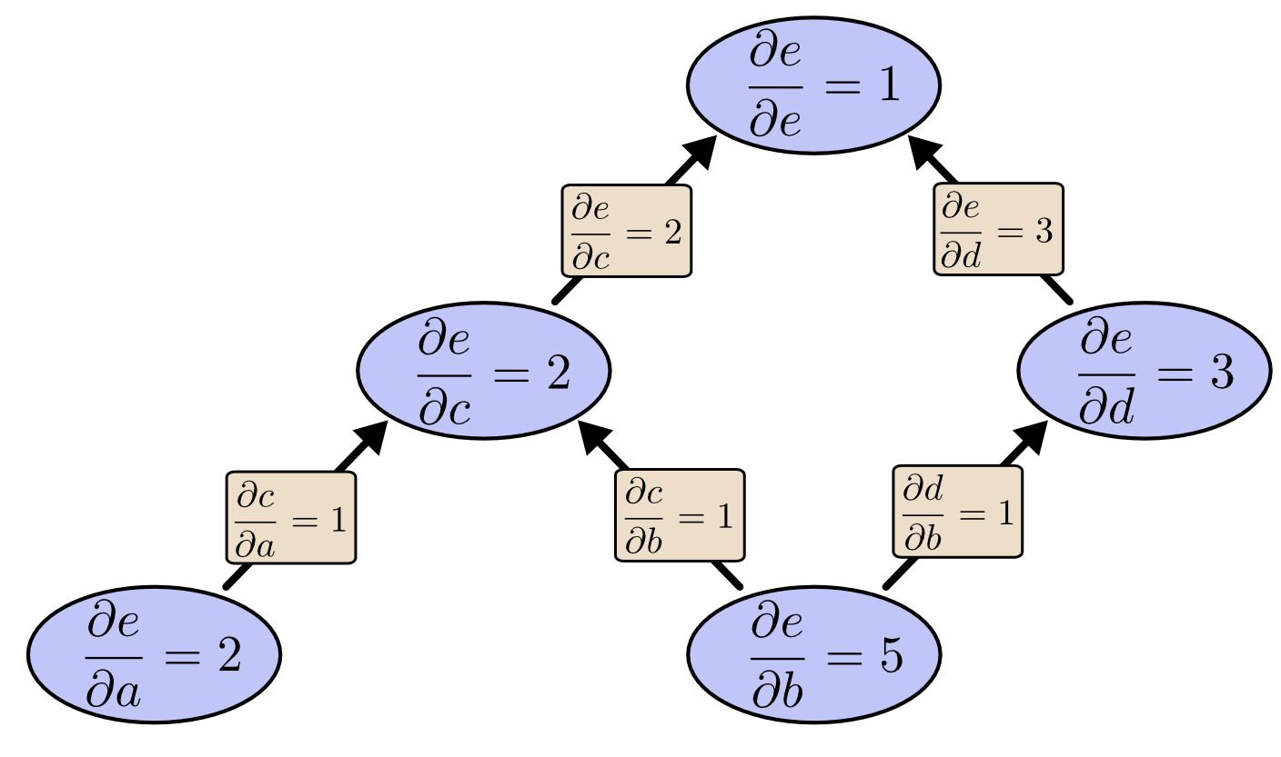
Backward (example: node e)

Slide 19

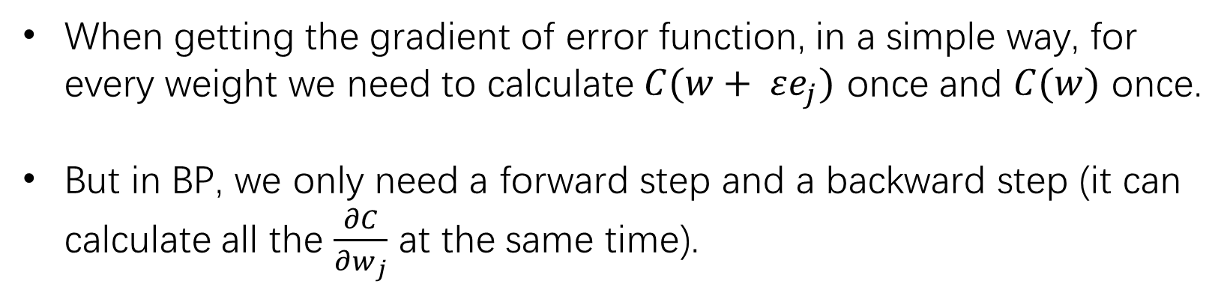

Why it is faster
($ε>0, ε→0$)
When getting the gradient of error function, in a simple way, for every weight we need to calculate $C(w+ εe_{j})$ once and $C(w)$ once.
But in BP, we only need a forward step and a backward step (it can calculate all the $\frac{∂C}{∂w_{j}}$ at the same time).

Slide 20
理论上这里应该放一大段能跑的代码↓↓↓

Slide 21
然而我还并没有写= =b

Slide 22
Reference:
https://en.wikipedia.org/wiki/Backpropagation
http://colah.github.io/posts/2015-08-Backprop/
https://tigerneil.gitbooks.io/neural-networks-and-deep-learning-zh/content/chapter2.html
https://mattmazur.com/2015/03/17/a-step-by-step-backpropagation-example/
http://ufldl.stanford.edu/wiki/index.php/Backpropagation_Algorithm
R. Rojas: Neural Networks, Springer-Verlag, Berlin, 1996

Slide 23
Thanks~

