Slide 1
An Introduction to Backpropagation
Tianyi Li

Slide 2
Index
What is BP
Why BP is faster
A simple example
Reference

Slide 3
What is BP
The backward propagation of errors, or backpropagation, is a common method of training artificial neural networks and used in conjunction with an optimization method such as gradient descent.
Backpropagation requires a known, desired output for each input value in order to calculate the loss function gradient – it is therefore usually considered to be a supervised learning method; but it is also used in some unsupervised networks.

Slide 4

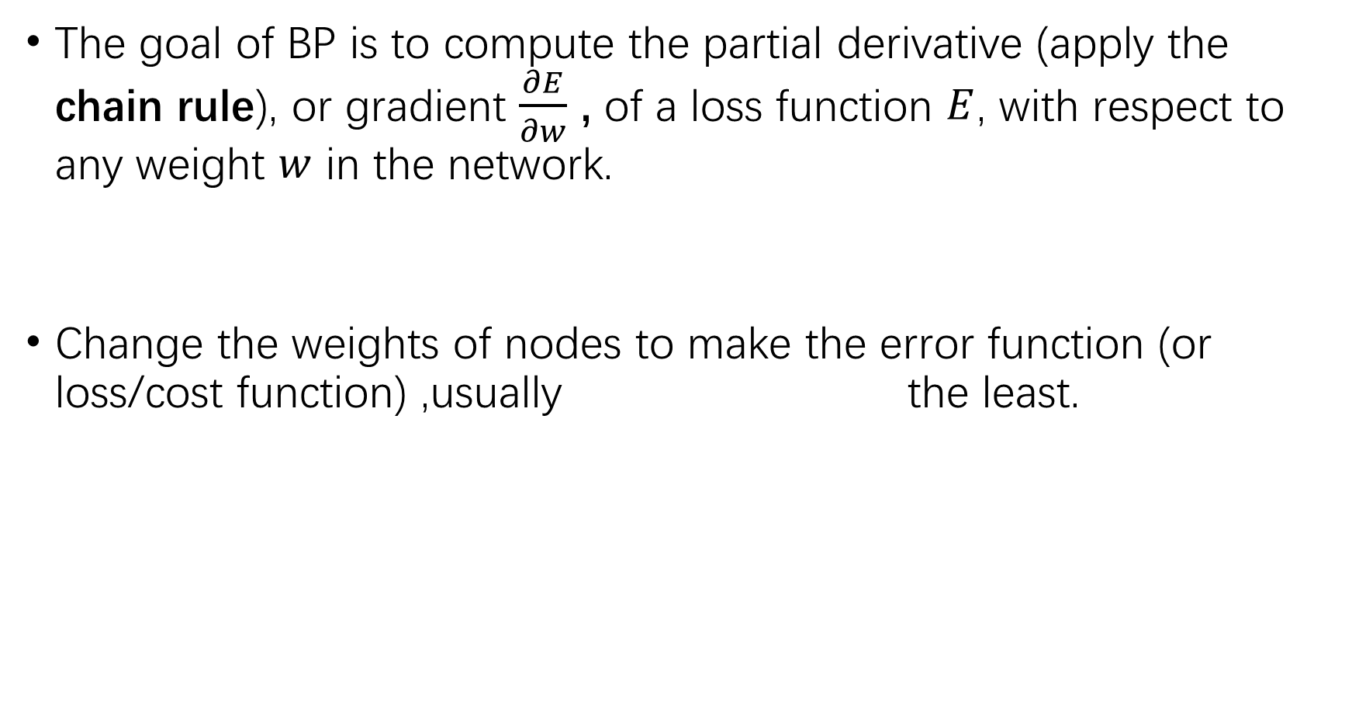
The goal of BP is to compute the partial derivative (apply the chain rule), or gradient $\frac{∂E}{∂w}$ , of a loss function $E$, with respect to any weight $w$ in the network.
Change the weights of nodes to make the error function (or loss/cost function) ,usually the least.

Slide 5
Why BP
For modern neural networks, it can make training with gradient descent faster, relative to a naive implementation.
Instead of summing over all of the paths explicitly, they compute the same sum more efficiently by merging paths back together at every node.

Slide 6
# Why it is faster:
In forward propagation:
Calculate how an input node affect all output nodes
Need to repeat many times to get every loss
In backward propagation:
Calculate how an output node affect all input nodes
Only need a forward and a backward to get every loss

Slide 7
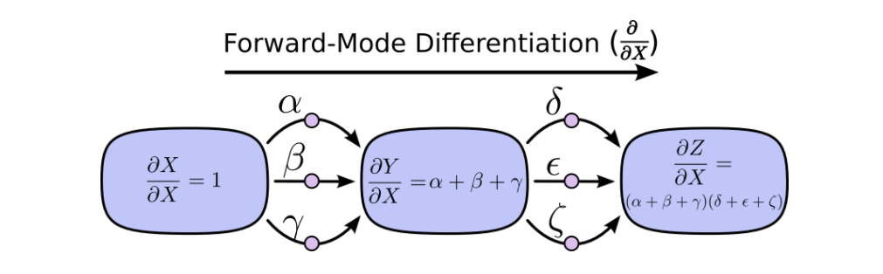
Forward
At every node, it sums all the paths feeding in.
Calculate how the node is affected by the input.

Slide 8
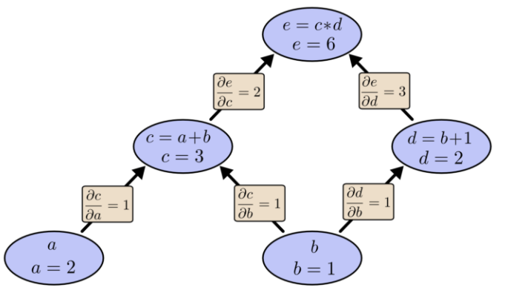
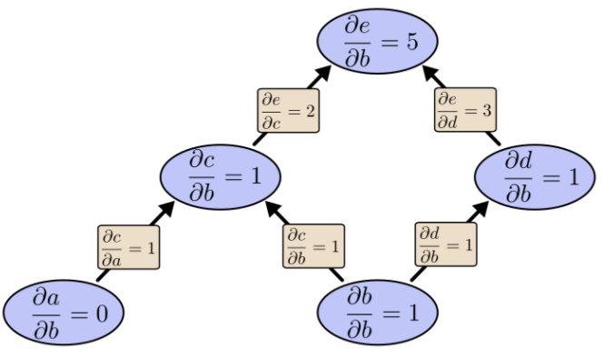
Forward (example: node b)

Slide 9
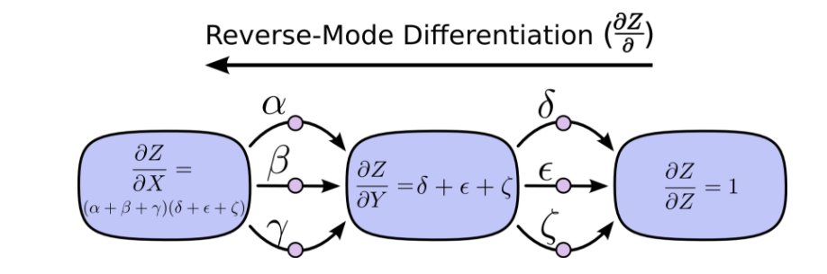
Backward
At each node, it merges all paths which originated at that node.
Calculate how the output is affected by the node.

Slide 10
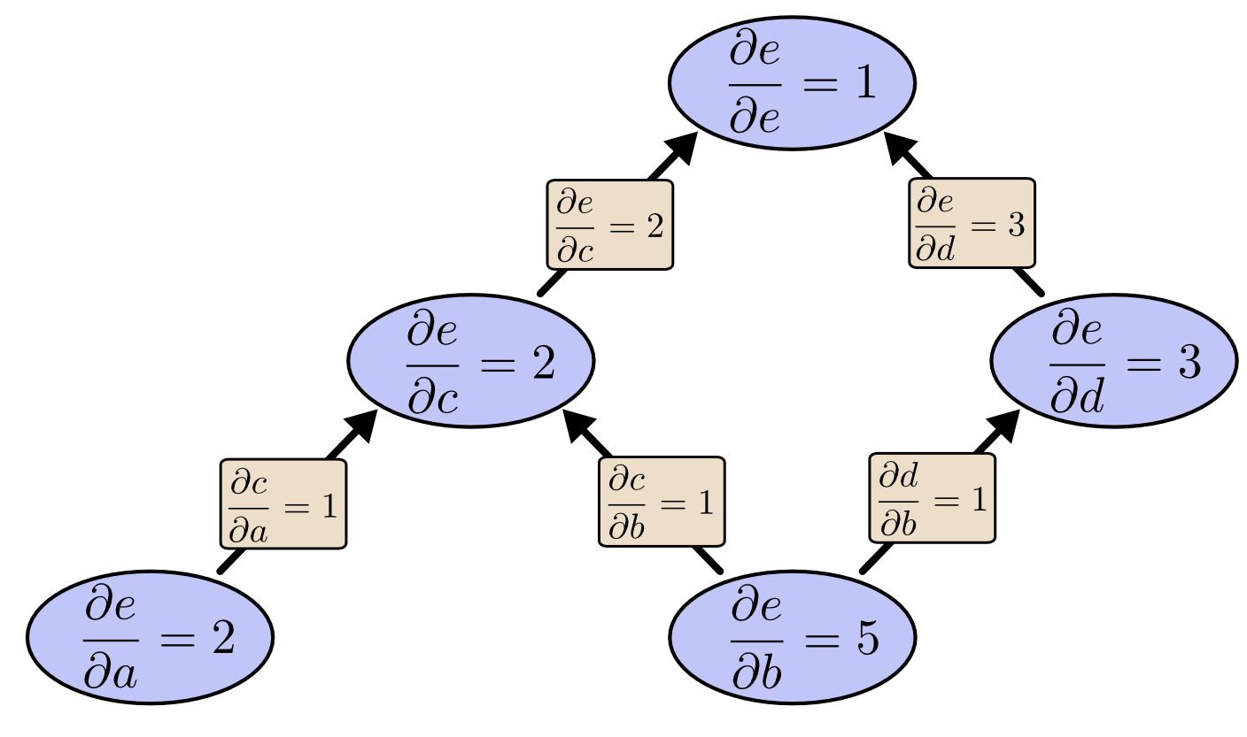
Backward (example: node e)

Slide 11

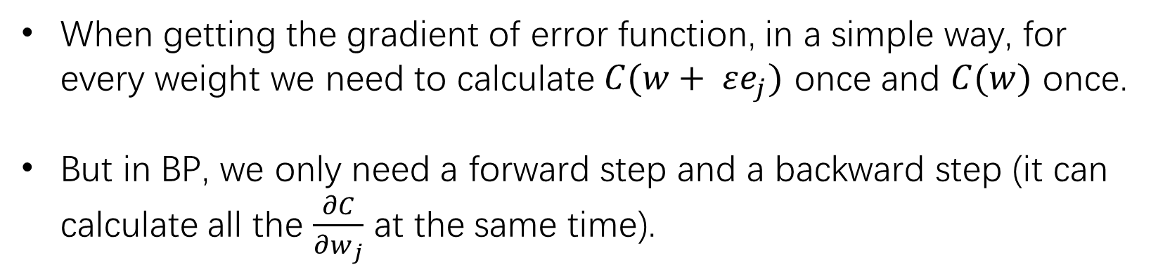

Why it is faster
($ε>0, ε→0$)
When getting the gradient of error function, in a simple way, for every weight we need to calculate $C(w+ εe_{j})$ once and $C(w)$ once.
But in BP, we only need a forward step and a backward step (it can calculate all the $\frac{∂C}{∂w_{j}}$ at the same time).

Slide 12
#activation function
It is used to turn a linear model to a non-linear one.
When adding layers and nodes to a neuron network without an activation function, it still a linear combination of weights, which can’t classify complex data.

Slide 13
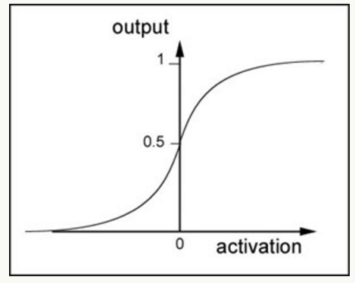

example: sigmoid function
Sigmoid:
$s\left(x\right)= \frac{1}{1 + e^{−x} }$
$\frac{d}{dx}s\left(x\right)= \frac{e^{−x}}{(1+ e^{−x})}=s(x)(1−s\left(x\right))$
It is continuous and derivable.

Slide 14
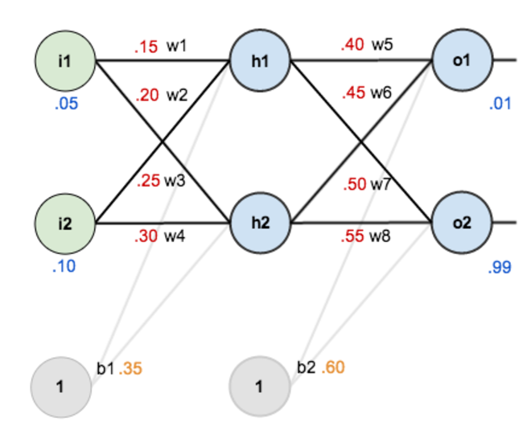
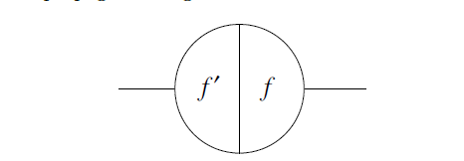
A simple example of BP
Each node has two sides.
(Bias b can be considered as input node with value 1.)

Slide 15
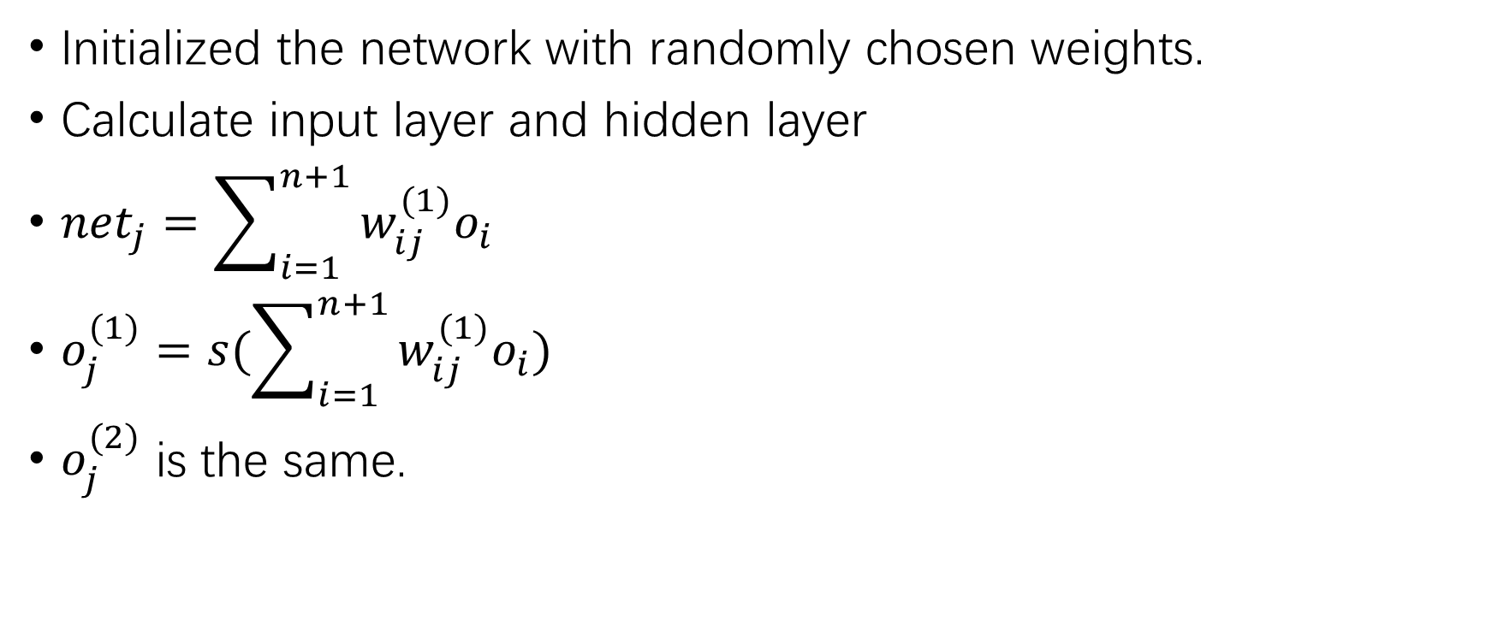
Step 1: feed-forward computation
Initialized the network with randomly chosen weights.
Calculate input layer and hidden layer
${net}_{j}=\sum_{i=1}^{n+1}{w_{ij}^{(1)}o_{i}}$
$o_{j}^{(1)}=s(\sum_{i=1}^{n+1}{w_{ij}^{(1)}o_{i}})$
$o_{j}^{(2)}$ is the same.

Slide 16
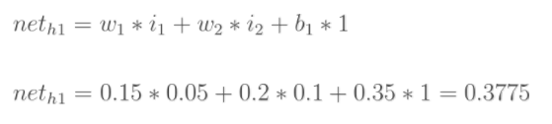


Step 1: feed-forward computation
Input layer -> hidden layer

Slide 17
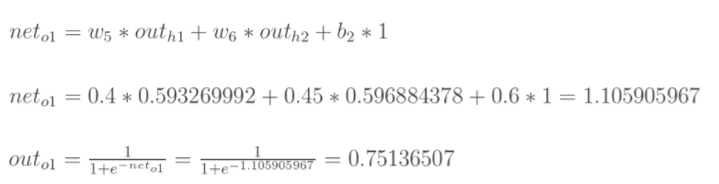

Step 1: feed-forward computation
Hidden layer -> output layer

Slide 18


Calculate total error

Slide 19

#Delta rule
$∇E=(\frac{∂E}{∂w_{1}},\frac{∂E}{∂w_{2}},…,\frac{∂E}{∂w_{l}})$
${∆w}_{i}=−γ\frac{∂E}{∂w_{i}}$
$\frac{∂E}{∂w_{ij}}= o_{i}δ_{j}$
${∆w}_{ij}=−γo_{i}δ_{j}$

Slide 20
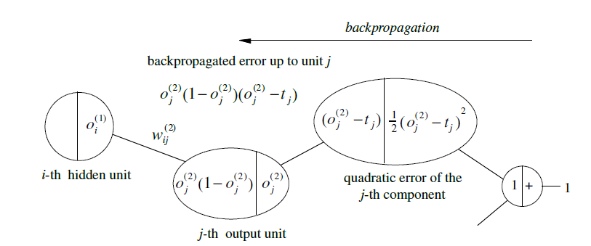
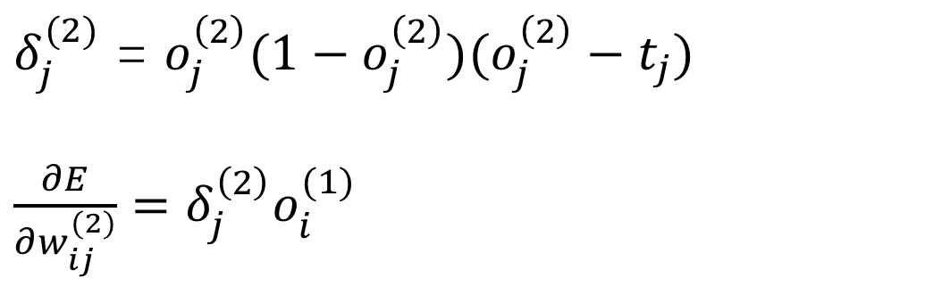
Step 2: BP to the output layer
$δ_{j}^{(2)}$ = $o_{j}^{\left(2\right)}(1−o_{j}^{\left(2\right)})(o_{j}^{\left(2\right)}−t_{j})$
$\frac{∂E}{∂w_{ij}^{(2)}}=δ_{j}^{\left(2\right)}o_{i}^{(1)}$

Slide 21
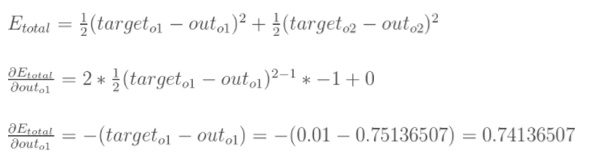
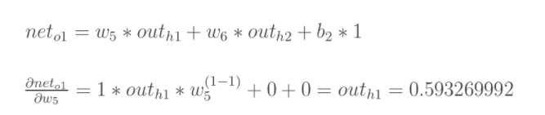
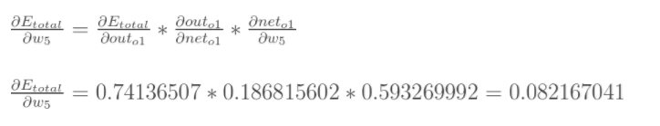
Step 2: BP to the output layer

Slide 22
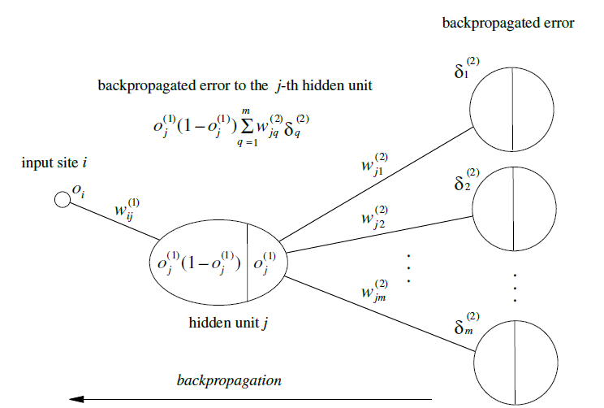
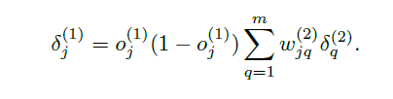

Step 3: BP to the hidden layer

Slide 23
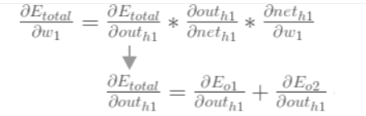

Step 3: BP to the hidden layer

Slide 24
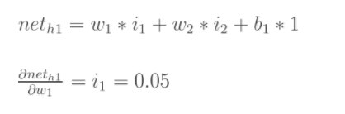
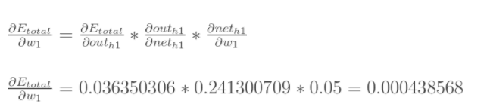
Step 3: BP to the hidden layer

Slide 25
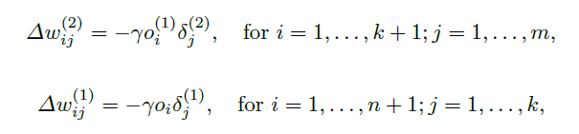
Step 4: weight updates

Slide 26

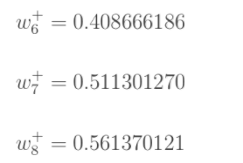
Step 4: weight updates
From step 2:

Slide 27

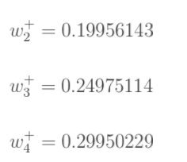

Step 4: weight updates
From step 3:
$$E_{total}=\text{0.291027924}$$
Stop when the value of the error function has become sufficiently small and we get a trained network.

Slide 28
Reference:
https://en.wikipedia.org/wiki/Backpropagation
http://colah.github.io/posts/2015-08-Backprop/
https://tigerneil.gitbooks.io/neural-networks-and-deep-learning-zh/content/chapter2.html
https://mattmazur.com/2015/03/17/a-step-by-step-backpropagation-example/
http://ufldl.stanford.edu/wiki/index.php/Backpropagation_Algorithm
R. Rojas: Neural Networks, Springer-Verlag, Berlin, 1996

Slide 29
https://www.oschina.net/code/snippet_1782684_45069
http://xuhongxu.com/ml10-backpropagation/
http://blog.csdn.net/u014313009/article/details/51039334
http://galaxy.agh.edu.pl/~vlsi/AI/backp_t_en/backprop.html
https://zhuanlan.zhihu.com/p/25279356
https://www.zybuluo.com/hanbingtao/note/476663
https://iamtrask.github.io/2015/07/12/basic-python-network/
http://www.emergentmind.com/neural-network
http://yongyuan.name/blog/back-propagtion.html

Slide 30
Thanks~

