Slide 1

Note: The data and information in this document is reflective of a hypothetical situation and client. This document is to be used for KPMG Virtual Internship purposes only.
Sprocket Central Pty Ltd
Data analytics approach
by Cynthyá Belloni
July/2021

Slide 2

Note: The data and information in this document is reflective of a hypothetical situation and client. This document is to be used for KPMG Virtual Internship purposes only.
Agenda
Introduction
Data Exploration
Model Development
Interpretation

Slide 3
Note: The data and information in this document is reflective of a hypothetical situation and client. This document is to be used for KPMG Virtual Internship purposes only.
Introduction
Analysing the new customer to help Sprocket grow its business
Analysed the dataset received from Sprocket, to determine trends and behaviour of the new customers, per state.
Select on high-value customers to drive the business and to be targeted to drive the most value for the organisation.
Sprocket Central Pty Ltd
is a long-standing KPMG client whom specialises in high-quality bikes and
accessible cycling accessories
to riders.
Their stores are localized in Queensland(QLD), New South Wale(NSW) and Victoria(VIC).

Slide 4
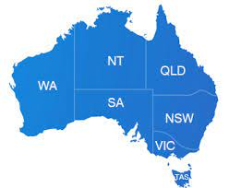
Note: The data and information in this document is reflective of a hypothetical situation and client. This document is to be used for KPMG Virtual Internship purposes only.
Data Exploration
What did we explore ?
The following information will be explored by State:
Gender
Owns Car
Group age
Wealth Segment
Job industry

Slide 5
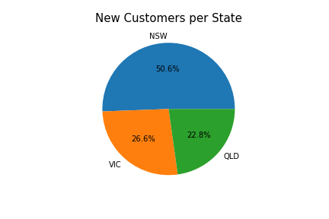
Note: The data and information in this document is reflective of a hypothetical situation and client. This document is to be used for KPMG Virtual Internship purposes only.
Model Development
Overview – Customers per State
Considering different population, culture, transportation, job industry, etc the analysis was done per State.
Comparing the population ranking, the state NSW has the biggest population in Australia and and it is where the largest number of customers are also concentrated.
State | Population | Rank
NSW | 8,166,369 | 1
VIC | 6,680,648 | 2
QLD | 5,184,847 | 3
Source: https://en.wikipedia.org/wiki/Australia

Slide 6
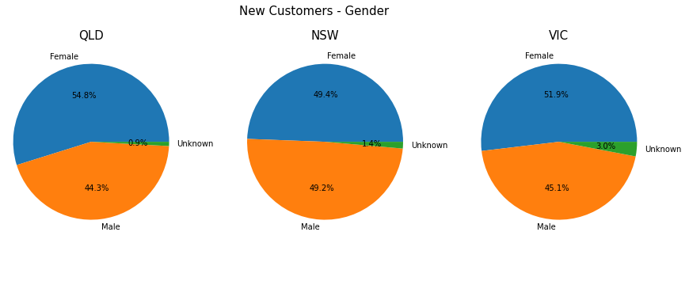
Note: The data and information in this document is reflective of a hypothetical situation and client. This document is to be used for KPMG Virtual Internship purposes only.
Model Development
Gender
In the state QLD, the company has more than 54% of female customers.

Slide 7
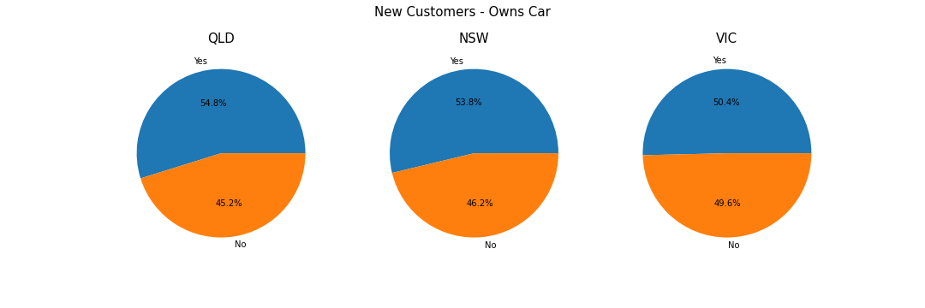
Note: The data and information in this document is reflective of a hypothetical situation and client. This document is to be used for KPMG Virtual Internship purposes only.
Model Development
Owns Car
The state QLD has the biggest percentage of customers that owns car.

Slide 8
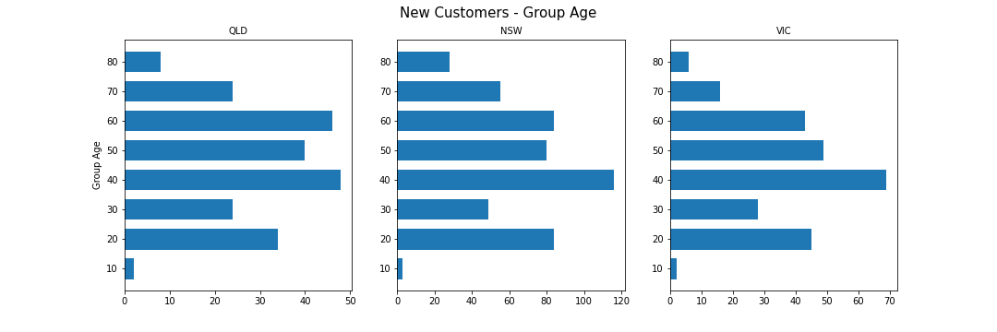
Note: The data and information in this document is reflective of a hypothetical situation and client. This document is to be used for KPMG Virtual Internship purposes only.
Model Development
Group Age
The age group of 40 to 49 is the most popular.

Slide 9
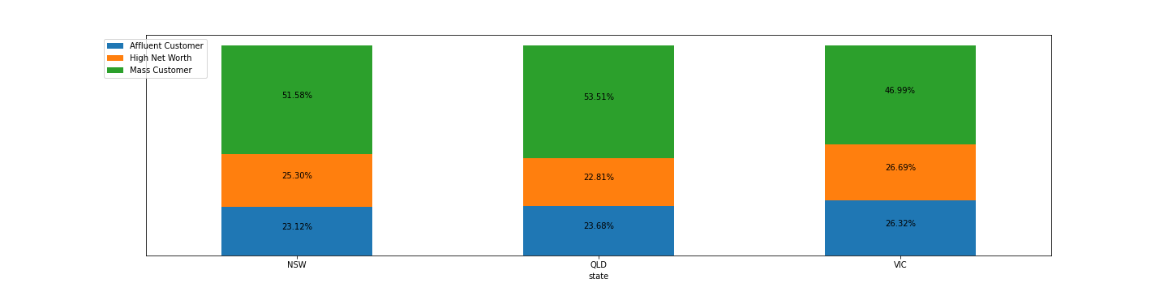
Note: The data and information in this document is reflective of a hypothetical situation and client. This document is to be used for KPMG Virtual Internship purposes only.
Model Development
Wealth Segment
Mass consumers are the most relevant to the company.

Slide 10
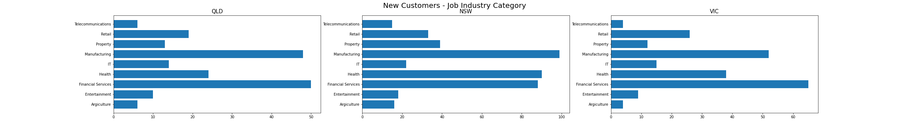
Note: The data and information in this document is reflective of a hypothetical situation and client. This document is to be used for KPMG Virtual Internship purposes only.
Model Development
Job Industry Category
The industry category most relevant are Manufacturing and Financial Services.

Slide 11
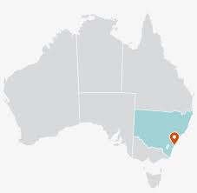


Note: The data and information in this document is reflective of a hypothetical situation and client. This document is to be used for KPMG Virtual Internship purposes only.
Interpretation
In general, the customers in the three states had a very similar behaviour, which we can say that the most common profile was at least one of this particularity:
Located in NSW
Female
Owns Car
Between 40 and 49 years old
Mass Customer
Work in Manufacturing or Financial Services Industry

Slide 12
Note: The data and information in this document is reflective of a hypothetical situation and client. This document is to be used for KPMG Virtual Internship purposes only.
Appendix

Slide 13
Note: The data and information in this document is reflective of a hypothetical situation and client. This document is to be used for KPMG Virtual Internship purposes only.
Appendix
state | group_age | purchase
NSW | 10 | 3
NSW | 20 | 84
NSW | 30 | 49
NSW | 40 | 116
NSW | 50 | 80
NSW | 60 | 84
NSW | 70 | 55
NSW | 80 | 28
QLD | 10 | 2
QLD | 20 | 34
QLD | 30 | 24
QLD | 40 | 48
QLD | 50 | 40
QLD | 60 | 46
QLD | 70 | 24
QLD | 80 | 8
VIC | 10 | 2
VIC | 20 | 45
VIC | 30 | 28
VIC | 40 | 69
VIC | 50 | 49
VIC | 60 | 43
VIC | 70 | 16
VIC | 80 | 6
Some tables
state | job_industry_category | purchase
NSW | Argiculture | 16
NSW | Entertainment | 18
NSW | Financial Services | 88
NSW | Health | 90
NSW | IT | 22
NSW | Manufacturing | 99
NSW | Property | 39
NSW | Retail | 33
NSW | Telecommunications | 15
QLD | Argiculture | 6
QLD | Entertainment | 10
QLD | Financial Services | 50
QLD | Health | 24
QLD | IT | 14
QLD | Manufacturing | 48
QLD | Property | 13
QLD | Retail | 19
QLD | Telecommunications | 6
VIC | Argiculture | 4
VIC | Entertainment | 9
VIC | Financial Services | 65
VIC | Health | 38
VIC | IT | 15
VIC | Manufacturing | 52
VIC | Property | 12
VIC | Retail | 26
VIC | Telecommunications | 4
state | purchase
NSW | 506
QLD | 228
VIC | 266
state | owns_car | purchase
NSW | No | 272
NSW | Yes | 234
QLD | No | 103
QLD | Yes | 125
VIC | No | 132
VIC | Yes | 134

