Slide 1
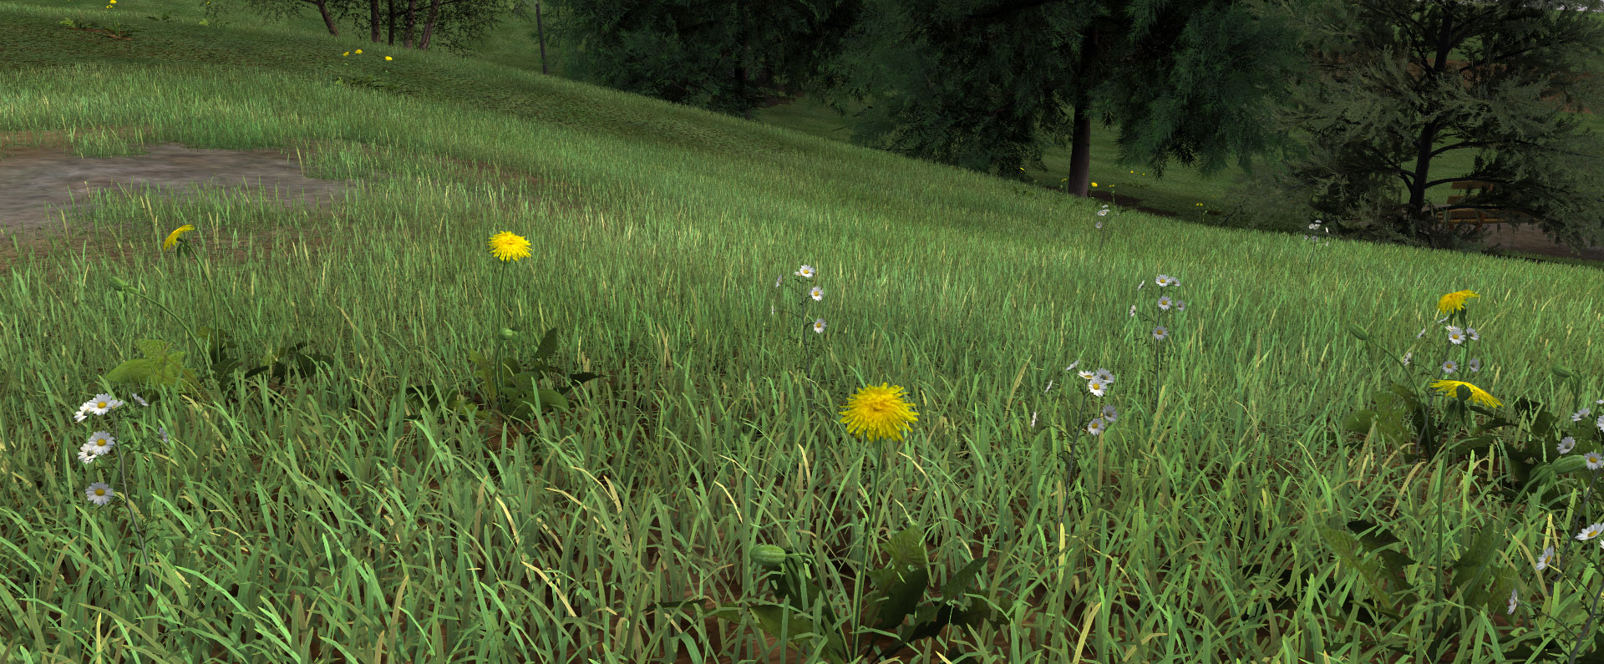
Introduction to Computer Graphics: Grass Rendering
Colussi Maëlle, Vandroux Lucas, David Raphaël

Slide 2
Goal of our project:
Create a realistic grass rendering in realtime.
Idea from the work of Kevin Boulanger:
http://www.kevinboulanger.net/grass.html

Slide 3
Implementation:
Need to create a particles system
For each particle, a bade of grass would be added
Each blade of grass would consist of two crossed billboard planes with a grass texture

Slide 4
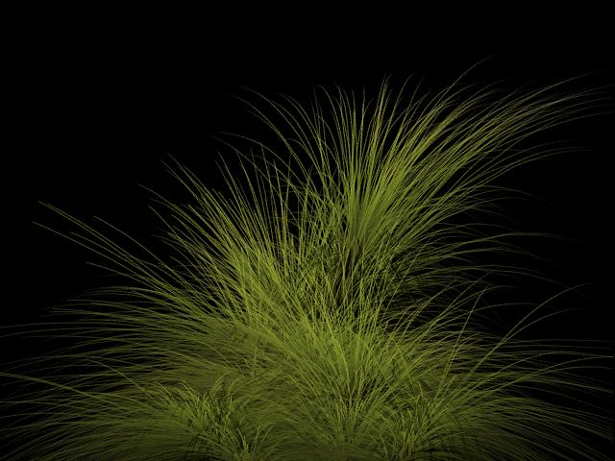
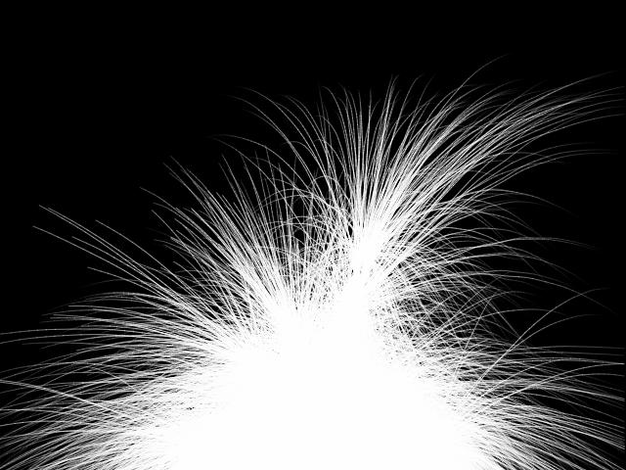
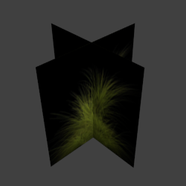
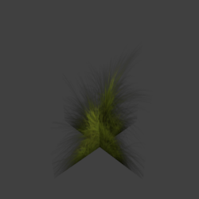
+
=>

Slide 5
Idea behind the particle system:
We do not want to store each particles in an external file and then load them. We want to generate them.
This can be done by using a small pattern of particles (no more than 25) in a .obj file.
This pattern would be placed at the beginning of the terrain plane.
At every step, we draw the particles in an array, translate the pattern and do it again.

