Slide 1


Grass Rendering
Maëlle Colussi, Raphaël David, Lucas Vandroux
Introduction to Computer Graphics
Fall 2012

Slide 2
Demo
on live...

Slide 3
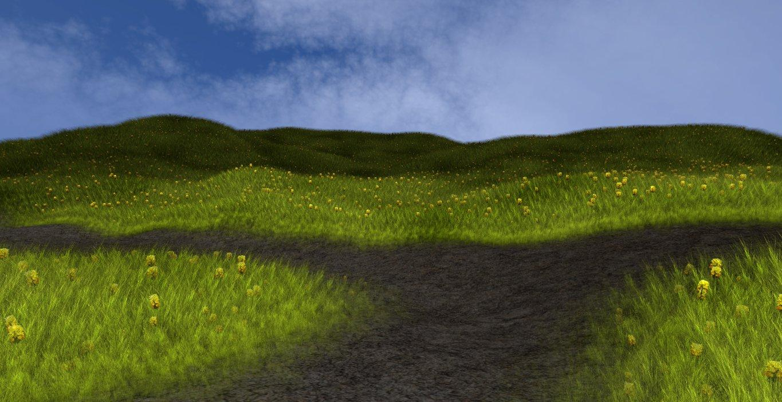
Results

Slide 4
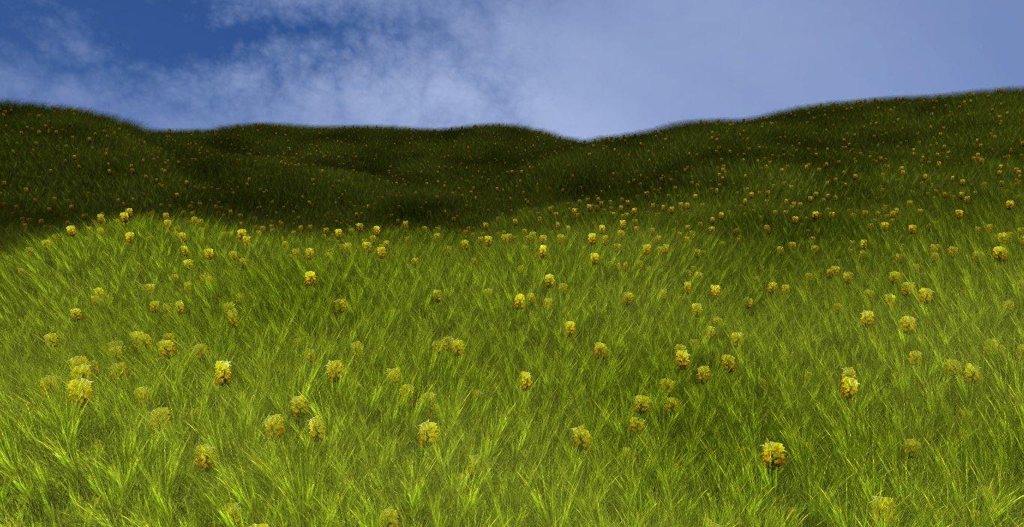
Results (cont.)

Slide 5
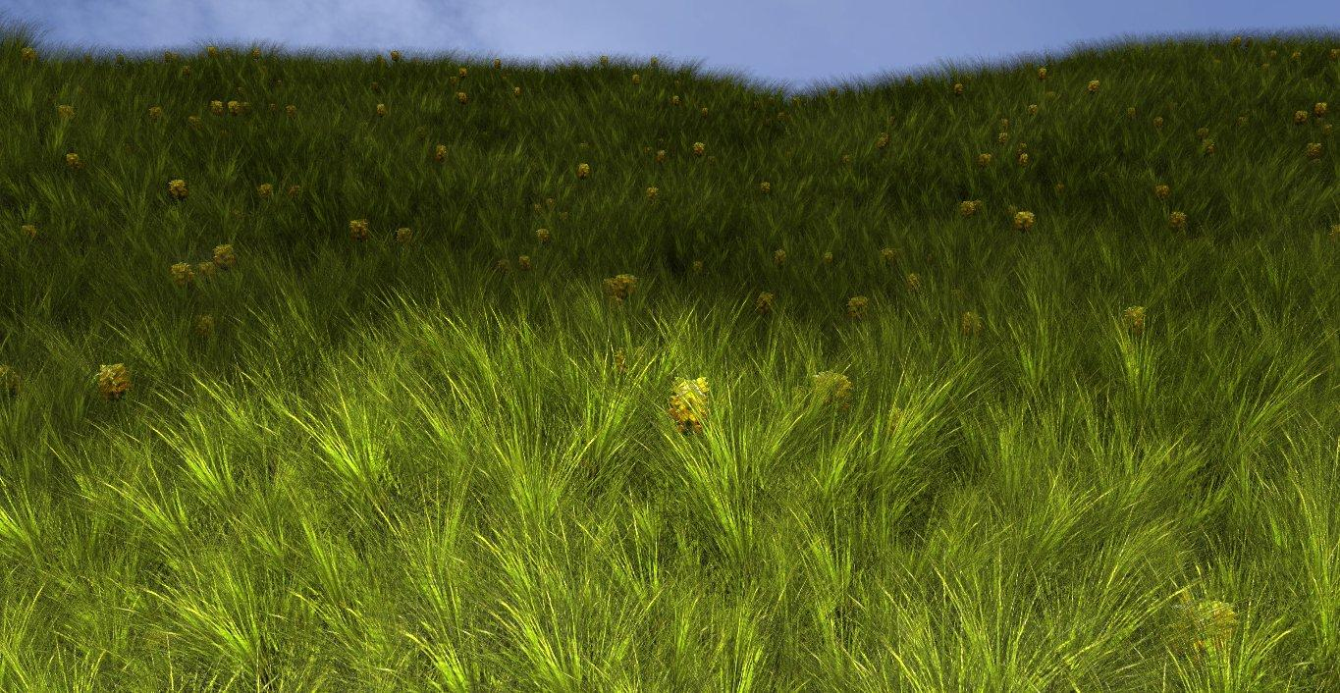
Results (cont.)

Slide 6
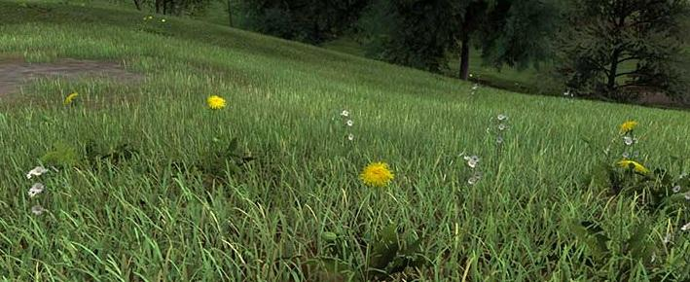
Background Information
Goal : create a realistic grass rendering in realtime
Inspiration : work of Kevin Boulanger (http://www.kevinboulanger.net/grass.html)

Slide 7
Method
• Need to create a particles system
• For each particle, a blade of grass would be added
• Each blade of grass would consist of two crossed billboard planes with a grass texture

Slide 8
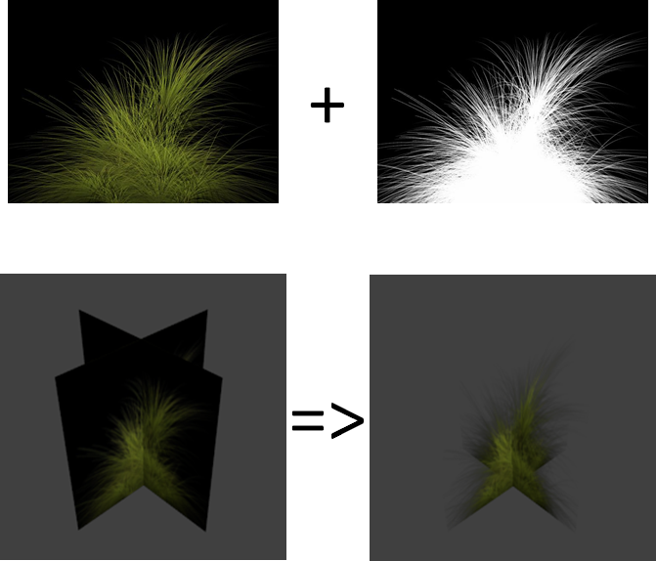
Method: blade of grass

Slide 9
Method: generate the particles
• We use a small pattern of particles (no more than 50)
• Translation of the pattern to cover the terrain in x, z coordinates
• To find y coordinate, use of texture coordinates of the field as parametrization with some scaling

Slide 10
Method: density
We use a black and white texture to represent the density of grass
For each particle, we look for the value of the density to determine if a blade of grass should be drawn

Slide 11
Method: wind
The wind is a implemented in the vertex shader
To allow our grass to have a fluid simulation, we needed to use a periodic function
That's why our wind is implemented with a sinus function

Slide 12
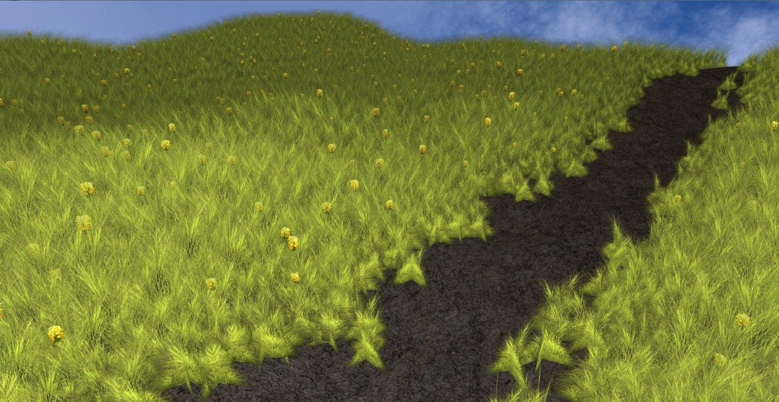
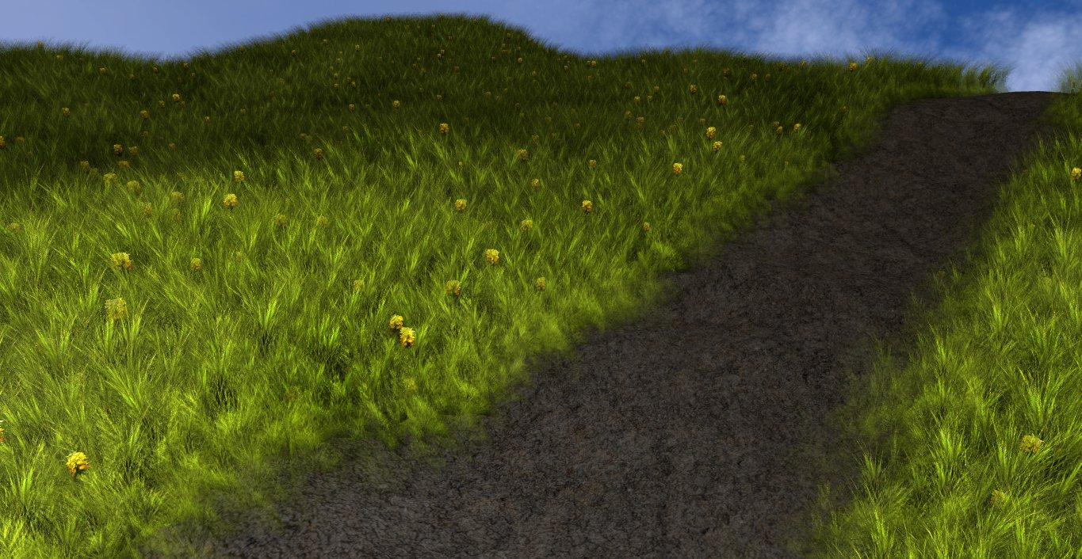
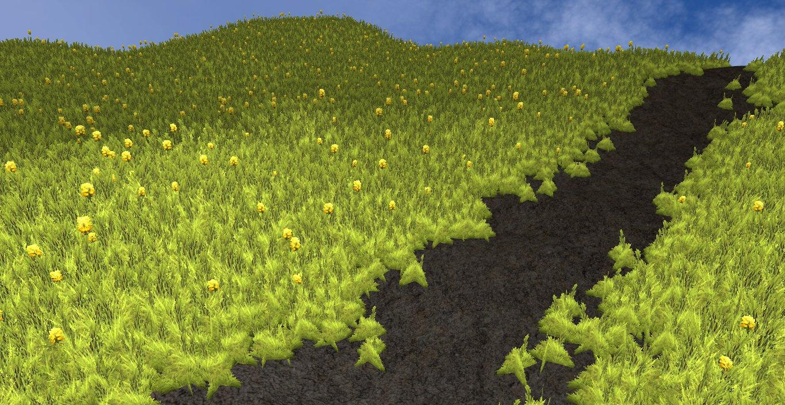
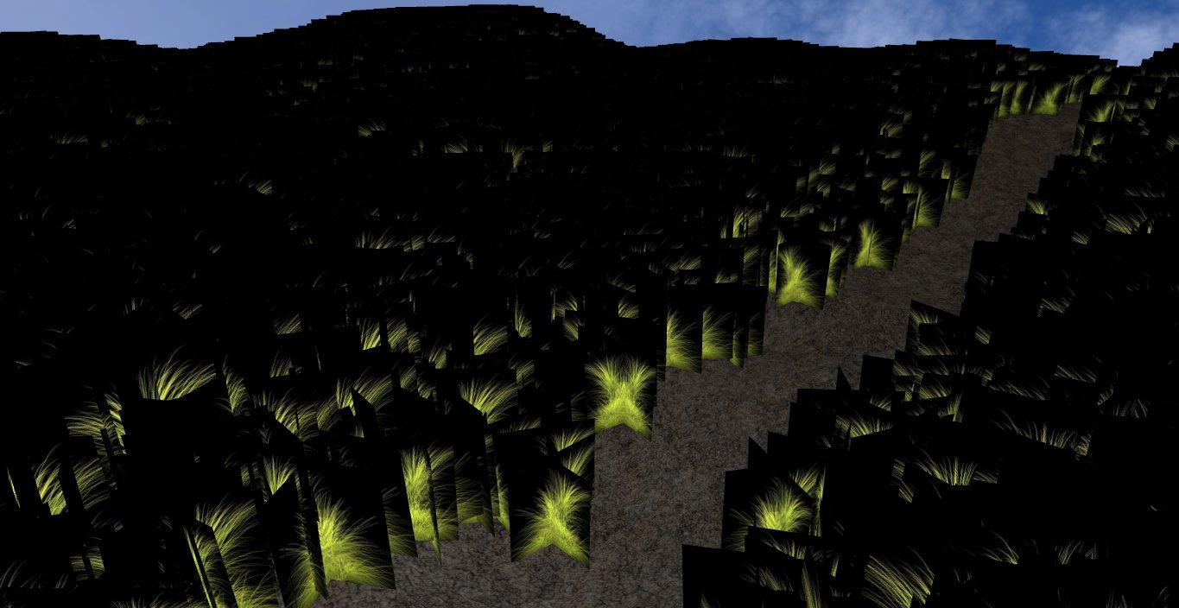
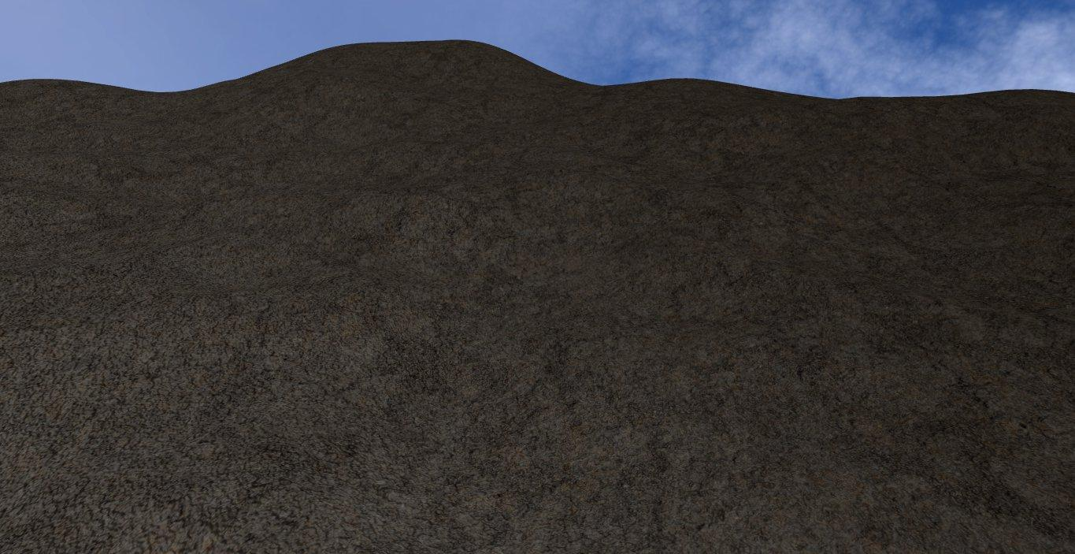
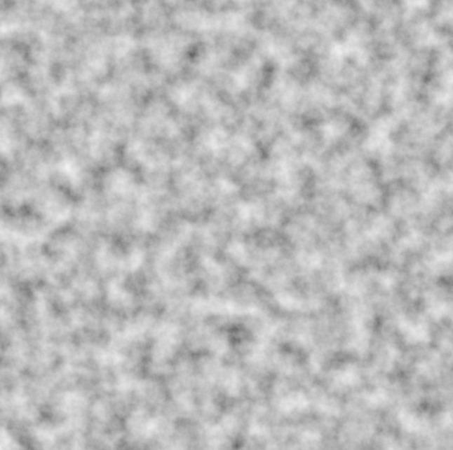

Method: all steps

Slide 13
Problems/Future Work
Problems encountered:
Draw all the grass in real time
Solution: draw the grass at the initialisation directly in the graphics card (faster for rendering)
Future work that could be done:
Use the same system to render a forest
Implement flexible grass where we can roll a ball

Slide 14
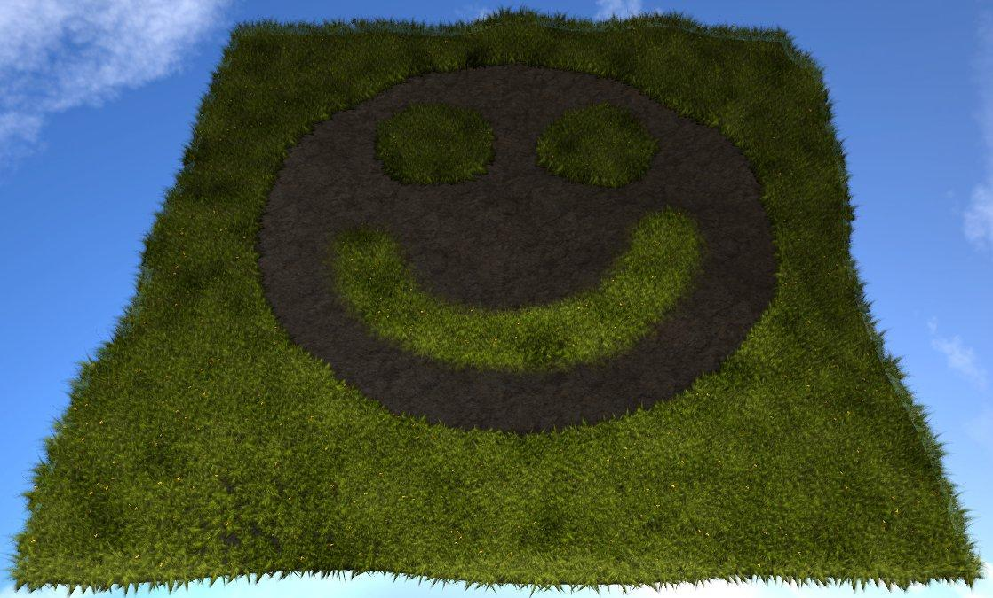
Thank you for your attention!

