Slide 1
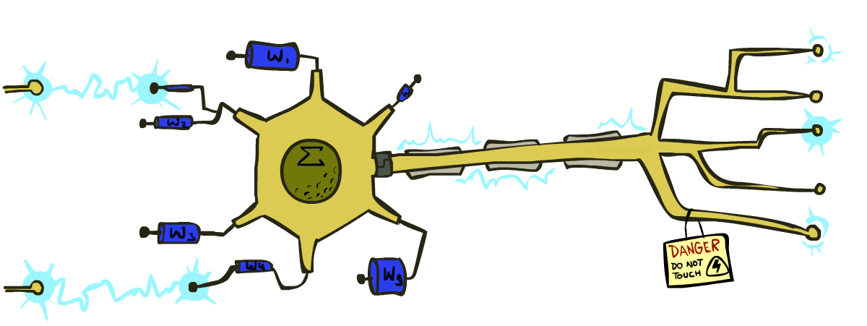
CS 188: Artificial Intelligence
Perceptrons
Instructors: Dan Klein and Pieter Abbeel --- University of California, Berkeley
[These slides were created by Dan Klein and Pieter Abbeel for CS188 Intro to AI at UC Berkeley. All CS188 materials are available at http://ai.berkeley.edu.]

Slide 2
Errors, and What to Do
Examples of errors
Dear GlobalSCAPE Customer,
GlobalSCAPE has partnered with ScanSoft to offer you the latest version of OmniPage Pro, for just $99.99* - the regular list price is $499! The most common question we've received about this offer is - Is this genuine? We would like to assure you that this offer is authorized by ScanSoft, is genuine and valid. You can get the . . .
. . . To receive your $30 Amazon.com promotional certificate, click through to
http://www.amazon.com/apparel
and see the prominent link for the $30 offer. All details are there. We hope you enjoyed receiving this message. However, if you'd rather not receive future e-mails announcing new store launches, please click . . .

Slide 3
What to Do About Errors
Problem: there’s still spam in your inbox
Need more features – words aren’t enough!
Have you emailed the sender before?
Have 1M other people just gotten the same email?
Is the sending information consistent?
Is the email in ALL CAPS?
Do inline URLs point where they say they point?
Does the email address you by (your) name?
Naïve Bayes models can incorporate a variety of features, but tend to do best in homogeneous cases (e.g. all features are word occurrences)

Slide 4
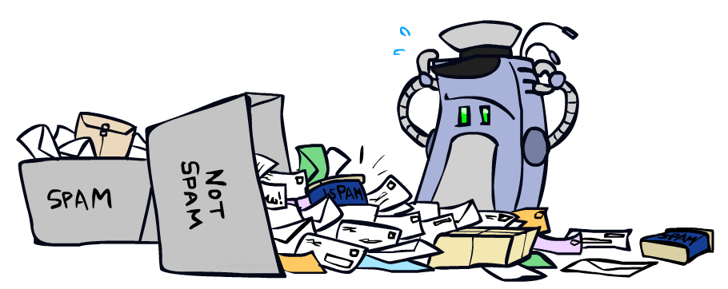
Error-Driven Classification

Slide 5
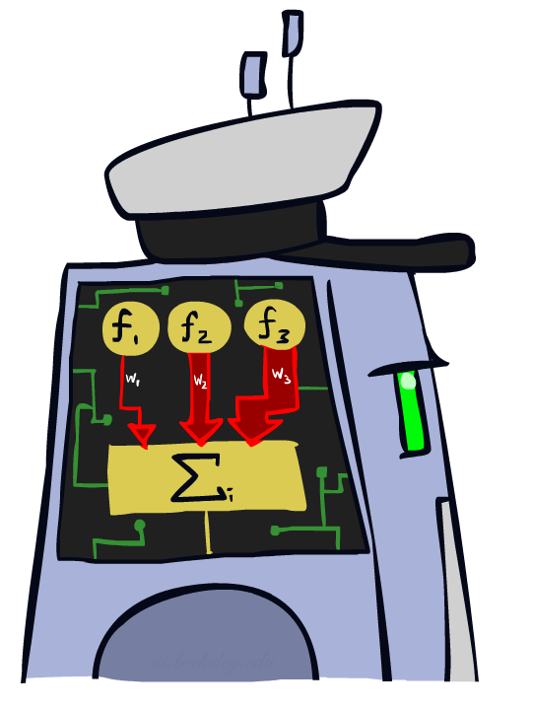
Linear Classifiers

Slide 6
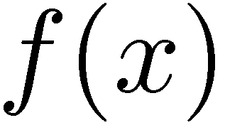

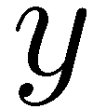

Feature Vectors
Hello,
Do you want free printr cartriges? Why pay more when you can get them ABSOLUTELY FREE! Just
# free : 2
YOUR_NAME : 0
MISSPELLED : 2
FROM_FRIEND : 0
...
SPAM
or
+
PIXEL-7,12 : 1
PIXEL-7,13 : 0
...
NUM_LOOPS : 1
...
“2”

Slide 7

Some (Simplified) Biology
Very loose inspiration: human neurons

Slide 8
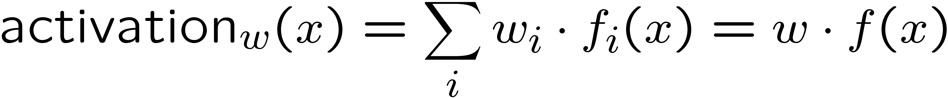
Linear Classifiers
Inputs are feature values
Each feature has a weight
Sum is the activation
If the activation is:
Positive, output +1
Negative, output -1
w₁
f₁
Σ
w₂
>0?
f₂
w₃
f₃

Slide 9

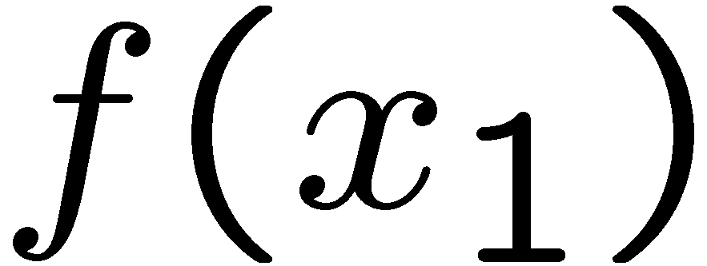
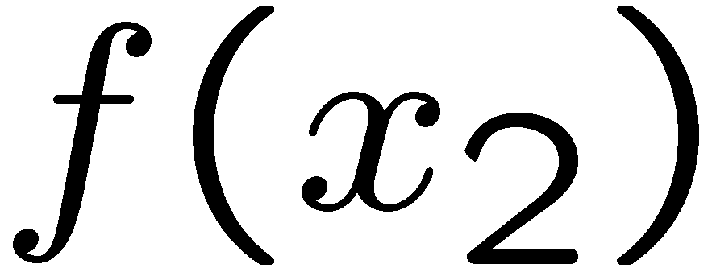
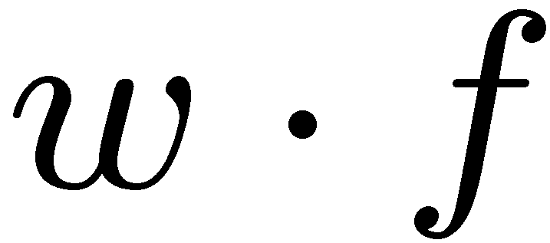
Weights
Binary case: compare features to a weight vector
Learning: figure out the weight vector from examples
# free : 4
YOUR_NAME :-1
MISSPELLED : 1
FROM_FRIEND :-3
...
# free : 2
YOUR_NAME : 0
MISSPELLED : 2
FROM_FRIEND : 0
...
# free : 0
YOUR_NAME : 1
MISSPELLED : 1
FROM_FRIEND : 1
...
Dot product positive means the positive class

Slide 10
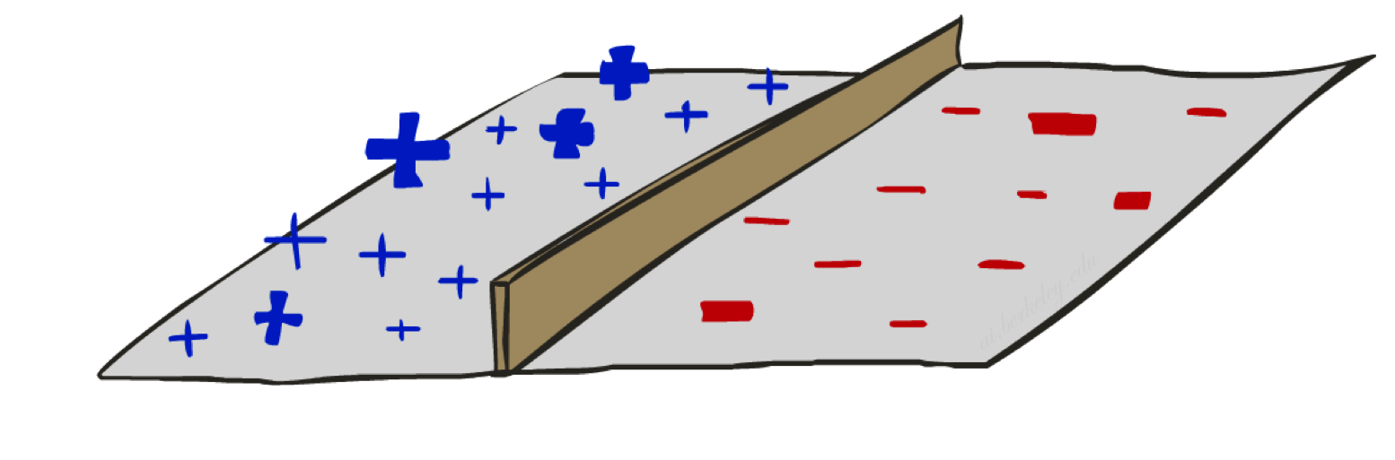
Decision Rules

Slide 11
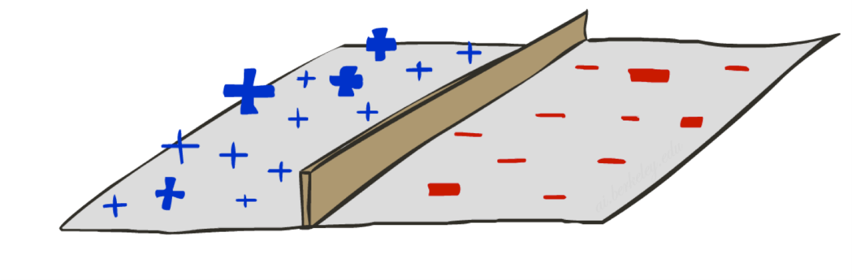

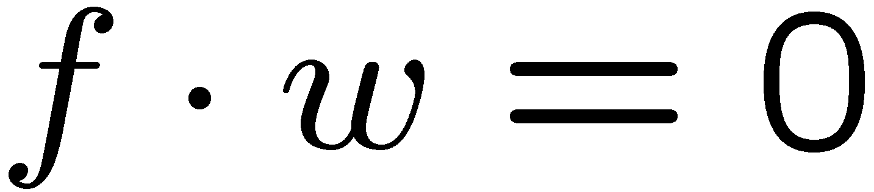
Binary Decision Rule
In the space of feature vectors
Examples are points
Any weight vector is a hyperplane
One side corresponds to Y=+1
Other corresponds to Y=-1
money
2
+1 = SPAM
1
BIAS : -3
free : 4
money : 2
...
0
-1 = HAM
0
1
free

Slide 12
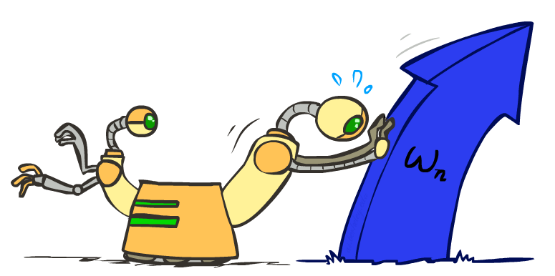
Weight Updates

Slide 13
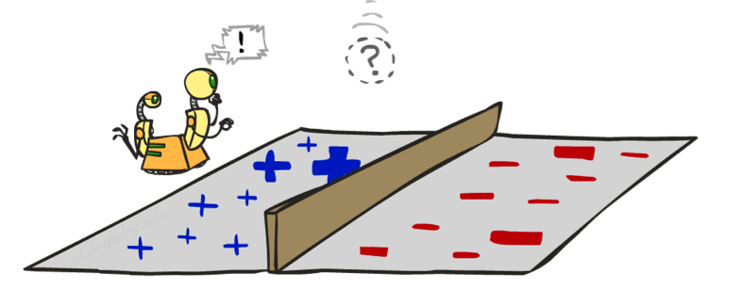
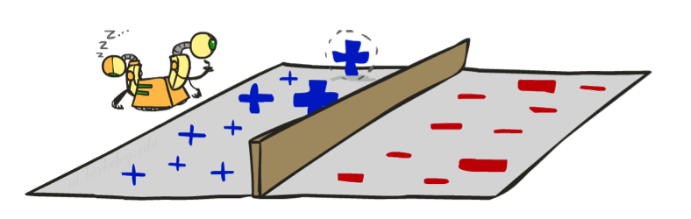
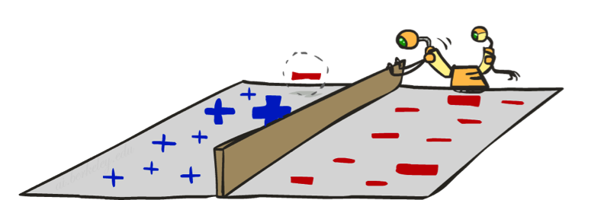
Learning: Binary Perceptron
Start with weights = 0
For each training instance:
Classify with current weights
If correct (i.e., y=y*), no change!
If wrong: adjust the weight vector
Notes:
http://isl.ira.uka.de/neuralNetCourse/2004/VL_11_5/Perceptron.html

Slide 14
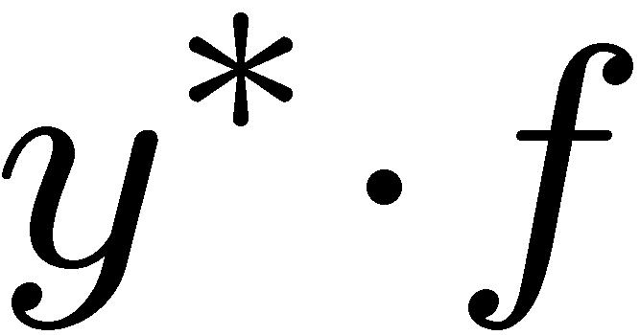
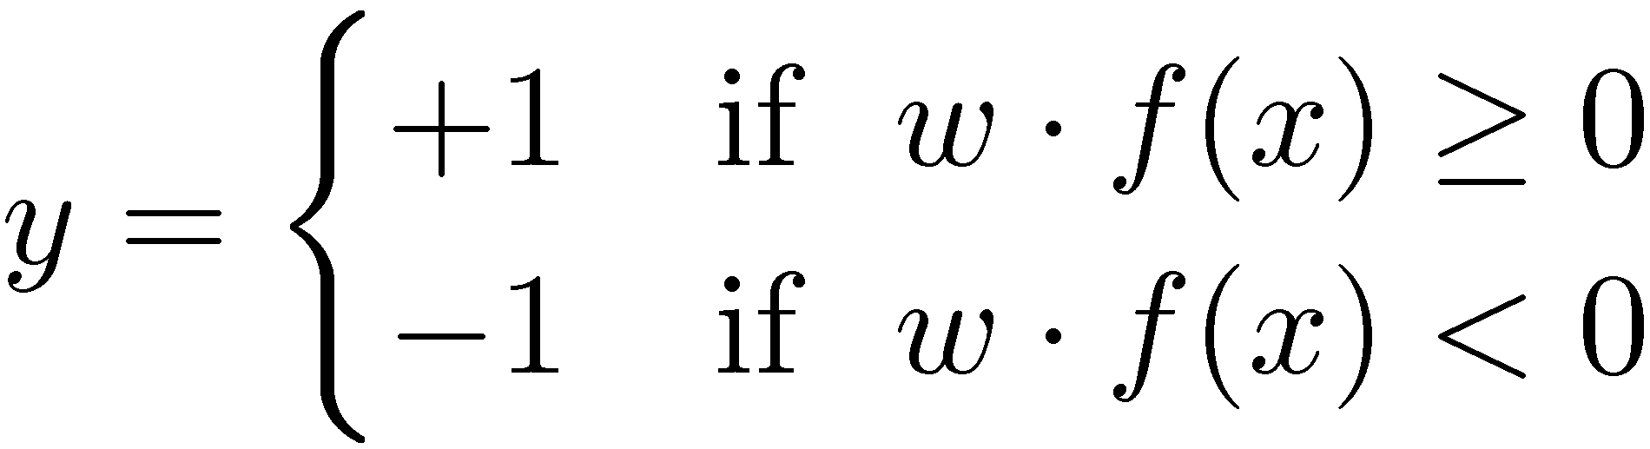

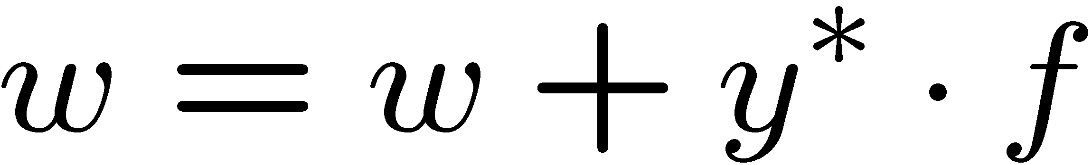
Learning: Binary Perceptron
Start with weights = 0
For each training instance:
Classify with current weights
If correct (i.e., y=y*), no change!
If wrong: adjust the weight vector by adding or subtracting the feature vector. Subtract if y* is -1.
Notes:
http://isl.ira.uka.de/neuralNetCourse/2004/VL_11_5/Perceptron.html

Slide 15
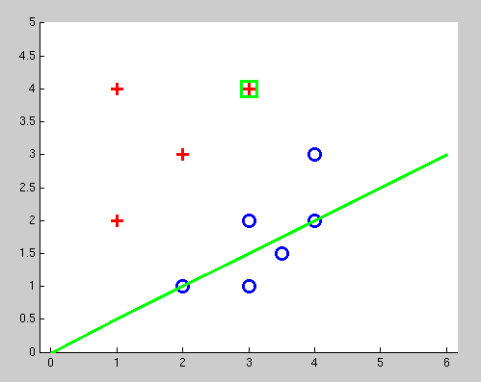
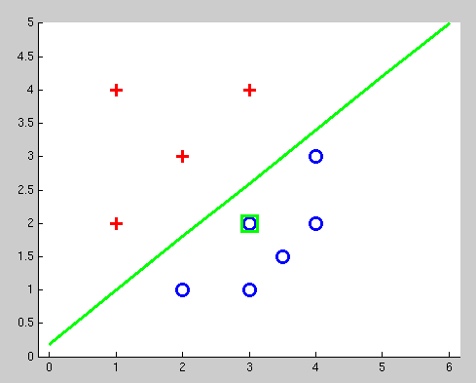
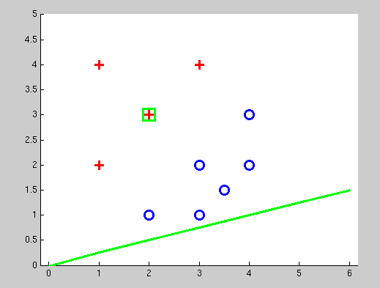
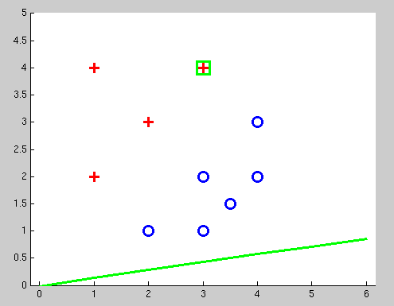
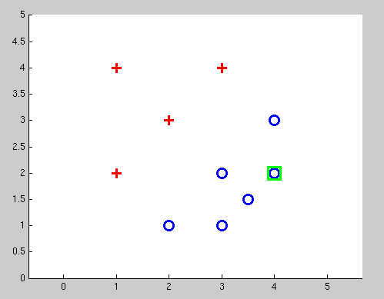
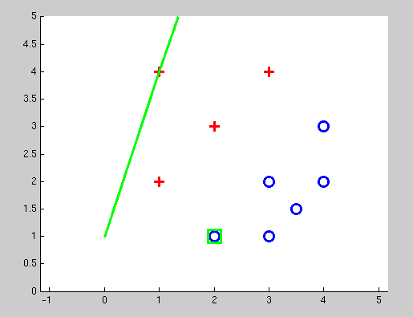
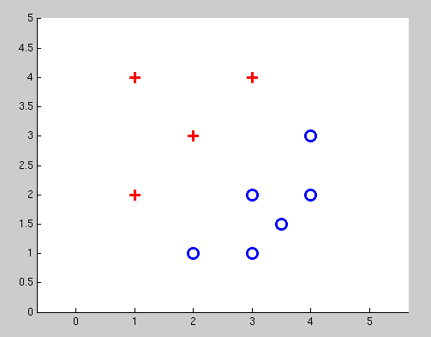
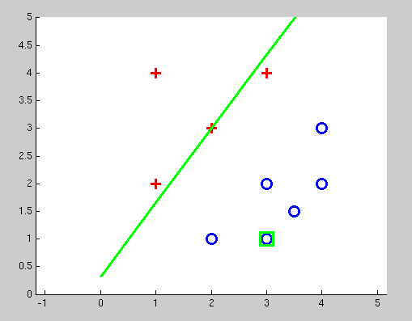
Examples: Perceptron
Separable Case

Slide 16
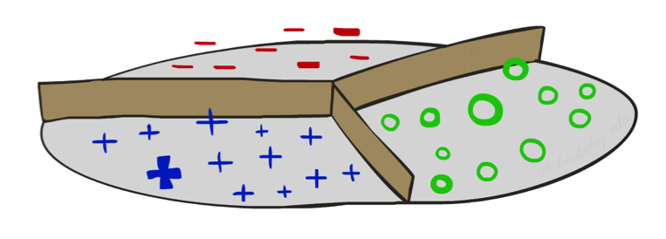


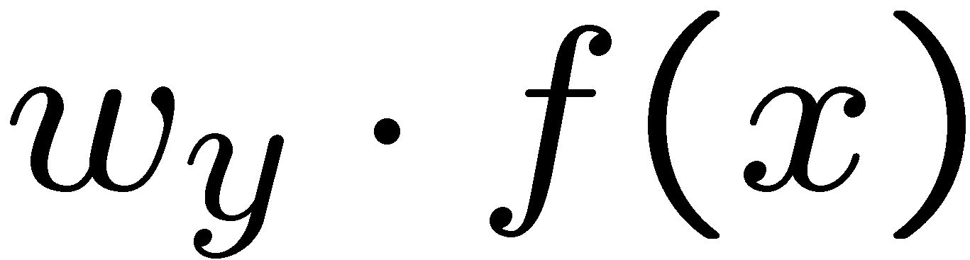


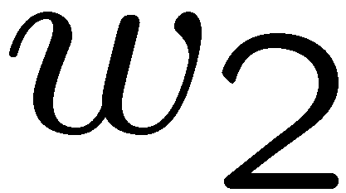
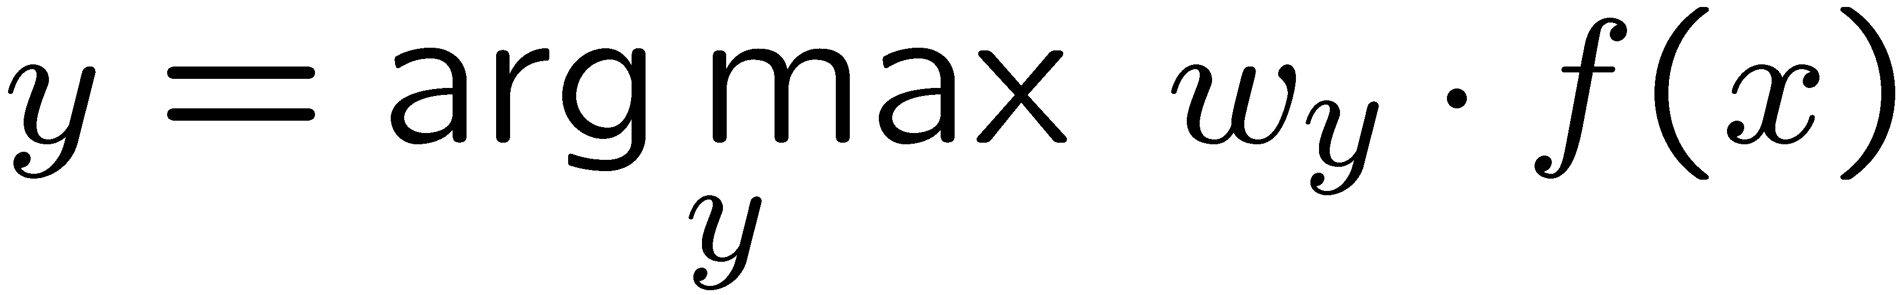
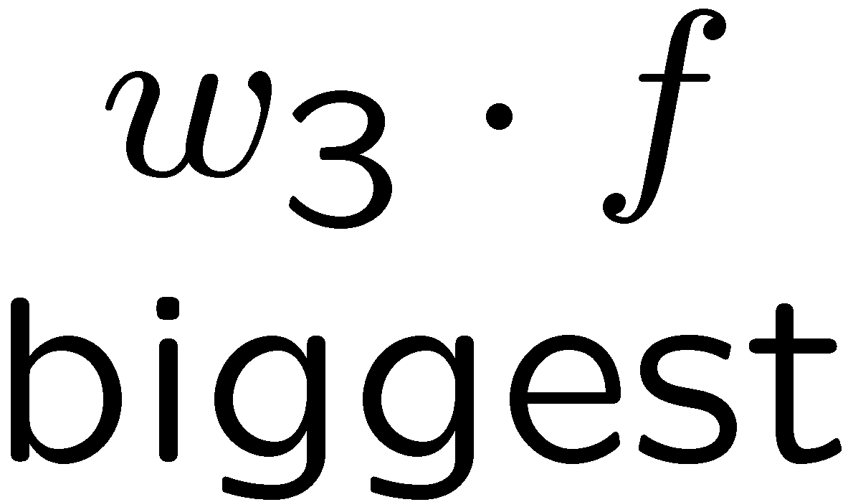
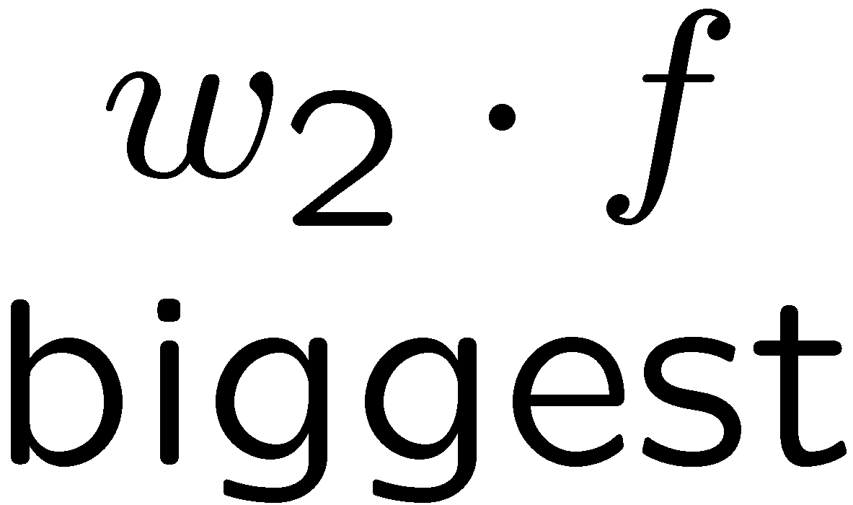
Multiclass Decision Rule
If we have multiple classes:
A weight vector for each class:
Score (activation) of a class y:
Prediction highest score wins
Binary = multiclass where the negative class has weight zero

Slide 17

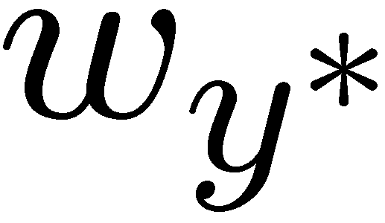

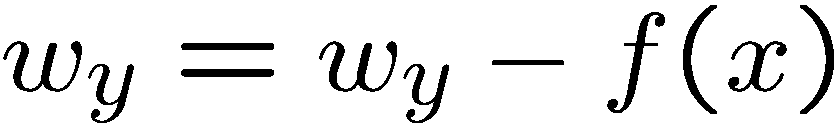
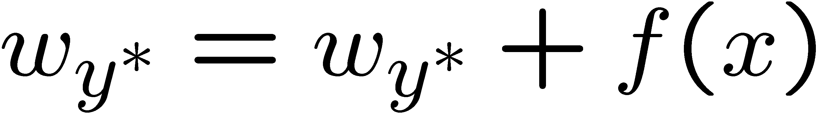
Learning: Multiclass Perceptron
Start with all weights = 0
Pick up training examples one by one
Predict with current weights
If correct, no change!
If wrong: lower score of wrong answer, raise score of right answer

Slide 18



Example: Multiclass Perceptron
“win the vote”
“win the election”
“win the game”
BIAS : 1
win : 0
game : 0
vote : 0
the : 0
...
BIAS : 0
win : 0
game : 0
vote : 0
the : 0
...
BIAS : 0
win : 0
game : 0
vote : 0
the : 0
...

Slide 19
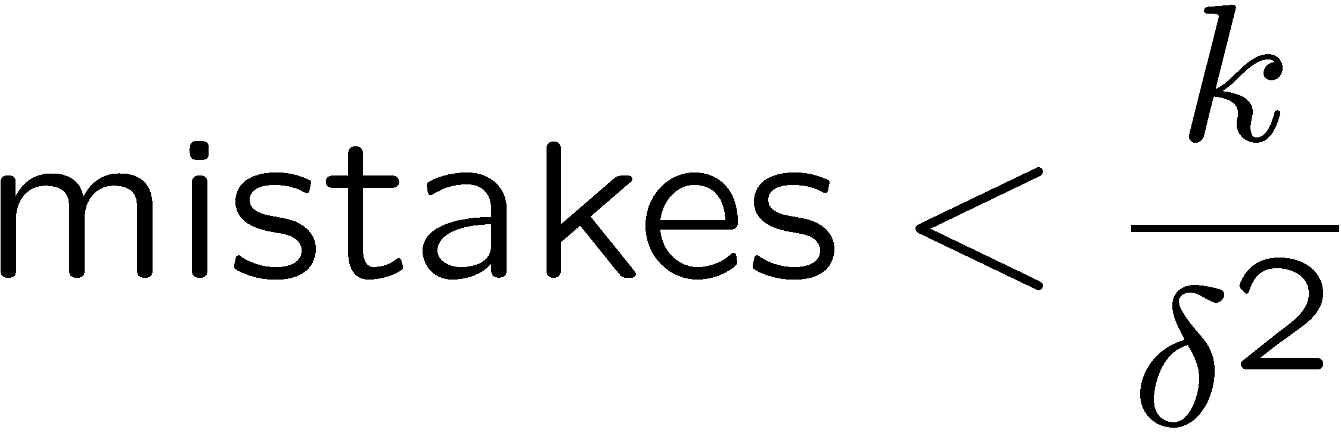
Properties of Perceptrons
Separable
Separability: true if some parameters get the training set perfectly correct
Convergence: if the training is separable, perceptron will eventually converge (binary case)
Mistake Bound: the maximum number of mistakes (binary case) related to the margin or degree of separability
Non-Separable

Slide 20
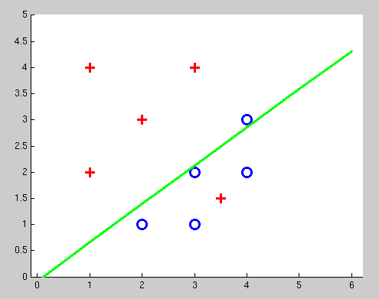
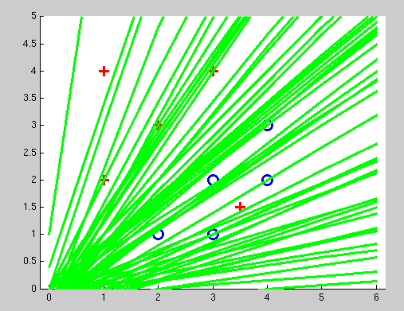
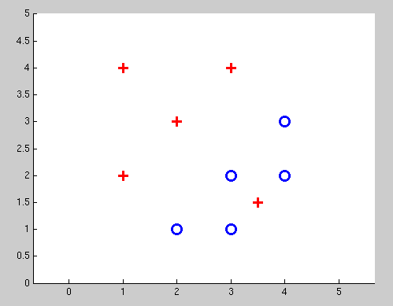
Examples: Perceptron
Non-Separable Case

Slide 21
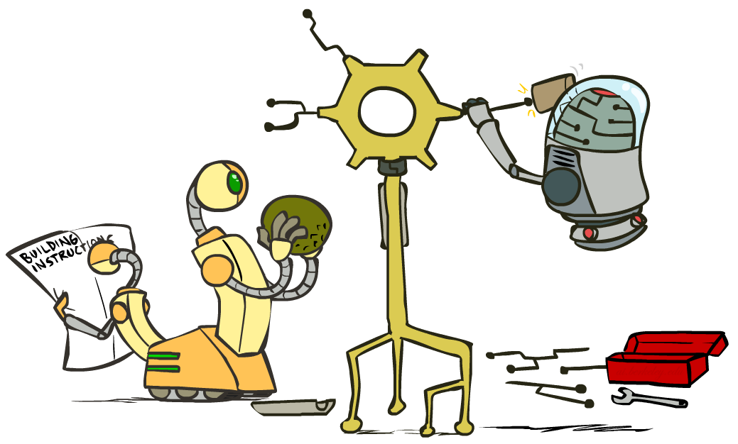
Improving the Perceptron

Slide 22
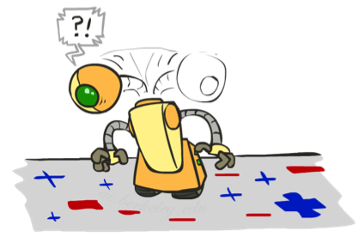
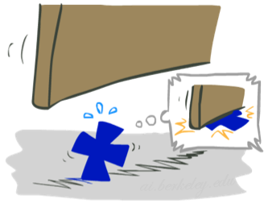

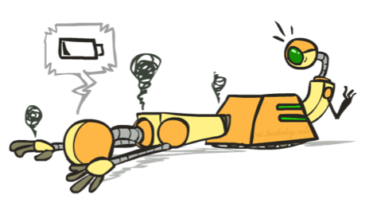




Problems with the Perceptron
Noise: if the data isn’t separable, weights might thrash
Averaging weight vectors over time can help (averaged perceptron)
Mediocre generalization: finds a “barely” separating solution
Overtraining: test / held-out accuracy usually rises, then falls
Overtraining is a kind of overfitting

Slide 23
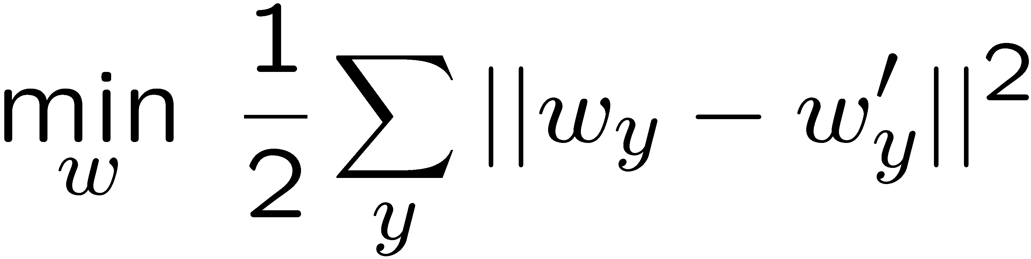
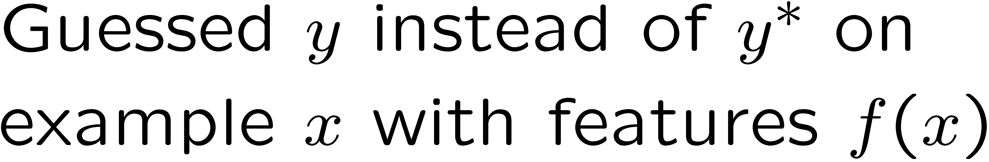
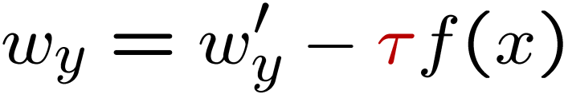
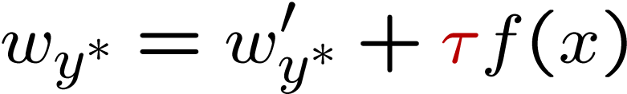
Fixing the Perceptron
Idea: adjust the weight update to mitigate these effects
MIRA*: choose an update size that fixes the current mistake…
… but, minimizes the change to w
The +1 helps to generalize
* Margin Infused Relaxed Algorithm

Slide 24
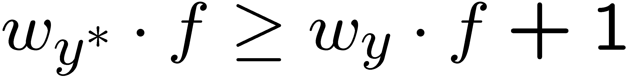
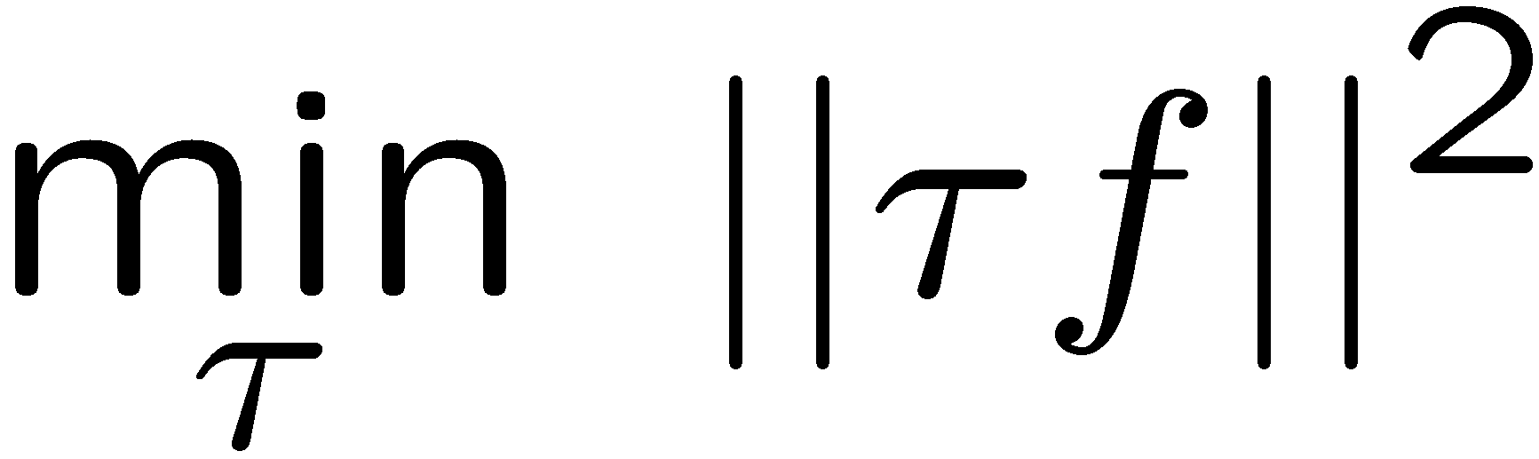



Minimum Correcting Update
min not τ=0, or would not have made an error, so min will be where equality holds

Slide 25




Maximum Step Size
In practice, it’s also bad to make updates that are too large
Example may be labeled incorrectly
You may not have enough features
Solution: cap the maximum possible value of τ with some constant C
Corresponds to an optimization that assumes non-separable data
Usually converges faster than perceptron
Usually better, especially on noisy data

Slide 26
Linear Separators
Which of these linear separators is optimal?

Slide 27


Support Vector Machines
Maximizing the margin: good according to intuition, theory, practice
Only support vectors matter; other training examples are ignorable
Support vector machines (SVMs) find the separator with max margin
Basically, SVMs are MIRA where you optimize over all examples at once
MIRA
SVM

Slide 28
Classification: Comparison
Naïve Bayes
Builds a model training data
Gives prediction probabilities
Strong assumptions about feature independence
One pass through data (counting)
Perceptrons / MIRA:
Makes less assumptions about data
Mistake-driven learning
Multiple passes through data (prediction)
Often more accurate

Slide 29

Improving the Perceptron

Slide 30


Probabilistic Classification
Naïve Bayes provides probabilistic classification
Perceptron just gives us a class prediction
Can we get it to give us probabilities?
Turns out it also makes it easier to train!
1: 0.001
2: 0.703
…
6: 0.264
…
0: 0.001
1: 0.001
2: 0.001
…
0: 0.991
Note: I’m going to be lazy and use “x” in place of “f(x)” here – this is just for notational convenience!

Slide 31


A Probabilistic Perceptron

Slide 32




A 1D Example
definitely blue
not sure
definitely red
probability increases exponentially as we move away from boundary
normalizer

Slide 33




The Soft Max

Slide 34






How to Learn?
Maximum likelihood estimation
Maximum conditional likelihood estimation

Slide 35

Local Search
Simple, general idea:
Start wherever
Repeat: move to the best neighboring state
If no neighbors better than current, quit
Neighbors = small perturbations of w
Notes:
35

Slide 36
Our Status
Our objective
Challenge: how to find a good w ?
Equivalently:

Slide 37
1D optimization
Could evaluate and
Then step in best direction
Or, evaluate derivative:
Which tells which direction to step into

Slide 38

2-D Optimization
Source: Thomas Jungblut’s Blog

Slide 39

Steepest Descent
Idea:
Start somewhere
Repeat: Take a step in the steepest descent direction
Figure source: Mathworks

Slide 40
Steepest Direction
Steepest Direction = direction of the gradient

Slide 41

How to Learn?

Slide 42



Optimization Procedure: Gradient Descent

Slide 43


Stochastic Gradient Descent
compare this to the multiclass perceptron: probabilistic weighting!
probability of incorrect answer
probability of incorrect answer

Slide 44
Next: Kernels and Clustering

